Slide 1

Improved ${}_{}^{3}{He}\left(K^{−},Λp\right)n$ Spectroscopy to Search for the $\overline{K}NN$ Bound State with J-PARC E15-2nd Data
Notes:
Today, I talk about our recent study for the KbarNN bound state based on J-PARC E15 – 2nd experiment data.
We applied an exclusive Lambda-p invariant-mass spectroscopy in the Lambda p n final state to higher statistics data than our 1st experiment.
I am Takumi Yamaga from Osaka universiy.

Slide 2
Contents
Introduction of KNN bound state
E15 Experiment
Results of E15-2nd
Summary
Notes:
These are contents of my talk.
After introduction of KbarNN bound state, I will explain our experiment and analysis procedure.
Then, I will show our preliminary results based on E15 2nd experiment.
First of all, I introduce the KbarNN bound state and our physics motivation.

Slide 3
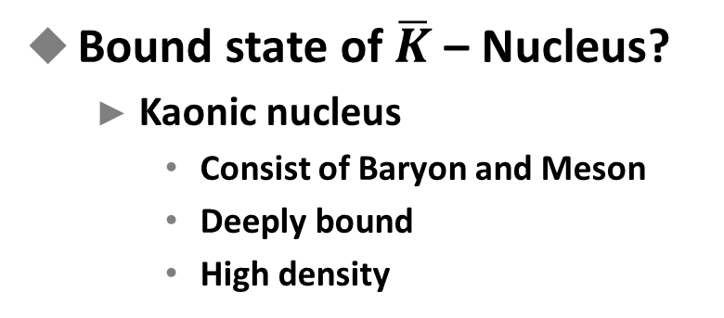
KbarN Interaction and Kaonic Nuclei
KbarN interaction
  On / Above threshold
    Well studied
      Low-energy scattering
      X-ray from Kaonic atoms
    Kbar – Nucleon
      Attractive in I=0
    Kbar – Nucleus
      Attractive
  Subthreshold
    Not well understood
Bound state of $\overline{K}$ – Nucleus?
  Kaonic nucleus
    Consist of Baryon and Meson
    Deeply bound
    High density
Information of KbarN interaction
in subthreshold region
Start with the “simplest” KbarNN system
Notes:
Before talking about kaonic nuclei, let’s consider about the component of that.
The constituent of the kaonic nuclei are kaon and nucleus.
Both of them are well understood now a day.
Also, the interaction between these on mass threshold is also well studied by experimental measurement of
Low-energy KbarN scattering, X-ray from Kaonic atoms and many theoretical calculations.
As a results of them, the interaction between anti-kaon and nucleon is kwon as strong attractive force in isospin 0 channel.
And, that between anti-kaon and nucleus is also attractive.
On the other hands, we don’t understand well the Kbar N interaction in the energy below the mass threshold.
Because, these measurement cannot provide any information in subthreshold region.
So, there has been many discussion in this energy region.
==
Anyway, we have known the KbarN interaction is attractive on threshold.
Naively, such a attractive force would help to construct a bound state of anti-kaon and nucleus.
This bound state is called as “kaonic nuclei”.
The kaonic nucleus is really different from normal nucleus.
Because, this state is build by not only baryon but also by meson.
And, due to strong attractive force of KbarN interaction,
Deeply binding energy and higher density than normal nucleus are expected.
So, the kaonic nucleus itself is really interesting object.
==
Furthermore, the kaonic nucleus has important information of KbarN interaction in subtrheshold region.
So, there has been many studies for kaonic nucleus.
But, because the studying for such a exotic state is so difficult, we start from the most simplest kaonic nuclei, KbarNN system.

Slide 4
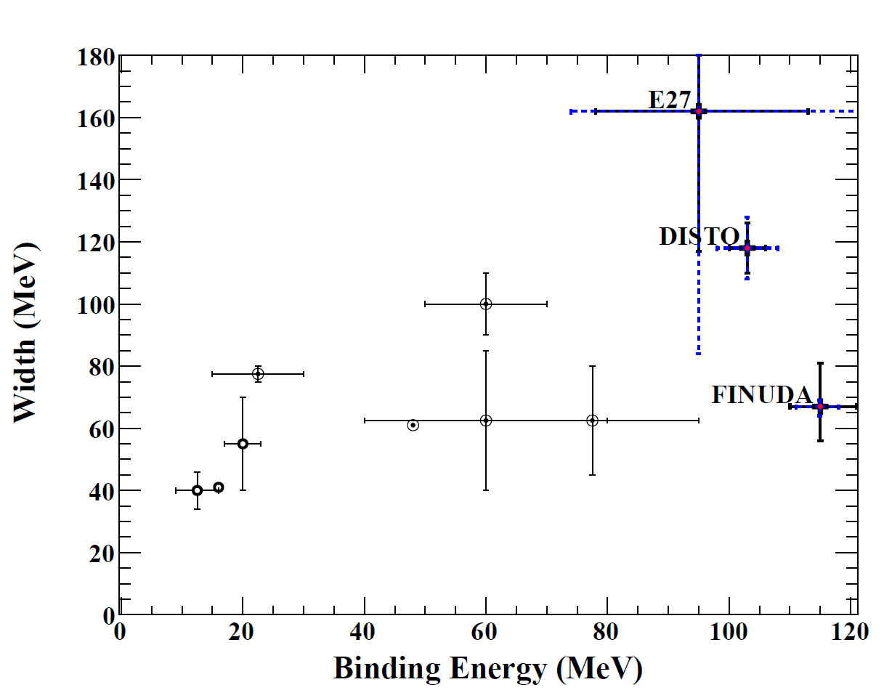
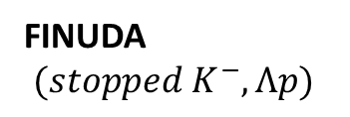
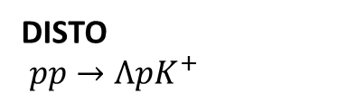
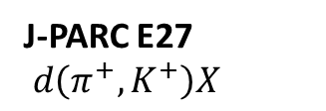
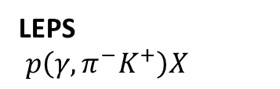

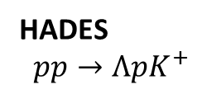
Situation of $K^{−}pp$ bound state
  Theoretical calc.
Bound state exists
KbarN interaction model
E-dep. / E-indep.
  Experiments
E-indep.
Reports structure
/ NO structure
E-dep.
J-PARC E27
$d\left(π^{+}, K^{+}\right)X$
LEPS
$p\left(γ,π^{−}K^{+}\right)X$
DISTO
$pp→ΛpK^{+}$
HADES
$pp→ΛpK^{+}$
FINUDA
$(stopped K^{−},Λp)$
Notes:
In here, I want to summarize the situation of the KbarNN, so-called Kpp bound state, briefly.
By theoretical calculations, the existence of Kpp bound state is strongly bereaved.
Because, all of them are report the existence of the bound state even they use different KbarN interaction model.
On the other hands, In experimental side, these three group reported structure which is considered as coming from Kpp bound state.
But, these groups reported these is no significant structure in the bound region.
So, the existence of the Kpp bound state is still not confirmed.
==
And, this plot summarizes the binding energy and decay width of each reported Kpp bound state.
These three are experimental results, and these plotsreported by theoretical groups.
As you see in here, the binding energy and decay width distributes widely in each report.
==
Like this, Kpp is still not clear and it a matter to study more.
So we have been searching for this Kpp bound state at J-PARC.

Slide 5
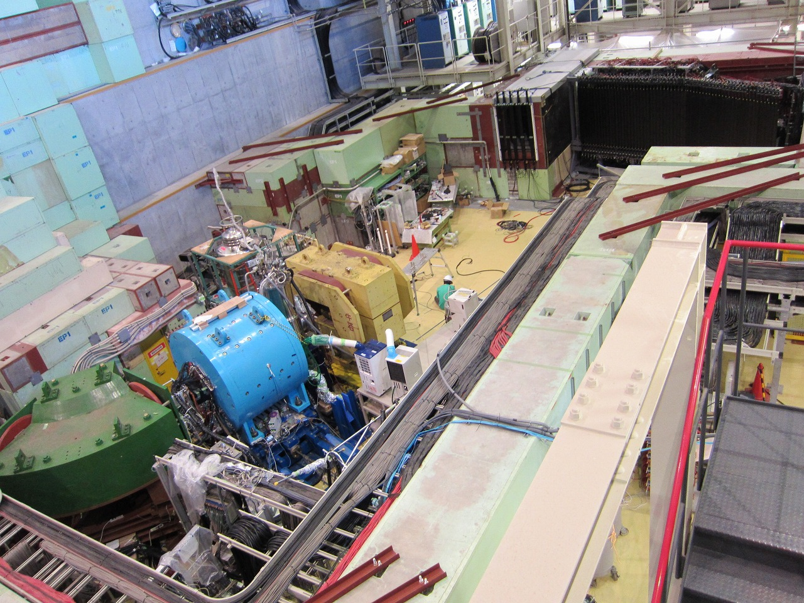


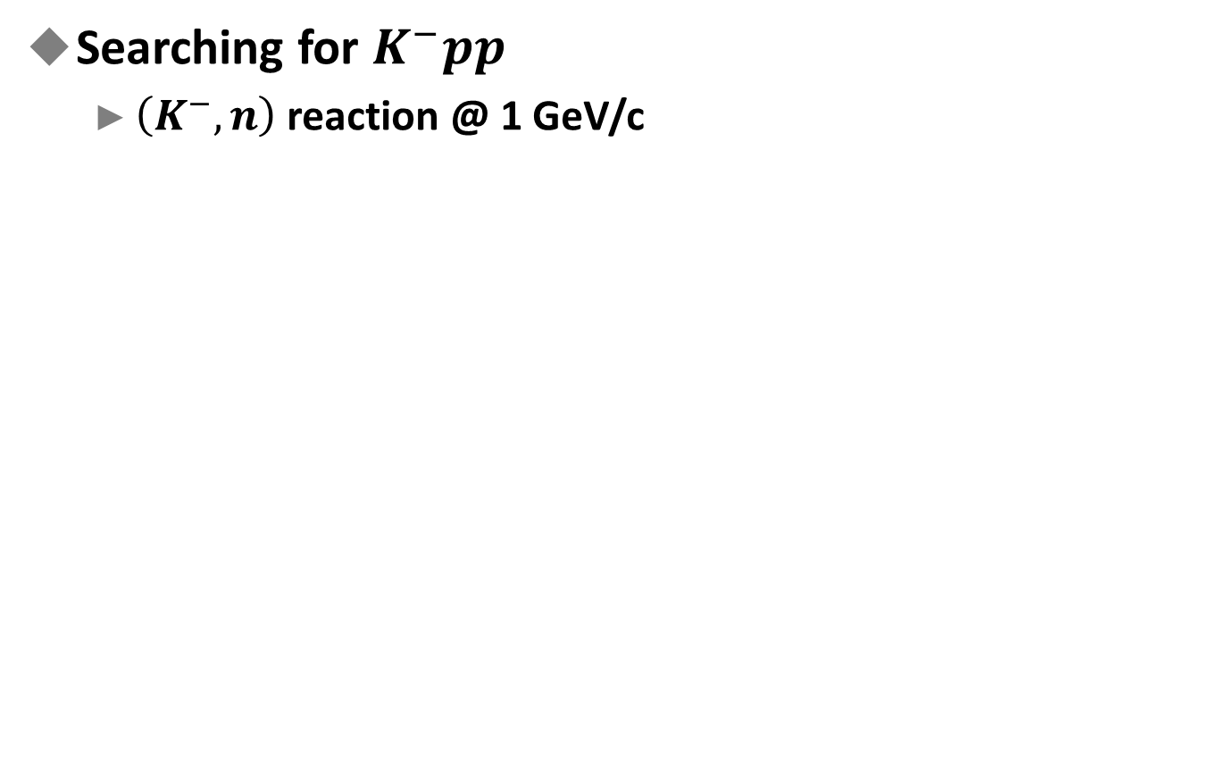








J-PARC E15 Experiment
Searching for $K^{−}pp$
  $\left(K^{−}, n\right)$ reaction @ 1 GeV/c
Detect!
$$p$$
Neutron counter
$$K^{−}$$
$${}_{}^{3}{He}$$
$$"K^{−}pp"$$
$$"K^{−}pp"$$
$$n$$
$$n$$
Flight length : 15 m
$$Λ$$
Beam sweeping magnet
$$p$$
CDS
Detect!
Beam spectrometer
$$π^{−}$$
Notes:
We are searching for the K-pp bound state by using (K-, n) reaction at J-PARC hadron experimental facility.
The reaction can be drawn as this very simple picture.
1 GeV/c kaon beam is irradiated onto the liquid helium-three target.
And the neutron is kicked out to forward direction, with bring large momentum.
Then, K-minus and 2 protons remain and would form the K-pp bound state.
The K-pp decays into lambda p pair which is one of the expected decay mode of the K-pp bound state.
===
This is overview picture of our experimental setup.
The intense kaon beam is provided form here,
And its momentum is measured by beam spectrometer system here.
The helium-three target is located in center of the cylindrical detector system here.
And there are forward counters in downstream.
===
In this talk, I focus on the analysis using only CDS.
We detect this proton and pi-p pair from charged decay of Lambda by the CDS.

Slide 6
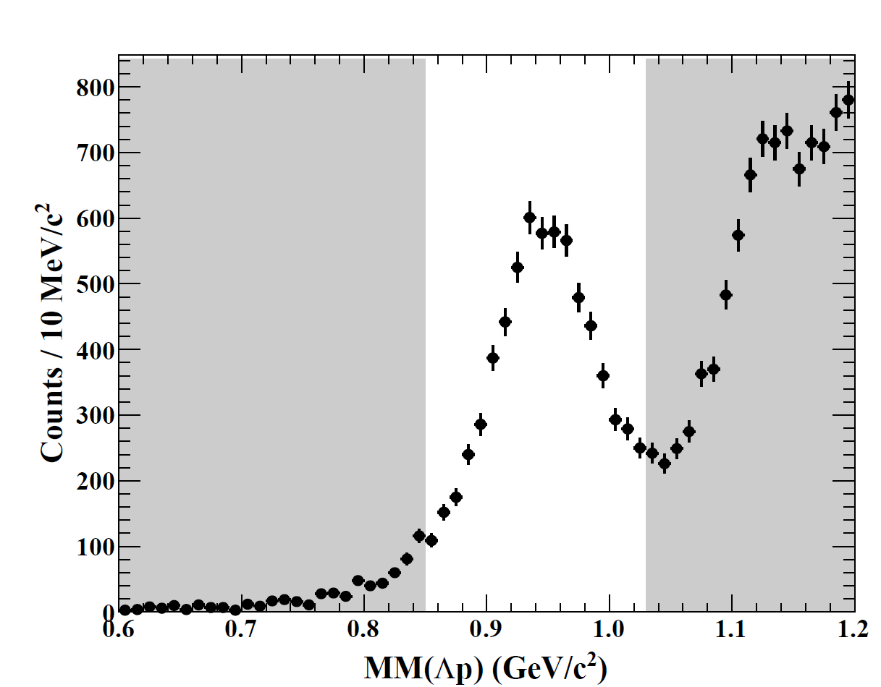
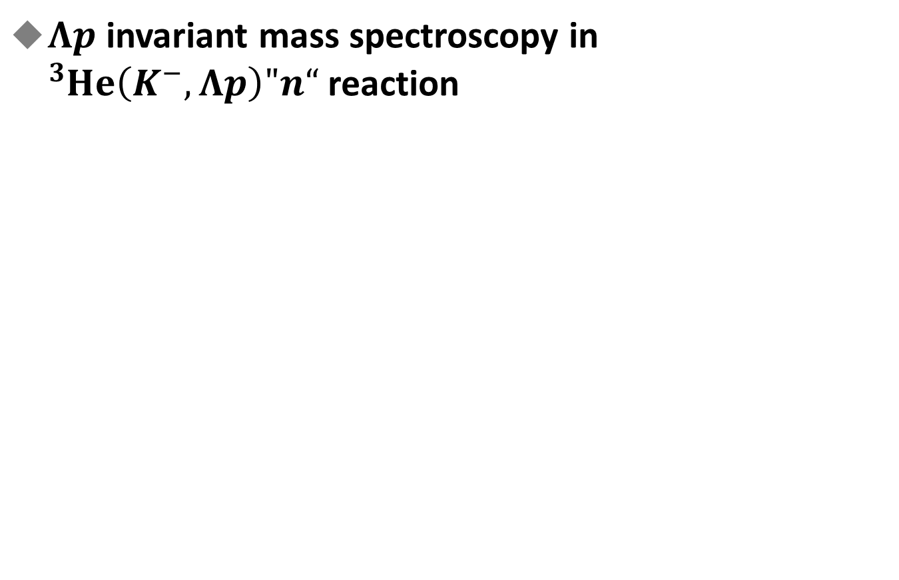
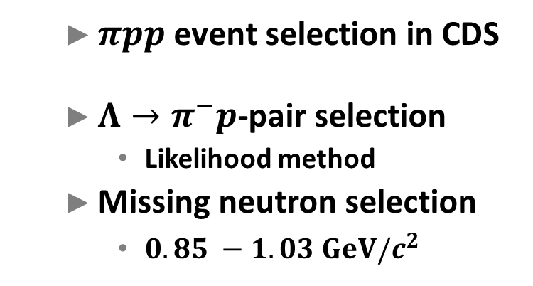


J-PARC E15 Experiment
$Λp$ invariant mass spectroscopy in ${}_{}^{3}{He}\left(K^{−}, Λp\right)"n“$reaction
${}_{}^{3}{He}(K^{−}, Λp)"X"$ Missing-mass
Preliminary
  $πpp$ event selection in CDS
  $Λ→π^{−}p$-pair selection
    Likelihood method
  Missing neutron selection
    $0.85 −1.03 GeV/c^{2}$
“$n$”
Notes:
we calculate particle mass by using measured momentum and velocity,
And we can plot a PID plot like this.
We select the pi-minus and proton in the region indicated red line which is corresponding to 2.5 sigma region.
To avoid contaminations, we removed overlap regions.
===
Then, we try to reconstruct Lambda form two pi-p pair.
We use Log likelihood method to select correct pi p pair from Lambda decay.
And this figure shows invariant mass spectrum of pip pairs.
The blue events are selected as Lambda decay events, which is located around Lambda mass correctly.
The contamination from wrong pip pair is expected to be less than a few percent.
==
At the last, we check the Lp missing mass spectrum to ensure the final state is Lpn.
In this analysis, the neutron window is set to here.
In this way, we ready to start an exclusive Lp invariant mass analysis.

Slide 7
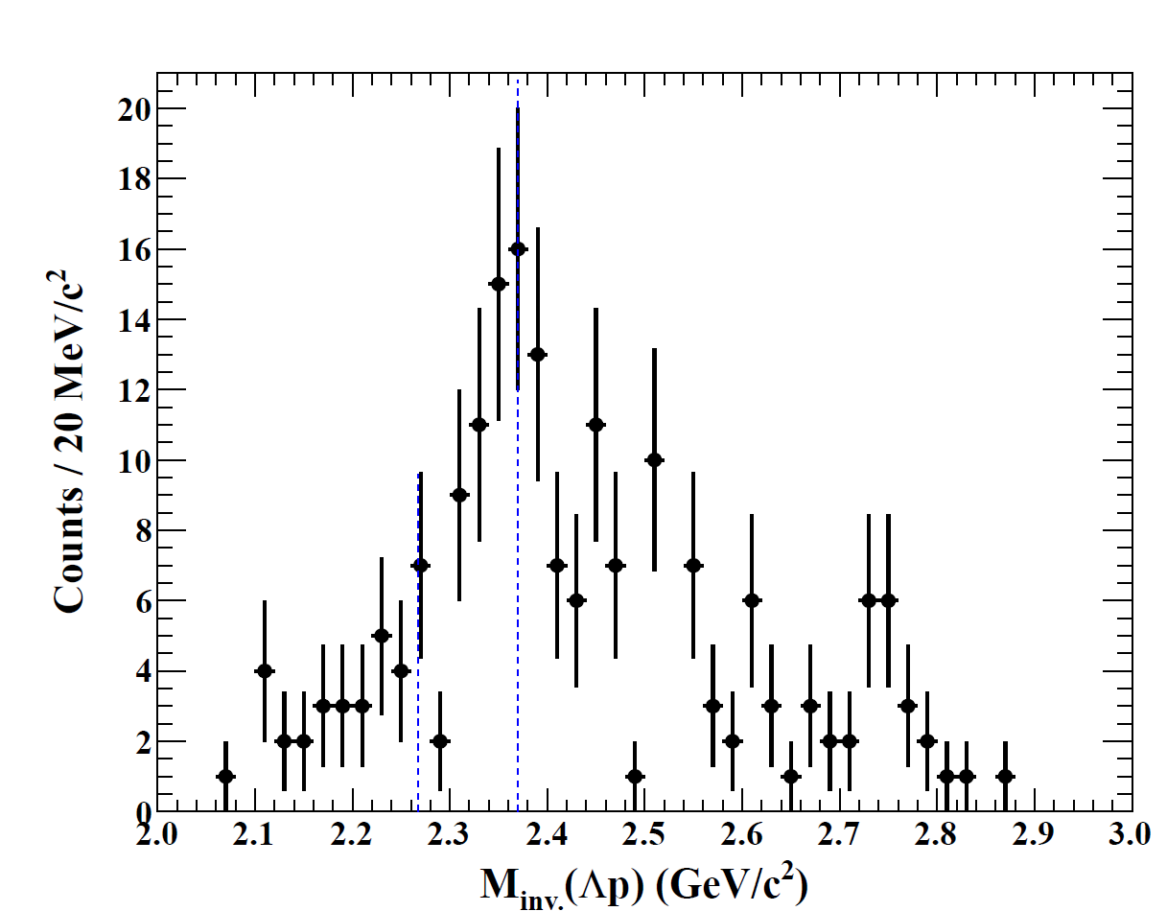
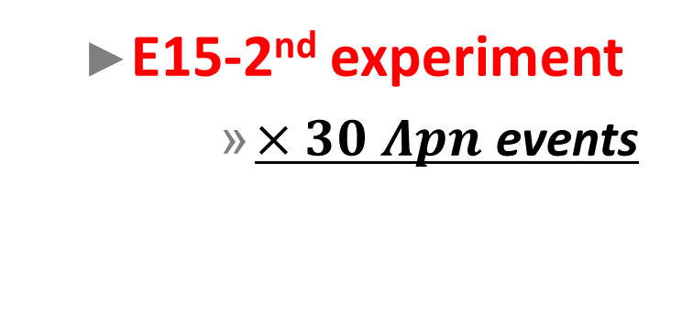


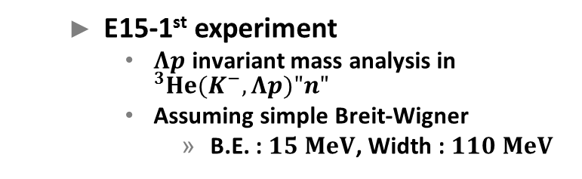
E15-1st Result
Y. Sada, et al, Prog. Theor. Exp. Phys. (2016) 051D01
  E15-2nd experiment
      $×30$ $Λpn$ events
Increasing Statistics
  E15-1st experiment
    $Λp$ invariant mass analysis in ${}_{}^{3}{He(K^{−},Λp)"n"}$
    Assuming simple Breit-Wigner
      B.E. : $15 MeV$, Width : $110 MeV$
$$M_{K^{−}pp}$$
$$M_{πΣp}$$
Notes:
First, I want to show our 1st experimental results.
In the beginning of this year, we published a paper based on our 1st physics data-taking performed in 2013.
A structure was observed just below the Kpp threshold like this.
And by assuming simple breit-wigner shape combined with s-wave form factor, we evaluated pole position and its width as these values.
But, due to lack of statistics, we only assumed 1 pole structure with simple picture.
And we cannot detail analysis such as studying for angular dependence.
===
So, to do more detail analysis and confirm the origin of the structure,
We performed 2nd physics data-taking in the last year.
In that time about 30 times larger events were accumulated.

Slide 8
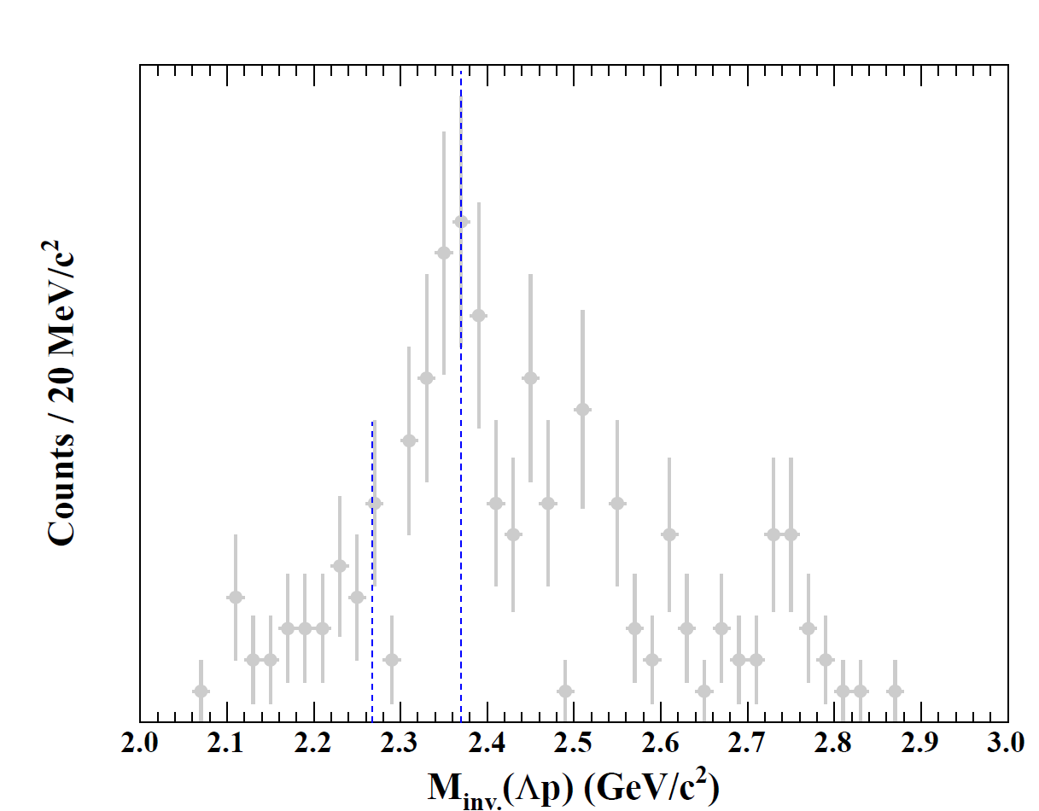
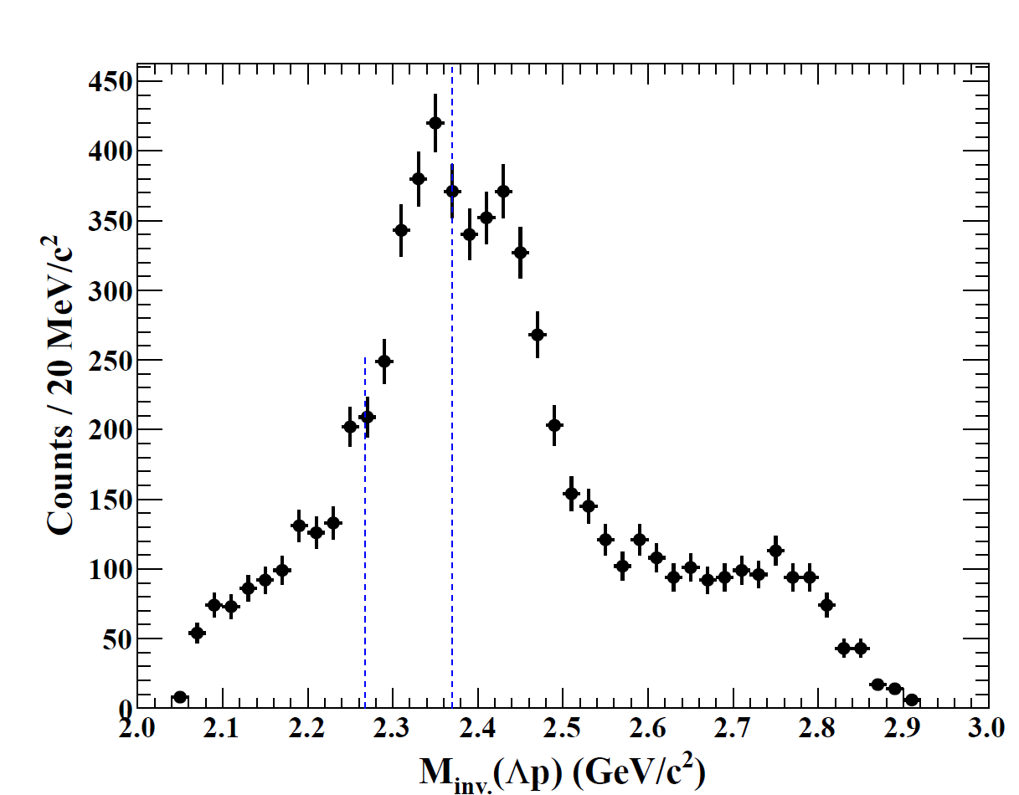

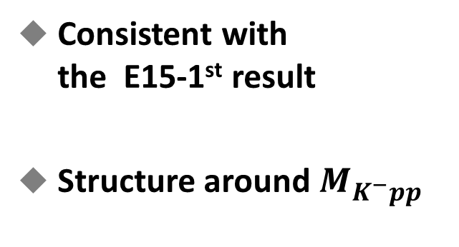
E15-2nd Result
$n_{window}=0.85 −1.03 GeV/c^{2}$
Preliminary
  E15-2nd experiment
      $×30$ $Λpn$ events
Consistent with
the E15-1st result
Structure around $M_{K^{−}pp}^{}$
$$M_{K^{−}pp}$$
$$M_{πΣp}$$
Notes:
And, this plot is our 2nd result.
Again, I put our 1st result in here.
Two results are consistent within the statistics
And the structure around Kpp mass threshold is confirmed with higher statistics data.
To understand the structure, we studied a correlation between Lp invariant mass and neutron emission angle.

Slide 9
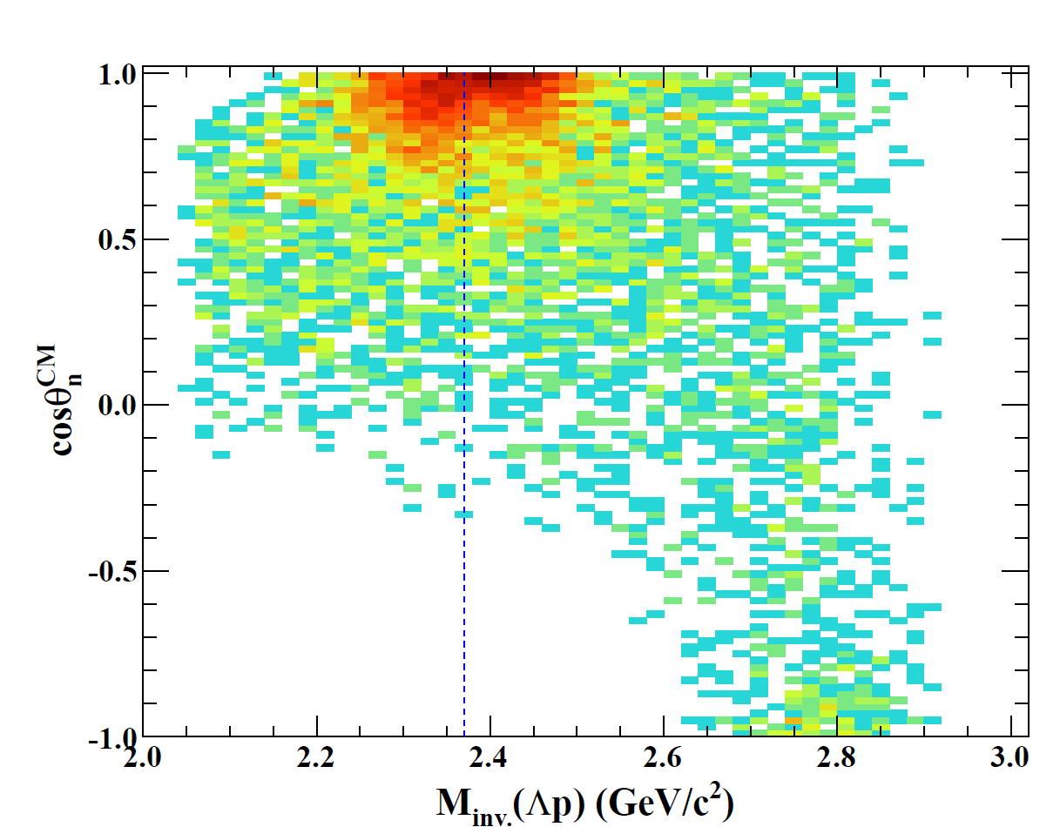





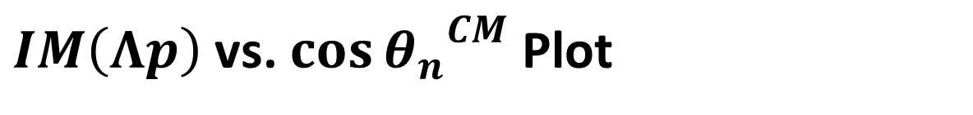

$IM\left(Λp\right)$ vs. $\cos{{θ_{n}^{}}^{CM}}$ Plot
$IM\left(Λp\right)$ vs. $\cos{{θ_{n}^{}}^{CM}}$
Neutron opening angle
$$"n"$$
CM frame
$$θ_{n}^{CM}$$
Forward angle
$$Λ$$
Beam
$$M_{K^{−}pp}$$
Out of acceptance
$$p$$
Preliminary
Notes:
That correlation is plot in this figure.
In this figure, the horizontal axis shows Lp invariant mass and vertical axis shows cos theta n.
Where, theta n is measured in CM frame like this.
We can see that events corresponding to the structure around Kpp mass threshold is located in forward neutron angle.

Slide 10
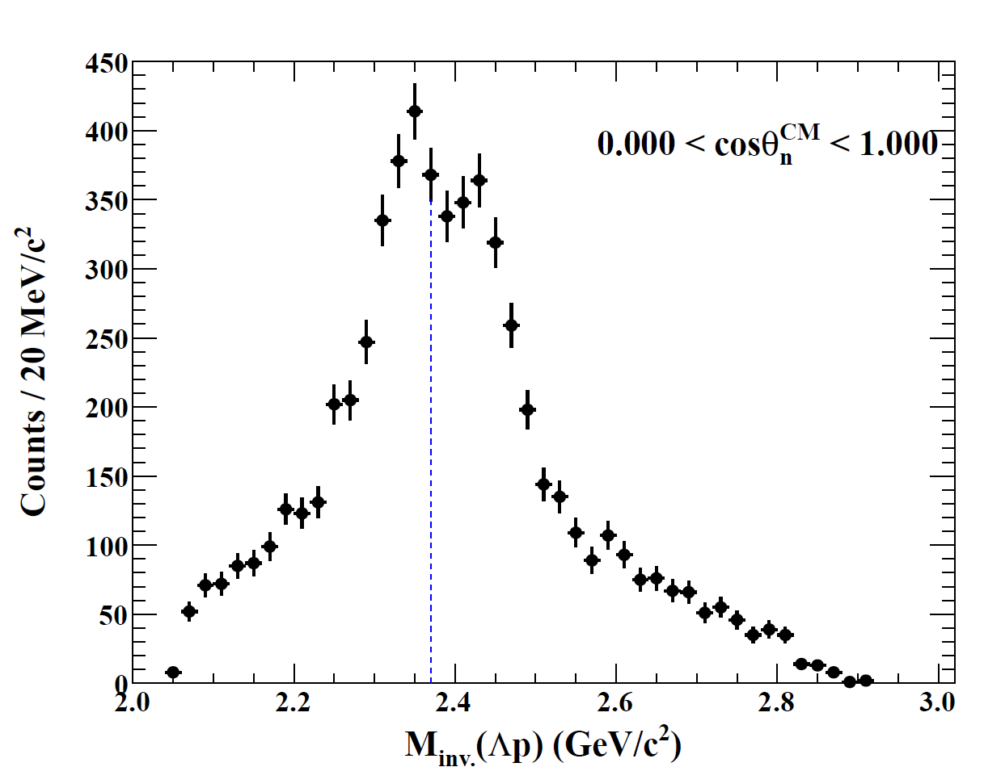
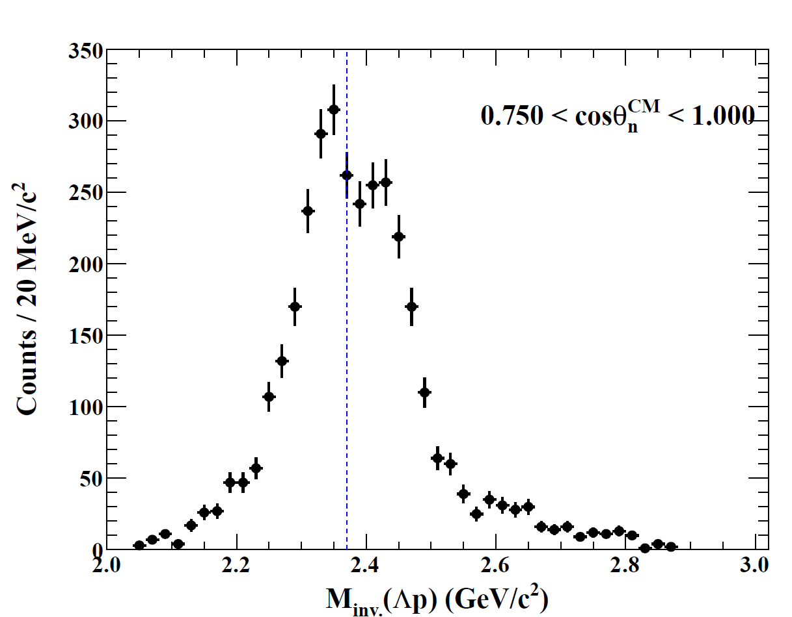
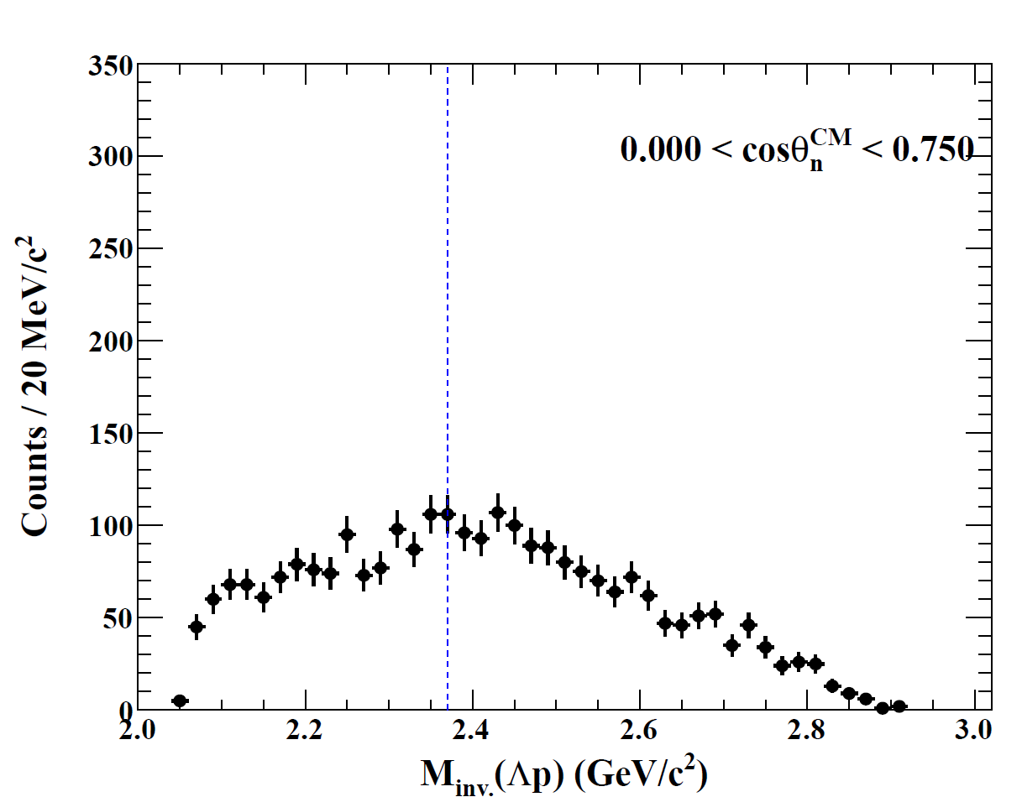
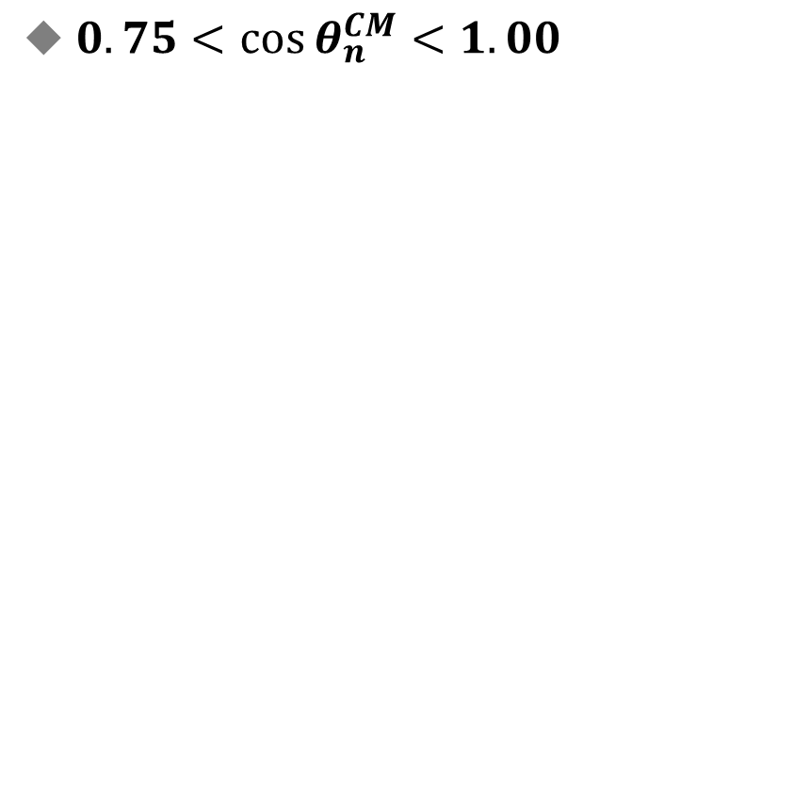
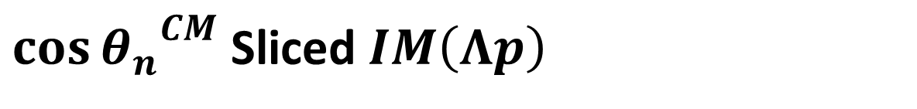



$\cos{{θ_{n}^{}}^{CM}}$ Sliced $IM\left(Λp\right)$
$0.00<\cos{θ_{n}^{CM}}<1.00$
$0.75<\cos{θ_{n}^{CM}}<1.00$
$0.00<\cos{θ_{n}^{CM}}<0.75$
Preliminary
Out of acceptance
Preliminary
2 peaks + 3NA
2 peaks + 3NA
2 peaks + 3NA
$$M_{K^{−}pp}$$
Notes:
To pick up the strucutre, we select the forward angle region and check the Lp invariant mass.

Slide 11
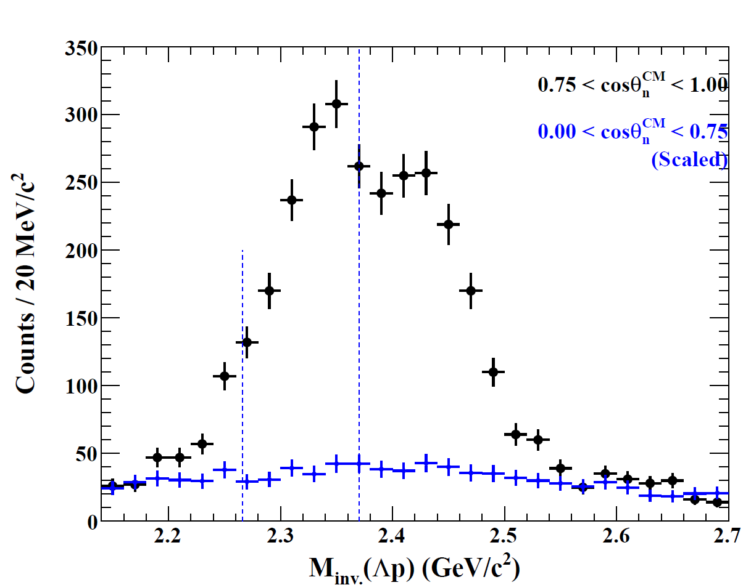
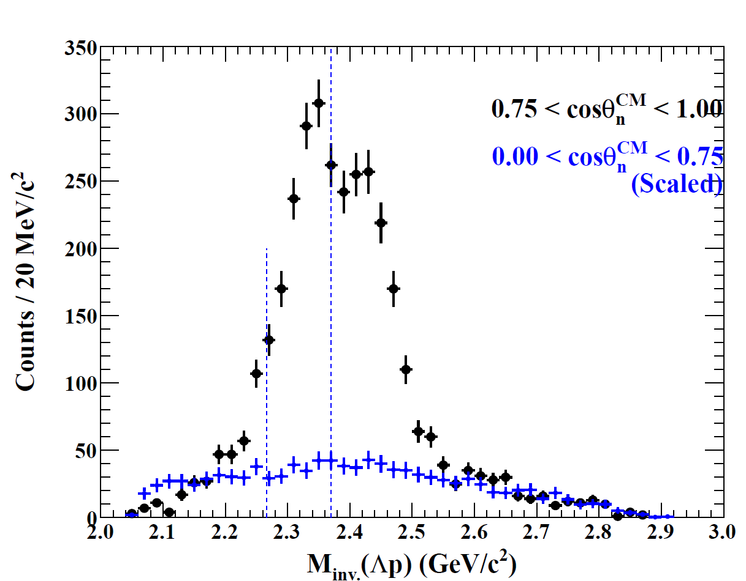
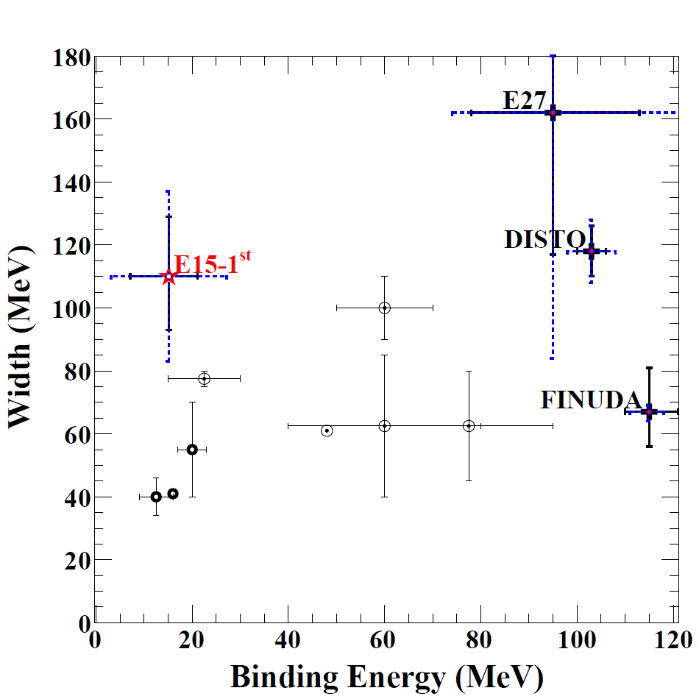

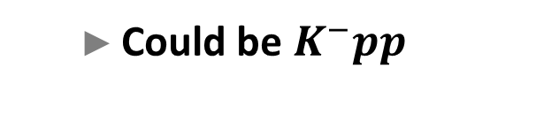



$\cos{{θ_{n}^{}}^{CM}}$ Sliced $IM\left(Λp\right)$
Preliminary
2 peaks observed
Above threshold
  Quasi-elastic process
E-indep.
$$M_{K^{−}pp}$$
Below threshold
$$M_{πΣp}$$
$$M_{K^{−}pp}$$
E-dep.
$$M_{πΣp}$$
  Could be $K^{−}pp$
This work
Notes:
Here is our reported value.
The decay width is not so changed from other experiment.
But, the binding energy is much lower than others which is almost consistent with theoretical calculation using energy dependent KbarN potential.

Slide 12
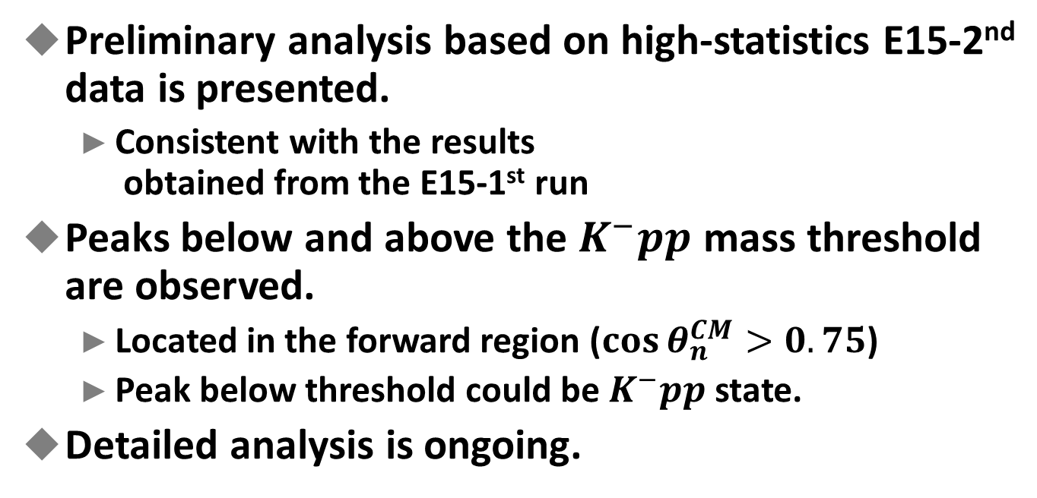
Summary
Preliminary analysis based on high-statistics E15-2nd data is presented.
  Consistent with the results
  obtained from the E15-1st run
Peaks below and above the $K^{−}pp$ mass threshold are observed.
  Located in the forward region ($\cos{θ_{n}^{CM}>0.75}$)
  Peak below threshold could be $K^{−}pp$ state.
Detailed analysis is ongoing.

Slide 13
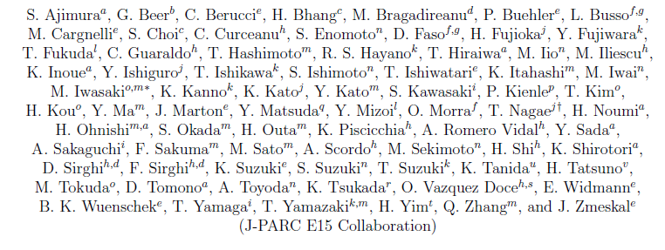

Thank you for your attention
$∼$ The E15 collaboration $∼$

