Slide 1
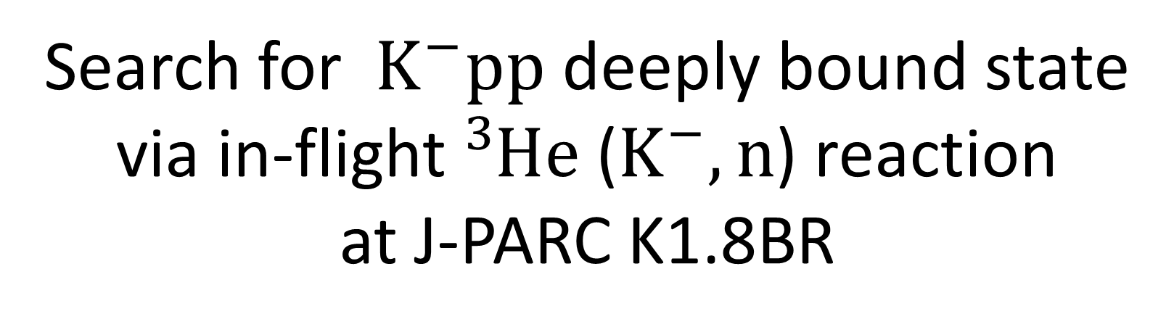
Search for $K^{−}pp$ deeply bound state via in-flight ${}_{ }^{3}{He}$($K^{−},n$) reaction at J-PARC K1.8BR
Shingo Kawasaki for the J-PARC E15 collaboration
RCNP, Osaka University
Notes:
I’m Shingo Kawasaki, from Osaka University, Japan.
I would like to talk about experimental search for K-pp deeply bound state via in-flight ³He(K-, n) reaction at J-PARC K1.8 BR.

Slide 2
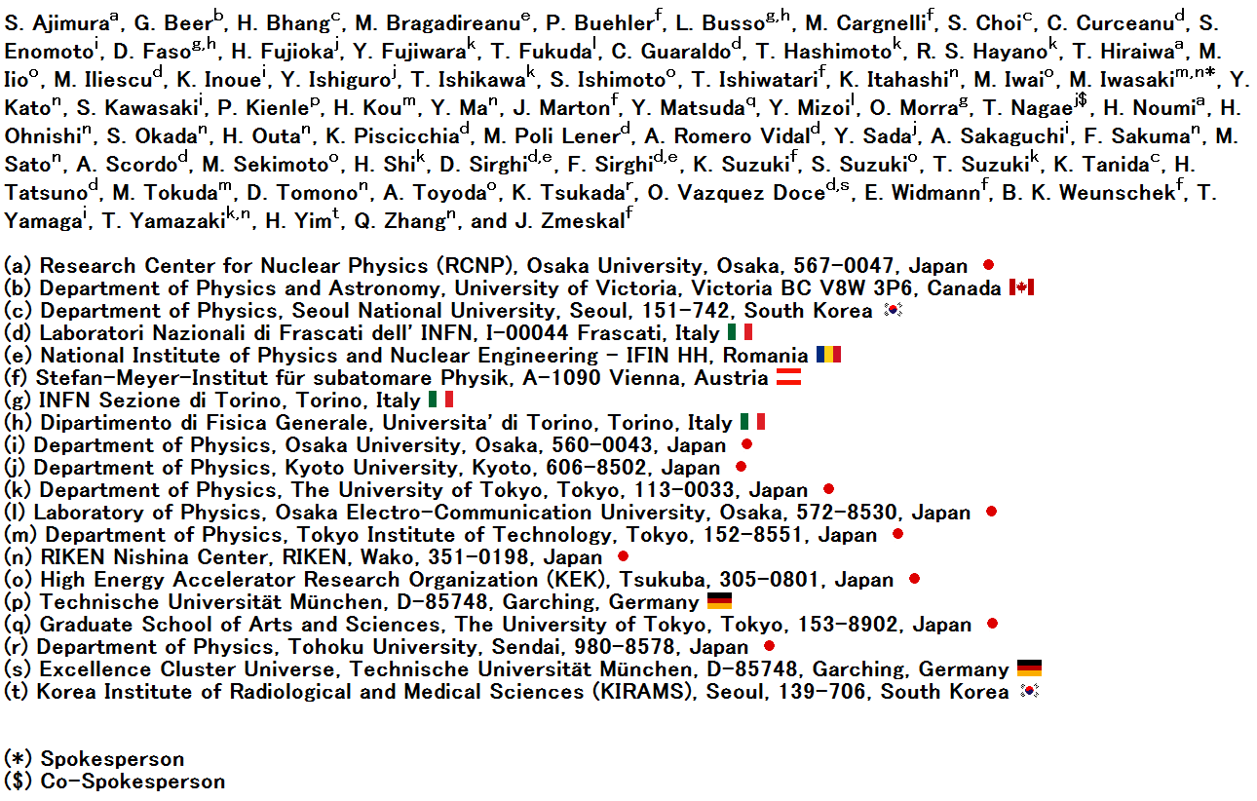
J-PARC E15 collaboration
Notes:
This is the J-PARC E15 collaboration

Slide 3
Contents
Introduction
J-PARC E15 experiment
Performance of detectors
Semi-inclusive spectrum
Summary
Notes:
The contents of my talk are as follows. First, I talk about introduction of our experiment and explain the J-PARC E15 experiment. Next, I present analysis result of E15 first physics run.

Slide 4
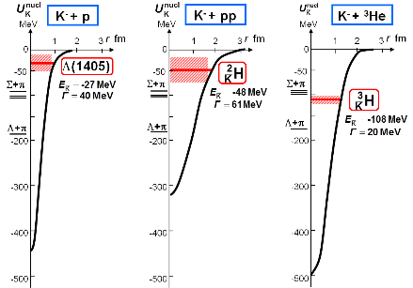
K⁻pp deeply bound state
$\overline{K}$N interaction of I=0 shows strongly attractive.
Based on the data of experiment of X ray from Kaonic atom
→Kaon deeply bound to nucleus ?
Investigate
kaonic deeply bound state
in most simple system K⁻pp
Y. Akaishi & T. Yamazaki, Phys. Rev. C65 (2002) 044005.
Y. Akaishi & T. Yamazaki, Phys. Lett. B535 (2002) 70.
Notes:
It is well known that KbarN interaction of I=0 shows strong interaction. In assumption that Λ(1405) is KbarN bound state of I=0, Kaonic nuclear bound states are predicted base on the data of experiment of X-ray from Kaonic hydrogen. It is interest to investigate a simplest kaonic nuclear system, K-pp.

Slide 5
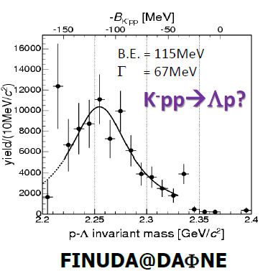
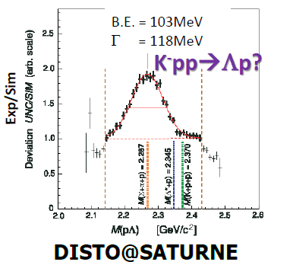
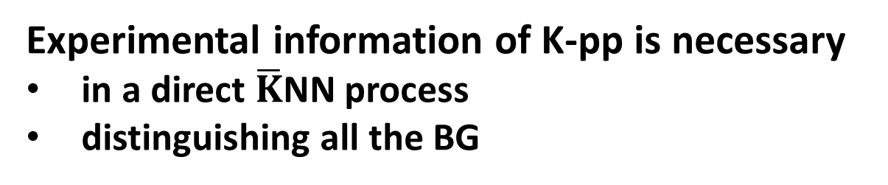
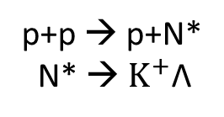
Experimental suggestion of K-pp
A(stopped K-, Λp)
p + p → (Λ + p) + K+
2NA + Σ → γΛ
2NA + ΣN-ΛN conversion
p+p → p+N*
N* → $K^{+}$Λ
Possible BG
BG cannot be eliminated
Experimental information of K-pp is necessary
in a direct $\overline{K}$NN process
distinguishing all the BG
Notes:
The past experiments of stopped kaon reaction and pp collision claimed observation of K-pp peak structure in Λp final state, but the binding energies and the widths obtained are not consistent. In these experiment, the BG process like 2NA cannot be eliminated. Therefore more experimental information of K-pp distinguished from all the BG processes is necessary.

Slide 6
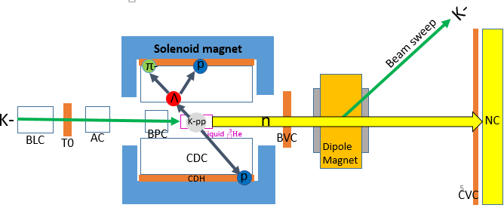
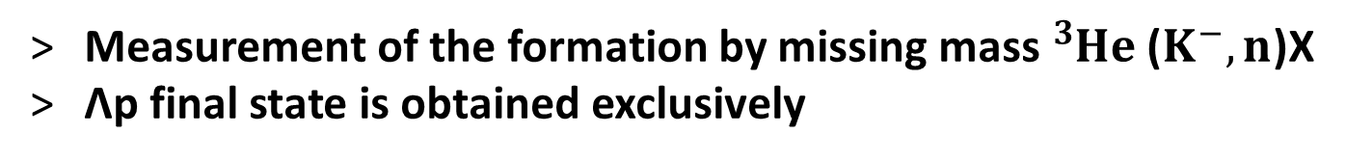
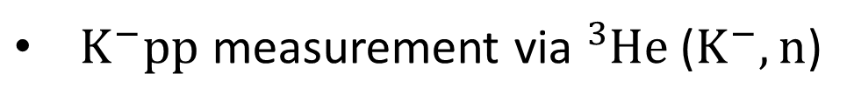



J-PARC E15 experiment
$K^{−}pp$ measurement via ${}_{ }^{3}{He}$($K^{−},n$)
p
reaction
p
p
n
$$K^{−}$$
p
n
$$K^{−}$$
1.0 GeV/c
$${}_{ }^{3}{He}$$
1.2~1.3 GeV/c
Bound state
by forward scattered neutron
Today’s talk
Measurement of the formation by missing mass ${}_{ }^{3}{He}$($K^{−},n$)X
Λp final state is obtained exclusively
Notes:
In order to produce K-pp bound state suppressing the BG processes, we employ a in-flight ³He(K-, n) reaction on the liquid ³He target. The experiment is performed at the K1.8BR beam-line in the Hadron Experimental Hall of the J-PARC. This is a schematic drawing of the E15 setup. Kaon beam of 1 GeV/c kick a neutron out of the 3He target in a forward angle. The Kaon slow down to form K-pp with residual nucleus. We measure the scattered neutron momentum by TOF counter placed 15 m ahead in the forward direction to obtain the missing mass spectrum. All decay charged particles associated with the ³He(K-,n) reactions are detected by cylindrical detector system which operate in a magnetic field of 0.7 T. Today, I will talk about the missing mass spectrum.

Slide 7
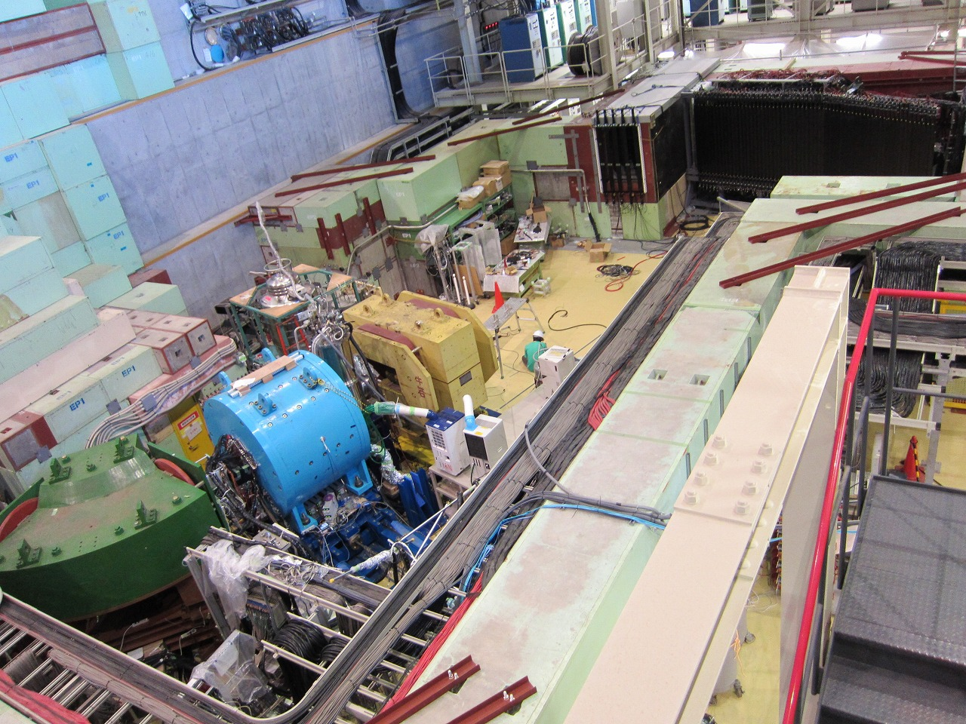
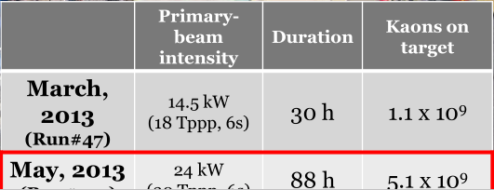
K1.8BR spectrometer [Jun. 2012]
beam dump
beam sweeping
magnet
Neutron
Charge Veto
Proton Counter
liquid ³He-target
system
CDS
~15m
beam line
spectrometer
Notes:
Here is the picture of the J-PARC K1.8 BR spectrometer. This part is Beam spectrometer, and this sky blue object is cylindrical detector system. The liquid 3He target is placed in the center of it. This is neutron counter, and kaons which do not react are swept off the NC by this magnet.

Slide 8
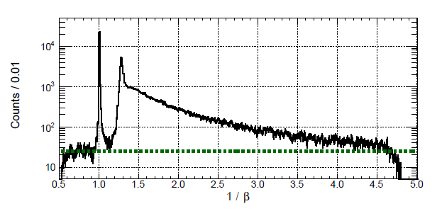
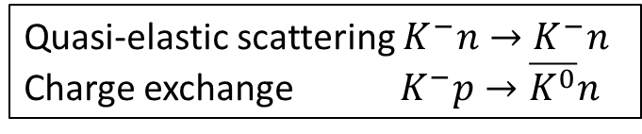
Performance of detectors
3 m
Neutron Counter
neutron counter
1/β
22 msr
charge veto
γ
Quasi-elastic scattering $K^{−}n→K^{−}n$
Charge exchange $K^{−}p→\overline{K^{0}}n$
n
n
15 m
accidental background
beam charge veto
Separate γ and neutron
S/N ratio ~100@Quasi-free peak
Time resolution ~150 ps@ γ peak
target
beam
Notes:
Next, we present the performance of detectors. First, I talk about NC for forward scattered neutron. We measures neutron momentum by NC of TOF-counter. This figure is inverse beta of hit events at NC with rejection of charged particles by two veto-counters between target and NC. γ-events are separated clearly from neutron events. In neutron events, QF and charge exchange reaction peak can be seen clearly. A green dot line represents the accidental BG. The BG level is very low. The signal to noise ratio at QF peak is ~100. The time resolution is ~150 ps at γ-peak, which is equivalent to ~10 MeV/c² missing-mass resolution. A small tail to lower beta can be seen in the γ-peak, which is thought to be delayed γ-events, such as π0s produced at materials located after the target.

Slide 9
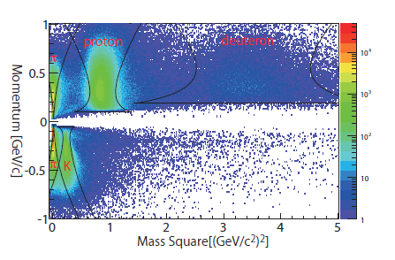
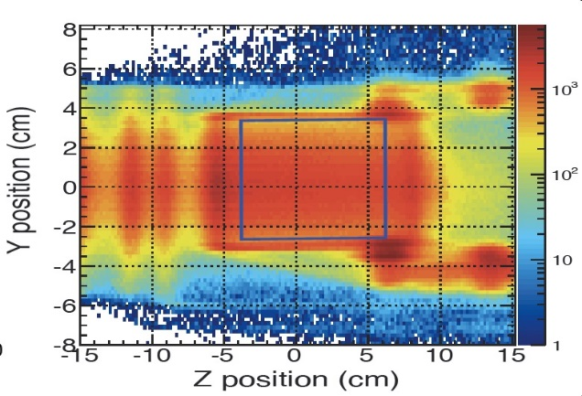
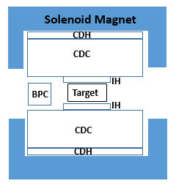
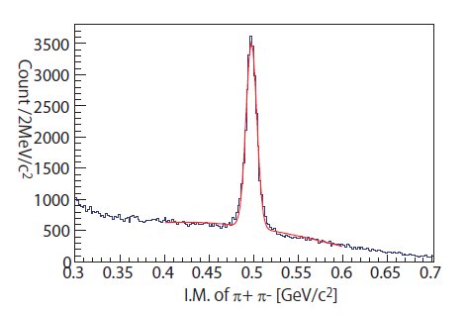
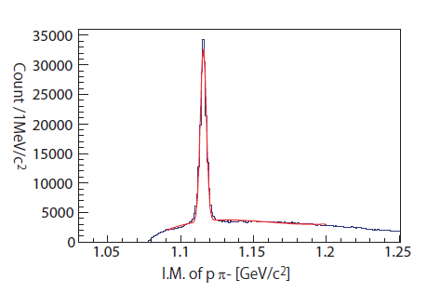
Cylindrical Detector System (CDS)
Particle identification
Vertex position
CDS
p, π±,K⁻, d
beam
K⁰s reconstruction
Λ reconstruction
Peak : 497.42 MeV/c²
σ : 6.04 MeV/c²
Peak : 1115.57 MeV/c²
σ : 2.02 MeV/c²
Charged decay p, π±,K⁻, d are identified
Vertex position reconstruct the target cell frame
Λ,K⁰s are reconstructed as designed.
Notes:
Second, I talk about cylindrical detector system, CDS for short. CDS measures and identifies the decay charged particles associated with the ³He(K-,n) reactions. The decay charged particles, p,π±,K-,d, are separated clearly by curvature momentum and TOF. The vertex position reconstruct the target cell frame well. Λ, K⁰s are reconstructed by detected p, π± clearly. All detectors performances are good.

Slide 10
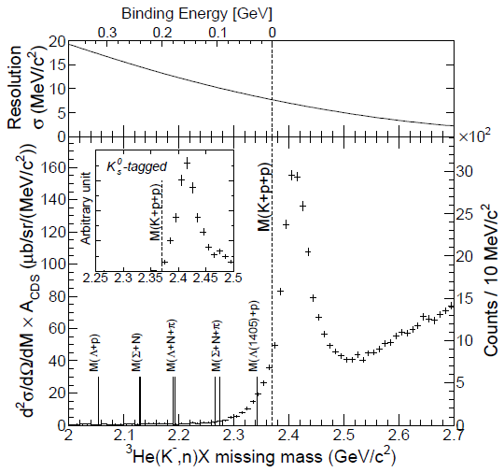
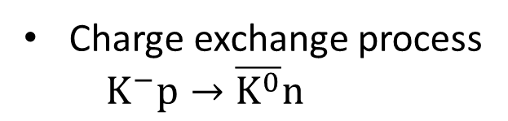
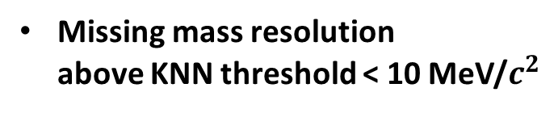
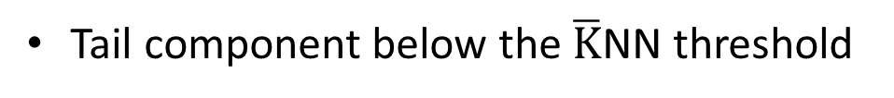
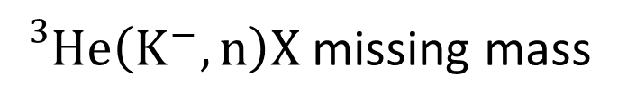
Semi-inclusive spectrum
${}_{}^{3}{He}\left(K^{−}, n\right)X$ missing mass
arXiv: [nucl-ex]1408.5637
submitted to PLB by Hashimoto-san
Missing mass resolution
above KNN threshold < 10 MeV/$c^{2}$
Charge exchange process
$K^{−}p→\overline{K^{0}}n$
Detector resolution does
not yield the structure
Tail component below the $\overline{K}$NN threshold
Notes:
We obtain the ³He(K-,n) missing mass spectrum by the forward neutron momentum.
The QF peak around 2.4 GeV/c2 can be seen clearly. Clear peak structure does not appear in the deeply bound region ~100 MeV/c2 where the experiment of FINUDA and DISTO groups observed the structure in different production reaction.
However the tail component below the KNN threshold, which is shown in red line, can be seen. The missing mass resolution above KNN threshold is evaluated to be less than 10 MeV/c2 from the NC time resolution. K0s tagged spectrum is also shown, which is contributed from the charged exchange process. The spectrum seems to be rise from about the KNN threshold, which means that the detector resolution does not yield the structure.

Slide 11
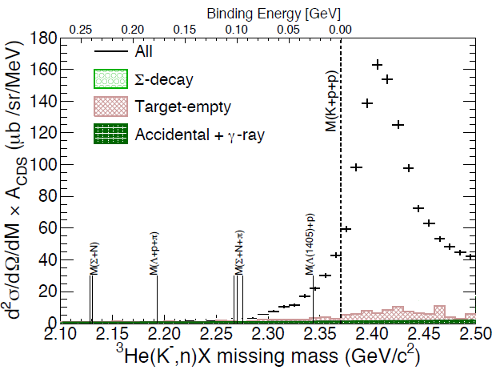
Examine the tail component by Background
Material around the target
Accidental and γ-ray of NC
Notes:
Then we evaluate possible BG sneak into the tail component. We consider the BG coming from the material around the target due to the resolution of 3He fiducial volume with empty-target data, the accidental and tail γ-ray events of NC. These BG contribute to the tail component slightly.

Slide 12
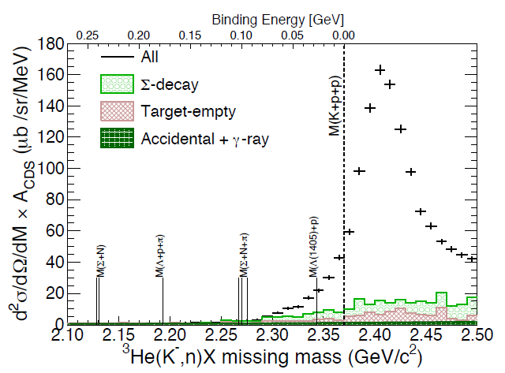




Sigma production process in the tail component
This contribution is measurable
$$K^{−}N→ πΣ^{±}$$
Reconstruction
$Σ^{±}→π^{±}n_{Forward}$
π
$$π^{±}$$
CDS
n
NC
$$Σ^{±}$$
Reconstruction efficiency ~90%
All yield in the tail component cannot be explain by these BG
Notes:
The fast neutron from the 1NR process can contribute the tail component. Only Σ→πN reaction can contribute in the E15 experiment acceptance. We can measure the Σ production process by reconstructing the invariant masses of Σ from the detected forward n and decay charged π. The efficiency of the Σ reconstruction is 90 %. All yields in the tail component cannot be explained by these BG processes.

Slide 13
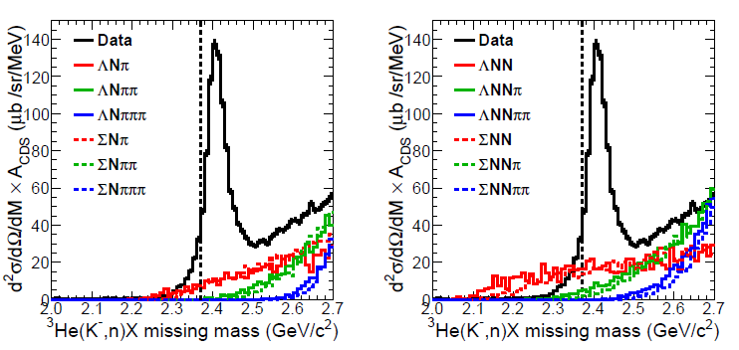
Mesonic 2NA and Mesonic/Non-Mesonic 3NA
(KNNN_{s}→πY(*)NN_{s} / KNNN→(π)Y(*)NN)
Mesonic 2NA
3NA
SIM
SIM
Contributions to the tail component are small
Notes:
Then the contribution from the mesonic 2NA and 3NA are estimated by MC simulation. In these figures, the yield of 100 mb is generated for each branch. Since production cross sections of these processes are expected to be much less than 100 mb, it seems that the contribution from the processes is small.

Slide 14
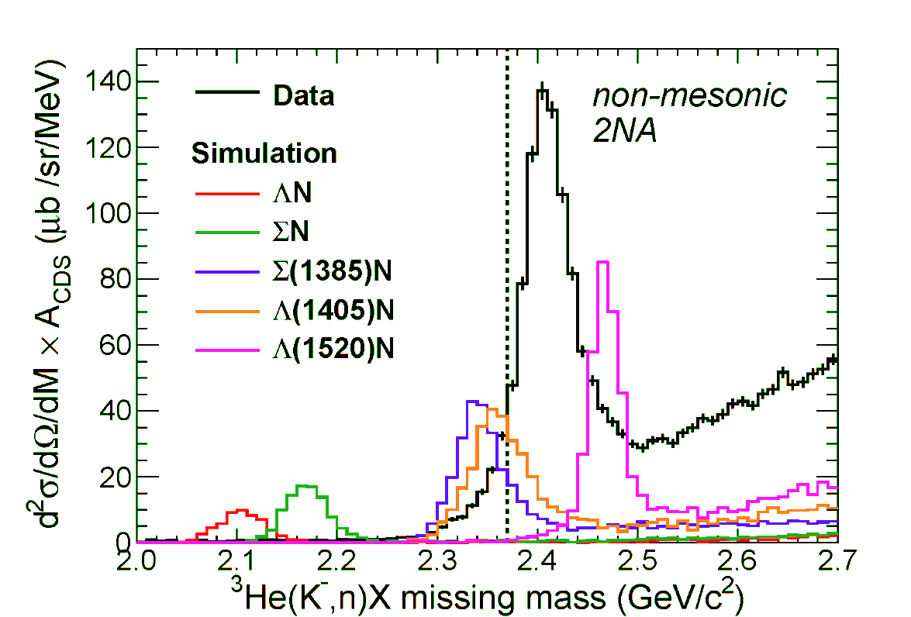
Possible process to contribute to the tail component
Non-Mesonic 2NA
(KNNN_{s}→Y(*)NN_{s})
SIM
Assumption
Line-shape: Breit-Wigner distribution
Charged decays are equal weight
KNN->Y N have few yield in the tail component
KNN->Y*N can have a yield in the tail component
Notes:
The contribution from the non-mesonic 2NA are also estimated by MC simulation. In these figures, the yield of 20 mb/sr at θ_{lab} =0° is generated for each branch. The peak structure from Y event cannot be seen in our data, and the contribution from the process in the tail component is very small. Y* event can have a yield in the tail component. However there are few data events to examine the process exclusively, so we plan to investigate the tail component by πΣ decay channel with much higher statistics.

Slide 15
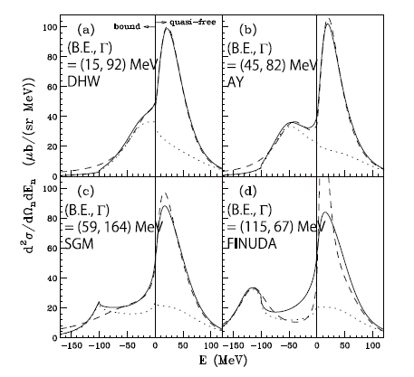
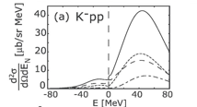
Comparison of the tail component with theoretical calculation
inclusive-spectra of the ³He(K⁻, n) reaction at p_{K} =1.0 GeV/c and θ_{lab}=0°
Koike, Harada,PRC80(2009)055208
Yamagata-Sekihara, et al.,
PRC80(2009)045204
CS of all bound region ~100 μb/sr
CS of all bound region ~1000 μb/sr
Comparable to our data
Notes:
Then we compare the tail component with theoretical calculation by assuming that all the tail component is contributed from loosely-bound K-pp. In calculation by Koike and Harada, σ of all bound region is ~1000 μb/sr. On the other hand, in calculation by Yamagata and Sekihara, σ is ~100 μb/sr. The measured cross section integrated in the bound region is rather comparable to that predicted by Koike and Harada, although the spectrum shape is not yet understood by the calculation.

Slide 16
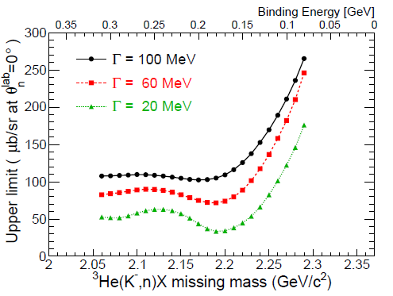
Upper limit of K-pp→Λp cross section for a deeply bound region
in the missing mass range from 2.06 to 2.29 GeV/c²
Confidence Level 95%
Assumption of K-pp
Shape: Breit-Wigner distribution
Decay: K-pp->Λp (100%)
: Isotropic
~100 μb/sr
CS of QF ~10000 μb/sr
The Upper limit is much smaller than the cross section of quasi-elastic (0.5~5 % (or a few %) of QF)
Notes:
we evaluate the upper limit of σ for K-pp deeply bound state in the missing mass range from 2.06 to 2.29 GeV/c2 by assuming K-pp shape, decay branch (Λp 100 %) and isotropic decay angular distribution. We can obtain the upper limit of σ in the bound region of >~100 MeV, which is much smaller than the σ of quasi-elastic (0.5~5 % (or a few %) of QF).

Slide 17
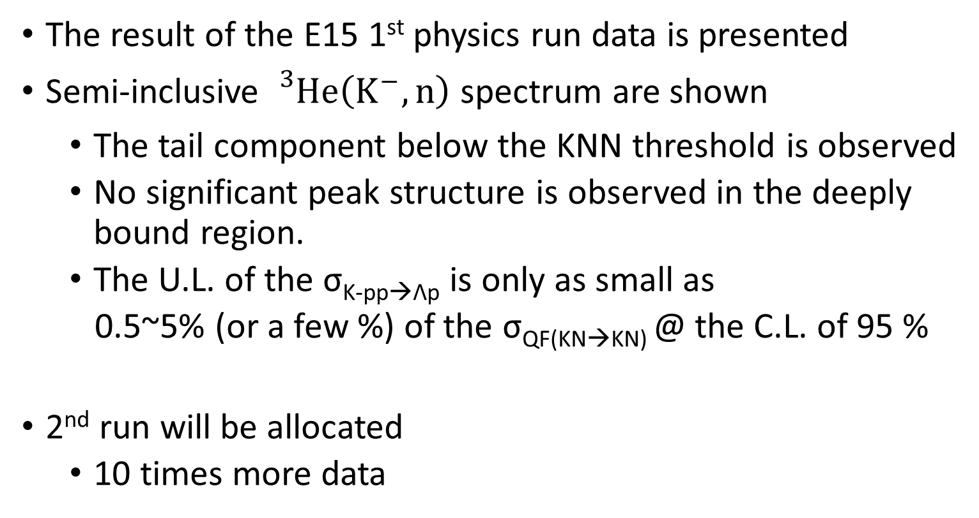
Summary
The result of the E15 1st physics run data is presented
Semi-inclusive ${}_{}^{3}{He}\left(K^{−}, n\right)$ spectrum are shown
    The tail component below the KNN threshold is observed
  No significant peak structure is observed in the deeply bound region.
  The U.L. of the σ_{K-pp→Λp} is only as small as
  0.5~5% (or a few %) of the σ_{QF(KN→KN)} @ the C.L. of 95 %
2nd run will be allocated
  10 times more data

Slide 18
Back up

Slide 19
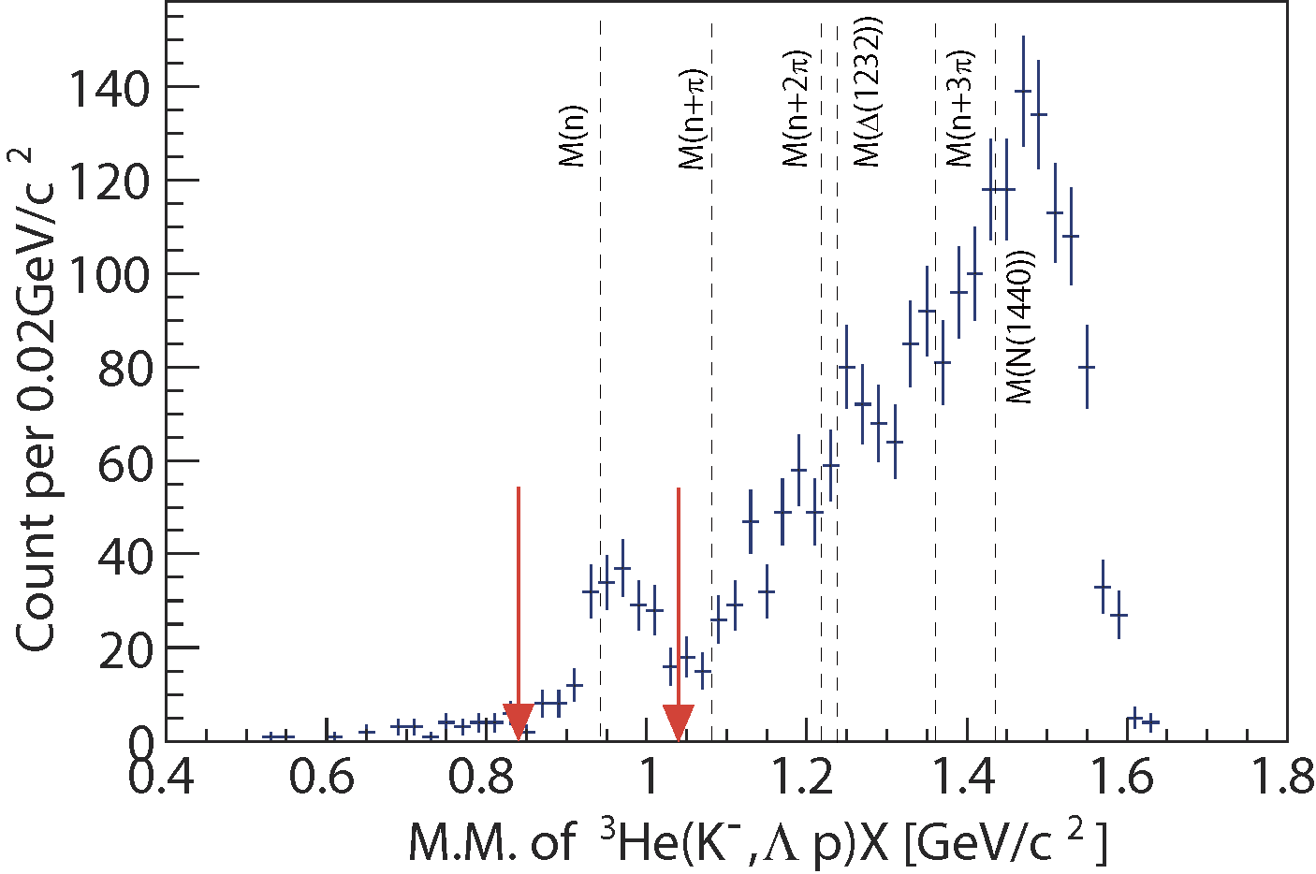
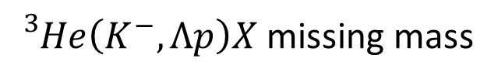
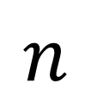
Exclusive analysis
Exclusive ${}_{}^{3}{He}\left(K^{−}, Λp\right)n$ for K-pp→ $Λp$→p$π^{−}$p
${}_{}^{3}{He}\left(K^{−}, Λp\right)X$ missing mass
$$n$$
Missing neutron peak can be seen.
Select the region from 0.84 to 1.04 GeV/c² as Λpn final state.
Σ⁰pn contamination ~20%

Slide 20
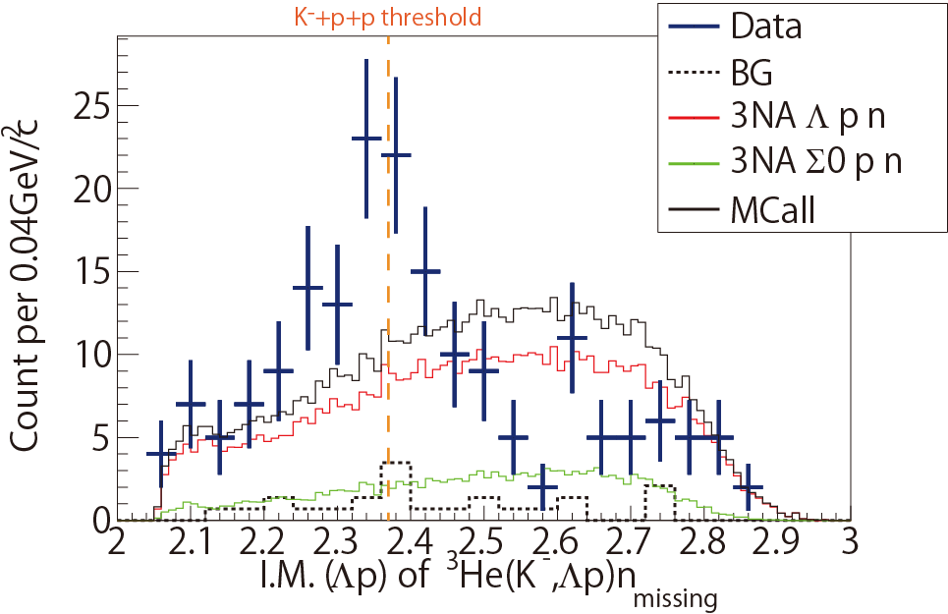
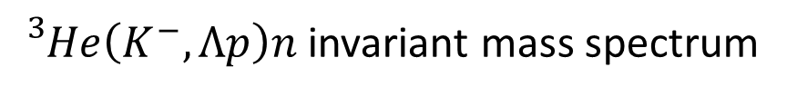
Invariant mass Λp
${}_{}^{3}{He}\left(K^{−}, Λp\right)n$ invariant mass spectrum
Simulated distribution from 3NA process is overlaid
The shape cannot be explained by 3NA
Statistics are not enough

