Slide 1
A Search for
Deeply-bound Kaonic nuclear states
RCNP, Osaka University
Kentaro Inoue
For THE E15 Collaboration
Notes:
I would talk about a search for deeply-bound kaonic nuclear states.
This is E15 experiment.

Slide 2
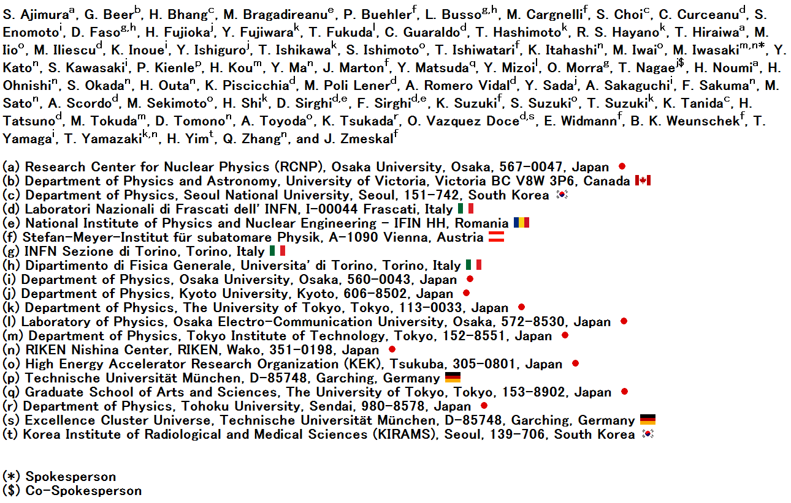
E15 Collaboration LIST
0
Notes:
This is E15 collaboration list.

Slide 3
Contents
•Introduction
•E15 experimental
Set up
Detector Performance
•Analysis result
Semi-inclusive ³He(K⁻, n)
Exclusive spectrum
³He(K⁻, d) analysis
•Summary
1
Notes:
Contents is show here
First, I will introduce experiment briefly.
Next, the experimental setup is explained.
Then, I will show some experimental results.

Slide 4
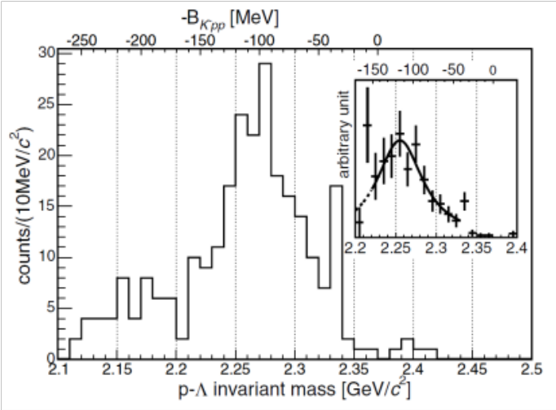
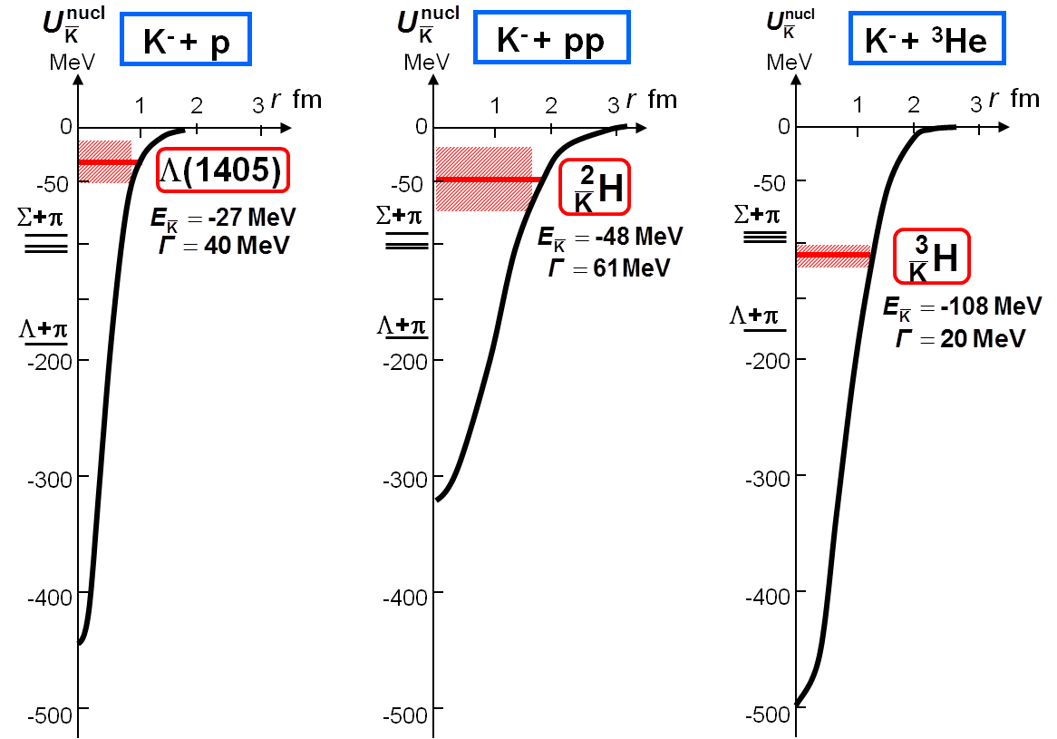
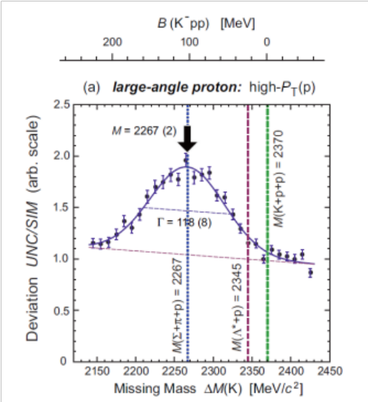
Introduction
•We know KN interaction is strongly attractive.
•A deeply kaonic nucleus may be formed when anti-kaon is
embedded in nucleus.
•K⁻pp is the lightest one.
FINUDA
B=115±6±4MeV
Γ=67±14±3MeV
DISTO
Y. Akaishi & T. Yamazaki, Phys. Rev. C65 (2002) 044005.
B=105±2±5MeV
Γ=118±8±10MeV
Y. Akaishi & T. Yamazaki, Phys. Lett. B535 (2002) 70.
2
Notes:
We know anti-kaon and nucleon interaction is strongly attractive.
A deeply kaonic nucleus expected to be formed when anti-kaon is embedded in nucleus.
The “K-pp” system is the lightest one, which we will search for.
There are two experimental report on K-pp system.
The FINUDA group reported a bump at K-pp binding energy of 115MeV with width of 67MeV.
The DISTO group reported a bump at binding energy of 105MeV with width of 118MeV.
However, contribution of the physics background processes are still under discussion.
Interpretation of the bump is no fixed yet.

Slide 5
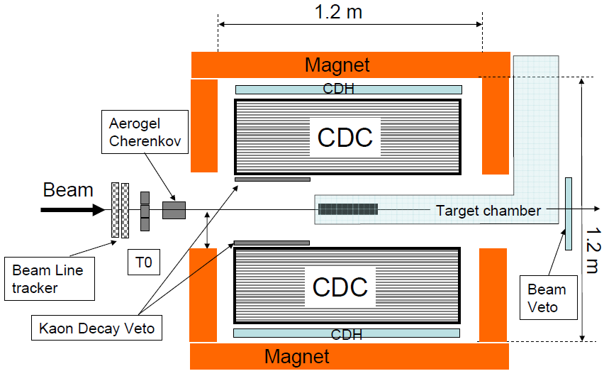
E15 Experiment
K⁻
1GeV/c
³He
K⁻pp
Missing Mass Spectroscopy
Reaction
+
+
Neutron momentum measured by TOF.
n
Λ
Invariant Mass Reconstruction
from decay particles detected by CDS
Decay
π⁻
p
p
Complete measurement
for K⁻pp
NC
•formation
•decay particles
15 m
３
From M. Iio et al. @PANIC2008
Notes:
We use an inflight 3He(K-, n) reaction, where a K- kicks a neutron out of 3He forming the K-pp bound state.
A 1GeV/c kaon beam is irradiated on liquid 3He target
The scattered neutron is detected by NC and momentum is measured by TOF.
We can observe the K-pp spectrum in a missing mass of 3He(K-, n).
The K-pp bound state is expected to decay into Lp.
We also detect all particles of the Lp final states by the CDS surrounded by the 3He target, and reconstruct the K-pp invariant mass.
We investigate the K-pp bound state in formation and decays.
The E15 experiment realize a complete measurement for K-pp

Slide 6
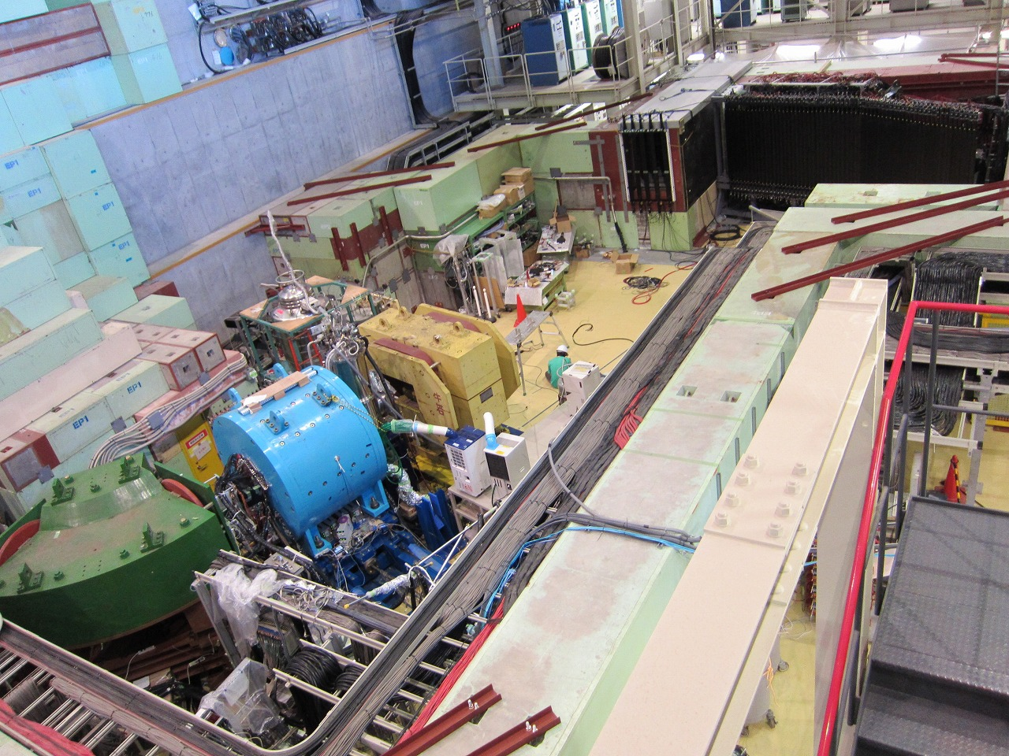
K1.8BR spectrometer [Jun. 2012]
beam dump
beam sweeping
magnet
Neutron
Charge Veto
Proton Counter
liquid ³He-target
system
CDS
CDS
(Ushiwaka)
CVC
K⁻
π
n
~15m
beam line
spectrometer
³He target
NC
p
CDC
CDH
PC
Notes:
This is K1.8BR experimental area.
Green one is beam spectrometer.
beam momentum is analyzed by this.
Sky blue is CDS, target is placed at center of this.
This is neutron counter.
Next is detector performance

Slide 7
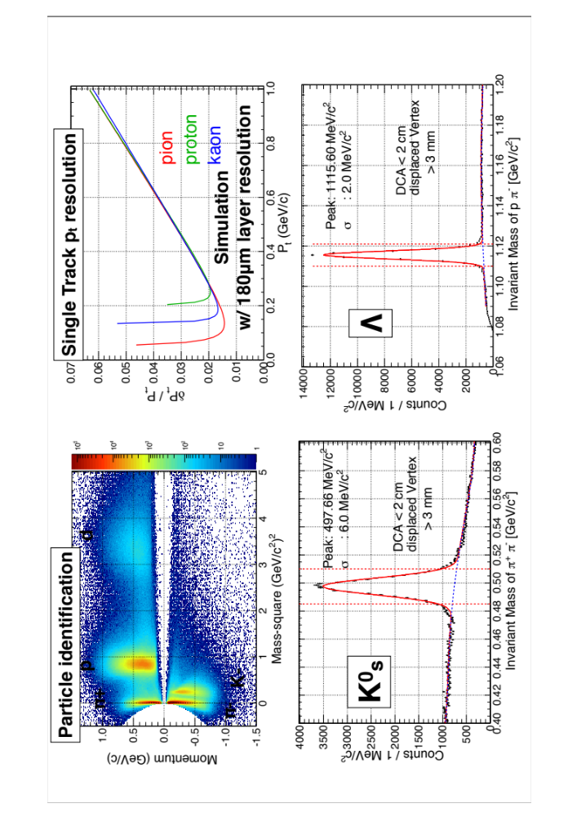
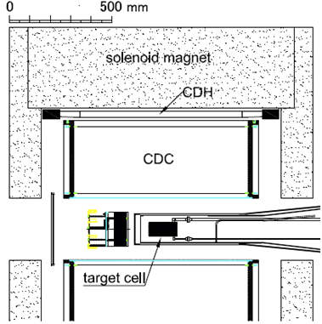
CDS Performance
CDC: Drift Chamber
CDH: Hodoscope
Magnet: 0.7T
Cover 60% of the solid angle.
K
Design performance was achieved!!
５
Notes:
Left up figure show performance of particle identification.
π+, π-, K-, proton and deuteron are identified.
K0 and Lambda invariant masses are clearly reconstructed, as shown in bottom figures.

Slide 8
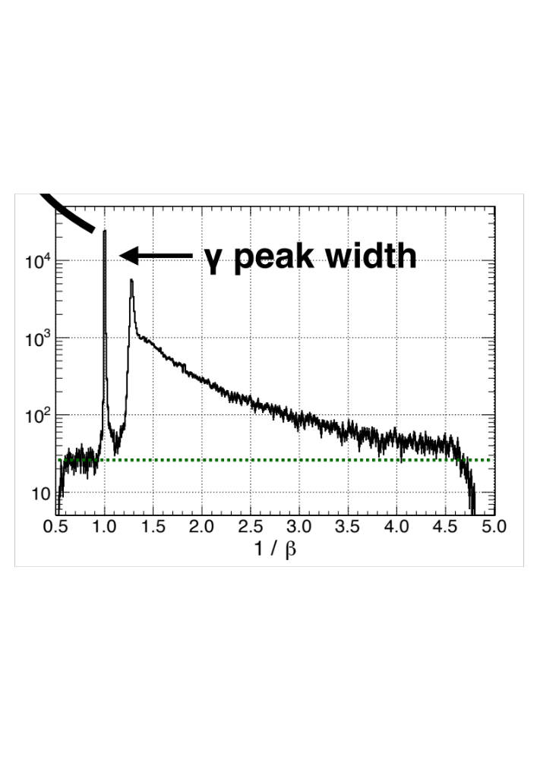
NC Performance
KN-KN quasi-elastic scattering
accidental background
S/N〜100@QF neutron peak
→Offline threshold is 8MeVee
σ_{TOF}~160ps @ γ
→σ_{MM}~10MeV/c² at the interested region
６
Notes:
This is 1/β spectrum of forward scattered neutral particles detected by NC.
A γ peak is clearly seen at beta=1.
From this peak, time resolution is found to be 160ps.
Which corresponds to the missing mass resolution of 10MeV/c2 in the interesting region.
A cut for the energy deposit in the NC at 8 MeVee reduces accidental events.
The S/N is as good as 100 at the peak corresponding to the KN quasi-elastic scattering.

Slide 9
J-PARC E15 1st stage physics run
Accumulated data
  w/ liquid helium-3 target: ~1% of original proposal
period | Primary beam intensity | duration | Kaon on target
March,2013 | 14.5kW(18Tppp, 6s cycle) | 30 hours | 1.1×10⁹
May, 2013 | 24kw (30Tppp, 6s cycle) | 88 hours | 5.1×10⁹
Analysis Result
1.Semi-inclusive ³He(K⁻, n) spectrum
2.Exlusive spectrum
3.³He(K⁻, d) analysis
７
Notes:
E15 1st stage physics run had performed in march and may of the last year.
Six point two giga kaon irradiated to liquid helium-3 target.
This value is only 1% of original proposal.
I will present analysis the run in may.

Slide 10
Semi-inclusive ³He(K⁻,n) spectrum
•³He(K⁻, n) missing mass spectrum
•Compression with quasi-free K⁰ Spectrum
•Contaminate target cell
•Contribution of Σ decay
NC
K beam
X
n
³He target
NC
(charged tag)
８
Notes:
Next is physics result.
First, I talk about semi-inclusive 3HE(K-, n) spectrum.
Semi-inclusive mean requirement of 1 charged track in CDS,
So, this spectrum can’t be compared with theoretical calculation.

Slide 11
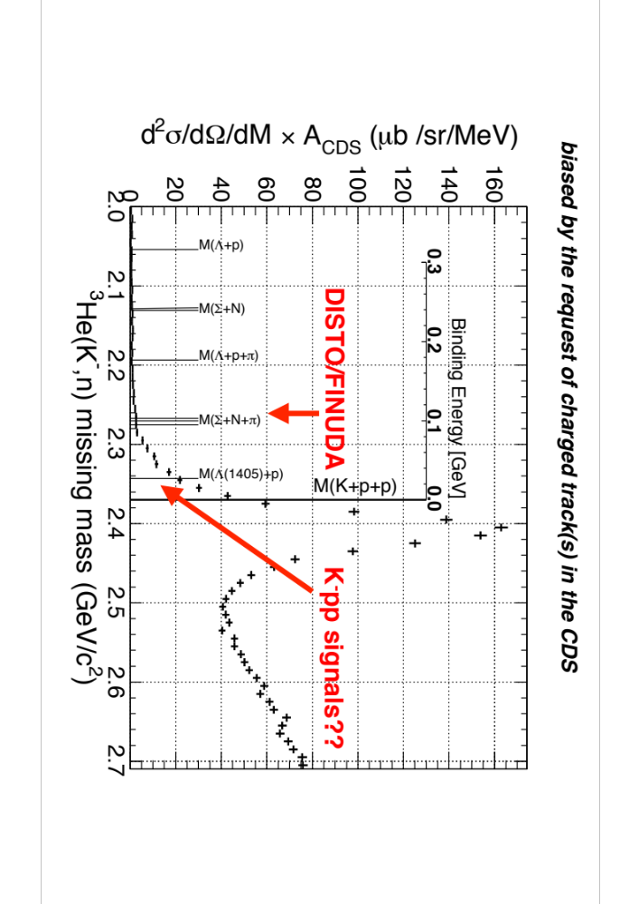
Semi-inclusive ³He(K⁻,n) spectrum
Yield excess
K⁻pp bound region
９
Notes:
This is “semi”-inclusive 3He(K-, n) missing mass spectrum.
The K-pp threshold here.
The position of the FINUDA/DISTO’s bump are located around here.
Peak structure is not seen in bound region.
However, the spectrum shows a yield excess in bound region.

Slide 12
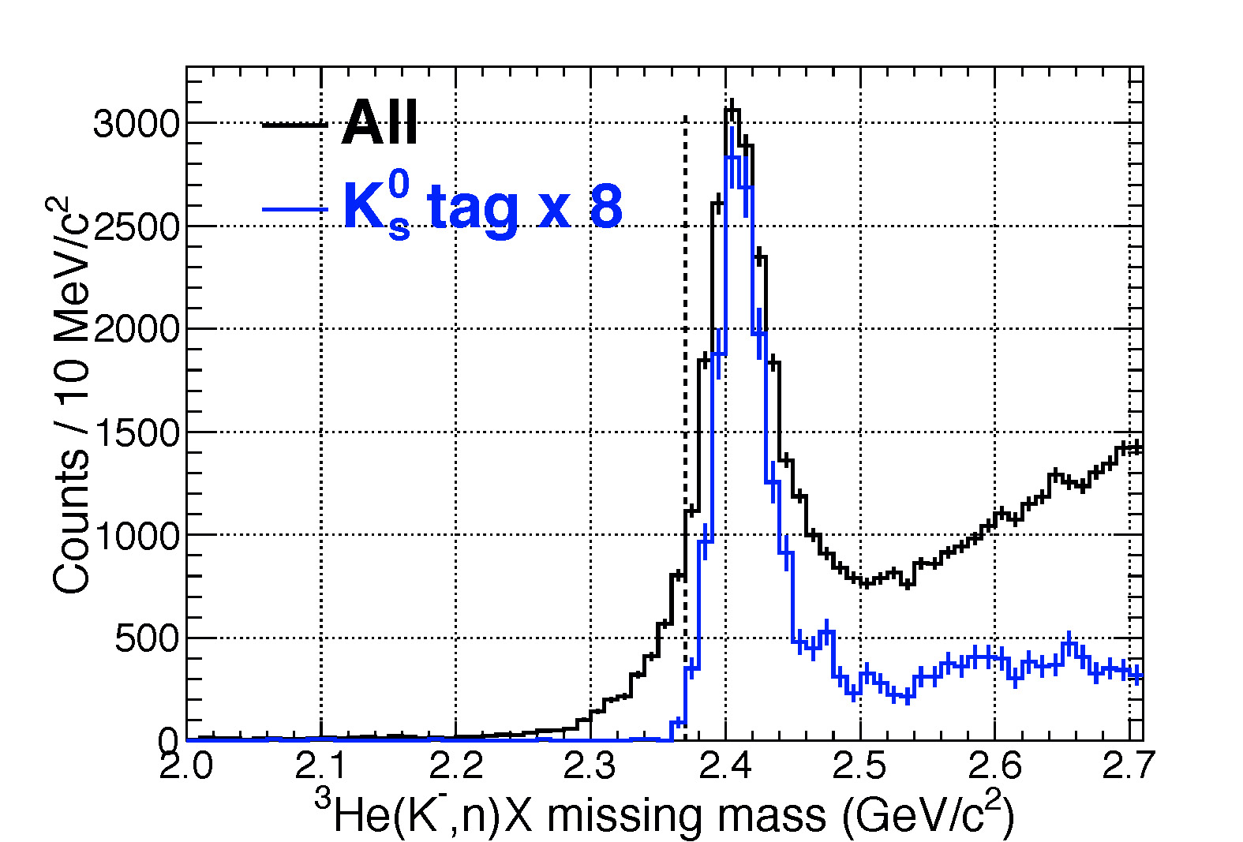
Compression with quasi-free K⁰ Spectrum
Tail component in bound region
is not due to detector resolution
1０
Notes:
This is comparison with quasi-free K0s spectrum.
Blue line is K0s tagged spectrum by CDS.
The peak is expected to correspond to the K- p to K0 n elastic scattering events.
Since the spectrum rises to just from the K-pp threshold.
The excess below the threshold cant’t be explained by smearing effects due to the detector resolutions.

Slide 13
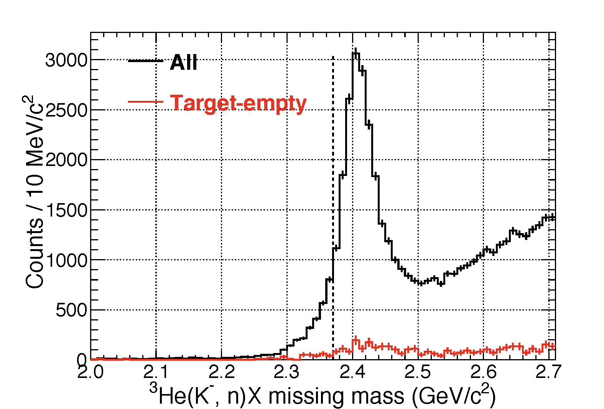
Contamination from other than ³He target
Contamination contribution is too small
1１
Notes:
Contamination from the other than 3He target was estimated by the target-empty run.
Red line shows the obtained spectrum.
You can see that the contamination is not significant.

Slide 14
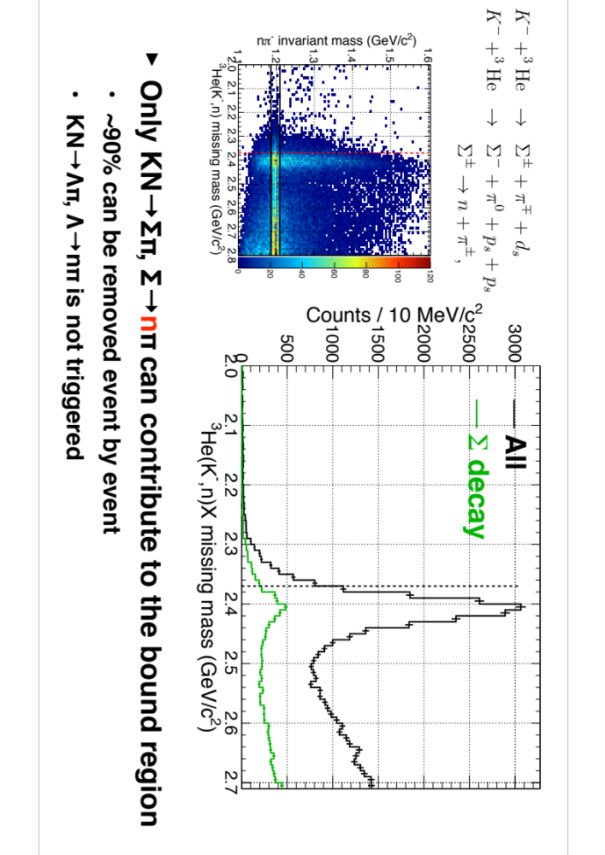
Single-nucleon processes
1２
Notes:
Fast neutrons may come from Charged sigmas, whiere the sigma’s can be produced by the reaction as shown here.
Since we require one charged track in the CDS, these sigma’s mass can be reconstructed from a neutron detect by NC and a pion detected by CDS.
Left figure shows a 2-D plot of 3He(K-, n) missing mass versus n pi- invariant mass.
A locus of Sigma is clearly seen between black lines.
The KN to πΣ process contribute to the bound region, which is shown by a green line in right figure.
The KN to Λπ process is not triggered since no charged particle is associated with a neutron in the Λ decay.

Slide 15
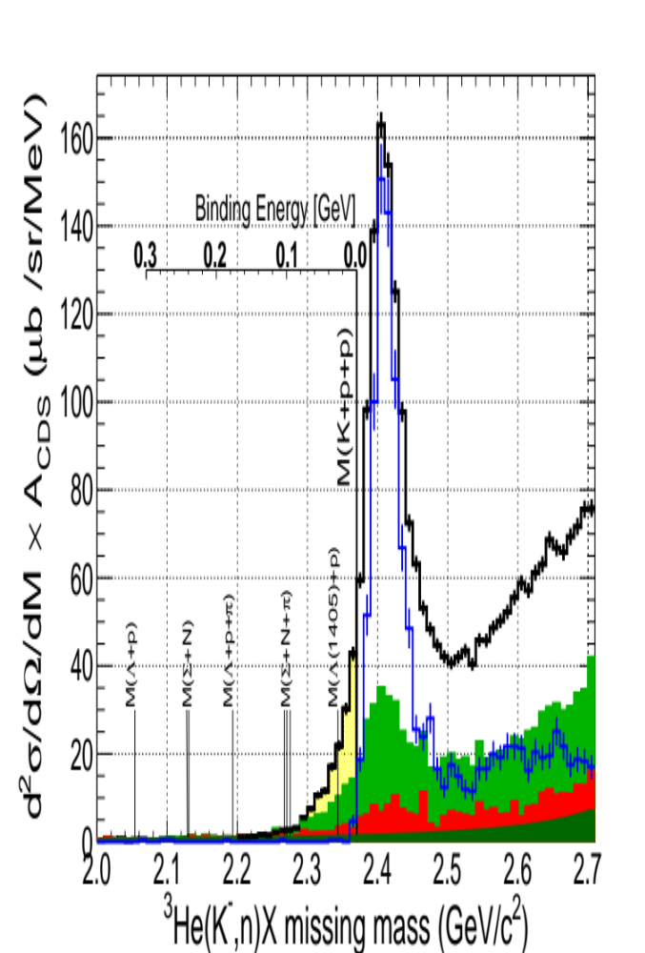
What is the excess? - Multi-NA
Unknown excess
Σ-decay
Target-empty
Continuous BG
There remains a statistically significant excess.
13
Notes:
Here again shows the semi-inclusive spectrum /overlaid with a contamination from other than 3He target, indicated by the red hatched area, and the sigma-decay contribution , indicated by the green hatched area.
We can find a statically significant excess remained in the bound region.

Slide 16
Exclusive Spectrum
•³He(K⁻, Λp) missing mass
•Λp”n” energy correlation diagram
³He target
(missing n)
K beam
?
?
Λ
p
CDS
missing n
１４
Notes:
Next, I will explain an exclusive spectrum.
I will show a 3He(K-, Λp) missing mass.
And, I will explain event distribution in the Λpn energy correlation diagram.

Slide 17
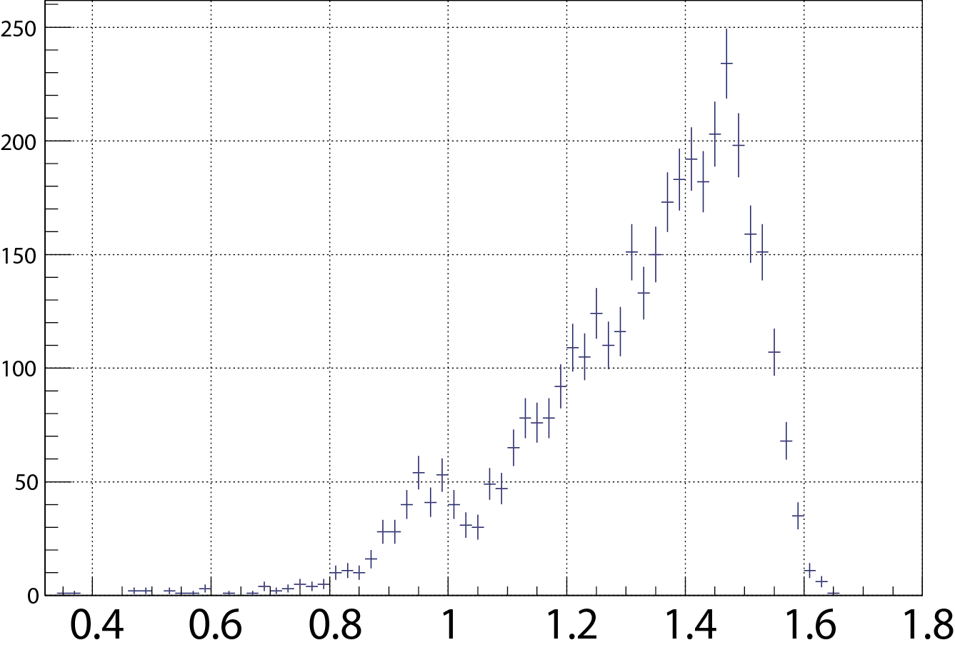
³He(K⁻, Λp) Missing Mass
K
beam
*including Σ⁰pn→γΛ pn events
³He
(missing n)
?
?
Count/20MeV/c²
n
Λ
p
M.M. of ³He(K⁻, Λp) [GeV/c²]
•Missing neutron peak
is clearly seen.
•This include Σ⁰(γΛ)pn.
To study origin of Λpn
events.
Next, check energy
correlation.
１５
Notes:
This is 3He(K-, Λp) missing mass spectrum.
The spectrum shows a peak at the neutron mass.
We could identify a missing neutron.
Selecting the neutron mass region, we can extract an event sample of the Λpn final state.
Σ0 decay to Λ and γ.
Since, the γ energy is a few., identification of Λpn and Σ0pn is not easy.
The missing neutron peak maybe include Σ0pn events.

Slide 18
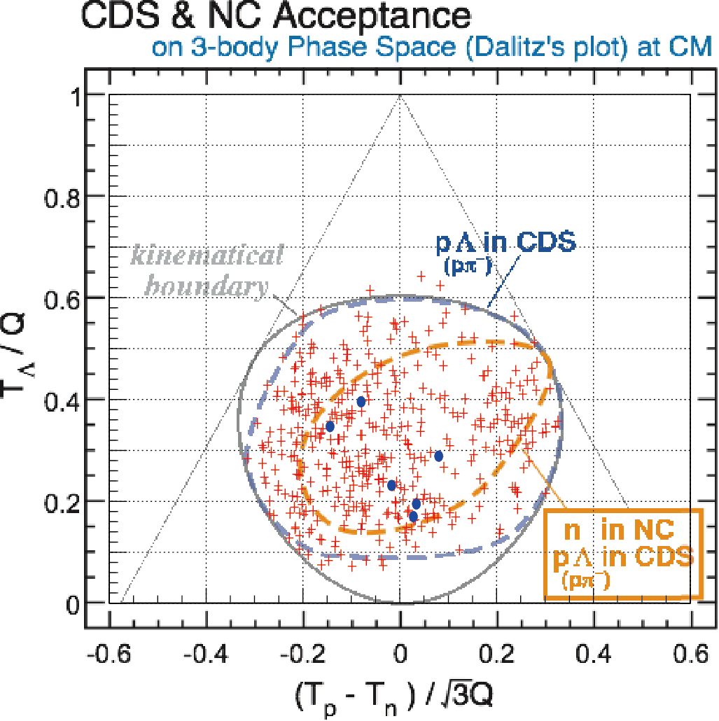
Λ p missing “n” correlation
+ all events
● w/ forward n in the NC
Λ
Selected neutron missing
mass peak.
*including Σ⁰→γΛ events
Kinematical
boundary region
Preliminary
n
n
p
１７
Notes:
This is an energy correlation of Λp and missing n
Yellow line show kinematical boundary region.
Red line expresses kinematical energy of Λ.
Green line expresses kinematical energy of neutron.
Blue line expresses kinematical energy of proton.
If event is distributed at a cross point of kinematical boundary and color line, corresponding particle particle is emitted energetically in one direction and the other two are opposite.
If event is distributed at a cross point of a side of triage and a color line, corresponding particle stop and the other two particles are opposite.

Slide 19
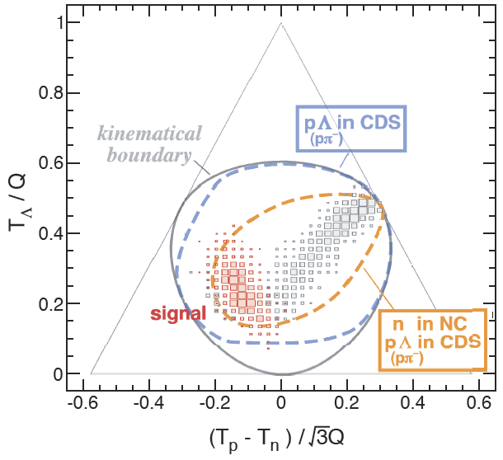
Σ-Λ conversion
(2 step)
2N-abs
K⁻pp
n
n
K⁻
n
³He
³He
p
Σ
Λ
p
K⁻
³He
Λ
K⁻
p
Λ
“K⁻pp”
n
n
Sim.
K⁻
K⁻
Λ
Σ
p
³He
³He
p
Λ
Σ-Λ
2N
K⁻pp
２０
Notes:
We can consider seceral reaction processes that appear Λpn in the final state, as shown in these figures.
Different process show different patterns of event distribution in the energy-correlation diagram
In the case of 2-nucleon absorption process, one nucleon, say a neutron becomes a spectator.
As a result, the neutron energy is kept low and is expected to be located in this area.
Σ-Λ conversion process is a kind of 2N-absorption process.
But an intermediate sigma interacts with a residual

Slide 20
Λ p missing “n” correlation
+ all events
● w/ forward n in the NC
Selected neutron missing
mass peak.
*including Σ⁰→γΛ events
・Events are scattered widely in phase space.
・Multi-N absorption processes exist.
☑It seems 3N-abs(Λpn) exists
pΛ in CDS
Preliminary
１８
Notes:
This line is the CDS acceptance for Λp.
Observed events are scattered widely in the phase space.
It seems a pattern of 3N-absorption process.

Slide 21
Λ p missing “n” correlation
+ all events
● w/ forward n in the NC
Selected neutron missing
mass peak.
*including Σ⁰→γΛ events
2N-abs
(Λpn_{s} ,π⁰Λpn_{s})
・Events are scattered widely in phase space.
・Multi-N absorption processes exist.
☑It seems 3N-abs(Λpn) exists
☑2N-abs is very weak.
・“Λpn” w/ forward n in the NC are a few events.
☑We would like to carry out high statistical experiments !
Preliminary
２１
Notes:
There is no event locus at the area expected for 2N-absorption processes.
So, the processes seem (very) weak.

Slide 22
Λ p missing “n” correlation
+ all events
● w/ forward n in the NC
Selected neutron missing
mass peak.
*including Σ⁰→γΛ events
・Events are scattered widely in phase space.
・Multi-N absorption processes exist.
☑It seems 3N-abs(Λpn) exists
☑2N-abs is almost nothing.
☑ can not see Σ-Λ conversion line?
・“Λpn” w/ forward n in the NC is a few events.
☑We would like to carry out high statistical experiments !
Σ-Λ conversion
(2step)
Preliminary
Sim.
２２
Notes:
We cannot find a special concentration for the Σ-Λ conversion process.

Slide 23
Λ p missing “n” correlation
+ all events
● w/ forward n in the NC
Selected neutron missing
mass peak.
*including Σ⁰→γΛ events
・Events are scattered widely in phase space.
・Multi-N absorption processes exist.
☑It seems 3N-abs(Λpn) exists
☑2N-abs is almost nothing.
☑ can not see Σ-Λ conversion line?
・“Λpn” w/ forward n in the NC is a few events.
☑We would like to carry out high statistical experiments !
K-pp
B. E. = 100 MeV
Γ = 100 MeV
Preliminary
Sim.
２３
Notes:
We find events at around the K-pp signal region.
However, analysis is still in progress for understanding of these events.

Slide 24
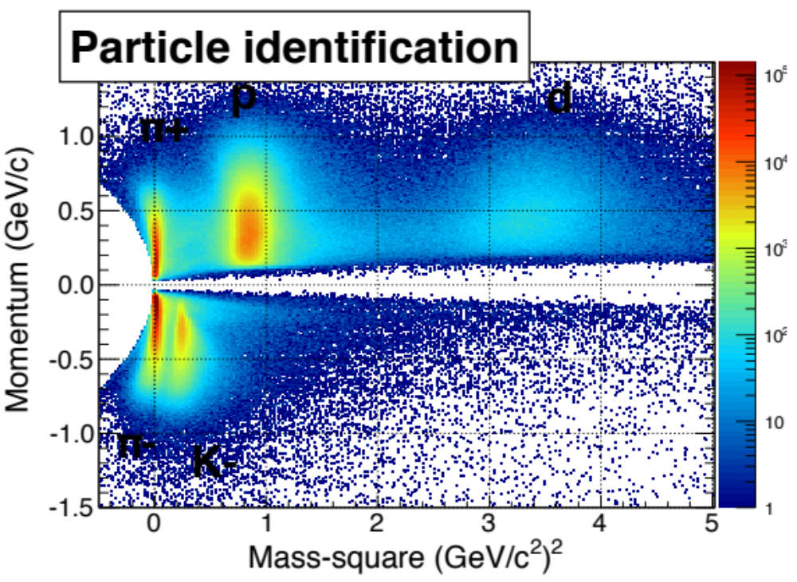
³He(K⁻, d) Spectrum
•³He(K⁻, d) missing mass spectrum
•³He(K⁻, d K⁻) missing mass spectrum
•³He(K⁻, d) missing mass tagged K⁻ “p”
K beam
Elastic scatter?
Hyperon?
3N-absorption?
２５
Notes:
Finally, I will switch to analysis on the (K-, d) reaction.
As deuteron are clearly identified by CDS, we observed the (K-, d) spectrum.

Slide 25
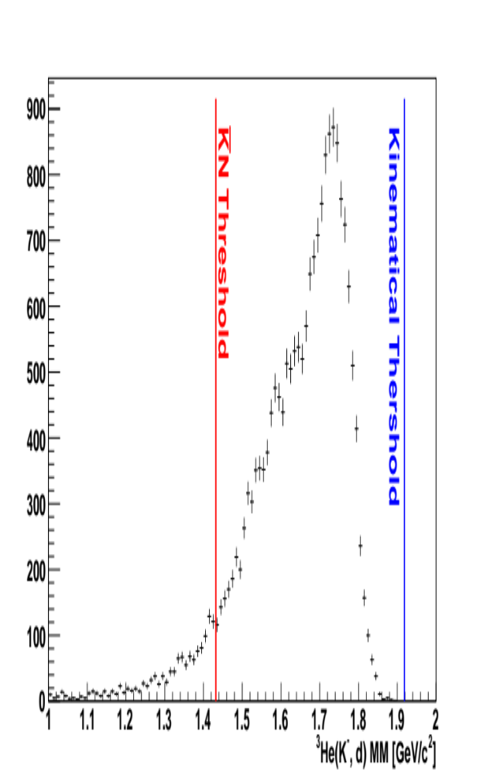
³He(K⁻, d) missing mass spectrum
d is detected by CDS
CDS
acceptance
³He(K⁻, d) spectrum is widely spared.
This spectrum is hard to explain by elastic scatter
2６
Notes:
This is ³He(K⁻, d) missing mass spectrum.
Blue line is the kinematical limit of the 3He(K-, d) reaction at 1GeV/c.
The Red line shows the KbarN threshold.
When the quasi-elastic scattering takes place dominantly, a bump structure close to the KbarN threshold is expected to be seen, as in the case with the 3He(K-, n) spectrum.
However, the observed spectrum is distributed rather in the higher missing mass region.
This is hardly explained by the quasi-elastic scattering of K- with d in He3.

Slide 26
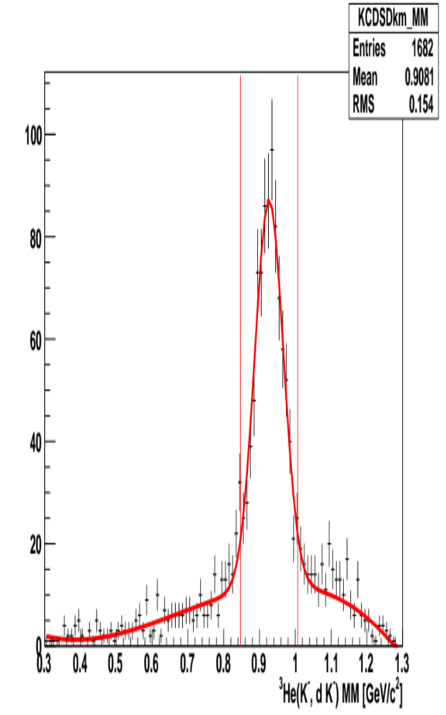
³He(K⁻, d K⁻) missing mass
d & K⁻ are detected by CDS
³He(K⁻, d K⁻ ) MM is clearly seen missing proton.
K⁻+³He→d+K⁻+”p” has low BG
2７
Notes:
Then, we select the events of dK-p in the final state.
Here, a missing proton is identified in the 3He(K-, dK-) missing mass spectrum, as shown in this figure.

Slide 27
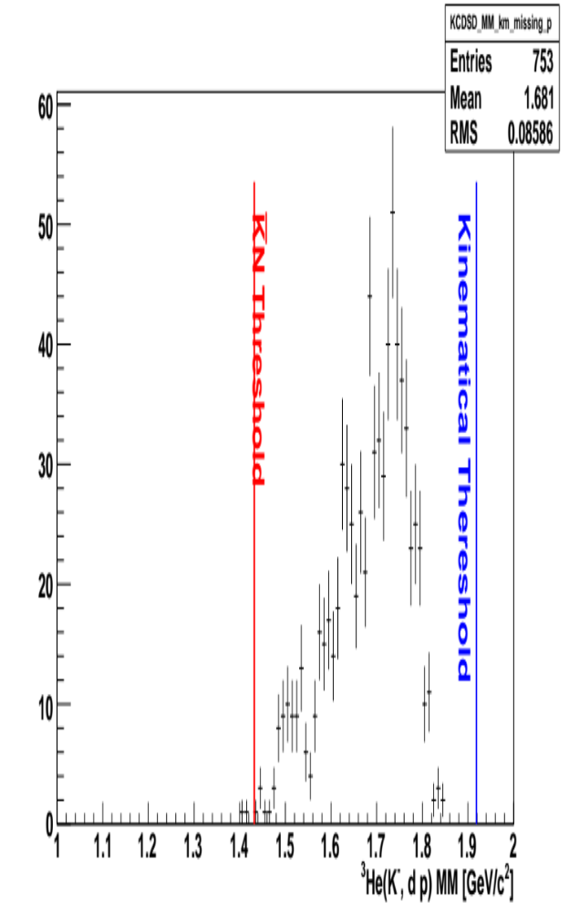
³He(K⁻, d) missing mass w K⁻ “p”
CDS d & K⁻, missing p
³He(K⁻,d) spectrum don’t change by K⁻ “p” tag.
K⁻ is absorbed in ³He, decay into d K⁻ p.
• directly? via Y*? Analysis is in progress.
This channel is very interesting.
2８
Notes:
The shape of the 3He(K-, d) missing mass spectrum doesn’t change by tagging K- and missing proton.
It seems that the energy of the kaon absorbed in 3He is shared with d, K- and p.
The spectrum shape may be explained by process of 3-body d K- p decay and/or two-body dY* going to d K- p finally after the K- absorption to 3He.
Analysis is in progress.

Slide 28
Summary
•J-PARC E15 1st physics run was performed.
All detectors are working well and design values.
Unfortunately, stopped at only 24kW*4day running time
(<1% of full proposal)
•Semi-inclusive ³He(K⁻, n) spectrum has an yield
excess below the K-pp threshold.
•Λp missing n analysis indicate existence of
3-N absorption process
•³He+K⁻→d+K⁻+p channel is clearly seen.
→The spectrum suggests 3-N kaon absorption.
2９

Slide 29
Thanks your attention!

