Slide 1
Recent results and future prospects of the K^{bar}NN search @ J-PARC E15
F. Sakuma, RIKEN
for the J-PARC E15 collaboration
Results of the E15 1st physics run
Future prospects of E15
Summary
原子核媒質中のハドロン研究 II J-PARC 2014 10/24-25

Slide 2
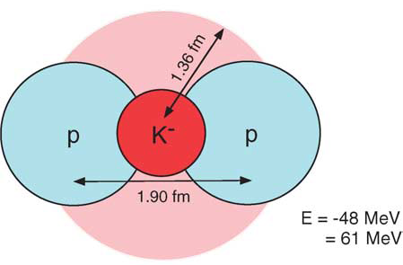
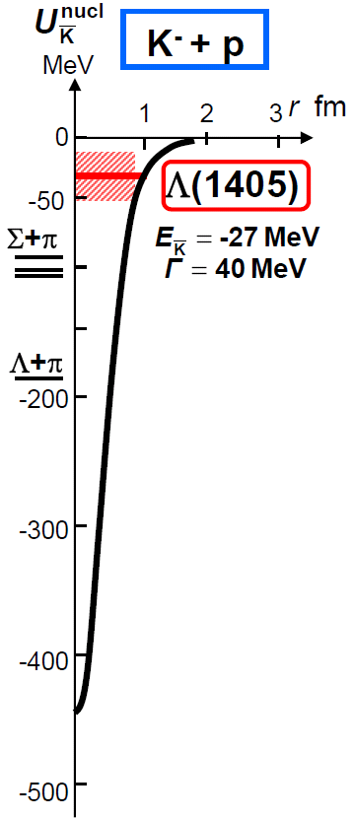
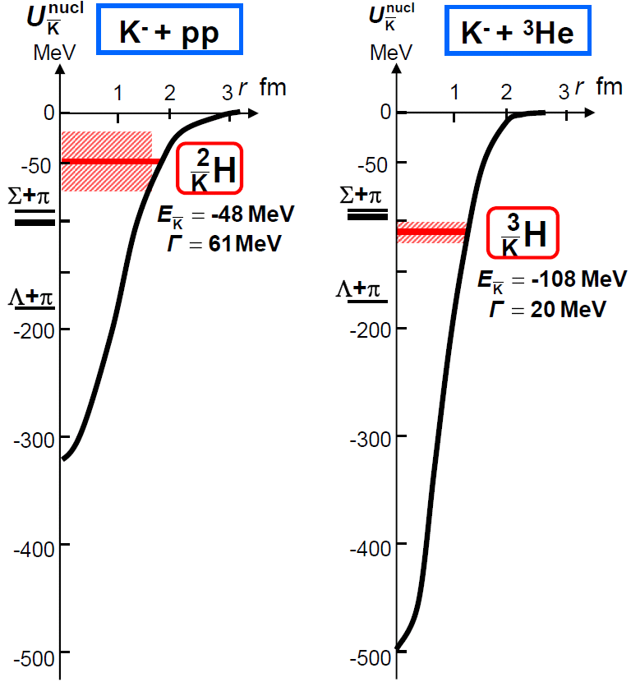
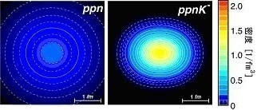
Kaonic Nuclei
Kaonic nucleus is a bound state of nucleus and anti-kaon (K^{bar}NN, K^{bar}NNN, K^{bar}K^{bar}NN, ...)
Density [1/fm³]
Y.Akaishi & T.Yamazaki, PLB535, 70(2002).
T.Yamazaki, A.Dote, Y.Akiaishi, PLB587, 167 (2004).

Slide 3
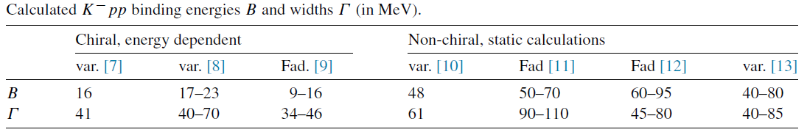
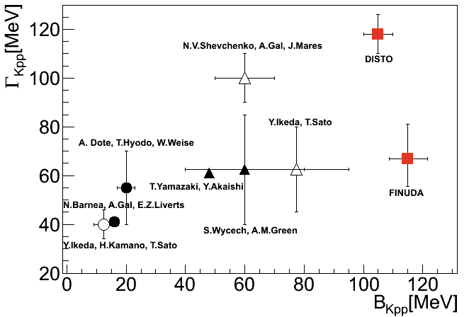
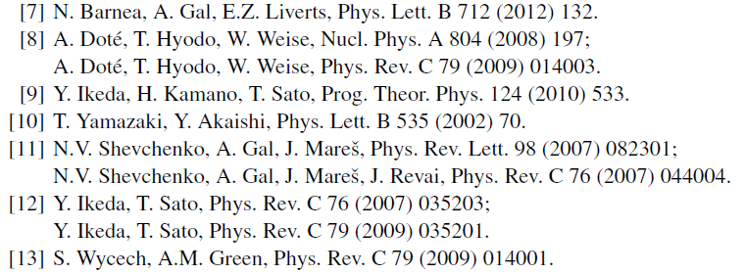
K⁻pp Bound State
K⁻pp : the simplest K^{bar}-nuclear state
A.Gal, NPA914(2013)270
Y.Ichikawa, EXA2014
All theoretical studies predict existence of the K⁻pp
→ However, B.E. and Γ are controversial

Slide 4

Experimental Principle of E15
A search for the simplest kaonic nucleus, K⁻pp, using ³He(in-flight K⁻,n) reaction
two-nucleon absorption
hyperon decays
CAN be discriminated kinematically

Slide 5

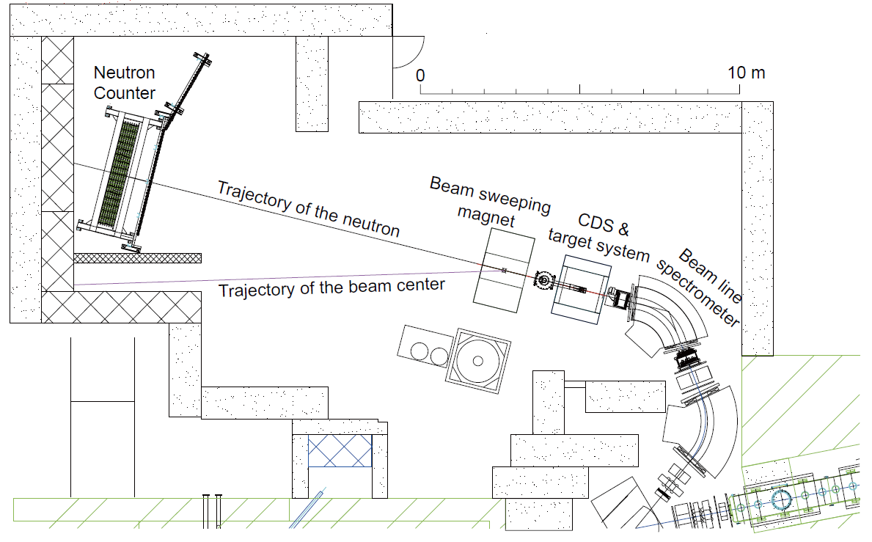
Experimental Setup
15m

Slide 6
E15 1st Stage Physics-Run
Production run of ~1% of the approved proposal was successfully performed in 2013.
All detector systems worked well as designed.
 | Primary-beam intensity | Secondary-kaon intensity | Duration | Kaons on target (w/ tgt selection)
March, 2013 (Run#47) | 14.5 kW (18 Tppp, 6s) | 80 k/spill | 30 h | 1.1 x 10⁹
May, 2013 (Run#49c) | 24 kW (30 Tppp, 6s) | 140 k/spill | 88 h | 5.3 x 10⁹
* production target: Au 50% loss, spill length: 2s, spill duty factor: ~45%, K/pi ratio: ~1/2
* ~70% of beam kaons hit the fiducial volume of ³He target

Slide 7
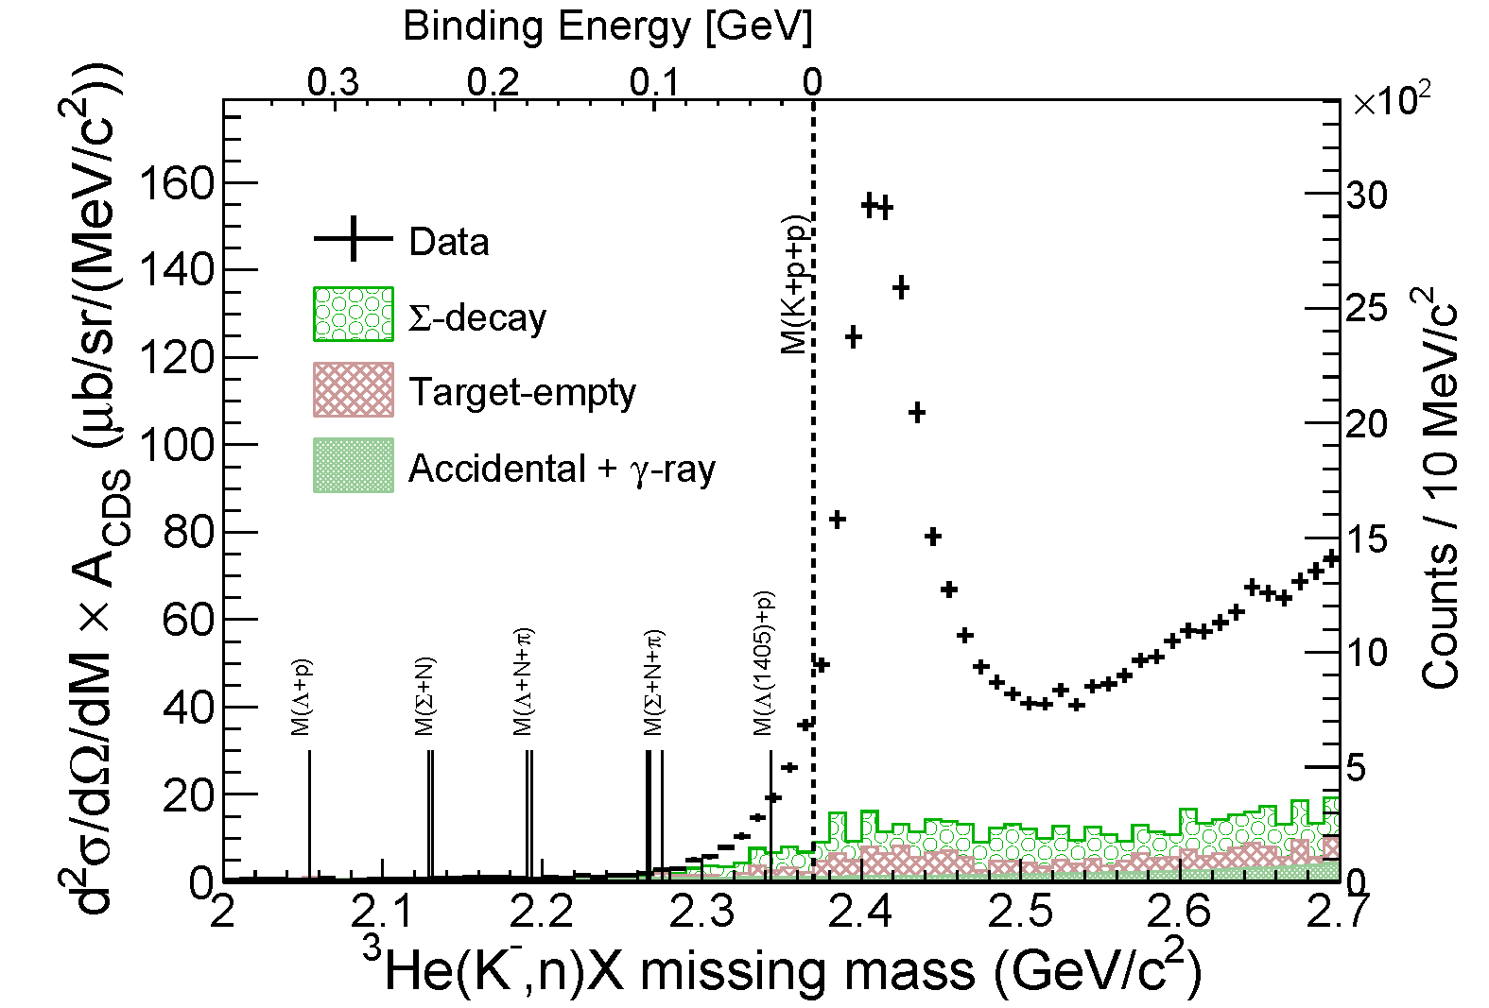
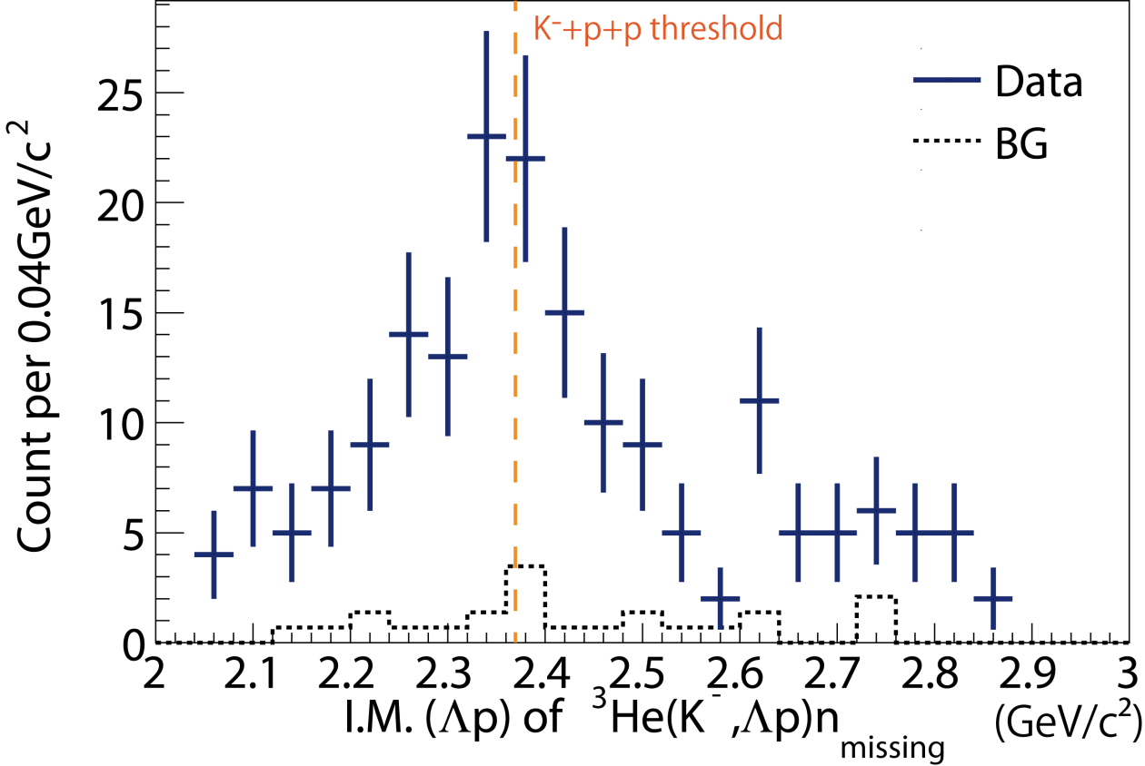
Summary of E15 1st
FINUDA/DISTO
³He(K⁻,n)X M.M.
Formation Channel
Semi-Inclusive ³He(K⁻,n)X
No significant bump structure in the deeply bound region
Excess below the threshold attributed to 2NA of Λ*n?
Λp I.M.
of ³He(K⁻,Λp)n
Decay Channel
Exclusive ³He(K⁻,Λp)n
Hint of the excess around the threshold
Cannot be from 2NA of Λ*n (final state = Λpn)
preliminary

Slide 8
Formation Channel,
Semi-Inclusive ³He(K⁻,n)X
T.Hashimoto et al., arXiv:1408.5637, submitted to PLB

Slide 9
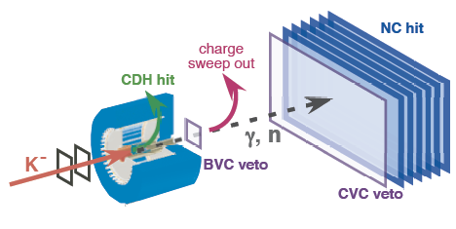
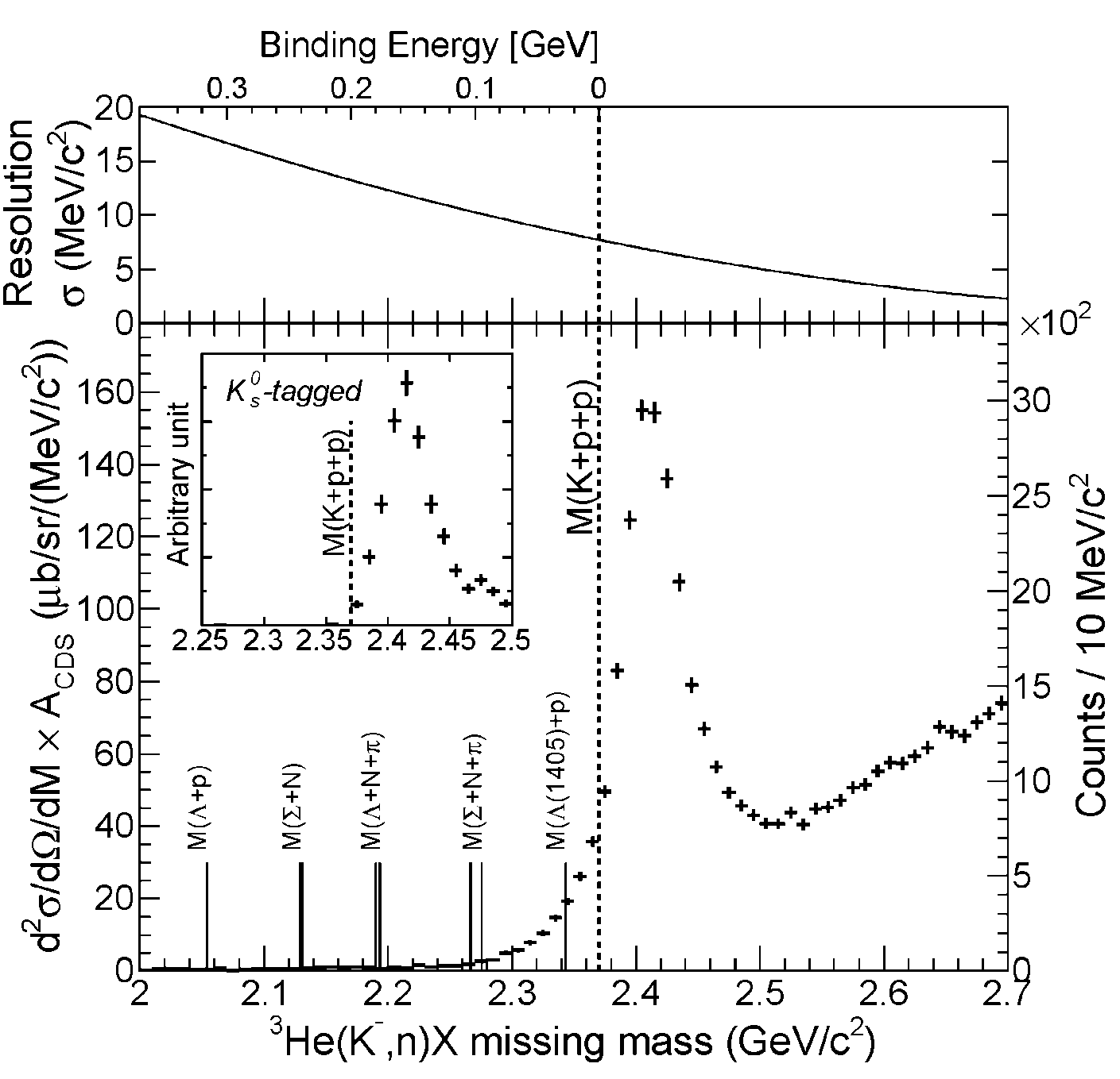
Semi-Inclusive Spectrum
Quasi Elastic
K⁻ + ³He → K⁻ + n + p_{s} + p_{s}
dσ/dΩ_{θ=0deg} ~ 6mb/sr
and
Charge-Exchange
K⁻ + ³He → K⁰ + n + d_{s}
K⁰ → π⁺ + π⁻
dσ/dΩ_{θ=0deg} ~ 11mb/sr
The tail structure is not due to “the detector resolution”

Slide 10
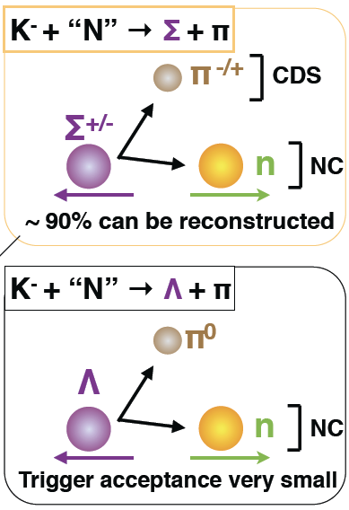
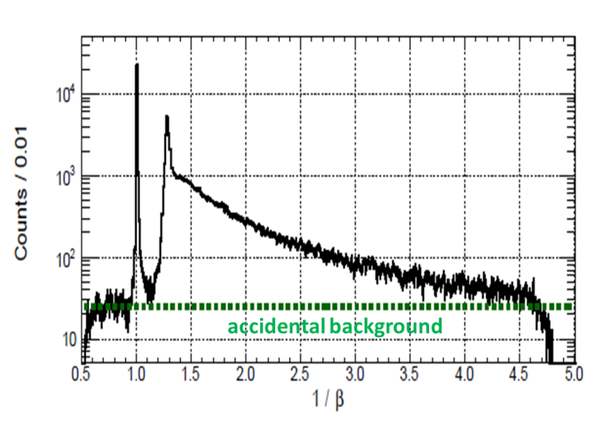
Background Evaluation
(Phys. BG)
(Exp. BG)
evaluated using empty-target data
(Exp. BG)
1/β distribution for γ/n

Slide 11
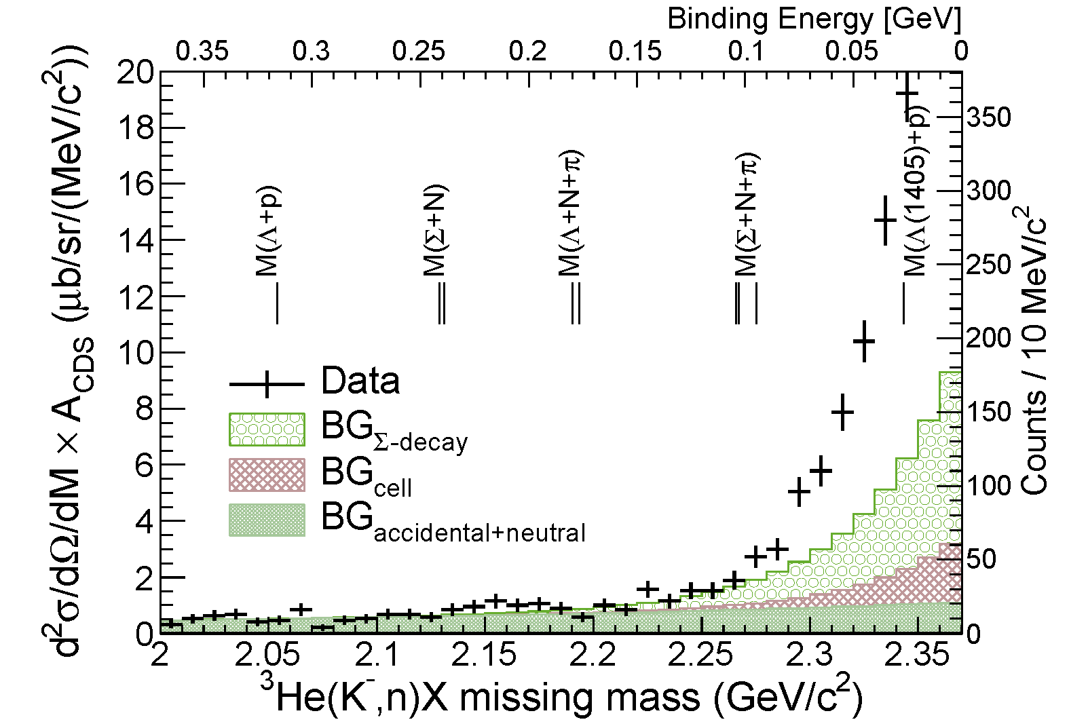
Spectrum below the Threshold
FINUDA/
DISTO
No significant bump-structure in the deep-binding region
Statistically significant excess just below the threshold

Slide 12
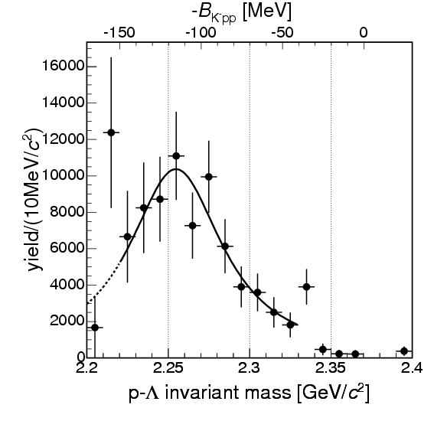
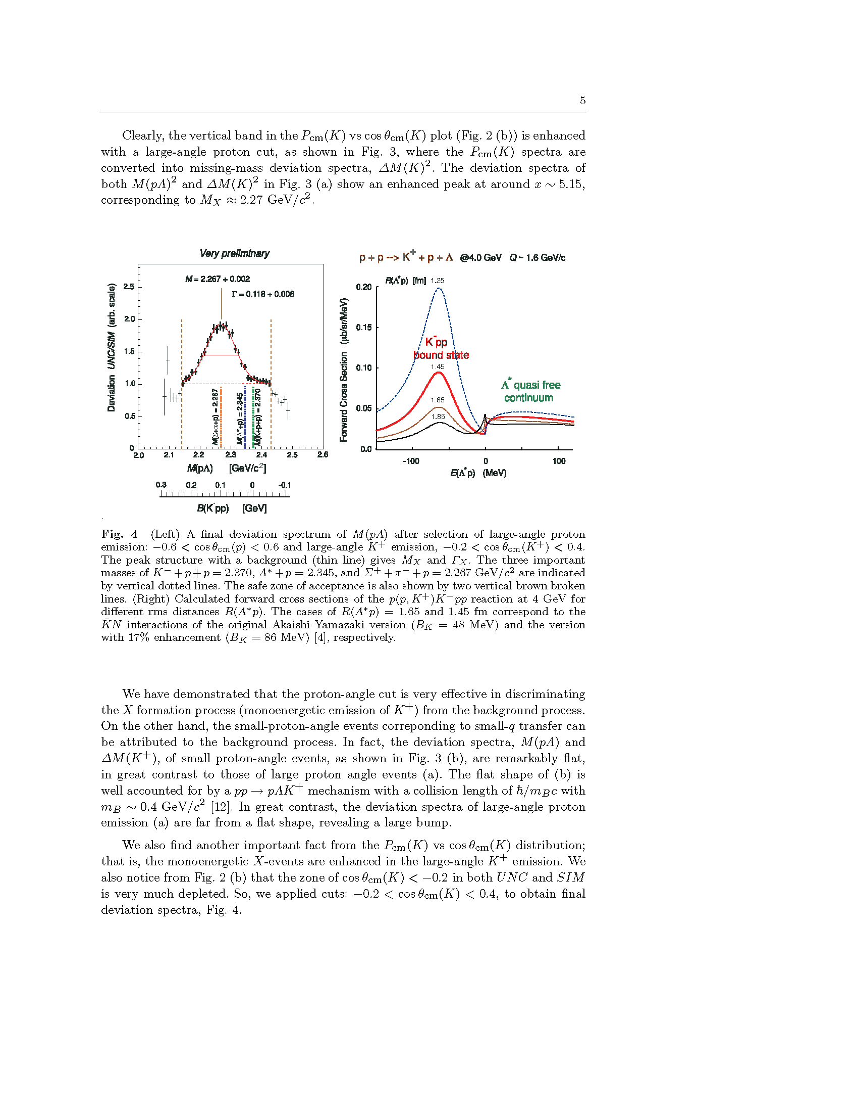
Comparison between E15 and Other Results
M(K+p+p)
FINUDA@DAΦNE
PRL94(2005)212303
A(stopped K⁻, Λp)
DISTO@SATURNE
PRL104(2010)132502
p + p → (Λ + p) + K⁺ @ 2.85GeV

Slide 13
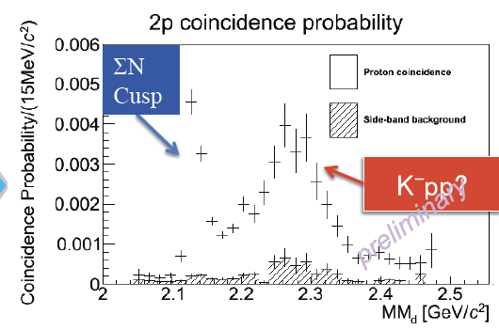
Comparison between E15 and Other Results
M(K+p+p)
E27@J-PARC
EXA2014 conference
d(π⁺, K⁺) @ 1.7GeV/c
Bump structure in the deep-binding region reported from other experiments was NOT seen in E15
Excess near the threshold can be seen only in E15

Slide 14
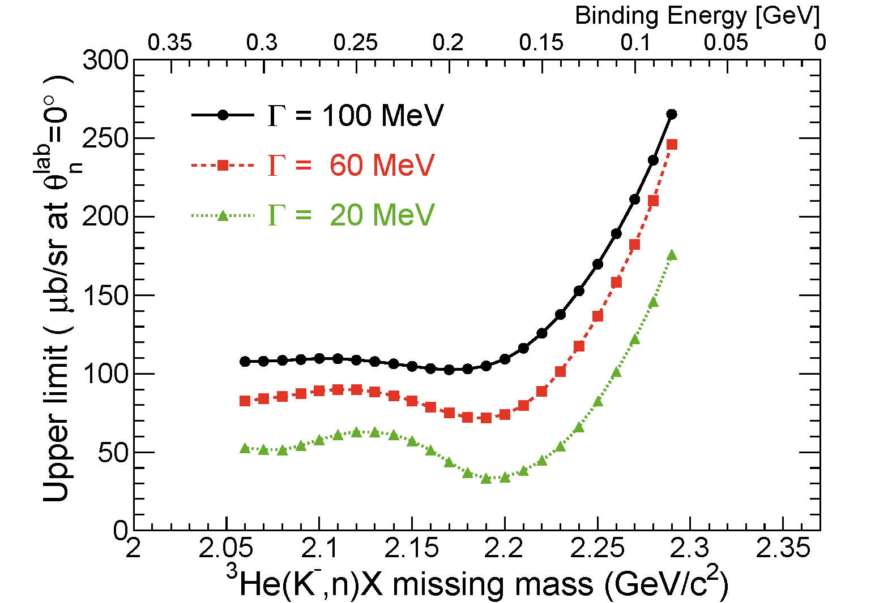
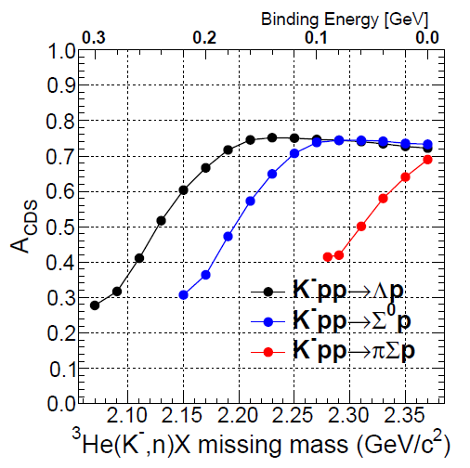
U.L. of the deeply-Bound K⁻pp
CDS tagging eff.
95% C.L.
K⁻pp→Λp
Assumptions
K⁻pp → Λp decay mode (isotropic decay)
K⁻pp shape = Breit-Wigner
U.L. depends on the decay mode

Slide 15
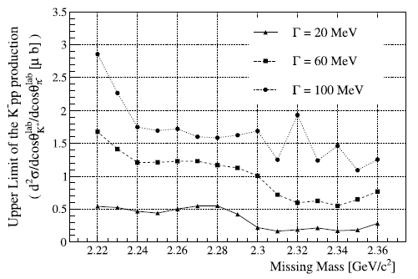
U.L. of the deeply-Bound K⁻pp
E15(K⁻+³He):
(UL) 0.5-5% of QF
FINUDA(stopped K⁻):
~0.1% of stopped K⁻
DISTO(p+p):
larger than Λ* @ 2.85GeV
LEPS(γ+d)
(UL) 1.5-26% of γN→K⁺π⁻Y
95% C.L.
K⁻pp→Λp
LEPS@SPring-8
Upper limits (CS) can be directly compared with QF yield.
PLB728(2014)616
γ + d → K⁺ + π⁻ + X
@ 1.5-2.4GeV

Slide 16
Spectrum below the Threshold
?
No significant bump-structure in the deep-binding region
Statistically significant excess just below the threshold

Slide 17
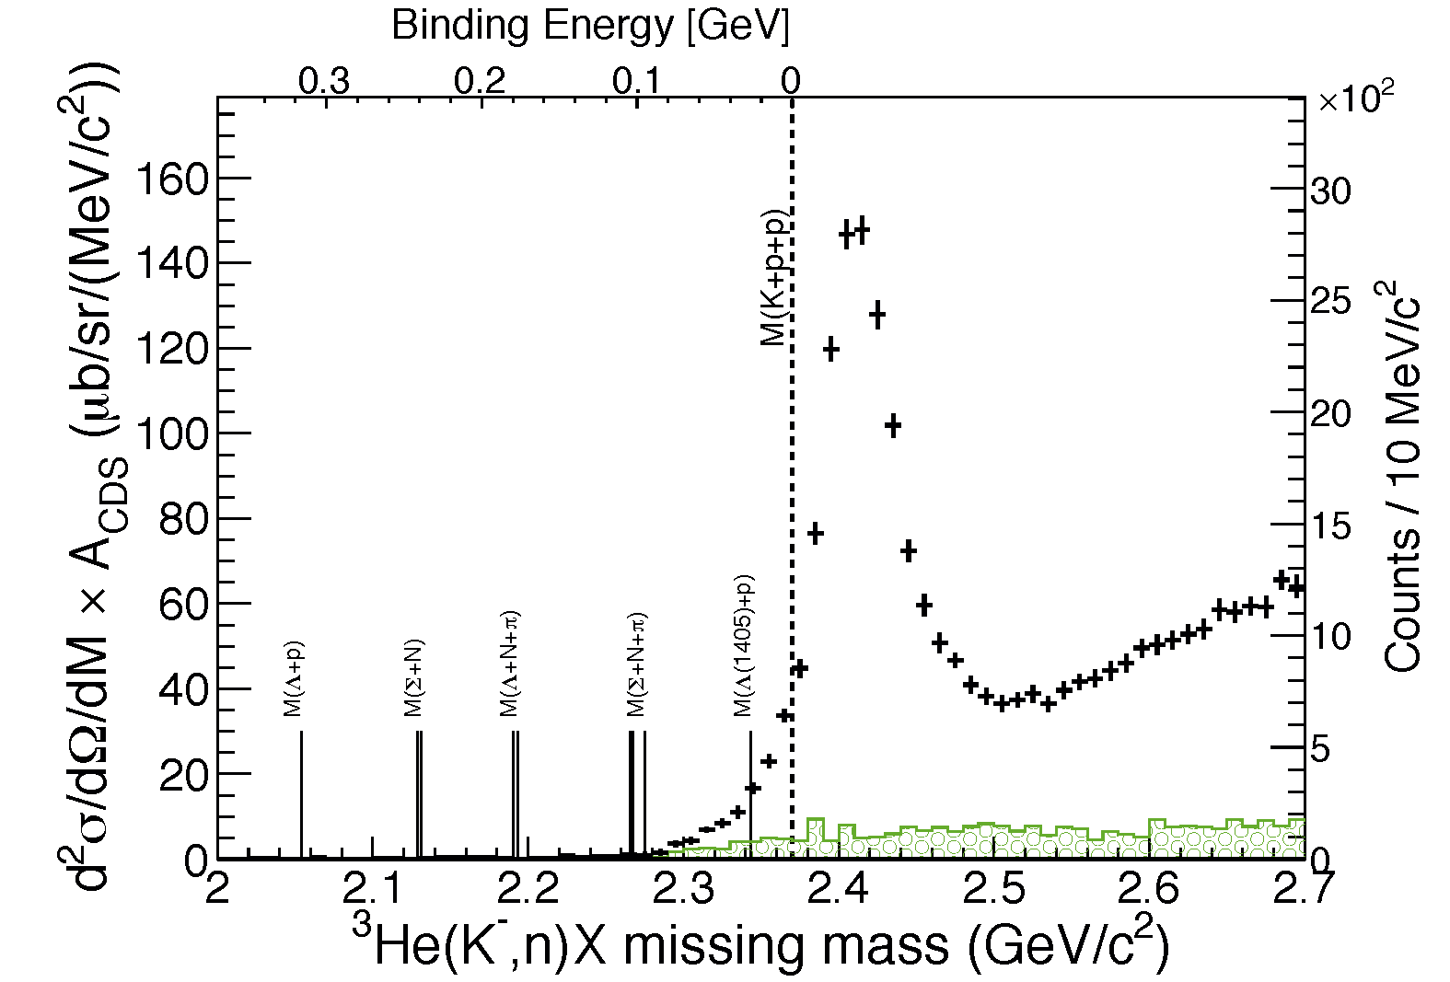
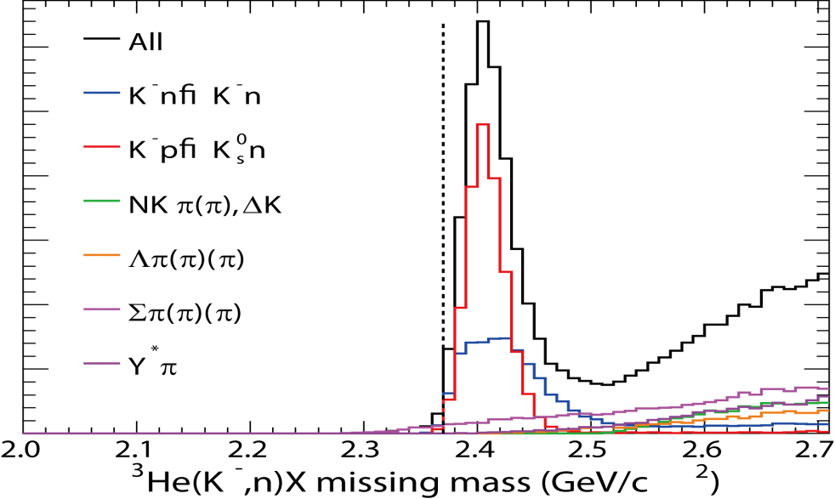
Excess = Elementary Processes?
DATA
(BG subtracted)
The tail structure is NOT reproduced by well known processes
would be attributed to the imaginary part of the attractive K^{bar}N
→ Multi-NA? K⁻pp?
Σ decay contributions
SIM
Detector acceptance and all known K⁻N interactions are taken in to account:
  Cross-section [CERN-HERA-83-02]
  Fermi-motion
  Angular distribution
Simple assumptions:
  σ_{tot} = 2*σ_{K-p} + σ_{K-n} (~150mb)

Slide 18
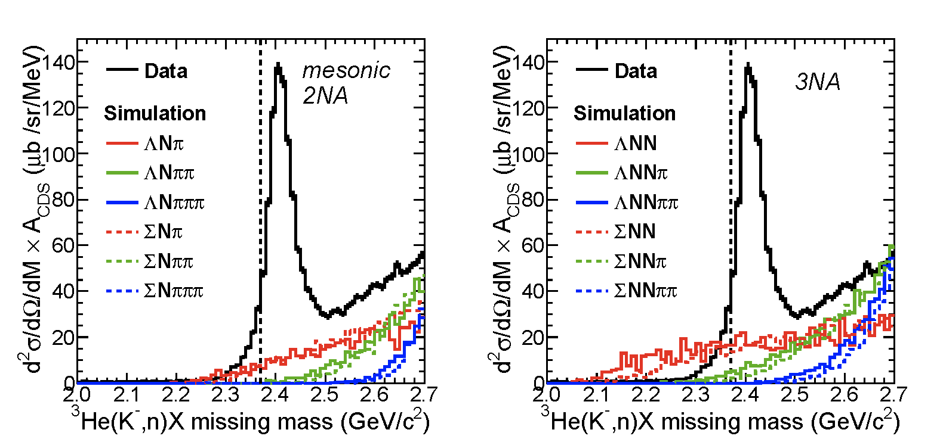
Excess = πΣN, πΣNN, etc?
Each process is simulated with unreasonably large CS of 100mb
➔ contributions in the binding region are negligible

Slide 19
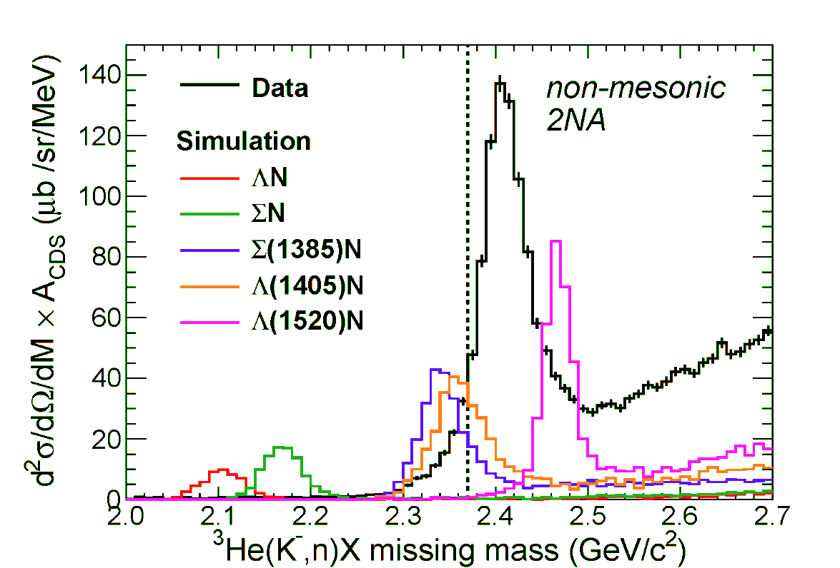
Excess = Λ*N, etc?
CS of each process :
20mb/sr @ 0 degrees
BW shape with
PDG values
ΛN/ΣN branches are negligibly small
Λ(1405)n branch seems to reproduce the excess
  Λ(1405) shape is “simple BW with PDG values”
  need rather large CS of ~5mb/sr
For further study, exclusive measurement of πΣN is needed.
(consistent with KEK-PS E548)

Slide 20
Excess = Loosely-Bound K⁻pp?
DATA
(BG subtracted)
CDS tagging eff.
K-pp?
Σ decay contributions
The excess is assumed to be fully attributed to the bound K⁻pp state
dσ/dΩ(θ_{lab}=0º) of the excess is ~ mb/sr
(Excess/QF < ~10%)

Slide 21
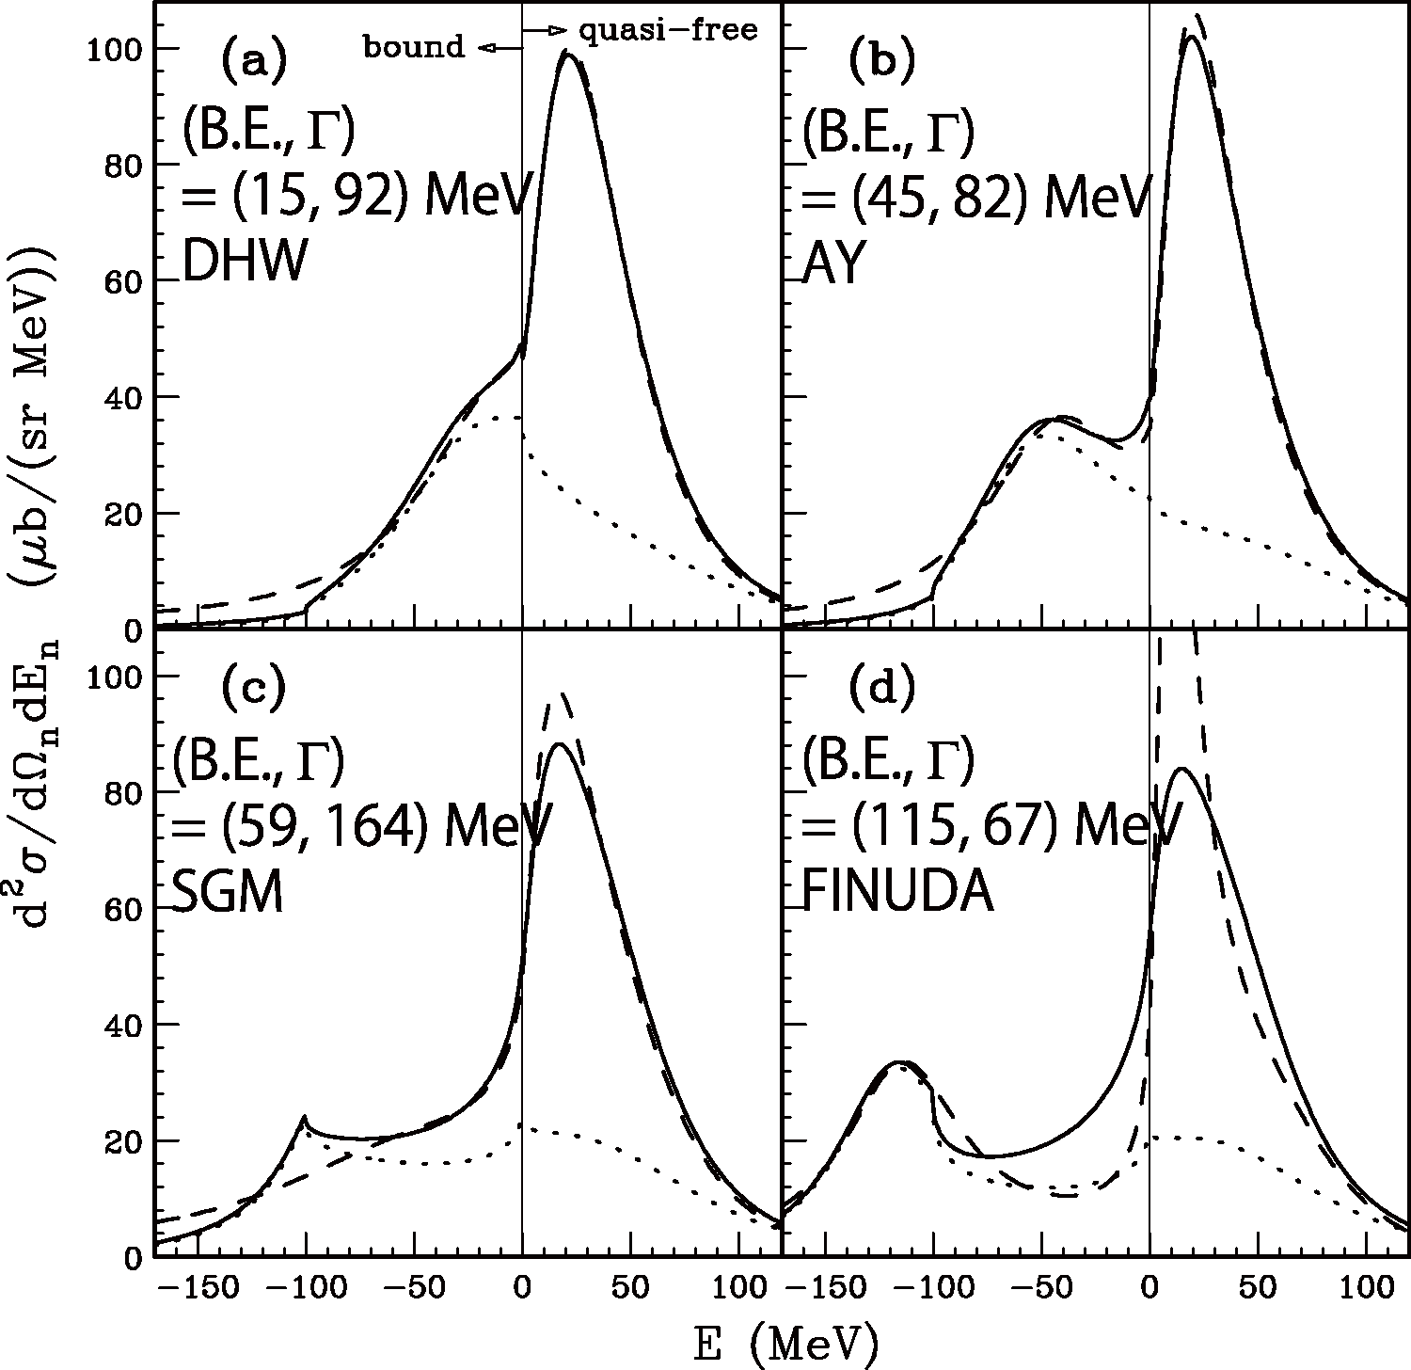
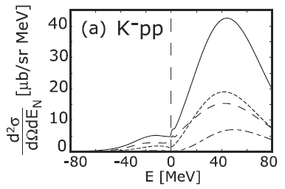
Comparison between E15 and Calc.
semi-inclusive
DATA
(BG subtracted)
semi-inclusive
DATA
(BG subtracted)
inclusive
Koite, Harada,
PRC80(2009)055208
inclusive
integrated CS:
~0.1 mb/sr
integrated CS:
~mb/sr
Yamagata-Sekihara, et al.,
PRC80(2009)045204
CS is roughly consistent with KH
Loosely-bound K-pp state ???
πΣN measurement
is an important key

Slide 22
Decay Channel,
Exclusive ³He(K⁻,Λp)n

Slide 23
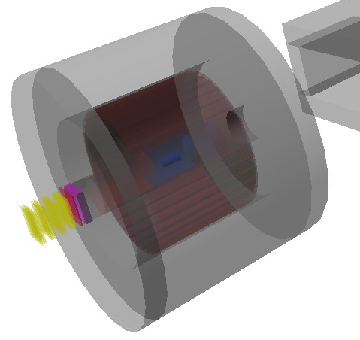
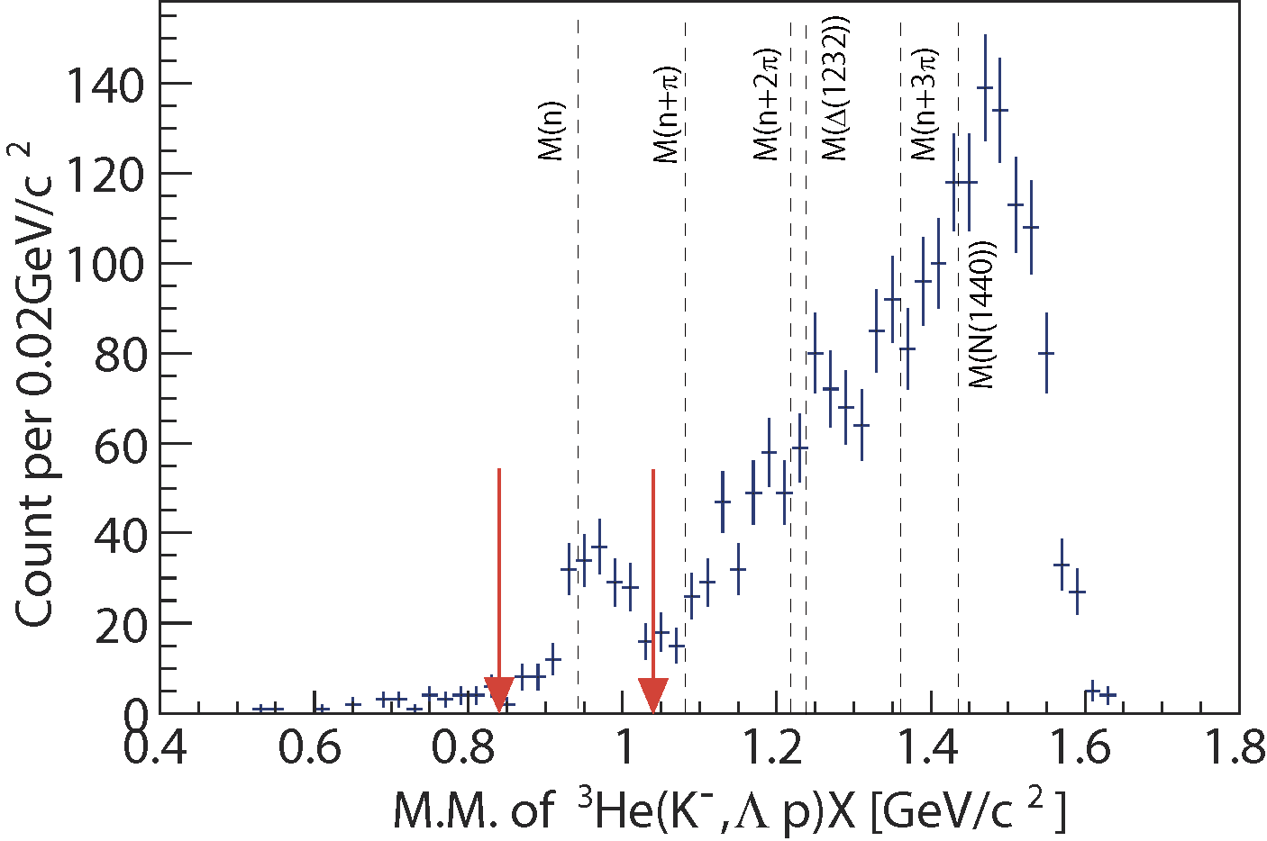
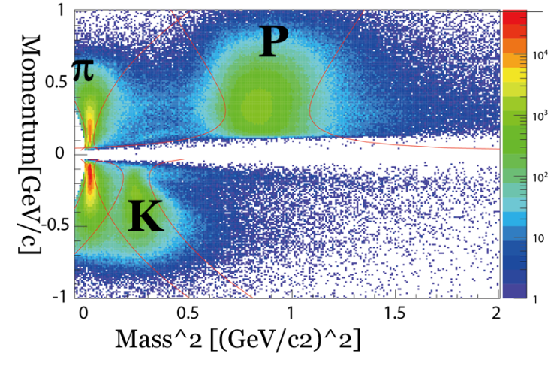
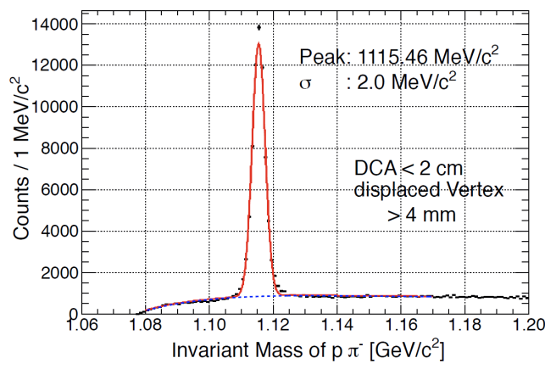
Exclusive ³He(K⁻,Λp)n events
CDS
preliminary
p
missing n
n
Λ
π⁻
p
1GeV/c
K⁻ beam
K⁻³He→Λ(Σ⁰)pn events can be identified exclusively
  # of Λ(Σ⁰)pn events: ~190
    Σ⁰pn contamination: ~20%

Slide 24
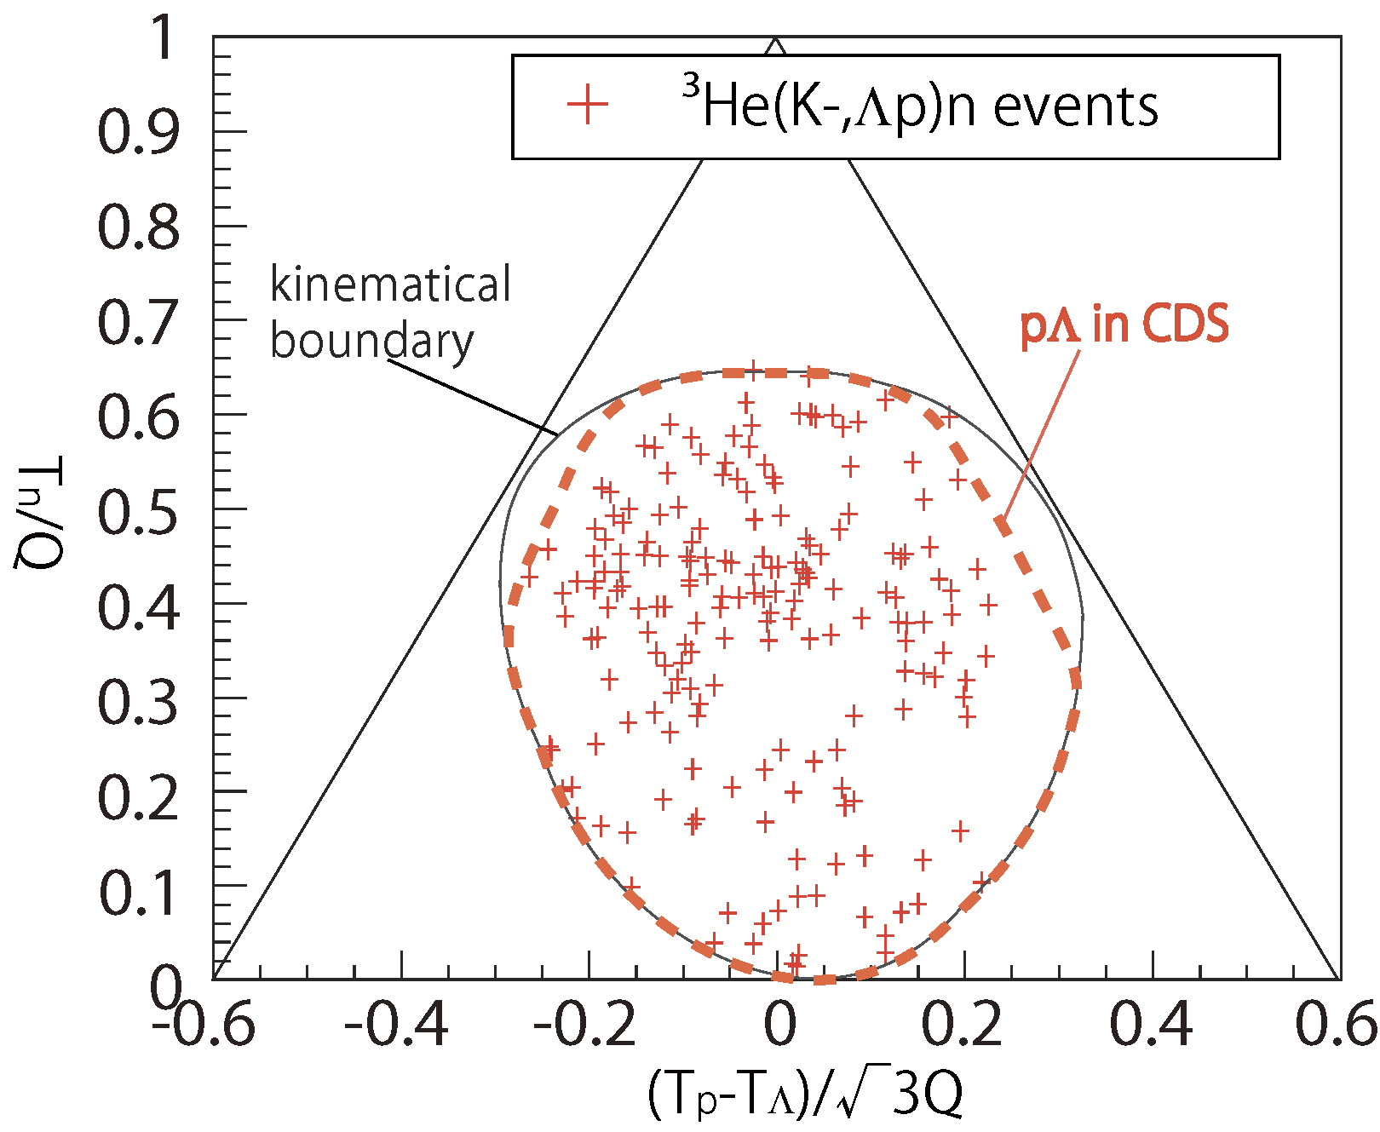
Dalitz plot
3NA:
e.g. K⁻³He→Λpn
preliminary
Observed events seem to be scattered widely in the phase-space of
K⁻+³He->Λ+p+n

Slide 25
Dalitz plot
2NA:
e.g. K⁻³He→Λpn_{s}
preliminary
2NA+2step:
e.g. K⁻³He→Σ⁰pn_{s},
Σ⁰n_{s}→Λn
2NA+2step:
e.g. K⁻³He→Λpn_{s},
pn_{s}→pn
2NA+2step:
e.g. K⁻³He→Σ⁰np_{s},
Σ⁰p_{s}→Λp
K⁻pp form.:
K⁻³He→(K⁻pp)n,
K⁻pp→Λp

Slide 26
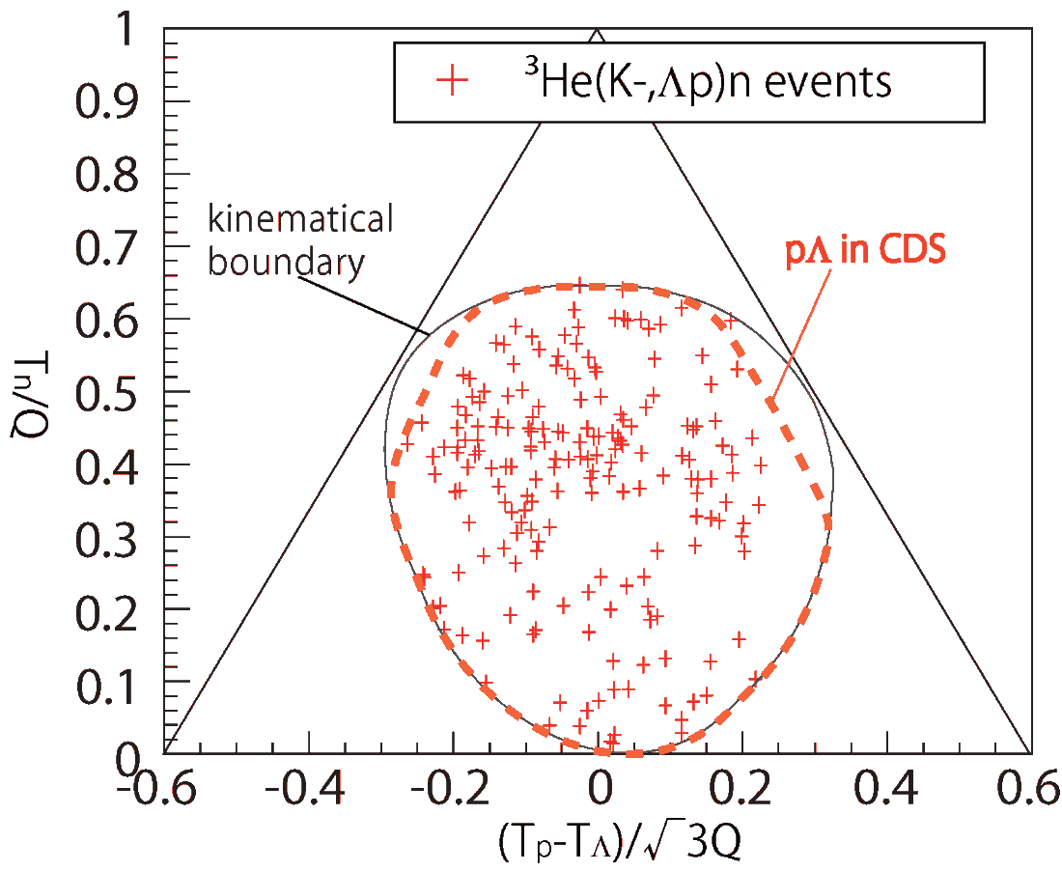
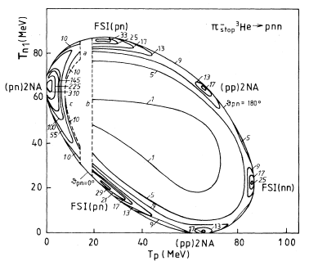
K-induced vs π-induced
[1] D. Gotta, et al., PRC51. 496 (1995)
[2] P. Weber et al., NPA501 765 (1989)
[3] G. Backenstoss et al., PRL55. 2782 (1985)
π⁻ stopped [1]
  2nucleon absorption &FSI (50%/π _{stopped}) are clearly seen
  3nucleon absorption <3% /π _{stopped}
π⁻ in-flight [2],[3]
  2nucleon absorption 0.85 ± 0.17mb (266 MeV/c)
  3nucleon absorption 3.7 ± 0.6 mb(220 MeV/c)
  3NA/2NA ~ 4
in-flight K
preliminary
stopped π
simple 2NA reactions
are negligibly small ?!

Slide 27
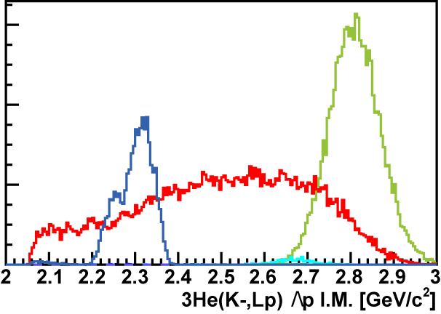
Λp Invariant Mass
preliminary
FS = Λ (Σ⁰ ) pn
→ cannot be from
2NA of Λ*n
Excess around the threshold?
SIM
Further study is ongoing, such as contribution from 2NA+2step.
K-pp
B.E = 50MeV
Γ = 50MeV
2NA
3NA
Σ⁰p
Λp

Slide 28
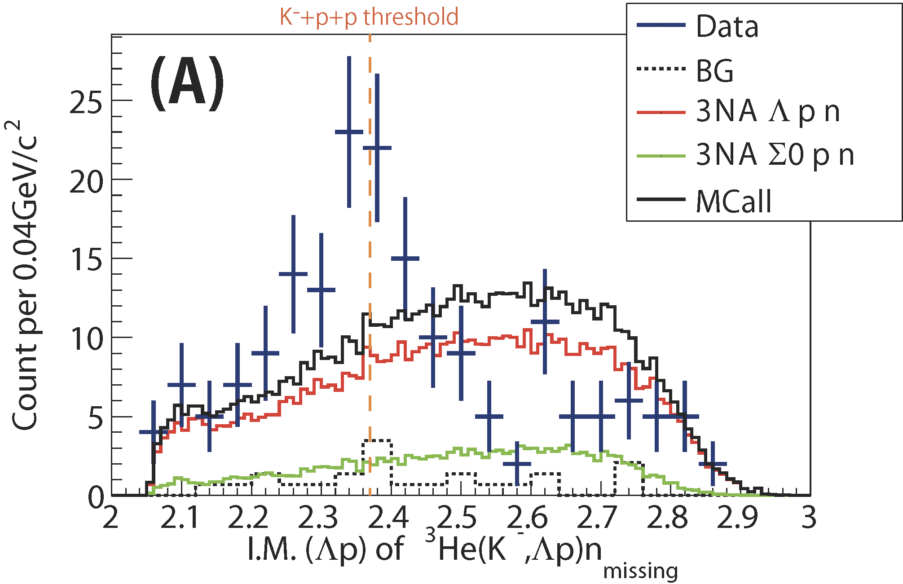
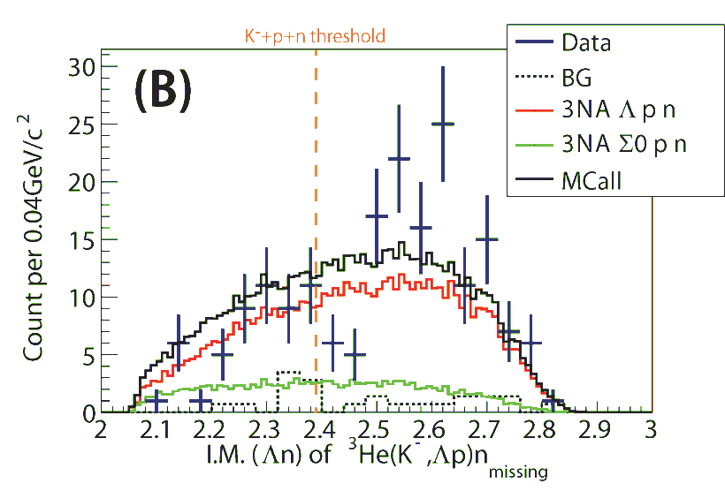
Comparison with Phase-Space
IM(Λp)
~190 events
preliminary
IM(Λn)
preliminary
total CS : ~200 μb
  when phase-space distributions are assumed
Excess around the threshold?
(~ 0.1% of total cross section of K⁻³He)

Slide 29
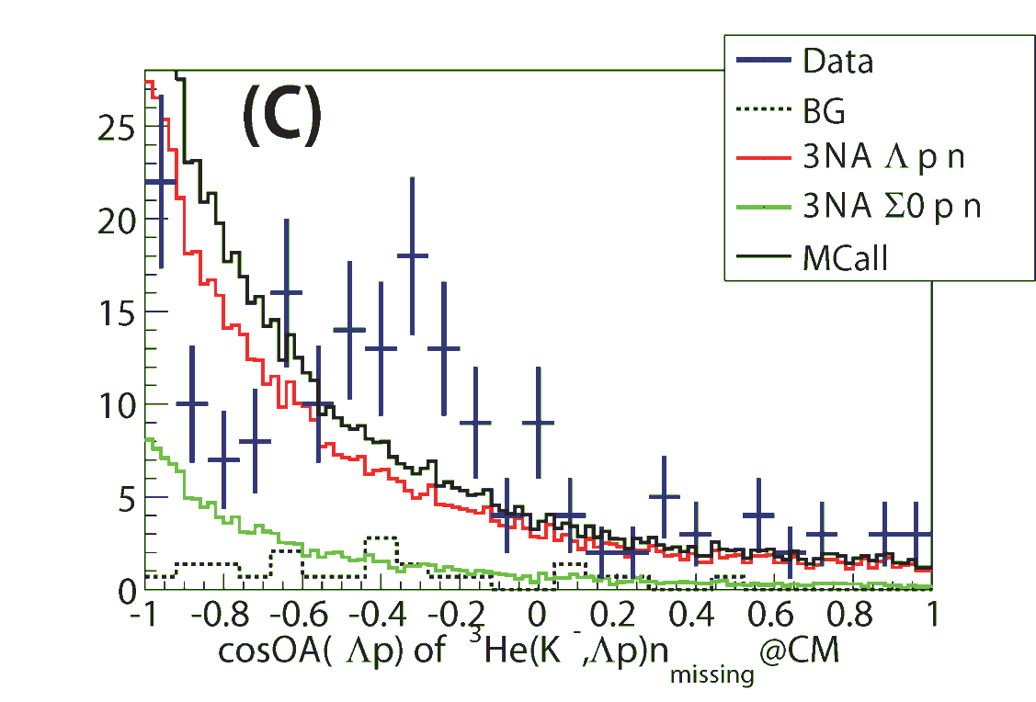
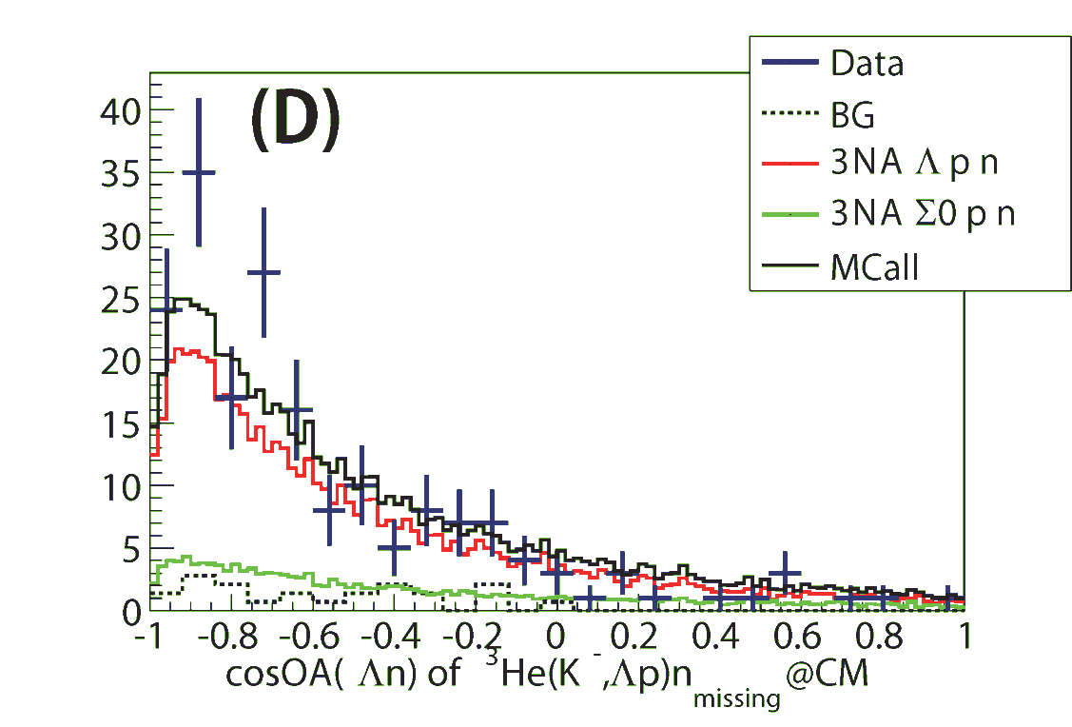
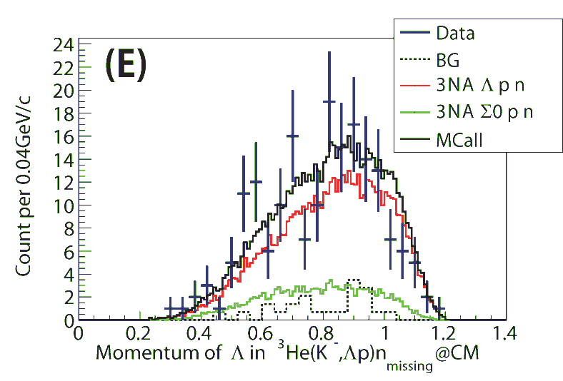
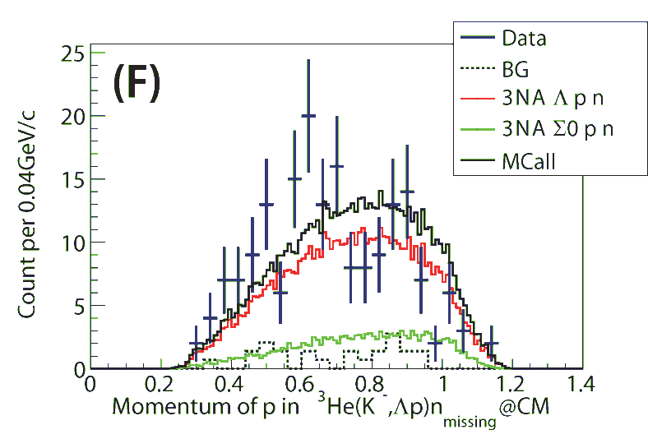
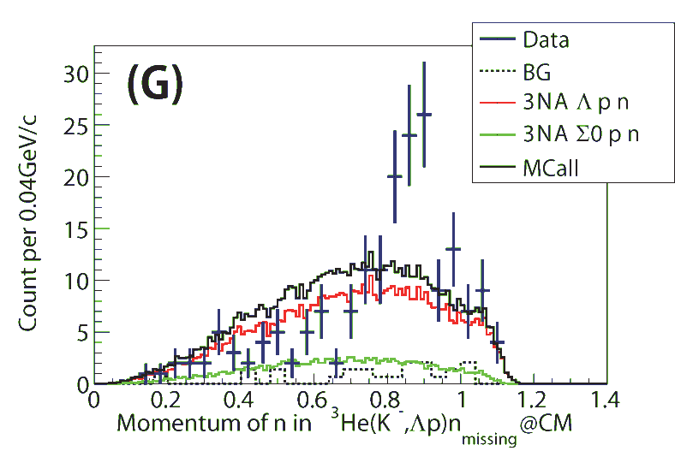
Comparison with Phase-Space
cos(Λp)
cos(Λn)
preliminary
preliminary
p_{Λ}
preliminary
p_{p}
preliminary
p_{n}
preliminary
data cannot be reproduced by the phase-space?

Slide 30
Formation + Decay Channel,
Kinematically Complete ³He(K⁻,Λpn)

Slide 31
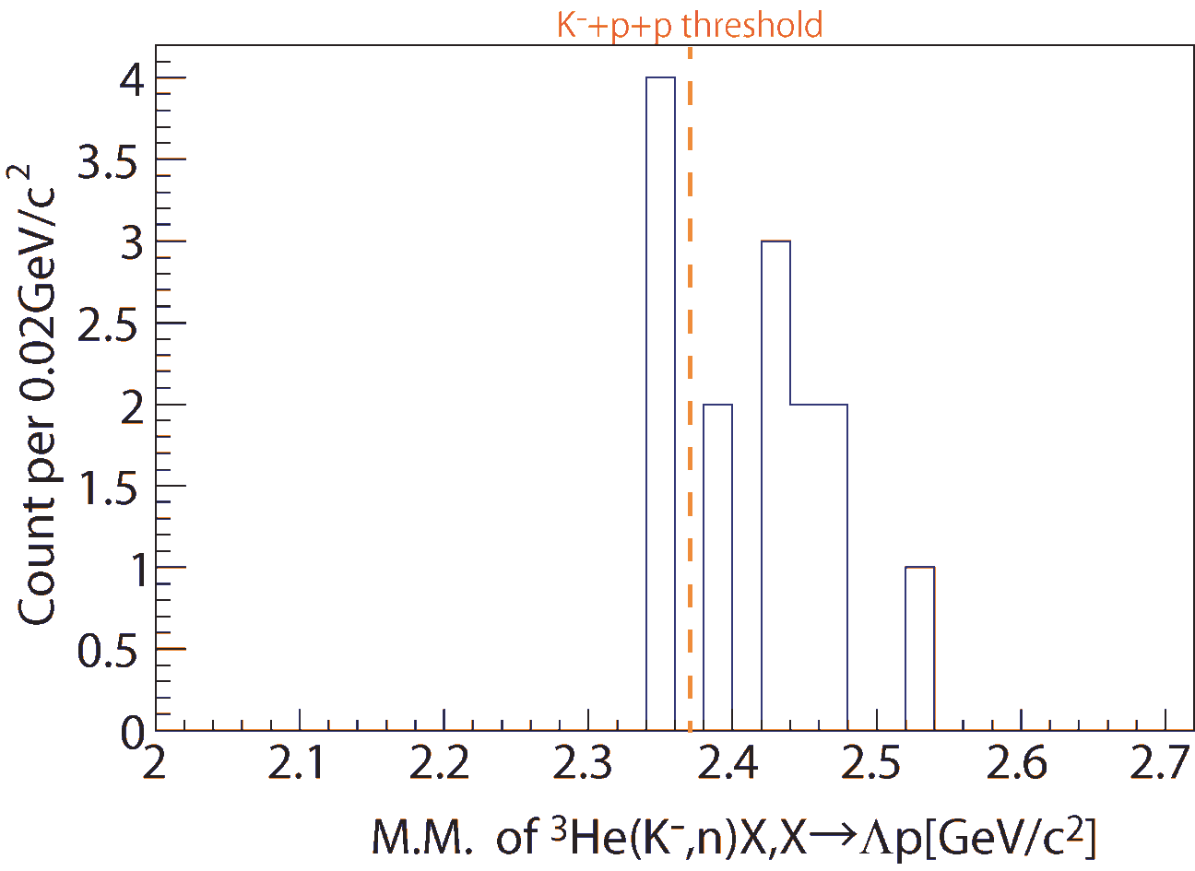
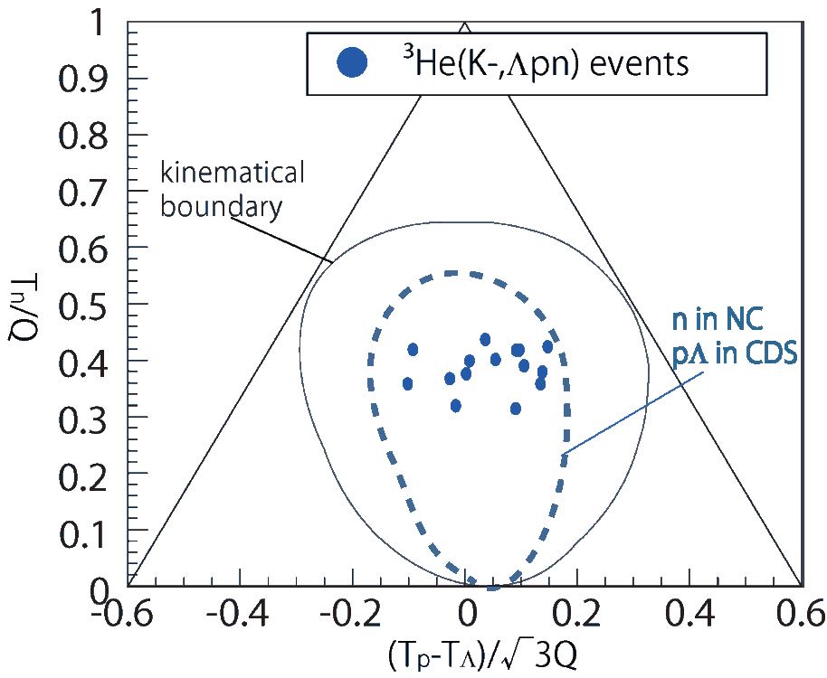
Kinematically-complete measurement of ³He(K⁻, Λpn)
preliminary
only
~15 events
preliminary
Minimum momentum transfer of the ³He(K⁻,n) reaction
→ would enhance the S=-1 di-baryon production
More beam time is required

Slide 32
Future Prospects of E15

Slide 33
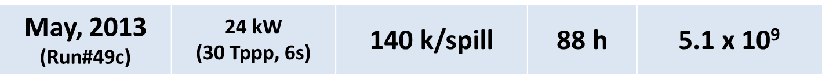
E15 2nd stage (approved)
x10
E15^{2nd}: 50x10⁹ kaons on target
in 2015
The goal of the E15^{2nd}
derive πΣN decay information in ³He(K⁻,n)X reaction
confirm the spectral shape of the Λp invariant-mass by the exclusive measurement of ³He(K⁻,Λp)n
explore the neutron spectrum at θ_{lab}=0^{O} with the kinematically complete measurement of ³He(K⁻,Λpn)

Slide 34
Summary of E15 1st
FINUDA/DISTO
³He(K⁻,n)X M.M.
Formation Channel
Semi-Inclusive ³He(K⁻,n)X
No significant bump structure in the deeply bound region
Excess below the threshold attributed to 2NA of Λ*n?
Λp I.M.
of ³He(K⁻,Λp)n
Decay Channel
Exclusive ³He(K⁻,Λp)n
Hint of the excess around the threshold
Cannot be from 2NA of Λ*n (final state = Λpn)
preliminary

Slide 35
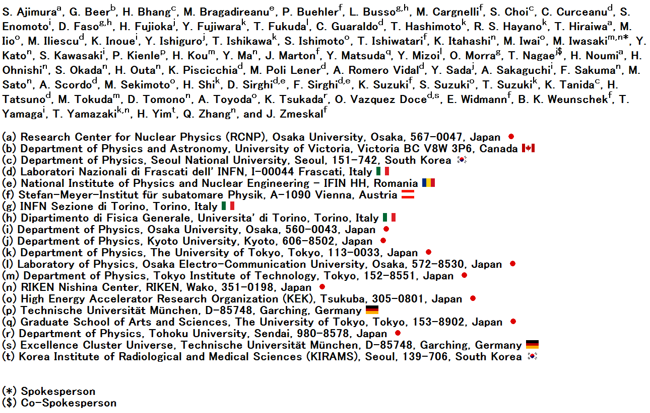
The J-PARC E15 Collaboration

