Slide 1


Λ(1405)pn Final State in the K⁻ + ³He reaction
-- in relation to the “K⁻pp” bound state --
F. Sakuma, RIKEN
on behalf of the J-PARC E15 collaboration
STRANEX: Recent progress and perspectives
in STRANge EXotic atoms studies and related topics
ECT*, Trento
21-25 October 2019

Slide 2
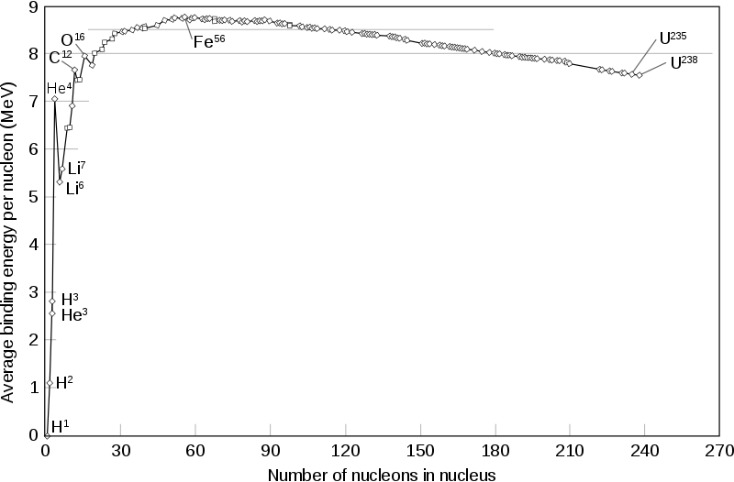
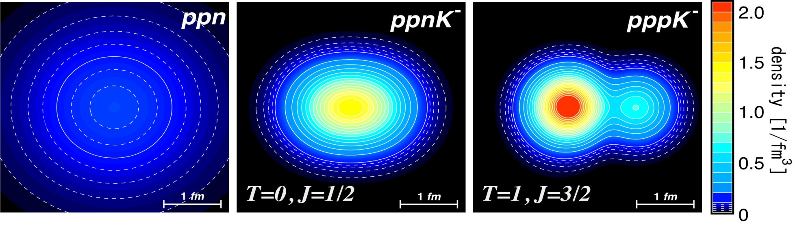
K^{bar}-Nuclear Bound State
Predicted from attractive K^{bar}N interaction in I=0
Kaonic Nuclei | Binding Energy [MeV] | Width [MeV]
Λ(1405) = K⁻p | 27 | 40
K⁻pp | 48 | 61
K⁻ppp | 97 | 13
K⁻ppn | 118 | 21
Y.Akaishi and T.Yamazaki, PRC65(2002)044005.
A. Dote et al. PRC70(2004)044313. etc.
c.f. Nuclear Binding Energy
few MeV @ A = 2,3
provide new insight on K^{bar}N interaction in media

Slide 3
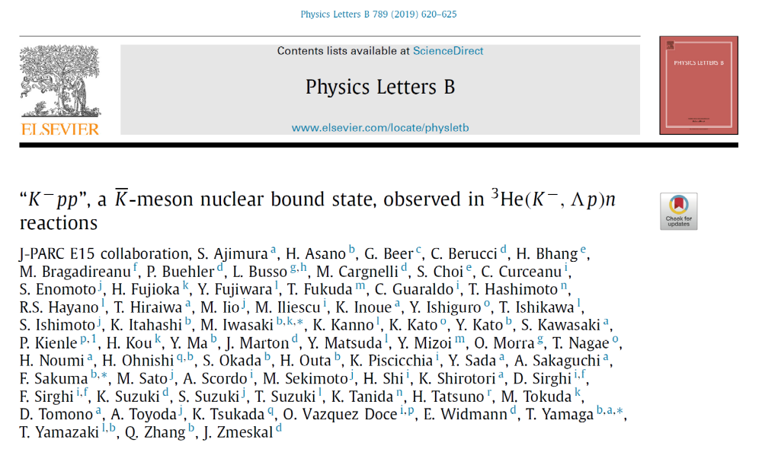
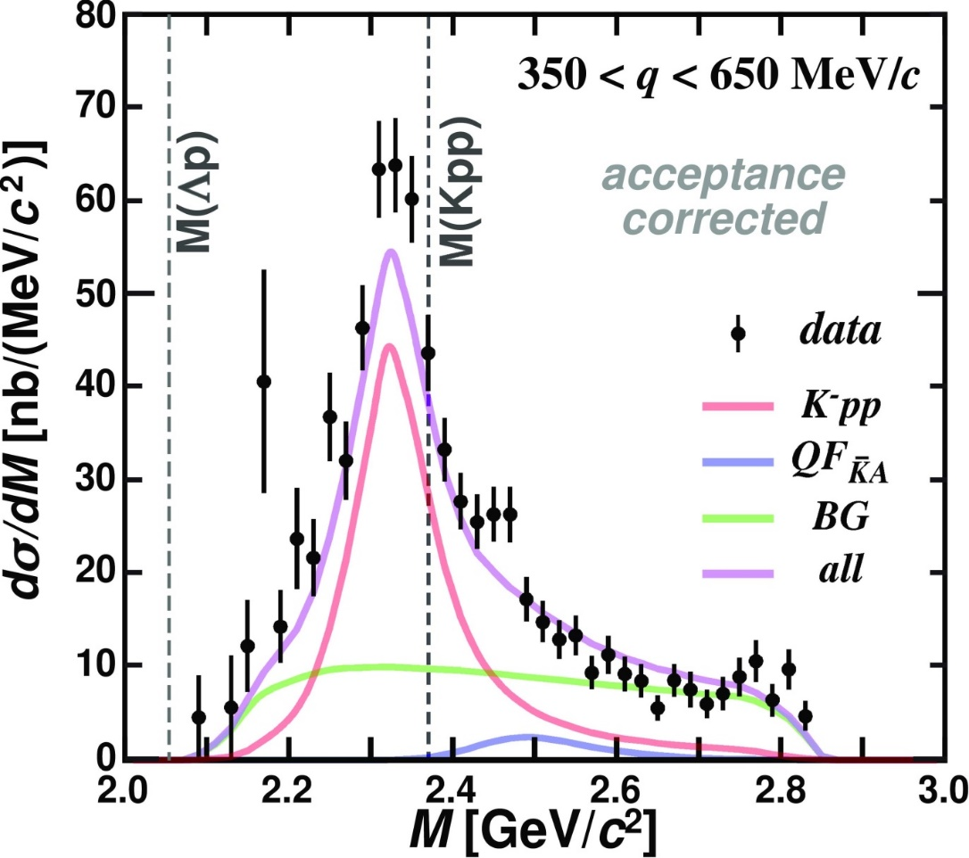
We observed the “K⁻pp” Bound-State
PLB789(2019)620.
“K⁻pp”

Slide 4

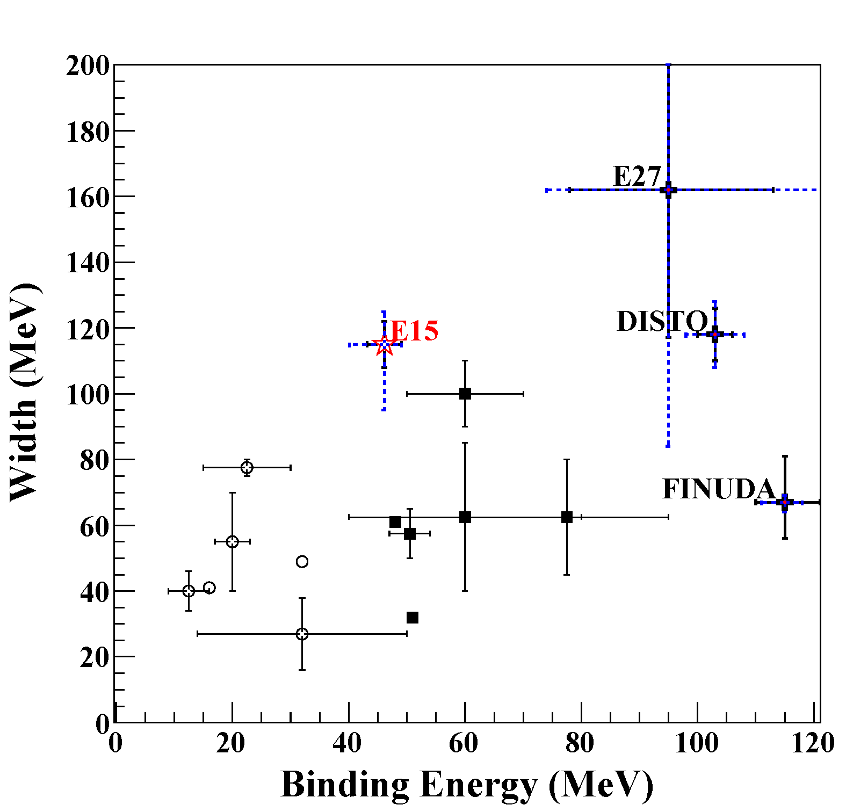
Observed “K⁻pp”
the most reliable observation
- simple K- induced reaction
- exclusive measurement
- good BG separation from 2NA
K⁻³He→nX
Binding energy: ~50 MeV
  Deeper than chiral-SU(3) based theoretical predictions
Width: ~100 MeV
  Seems to be larger than theoretical calculations (mesonic πY decays only)
Phenomenological
Chiral

Slide 5
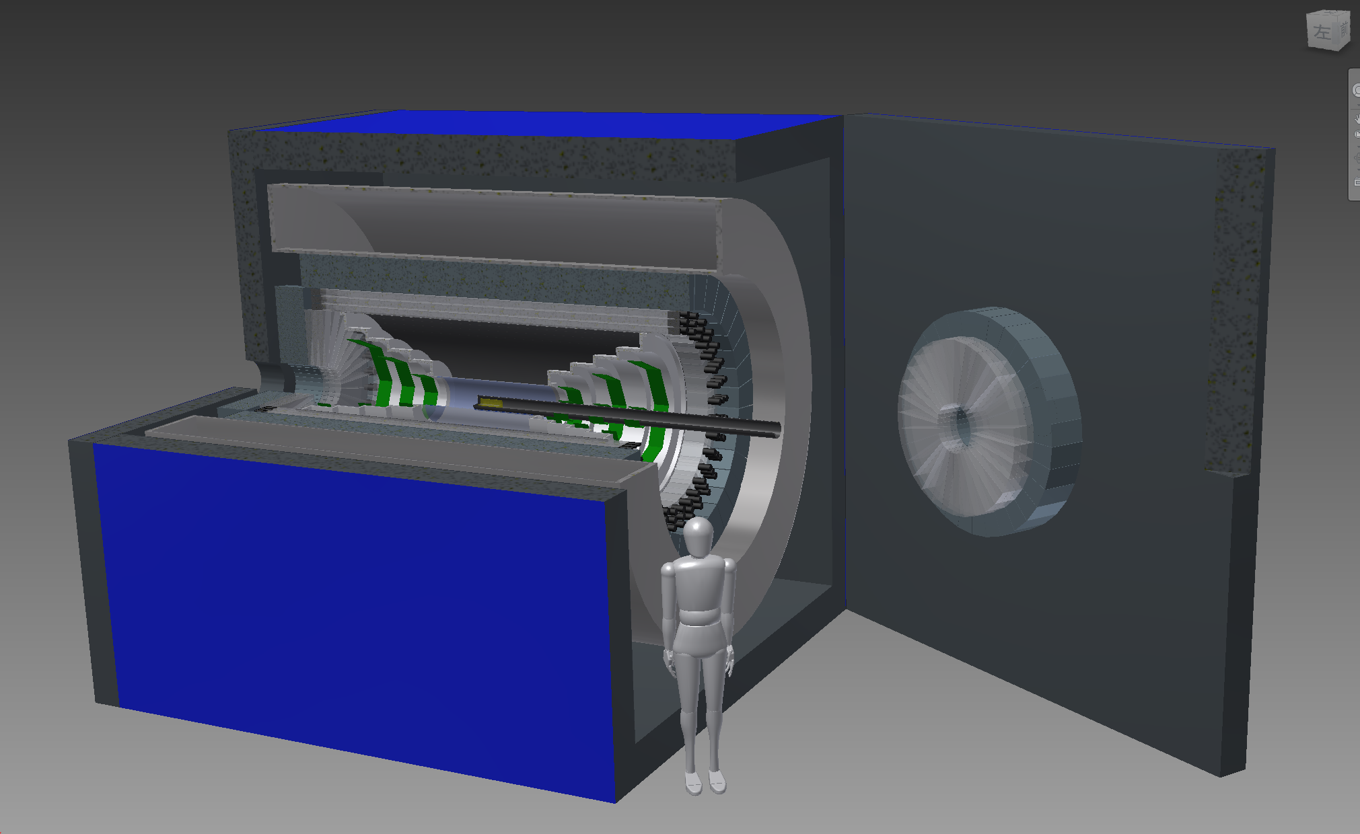
We need further understanding
Spin/Parity of the “K⁻pp”
  New 4π detector system is needed
← Future plan
A new 4π detector with γ/n sensitive detectors

Slide 6
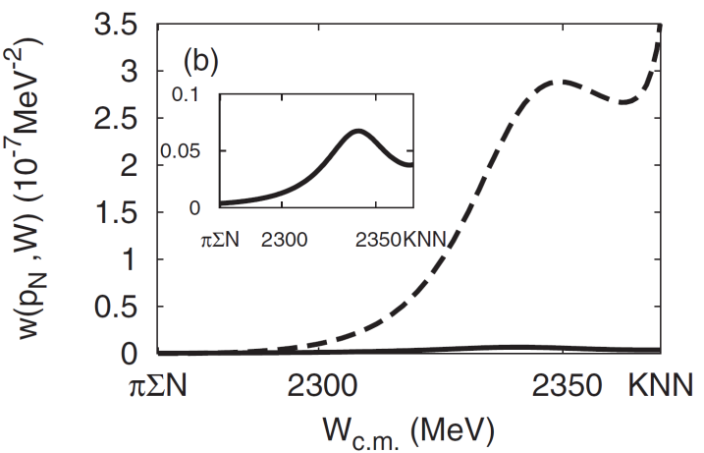
We need further understanding
Spin/Parity of the “K⁻pp”
  New 4π detector system is needed
Other decay channels
  πΣN mesonic decay is theoretically expected to be the dominant channel
    Only YN non-mesonic decays were reported
← Future plan
S.Ohnish et al.,PRC88(2013)025204
kaon absorption probability
of Λ*N→πΣN/ΛN
πΣN channel
ΛN channel

Slide 7
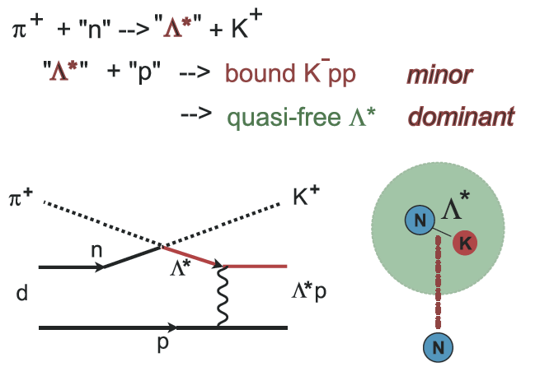
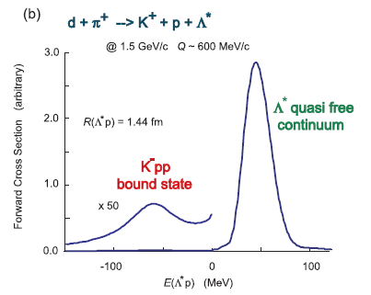
We need further understanding
Spin/Parity of the “K⁻pp”
  New 4π detector system is needed
Other decay channels
  πΣN mesonic decay is theoretically expected to be the dominant channel
    Only YN non-mesonic decays were reported
Reaction mechanism
  Relation between Λ(1405) & “K⁻pp”
    Λ(1405) has been considered as “K⁻p”
    Theoretically, “K⁻pp” is expected to be produced via Λ(1405)+p→”K⁻pp” door-way process
← Future plan
Yamazaki & Akaishi, PRC76(2007)045201.

Slide 8
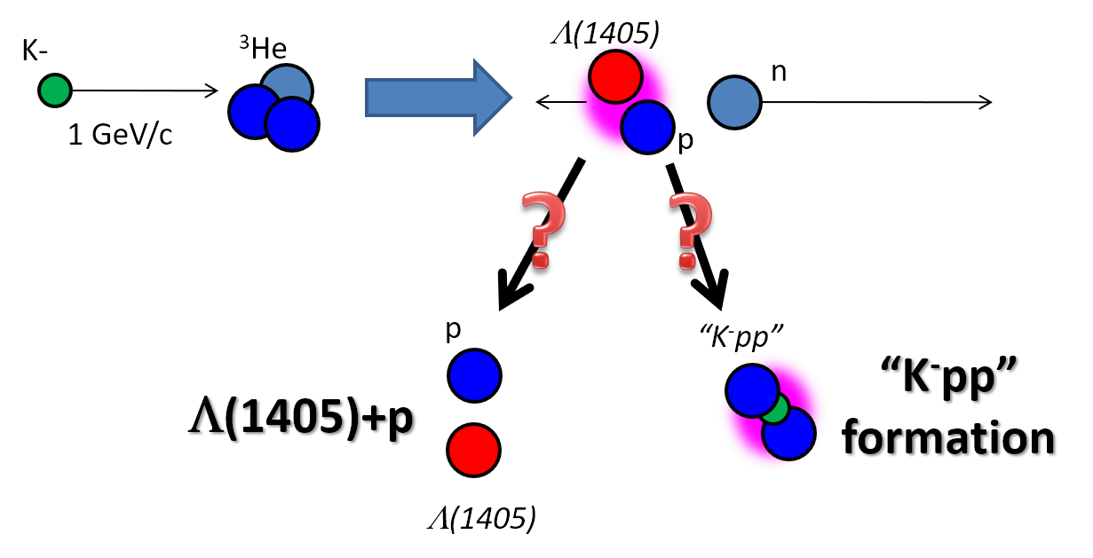
We need further understanding
Spin/Parity of the “K⁻pp”
  New 4π detector system is needed
Other decay channels
  πΣN mesonic decay is theoretically expected to be the dominant channel
    Only YN non-mesonic decays were reported
Reaction mechanism
  Relation between Λ(1405) & “K⁻pp”
    Λ(1405) has been considered as “K⁻p”
    Theoretically, “K⁻pp” is expected to be produced via Λ(1405)+p→”K⁻pp” door-way process
← Future plan

Slide 9
We need further understanding
Spin/Parity of the “K⁻pp”
  New 4π detector system is needed
Other decay channels
  πΣN mesonic decay is theoretically expected to be the dominant channel
    Only YN non-mesonic decays were reported
Reaction mechanism
  Relation between Λ(1405) & “K⁻pp”
    Λ(1405) has been considered as “K⁻p”
    Theoretically, “K⁻pp” is expected to be produced via Λ(1405)+p→”K⁻pp” door-way process
← Future plan
K⁻ ³He → πΣpn @ E15

Slide 10
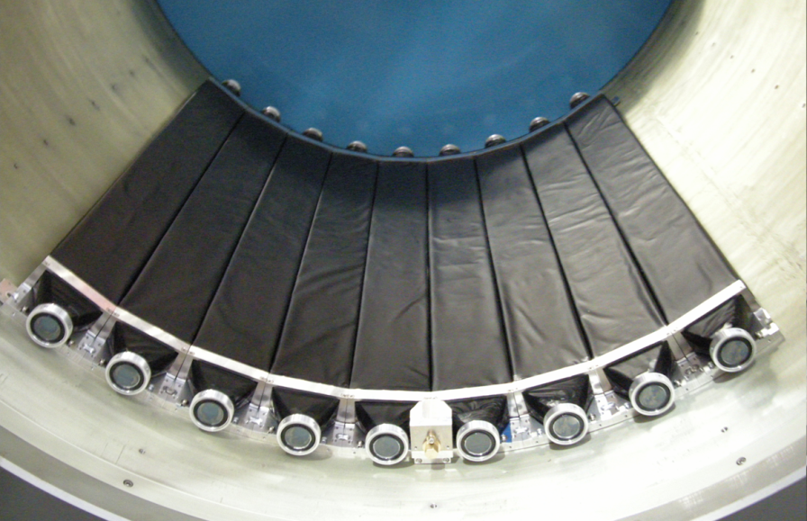
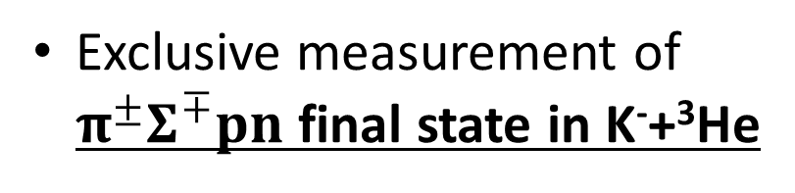
K⁻ ³He → πΣpn Measurement
CDS
Exclusive measurement of $π^{±}Σ^{∓}pn$ final state in K⁻+³He
p
“X”
K-
³He
n
1 GeV/c
Σ
π
n
π
CDS
Experimental challenge of neutron detection with thin scintillation counter (t=3cm)
t = 3cm
79cm
10cm
n detection efficiency ~ 3-10%

Slide 11
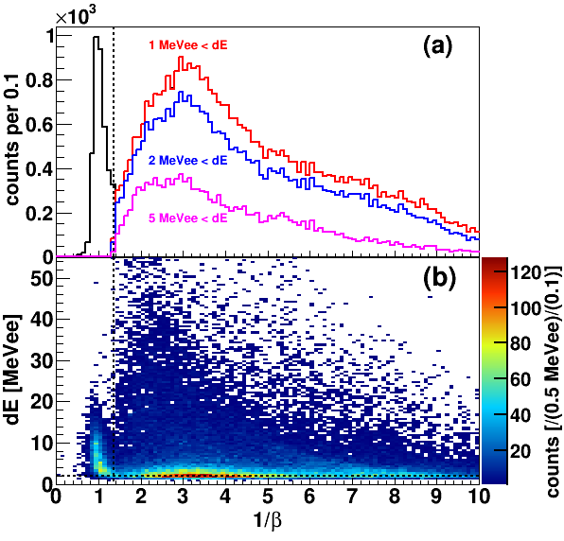
Neutron ID with CDS
γ
n
π⁺π⁻p events (3 tracks) in CDS with 4 CDH hits are selected
a CDH hit with CDC-veto (outer-layer) is applied to assure the “neutral hit”
Neutron can be identified with CDS

Slide 12
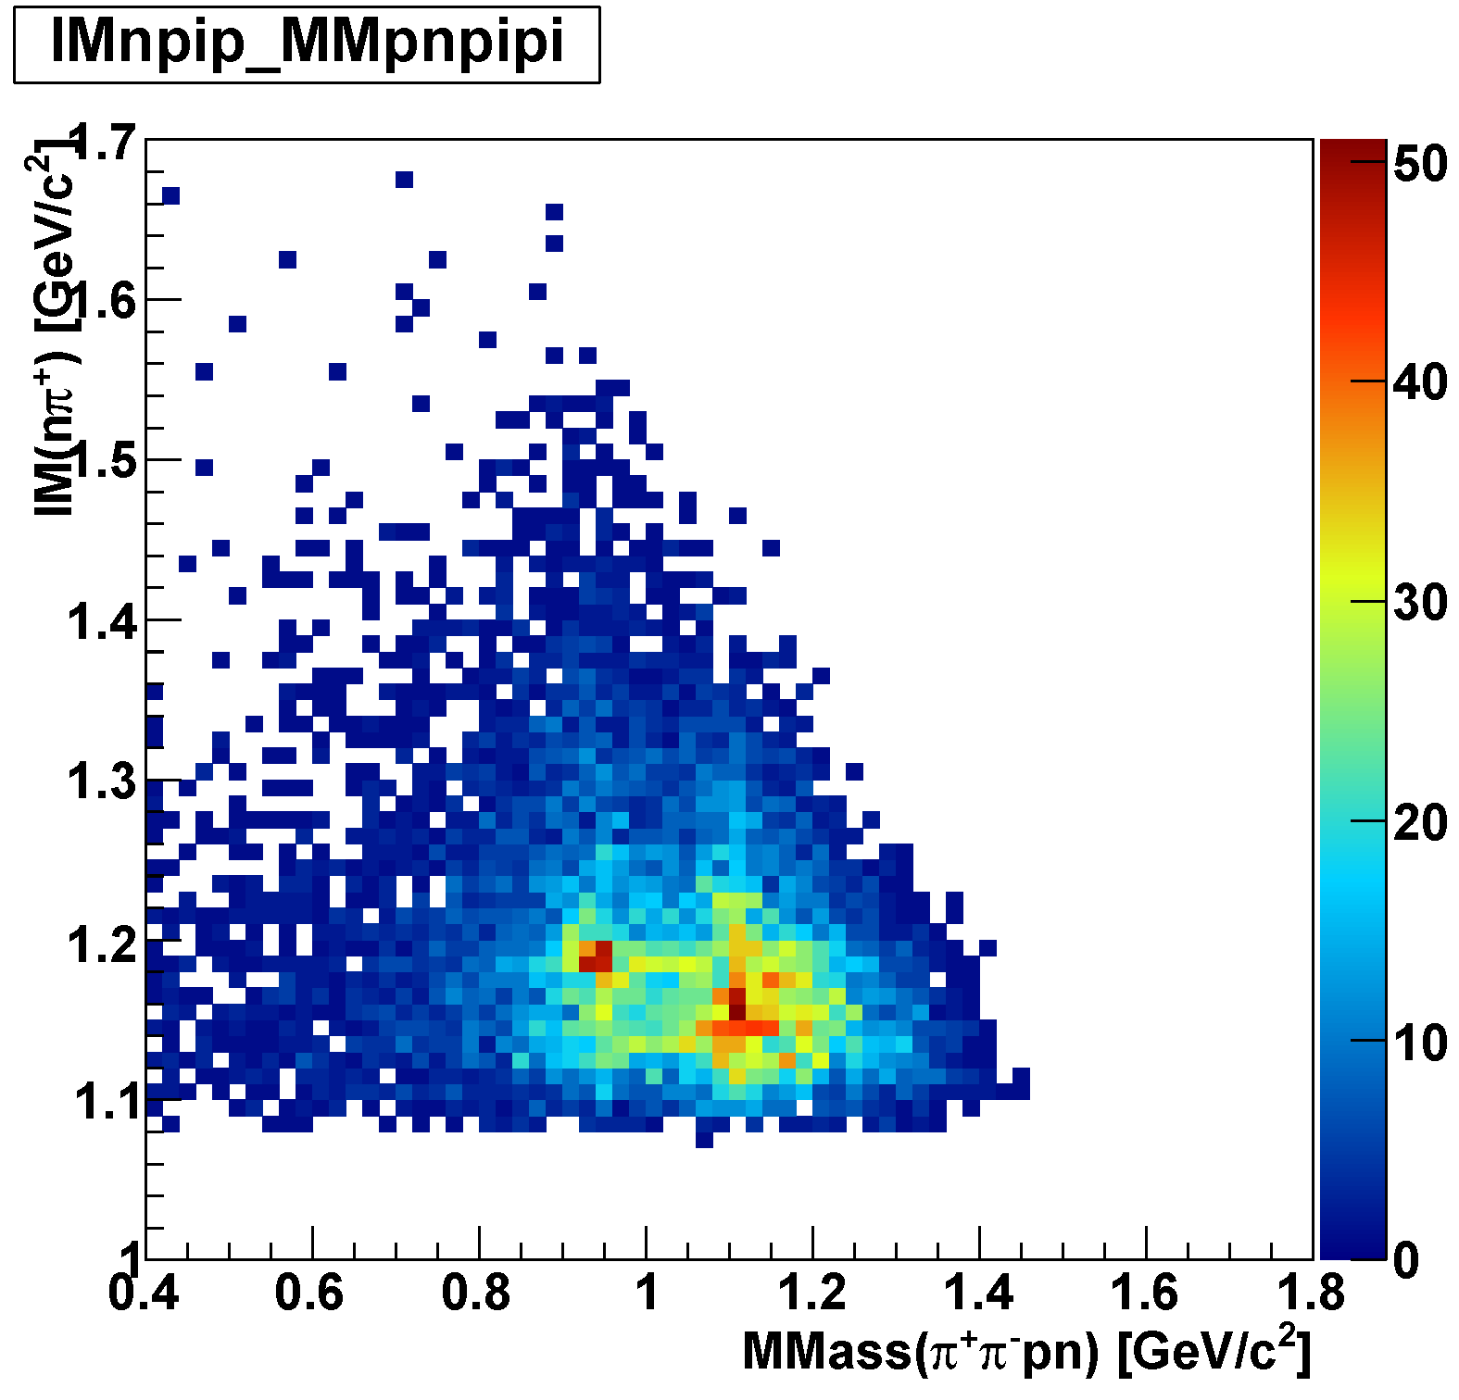
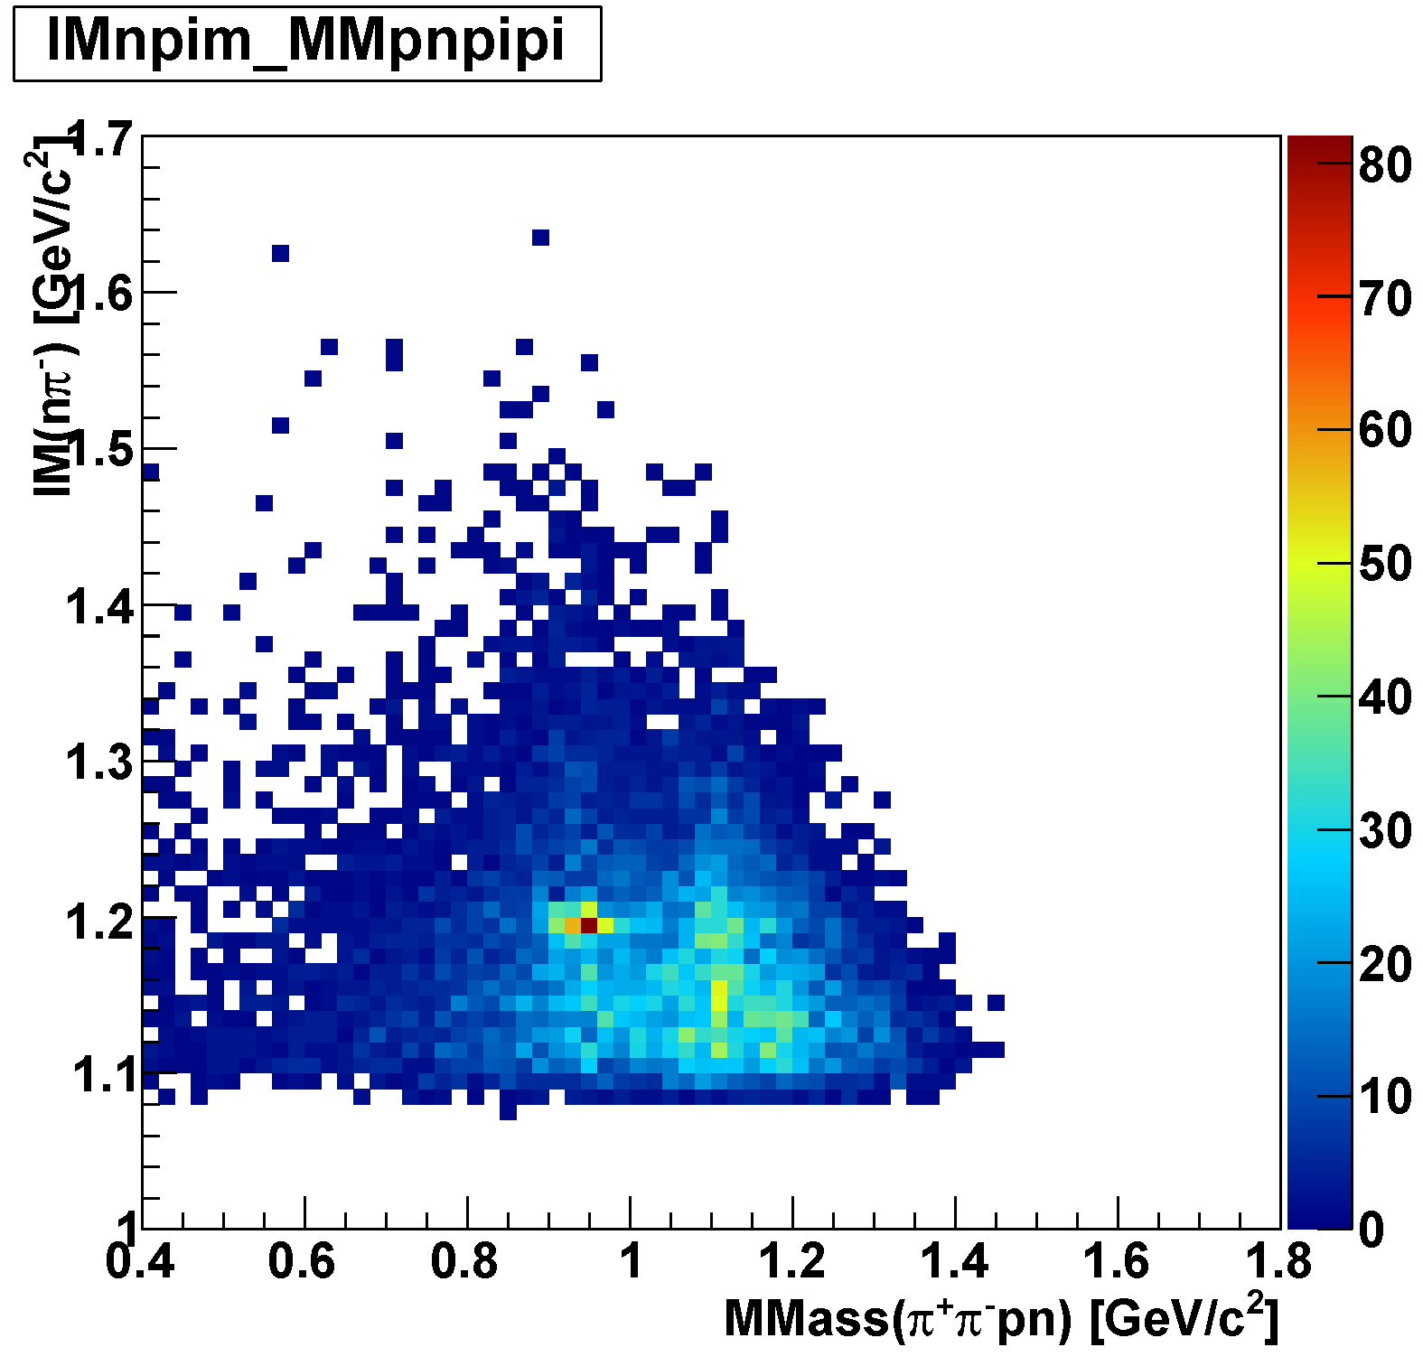
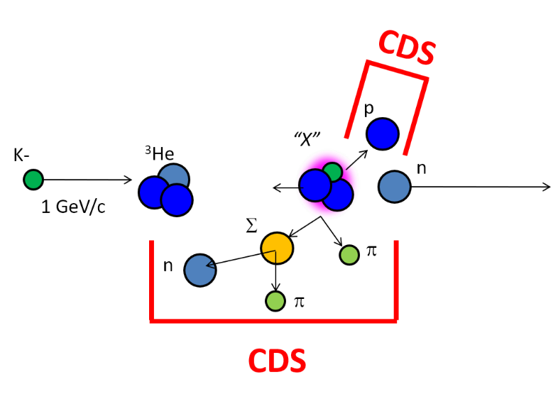
πΣpn Events
IM(nπ⁺) vs MM(π⁺π⁻pn)
IM(nπ⁻) vs MM(π⁺π⁻pn)
π⁻Σ⁺p n_{miss}
π⁺Σ⁻p n_{miss}
Σ⁺
Σ⁻
n_{miss}
n_{miss}

Slide 13
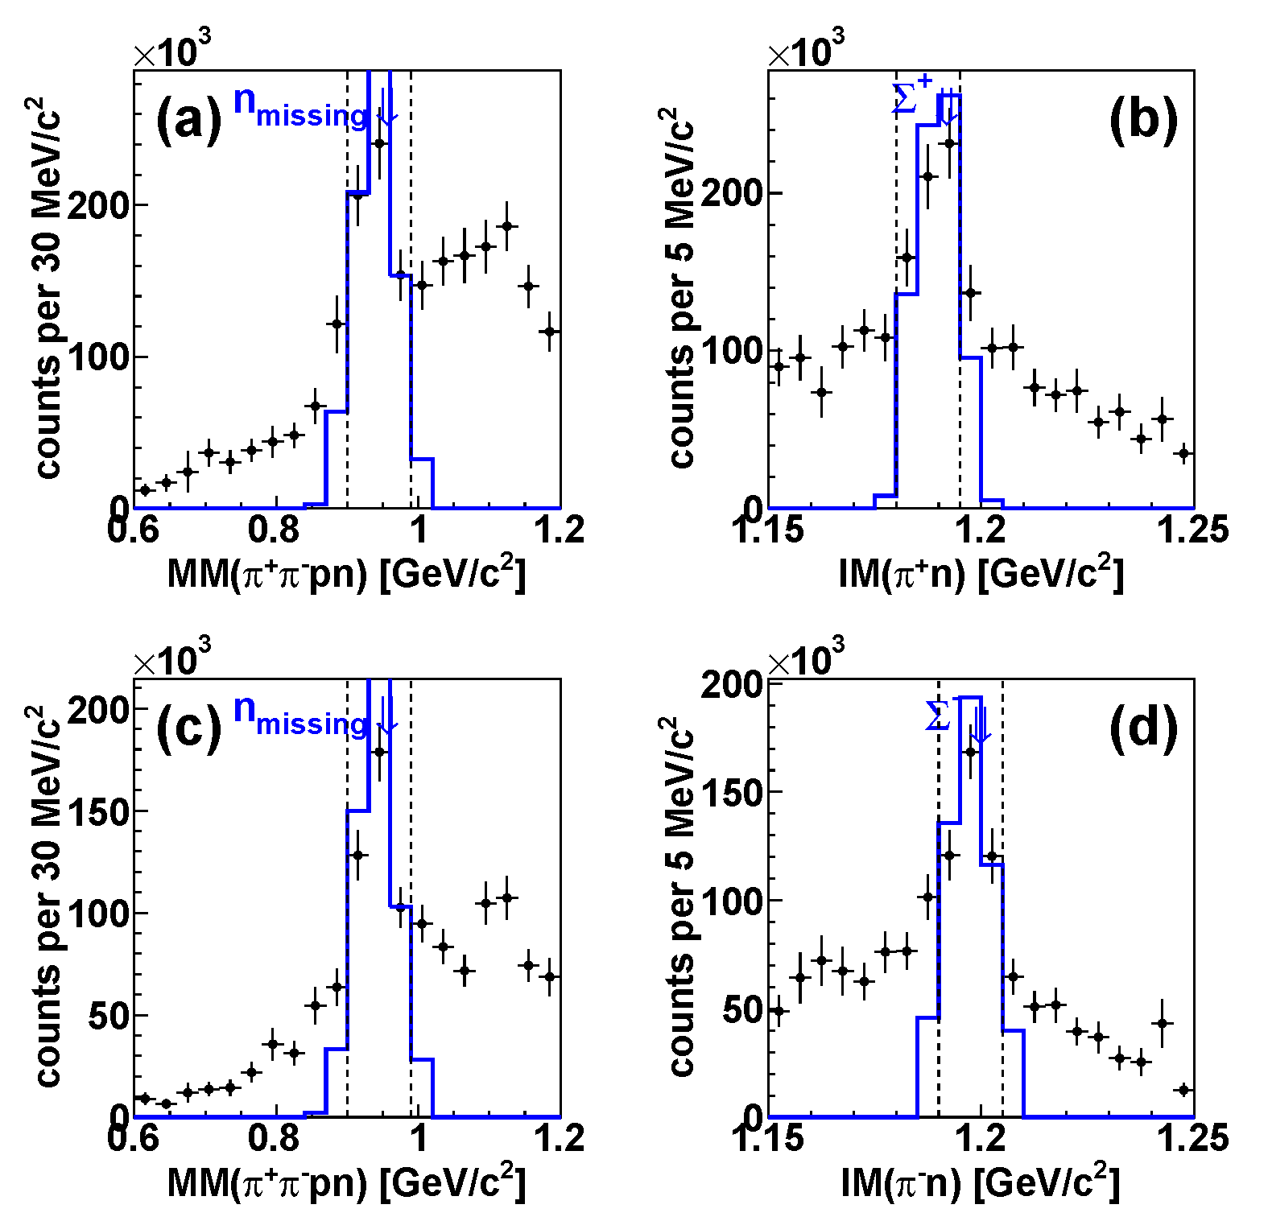
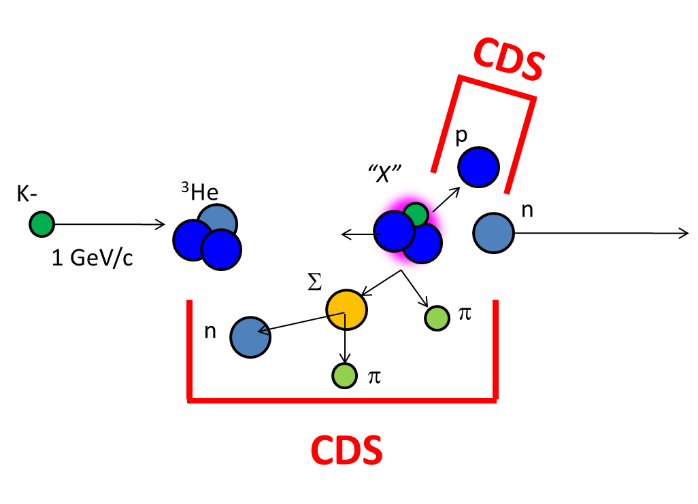
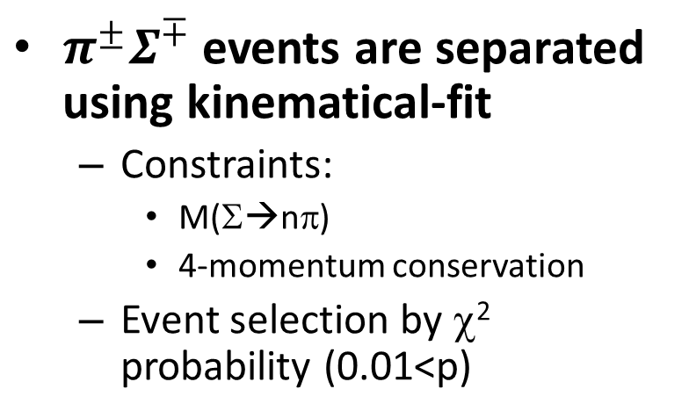

Selection of $π^{±}Σ^{∓}pn$ Final State
$π^{±}Σ^{∓}$ events are separated using kinematical-fit
  Constraints:
    M(Σ→nπ)
    4-momentum conservation
  Event selection by χ² probability (0.01<p)
e.g. after acc/eff correction
constraint: 4-mom. conservation
= n mass constraint
measured
measured
unmeasured
measured
measured
measured
constraint: Σ mass
ππpnΛ/Σ⁰ contribution can be seen
13

Slide 14
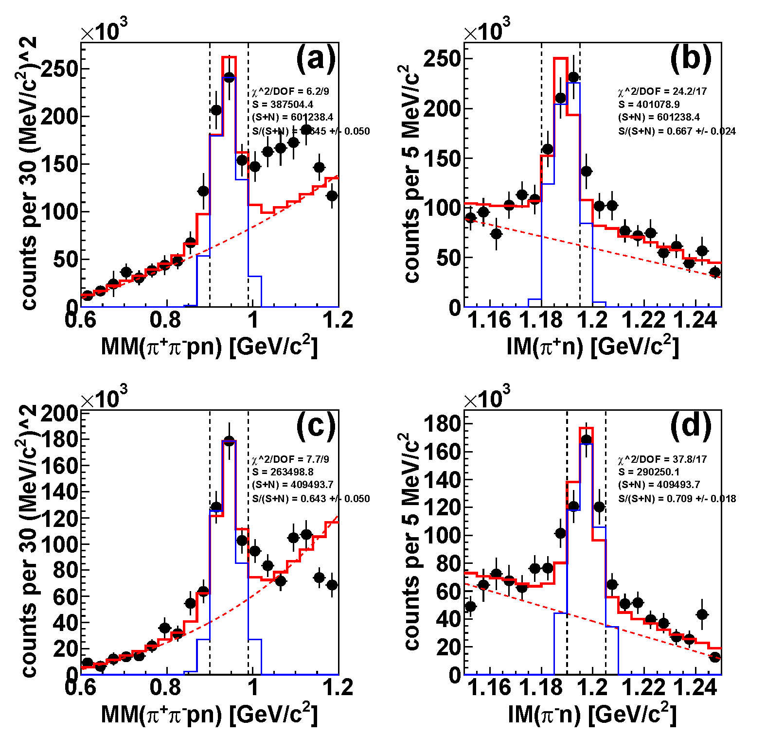
Selection of $π^{±}Σ^{∓}pn$ Final State
$π^{±}Σ^{∓}$ events are separated using kinematical-fit
  Constraints:
    M(Σ→nπ)
    4-momentum conservation
  Event selection by χ² probability (0.01<p)
e.g. after acc/eff correction
constraint: 4-mom. conservation
= n mass constraint
measured
measured
unmeasured
measured
measured
measured
constraint: Σ mass
simple BG evaluation & subtraction
14
Now, we are trying to improve Exp. BG evaluation

Slide 15
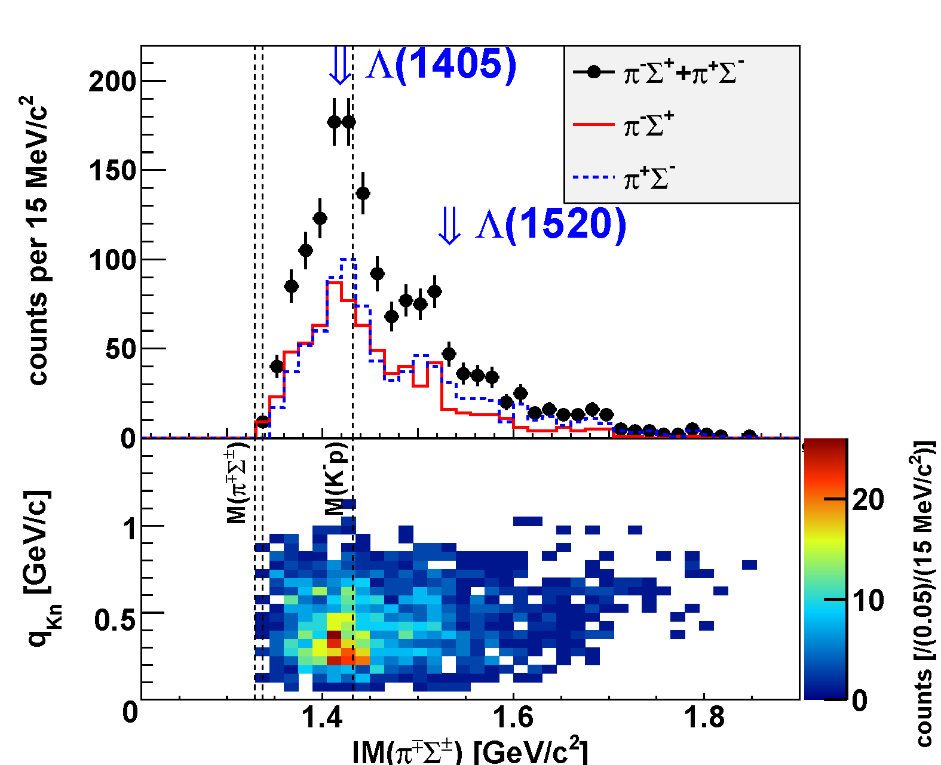
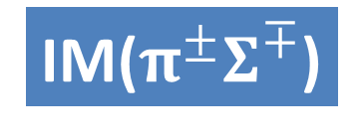

IM($π^{±}Σ^{∓}$) in $π^{±}Σ^{∓}pn$ Final State
w/ Exp. BG
IM($π^{±}Σ^{∓}$)
preliminary
q_{Kn}
Λ(1405) can be clearly seen in low q_{Kn}
15

Slide 16
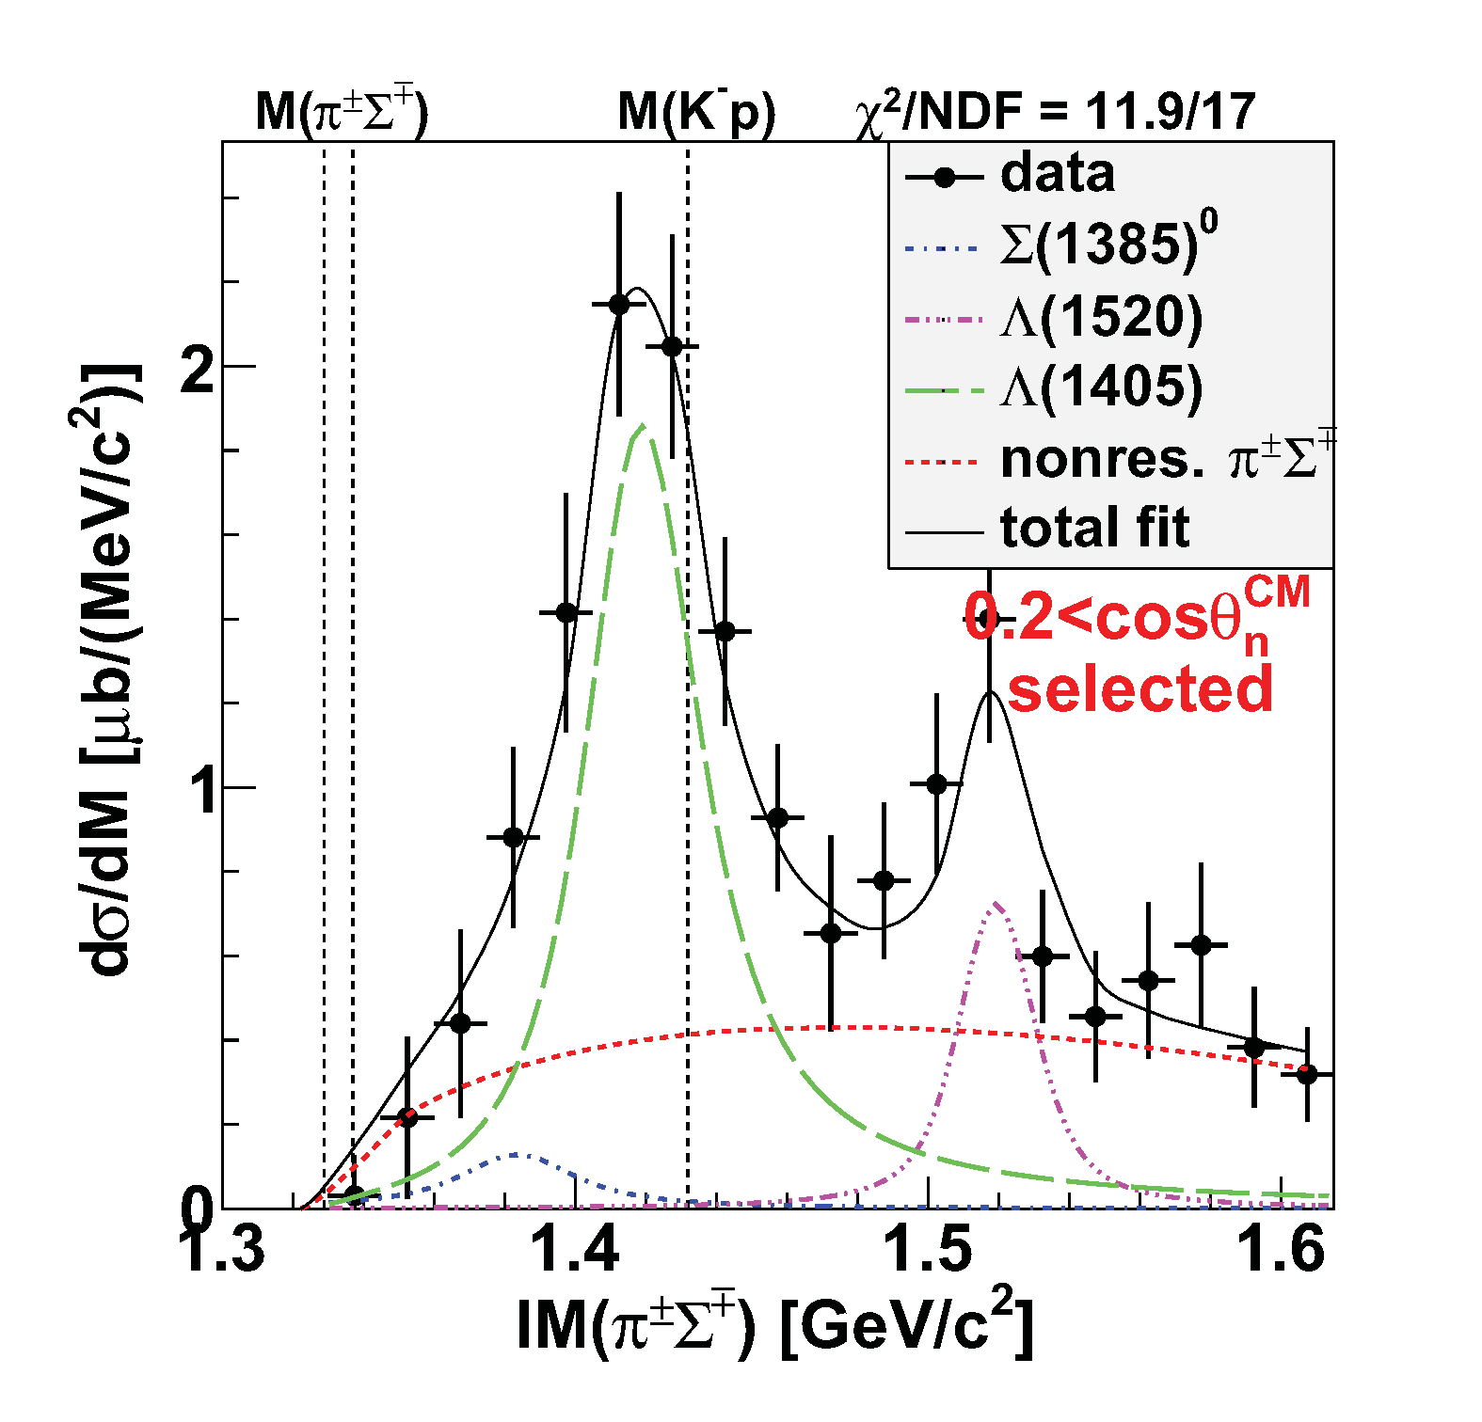
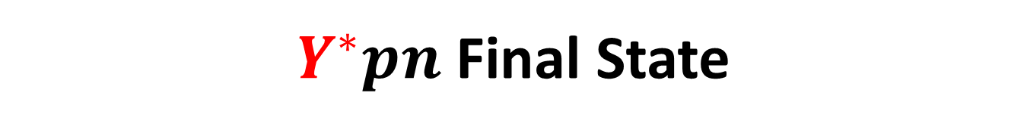
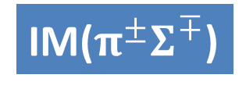
$Y^{∗}pn$ Final State
w/ simple BG subt.
Λ(1405)
IM($π^{±}Σ^{∓}$)
~ 150 μb
preliminary
Fit w/ Flatté formula:
Re(z) ~ 1420 MeV
-Im(z) ~ 15 MeV
Λ(1520)
~ 100 μb
Σ⁰(1385)
πΣpn
non-resonant
  ~ 20-100 μb
  [evaluated from
  Σ^{+/-}(1385)→π^{+/-}Λ
  measurement]
(Σ(1385)→πΛ/πΣ : 87.0/11.7%)

Slide 17
Λ(1405)pn Final State Selection
IM($π^{±}Σ^{∓}$)
Select Λ(1405)pn final state
preliminary
Below Λ(1520)
Small contribution from Σ(1385)
πΣpn
non-resonant
Λ(1405)pn

Slide 18
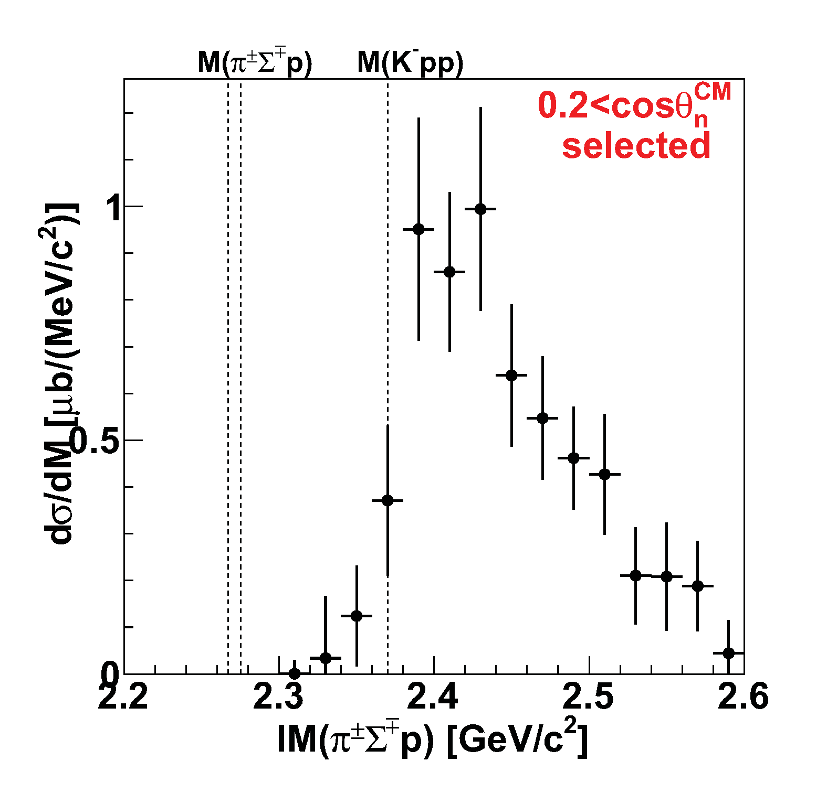
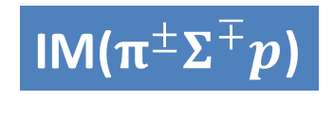
IM(πΣp) in Λ(1405)pn Final State
Λ(1405)pn
IM($π^{±}Σ^{∓}p$)
QF Λ(1405):
dominant above the threshold
M(Kpp)
“Kpp” ROI
preliminary

Slide 19
IM(πΣp) in Λ(1405)pn Final State
Λ(1405)pn
IM($π^{±}Σ^{∓}p$)
statistically,
NO significant structure
QF Λ(1405):
dominant above the threshold
M(πΣp)
M(Kpp)
“Kpp”→πΣN mesonic decay is theoretically expected to be the dominant channel
“Kpp” ROI
This will be due to phase-space limitation of
“K⁻pp”→πΣN decay.
preliminary

Slide 20
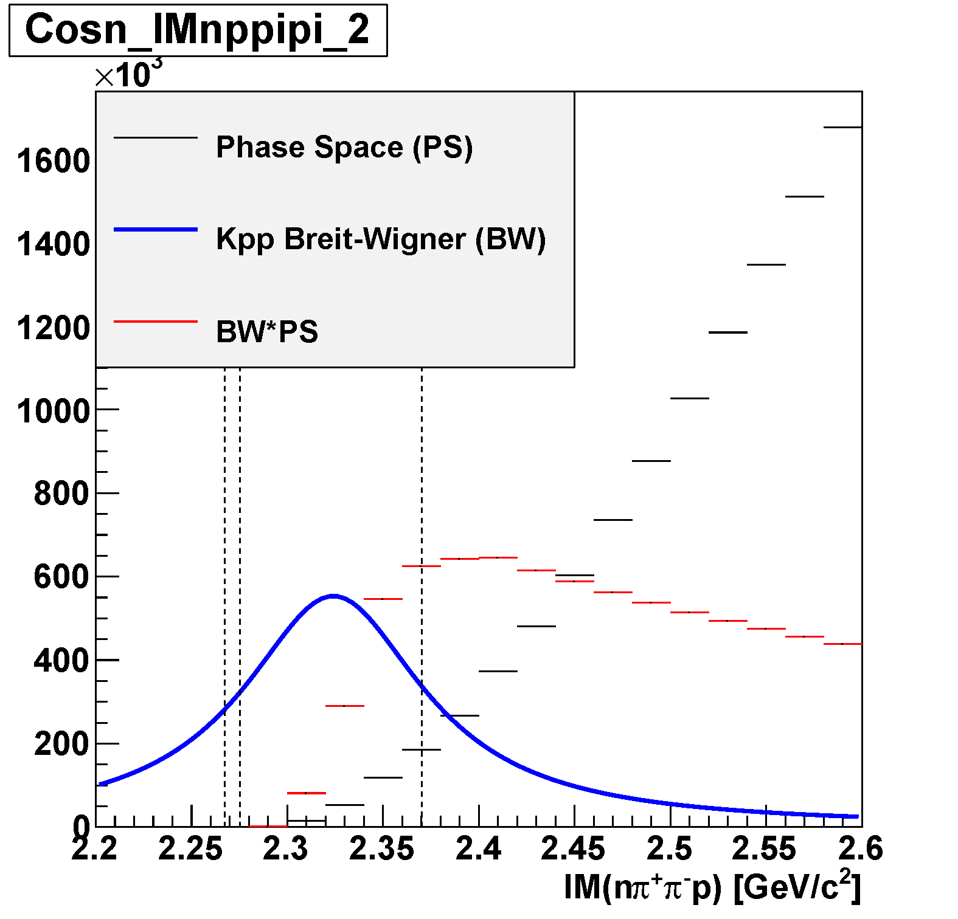

PS Limitation of “K⁻pp”→πΣp Decay
Phase space of πΣpn
IM($π^{±}Σ^{∓}p$)
Λ(1405)pn
M(πΣp)
M(Kpp)
preliminary
[BW] * [phase space]
Kpp BW obtained with Λp
“K⁻pp” spectrum would be found as a tail structure

Slide 21
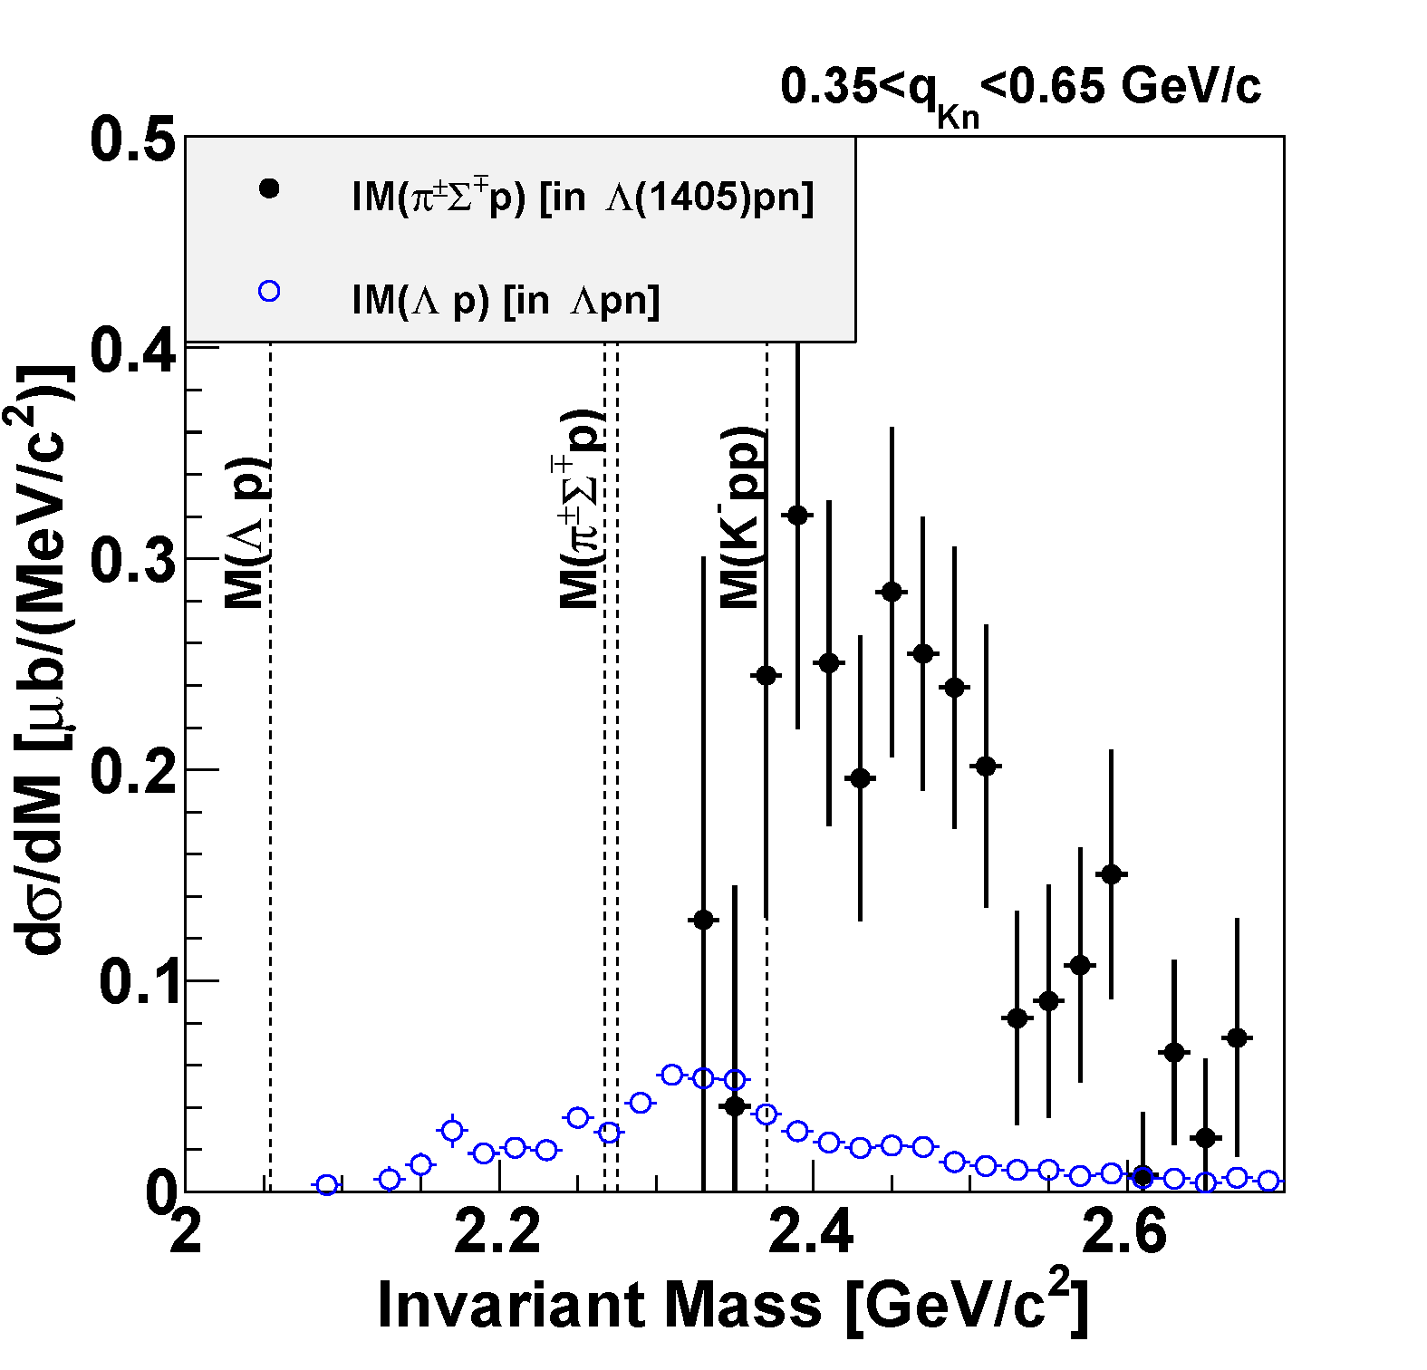
Comparison of Λpn & Λ(1405)pn
Large CS of the Λ(1405)p compared to the “K⁻pp”→Λp
M(Kpp)
preliminary
Λ(1405)pn
Λpn

Slide 22
Comparison of Λpn & Λ(1405)pn
Yamazaki & Akaishi, PRC76(2007)045201.
Large CS of the Λ(1405)p compared to the “K⁻pp”→Λp
M(Kpp)
preliminary
Λ(1405)pn
Λpn

Slide 23
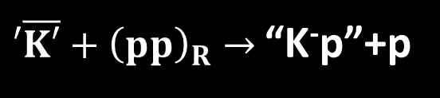
Comparison of Λpn & Λ(1405)pn
K-
³He
1 GeV/c
p
‘ K⁻’
n
preliminary
p
Λ(1405)pn
p
M(Kpp)
n
“K⁻p”
Intrinsic m_{K}²= E_{K}²-q²
preliminary
$′\overline{K′}+{\left(pp\right)}_{R}→$ “K⁻p”+p
Λ(1405)=“K⁻p”
Λpn
Λ(1405)p production is dominant
(energy-momentum mismatch is transferred to the proton)

Slide 24
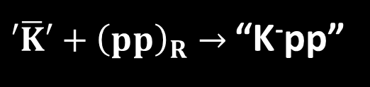
Comparison of Λpn & Λ(1405)pn
K-
³He
K-
³He
1 GeV/c
1 GeV/c
p
p
‘K⁻’
n
‘ K⁻’
n
preliminary
p
p
Λ(1405)pn
p
“K⁻pp”
n
M(Kpp)
n
“K⁻p”
E_{K}²-q² < intrinsic m_{K}²
Intrinsic m_{K}²= E_{K}²-q²
$′\overline{K}′+{\left(pp\right)}_{R}→$ “K⁻pp”
$′\overline{K′}+{\left(pp\right)}_{R}→$ “K⁻p”+p
Λ(1405)=“K⁻p”
Λpn
“K-pp” production is dominant
Λ(1405)p production is dominant
(energy-momentum mismatch is transferred to the proton)

Slide 25
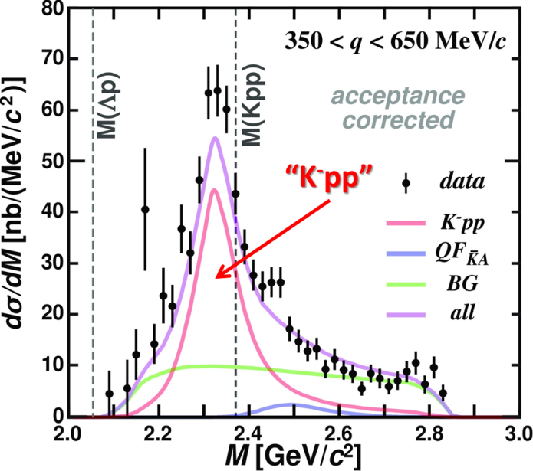
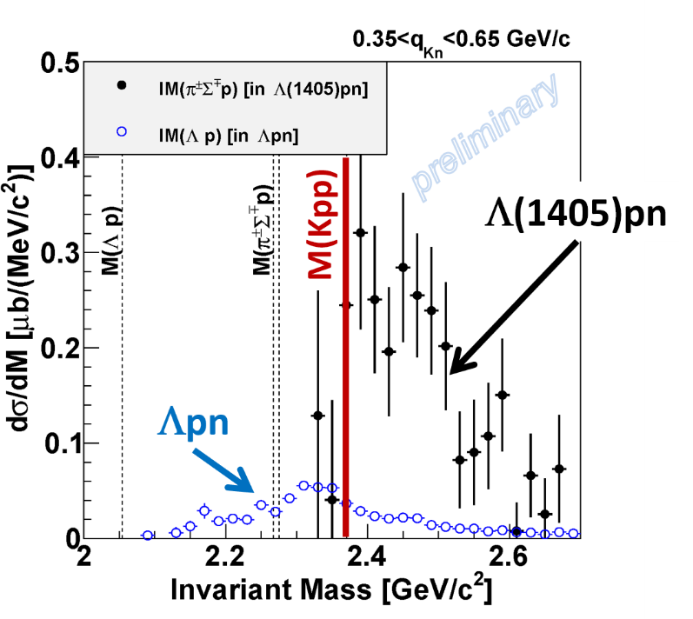
Summary
We observed the “K⁻pp” bound state in ³He(K⁻,Λp)n
  Binding energy: ~50 MeV
  Width: ~100 MeV
We found large CS of the Λ(1405)p formation compared to the “K⁻pp”
  quite important information on the production mechanism of the “K⁻pp”
← PLB789(2019)620.
← paper in preparation

Slide 26
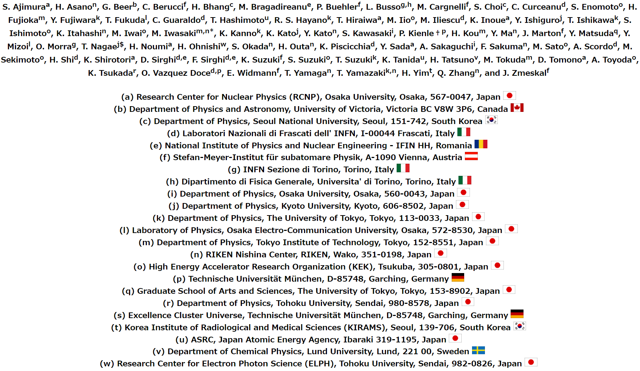
Thank You!
J-PARC E15 Collaboration

Slide 27
Spares

Slide 28
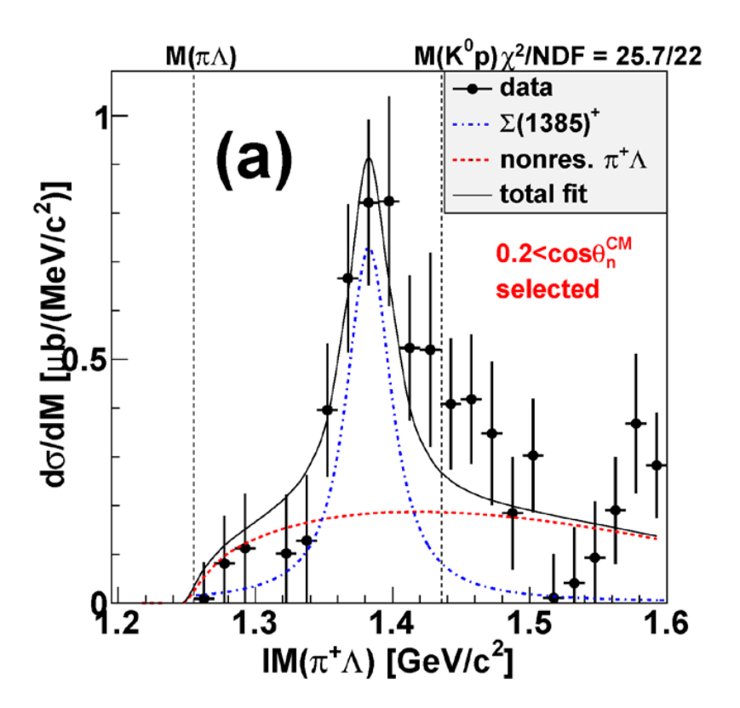
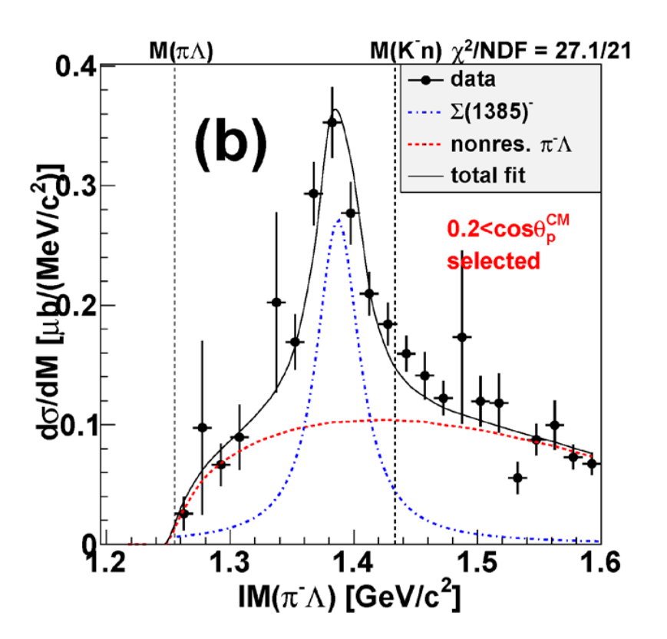
I=1 Channels, Σ^{+/-}(1385)
Σ⁺(1385) ~ 50 μb
Σ⁻(1385) ~ 20 μb
preliminary
preliminary
in π⁺Λnn final state
in π⁻Λpp final state
→ Σ⁰(1385) ~ 20-100 μb

Slide 29
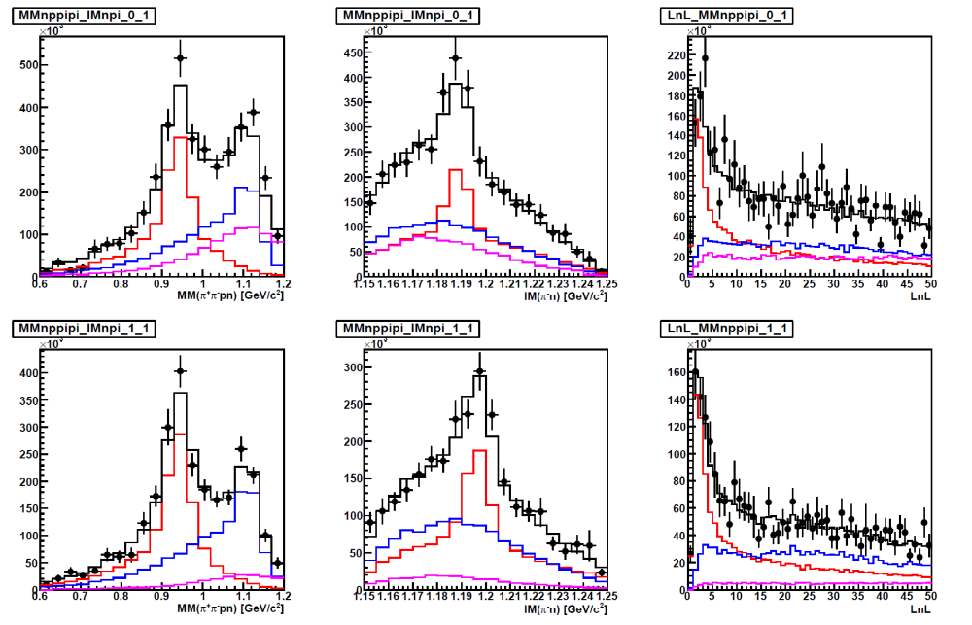
Selection of $π^{±}Σ^{∓}pn$ Final State
$π^{±}Σ^{∓}$ events are separated using kinematical-fit
  Constraints:
    M(Σ→nπ)
    4-momentum conservation
  Event selection by χ² probability (0.01<p)
e.g. after acc/eff correction
πΣpn
ππpnΛ
ππpnΣ⁰
constraint: 4-mom. conservation
= n mass constraint
measured
measured
unmeasured
Trying to improve Exp. BG evaluation by introducing
new analysis cuts
loglikelihood function with DCA
global fit with signal & BG’s
measured
measured
measured
constraint: Σ mass
29

Slide 30
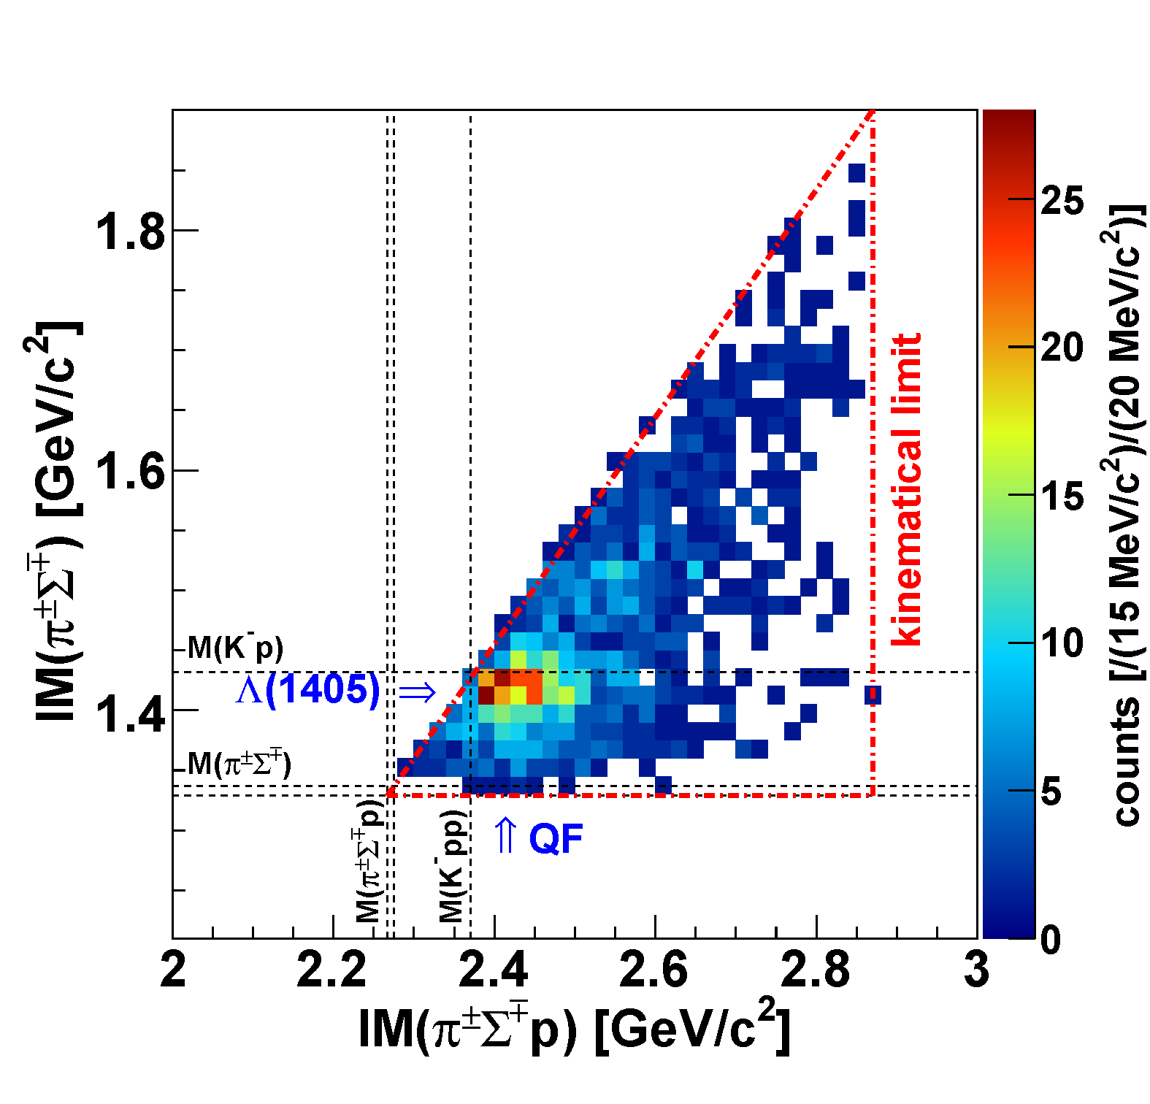
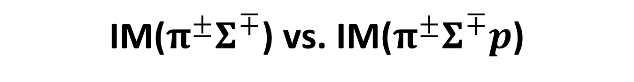

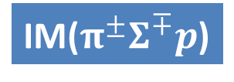
IM($π^{±}Σ^{∓}$) vs. IM($π^{±}Σ^{∓}p$)
w/ Exp. BG
preliminary
K-
³He
IM($π^{±}Σ^{∓}$)
1 GeV/c
p
n
p
p
n
IM($π^{±}Σ^{∓}p$)
Λ(1405)
Small phase-space of “K⁻pp”→πΣN

Slide 31
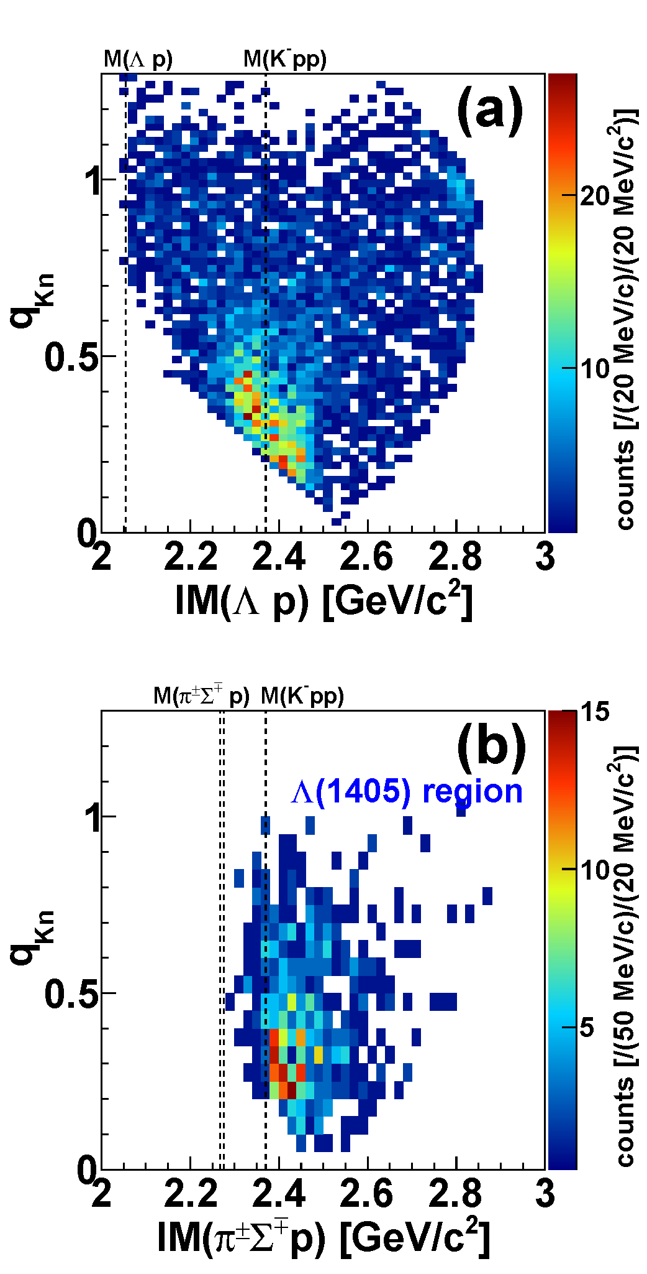
Comparison of Λpn & Λ(1405)pn
Λpn
Λ(1405)pn region
`
QF
QF
kinematical
limit
Kpp
Kpp
kinematical
limit
preliminary
No clear structure below M(Kpp) in the IM(πΣp)
QF followed by Λ(1405)p is dominant

Slide 32
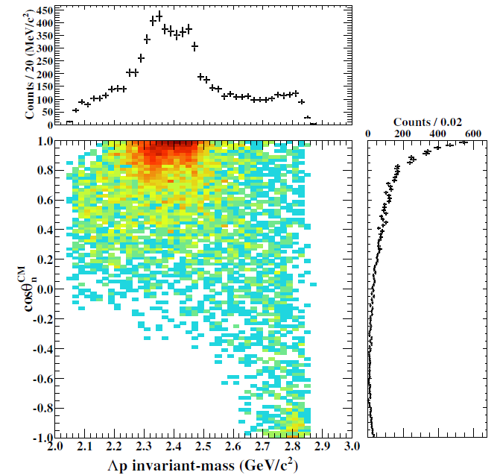
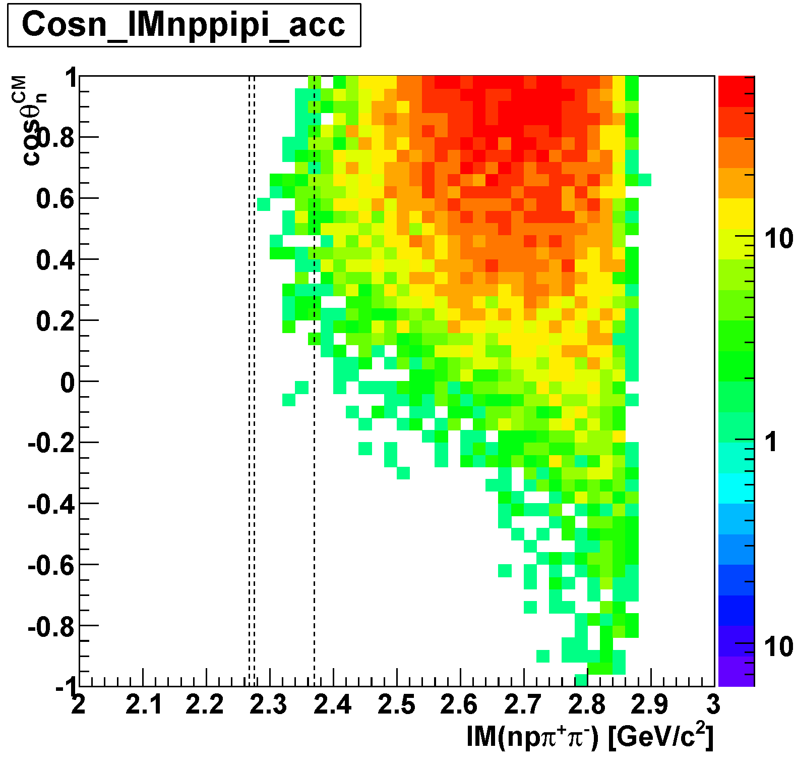
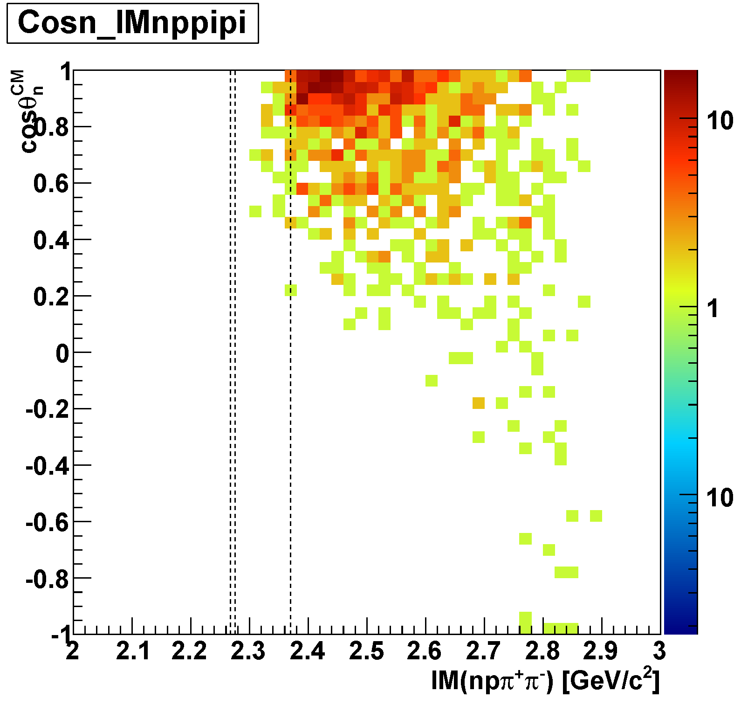
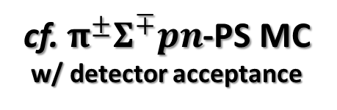


Detector Acceptance: Λp vs. πΣp
Detector acceptance is different between Λp and πΣp
  At cosθ_{n}~1:
    Λp: flat acceptance
    πΣp: limited acceptance below the threshold
DATA
$$Λp$$
detector
acceptance
MC
DATA
$$π^{±}Σ^{∓}p$$
M(K⁻pp)
M(πΣp)
cf. $π^{±}Σ^{∓}pn$-PS MC
w/ detector acceptance
M(πΣp)
M(K⁻pp)
preliminary
detector
acceptance

Slide 33
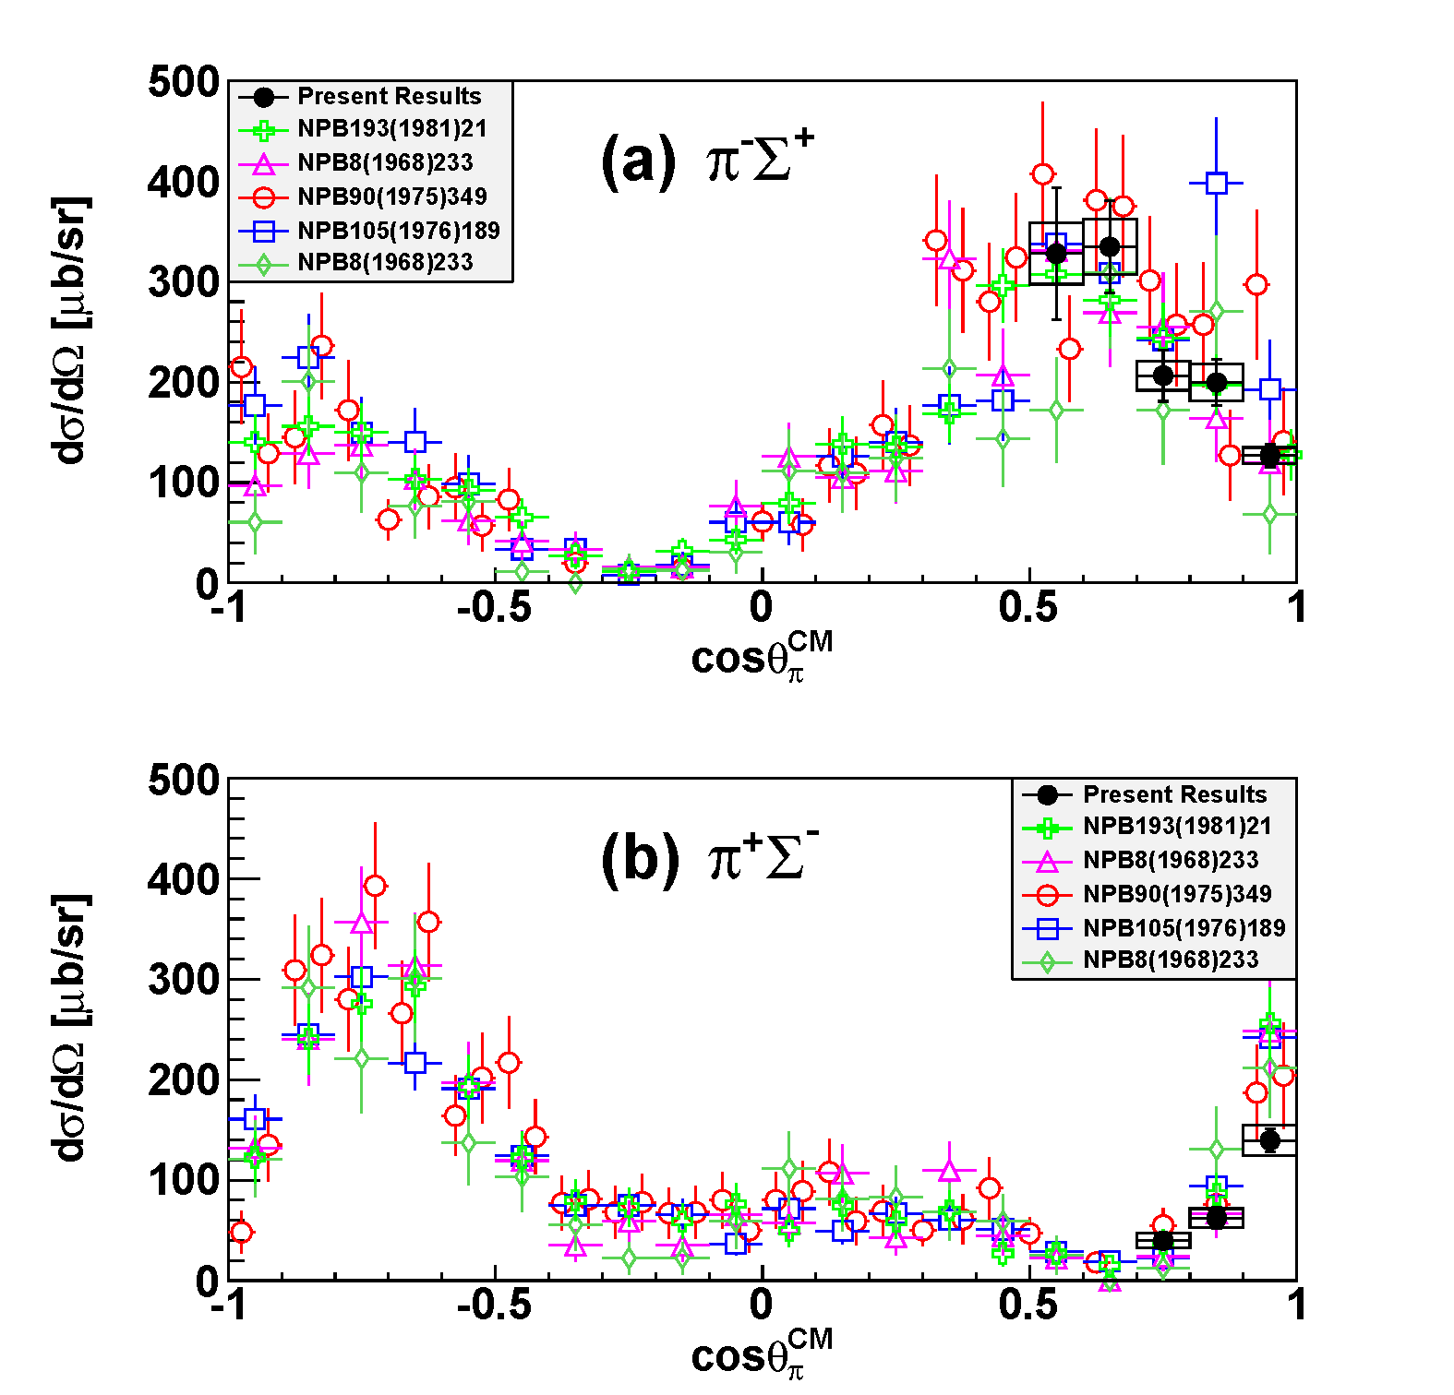
K⁻p→Σ⁺π⁻/Σ⁻π⁺ Cross Section
consistent with the references

Slide 34
Need further investigation
More quantitative studies of the “K⁻pp”
  J^{P} and other decay modes
Systematic studies of other kaonic nuclei:
  Single: “K⁻ppn” via [K⁻ + ⁴He], “K⁻ppnn/K⁻pppnn” via [K⁻ + ⁶Li]
  Double: “K⁻K⁻pp” via [p^{bar} + ³He]
A new 4π detector with γ/n sensitive detectors is required

Slide 36
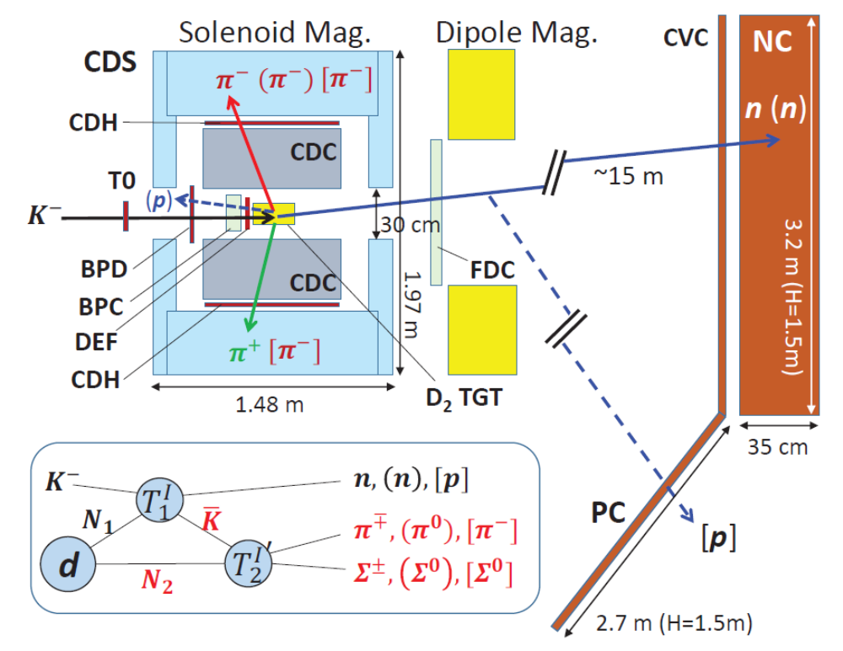
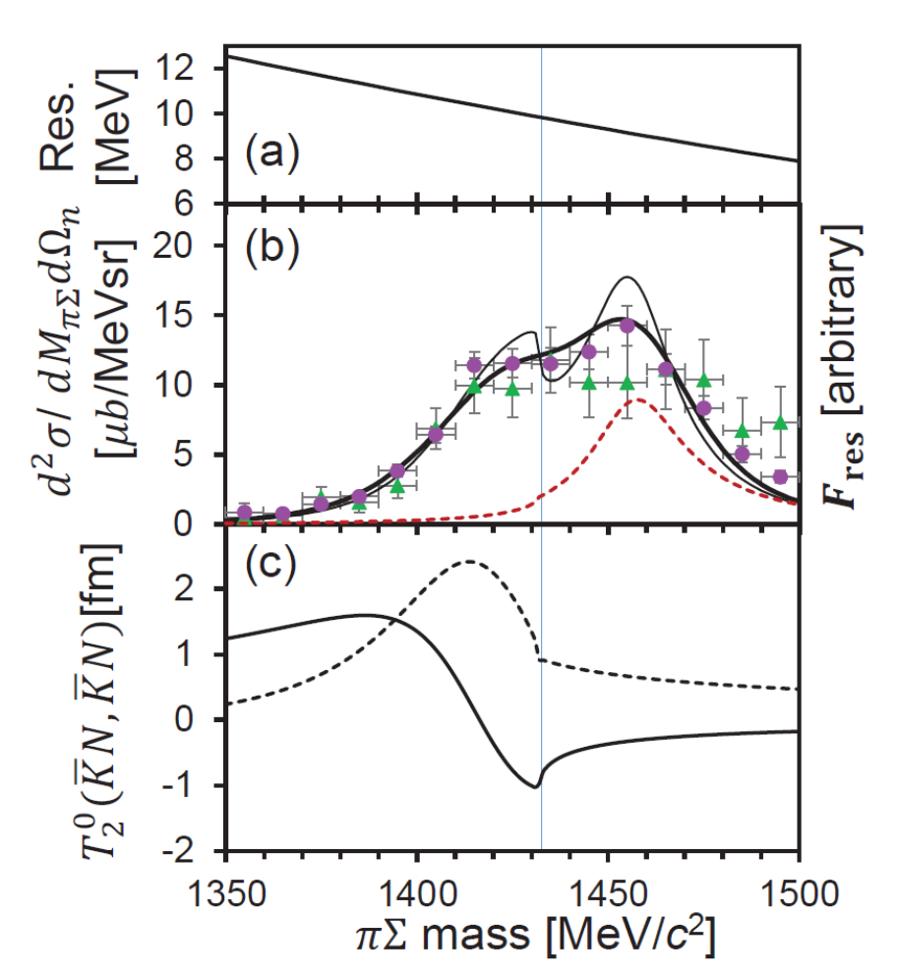
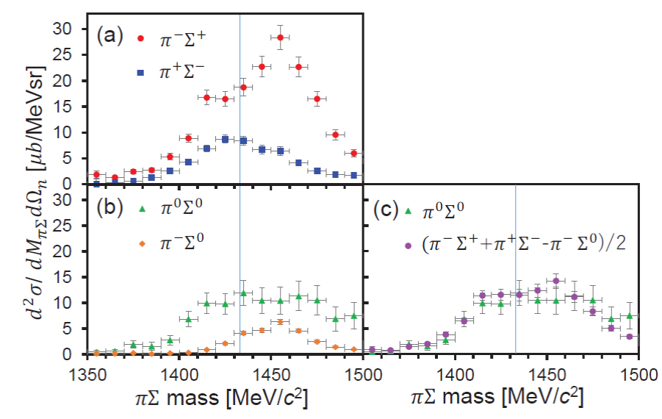

K⁻d→Λ(1405)n @ E31
Im(T₂⁰)
Re(T₂⁰)
A resonant pole at
in the I = 0 of the K^{bar}N→K^{bar}N scattering.
submitted to PRL / will be available in arXiv soon

Slide 37
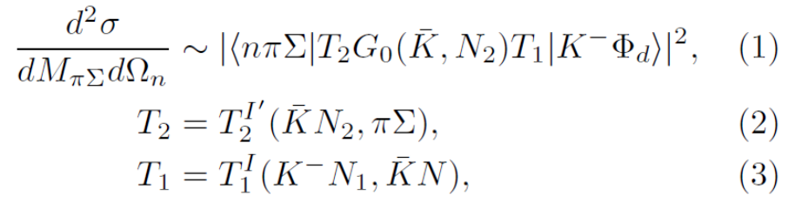


K⁻d→Λ(1405)n @ E31
simplified by factorization approximation
Im(T₂⁰)
Re(T₂⁰)
A resonant pole at
in the I = 0 of the K^{bar}N→K^{bar}N scattering.
submitted to PRL / will be available in arXiv soon

Slide 38

K⁻d→Λ(1405)n @ E31
Im(T₂⁰)
Re(T₂⁰)
Fitting results:
$A^{0}=−1.02\left(0.09\right)+0.92\left(0.09\right)i$ fm
$R^{0}=−0.27\left(0.24\right)−0.52\left(0.13\right)i$ fm
A resonant pole at
in the I = 0 of the K^{bar}N→K^{bar}N scattering.
the coupling of Λ(1405) to K^{bar}N is predominant
→ Λ(1405) as a K^{bar} N bound state.
submitted to PRL / will be available in arXiv soon

