Slide 1

K^{bar}NN bound state search at J-PARC
F. Sakuma, RIKEN
on behalf of the J-PARC E15 collaboration
MENU2016, July 25-30, 2016, Kyoto

Slide 2
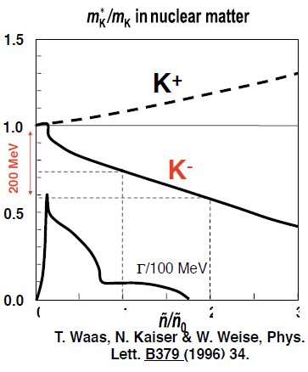
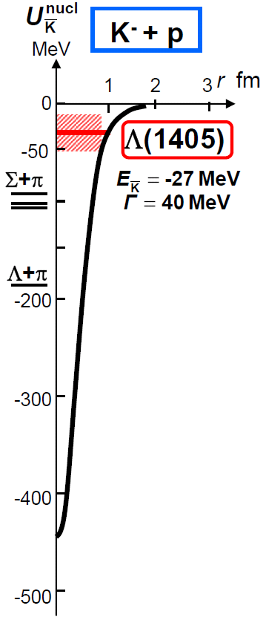
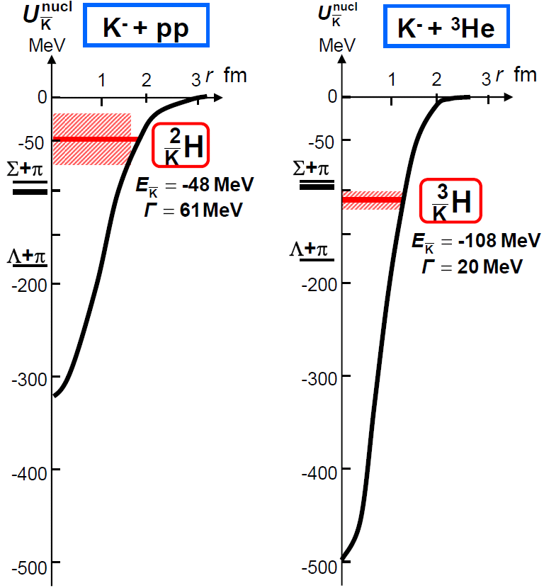
What are Kaonic Nuclei?
Bound states of nucleus and anti-kaon
Predicted as a consequence of attractive K^{bar}N interaction in I=0
Meson properties change
in nuclear media?
Y.Akaishi & T.Yamazaki, PLB535, 70(2002).
0
1
2
3
Will provide new insight on K^{bar}N interaction in media

Slide 3
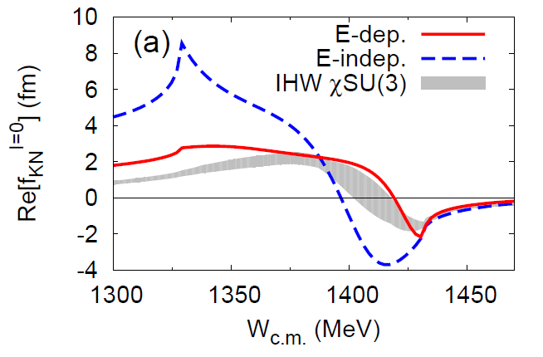
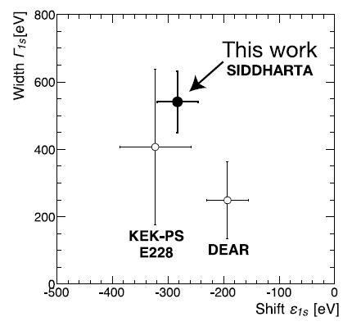
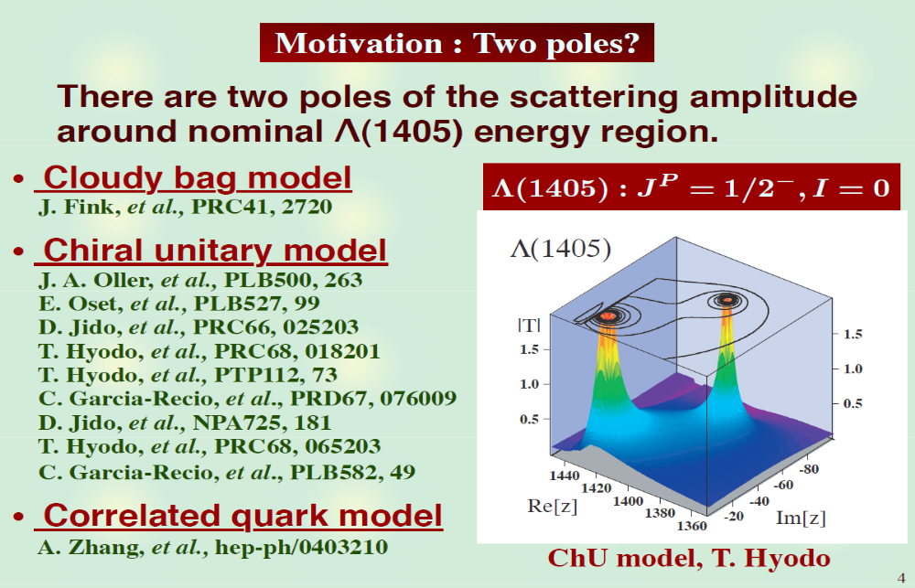
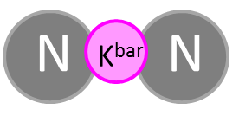

K^{bar}N interaction - A good probe for low-energy QCD
S.Ohnish et al.,PRC93(2016) 025207
Calculation on
K^{bar}N amplitude
in I = 0
?
K^{bar}N
M. Bazzi et al.,
(SIDDHARTA Coll.),
Phys. Lett. B704(2011)113
πΣ
‾ＫＮ
$$I=\frac{1}{2}, J^{P}=0^{−}$$
expected to be produced as a
Λ(1405)p doorway

Slide 4
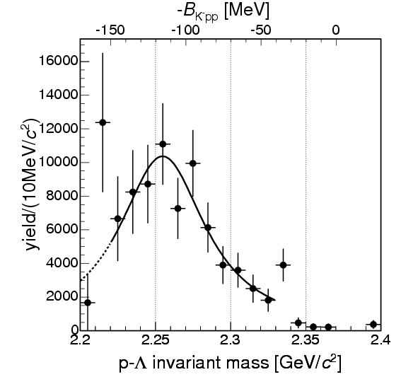
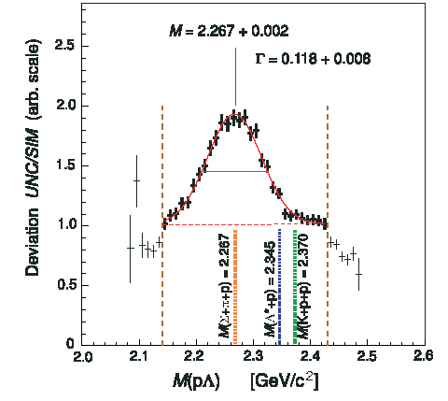
Pioneering Experiments on K^{bar}NN
B.E. = 115MeV
Γ = 67MeV
B.E. = 103MeV
Γ = 118MeV
“K⁻pp”→Λp?
Exp/Sim
FINUDA@DAΦNE
DISTO@SATURNE
PRL94(2005)212303
PRL104(2010)132502
⁶Li+⁷Li+¹²C(stopped K⁻, Λp)
p + p → (Λ + p) + K⁺ @ 2.85GeV
2NA followed by FSI?
PRC74(2006)025206
PRC82(2010)034608 etc.
pp→p(N*)→p(ΛK⁺)?
PRC92(2015)044002
vs.
K.Suzuki, HYP2015 talk

Slide 5
Theoretical Calculations on K^{bar}NN
K^{bar}N int. | Chiral SU(3) (energy dependent) |  |  | Phenomenological (energy independent)
Method | Variational |  | Faddeev | Variational |  | Faddeev
 | Barnea, Gal, Liverts | Dote, Hyodo, Weise | Ikeda, Kamano, Sato | Yamazaki, Akaishi | Wyceck, Green | Shevchenko, Gal, Mares | Ikeda, Sato
B (MeV) | 16 | 17-23 | 9-16 | 48 | 40-80 | 50-70 | 60-95
Γ (MeV) | 41 | 40-70 | 34-46 | 61 | 40-85 | 90-110 | 45-80
K^{bar}N interaction model:
  Chiral SU(3) [energy dependent]
  Phenomenological [energy independent]
Calculation method:
  Almost the same results = depending on K^{bar}N interaction
→ B.E. ~ 20 MeV
→ B.E. ~ 40-70 MeV
Dote, Tue. A-1

Slide 6
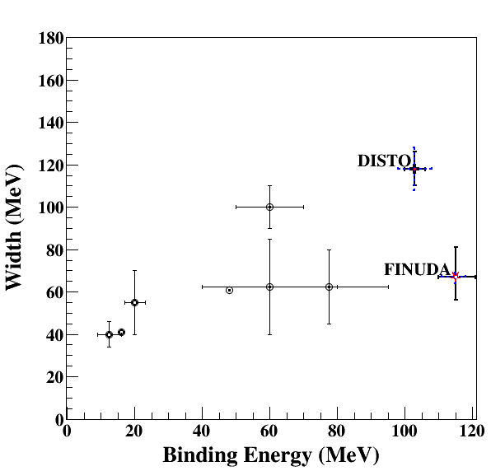
Comparison between Calcs. and Exps.
Binding energy
  Chiral:
  B.E. ~ 20MeV
  Phenomenological:
  B.E. ~ 40-70MeV
  Experiments (if K^{bar}NN):
  B.E. ~ 100MeV
Width
  almost agreement in Γ~40-100MeV
    Theor.: mesonic decay
    Exp.: non-mesonic decay
Chiral
Phenomenological

Slide 7
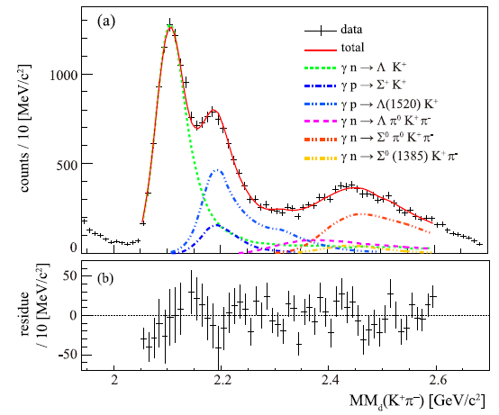
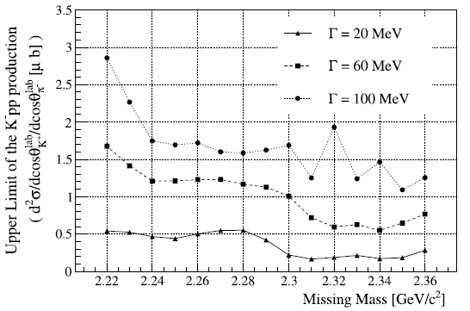
Recent Measurement at LEPS
A.O. Tokiyasu et al., Phys. Lett. B 728 (2014) 616.
Inclusive d(γ, K⁺π⁻)X
  E_{γ} = 1.5-2.4 GeV
  cosθ^{lab}_{K+/π-} > 0.95
  σ_{MM} ~ 10 MeV
BG: γN→K⁺π⁻Λ/Σ/Λ(1520)
NO peak structure
  U.L.: 0.17-2.9 μb
  (= 1.5-26% CS of γd→K⁺π⁻Y)
M[K+p+p]
◊ LEPS2 (4π measurement)

Slide 8
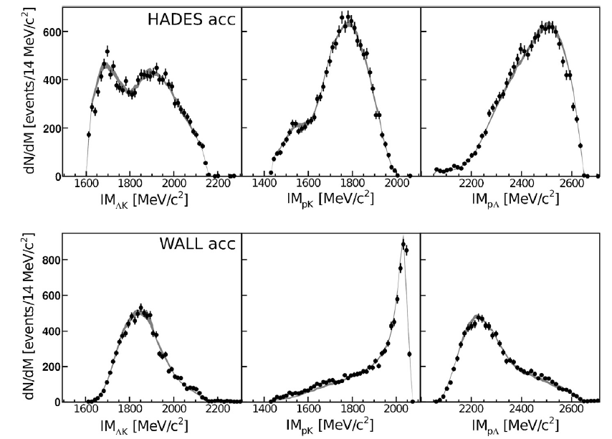
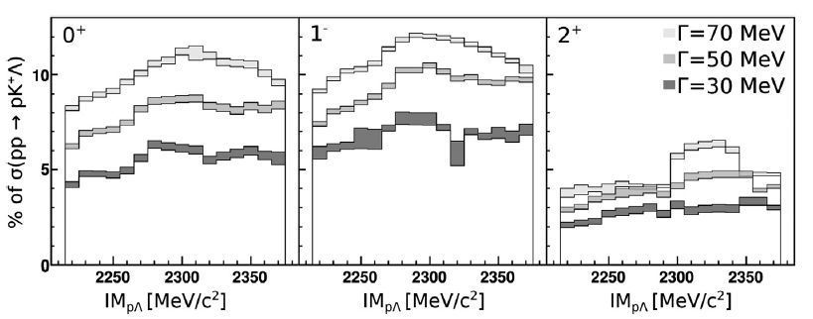
Recent Measurement at HADES
G. Agakishiev et al., Phys. Lett. B 742 (2015) 242
Kpp th
Exclusive pp→pΛK⁺
  E = 3.5 GeV
Bonn–Gatchina PWA
  Well reproduces the data with N* resonances
    pp→pN*→pΛK⁺
NO peak structure
  U.L.: 0.7-4.2 μb
  (= 2-12% CS of pp→pK⁺Λ)
  Λ(1405) production = 9.2 μb
  → σ(X=K^{bar}NN)/σ(Λ*) < ~50%
PRC87(2013)025201
vs.
DISTO: σ(X) > σ(Λ(1405)) @ 2.85GeV
◊ Combined analysis with COSY-TOF/DISTO/HOPI/HADES (pp→pK⁺Λ)

Slide 9
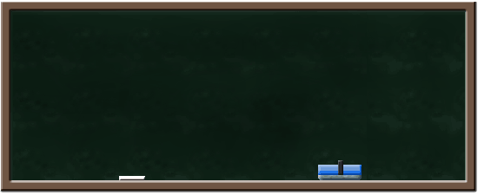
Brief Summary --- What We Have Learned? ---
Theoretical approach to K^{bar}NN
  Largely depends on K^{bar}N interaction below the K^{bar}N threshold
    Need feedback from Λ(1405)/”K-pp” experiments
Experimental approach to K^{bar}NN
  Still controversial…
  Have to hunt small/broad signal from large/widely distributed QF-BG
Exclusive measurement is crucial
Other production channels are needed:
π + A, ^{in-flight}K⁻ + A

Slide 10
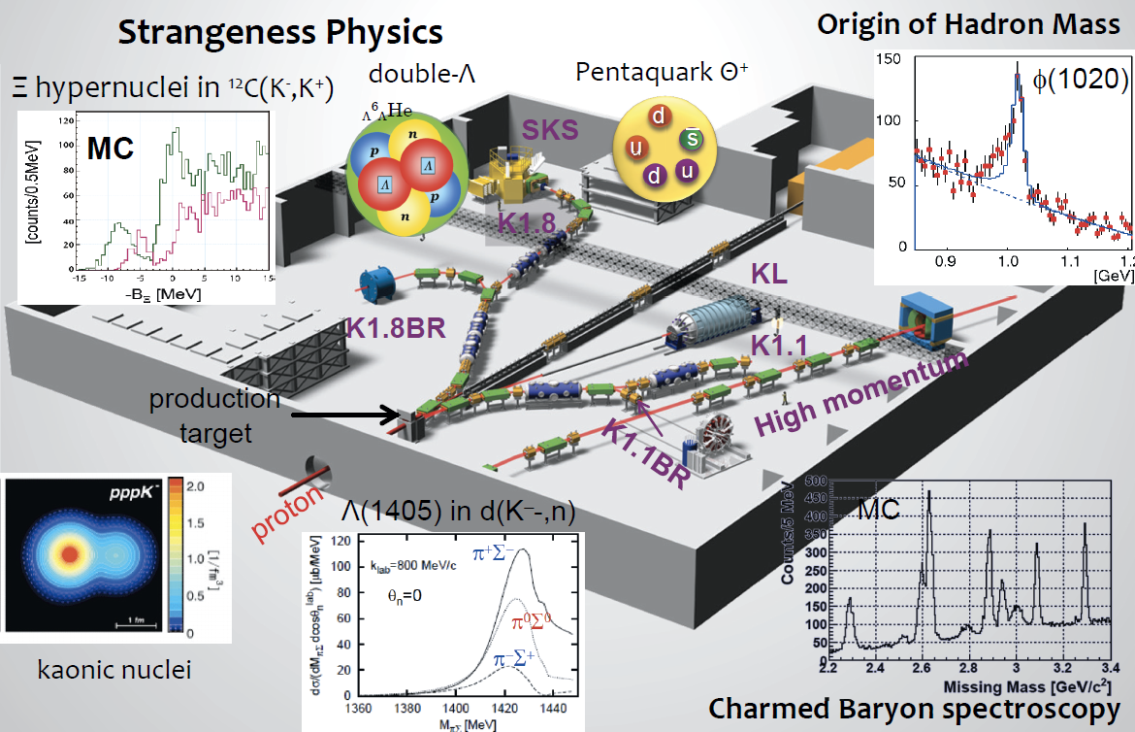
K^{bar}NN Searches at J-PARC
E27 d(π⁺,K⁺)X
@K1.8
E15 ³He(K⁻,n)X
@K1.8BR
Komatsu, Tue. A-5
Kawasaki, Fri. E-1
Takahashi, Fri. D-3
M.Naruki

Slide 11
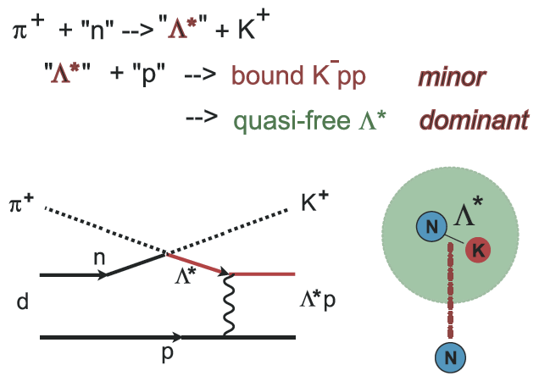
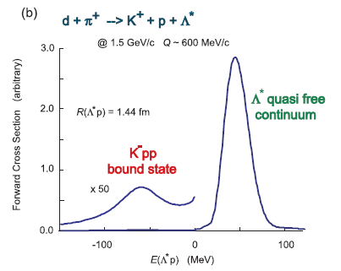
J-PARC E27 Experiment
d(π⁺, K⁺) reaction @ 1.69 GeV/c
  “K⁻pp” is expected to be produced as a Λ(1405) doorway
~1%?
Yamazaki & Akaishi, Phys. Rev. C 76 (2007) 045201.

Slide 12
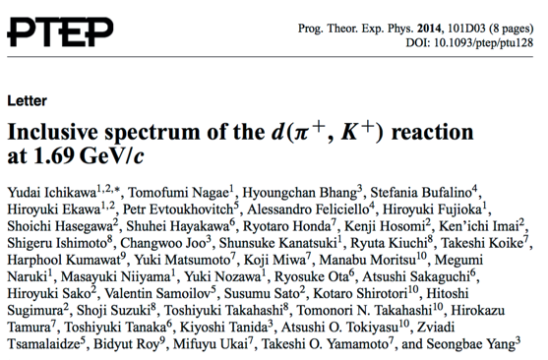
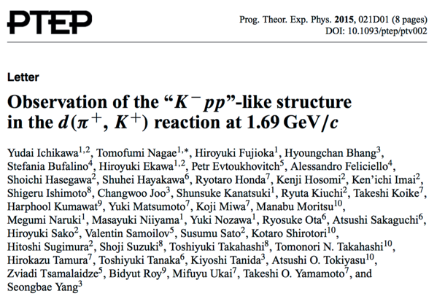
E27: Publications
inclusive d(π⁺,K⁺)X
Performed in 2012
Y. Ichikawa et al., PTEP (2014) 101D03.
Y. Ichikawa et al., PTEP (2015) 021D01.
exclusive d(π⁺,K⁺)Yp

Slide 13
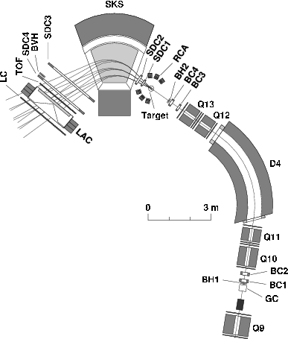
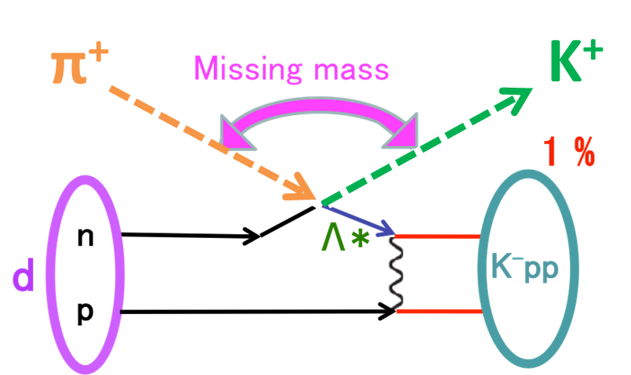
E27: Experimental Setup
SKS spectrometer
K1.8 beam line spectrometer
  1.69 GeV/c π⁺
  Δp/p ~ 2x10⁻³
SKS spectrometer
  0.8-1.3 GeV/c K⁺
  Δp/p ~ 2x10⁻³
  ΔΩ ~ 100 msr
Target : liquid deuterium (1.99 g/cm²)
K⁺
π⁺
K1.8 beam line
spectrometer
p_{π} = 1.69 GeV/c
Y.Ichikawa

Slide 14
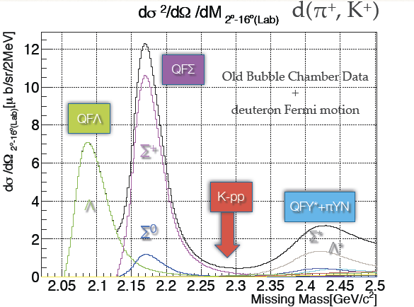
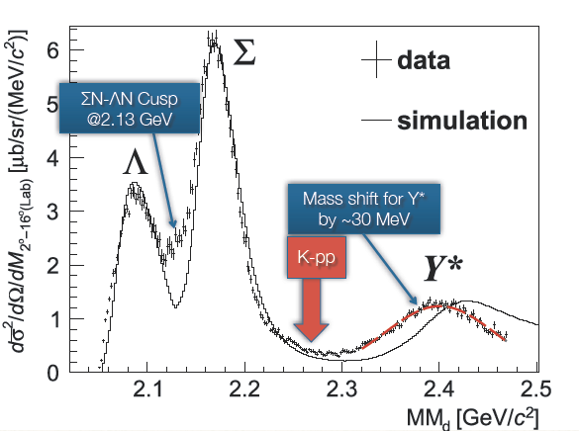
E27: Inclusive d(π⁺,K⁺)X
Y. Ichikawa et al., PTEP (2014) 101D03.
expected spectrum
“K⁻pp” signal is hidden by QF!?
+ data
- expected
ΣN-ΛN cusp
Y* mass shift?
Ichikawa, Tue. A-1
Tokiyasu, Fri. E-1
T.Nagae

Slide 15
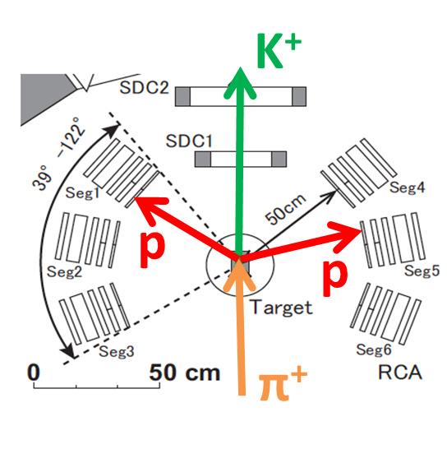
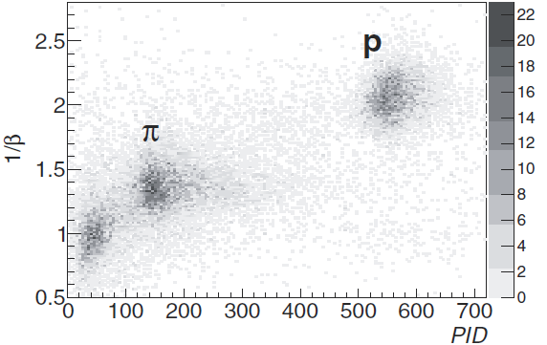
E27: Experimental Setup
SKS spectrometer
K1.8 beam line spectrometer
  1.69 GeV/c π⁺
  Δp/p ~ 2x10⁻³
SKS spectrometer
  0.8-1.3 GeV/c K⁺
  Δp/p ~ 2x10⁻³
  ΔΩ ~ 100 msr
Target : liquid deuterium (1.99 g/cm²)
K⁺
π⁺
Range Counter Arrays
Range Counter Arrays (RCA)
  5 layers of Plastic scinti.
  39-122 deg. (L+R)
  50 cm TOF
Y.Ichikawa

Slide 16
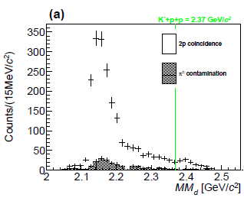
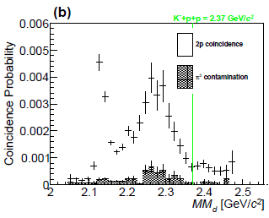
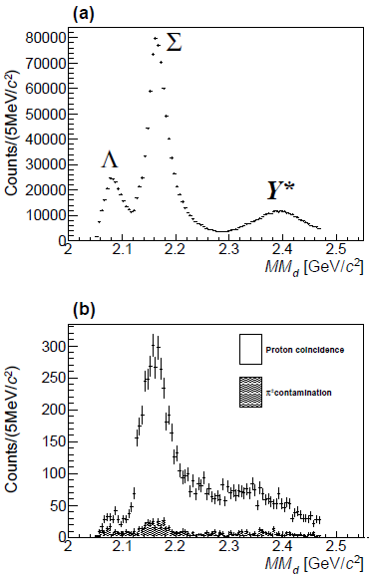
E27: Two-Proton Coincidence
Y. Ichikawa et al., PTEP (2015) 021D01.
p_{p} > 250 MeV/c
  QFs are suppressed
ΣN-ΛN cusp is clearly seen @ 2.13 GeV/c²
Broad enhancement is observed @ 2.28 GeV/c²
< 2p coincidence spectrum >
< 2p coincidence probability >
=
Y.Ichikawa, PhD-thesis.
Kyoto-U (2015)
< Inclusive spectrum >
ΣN-ΛN cusp
Broad bump
Y.Ichikawa

Slide 17
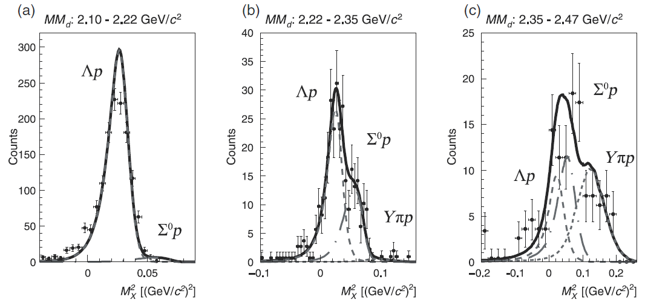
E27: Decay Mode Separation
Y. Ichikawa et al., PTEP (2015) 021D01.
①
②
③
Decay mode can be separated with MM[d(π⁺,K⁺pp)X]
  two-protons in final state: K⁺Λp, K⁺Σ⁰p, K⁺Yπp
①
②
③

Slide 18
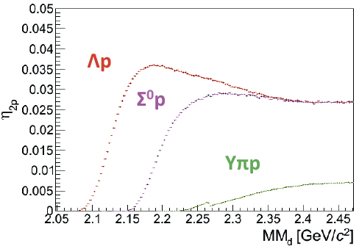
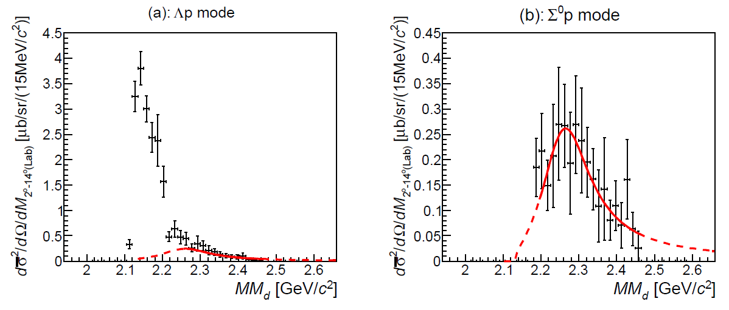
E27: “K⁻pp”-like Structure
Y. Ichikawa et al., PTEP (2015) 021D01.
Detector Acceptance
“K⁻pp”-like structure in Σ⁰p decay mode:
  Mass
  Binding energy
  Width
Relativistic Breit-Wigner
M(π+Σ+N)
Σ⁰p
M(K+p+p)
T.Nagae

Slide 19
E27: “K⁻pp”-like Structure
Y. Ichikawa et al., PTEP (2015) 021D01.
Decay branch:
Σ⁰p
Theor. Cal. on Y*N→YN : Γ_{Λp}/Γ_{Σ0p} = 1.2
Sekihara, Jido, Kanda-En’yo PRC79(2009)062201(R).
dσ/dΩ_{“K-pp”→Σ0p}:
dσ²/dΩ/dM_{2-14 deg.(Lab)} [μb/sr/(15MeV/c²)]
Λp
Y.Ichikawa, PhD-thesis. Kyoto-U (2015)
M(π+Σ+N)
p(π⁻,K⁰)Λ(1405) @ 1.69GeV/c:
dσ/dΩ_{Λ(1405)}=36.9μb/sr
M(K+p+p)
preliminary
BNL, NPB56(1973)15
= (dσ/dΩ_{”K-pp”→Yp}) / (dσ/dΩ_{Λ(1405)}) ~ 7-8%
→ large prob. of Λ(1405)p→“K⁻pp”
c.f., large prob. in DISTO, but < 50% in HADES
T.Nagae

Slide 20
J-PARC E15 Experiment
--- K^{bar}NN via ³He(K⁻,n) ---

Slide 21

J-PARC E15 Experiment
³He(in-flight K⁻,n) reaction @ 1.0 GeV/c
  2NA processes and Y decays can be discriminated kinematically
① semi-inclusive (K⁻,n)
② exclusive (K⁻,Λp)n_{missing}

Slide 22
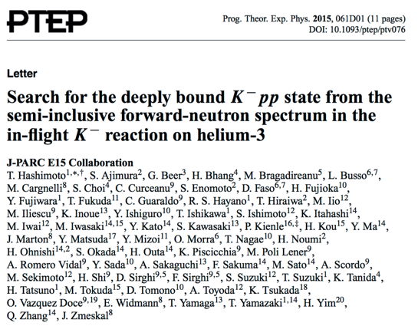
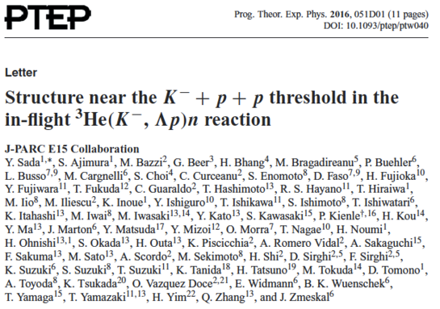
E15: Publications
E15^{1st} experiment:
Only 4days data-taking in 2013
inclusive ³He(K⁻,n)X
exclusive ³He(K⁻,Λp)n
T. Hashimoto et al., PTEP (2015) 061D01.
Y. Sada et al., PTEP (2016) 051D01.

Slide 23

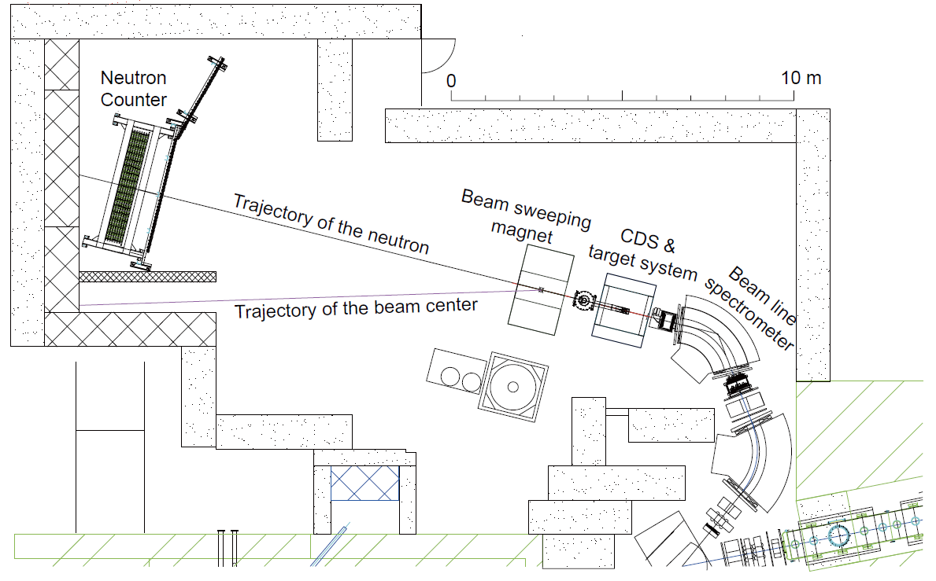
Experimental Setup
15m

Slide 24
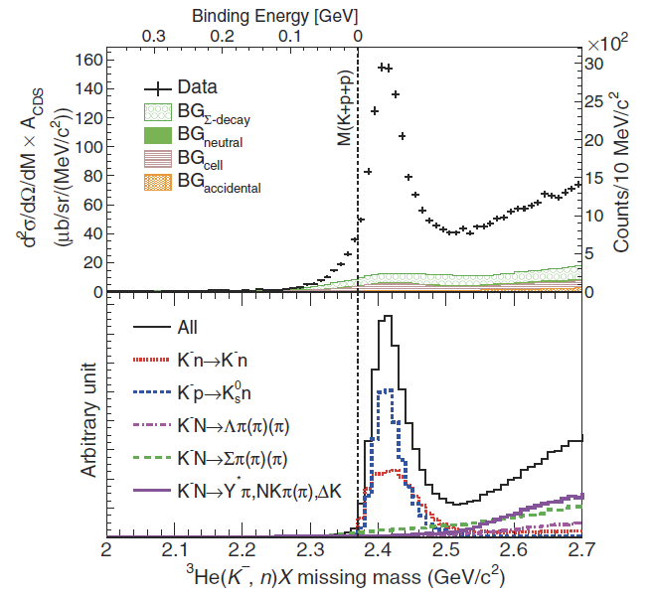
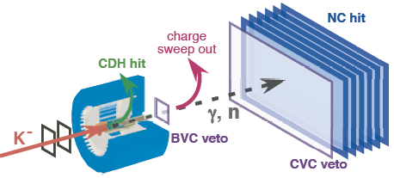
Semi-Inclusive ³He(K⁻,n)X
DATA
sub-threshold
excess
(Y* and/or K^{bar}NN?)
Quasi Elastic
K⁻ + ³He → K⁻ + n + p_{s} + p_{s}
dσ/dΩ_{θ=0deg} ~ 6mb/sr
MC
Charge-Exchange
K⁻ + ³He → K⁰ + n + d_{s}
dσ/dΩ_{θ=0deg} ~ 11mb/sr
T. Hashimoto et al., PTEP (2015) 061D01.

Slide 25
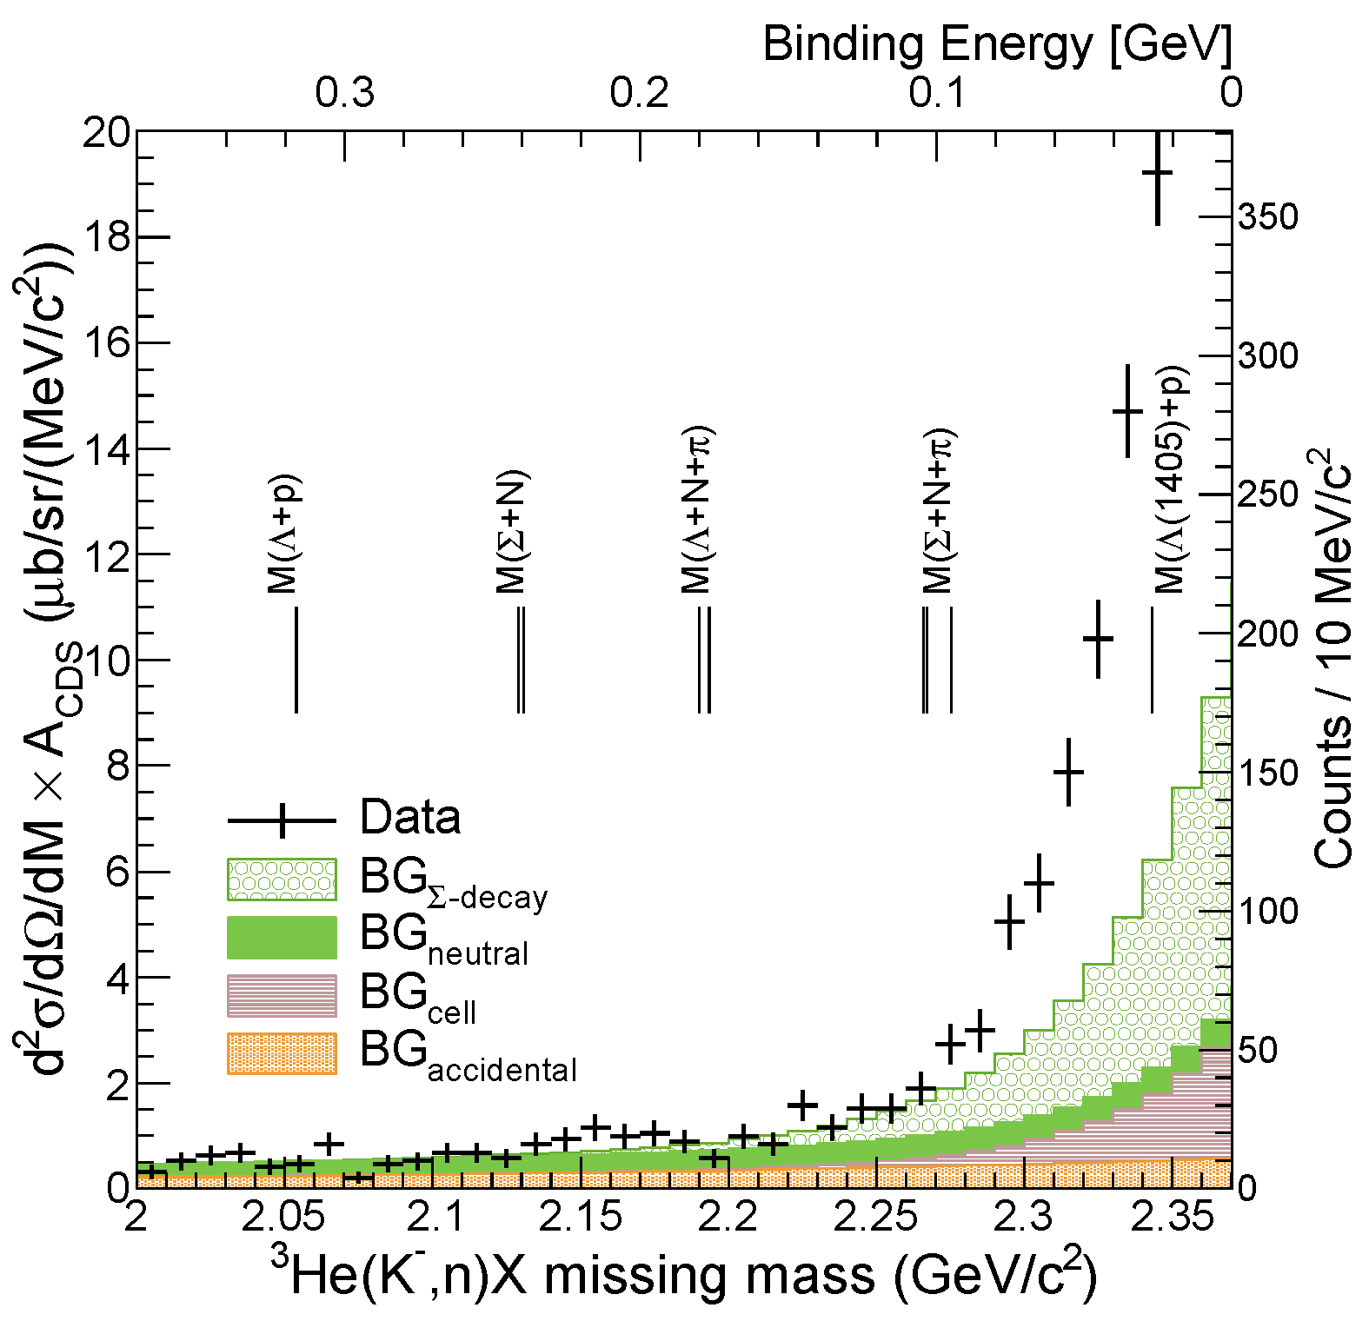
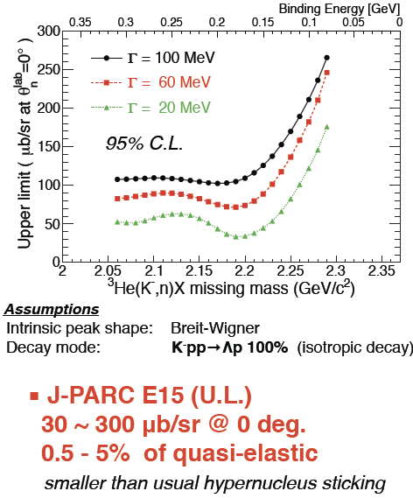
Semi-Inclusive ³He(K⁻,n)X
NO bump structure
FINUDA/DISTO/
E27
T. Hashimoto et al., PTEP (2015) 061D01.

Slide 26
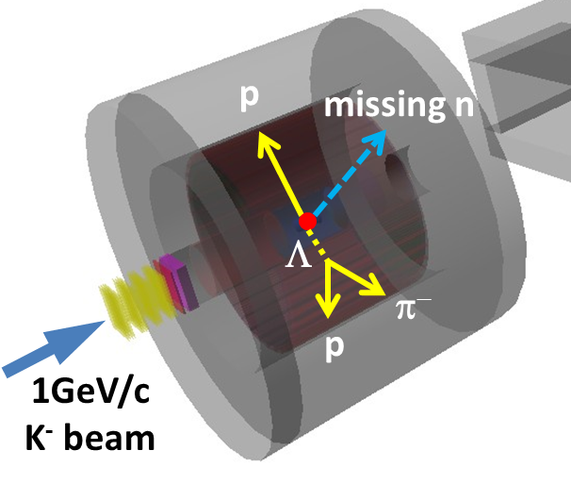
Exclusive ³He(K⁻,Λp)n
Y.Sada et al., PTEP (2016) 051D01.

Slide 27
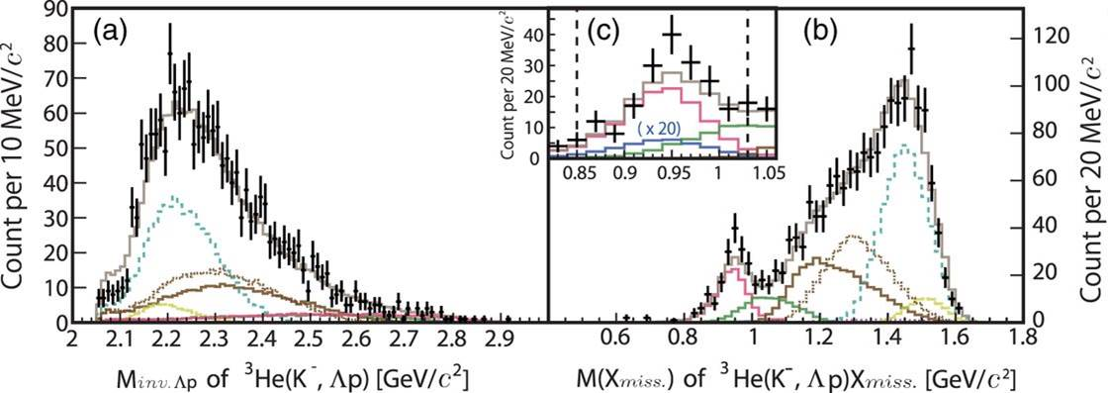

Inclusive ³He(K⁻,Λp)X
Y. Sada et al., PTEP (2016) 051D01.
Σ⁰pn
Λpn
Λpn_{s}
(2NA)
x20
Λpn
Σ⁰pn
YNNππ
YNNππ
YNNπ
YNNπππ
YNNπ
YNNπππ
Global fit both in Λp invariant- and missing-mass
  σ ~ 10 MeV/c²
  w/ simulated spectra
Neutron was identified by kinematics
  ³He(K⁻, Λp)n_{missing}
c.f. 3NA(Λpn):
  # of Λpn events: ~200
  Σ⁰pn contamination: ~20%

Slide 28
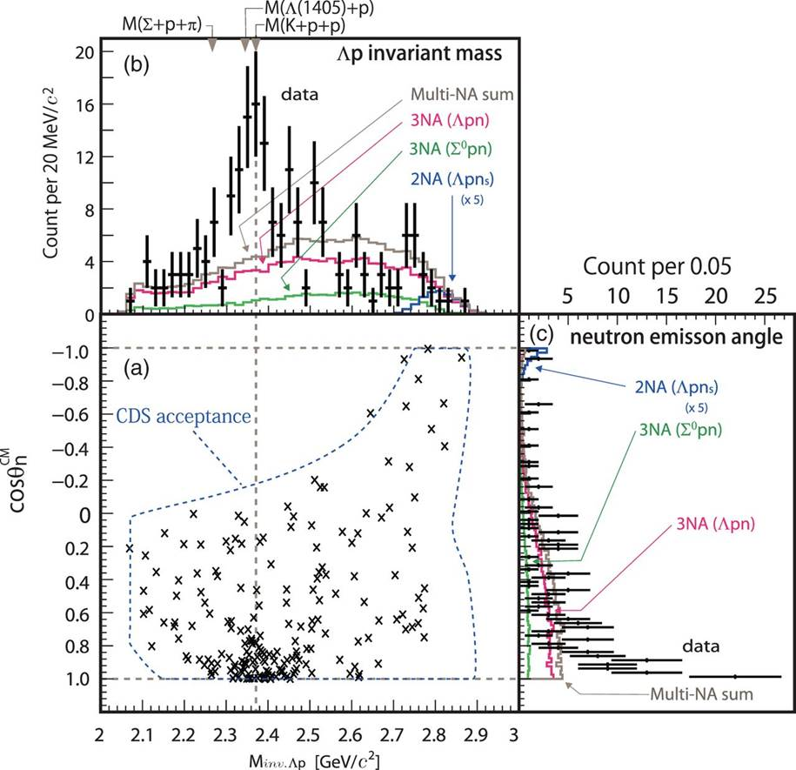
Exclusive ³He(K⁻,Λp)n
A bump structure exists near the K-pp threshold
Prefers Smaller momentum transfer to Λp (0.8<cosθ^{CM}_{n})
  S=-1 dibaryon?
    Λ*N?
    K^{bar}NN?
    …
Y. Sada et al., PTEP (2016) 051D01.

Slide 29
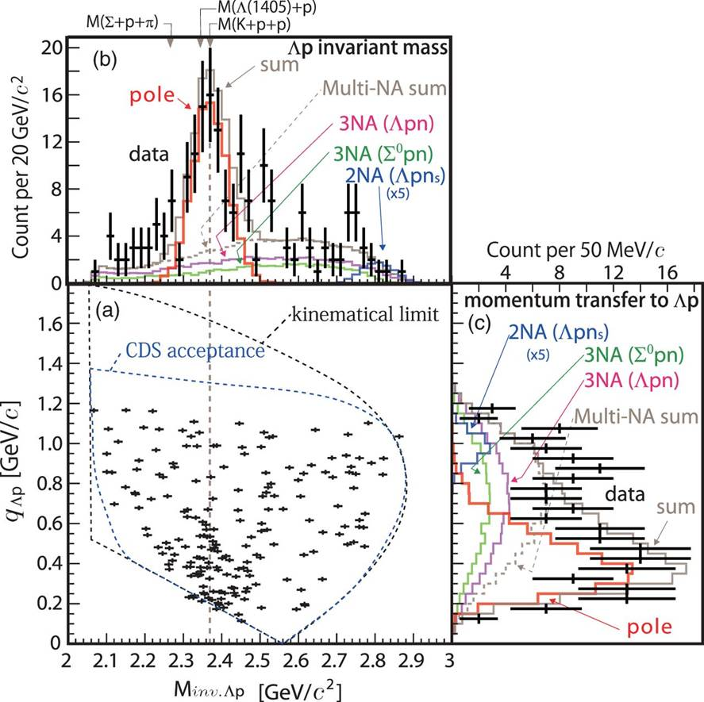
Assuming a Breit-Wigner
χ2-test with pole & 3NA(Ypn)
– S-wave Breit-Wigner pole
– w/ Gaussian form-factor
Y. Sada et al., PTEP (2016) 051D01.

Slide 30
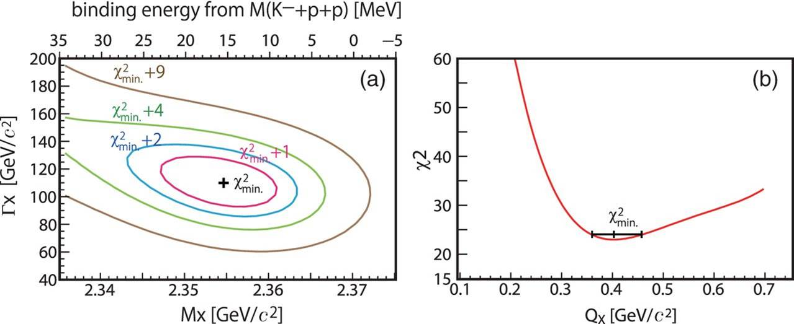
Assuming a Breit-Wigner
Y. Sada et al., PTEP (2016) 051D01.
phase space
Breit-Wigner
form factor
B.E = 15⁺⁶₋₈ (stat.) ± 12(syst.) MeV/c²
= 110⁺¹⁹₋₁₇(stat.) ± 27(syst.) MeV/c²
Q = 400⁺⁶⁰₋₄₀ MeV/c

Slide 31
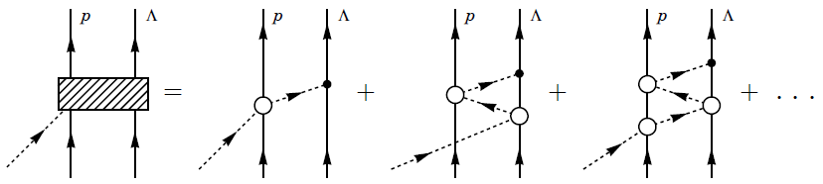
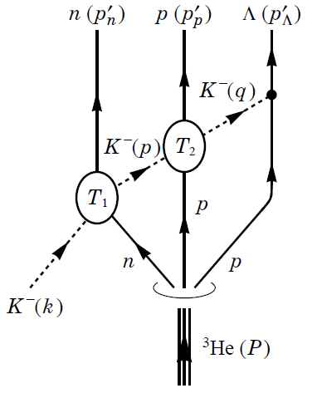
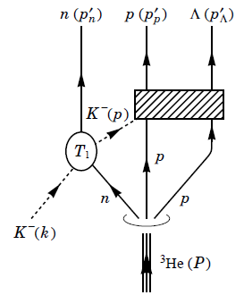
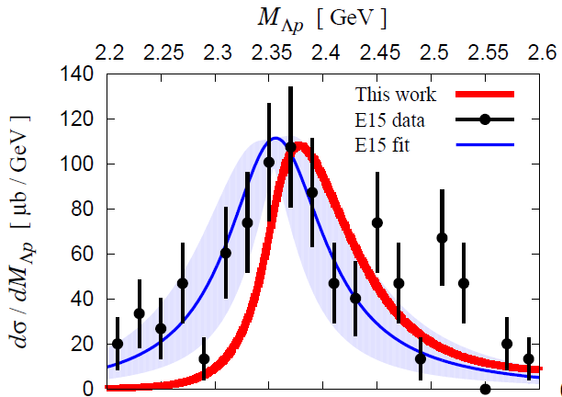
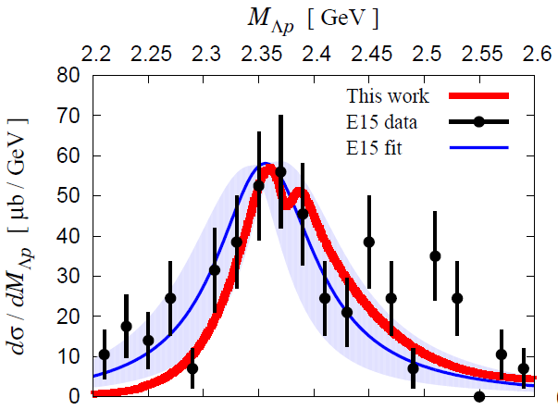
A Theoretical Interpretation
Sekihara, Oset, Ramos, arXiv:1607.02058
Chiral unitary approach
Sekihara, Tue. A-1
Uncorrelated
Λ(1405)p
state
quasi-elastic
kaon
scattering
K^{bar}NN
bound-state
B=16MeV
Γ=72 MeV
Opt.A (Watson)
Opt.A (Watson)
M[K+p+p]
M[K+p+p]

Slide 32
E15-2nd Experiment
--- completed in Dec. 2015 ---
What is the structure observed in E15^{1st} data?
 | E15-1st in 2013 | E15-2nd in 2015
data-taking | 4 days | 3 weeks
(K⁻,n) | ~7 times more data
(K⁻,Λp) | ~30 times more data*
* dedicated trigger was introduced for (K-,Λp)

Slide 33
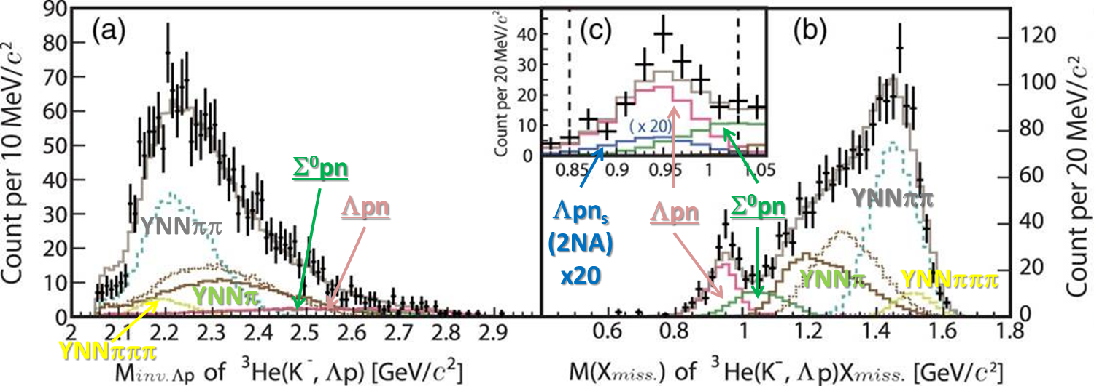


Inclusive ³He(K⁻,Λp)X
E15^{1st}
~0.2k
E15^{2nd}
miss. γn
(Σ⁰p)
preliminary
M[K+p+p]
miss. n
(Λp)
~6.0k

Slide 34



Exclusive ³He(K⁻,Λp)n
E15^{1st}
E15^{2nd}
Two structures are seen around M[K+p+p]!?
preliminary
M[K+p+p]
M[π+Σ+N]

Slide 35




³He(K⁻,Λp)n: Angular Dependence
M[K+p+p]
0.75 < cosθ_{n}
preliminary
0 < cosθ_{n}< 0.75
Sekihara, Oset, Ramos,
arXiv:1607.02058
M[K+p+p]

Slide 36
Summary
More detailed analysis will be shown in
- angular dependence, decay mode, etc.
Yamaga, Tue. A-1

Slide 37

Present Status of K^{bar}NN
Exp. CANDIDATES
  Upper limit
    LEPS/HADES
  B.E ~ 15 MeV
    E15^{1st}
  B.E. ~ 100 MeV
    FINUDA/DISTO/E27
Theor. calculations.
  Difficult to reproduce deeply bound state w/ normal K^{bar}N int.
Key measurements
Λ(1405) production
◊ Λ∗N doorway
πΣN decay channel
→ new info. of K^{bar}NN
Chiral
Phenomenological
K^{bar}NN or NOT? → Other Possibilities
Y*N dibaryon? / πYN pion-assisted dibaryon? / Double-pole K^{bar}NN? / Partial restoration of Chiral symmetry?
Dote, Tue. A-1

Slide 38
K^{bar}NN searches @ J-PARC
E27: d(π⁺,K⁺)Yp @ 1.69 GeV/c
  “K-pp”-like structure was found in Σ⁰p
    B ~ 100 MeV/c²
    Γ ~ 160 MeV/c²
    Γ(Λp)/Γ(Σ⁰p) ~ 1
E15: ³He(K⁻,Λp)n @ 1.0 GeV/c
  Structure around the threshold was fond in Λp
    B ~ 15 MeV/c²
    Γ ~ 110 MeV/c²
    Q ~ 400 MeV/c
Y. Ichikawa et al., PTEP (2014) 101D03.
Y. Ichikawa et al., PTEP (2015) 021D01.
large prob. of Λ(1405)p→“K⁻pp”
T. Hashimoto et al., PTEP (2015) 061D01.
Y. Sada et al., PTEP (2016) 051D01.
E15^{1st} results
E15^{2nd} results
Two structures !?
Yamaga, Tue. A-1
Further theoretical inputs are welcome!

Slide 39

Thank You!
J-PARC E15 Collaboration

Slide 40
Spares

Slide 41

E27: One-Proton Coincidence
Y. Ichikawa et al., PTEP (2015) 021D01.
p_{p} > 250 MeV/c
  QFs are suppressed
ΣN-ΛN cusp is clearly seen @ 2.13 GeV/c²
Broad enhancement is observed @ 2.28 GeV/c²
< 1p coincidence spectrum >
< 1p coincidence probability >
=
< Inclusive spectrum >
ΣN-ΛN cusp
Broad bump

Slide 42


Experimental Setup
Beamline spectrometer
  1.0 GeV/c K⁻
  Δp/p: 0.2%
Target System
  ~0.5l Liquid 3He @ 1.4K
    ρ = 0.081 g/cm³
Cylindrical Detector System
  Acceptance: 54<θ<126 deg.
    59% of 4π
  Δp_{t}/p_{t}: 5.3% p_{t} + 0.5%/β
Neutron Counter
  Acceptance: 20 msr
  Δp/p for 1.2GeV/c n: 0.7%

Slide 43

Subthreshold Excess?
preliminary
M(K⁻)
K⁻p→K⁰+n_{fw}
K⁻d→Y*+n_{fw}
K⁻³He→Y*N+n_{fw}
p(K⁻,n)X
well describes the spectrum
preliminary
M(K⁻+p)
Y* production are seen as excess
d(K⁻,n)X
  The main goal of E31
Fermi motion
M(K⁻+p+p)
Y* production (and/or exotic production) are seen as excess
³He(K⁻,n)X
Fermi motion
Exclusive analysis is crucial!

Slide 44

A Theoretical Interpretation
Sekihara, Oset, Ramos, arXiv:1607.02058
Chiral unitary approach
Sekihara, Tue. A-1
K^{bar}NN state
Sekihara, Oset, Ramos,
arXiv:1607.02058
A: Watson app.
B: Faddeev app.
B=16MeV, Γ=72 MeV
quasi-elastic kaon
scattering
M[K+p+p]
K^{bar}NN bound-state picture reproduces the data
→ The data CANNOT be explained with uncorrelated Λ(1405)p

Slide 45

E15 1st vs 2nd
Y. Sada et al., PTEP (2016) 051D01.
E15-2nd

Slide 46

Exclusive ³He(K⁻,Λp)n
The events widely distribute in the phase space
  Contribution from 2NA processes seem to be small
Event concentration is seen at T^{CM}_{n}/Q^{CM}~0.4

Slide 47

Exclusive ³He(K⁻,Λp)n
E15^{1st}
E15^{2nd}
preliminary

Slide 48
K^{bar}NN or NOT? --- Other Possibilities
A structure near K^{bar}NN threshold
Λ(1405)N bound state
  loosely-bound system, I=1/2, J^{π}=0⁻
  various decay modes, ΛN/ΣN/πΣN
πΛN-πΣN dibaryon
  structure near πΣN threshold
  I=3/2, J^{π}=2⁺ → no Λp decay (I=1/2)?
Double-pole K^{bar}NN
  loosely-bound K^{bar}NN, &
  broad resonance near the πΣN threshold → πΣN decay
Partial restoration of Chiral symmetry
  enhancement of the K^{bar}N interaction in dense nuclei
T. Uchino et al., NPA868(2011)53.
A structure near πΣN threshold
H. Garcilazo, A. Gal, NPA897(2013)167.
A. Dote, T. Inoue, T. Myo, PTEP (2015) 043D02.
S. Maeda, Y. Akaishi, T. Yamazaki, Proc. Jpn. Acad., B89(2013)418.

Slide 49



Exclusive ³He(K⁻,Λp)n
Small cos(θ_{n})
M[K+p+p]
preliminary
sliced
Large cos(θ_{n})
Sekihara, Oset, Ramos,
arXiv:1607.02058
Smaller momentum transfer is preferred

Slide 50


³He(K⁻,Λp)n: Decay Channel
Λp
M[K+p+p]
preliminary
Λp
Σ⁰p
sliced
Λp
Σ⁰p
Λp~Σ⁰p
Σ⁰p
πYN
Σ⁰p~πYN
Γ(Λp) > Γ(Σ⁰p) !?

Slide 52
K^{bar}N Interaction
A good probe for low energy QCD
At the K^{bar}N threshold:
Low-energy K-p scattering
Kaonic hydrogen X-ray
M. Bazzi et al.,(SIDDHARTA Coll.),
Phys. Lett. B704(2011)113
S.Ohnish et al.,PRC93(2016) 025207
K^{bar}N

Slide 53


K^{bar}N Interaction
A good probe for low energy QCD
At the K^{bar}N threshold:
Low-energy K-p scattering
Kaonic hydrogen X-ray
isospin dependent K^{bar}N
J-PARC E57:
kaonic deuterium with SDD
Zmeskal,
Okada,
post-WS
S.Ohnish et al.,PRC93(2016) 025207
J.Zmeskal
J-PARC E62:
kaonic ³He/⁴He with TES
K^{bar}N
S.Okada

Slide 54


K^{bar}N Interaction
A good probe for low energy QCD
Below the K^{bar}N threshold:
Λ(1405) plays an important role
s
$$J^{P}={\frac{1}{2}}^{−}$$
Moriya et al., (CLAS Coll.),
Phys. Rev. Lett. 112(2014)082004.
K^{bar}N molecular from LQCD
J.M.M. Hall et al.,
Phys. Rev. Lett. 114(2015)132002.
S.Ohnish et al.,PRC93(2016) 025207
K^{bar}N

Slide 55
K^{bar}N Interaction
A good probe for low energy QCD
Below the K^{bar}N threshold:
Λ(1405) plays an important role
s
$$J^{P}={\frac{1}{2}}^{−}$$
Moriya et al., (CLAS Coll.),
Phys. Rev. Lett. 112(2014)082004
K^{bar}N molecular from LQCD
J.M.M. Hall et al.,
Phys. Rev. Lett. 114(2015)132002.
Double pole structure
S.Ohnish et al.,PRC93(2016) 025207
πΣ
‾ＫＮ
K^{bar}N

Slide 56

K^{bar}N Interaction
A good probe for low energy QCD
Below the K^{bar}N threshold:
Λ(1405) plays an important role
s
$$J^{P}={\frac{1}{2}}^{−}$$
Moriya et al., (CLAS Coll.),
Phys. Rev. Lett. 112(2014)082004
K^{bar}N molecular from LQCD
J.M.M. Hall et al.,
Phys. Rev. Lett. 114(2015)132002.
Double pole structure
S.Ohnish et al.,PRC93(2016) 025207
J-PARC E31: d(K-,n)Λ(1405)
K^{bar}N
Kawasaki, Fri. E-1

Slide 57


K^{bar}N Interaction
A good probe for low energy QCD
Below the K^{bar}N threshold:
Λ(1405) plays an important role
Possible existence of “kaonic nuclei” → K^{bar}NN
the simplest kaonic nuclei:
$$I=\frac{1}{2}, J^{P}=0^{−}$$
Open question:
Really exist?
Binding energy?
Width?
…
?
K^{bar}N

