Slide 1


K⁻pp Bound System at J-PARC
F. Sakuma, RIKEN
on behalf of the J-PARC E15 collaboration
“The 15th International Conference on Meson-Nucleon Physics and the Structure of the Nucleon, MENU-2019“
Carnegie Mellon University, Pittsburgh Pennsylvania
June 2 to June 7, 2019

Slide 2
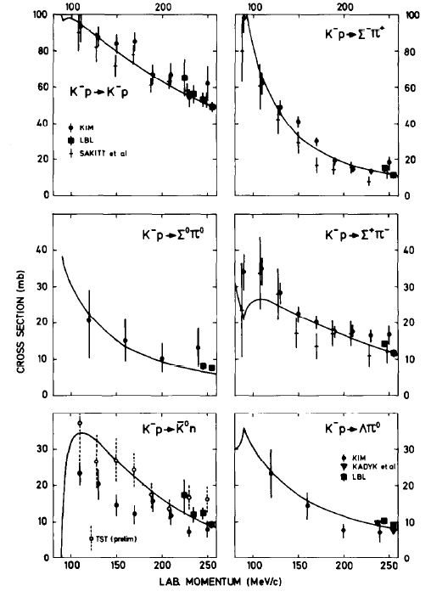
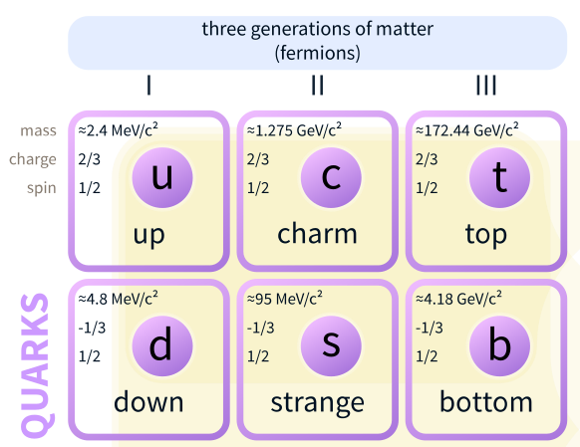
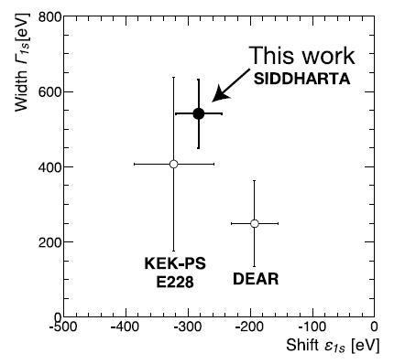


Meson in a Nucleus?
Lightest S=-1 meson, Κ⁻
  K^{bar}-N interaction: strongly attractive in I=0
Κ⁻
$$\overline{u}$$
$$s$$
K⁻p atom
PLB704(2011)113.
K⁻N scattering
NPB179(1981)33.
Wikipedia

Slide 3
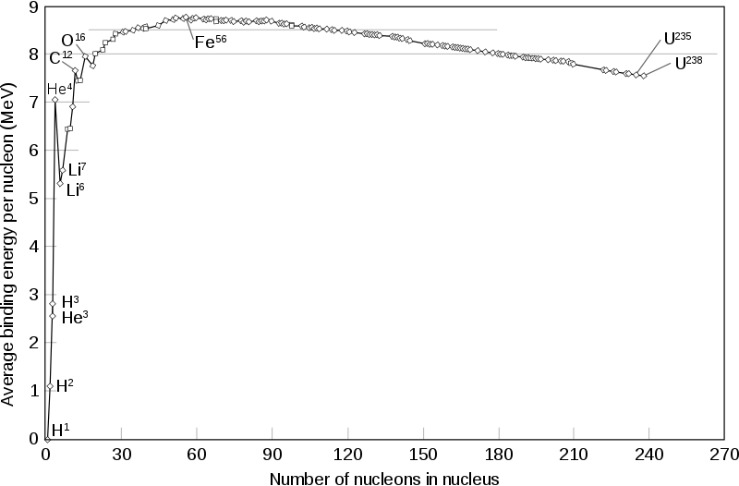
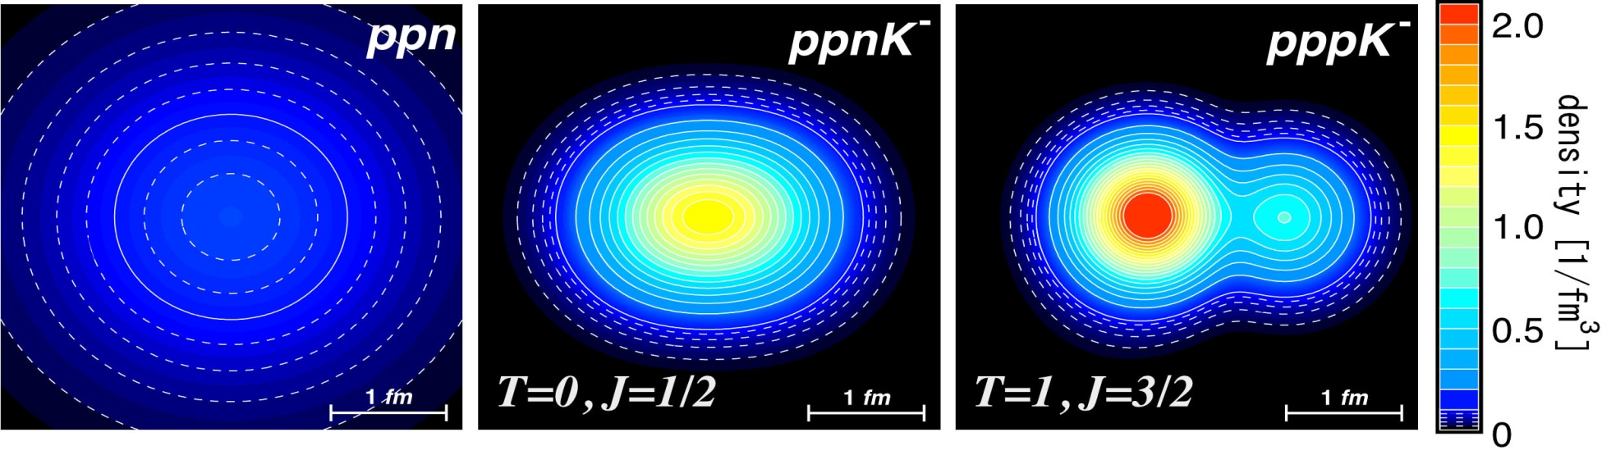
K^{bar}-Nuclear Bound State
Predicted from attractive K^{bar}N interaction in I=0
Kaonic Nuclei | Binding Energy [MeV] | Width [MeV]
Λ(1405) = K⁻p | 27 | 40
K⁻pp | 48 | 61
K⁻ppp | 97 | 13
K⁻ppn | 118 | 21
Y.Akaishi and T.Yamazaki, PRC65(2002)044005.
A. Dote et al. PRC70(2004)044313. etc.
c.f. Nuclear Binding Energy
few MeV @ A = 2,3
provide new insight on K^{bar}N interaction in media

Slide 4
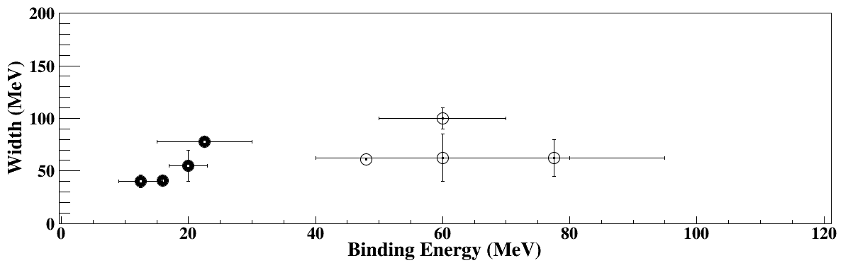
Theoretical Calculations on “K⁻pp”
K^{bar}N int. | Chiral SU(3) (energy dependent) |  |  |  | Phenomenological (energy independent)
Method | Variational |  | Faddeev |  | Variational |  | Faddeev
 | Barnea, Gal, Liverts | Dote, Hyodo, Weise | Ikeda, Kamano, Sato | Bayar, Oset | Yamazaki, Akaishi | Wyceck, Green | Shevchenko, Gal, Mares | Ikeda, Sato
B (MeV) | 16 | 17-23 | 9-16 | 15-30 | 48 | 40-80 | 50-70 | 60-95
Γ (MeV) | 41 | 40-70 | 34-46 | 75-80 | 61 | 40-85 | 90-110 | 45-80
B.E. ~ 20 MeV
B.E. ~ 40-70 MeV
Γ ~ 40-100 MeV

Slide 5
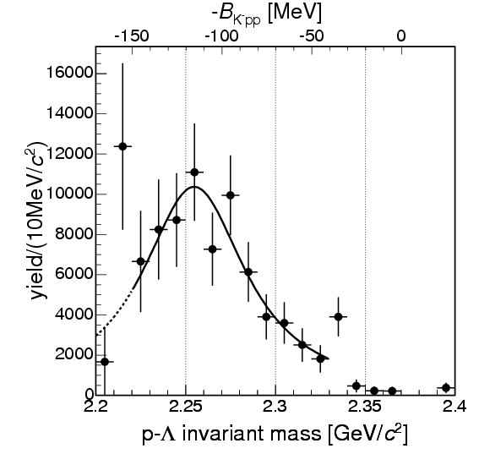
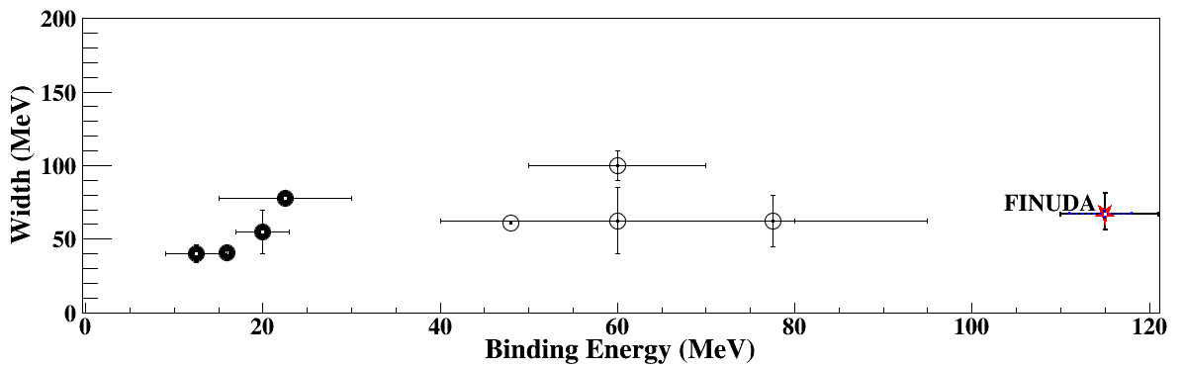
“K⁻pp” Search via Stopped-K⁻
FINUDA@DAΦNE
⁶Li+⁷Li+¹²C(stopped K⁻, Λp)
“K⁻pp”
M(K+p+p)
PRL94(2005)212303

Slide 6
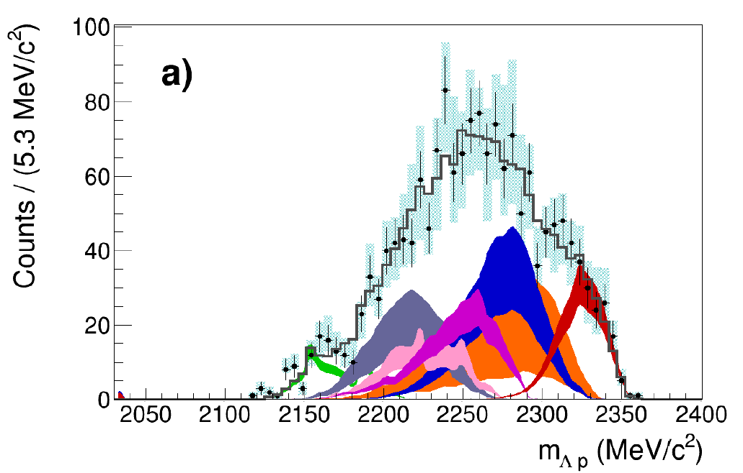
“K⁻pp” Search via Stopped-K⁻
FINUDA@DAΦNE
AMADEUS@DAΦNE
⁶Li+⁷Li+¹²C(stopped K⁻, Λp)
¹²C(stopped K⁻, Λp)
NO need of
“K⁻pp”
M(K+p+p)
multi-NA + FSI
many BGs
M(K+p+p)
PRL94(2005)212303
EPJC79(2019)190
?

Slide 7
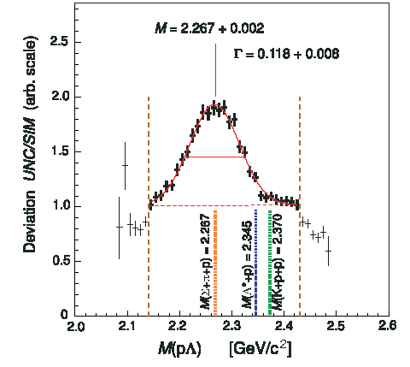
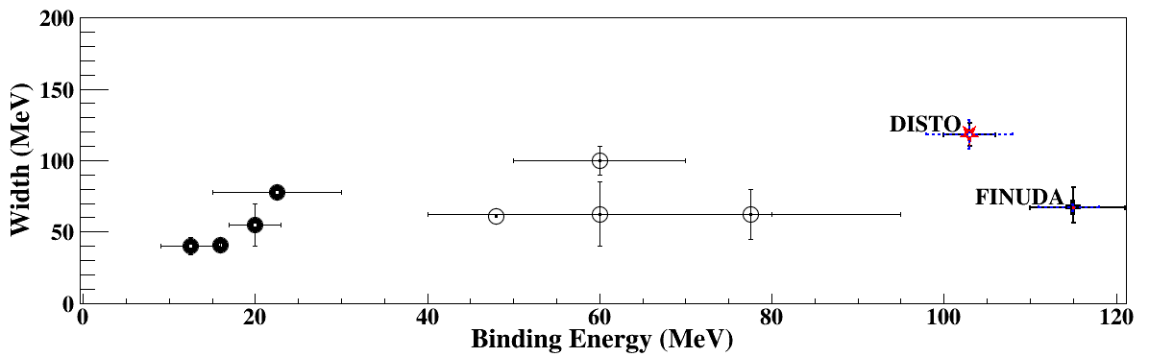
“K⁻pp” Search via pp Collisions
DISTO@SATURNE
p + p → (Λ + p) + K⁺ @ 2.85GeV
“K⁻pp”
M(K+p+p)
Data/Sim
PRL104(2010)132502
?

Slide 8
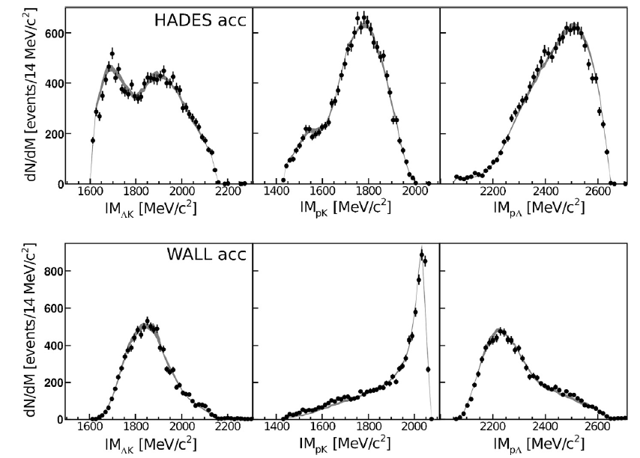

“K⁻pp” Search via pp Collisions
DISTO@SATURNE
HADES@GSI
PLB742(2015)242
p + p → (Λ + p) + K⁺ @ 2.85GeV
p + p → (Λ + p) + K⁺ @ 3.5GeV
NO need of
“K⁻pp”
M(K+p+p)
PWA w/ N^{*+}→ΛK⁺
Data/Sim
many N*s
M(K+p+p)
PRL104(2010)132502
$$p+p→p+N^{∗+}→p+Λ+K^{+}$$
JPS Conf. Proc. , 082003 (2017)
?
?

Slide 9
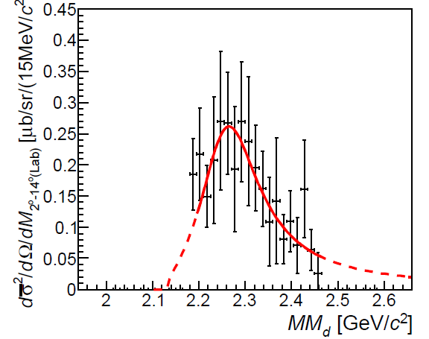
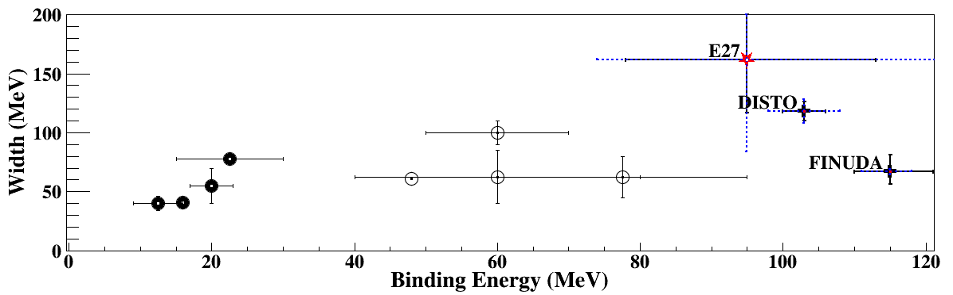
“K⁻pp” Search via d(π⁺,K⁺)X
E27@J-PARC
d(π⁺, K⁺)Σ⁰p @ 1.69 GeV/c
M(π+Σ+N)
M(Σ⁰+N)
M(K+p+p)
“K⁻pp”
PTEP(2015)021D01.
?
?

Slide 10
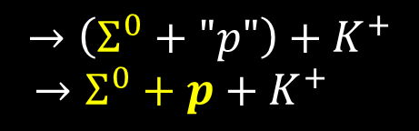

“K⁻pp” Search via d(π⁺,K⁺)X
E27@J-PARC
d(π⁺, K⁺)Σ⁰p @ 1.69 GeV/c
M(π+Σ+N)
M(Σ⁰+N)
M(K+p+p)
need to be confirmed with more statistics and a wide acceptance detector
“K⁻pp”
$$π^{+}+d→Σ^{0}+K^{+}+p_{spect}$$
(QF)
$$→\left(Σ^{0}+"p"\right)+K^{+}$$
$→Σ^{0}+p+K^{+}$
(FSI)
PTEP(2015)021D01.
?
?
?

Slide 11

“K⁻pp” Search WAS Controversial..
What we have learned from previous experiments:
Intermediate state is of importance
Should use more simple reaction
Exclusive measurement is a key
  → J-PARC E15 experiment
?
?
?

Slide 12


J-PARC E15 Experiment
³He(in-flight K⁻,n) reaction @ 1.0 GeV/c
  2NA and Y decays can be discriminated kinematically

Slide 13
J-PARC E15 Experiment
³He(in-flight K⁻,n) reaction @ 1.0 GeV/c
  2NA and Y decays can be discriminated kinematically
semi-inclusive ³He(K⁻,n)
PTEP (2015) 061D01.
exclusive (K⁻,Λp)n_{missing}
PTEP (2016) 051D01.
PLB789(2019)620.

Slide 14

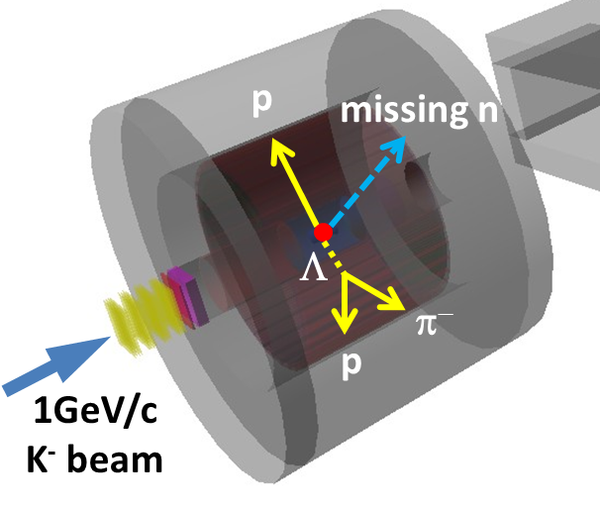
Experimental Setup @ K1.8BR
15m

Slide 15
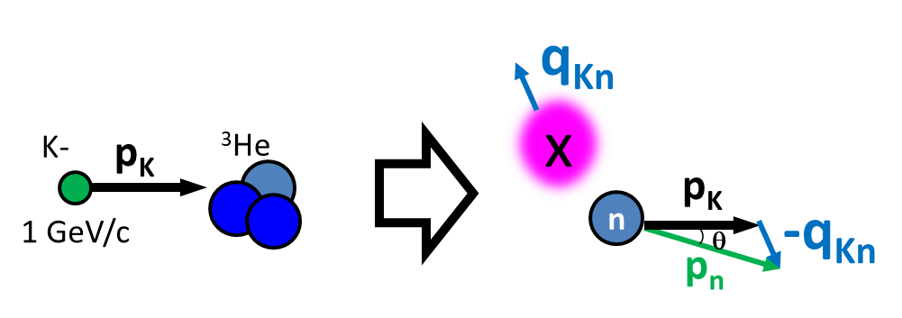
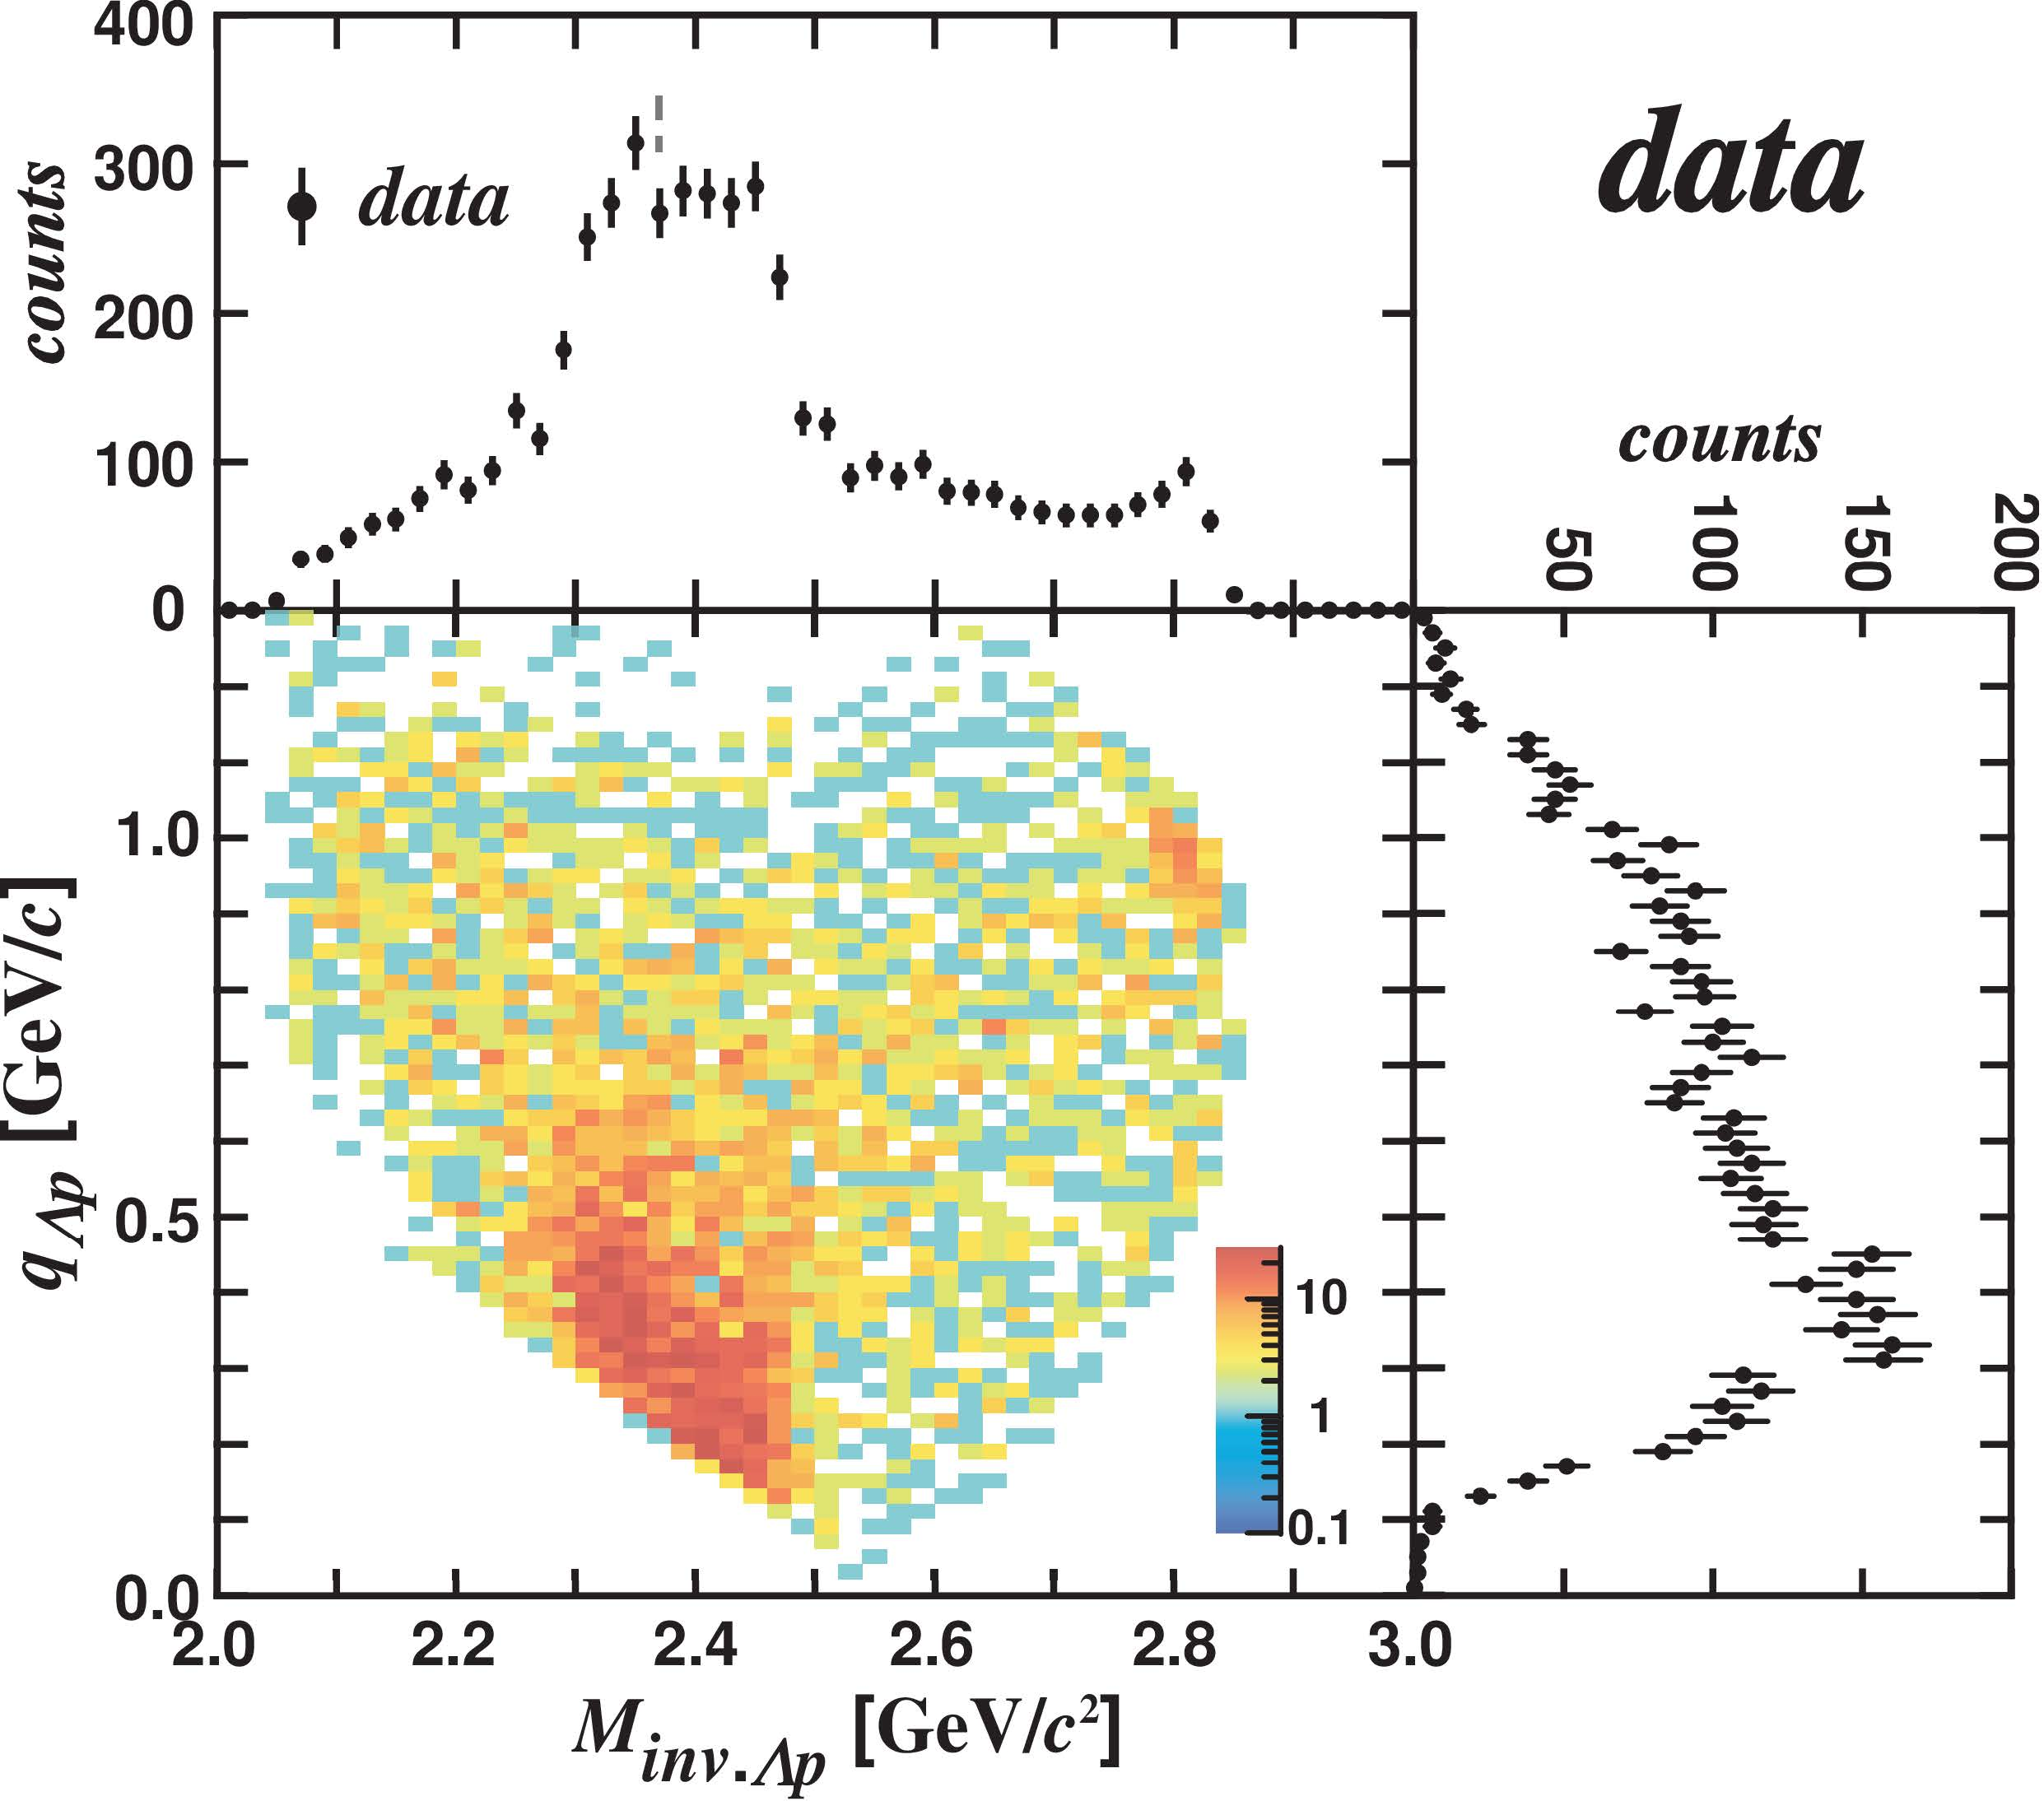
IM(Λp) vs. Momentum Transfer q_{Kn}
E15 collab., PLB789(2019)620.
IM(Λp)
M(K+p+p)
q_{Kn}

Slide 16
IM(Λp) vs. Momentum Transfer q_{Kn}
E15 collab., PLB789(2019)620.
IM(Λp)
Can be interpreted as 3 components
  Bound state
    centroid DOES NOT depend on q_{Kn}
M(K+p+p)
q_{Kn}
BS

Slide 17
IM(Λp) vs. Momentum Transfer q_{Kn}
E15 collab., PLB789(2019)620.
IM(Λp)
Can be interpreted as 3 components
  Bound state
    centroid DOES NOT depend on q_{Kn}
  Quasi-elastic K⁻ abs.
    centroid depends on q_{Kn}
M(K+p+p)
QF
q_{Kn}
BS

Slide 18
IM(Λp) vs. Momentum Transfer q_{Kn}
E15 collab., PLB789(2019)620.
IM(Λp)
Can be interpreted as 3 components
  Bound state
    centroid DOES NOT depend on q_{Kn}
  Quasi-elastic K⁻ abs.
    centroid depends on q_{Kn}
  Background
    Broad distribution
M(K+p+p)
QF
q_{Kn}
BS
BG
Fit the spectrum
with 3 components

Slide 19
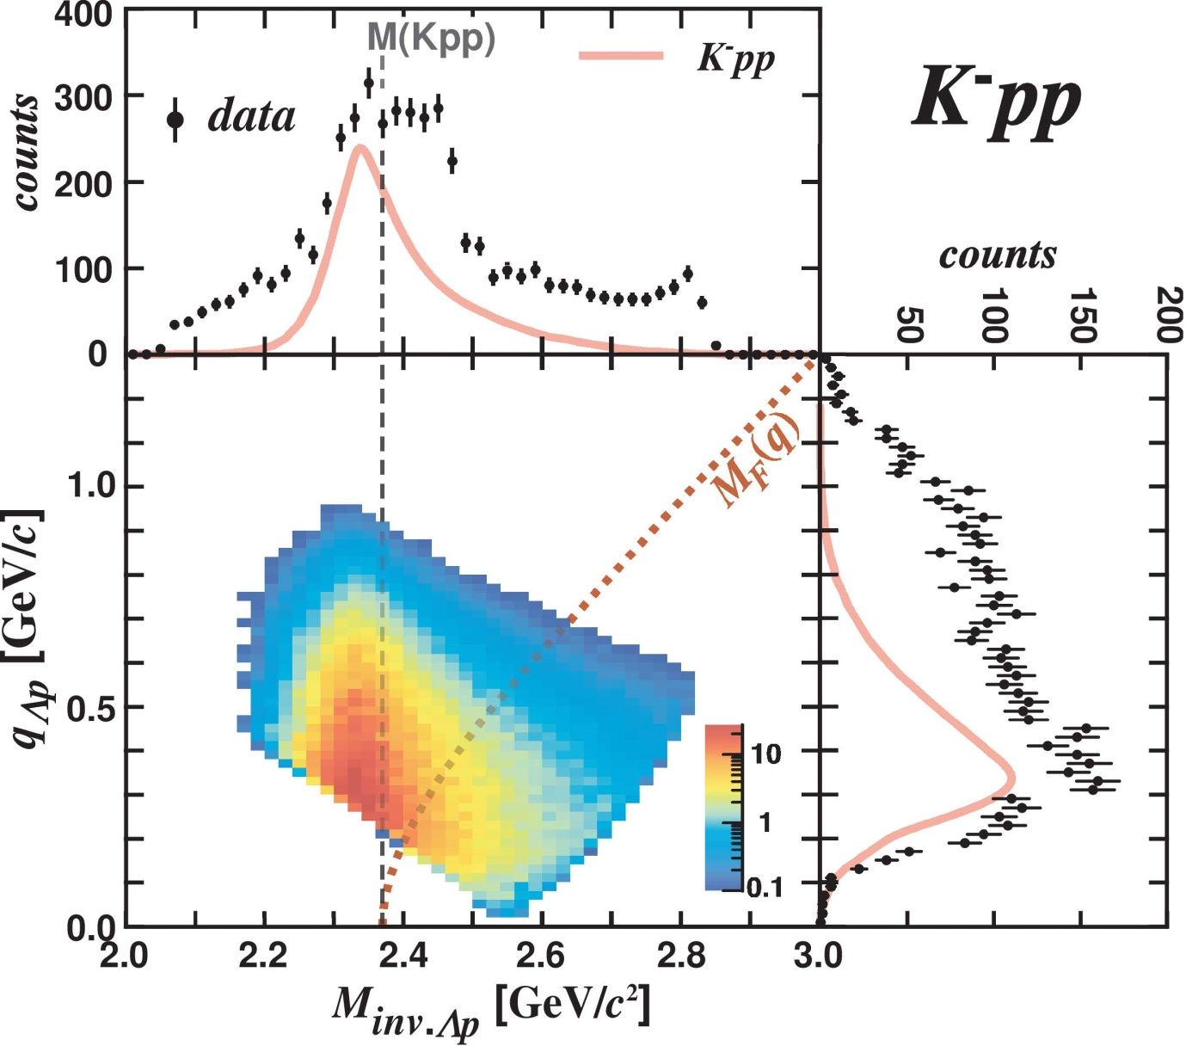
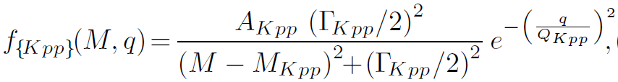
IM(Λp) vs. Momentum Transfer q_{Kn}
E15 collab., PLB789(2019)620.
IM(Λp)
Fit with 3 components
  Bound state
    centroid DOES NOT depend on q_{Kn}
    BW*(Gauss form-factor)
q_{Kn}
K-
³He
1 GeV/c
“x”
n
p
n
Λ

Slide 20
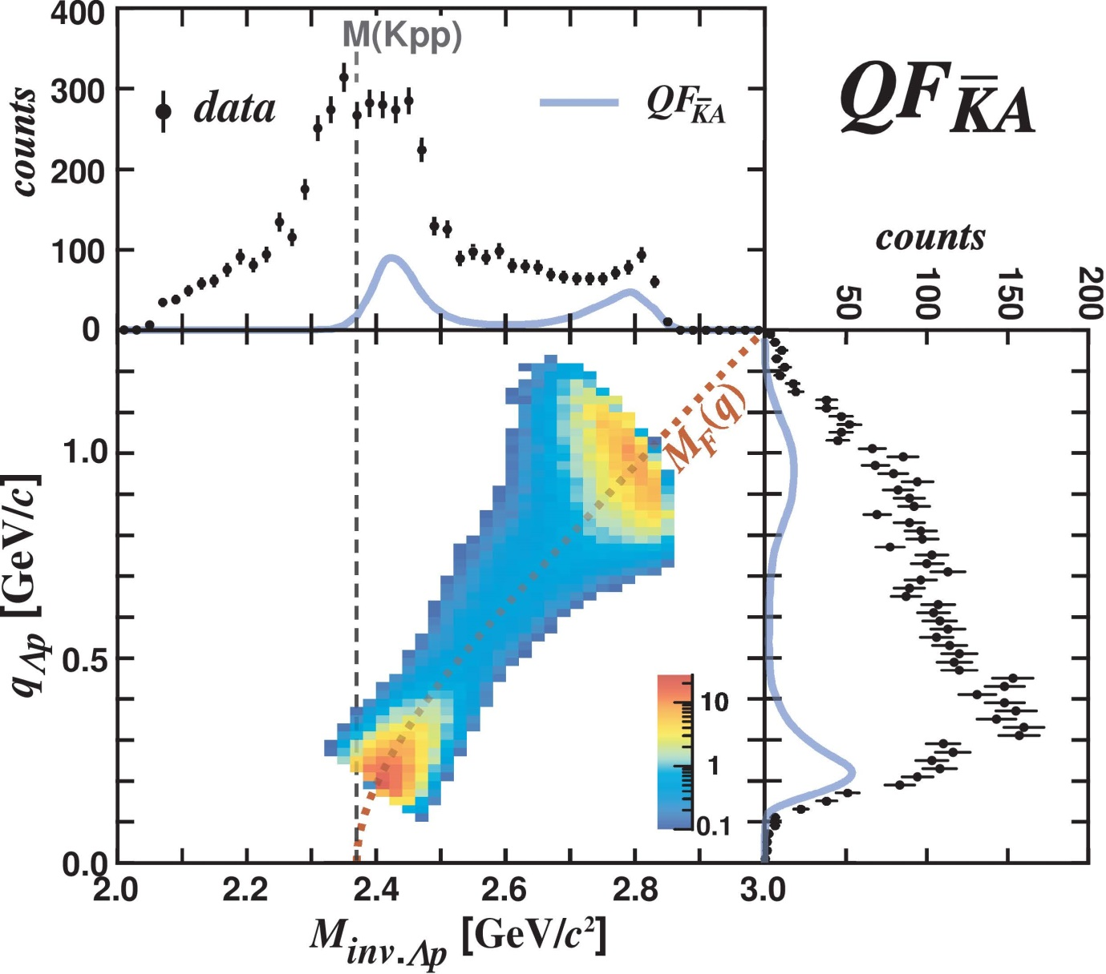
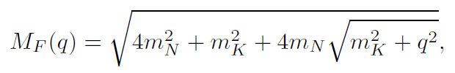
IM(Λp) vs. Momentum Transfer q_{Kn}
E15 collab., PLB789(2019)620.
IM(Λp)
Fit with 3 components
  Quasi-elastic K⁻ abs.
    centroid depends on q_{Kn}
    Followed by Λp conversion
q_{Kn}
K-
³He
2NA:
“n” is a spectator
1 GeV/c
p
K-
n
p
forward “n”
p
n
Λ

Slide 21
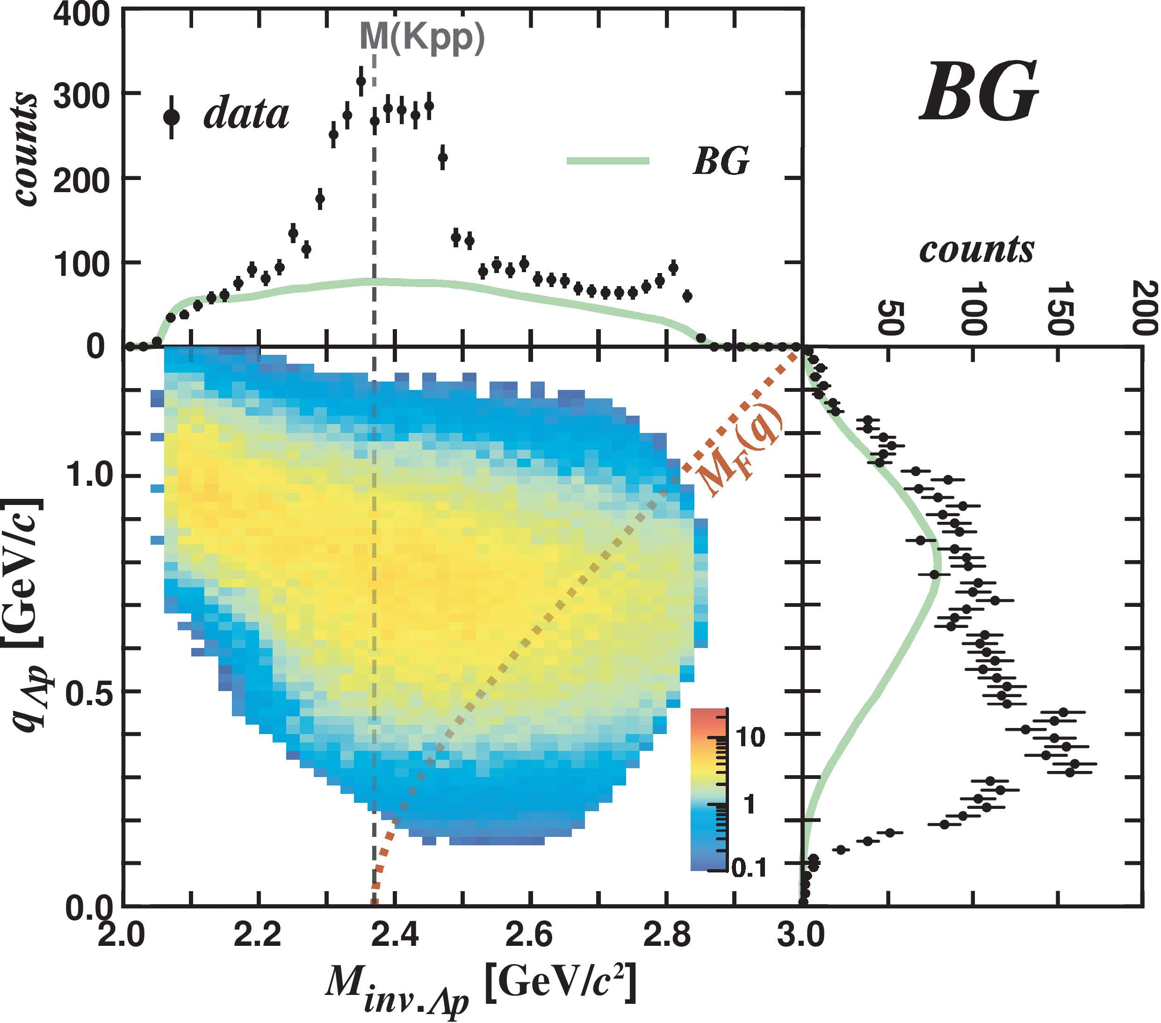
IM(Λp) vs. Momentum Transfer q_{Kn}
E15 collab., PLB789(2019)620.
IM(Λp)
Fit with 3 components
  Background
    Broad distribution
q_{Kn}
K-
³He
1 GeV/c
p
n
Λ

Slide 22
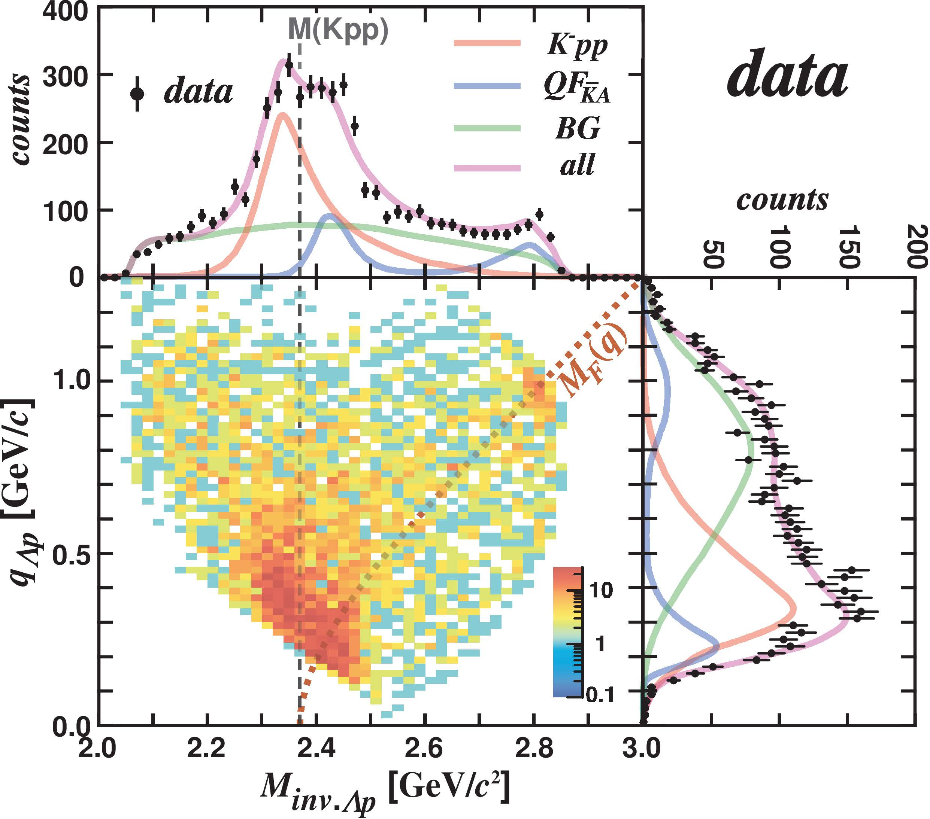
IM(Λp) vs. Momentum Transfer q_{Kn}
E15 collab., PLB789(2019)620.
IM(Λp)
Fit with 3 components
  Bound state
    centroid DOES NOT depend on q_{Kn}
    BW*(Gauss form-factor)
  Quasi-elastic K⁻ abs.
    centroid depends on q_{Kn}
    Followed by Λp conversion
  Background
    Broad distribution
q_{Kn}

Slide 23
IM(Λp) vs. Momentum Transfer q_{Kn}
E15 collab., PLB789(2019)620.
IM(Λp)
Fit with 3 components
  Bound state
    centroid DOES NOT depend on q_{Kn}
    BW*(Gauss form-factor)
  Quasi-elastic K⁻ abs.
    centroid depends on q_{Kn}
    Followed by Λp conversion
  Background
    Broad distribution
q_{Kn}
BS and QF are well separated in
0.35 < q_{Kn} < 0.65 GeV/c

Slide 24
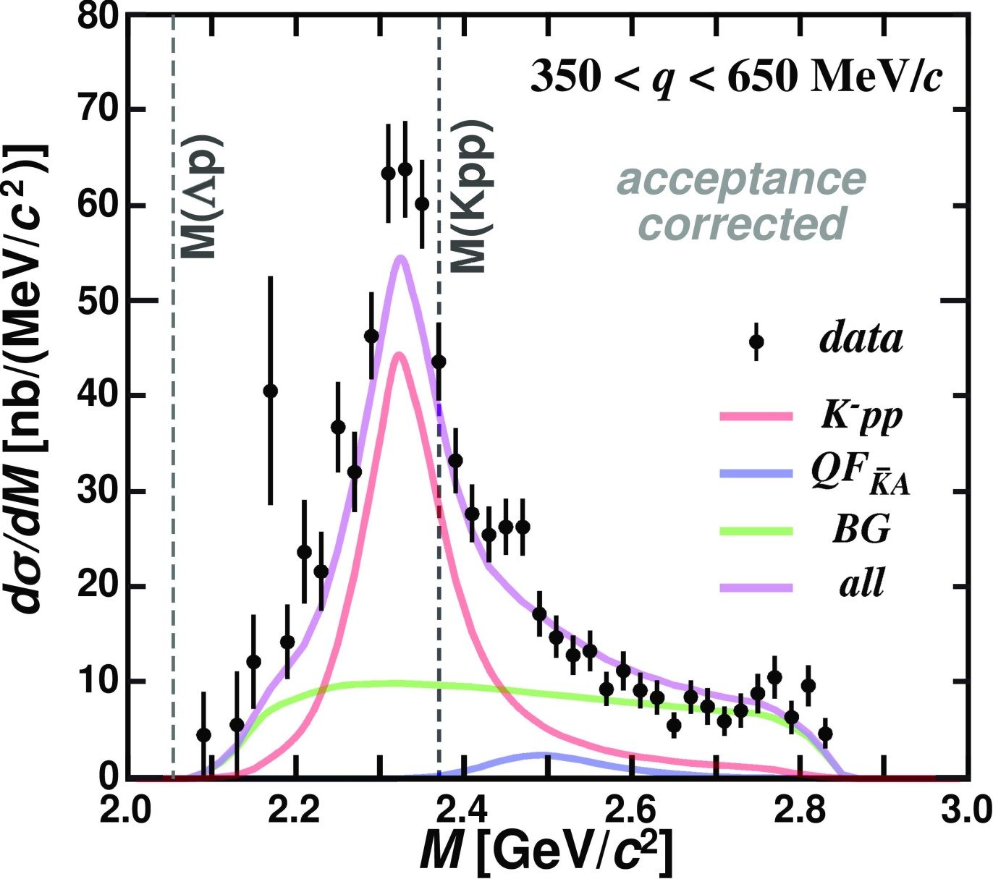
“K⁻pp” Bound-State
“K⁻pp”
E15 collab., PLB789(2019)620.

Slide 25

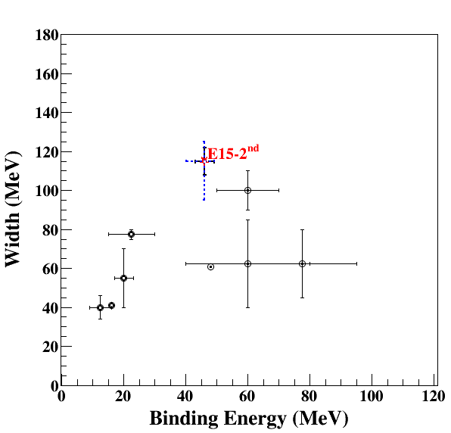
Observed “K⁻pp”
K⁻³He→nX
Binding energy: ~50 MeV
  Much deeper than chiral-SU(3) based theoretical predictions
Width: ~100 MeV
  Seems to be larger than theoretical calculations (mesonic πY decays only)
Chiral
Phenomenological

Slide 26
Observed “K⁻pp”
the most reliable observation
- simple K- induced reaction
- exclusive measurement
- good BG separation from 2NA
K⁻³He→nX
Binding energy: ~50 MeV
  Much deeper than chiral-SU(3) based theoretical predictions
Width: ~100 MeV
  Seems to be larger than theoretical calculations (mesonic πY decays only)
Chiral
Phenomenological

Slide 27
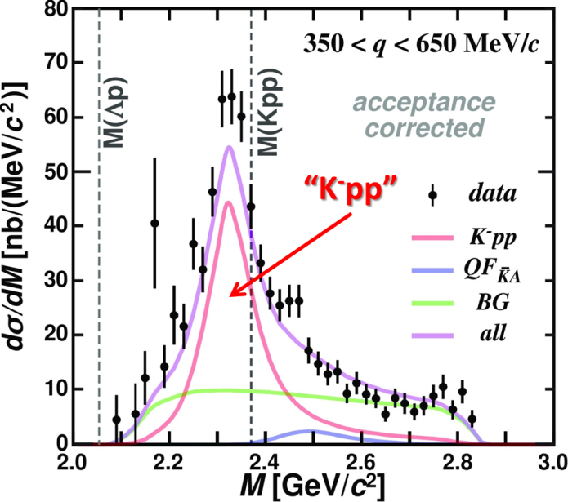
Conclusion I
We observed the “K⁻pp” bound state in ³He(K⁻,Λp)n
  Binding energy: ~50 MeV
  Width: ~100 MeV
← E15 collaboration, PLB789(2019)620.

Slide 28
We need further understanding
Spin/Parity of the “K⁻pp”
  New 4π detector system is needed
← Future plan

Slide 29
We need further understanding
Spin/Parity of the “K⁻pp”
  New 4π detector system is needed
Other decay channels
  πΣN mesonic decay is theoretically expected to be the dominant channel
    Only YN non-mesonic decays were reported
← Future plan

Slide 30
We need further understanding
Spin/Parity of the “K⁻pp”
  New 4π detector system is needed
Other decay channels
  πΣN mesonic decay is theoretically expected to be the dominant channel
    Only YN non-mesonic decays were reported
Reaction mechanism
  Relation between Λ(1405) & “K⁻pp”
    Λ(1405) has been considered as “K⁻p”
    Theoretically, “K⁻pp” is expected to be produced via Λ(1405)+p→”K⁻pp” door-way process
← Future plan

Slide 31
We need further understanding
Spin/Parity of the “K⁻pp”
  New 4π detector system is needed
Other decay channels
  πΣN mesonic decay is theoretically expected to be the dominant channel
    Only YN non-mesonic decays were reported
Reaction mechanism
  Relation between Λ(1405) & “K⁻pp”
    Λ(1405) has been considered as “K⁻p”
    Theoretically, “K⁻pp” is expected to be produced via Λ(1405)+p→”K⁻pp” door-way process
← Future plan
K⁻ ³He → πΣpn

Slide 32
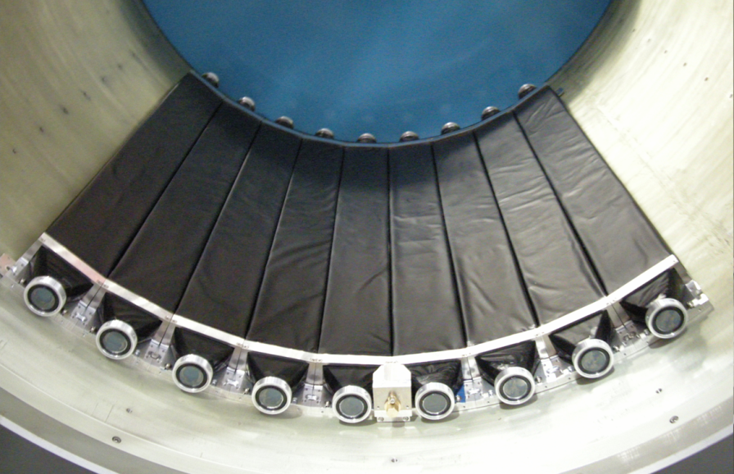
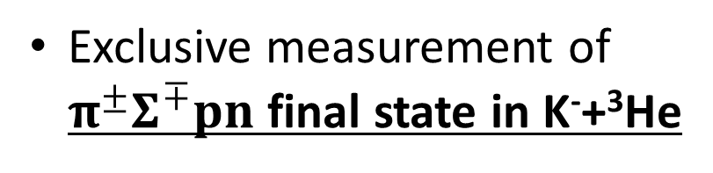
K⁻ ³He → πΣpn Measurement
CDS
Exclusive measurement of $π^{±}Σ^{∓}pn$ final state in K⁻+³He
p
“X”
K-
³He
n
1 GeV/c
Σ
π
n
π
CDS
Experimental challenge of neutron detection with thin scintillation counter (t=3cm)
t = 3cm
79cm
10cm
n detection efficiency ~ 3-10%

Slide 33
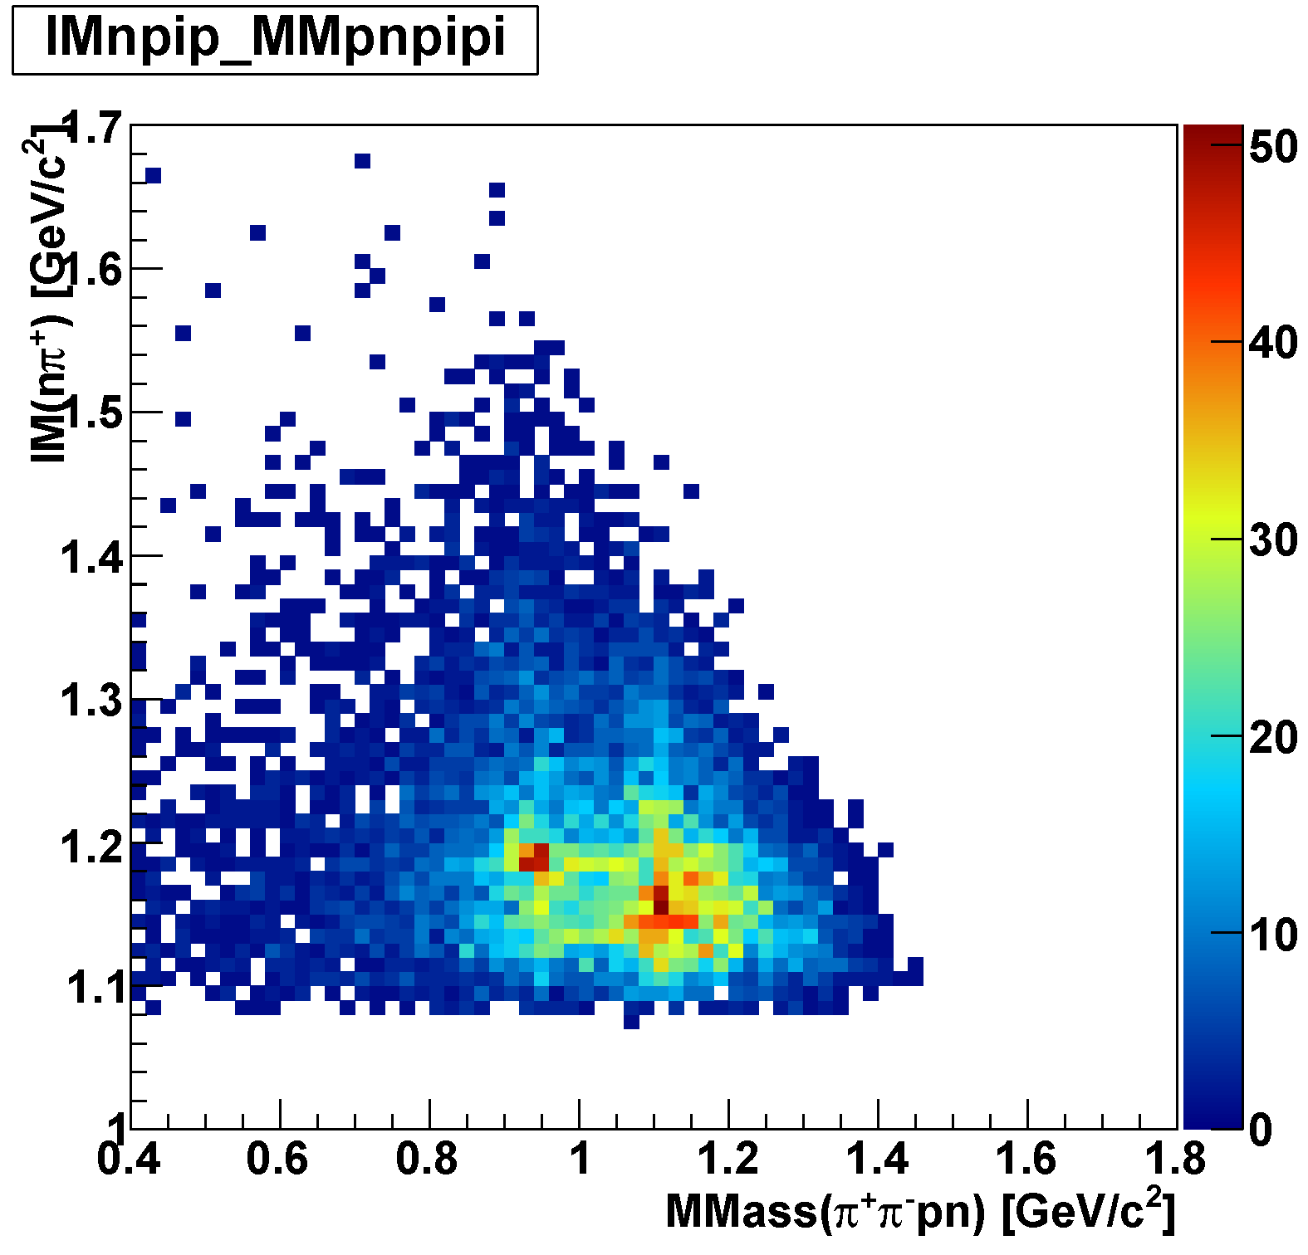
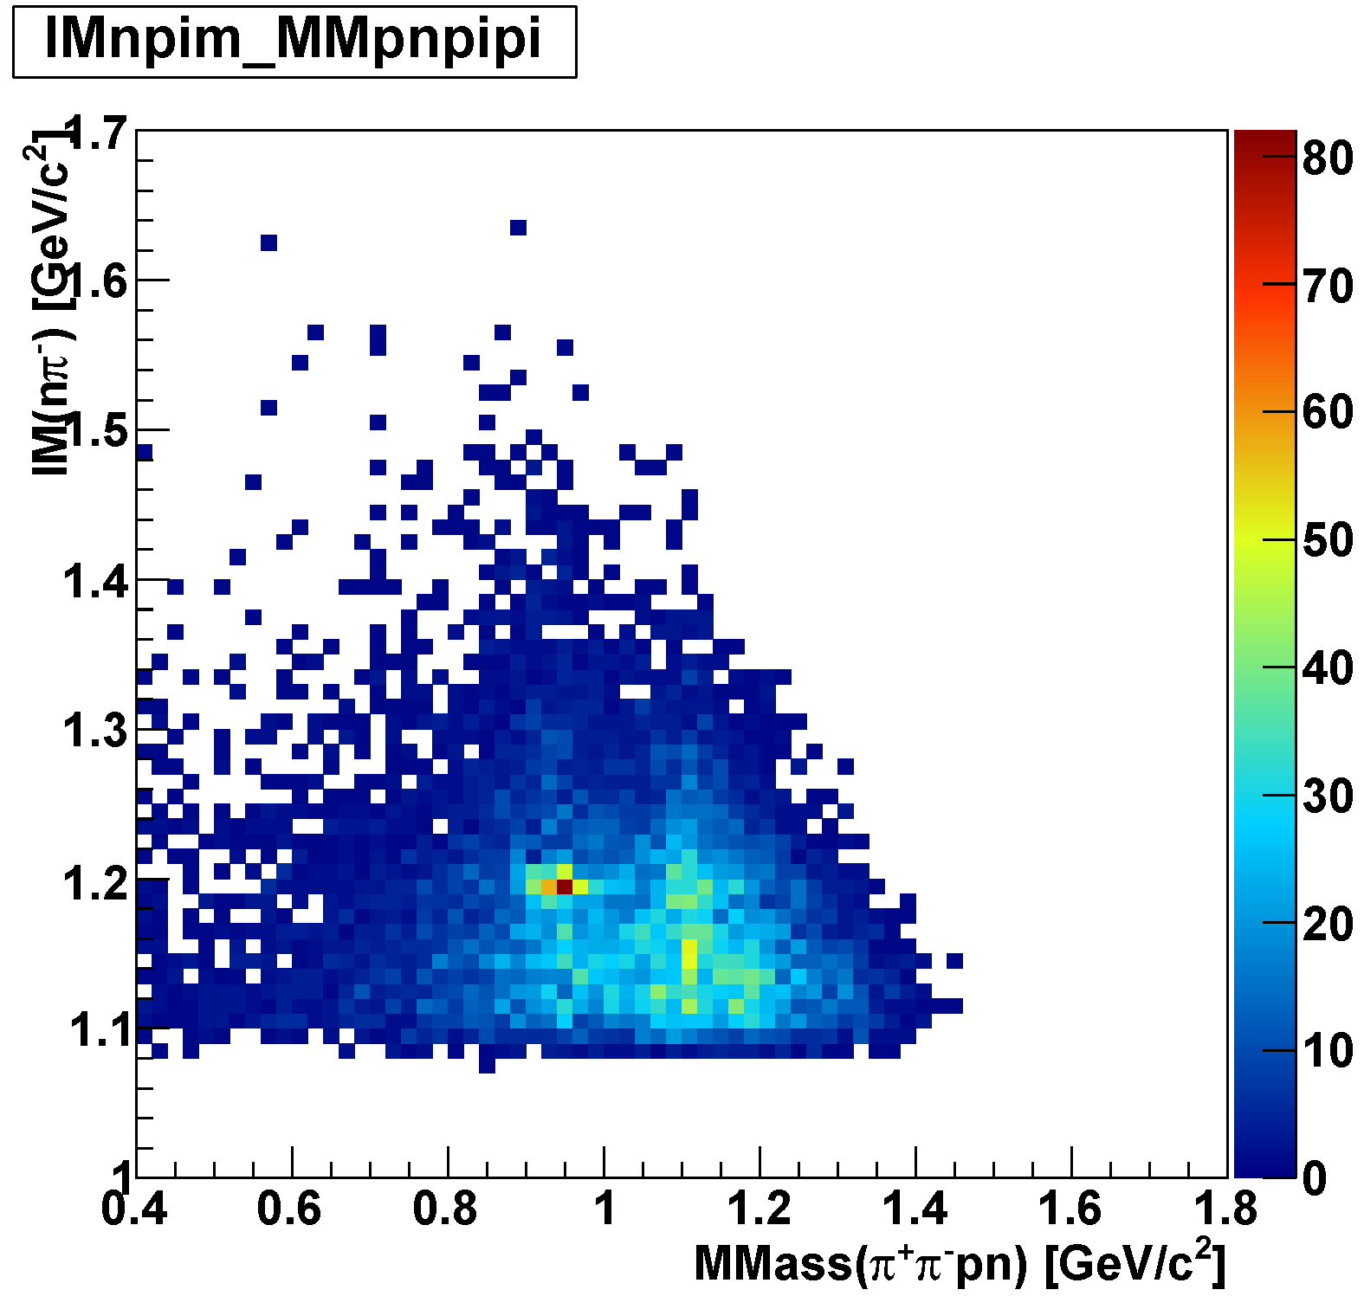
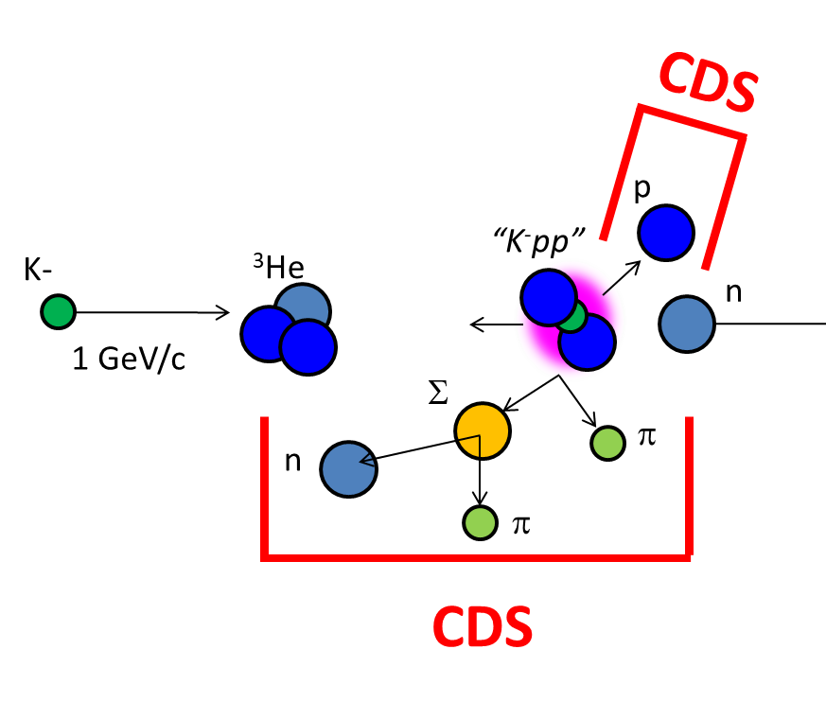
πΣpn Events
IM(nπ⁺) vs MM(π⁺π⁻pn)
IM(nπ⁻) vs MM(π⁺π⁻pn)
π⁻Σ⁺p n_{miss}
π⁺Σ⁻p n_{miss}
Σ⁺
Σ⁻
n_{miss}
n_{miss}

Slide 34
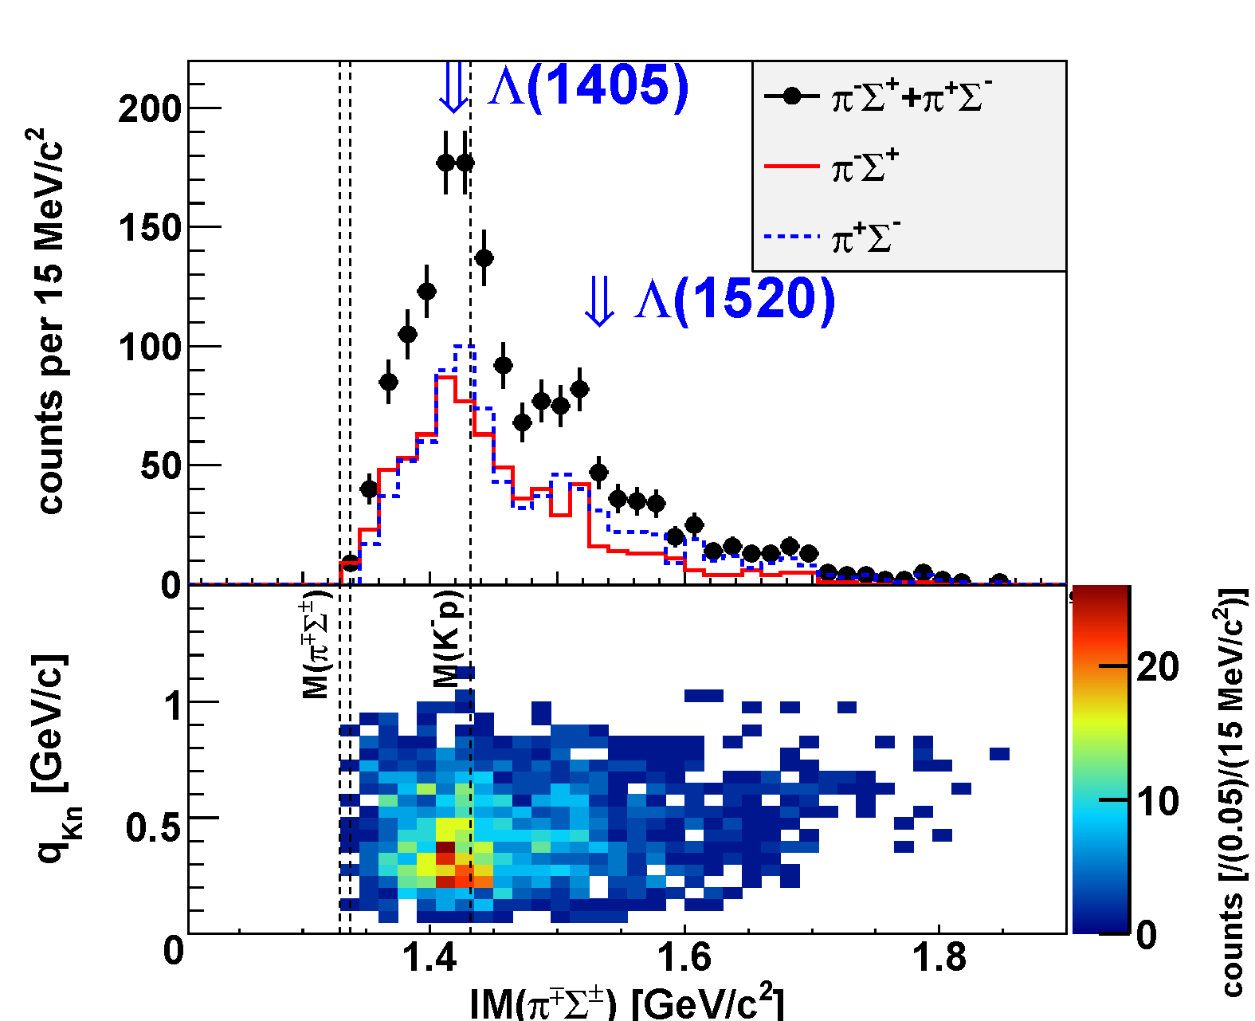


IM($π^{±}Σ^{∓}$) in $π^{±}Σ^{∓}pn$ Final State
IM($π^{±}Σ^{∓}$)
preliminary
q_{Kn}
Λ(1405) can be clearly seen in low q_{Kn}
34

Slide 35
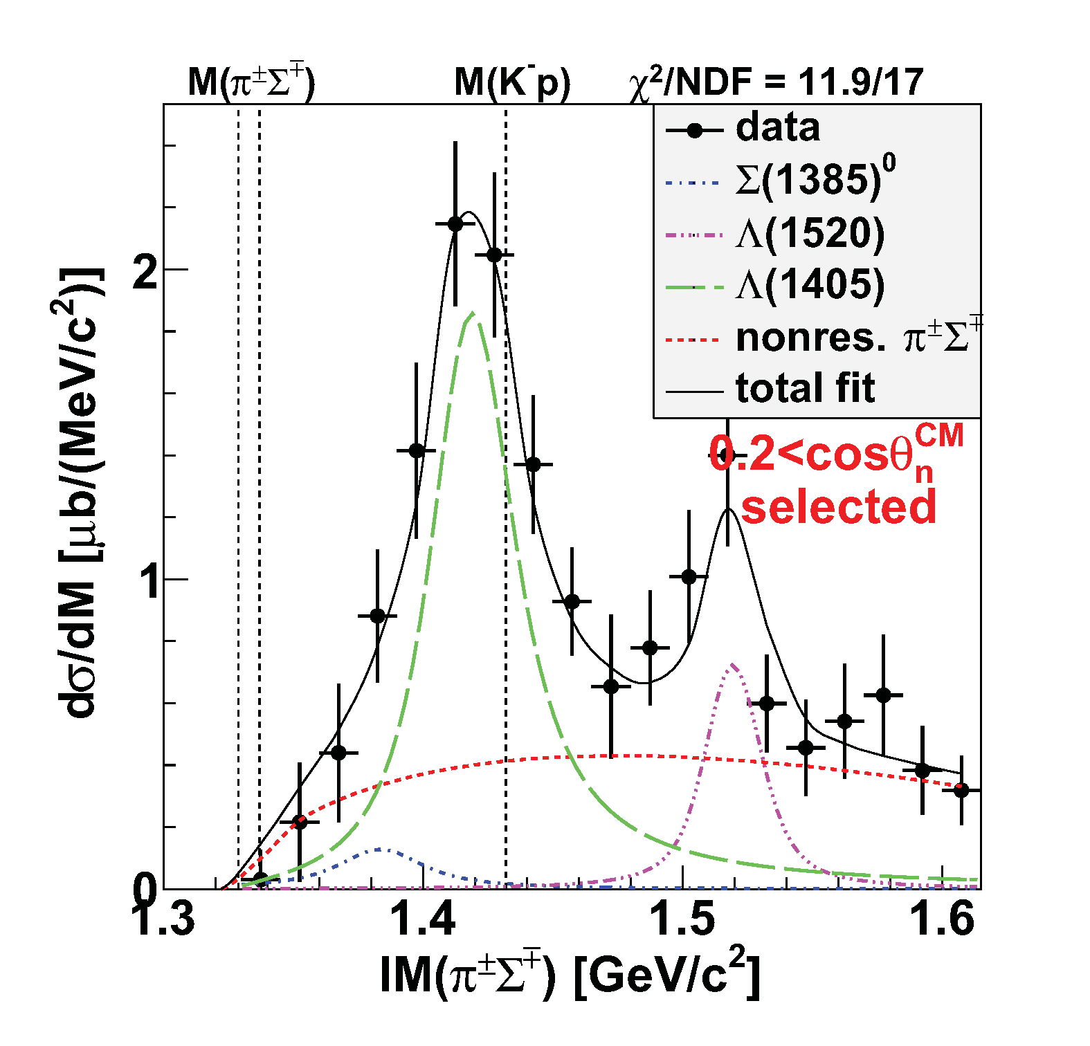

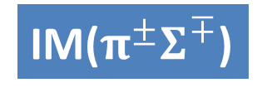
$Y^{∗}pn$ Final State
Λ(1405)
IM($π^{±}Σ^{∓}$)
~ 150 μb
preliminary
Fit w/ Flatté formula:
Re(z) ~ 1420 MeV
-Im(z) ~ 15 MeV
Λ(1520)
~ 100 μb
Σ⁰(1385)
πΣpn
non-resonant
  ~ 20-100 μb
  [evaluated from
  Σ^{+/-}(1385)→π^{+/-}Λ
  measurement]
(Σ(1385)→πΛ/πΣ : 87.0/11.7%)

Slide 36
Λ(1405)pn Final State Selection
IM($π^{±}Σ^{∓}$)
Select Λ(1405)pn final state
preliminary
Below Λ(1520)
Small contribution from Σ(1385)
πΣpn
non-resonant
Λ(1405)pn

Slide 37
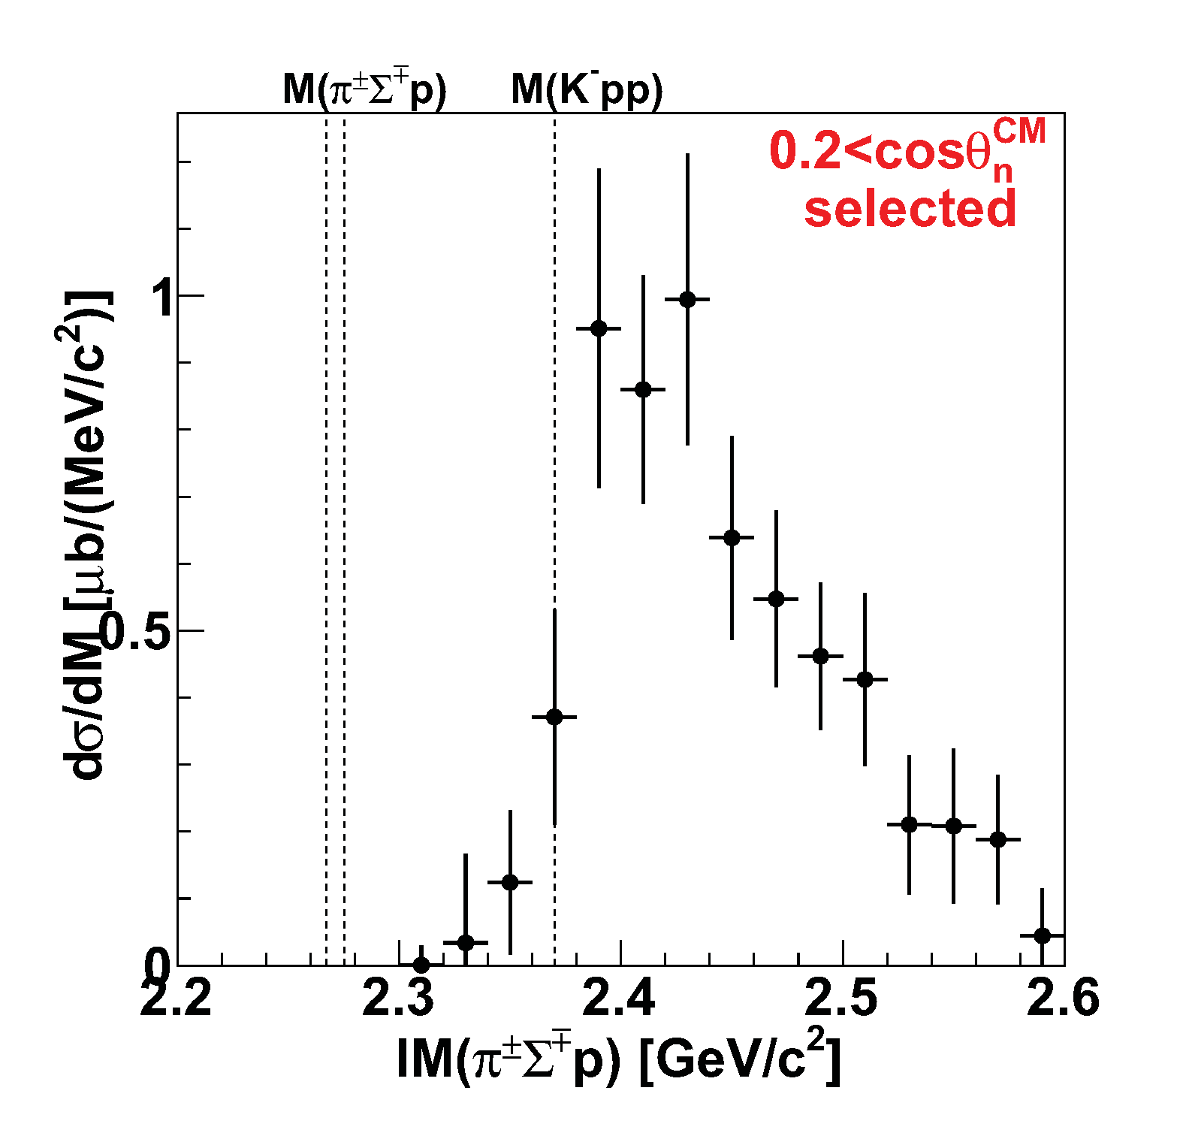
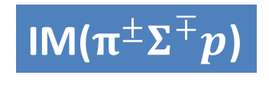
IM(πΣp) in Λ(1405)pn Final State
IM($π^{±}Σ^{∓}p$)
Λ(1405)pn
M(Kpp)
Dominant above the threshold
“Kpp” ROI
preliminary

Slide 38
IM(πΣp) in Λ(1405)pn Final State
IM($π^{±}Σ^{∓}p$)
“Kpp”→πΣN mesonic decay is theoretically expected to be the dominant channel
Λ(1405)pn
M(πΣp)
M(Kpp)
Dominant above the threshold
“Kpp” ROI
BUT, statistically,
NO significant structure
This will be due to phase-space limitation of
“K⁻pp”→πΣN decay.
preliminary

Slide 39
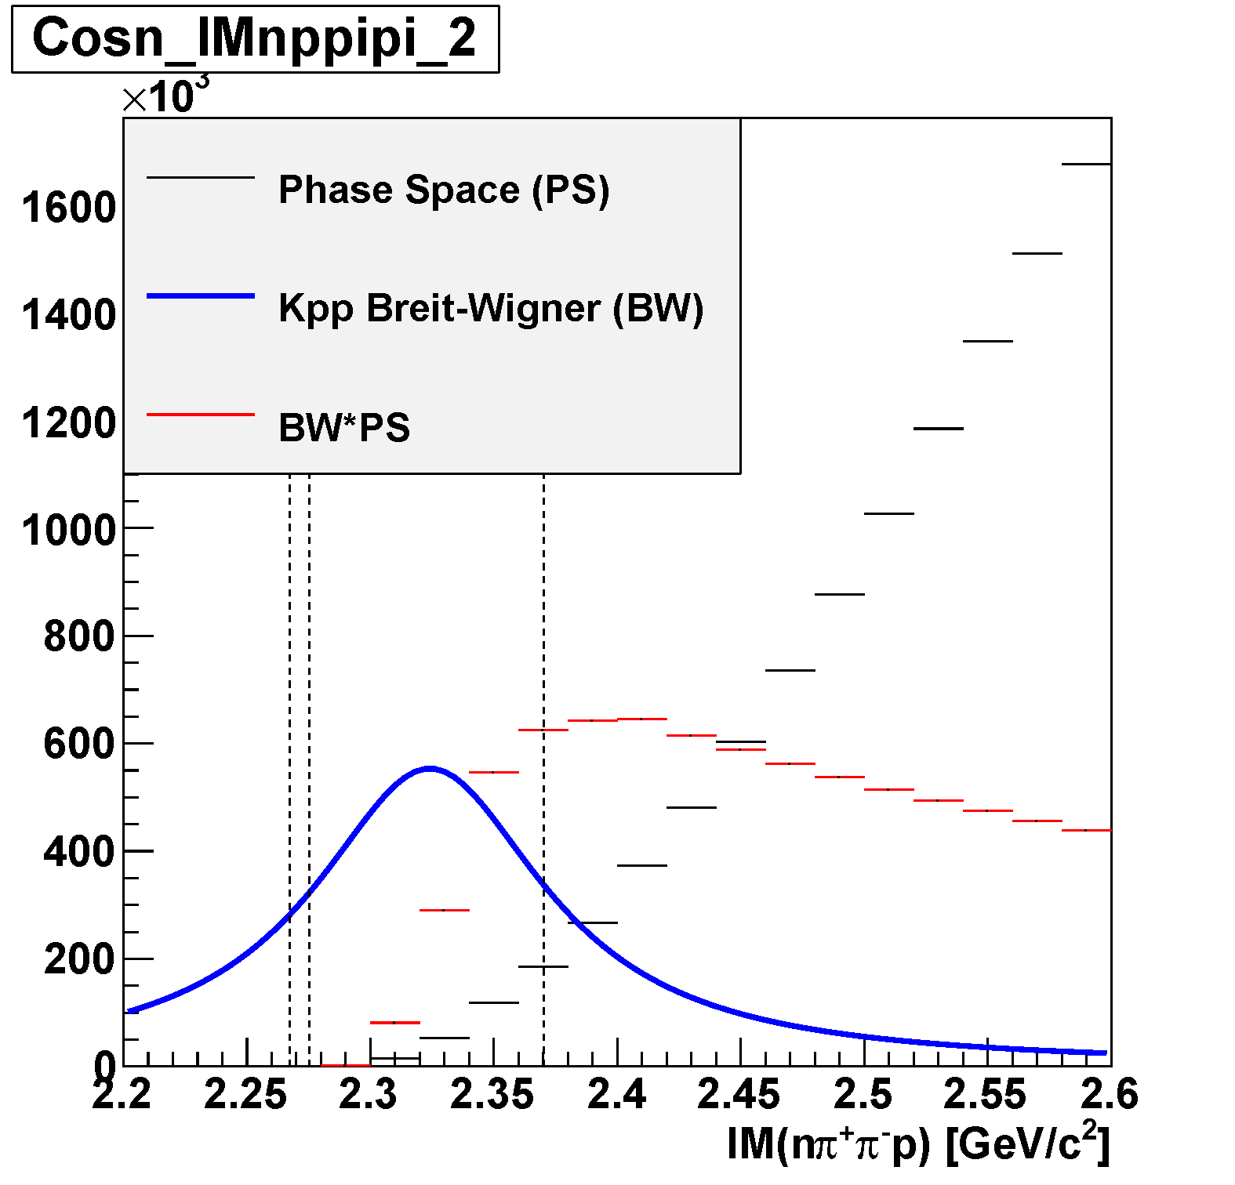

PS Limitation of “K⁻pp”→πΣp Decay
Phase space of πΣpn
IM($π^{±}Σ^{∓}p$)
Λ(1405)pn
M(πΣp)
M(Kpp)
preliminary
[BW] * [phase space]
Kpp BW obtained with Λp

Slide 40
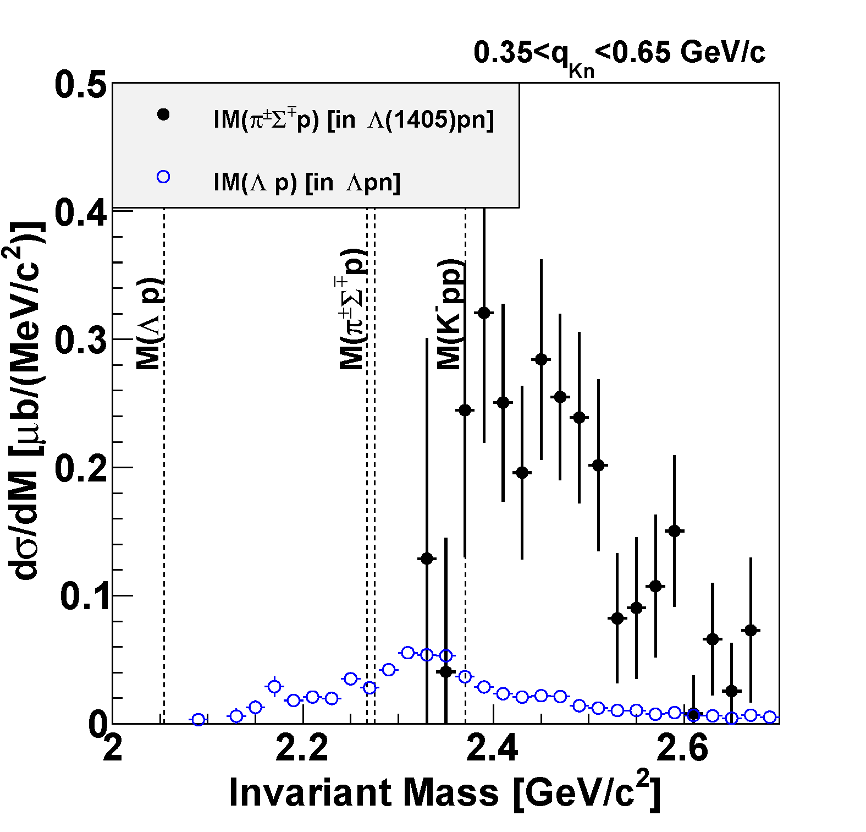
Comparison of Λpn & Λ(1405)pn
Large CS of the Λ(1405)p compared to the “K⁻pp”→Λp
M(Kpp)
preliminary
Λ(1405)pn
Λpn

Slide 41

Comparison of Λpn & Λ(1405)pn
K-
³He
1 GeV/c
p
K⁻
n
preliminary
p
Λ(1405)pn
p
M(Kpp)
n
“K⁻p”
Intrinsic m_{K} < E_{K}
preliminary
$′\overline{K′}+{\left(pp\right)}_{R}→$ “K⁻p”+p
Λ(1405)=“K⁻p”
Λpn
Λ(1405)p production is dominant
(energy-momentum mismatch is transferred to the proton)

Slide 42

Comparison of Λpn & Λ(1405)pn
K-
³He
K-
³He
1 GeV/c
1 GeV/c
p
p
‘K⁻’
n
K⁻
n
preliminary
p
p
Λ(1405)pn
p
“K⁻pp”
n
M(Kpp)
n
“K⁻p”
E_{K} < intrinsic m_{K}
Intrinsic m_{K} < E_{K}
$′\overline{K}′+{\left(pp\right)}_{R}→$ “K⁻pp”
$′\overline{K′}+{\left(pp\right)}_{R}→$ “K⁻p”+p
Λ(1405)=“K⁻p”
Λpn
“K-pp” production is dominant
Λ(1405)p production is dominant
(energy-momentum mismatch is transferred to the proton)

Slide 43
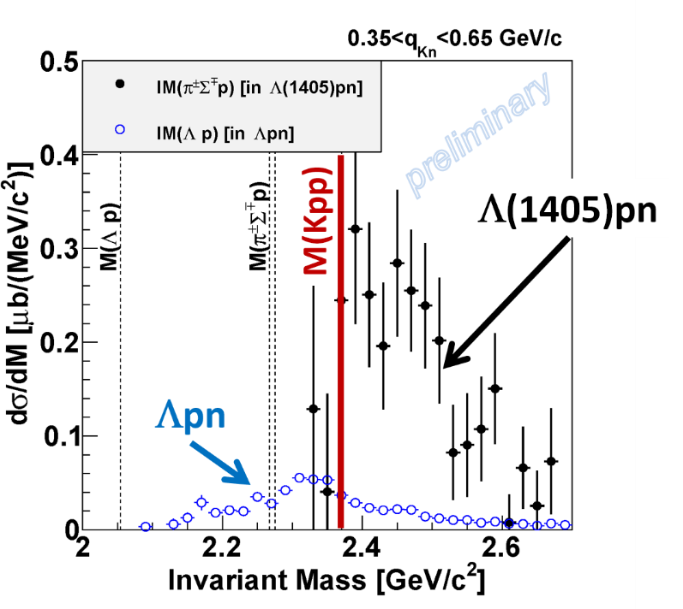
Conclusion II
We observed the “K⁻pp” bound state in ³He(K⁻,Λp)n
  Binding energy: ~50 MeV
  Width: ~100 MeV
We found large CS of the Λ(1405)p formation compared to the “K⁻pp”
  quite important information on the production mechanism of the “K⁻pp”
← E15 collaboration, PLB789(2019)620.
← paper in preparation

Slide 44
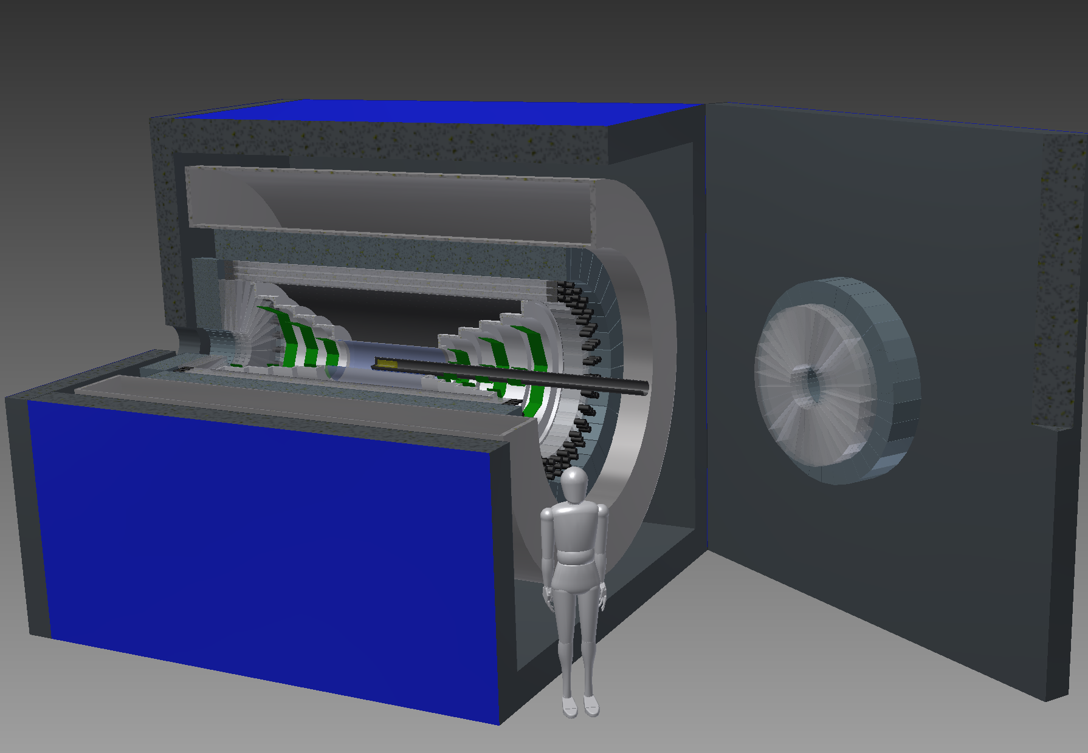
Need further investigation
More quantitative studies of the “K⁻pp”
  J^{P} and other decay modes
Systematic studies of other kaonic nuclei:
  Single: “K⁻ppn” via [K⁻ + ⁴He], “K⁻ppnn/K⁻pppnn” via [K⁻ + ⁶Li]
  Double: “K⁻K⁻pp” via [p^{bar} + ³He]
A new 4π detector with γ/n sensitive detectors is required

Slide 45
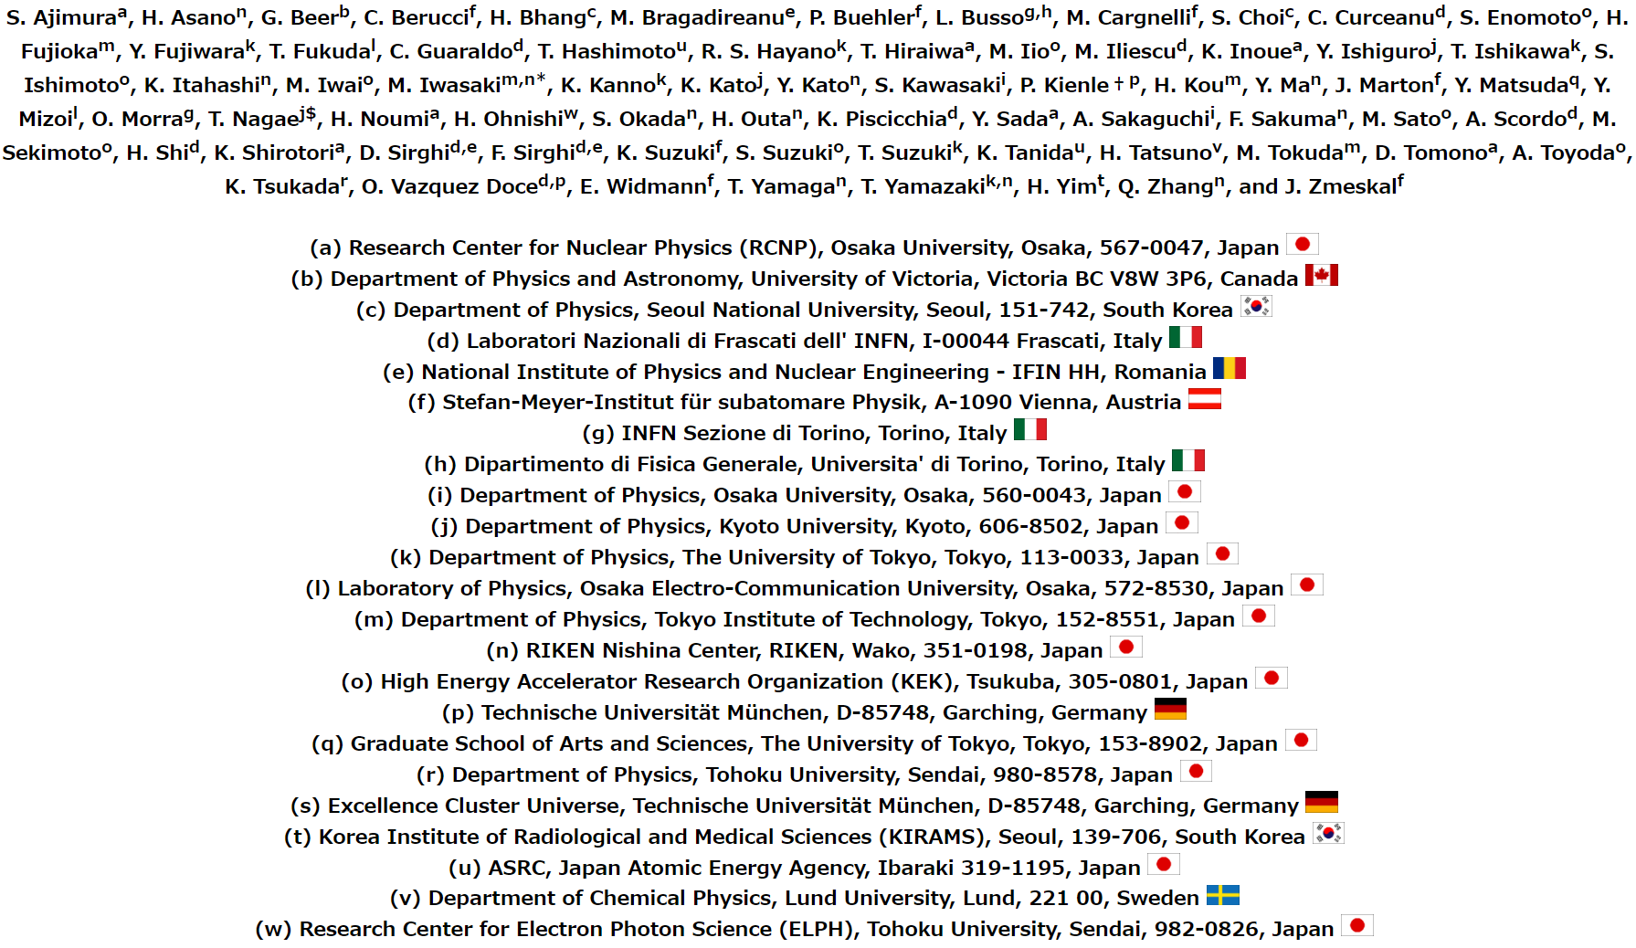
Thank You!
J-PARC E15 Collaboration

Slide 46
Spares

Slide 47
“K⁻pp” Bound-State
Fit values
that reproduce the spectrum:
$$B_{"Kpp"}=47 ± {3 \left(stat.\right) }_{−6}^{+3} \left(syst.\right) MeV$$
“K⁻pp”
$$Γ_{"Kpp"}=115 ± {7 \left(stat.\right) }_{−20}^{+10} \left(syst.\right) MeV$$
$$Q_{"Kpp"}=381 ± {14 \left(stat.\right) }_{−0}^{+57} \left(syst.\right) MeV$$
$$σ_{“Kpp”}∙{Br}_{Λp}=11.8 ± {0.4 \left(stat.\right) }_{−1.7}^{+0.2} \left(syst.\right) μb$$
E15 collab., PLB789(2019)620)

Slide 48
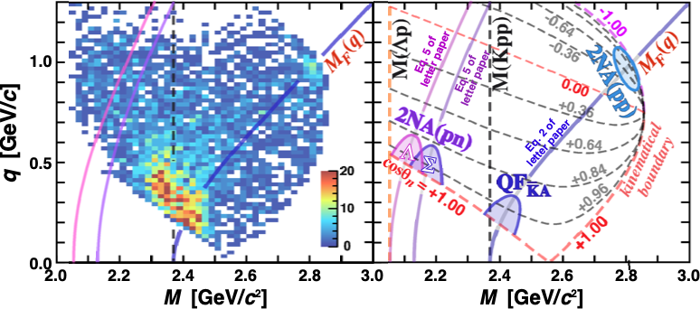

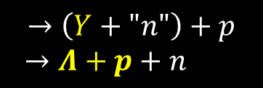

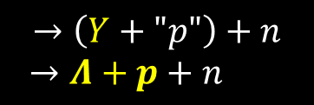
BG: 2NA followed by FSI
$$K^{−}+{}_{}^{3}{He}→\left(K^{−}+"pn"\right)+p_{spect}$$
$→Y+n+$ $p_{spect}$
$$K^{−}+{}_{}^{3}{He}→\left(K^{−}+"pp"\right)+n_{spect}$$
$→Y+p+$ $n_{spect}$
(2NA)
(2NA)
$$→\left(Y+"p"\right)+n$$
$→Λ+p+n$
$$→\left(Y+"n"\right)+p$$
$→Λ+p+n$
(FSI)
(FSI)

Slide 49
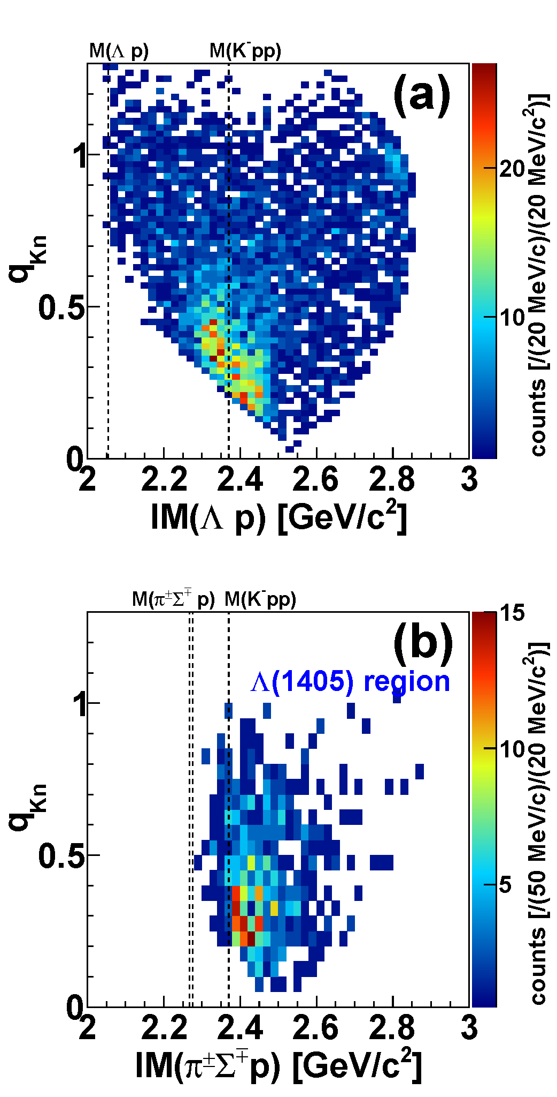
Comparison of Λpn & Λ(1405)pn
Λpn
Λ(1405)pn region
`
QF
QF
kinematical
limit
Kpp
Kpp
kinematical
limit
preliminary
No clear structure below M(Kpp) in the IM(πΣp)
QF followed by Λ(1405)p is dominant

Slide 50
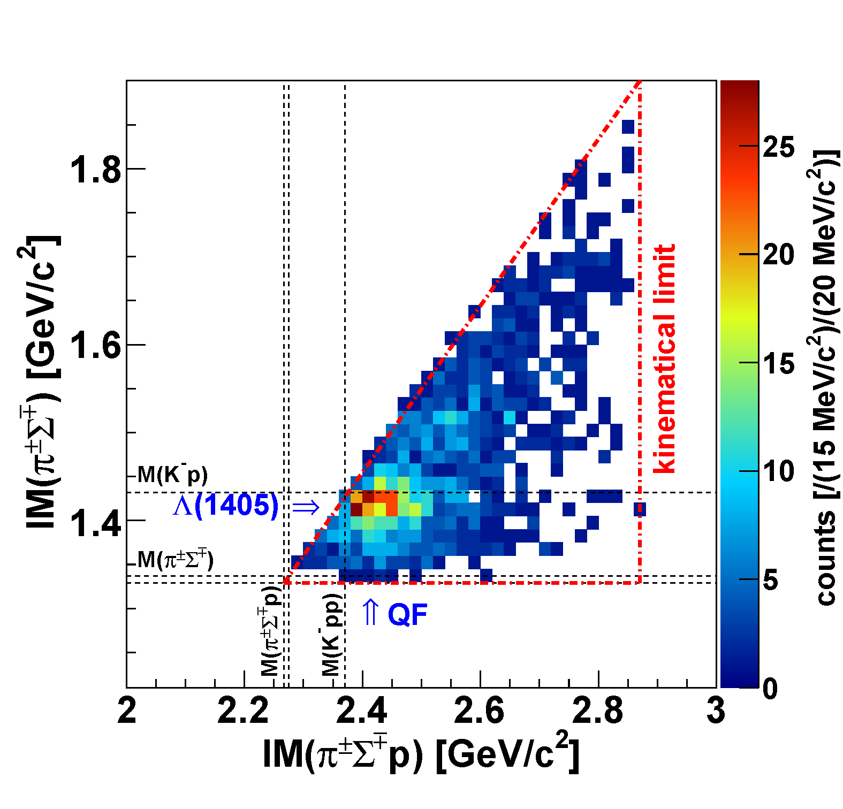
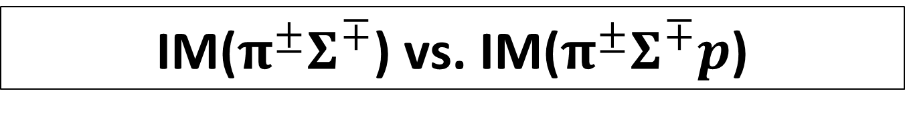

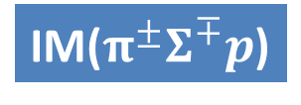
IM($π^{±}Σ^{∓}$) vs. IM($π^{±}Σ^{∓}p$)
preliminary
K-
³He
IM($π^{±}Σ^{∓}$)
1 GeV/c
p
n
p
p
n
IM($π^{±}Σ^{∓}p$)
Λ(1405)
Small phase-space of “K⁻pp”→πΣN

Slide 51
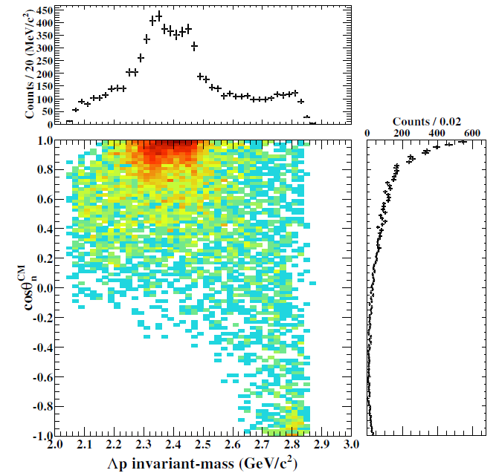





Detector Acceptance: Λp vs. πΣp
Detector acceptance is different between Λp and πΣp
  At cosθ_{n}~1:
    Λp: flat acceptance
    πΣp: limited acceptance below the threshold
DATA
$$Λp$$
detector
acceptance
MC
DATA
$$π^{±}Σ^{∓}p$$
M(K⁻pp)
M(πΣp)
cf. $π^{±}Σ^{∓}pn$-PS MC
w/ detector acceptance
M(πΣp)
M(K⁻pp)
preliminary
detector
acceptance

Slide 52


Neutron ID with CDS
π⁺π⁻p events (3 tracks) in CDS with 4 CDH hits are selected
a CDH hit with CDC-veto (outer-layer) is applied to identify the “neutral hit”
dE vs. 1/β
dE-cut dependence
1.372 < 1/β
(p_{n}<1GeV/c)
neutron ID
5MeVee < dE
Neutron can be identified with CDS

Slide 53

K⁻p→Σ⁺π⁻/Σ⁻π⁺ Cross Section
consistent with the references

Slide 54


Exclusive ³He(K⁻,Λp)n
E15^{1st}
E15^{2nd}

Slide 55


Semi-Inclusive ³He(K⁻,n)X
DATA
sub-threshold
excess
(Y* and/or K^{bar}NN?)
Quasi Elastic
K⁻ + ³He → K⁻ + n + p_{s} + p_{s}
dσ/dΩ_{θ=0deg} ~ 6mb/sr
MC
Charge-Exchange
K⁻ + ³He → K⁰ + n + d_{s}
dσ/dΩ_{θ=0deg} ~ 11mb/sr
T. Hashimoto et al., PTEP (2015) 061D01.

Slide 56


Slide 57

IM(Λp) vs. cos(θ_{n}^{CM})
E15 collab., arXiv:1805.12275
IM(Λp)
Structures around the K⁻pp threshold can be seen
= bound-state + quasi-elastic
M(K+p+p)
Structures are concentrated in forward-n region
= small momentum-transfer
detector
acceptance
cos(θ_{n}^{CM})

Slide 58





Results of ³He(K⁻,Λp)n [E15-2nd]
cosθ_{n} dependence
𝟎.𝟕5<𝐜𝐨𝐬𝜽_{𝒏}^{𝑪𝑴}<𝟏.𝟎
0.95<cosθ_{n}<1.0
0.90<cosθ_{n}<0.95
detector
acceptance
0.85<cosθ_{n}<0.90
0.80<cosθ_{n}<0.85
0.75<cosθ_{n}<0.80

Slide 59




Results of ³He(K⁻,Λp)n [E15-2nd]
Peak position
Width
Gaussian
Breit-Wigner
Above M(K-pp):
  peak shift by recoil kaon energy
Below M(K-pp):
  peak is independent to cosθ_{n}
  ( ~ momentum transfer)
Similar tendency as a theoretical calc., but QF seems to be originated from recoil kaon
QF
B.S.
Sekihara, Oset, Ramos,
PTEP(2016)123D03

Slide 60





A Theoretical Interpretation of E15
Sekihara, Oset, Ramos, PTEP(2016)123D03
Chiral unitary approach
Uncorrelated
Λ(1405)p
state
quasi-elastic
kaon
scattering
K^{bar}NN
bound-state
B=16MeV
Γ=72 MeV
Opt.A (Watson)
Opt.A (Watson)
M[K+p+p]
M[K+p+p]

