Slide 1

Search for the Kaonic Bound State
K^{bar}NN via ³He(K⁻, Λp/πΣp)n Reactions
F. Sakuma, RIKEN
on behalf of the J-PARC E15 collaboration
YKIS2018b Symposium “Recent Developments in Quark-Hadron Sciences”
June 11 - June 15, 2018, Yukawa Institute for Theoretical Physics, Kyoto University

Slide 2
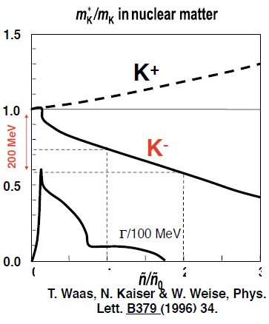
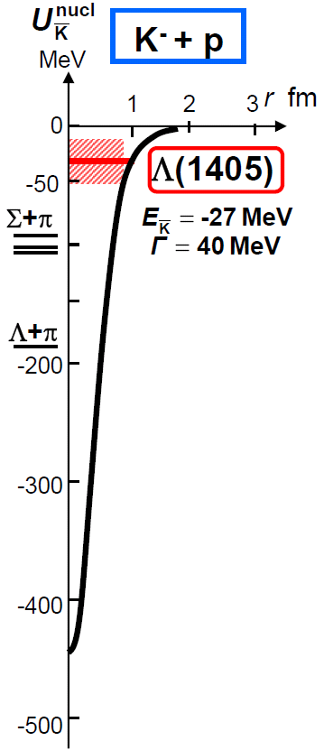
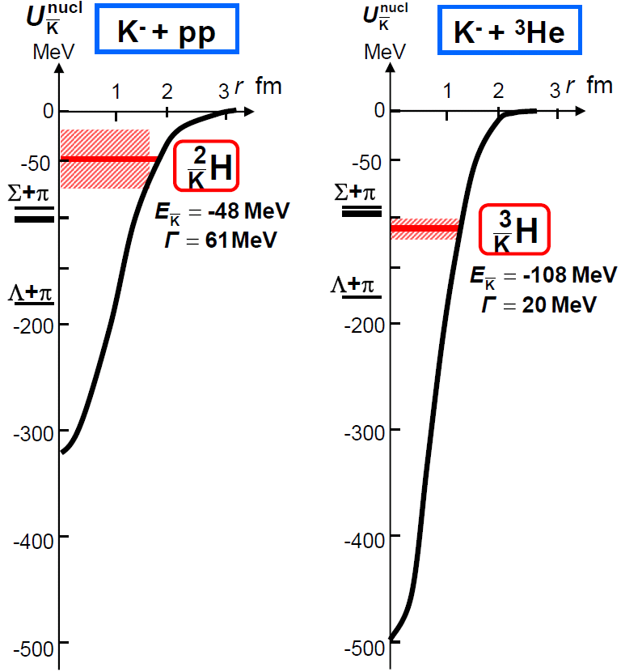
Kaonic Nuclei
Bound states of nucleus and anti-kaon
Predicted as a consequence of attractive K^{bar}N interaction in I=0
Meson properties change
in nuclear media?
Y.Akaishi & T.Yamazaki, PLB535, 70(2002).
0
1
2
3
Will provide new insight on K^{bar}N interaction in media

Slide 3
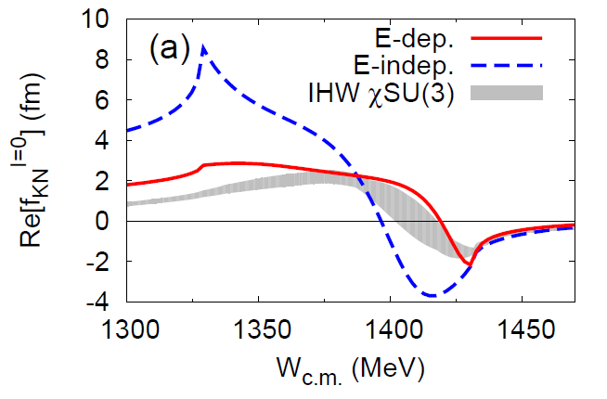
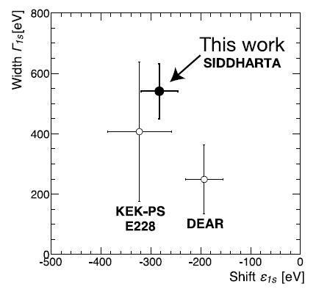
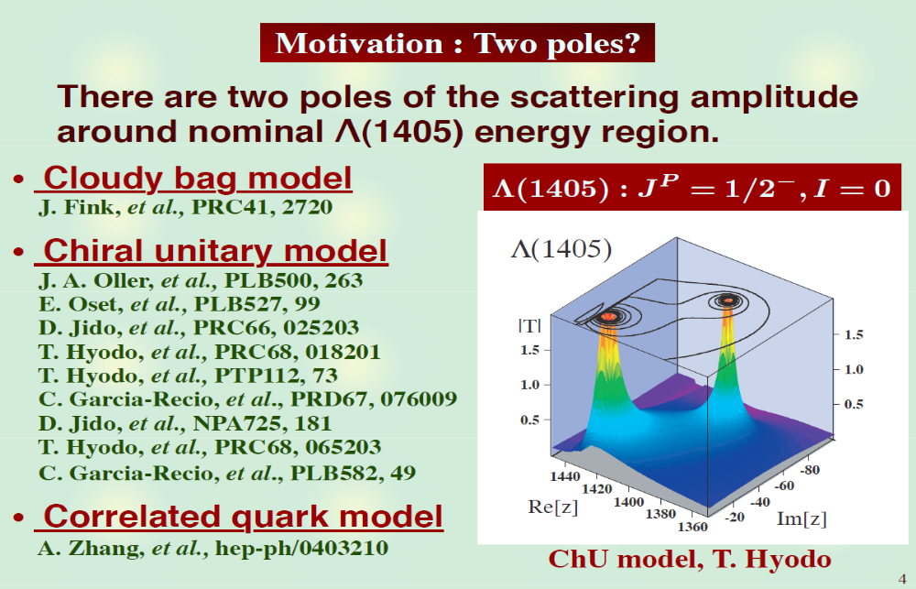
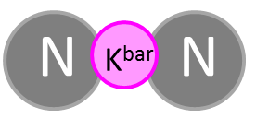

K^{bar}N interaction - A good probe for low-energy QCD
S.Ohnish et al.,PRC93(2016) 025207
Calculation on
K^{bar}N amplitude
in I = 0
?
K^{bar}N
M. Bazzi et al.,
(SIDDHARTA Coll.),
Phys. Lett. B704(2011)113
πΣ
‾ＫＮ
$$I=\frac{1}{2}, J^{P}=0^{−}$$
expected to be produced as a
Λ(1405)p doorway

Slide 4
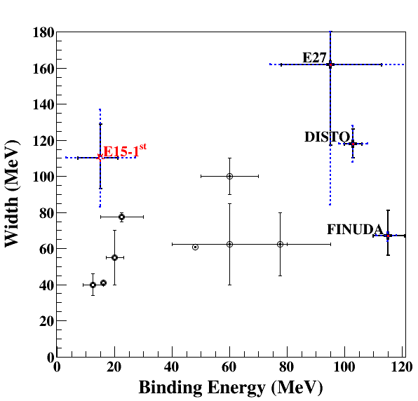

Present Status of K^{bar}NN = “K⁻pp”
K^{bar}NN is symbolically notated as “K⁻pp” in this talk
π⁻d→K⁺X
pp→K⁺X
stopped K⁻
Chiral
Phenomenological
Upper limits were also obtained:
LEPS@SPring8 [Inclusive d(γ, K⁺π⁻)X]
HADES@GSI [Exclusive pp→pΛK⁺]

Slide 5
Theoretical Calculations on K^{bar}NN
K^{bar}N int. | Chiral SU(3) (energy dependent) |  |  | Phenomenological (energy independent)
Method | Variational |  | Faddeev | Variational |  | Faddeev
 | Barnea, Gal, Liverts | Dote, Hyodo, Weise | Ikeda, Kamano, Sato | Yamazaki, Akaishi | Wyceck, Green | Shevchenko, Gal, Mares | Ikeda, Sato
B (MeV) | 16 | 17-23 | 9-16 | 48 | 40-80 | 50-70 | 60-95
Γ (MeV) | 41 | 40-70 | 34-46 | 61 | 40-85 | 90-110 | 45-80
K^{bar}N interaction model:
  Chiral SU(3) [energy dependent]
  Phenomenological [energy independent]
Calculation method:
  Almost the same results
→ B.E. ~ 20 MeV
→ B.E. ~ 40-70 MeV
Strongly depending on K^{bar}N interaction

Slide 6
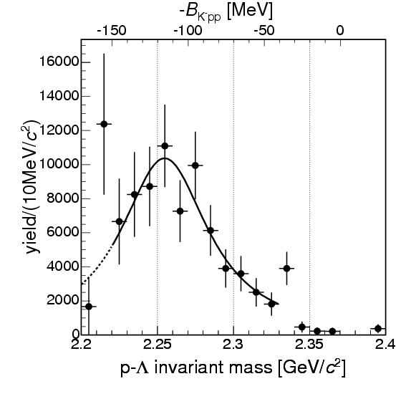
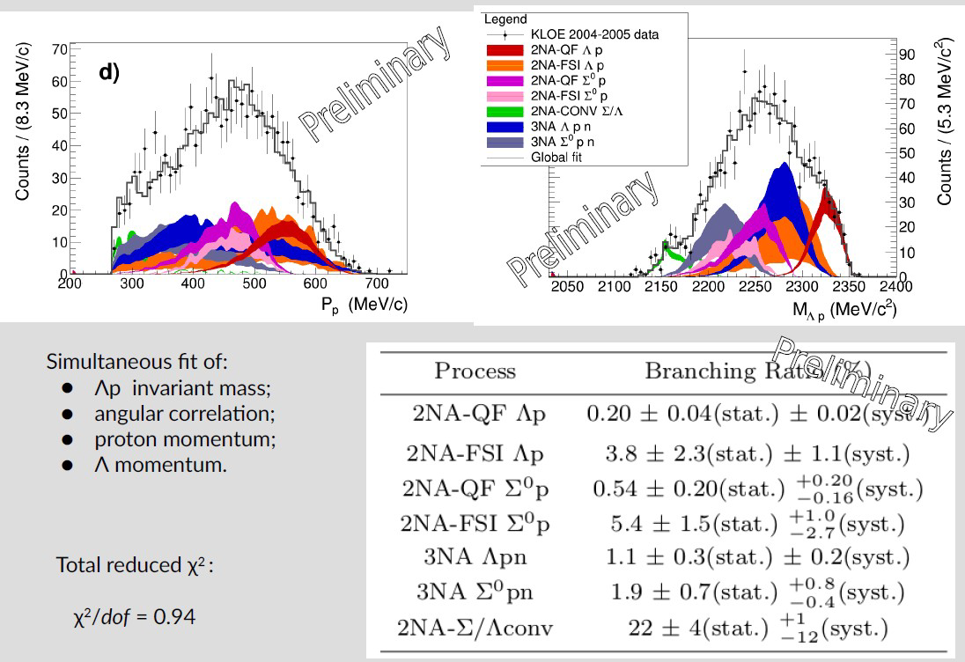
“K⁻pp” Search via Stopped-K⁻
B.E. = 115MeV
Γ = 67MeV
AMADEUS@DAΦNE
R. Del Grande MESON2018
¹²C(stopped K⁻, Λp)
M(K+p+p)
M(K+p+p)
FINUDA@DAΦNE
PRL94(2005)212303
⁶Li+⁷Li+¹²C(stopped K⁻, Λp)
2NA followed by FSI?
PRC74(2006)025206
PRC82(2010)034608 etc.
Spectrum can be reproduced with 2NA/3NA!

Slide 7
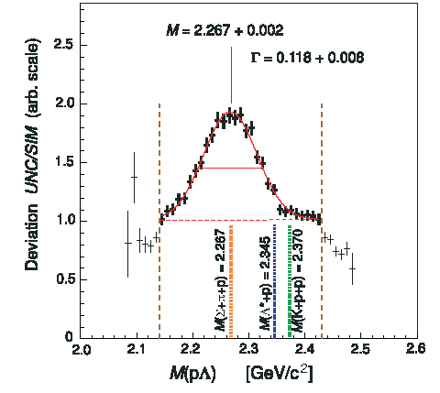
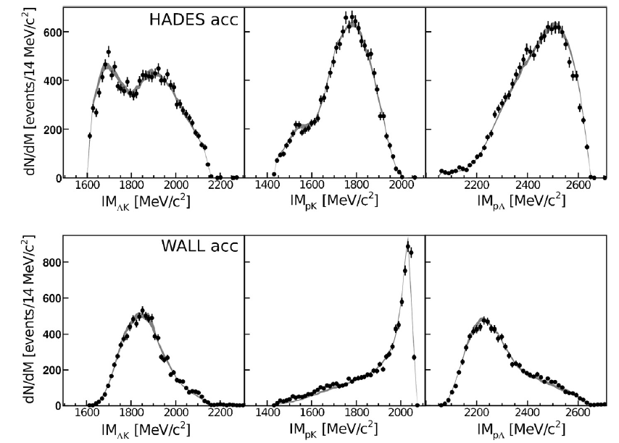
“K⁻pp” Search via pp Collision
HADES@GSI
B.E. = 103MeV
Γ = 118MeV
PLB742(2015)242
p + p → (Λ + p) + K⁺ @ 3.5GeV
M(K+p+p)
Exp/Sim
DISTO@SATURNE
PRL104(2010)132502
M(K+p+p)
p + p → (Λ + p) + K⁺ @ 2.85GeV
pp→p(N*)→p(ΛK⁺)?
PRC92(2015)044002
Spectrum can be reproduced with N*’s

Slide 8
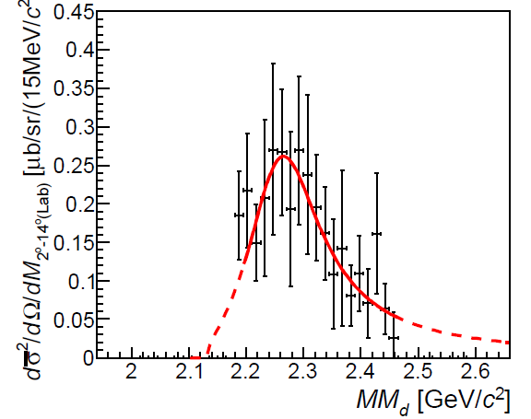
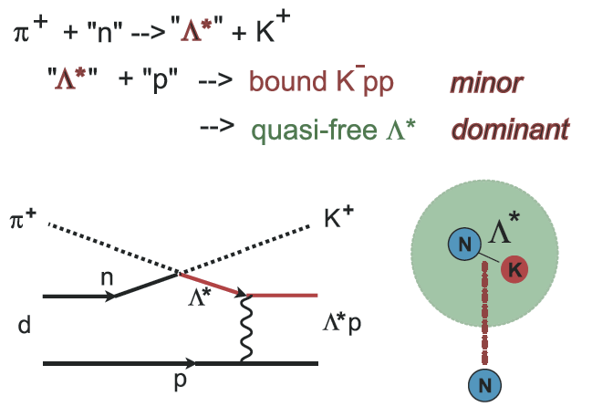
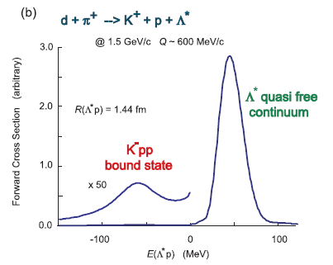
“K⁻pp” Search via d(π⁻,K⁺)X
M(π+Σ+N)
M(K+p+p)
B.E. = 95MeV
Γ = 162MeV
E27@J-PARC
PTEP(2015)021D01.
Yamazaki & Akaishi, PRC76(2007) 045201.
d(π⁻, K⁺)Yp @ 1.69 GeV/c
Need more statistics
Expect a new experiment with 4π detector @ J-PARC

Slide 9
Present Status of K^{bar}NN = “K⁻pp”
K^{bar}NN is symbolically notated as “K⁻pp” in this talk
π⁻d→K⁺X
pp→K⁺X
stopped K⁻
complicated reactions
→ “in-flight K⁻” induced reaction
Chiral
Phenomenological
Upper limits were also obtained:
LEPS@SPring8 [Inclusive d(γ, K⁺π⁻)X]
HADES@GSI [Exclusive pp→pΛK⁺]

Slide 10


J-PARC E15 Experiment
³He(in-flight K⁻,n) reaction @ 1.0 GeV/c
  2NA processes and Y decays can be discriminated kinematically
semi-inclusive ³He(K⁻,n)
T. Hashimoto et al., PTEP (2015) 061D01.
Updated with high-statistics data
(E15 collab., arXiv:1805.12275)
exclusive (K⁻,Λp)n_{missing}
Y. Sada et al., PTEP (2016) 051D01.

Slide 11
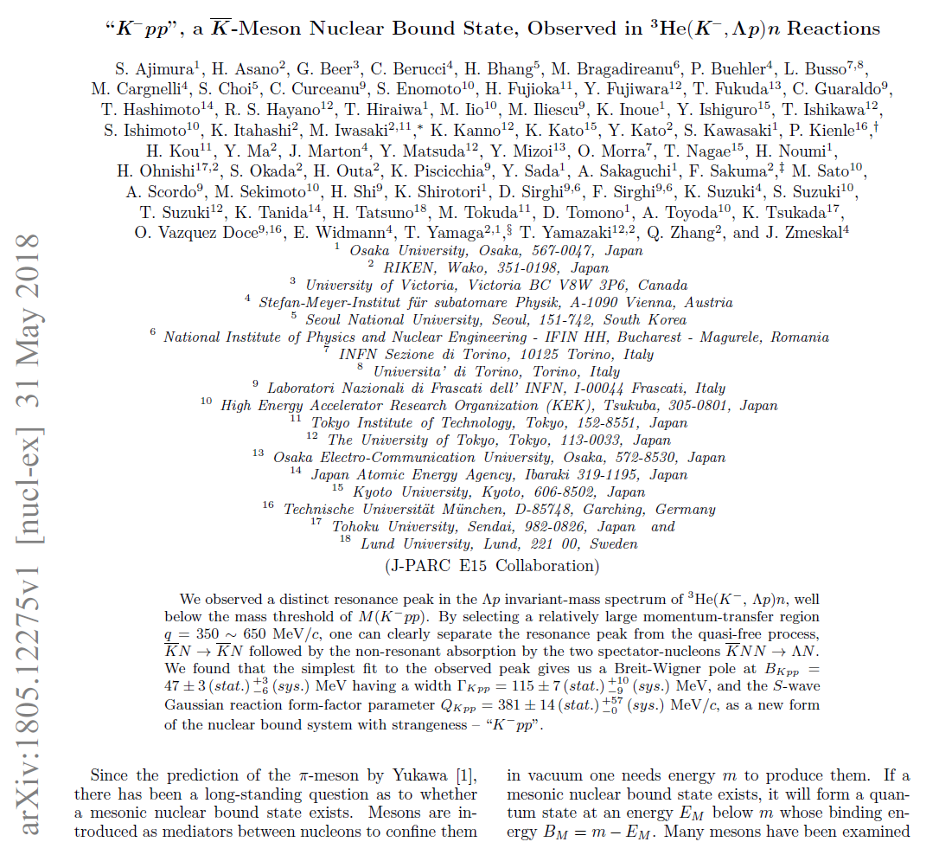
“K⁻pp” in ³He(K⁻,Λp)n

Slide 12

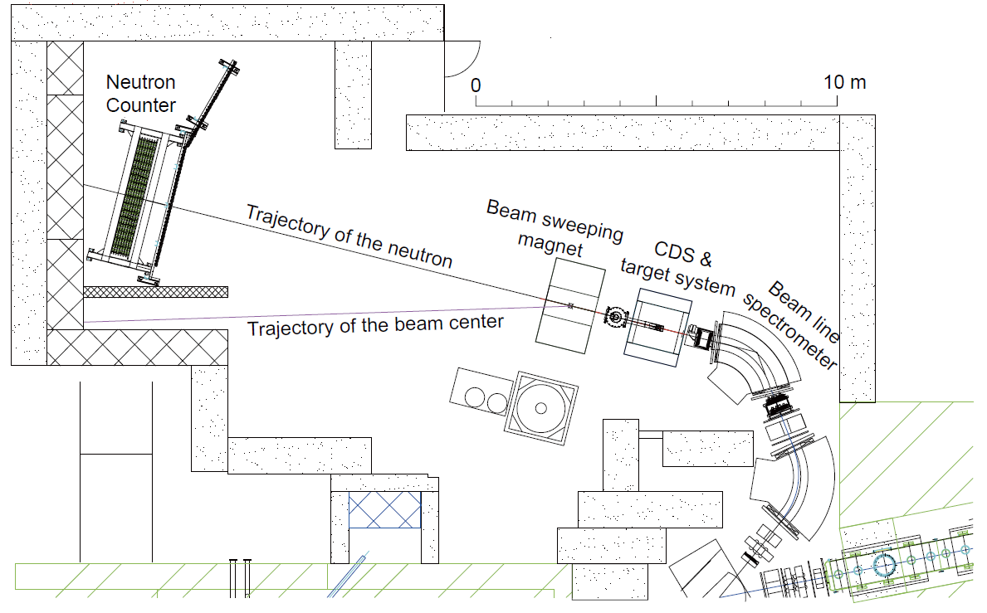
Experimental Setup @ K1.8BR
15m

Slide 13
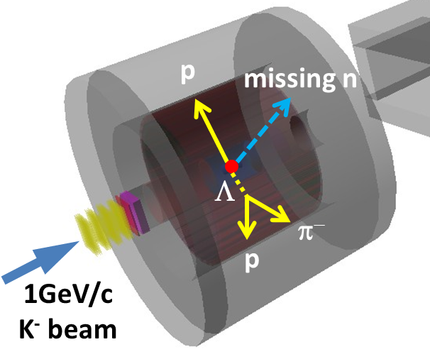
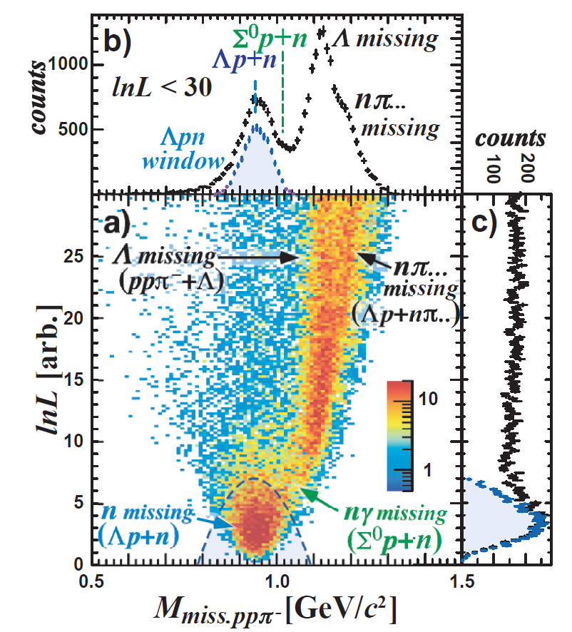
³He + K⁻ → Λ p n Selection
E15 collab., arXiv:1805.12275
Λ→π⁻p and p are detected with CDS
  A missing neutron is identified by missing-mass of ³He(K⁻,Λp)n
Λpn_{miss} events are selected by log-likelihood method (lnL)
  distance-of-closest-approach for each vertex
  kinematical constraint

Slide 14
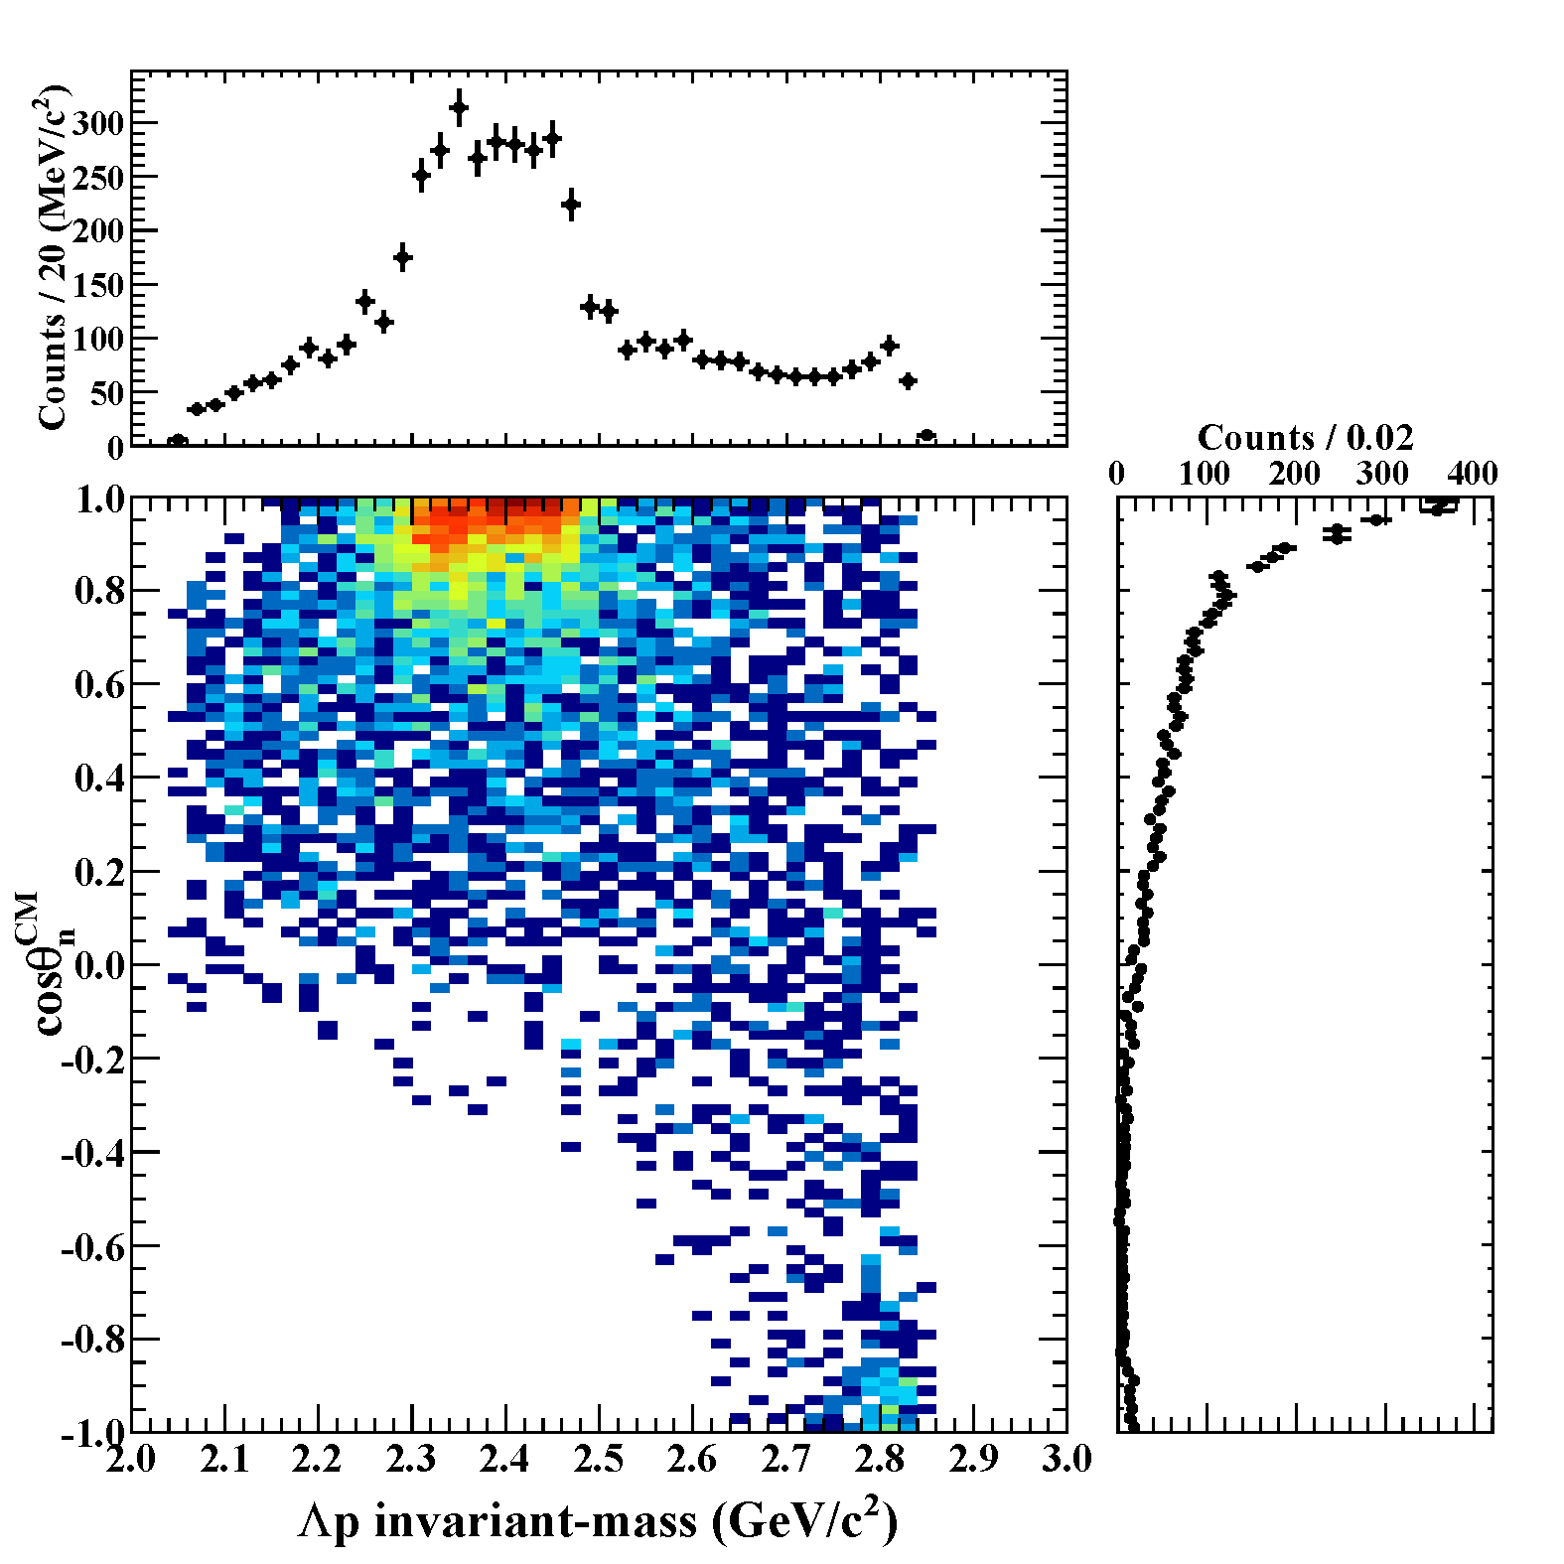
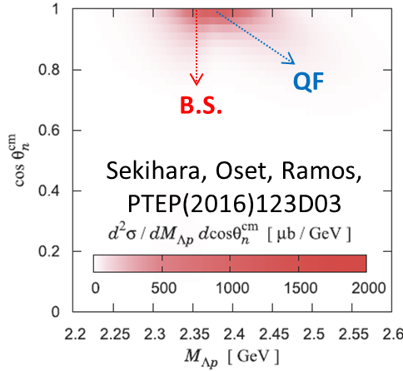
IM(Λp) vs. cos(θ_{n}^{CM})
E15 collab., arXiv:1805.12275
IM(Λp)
Structures around the K⁻pp threshold can be seen
= bound-state + quasi-elastic
M(K+p+p)
Structures are concentrated in forward-n region
= small momentum-transfer
detector
acceptance
cos(θ_{n}^{CM})

Slide 15
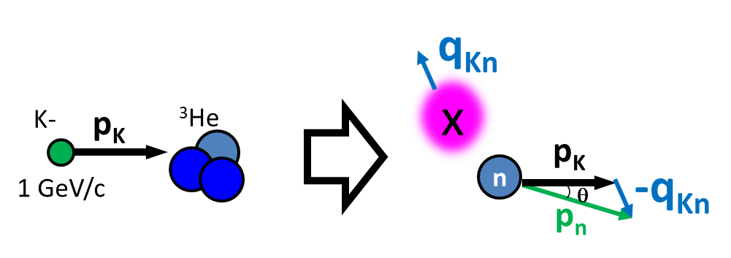
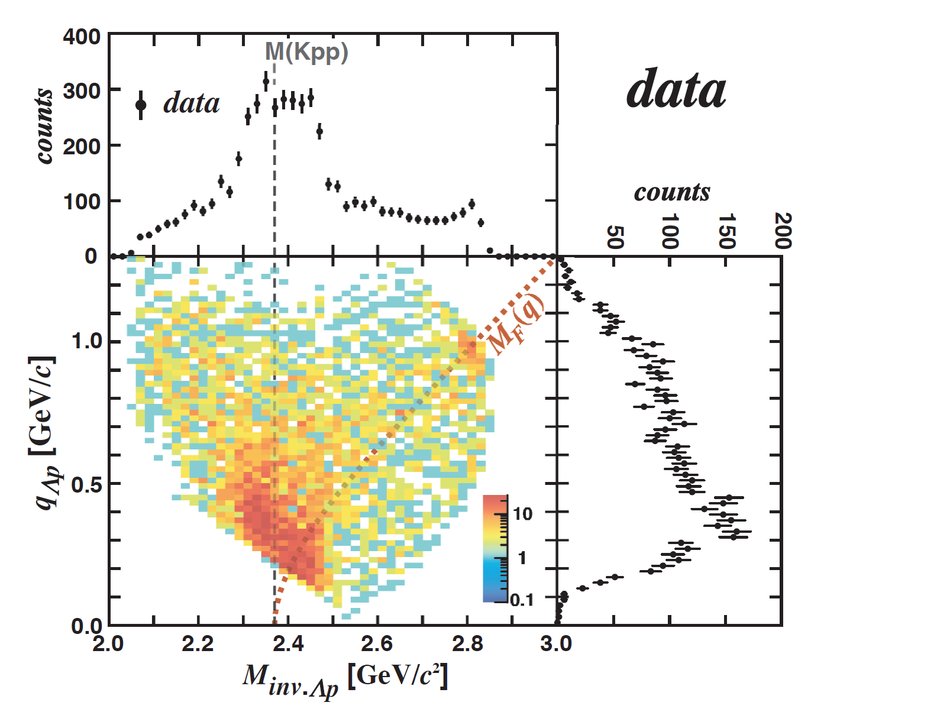
IM(Λp) vs. Momentum Transfer q_{Kn}
E15 collab., arXiv:1805.12275
IM(Λp)
Seems to consist of 3 components
  Bound state
    centroid NOT depend on q_{Kn}
  Qasi-elastic K⁻ abs.
    centroid depends on q_{Kn}
  Background
    Broad distribution
q_{Kn}=q_{Λp}

Slide 16
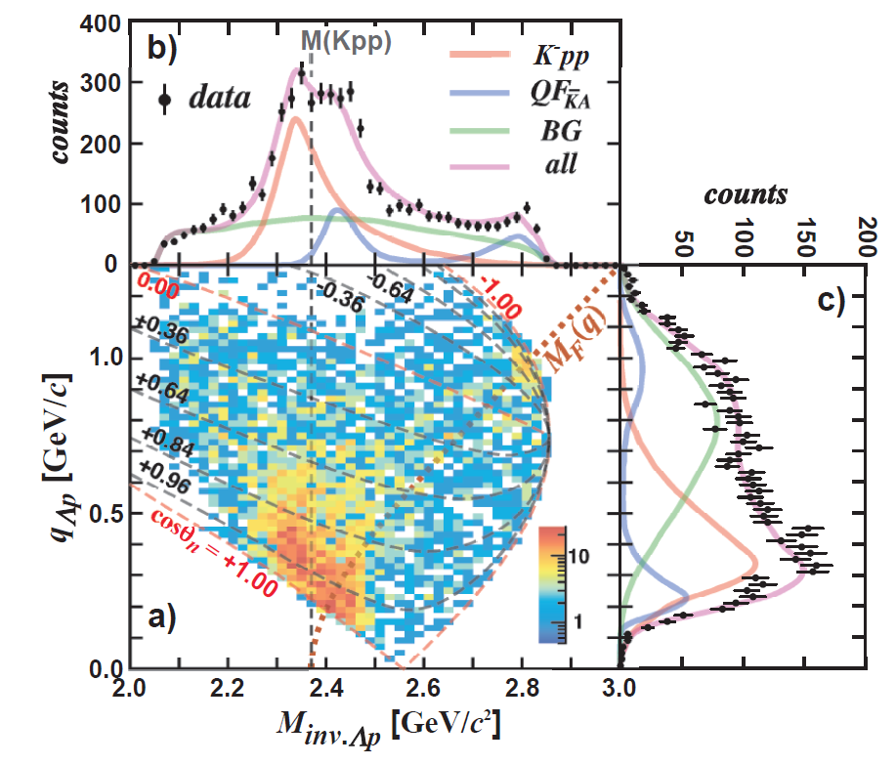
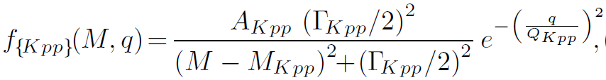
IM(Λp) vs. Momentum Transfer q_{Kn}
E15 collab., arXiv:1805.12275
IM(Λp)
Fit with 3 components
  Bound state
    centroid NOT depend on q_{Kn}
    BW*(Gauss form-factor)
  Qasi-elastic K⁻ abs.
    centroid depends on q_{Kn}
    Followed by Λp conversion
  Background
    Broad distribution
q_{Kn}=q_{Λp}
* We conduct the fitting in each 2D bin

Slide 17
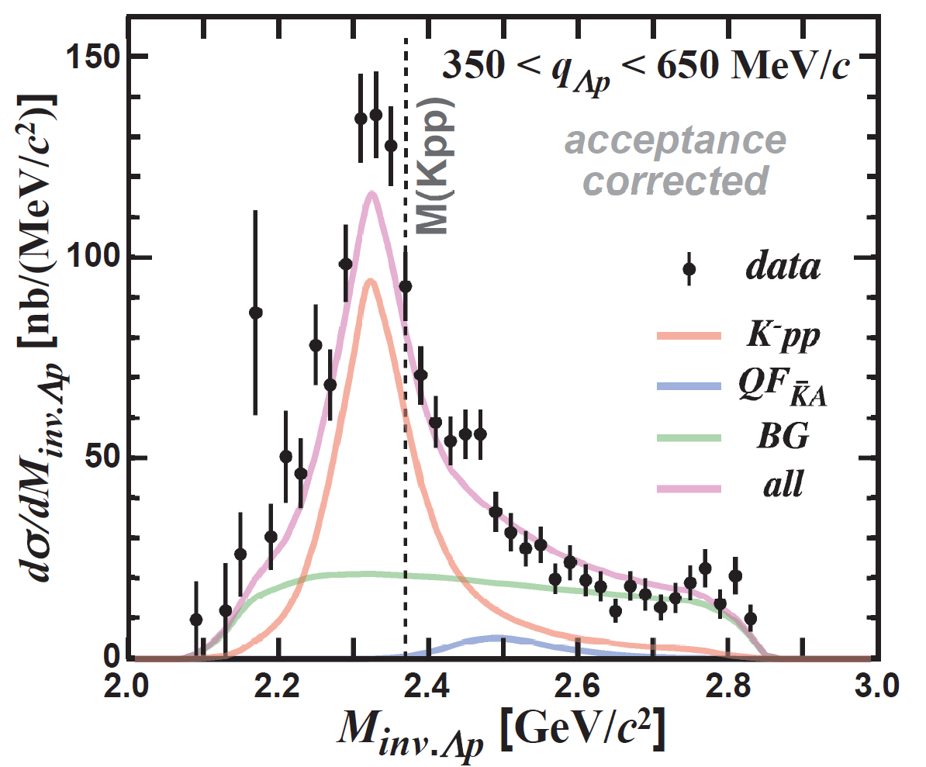
“K⁻pp” Bound-State
Select 0.35<q_{Kn}<0.65 GeV/c
  BS and QF are well separated
E15 collab., arXiv:1805.12275

Slide 18



“K⁻pp” Bound-State
Fit values
that reproduce the spectrum:
$$B_{"Kpp"}=47 ± {3 \left(stat.\right) }_{−6}^{+3} \left(syst.\right) MeV$$
$$Γ_{"Kpp"}=115 ± {7 \left(stat.\right) }_{−9}^{+10} \left(syst.\right) MeV$$
$$Q_{"Kpp"}=381 ± {14 \left(stat.\right) }_{−0}^{+57} \left(syst.\right) MeV$$
$$at below the M(K^{−}pp)$$
$$σ_{“Kpp”}∙{Br}_{Λp}=15 ± {1 \left(stat.\right) }_{−2}^{+2} \left(syst.\right) μb$$
E15 collab., arXiv:1805.12275

Slide 19


“K⁻pp” Bound-State
Binding energy: ~50 MeV
  Much deeper than chiral-SU(3) based theoretical predictions
Width: ~100 MeV
  Non-meonic YN decay modes would be dominant
    in theoretical calculations, width is evaluated with mesonic πYN channel
S-wave form factor: ~400 MeV
  K⁻ + ³He reaction would be compact (~0.5 fm)
$$B_{"Kpp"}=47 ± {3 \left(stat.\right) }_{−6}^{+3} \left(syst.\right) MeV$$
$$Γ_{"Kpp"}=115 ± {7 \left(stat.\right) }_{−9}^{+10} \left(syst.\right) MeV$$
$$Q_{"Kpp"}=381 ± {14 \left(stat.\right) }_{−0}^{+57} \left(syst.\right) MeV$$
E15 collab., arXiv:1805.12275

Slide 20
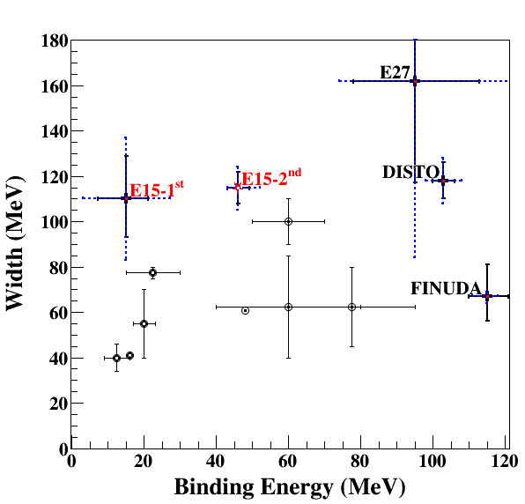
Present Status of “K⁻pp”
π⁻d→K⁺X
K⁻³He→nX
pp→K⁺X
stopped K⁻
Chiral
Phenomenological
For further understandings:
Λ(1405) production ◊ Λ∗N doorway
πΣN decay channel → new info. of K^{bar}NN

Slide 21
Λ(1405) in ³He(K⁻,πΣp)n
K-
³He
Λ(1405)
n
1 GeV/c
p
?
?
p
“K⁻pp”
“free”
Λ(1405)
“K⁻pp”
formation
Λ(1405)
21

Slide 22
Λ(1405)p and “K⁻pp”
Theoretically, “K⁻pp” is expected to be produced via Λ(1405)+p→”K⁻pp” door-way process
  comparison between Λ(1405)p and “K⁻pp” production would give us an important information
K-
³He
Λ(1405)
n
1 GeV/c
p
ω
“K⁻pp” formation
“free” Λ(1405)
?
Observed!
p
p
“K⁻pp”
n
n
Λ
Λ(1405)

Slide 23
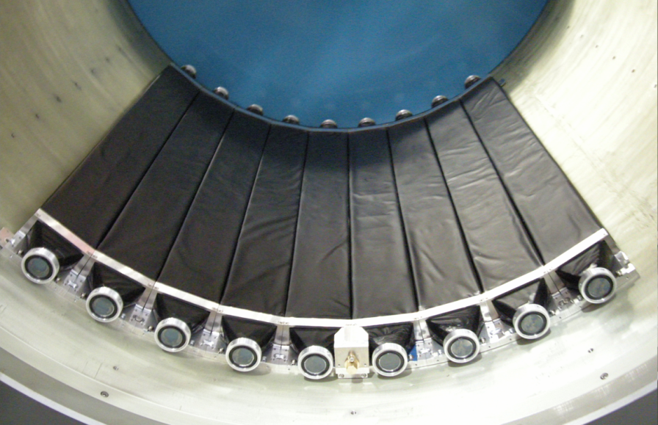
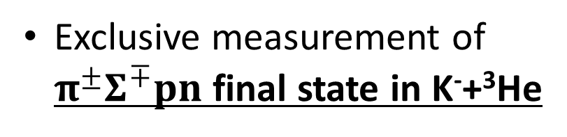
K⁻ ³He → πΣpn @ E15
CDS
Exclusive measurement of $π^{±}Σ^{∓}pn$ final state in K⁻+³He
p
“X”
K-
³He
n
1 GeV/c
Σ
π
n
π
CDS
Experimental challenge of neutron detection with thin scintillation counter (t=3cm)
t = 3cm
79cm
10cm
n detection efficiency ~ 3%

Slide 24
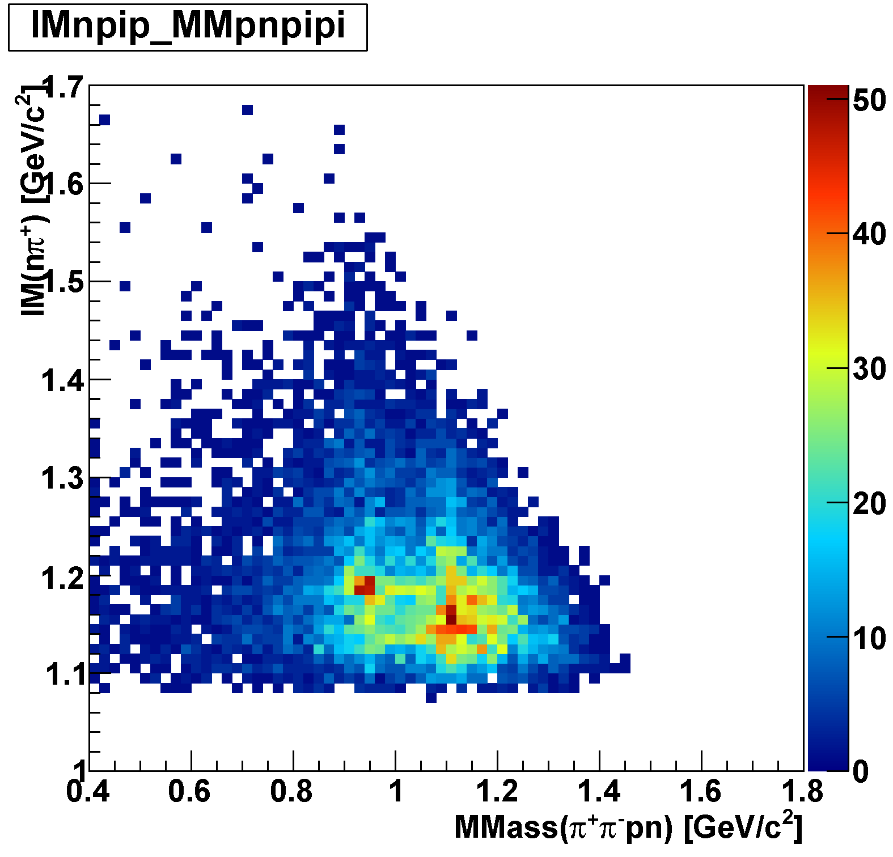
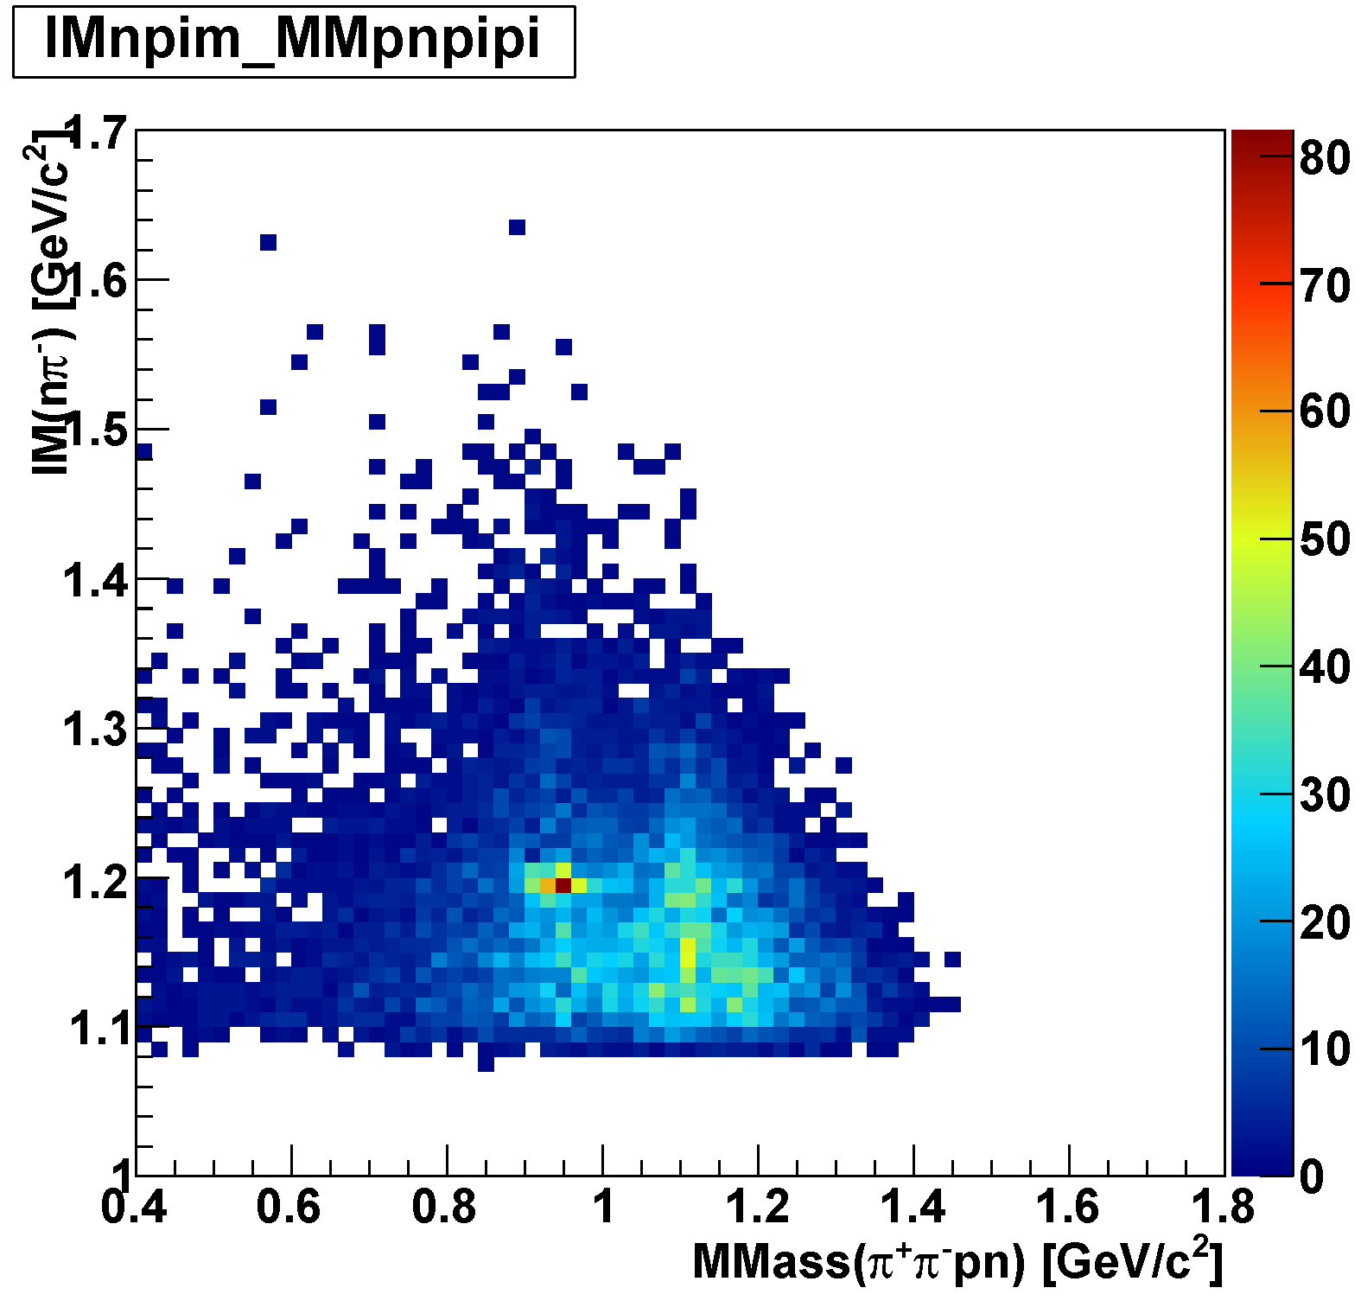
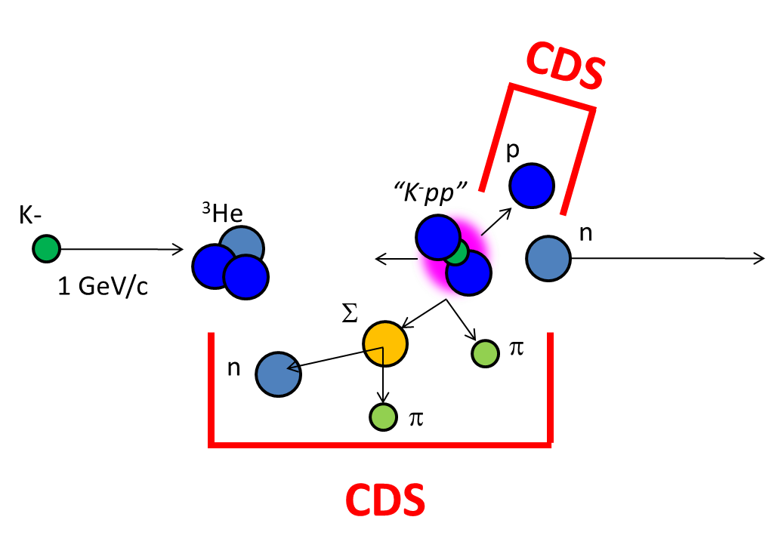
πΣpn Events
IM(nπ⁺) vs MM(π⁺π⁻pn)
IM(nπ⁻) vs MM(π⁺π⁻pn)
π⁻Σ⁺p n_{miss}
π⁺Σ⁻p n_{miss}
Σ⁺
Σ⁻
n_{miss}
M(Λ)
n_{miss}
M(Λ)

Slide 25
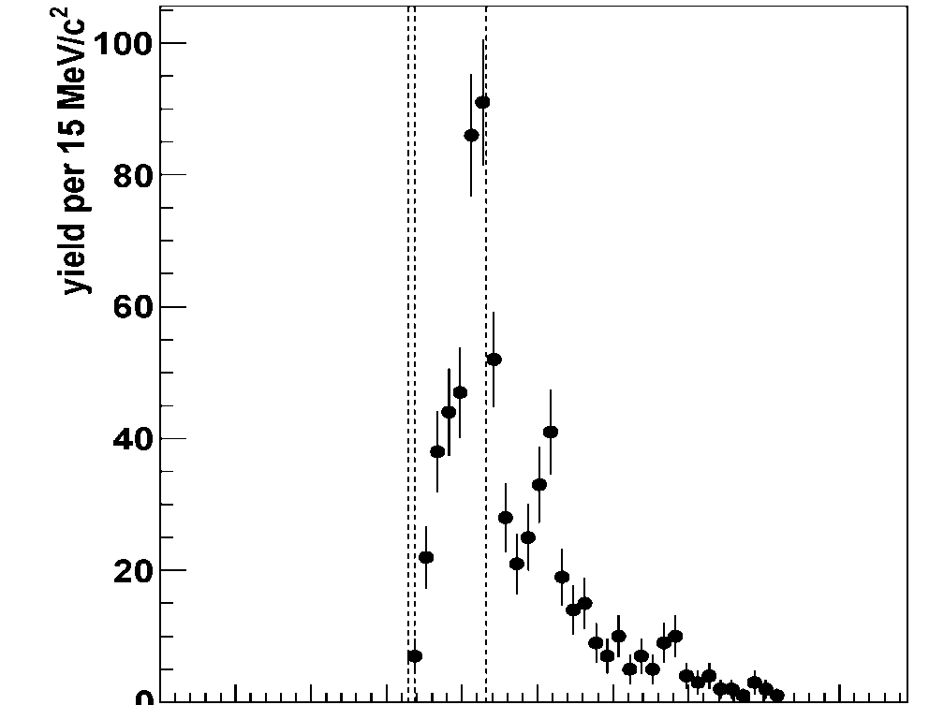
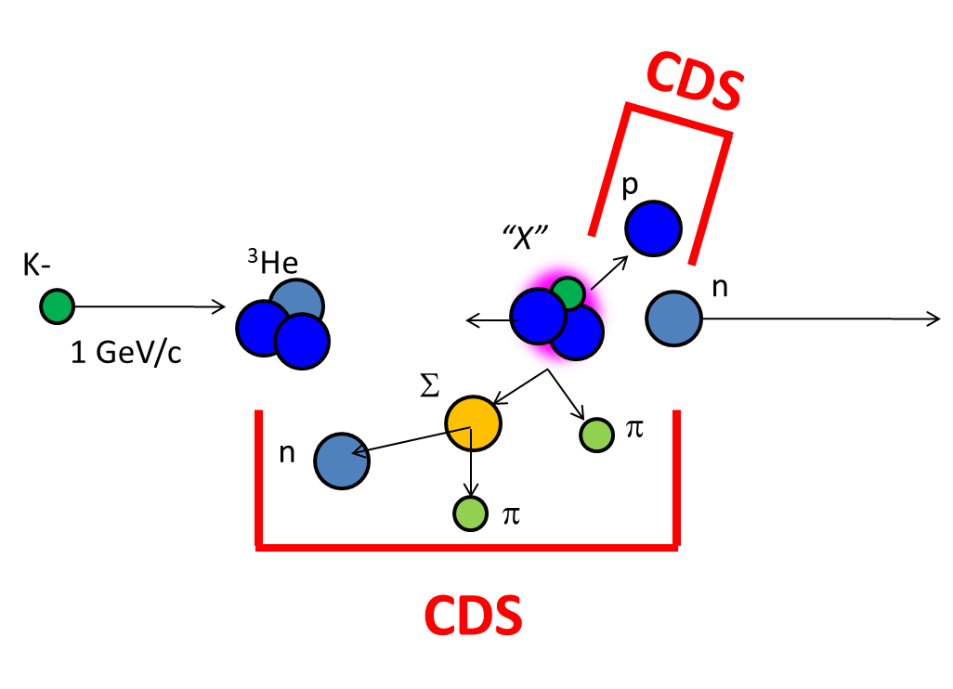
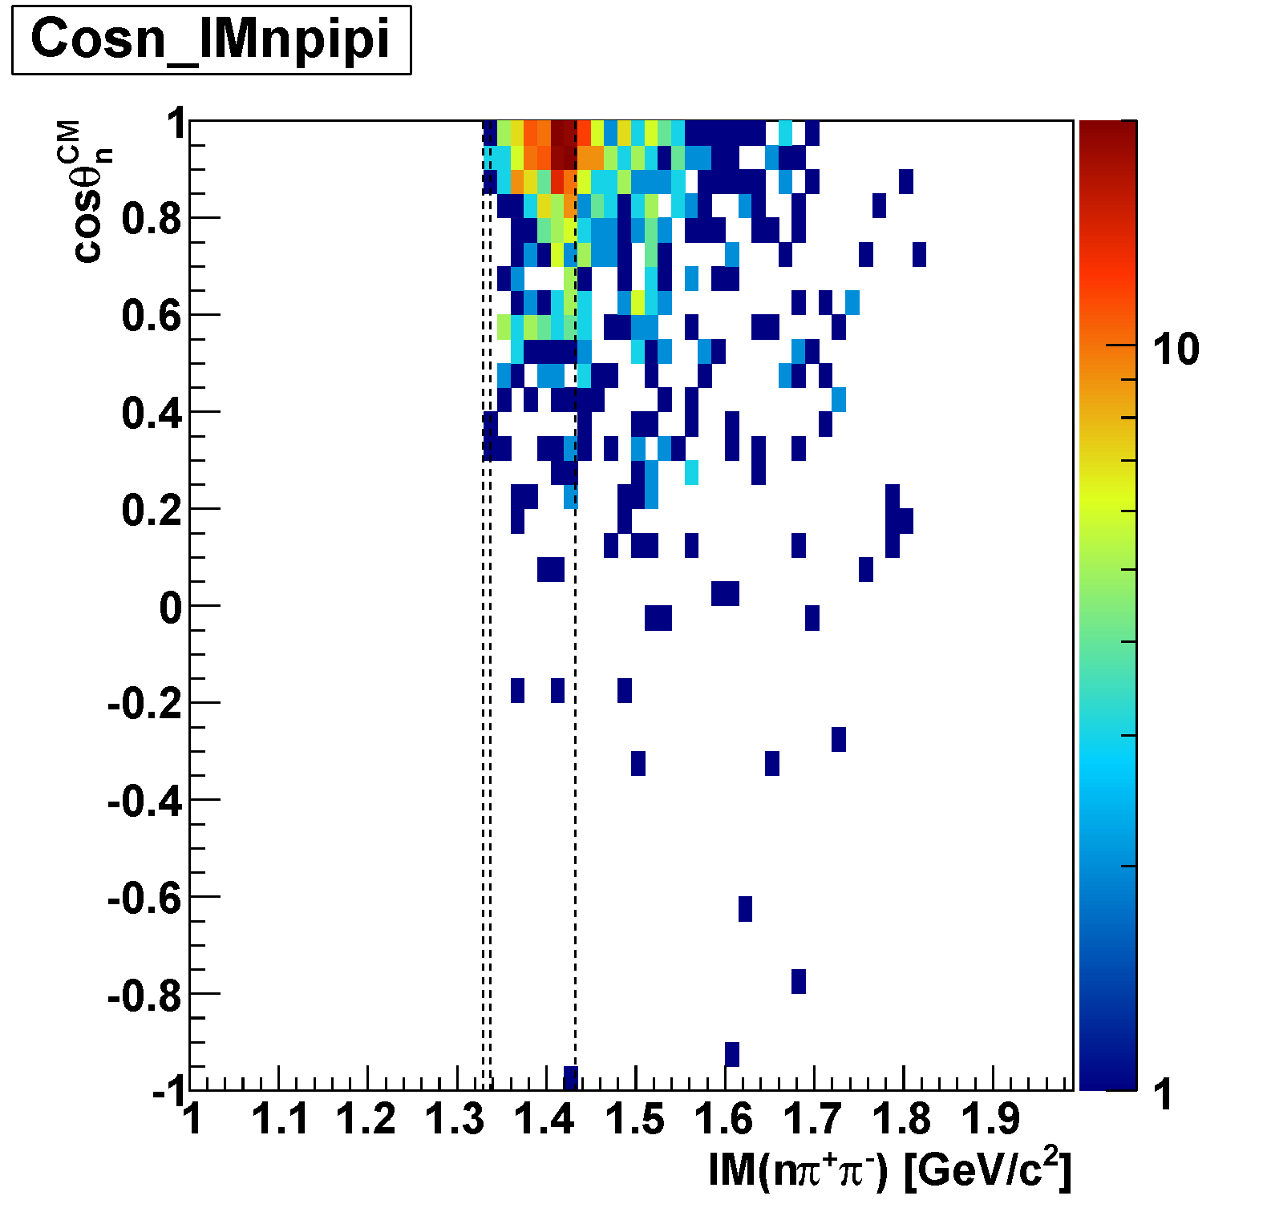
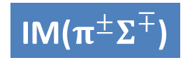
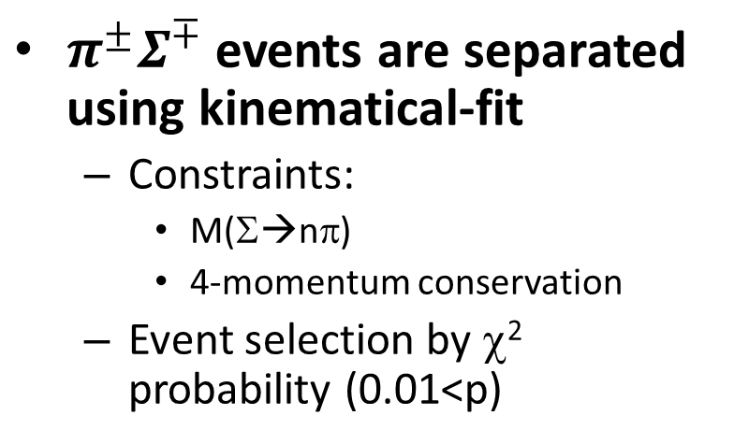
IM(πΣ) vs. cos(θ_{n}^{CM})
Σ(1385)/Λ(1405)
$π^{±}Σ^{∓}$ events are separated using kinematical-fit
  Constraints:
    M(Σ→nπ)
    4-momentum conservation
  Event selection by χ² probability (0.01<p)
IM($π^{±}Σ^{∓}$)
Λ(1520)
preliminary
constraint: 4-mom. conservation
= n mass constraint
measured
measured
unmeasured
cos(θ_{n-miss})
measured
measured
measured
M(πΣ)
M(K⁻p)
constraint: Σ mass

Slide 26
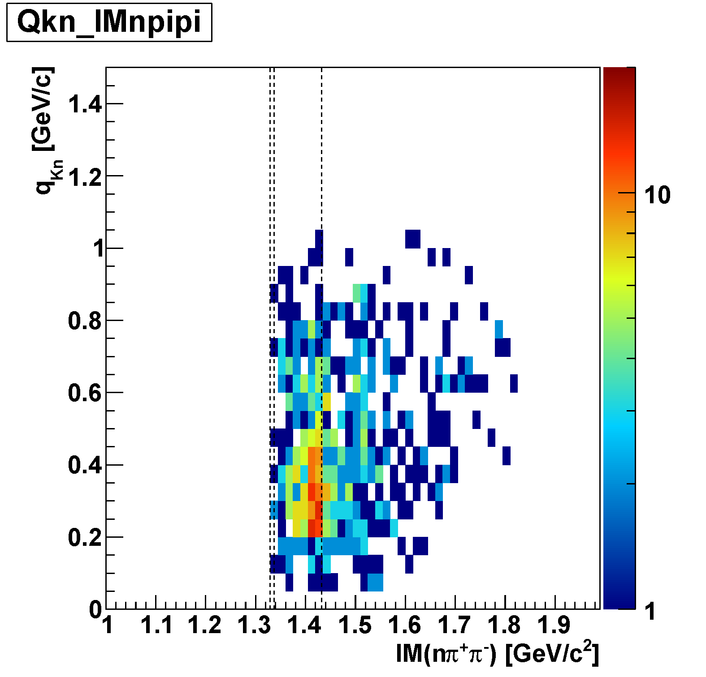
IM(πΣ) vs. Momentum Transfer q_{Kn}
Σ(1385)/Λ(1405)
IM($π^{±}Σ^{∓}$)
To compare “K⁻pp” and Λ∗ production CS’s, we select q_{Kn}<0.65 GeV/c region
  “K⁻pp” and Λ* signals can be seen in this region
Λ(1520)
preliminary
cf. ³He + K⁻ → Λ p n
³He + K⁻ → Λ∗ p n
M(πΣ)
q_{Kn}
M(K⁻p)
q_{Kn}
q_{Kn}<0.65
q_{Kn}<0.65
IM(Λp)

Slide 27
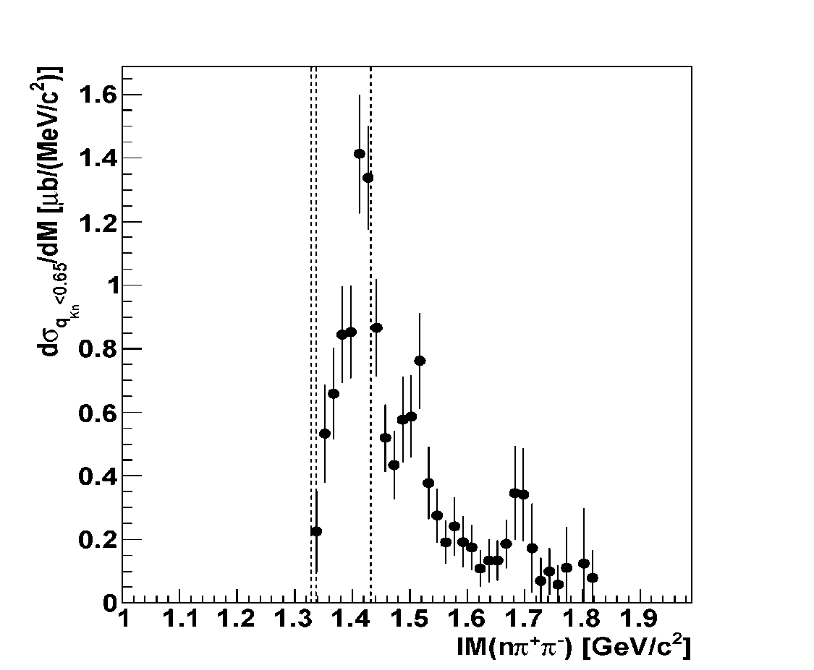
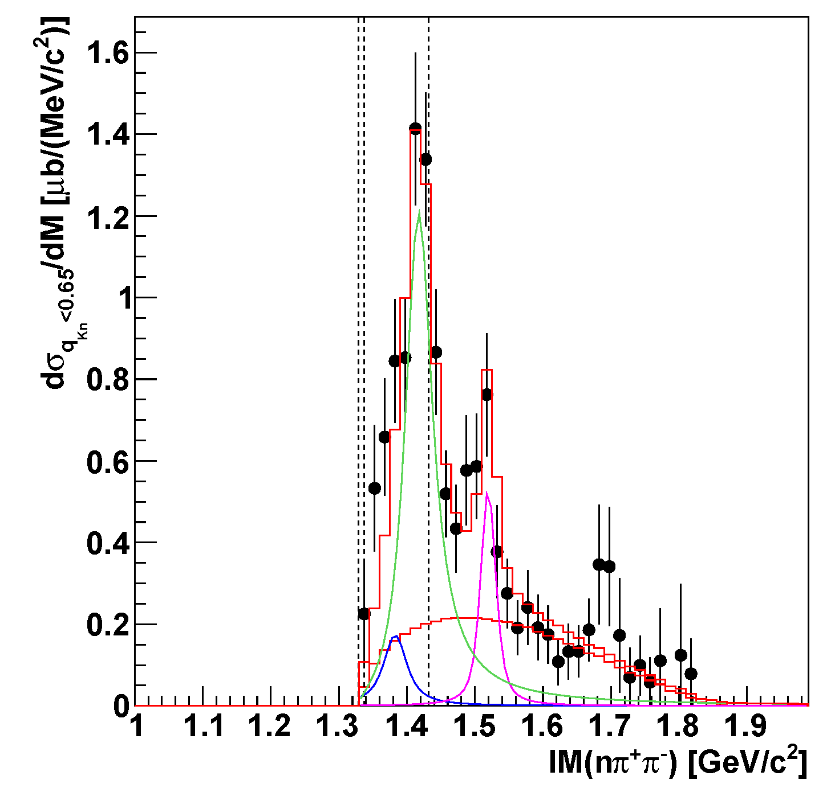
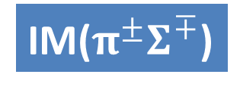
Y* CS (q_{Kn}<0.65)
Λ(1405)
M(πΣ)
M(K⁻p)
IM($π^{±}Σ^{∓}$)
~ 130-140 μb
L = 3.0 nb⁻¹
Flatté param.:
m_{R} ~ 1418 MeV/c
g_{πΣ} ~ 1.9E-1
g_{KN} ~ 1.7E-2
preliminary
Λ(1520)
~ 70 μb
Σ⁰(1385)
πΣpn
phases-space
  ~ 40-80 μb
  [evaluated from
  Σ⁺(1385)→π⁺Λ
  measurement]
(Σ(1385)→πΛ/πΣ : 87.0/11.7%)

Slide 28
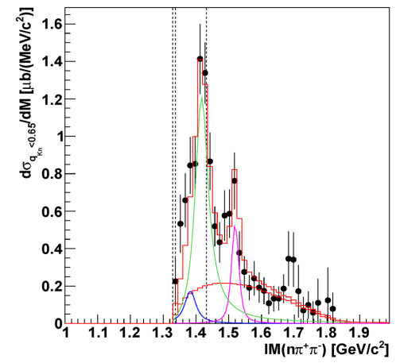
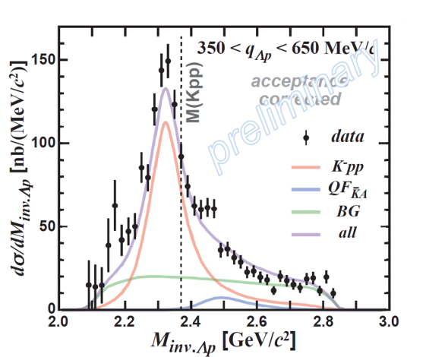

Production of Λ(1405)p and “K⁻pp”
Λ(1405)
K-
³He
n
1 GeV/c
p
“free” Λ(1405)
“K⁻pp”→Λp
p
~ 130μb
“K⁻pp”
p
~ 20μb
n
n
IM($π^{±}Σ^{∓}$)
Λ
IM(Λp)
Λ(1405)
Large CS of Λ*compared to “K⁻pp” formation

Slide 29
“K⁻pp” in ³He(K⁻,πΣp)n
Search for “K⁻pp” → πΣN decay channel

Slide 30
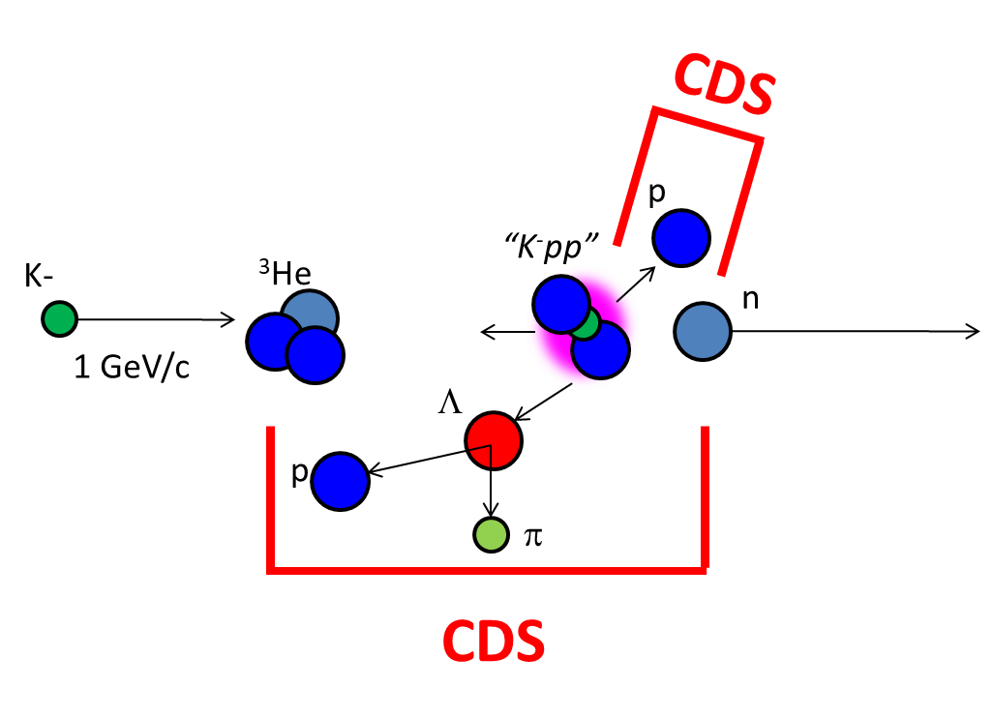


Two Decay Mode of “K⁻pp”
1. “K⁻pp” search via Λp channel
→ Non-mesonic channel
FINUDA/DISTO/E27/E15…
“K⁻pp” ($J^{P}=0^{−}$) → Λ( ${\frac{1}{2}}^{+}$) p(${\frac{1}{2}}^{+}$)
2. “K⁻pp” search via πΣp channel
→ Mesonic channel
NO measurement so far
“K⁻pp” ($J^{P}=0^{−}$) → π($0^{−}$) Σ(${\frac{1}{2}}^{+}\text{)}$ p( ${\frac{1}{2}}^{+}\text{)}$

Slide 31
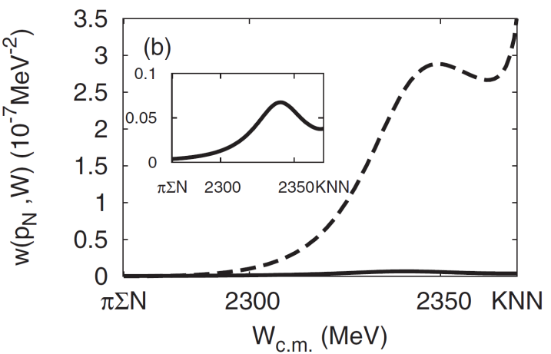
Two Decay Mode of “K⁻pp”
S.Ohnish et al.,PRC88(2013)025204
Theoretically,
πΣN decay is expected to be
the dominant channel
kaon absorption probability
of Λ*N→πΣN/ΛN
πΣN channel
ΛN channel
2. “K⁻pp” search via πΣp channel
→ Mesonic channel
NO measurement so far
“K⁻pp” ($J^{P}=0^{−}$) → π($0^{−}$) Σ(${\frac{1}{2}}^{+}\text{)}$ p( ${\frac{1}{2}}^{+}\text{)}$

Slide 32
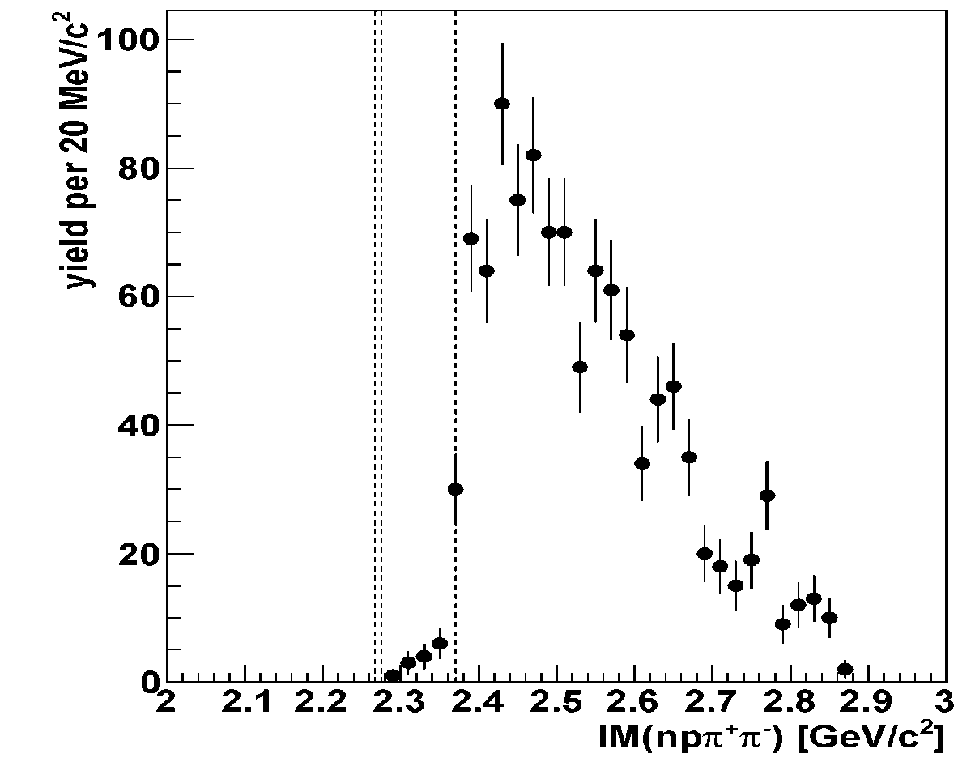
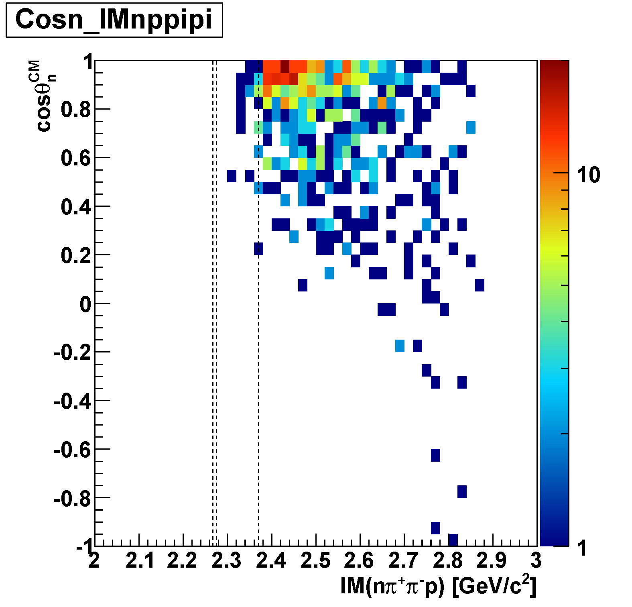
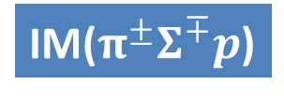
IM(πΣp) vs. cos(θ_{n}^{CM})
IM($π^{±}Σ^{∓}p$)
M(πΣp)
M(K⁻pp)
preliminary
cos(θ_{n-miss})

Slide 33
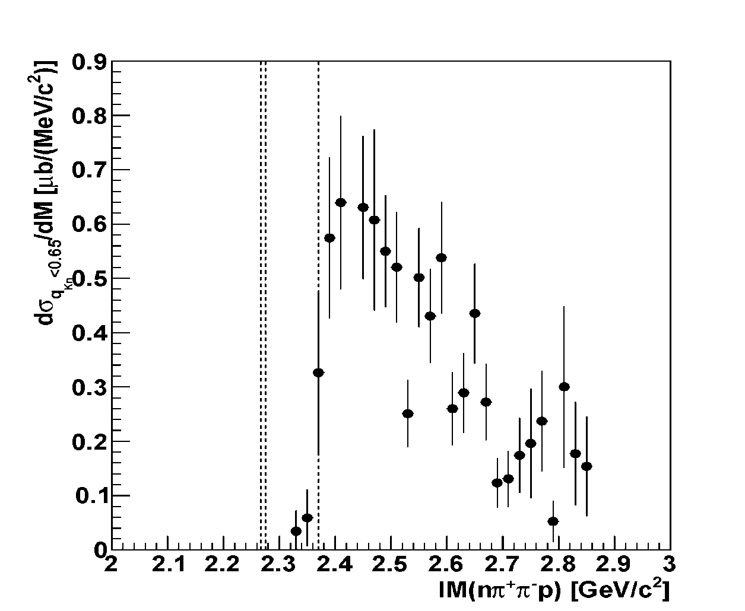
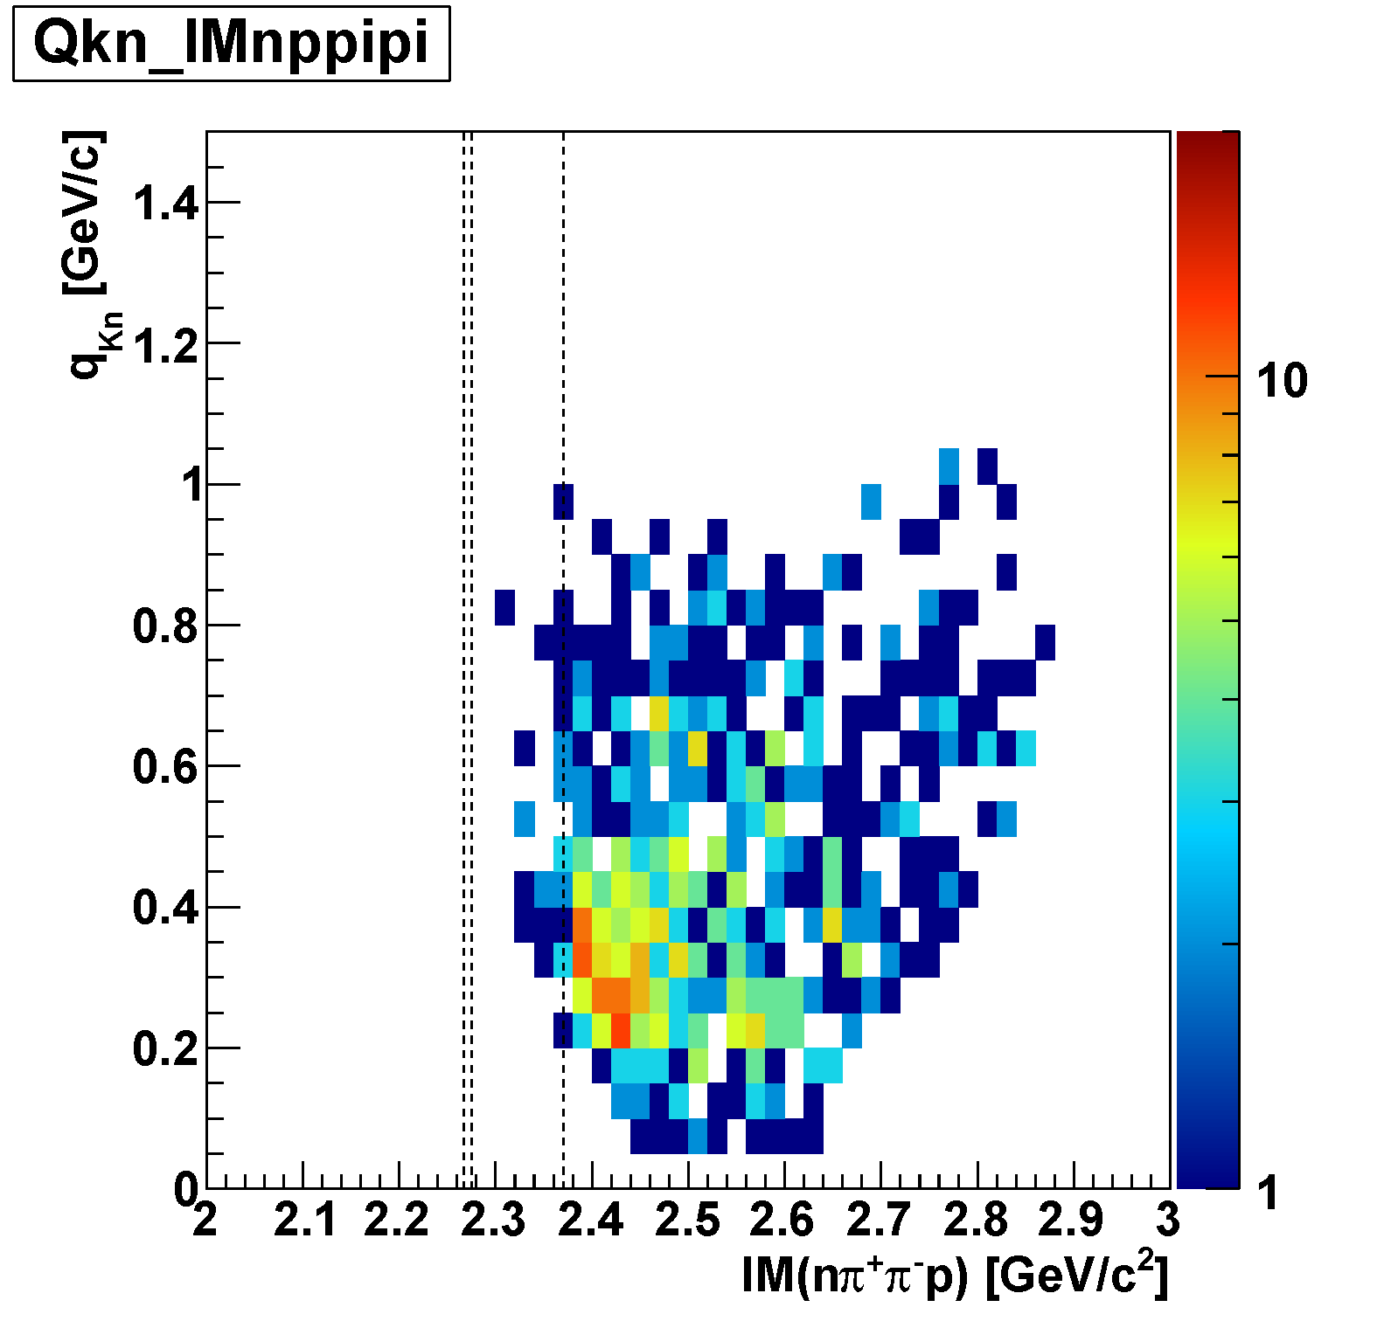

IM(πΣp) vs. Momentum Transfer q_{Kn}
IM($π^{±}Σ^{∓}p$)
M(πΣp)
M(K⁻pp)
q_{Kn}<0.65 GeV/c
preliminary
~ 2 μb
q_{Kn}
q_{Kn}<0.65

Slide 34




IM(Λp)
~ 20μb
Λp decay is dominant
below M(K⁻pp)
q_{Kn}<0.65 GeV/c
IM($π^{±}Σ^{∓}$p)
preliminary
~ 2μb

Slide 35




IM($π^{±}Σ^{∓}$) vs. IM($π^{±}Σ^{∓}p$)
preliminary
IM($π^{±}Σ^{∓}$)
K-
³He
1 GeV/c
kinematical limit
p
n
Λ(1405)
M(K⁻p)
Bound Region
p
M(πΣ)
p
QF
n
M(πΣp)
M(K⁻pp)
IM($π^{±}Σ^{∓}p$)
Λ(1405)
Small phase-space of “K⁻pp”→πΣN

Slide 36


Conclusions
We have observed a resonance peak below the K⁻pp threshold in ³He(K⁻,Λp)n, “K⁻pp”
  Binding energy: ~50 MeV
  Width: ~100 MeV
  S-wave form factor: ~400 MeV
Λ(1405) was clearly observed in $π^{±}Σ^{∓}$p n_{miss} final state
  Large CS of Λ*compared to “K⁻pp” formation
Weak structure below the K⁻pp threshold is seen in IM($π^{±}Σ^{∓}$p)
  Non-meonic YN decay modes would be dominant
← E15 collab., arXiv:1805.12275
← need theoretical feedbacks
  ← need further investigation of “K⁻pp” → πΣN

Slide 37
What we have to do next
More quantitative studies of the “K⁻pp”
  J^{P}
    Angular distributions of “K⁻pp”→Λp and Λ→π⁻p are consistent with S-wave, in current statistics
  πΣp decay mode
    Due to phase-space, or, detector acceptance(?)
Series of the kaonic nuclei searches:
  “K⁻ppn” via [K⁻ + ⁴He], “K⁻ppnn/K⁻pppnn” via [K⁻ + ⁶Li], etc.
  “K⁻K⁻pp” via [p^{bar} + ³He annihilation]
We need a 4π detector system
with γ/n sensitive detectors

Slide 38

Thank You!
J-PARC E15 Collaboration

Slide 39
Spares

Slide 40


Slide 41





A Theoretical Interpretation of E15
Sekihara, Oset, Ramos, arXiv:1607.02058
Chiral unitary approach
Uncorrelated
Λ(1405)p
state
quasi-elastic
kaon
scattering
K^{bar}NN
bound-state
B=16MeV
Γ=72 MeV
Opt.A (Watson)
Opt.A (Watson)
M[K+p+p]
M[K+p+p]

Slide 42
K^{bar}NN or NOT? --- Other Possibilities
A structure near K^{bar}NN threshold
Λ(1405)N bound state
  loosely-bound system, I=1/2, J^{π}=0⁻
  various decay modes, ΛN/ΣN/πΣN
πΛN-πΣN dibaryon
  structure near πΣN threshold
  I=3/2, J^{π}=2⁺ → no Λp decay (I=1/2)?
Double-pole K^{bar}NN
  loosely-bound K^{bar}NN, &
  broad resonance near the πΣN threshold → πΣN decay
Partial restoration of Chiral symmetry
  enhancement of the K^{bar}N interaction in dense nuclei
T. Uchino et al., NPA868(2011)53.
A structure near πΣN threshold
H. Garcilazo, A. Gal, NPA897(2013)167.
A. Dote, T. Inoue, T. Myo, PTEP (2015) 043D02.
S. Maeda, Y. Akaishi, T. Yamazaki, Proc. Jpn. Acad., B89(2013)418.

Slide 43


³He(K⁻,Λp)n: Decay Channel
Λp
M[K+p+p]
preliminary
Λp
Σ⁰p
sliced
Λp
Σ⁰p
Λp~Σ⁰p
Σ⁰p
πYN
Σ⁰p~πYN
Γ(Λp) > Γ(Σ⁰p) !?

Slide 44


Slide 45


Slide 46


Slide 47


Slide 48

DATA

Slide 49


Neutron ID with CDS
π⁺π⁻p events (3 tracks) in CDS with 4 CDH hits are selected
a CDH hit with CDC-veto (outer-layer) is applied to identify the “neutral hit”
dE vs. 1/β
dE-cut dependence
1.372 < 1/β
(p_{n}<1GeV/c)
neutron ID
5MeVee < dE
Neutron can be identified with CDS

Slide 50


Λ*pn Events
IM(nπ⁺π⁻) vs MM(π⁺π⁻pn)
M(Λ(1520))
M(Λ(1405))
Λ(1520)p n_{miss}
Λ(1405)p n_{miss}
M(n)
M(Λ)

Slide 51






Y* CS (q_{Kn}<0.65)
$πΣ$p n_{miss} final state
$π^{+}Λ$n n_{miss} final state
M(πΣ)
M(K⁻p)
IM($π^{±}Σ^{∓}$)
M(πΛ)
M(K⁻p)
IM($π^{+}Λ$)
Λ(1405)
preliminary
Σ⁺(1385)
preliminary
L = 3.0 nb⁻¹
~ 40 μb
πΛpn
phases-space
Λ(1520)
πΣpn
phases-space
assumption
we assume Σ⁰(1385) CS at 1.0 GeV/c to be:
σ(Σ^{*0}) ~ 1-2*σ(Σ^{*+})
Σ⁰(1385)
  K⁻ + ³He → Σ⁰(1385) + p + n: ~ 40-80 μb (assumption)
  K⁻ + ³He → Λ(1405) + p + n: ~ 130 μb
  K⁻ + ³He → Λ(1520) + p + n: ~ 70 μb

Slide 52

IM(πΣp) vs. Momentum Transfer q_{Kn}
IM($π^{±}Σ^{∓}p$)
M(πΣp)
M(K⁻pp)
q_{Kn}<0.65 GeV/c
preliminary
Corresponding to
Λ(1405) mass-region
~ 2 μb
q_{Kn}
q_{Kn}<0.65

Slide 53






Detector Acceptance: Λp vs. πΣp
Detector acceptance is different between Λp and πΣp
  At cosθ_{n}~1:
    Λp: flat acceptance
    πΣp: limited acceptance below the threshold
DATA
$$Λp$$
preliminary
detector
acceptance
MC
DATA
$$π^{±}Σ^{∓}p$$
M(K⁻pp)
M(πΣp)
cf. $π^{±}Σ^{∓}pn$-PS MC
w/ detector acceptance
M(πΣp)
M(K⁻pp)
preliminary
detector
acceptance

