Slide 1


K^{bar}-Nuclear Bound State at J-PARC
F. Sakuma, RIKEN
on behalf of the J-PARC E15 collaboration
“13th International Conference on Nucleus-Nucleus Collisions (NN2018)“
Dec. 4(Tue.)-8(Sat.), 2018 in Omiya, Saitama, Japan

Slide 2
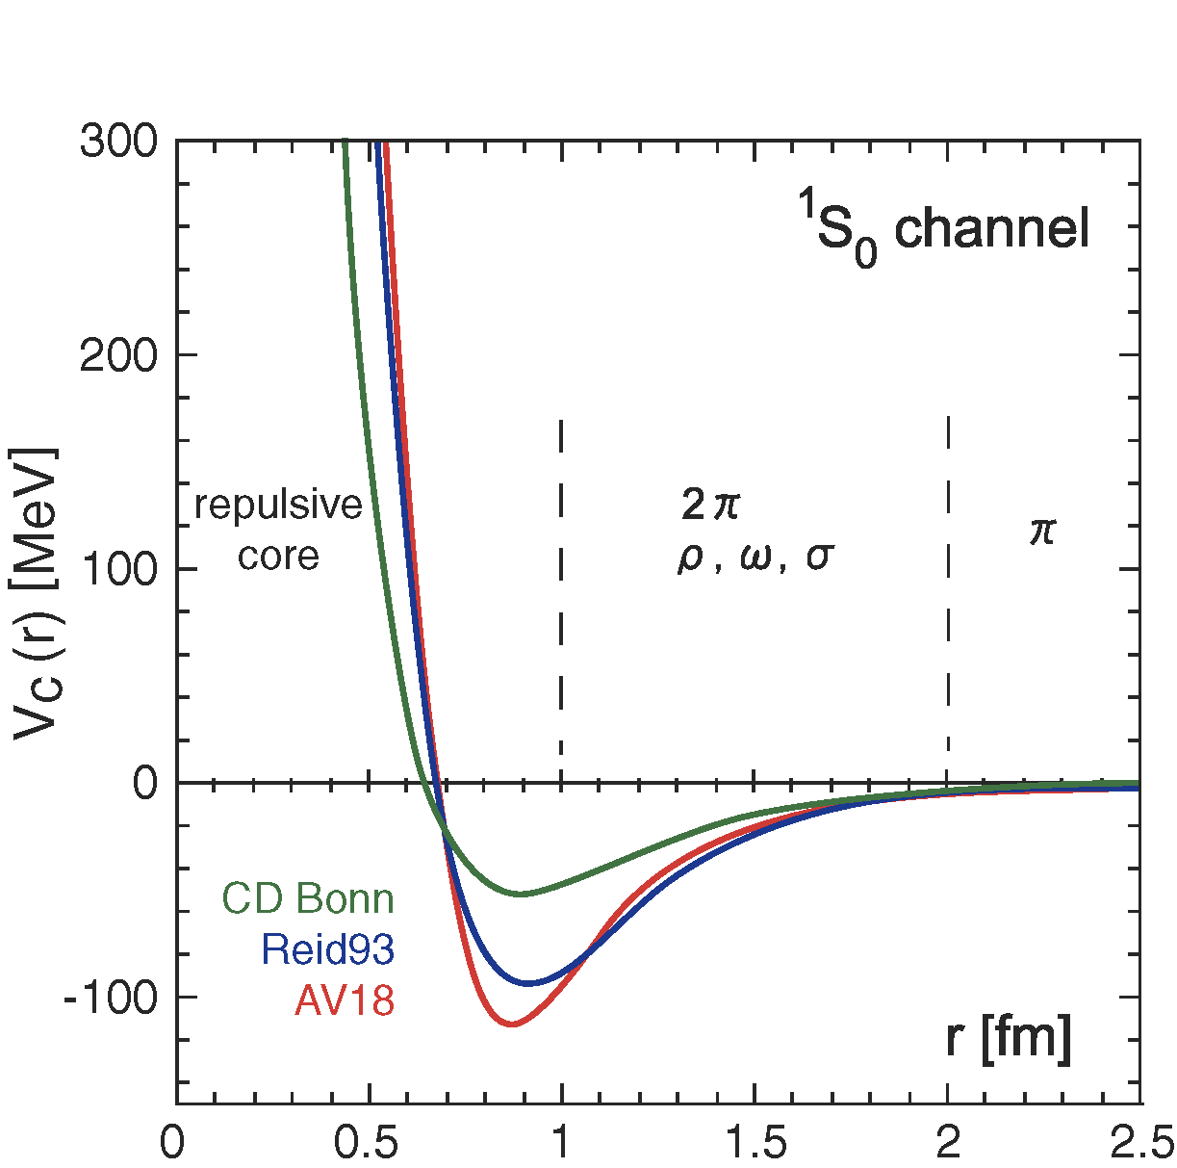
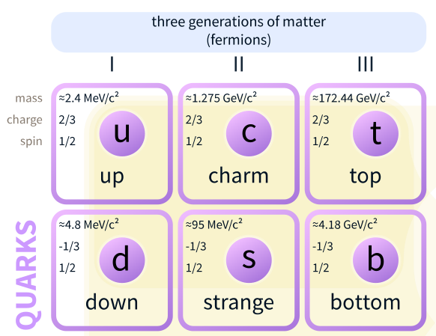


Meson-Baryon Interaction
“virtual” light mesons
  play an important role in a nucleus as “glue”
π⁻
$$\overline{u}$$
$$d$$
NN potential
Wikipedia
PRL99(2007)022001.

Slide 3
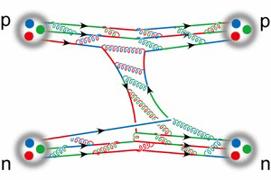
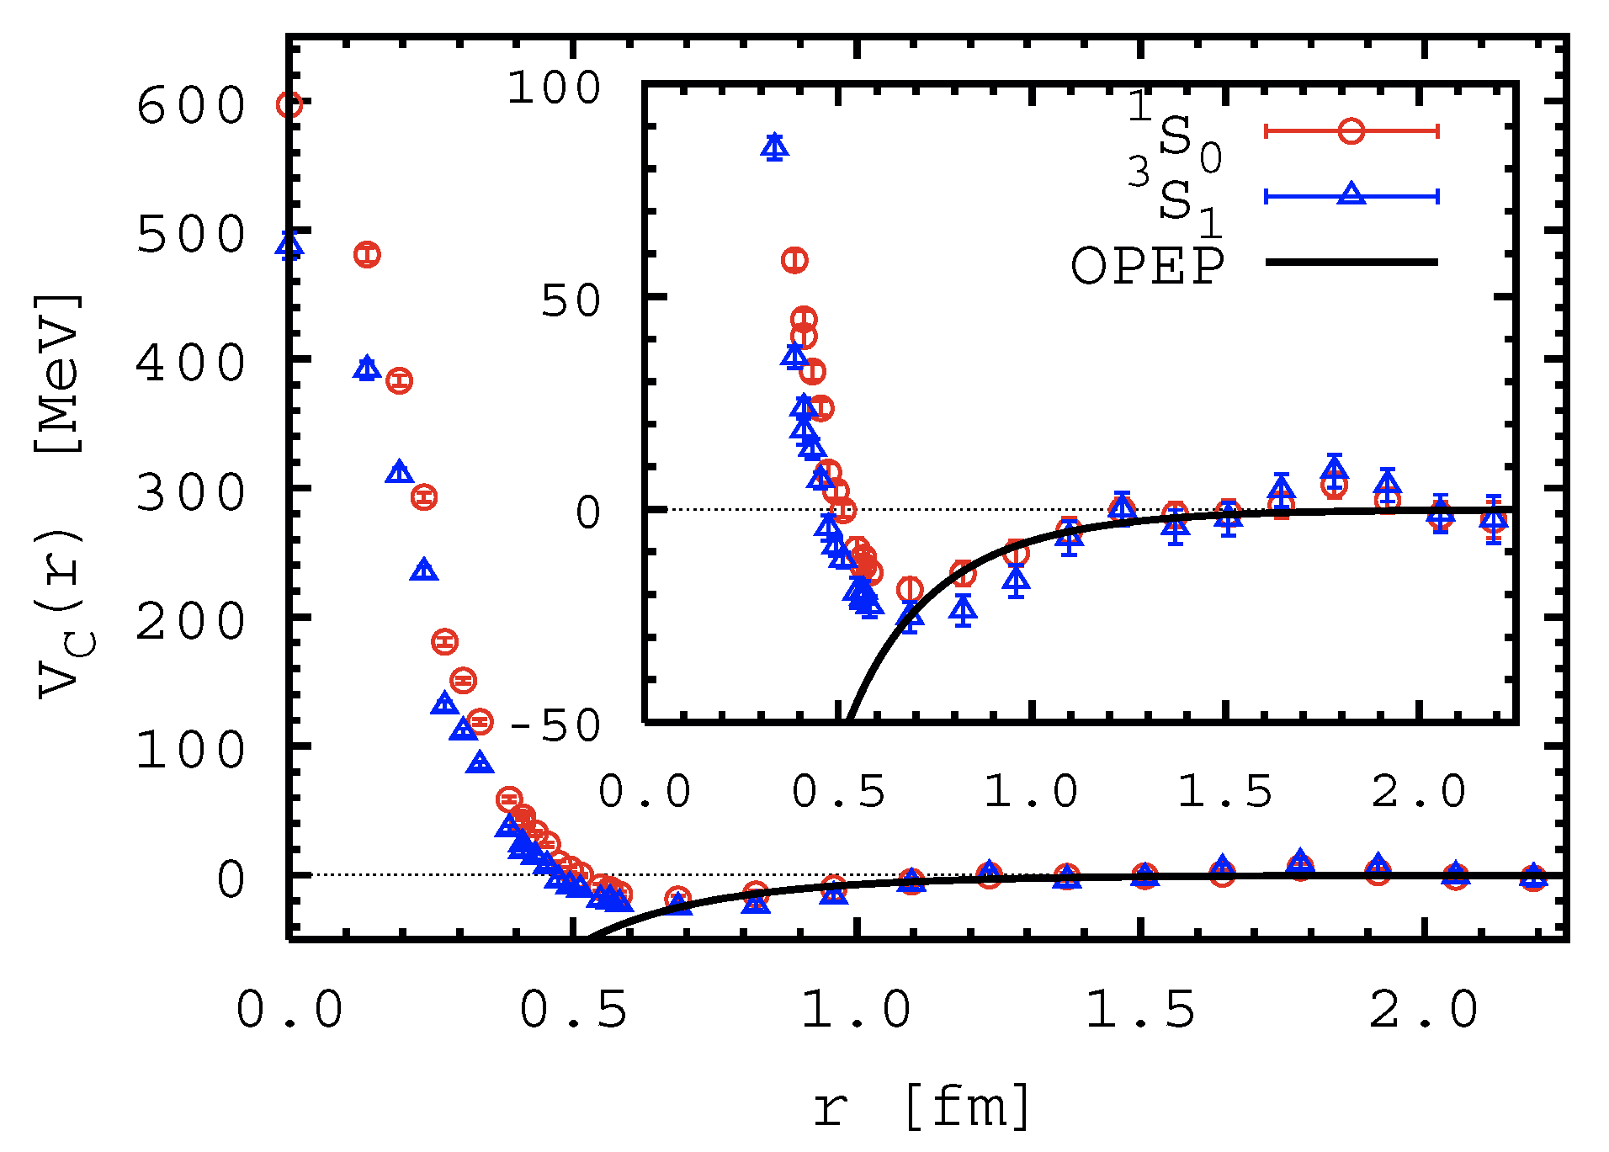
Meson-Baryon Interaction
“virtual” light mesons
  play an important role in a nucleus as “glue”
π⁻
$$\overline{u}$$
$$d$$
LQCD calculation
π⁰
PRL99(2007)022001.

Slide 4
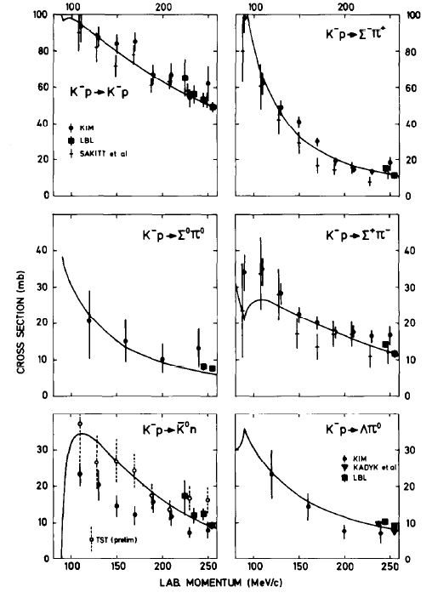
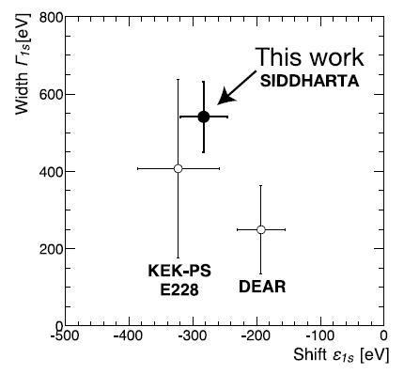

Κ⁻ Meson in Nucleus?
Lightest S=-1 meson, Κ⁻
  K^{bar}-N interaction: strongly attractive in I=0
Κ⁻
$$\overline{u}$$
$$s$$
K⁻p atom
PLB704(2011)113.
K⁻N scattering
NPB179(1981)33.
Wikipedia

Slide 5
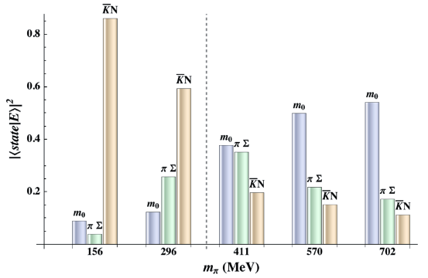
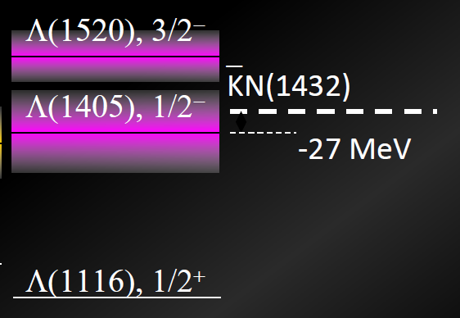


Κ⁻ Meson in Nucleus?
Lightest S=-1 meson, Κ⁻
  K^{bar}-N interaction: strongly attractive in I=0
Λ(1405)
  considered as a K^{bar}N molecular state
$$p$$
$$K^{−}$$
Λ(1405)
K^{bar}N molecule from LQCD
Br(Λ(1405)→πΣ) ~ 100%
πΣ(1333)
PRL114(2015)132002.

Slide 6
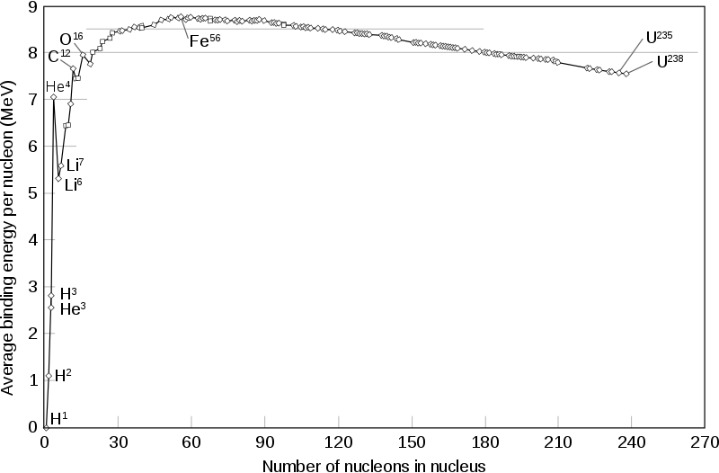
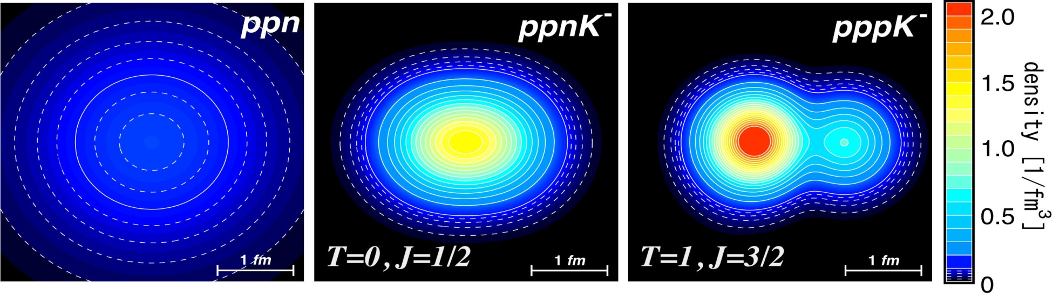
K^{bar}-Nuclear Bound State
Predicted from attractive K^{bar}N interaction in I=0
Y.Akaishi and T.Yamazaki, PRC65(2002)044005.
A. Dote et al. PRC70(2004)044313. etc.
Kaonic Nuclei | Binding Energy [MeV] | Width [MeV] | Central Density
K⁻p | 27 | 40 | 3.5ρ₀
K⁻pp | 48 | 61 | 3.1ρ₀
K⁻ppp | 97 | 13 | 9.2ρ₀
K⁻ppn | 118 | 21 | 8.8ρ₀
c.f. Nuclear Binding Energy
few MeV @ A = 2,3

Slide 7
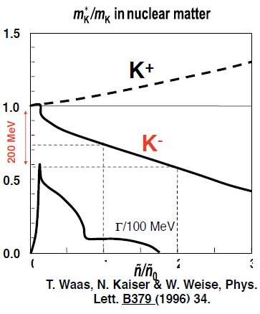
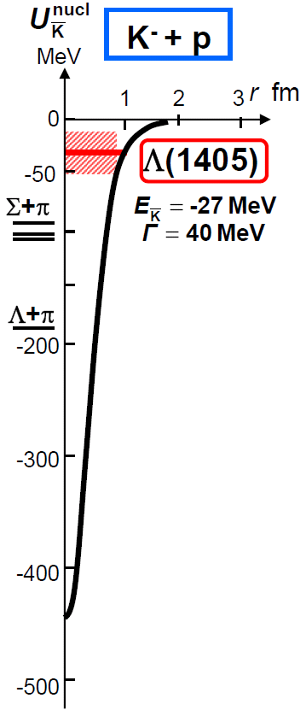
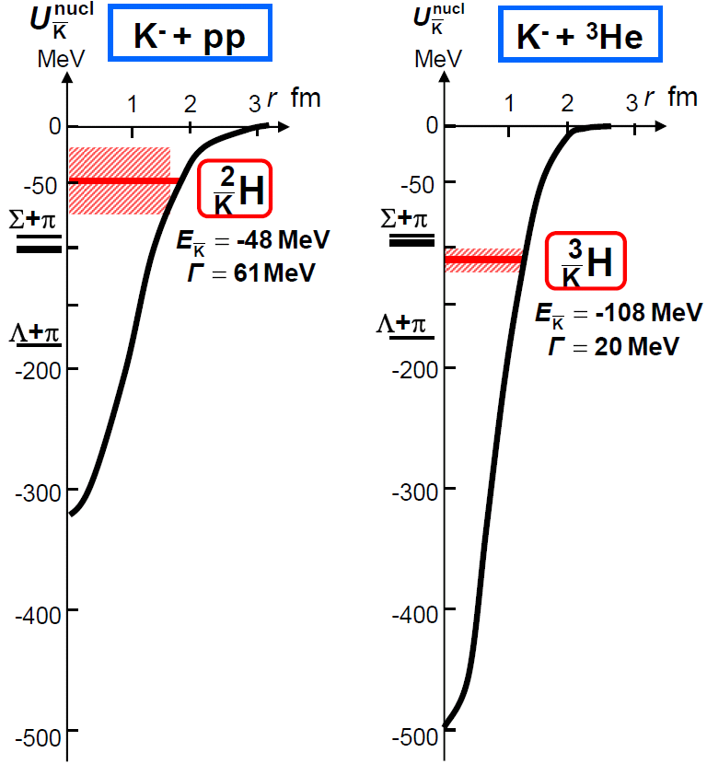
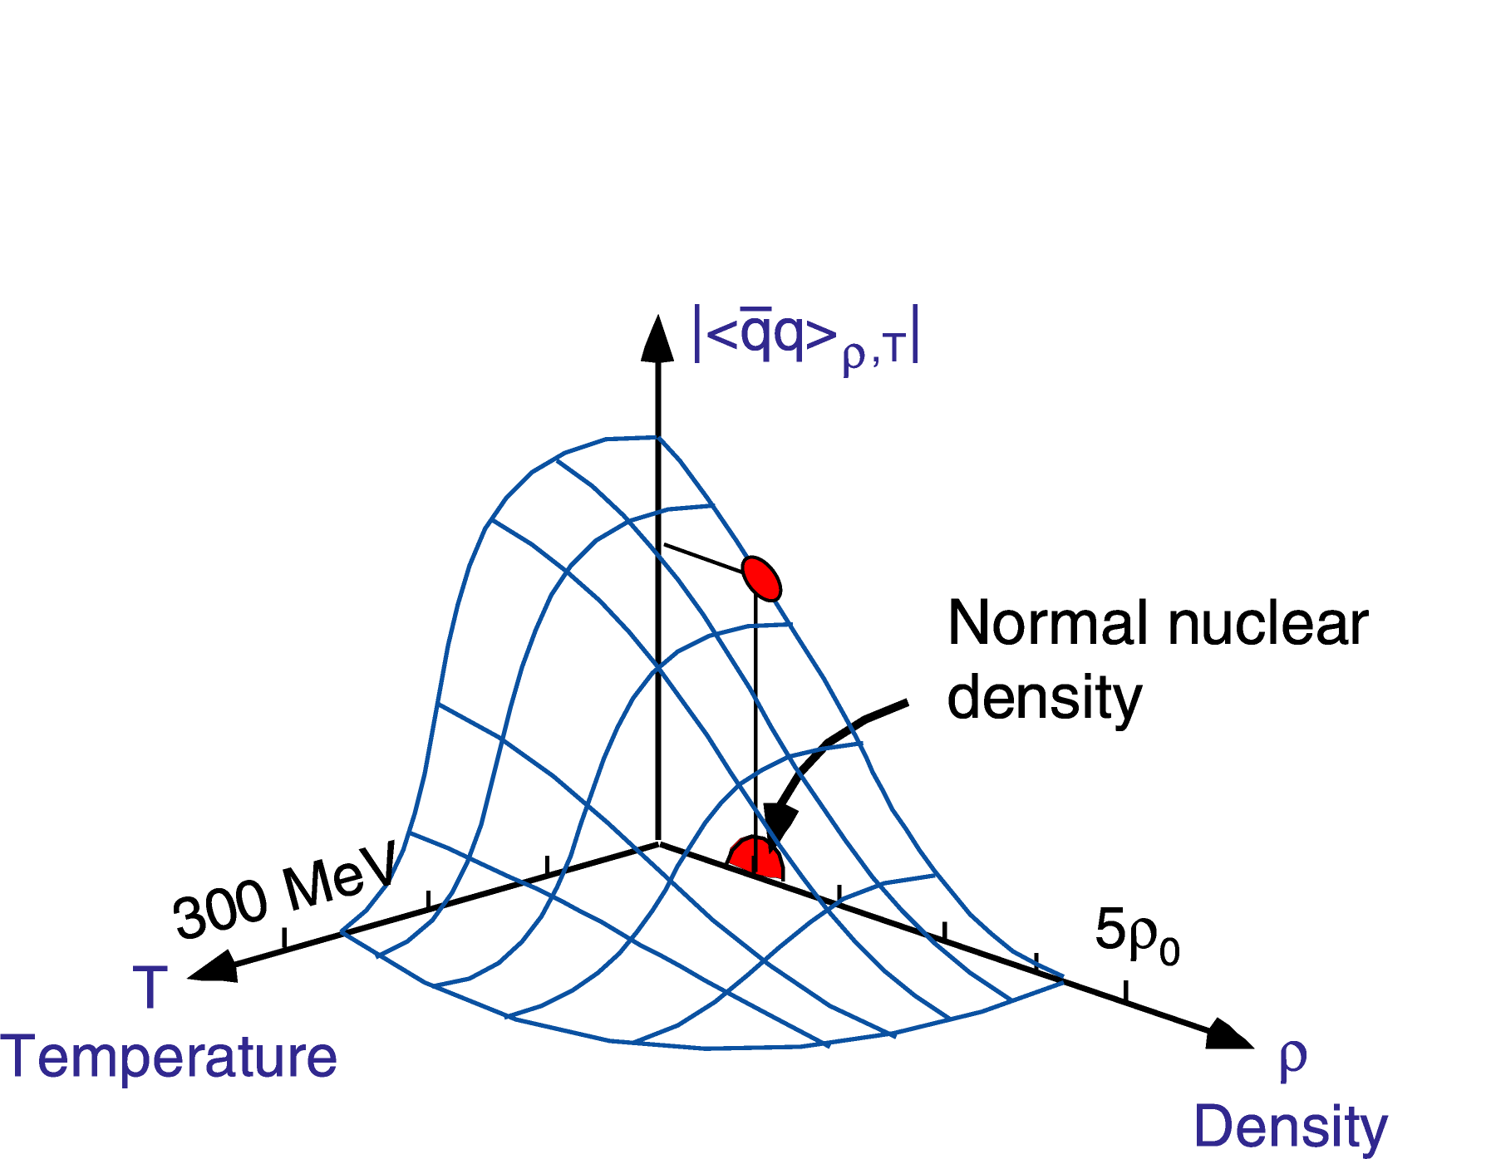
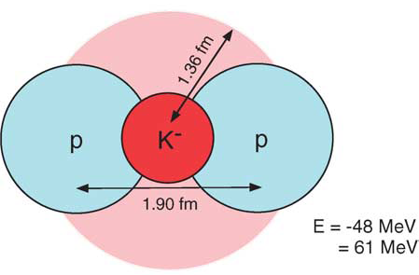
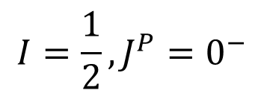
K^{bar}-Nuclear Bound State
Y.Akaishi & T.Yamazaki, PLB535, 70(2002).
Kaonic Nuclei
Meson Properties
in Media
0
1
2
3
$$I=\frac{1}{2}, J^{P}=0^{−}$$
W.Weise NPA553, 59 (1993).
Chiral Symmetry = Origin of the QCD Mass

Slide 8
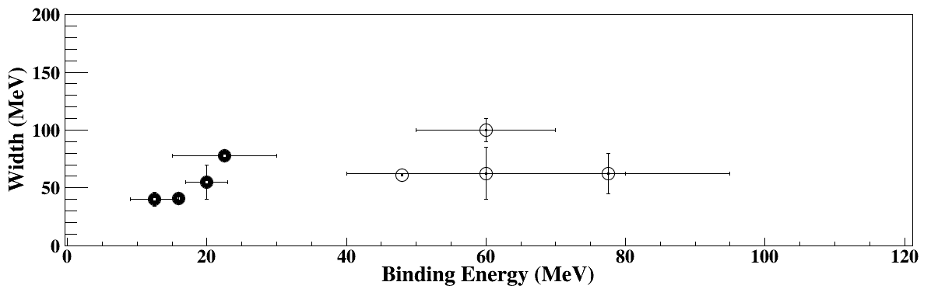
Theoretical Calculations on “K⁻pp”
K^{bar}N int. | Chiral SU(3) (energy dependent) |  |  |  | Phenomenological (energy independent)
Method | Variational |  | Faddeev |  | Variational |  | Faddeev
 | Barnea, Gal, Liverts | Dote, Hyodo, Weise | Ikeda, Kamano, Sato | Bayar, Oset | Yamazaki, Akaishi | Wyceck, Green | Shevchenko, Gal, Mares | Ikeda, Sato
B (MeV) | 16 | 17-23 | 9-16 | 15-30 | 48 | 40-80 | 50-70 | 60-95
Γ (MeV) | 41 | 40-70 | 34-46 | 75-80 | 61 | 40-85 | 90-110 | 45-80
B.E. ~ 20 MeV
B.E. ~ 40-70 MeV
Γ ~ 40-100 MeV

Slide 9
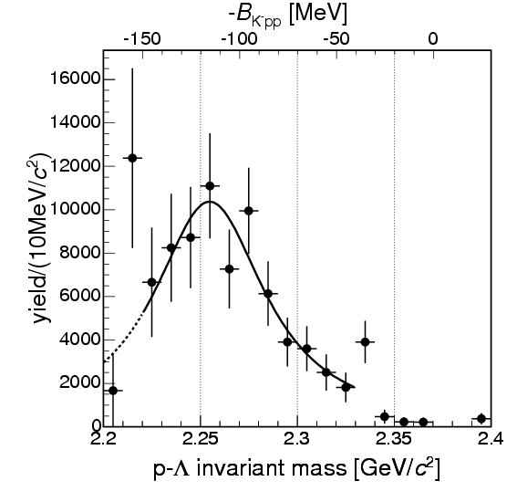
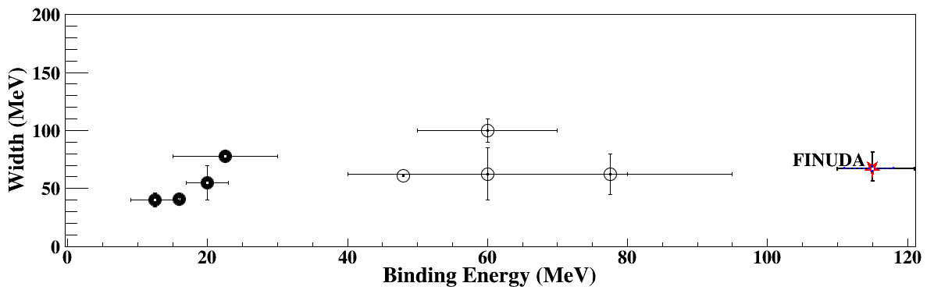
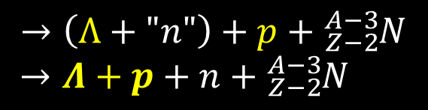
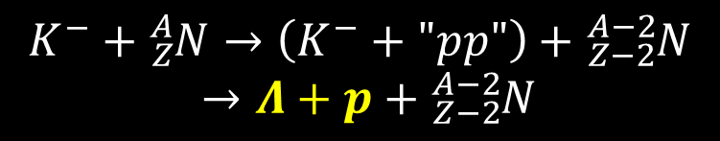
“K⁻pp” Search via Stopped-K⁻
FINUDA@DAΦNE
multi-nucleon absorption processes followed by FSI?
  PRC74(2006)025206
  PRC82(2010)034608
⁶Li+⁷Li+¹²C(stopped K⁻, Λp)
“K⁻pp”
M(K+p+p)
$$K^{−}+{}_{Z}^{A}N→\left(K^{−}+"pp"\right)+{}_{Z−2}^{A−2}N$$
$→Λ+p+{}_{Z−2}^{A−2}N$
(2NA)
$$→\left(Λ+"n"\right)+p+{}_{Z−2}^{A−3}N$$
$→Λ+p+n+{}_{Z−2}^{A−3}N$
PRL94(2005)212303
(FSI)

Slide 10
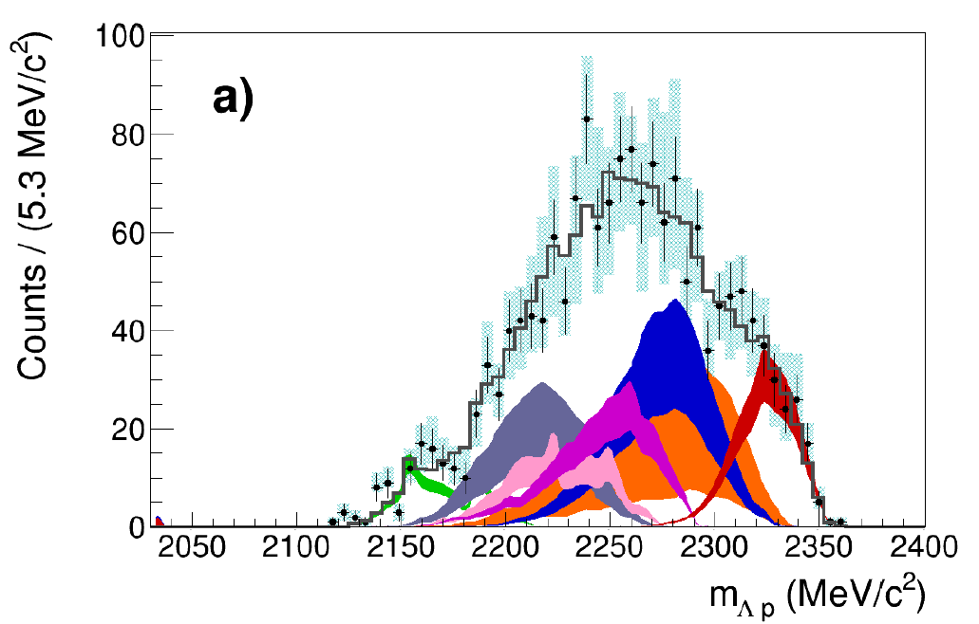
“K⁻pp” Search via Stopped-K⁻
FINUDA@DAΦNE
AMADEUS@DAΦNE
⁶Li+⁷Li+¹²C(stopped K⁻, Λp)
¹²C(stopped K⁻, Λp)
NO need of
“K⁻pp”
M(K+p+p)
M(K+p+p)
multi-nucleon
absorption
many BGs
PRL94(2005)212303
nucl-ex:1809.07212
?

Slide 11
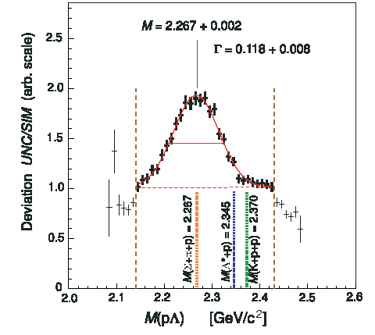
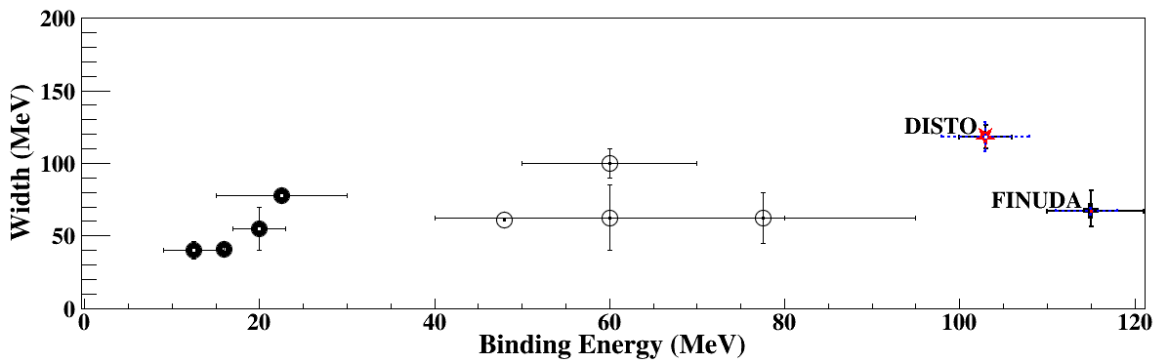
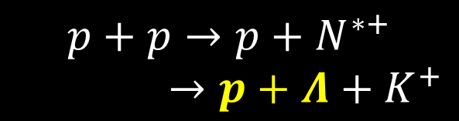
“K⁻pp” Search via pp Collision
DISTO@SATURNE
p + p → (Λ + p) + K⁺ @ 2.85GeV
“K⁻pp”
contribution of N^{*+}→ΛK⁺?
  PRC92(2015)044002
M(K+p+p)
Exp/Sim
$$p+p→p+N^{∗+}$$
$→p+Λ+K^{+}$
PRL104(2010)132502
?

Slide 12
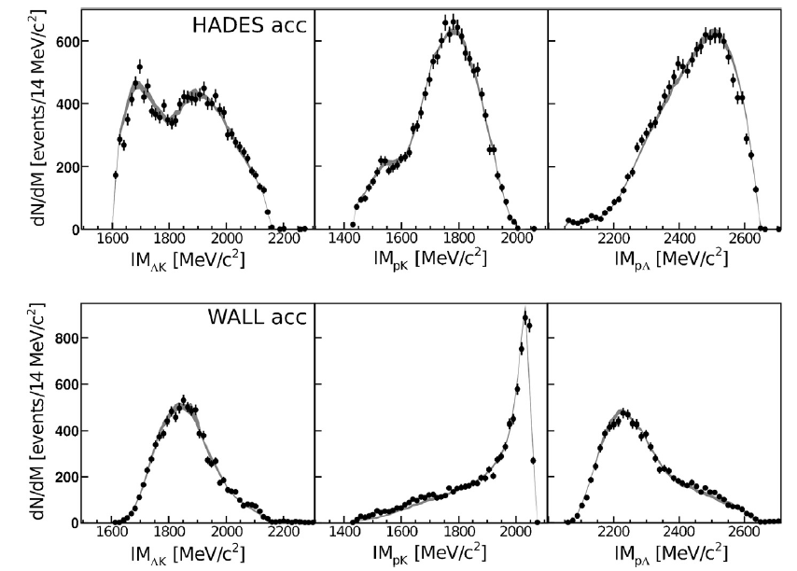
“K⁻pp” Search via pp Collision
DISTO@SATURNE
HADES@GSI
p + p → (Λ + p) + K⁺ @ 2.85GeV
p + p → (Λ + p) + K⁺ @ 3.5GeV
NO need of
“K⁻pp”
M(K+p+p)
PWA w/ N^{*+}→ΛK⁺
Exp/Sim
many N*s
M(K+p+p)
PRL104(2010)132502
PLB742(2015)242
JPS Conf. Proc. , 082003 (2017)
?
?

Slide 13
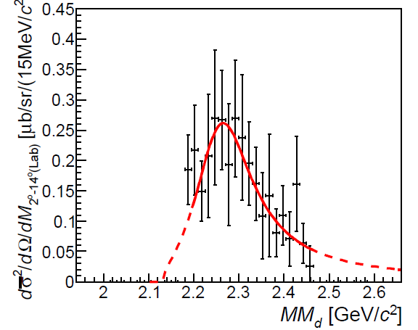
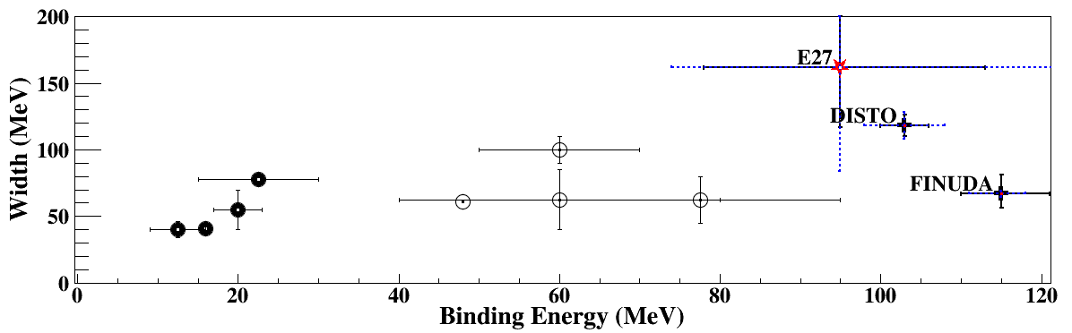
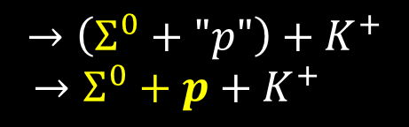

“K⁻pp” Search via d(π⁺,K⁺)X
E27@J-PARC
M(π+Σ+N)
M(Σ⁰+N)
M(K+p+p)
d(π⁺, K⁺)Σ⁰p @ 1.69 GeV/c
“K⁻pp”
need more statistics and wide acceptance detector
$$π^{+}+d→Σ^{0}+K^{+}+p_{spect}$$
(QF)
$$→\left(Σ^{0}+"p"\right)+K^{+}$$
$→Σ^{0}+p+K^{+}$
(FSI)
PTEP(2015)021D01.
Still controversial
(intermediate state is of importance)
need more simple reaction
to clarify the situation
?
?

Slide 14


J-PARC E15 Experiment
³He(in-flight K⁻,n) reaction @ 1.0 GeV/c
  2NA and Y decays can be discriminated kinematically
semi-inclusive ³He(K⁻,n)
T. Hashimoto et al., PTEP (2015) 061D01.
exclusive (K⁻,Λp)n_{missing}
Y. Sada et al., PTEP (2016) 051D01.
Updated with high-statistics data
(arXiv:1805.12275, accepted to PLB)

Slide 15

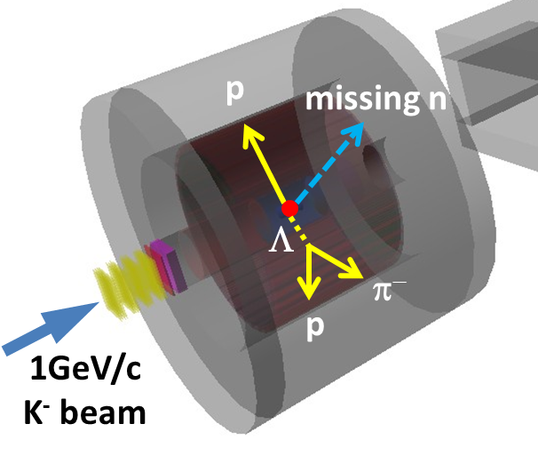
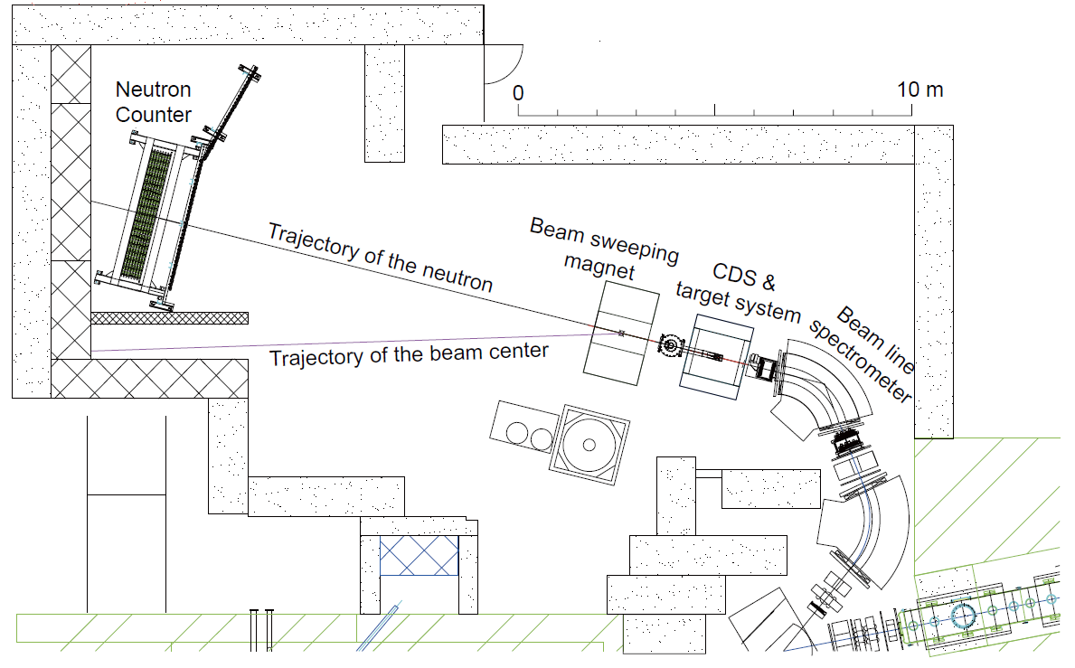
Experimental Setup @ K1.8BR
15m

Slide 16
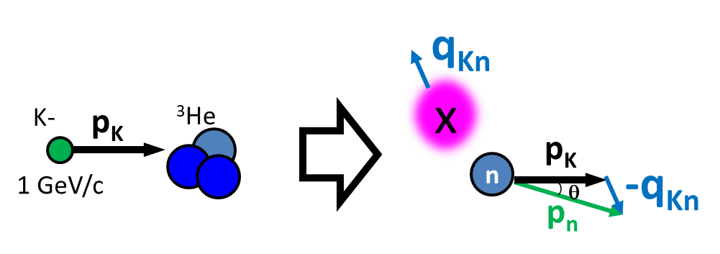
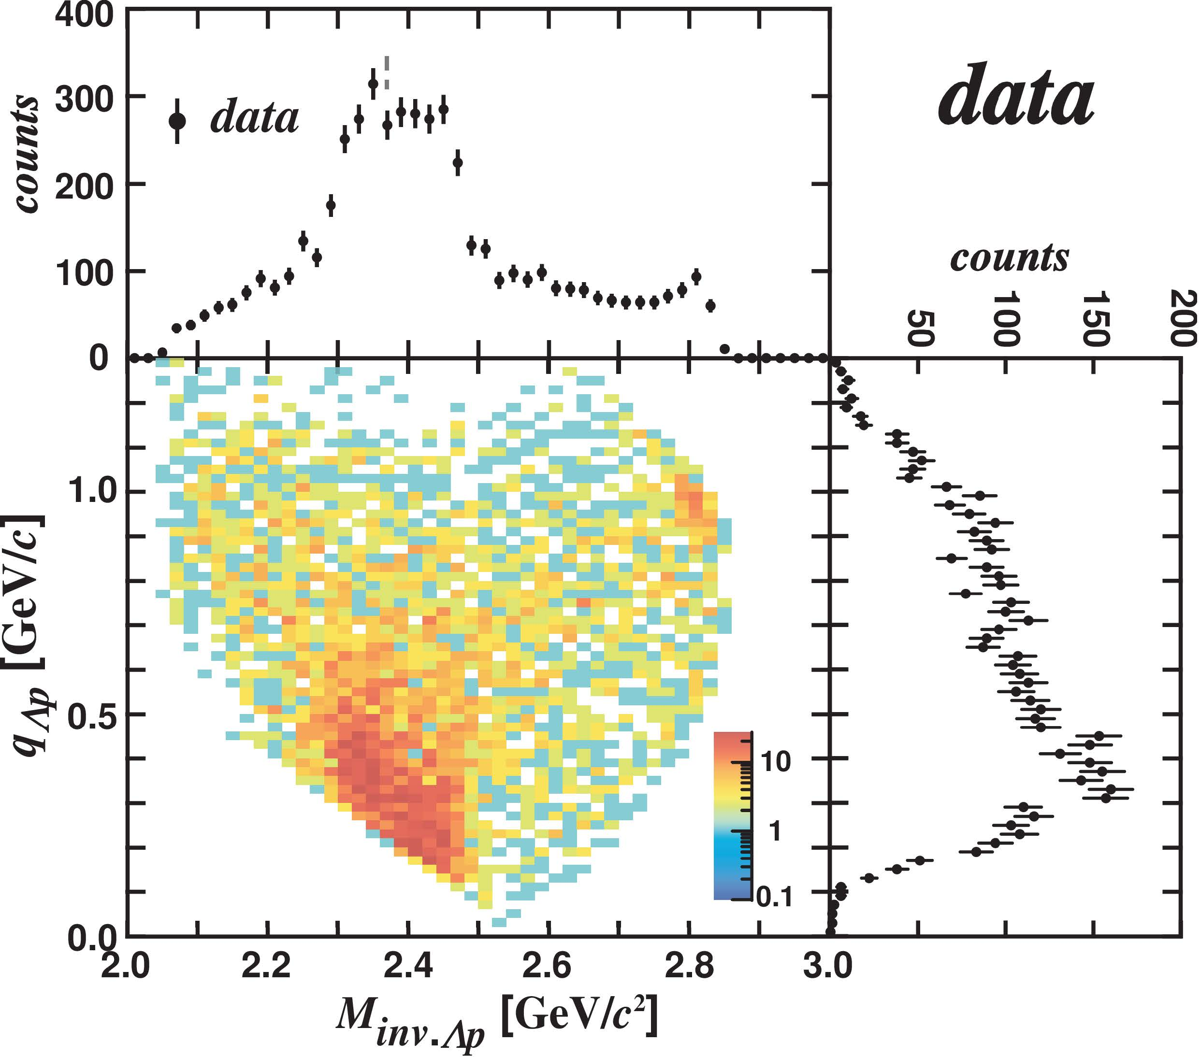
IM(Λp) vs. Momentum Transfer q_{Kn}
E15 collab., arXiv:1805.12275
IM(Λp)
Can be interpreted as 3 components
  Bound state
    centroid DOES NOT depend on q_{Kn}
  Quasi-elastic K⁻ abs.
    centroid depends on q_{Kn}
  Background
    Broad distribution
M(K+p+p)
QF
q_{Kn}
BS
BG

Slide 17
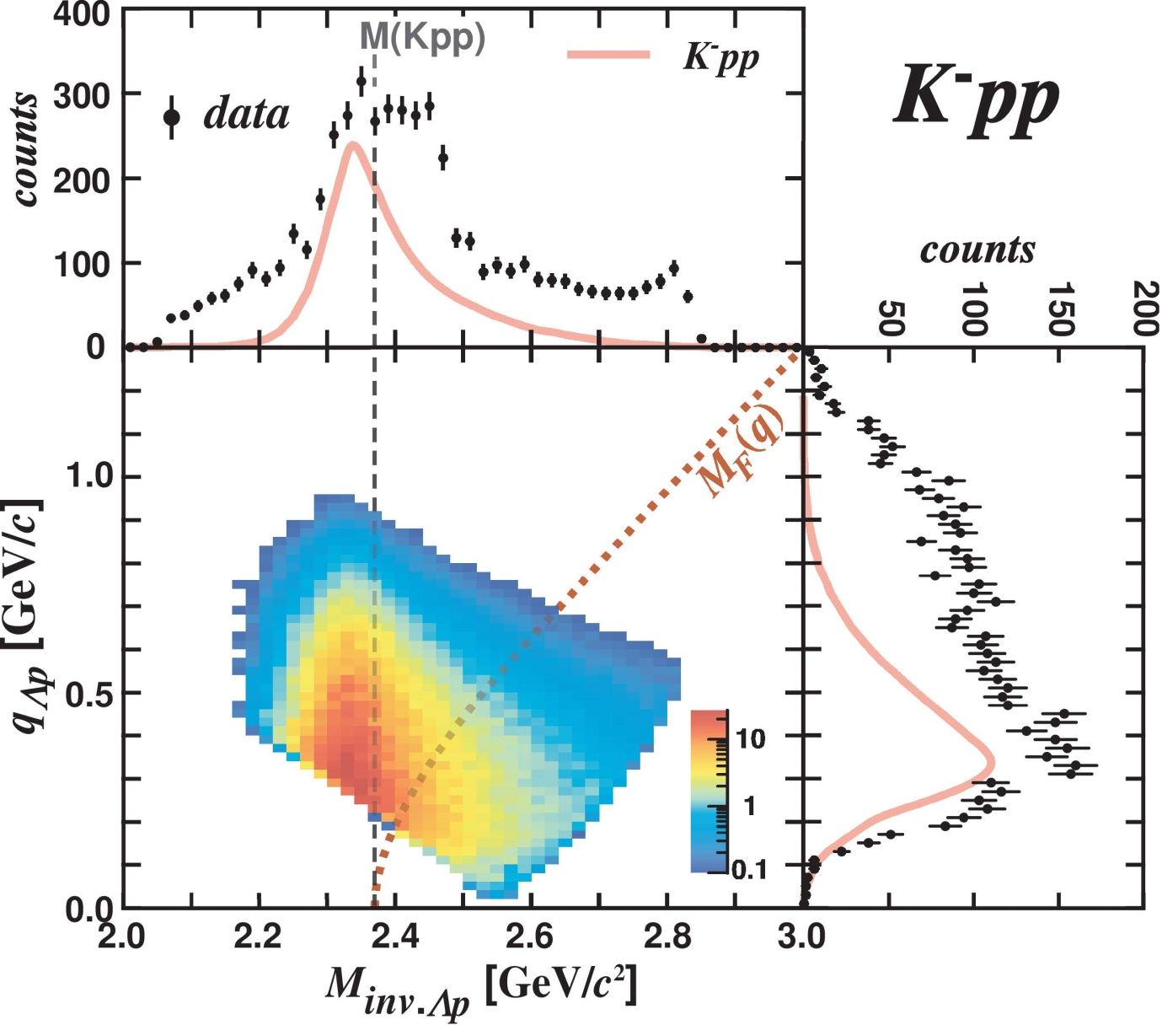
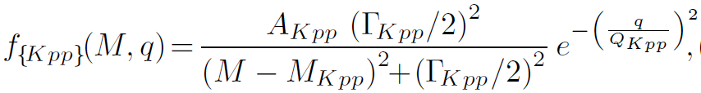
IM(Λp) vs. Momentum Transfer q_{Kn}
E15 collab., arXiv:1805.12275
IM(Λp)
Fit with 3 components
  Bound state
    centroid DOES NOT depend on q_{Kn}
    BW*(Gauss form-factor)
q_{Kn}
K-
³He
1 GeV/c
“x”
n
p
n
Λ

Slide 18
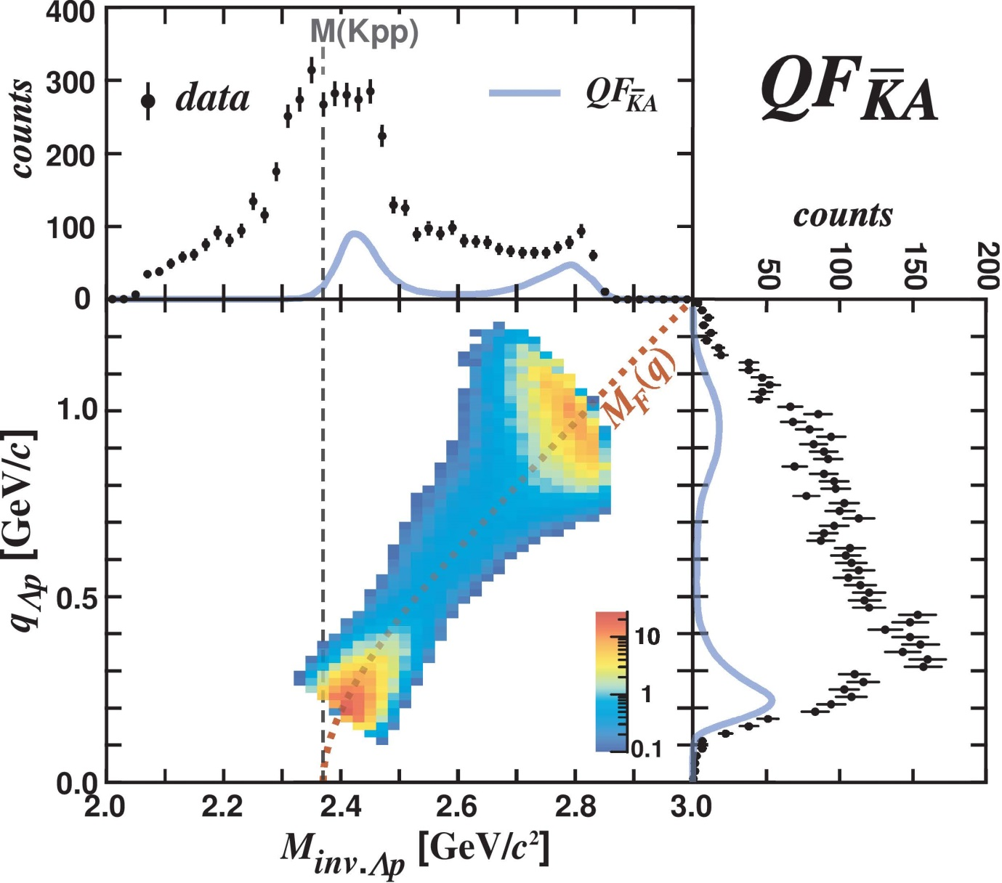
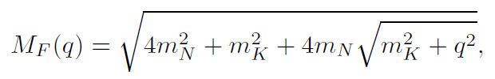
IM(Λp) vs. Momentum Transfer q_{Kn}
E15 collab., arXiv:1805.12275
IM(Λp)
Fit with 3 components
  Quasi-elastic K⁻ abs.
    centroid depends on q_{Kn}
    Followed by Λp conversion
q_{Kn}
K-
³He
2NA:
“n” is a spectator
1 GeV/c
p
K-
n
p
forward “n”
p
n
Λ

Slide 19
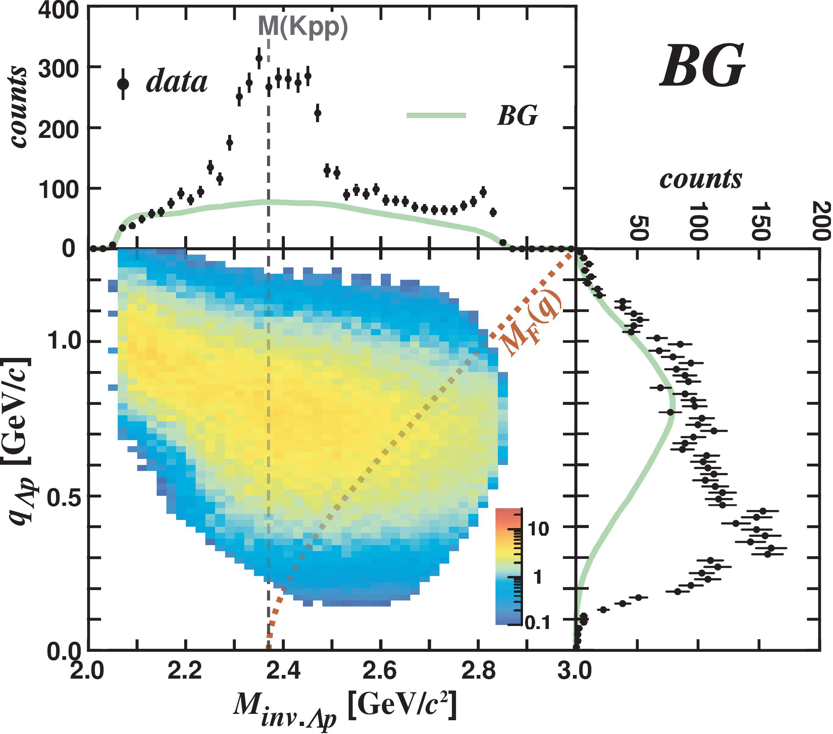
IM(Λp) vs. Momentum Transfer q_{Kn}
E15 collab., arXiv:1805.12275
IM(Λp)
Fit with 3 components
  Background
    Broad distribution
q_{Kn}
K-
³He
1 GeV/c
p
n
Λ

Slide 20
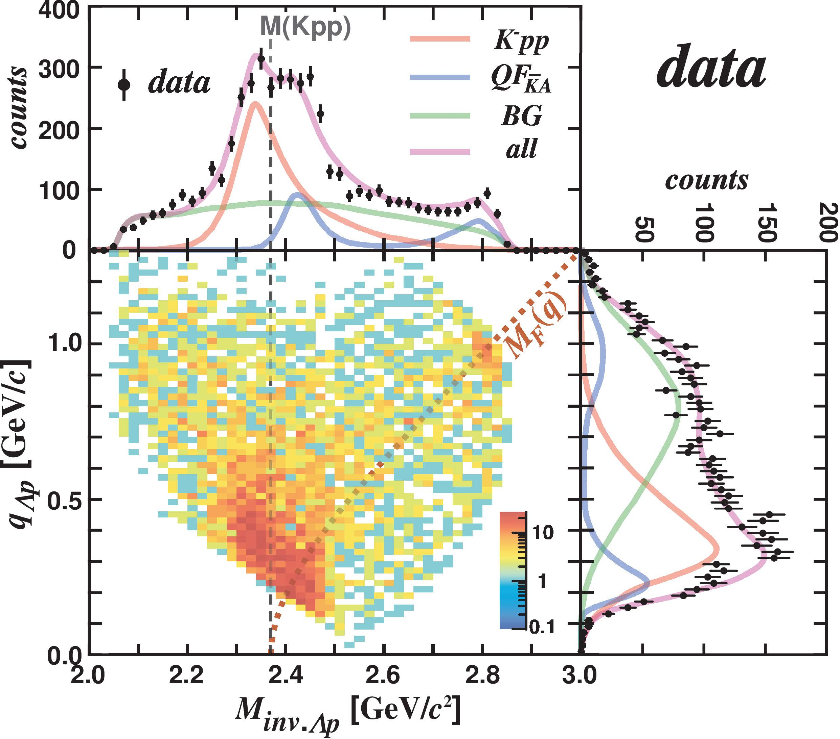
IM(Λp) vs. Momentum Transfer q_{Kn}
E15 collab., arXiv:1805.12275
IM(Λp)
Fit with 3 components
  Bound state
    centroid DOES NOT depend on q_{Kn}
    BW*(Gauss form-factor)
  Quasi-elastic K⁻ abs.
    centroid depends on q_{Kn}
    Followed by Λp conversion
  Background
    Broad distribution
q_{Kn}
Reproduced well!

Slide 21
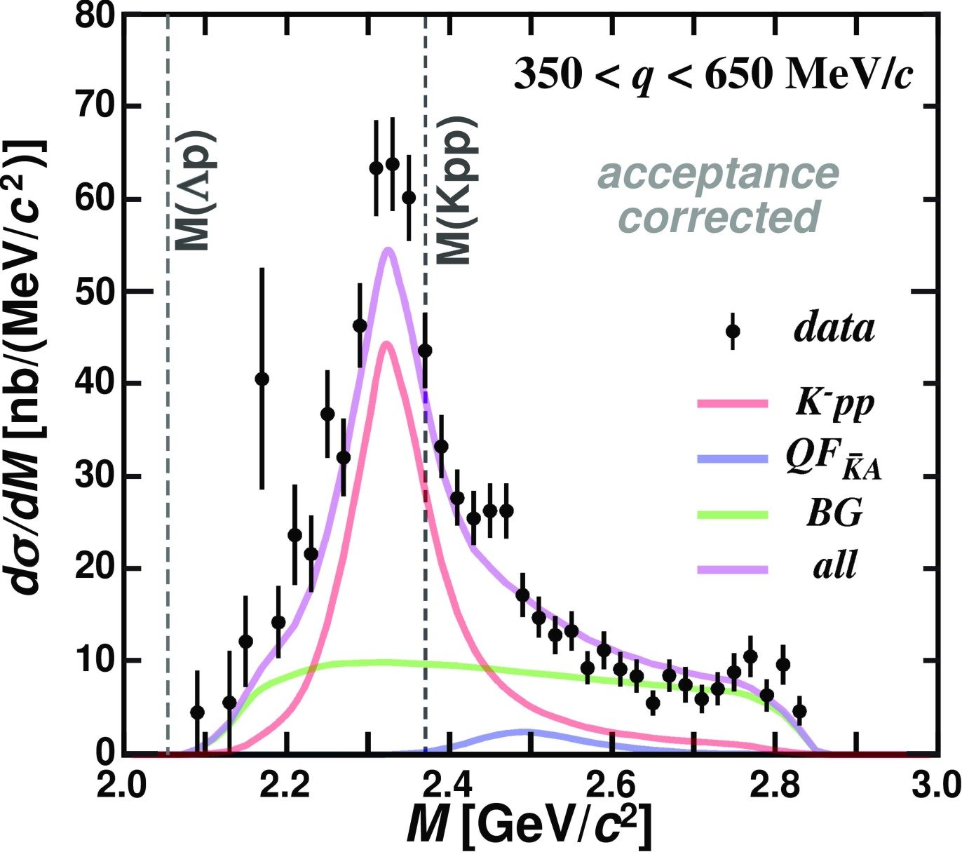
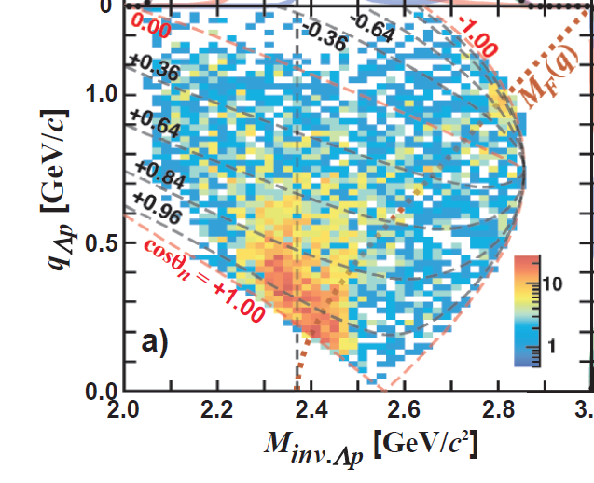
“K⁻pp” Bound-State
Select 0.35<q_{Kn}<0.65 GeV/c
  BS and QF are well separated
“K⁻pp”
E15 collab., arXiv:1805.12275

Slide 22
“K⁻pp” Bound-State
Fit values
that reproduce the spectrum:
$$B_{"Kpp"}=47 ± {3 \left(stat.\right) }_{−6}^{+3} \left(syst.\right) MeV$$
“K⁻pp”
$$Γ_{"Kpp"}=115 ± {7 \left(stat.\right) }_{−20}^{+10} \left(syst.\right) MeV$$
$$Q_{"Kpp"}=381 ± {14 \left(stat.\right) }_{−0}^{+57} \left(syst.\right) MeV$$
$$σ_{“Kpp”}∙{Br}_{Λp}=11.8 ± {0.4 \left(stat.\right) }_{−1.7}^{+0.2} \left(syst.\right) μb$$
E15 collab., arXiv:1805.12275

Slide 23

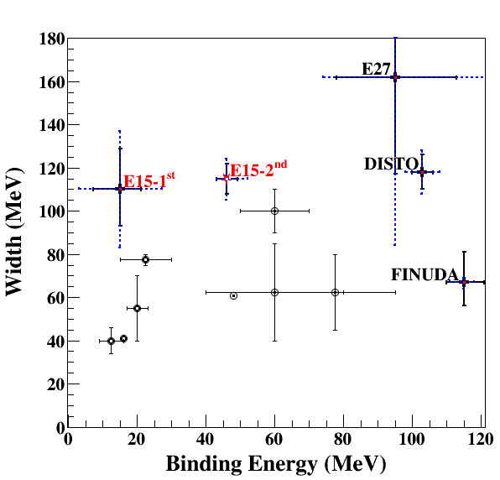
Observed “K⁻pp”
the most reliable observation
- simple reaction
- exclusive measurement
- no BG from 2NA
π⁺d→K⁺X
K⁻³He→nX
pp→K⁺X
Binding energy: ~50 MeV
  Much deeper than chiral-SU(3) based theoretical predictions
Width: ~100 MeV
  Seems to be larger than theoretical calculations
stopped K⁻
Chiral
Phenomenological

Slide 24
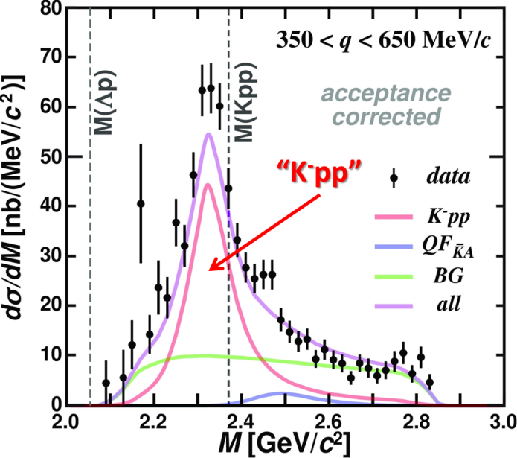
Conclusion I
We observed the “K⁻pp” bound state in ³He(K⁻,Λp)n
  Binding energy: ~50 MeV
  Width: ~100 MeV
← arXiv:1805.12275, accepted to PLB

Slide 25
We need further understandings
Spin/Parity of the “K⁻pp”
  New 4π detector system is needed
Other decay channels
  πΣN mesonic decay is theoretically expected to be the dominant channel
    Only YN non-mesonic decays were reported
Reaction mechanism
  Relation between Λ(1405) & “K⁻pp”
    Λ(1405) has been considered as “K⁻p”
    Theoretically, “K⁻pp” is expected to be produced via Λ(1405)+p→”K⁻pp” door-way process
← Future plan
K⁻ ³He → πΣpn

Slide 26
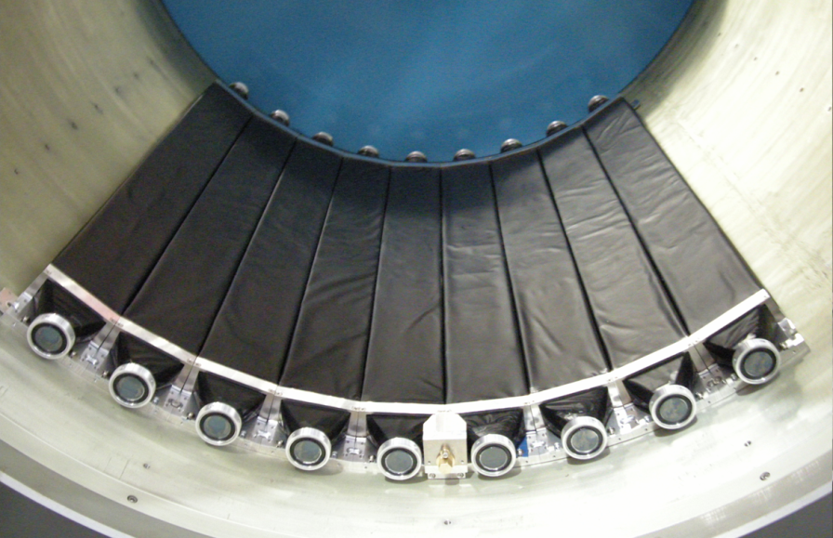
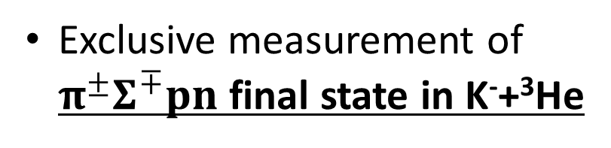
K⁻ ³He → πΣpn @ E15
CDS
Exclusive measurement of $π^{±}Σ^{∓}pn$ final state in K⁻+³He
p
“X”
K-
³He
n
1 GeV/c
Σ
π
n
π
CDS
Experimental challenge of neutron detection with thin scintillation counter (t=3cm)
t = 3cm
79cm
10cm
n detection efficiency ~ 3-10%

Slide 27
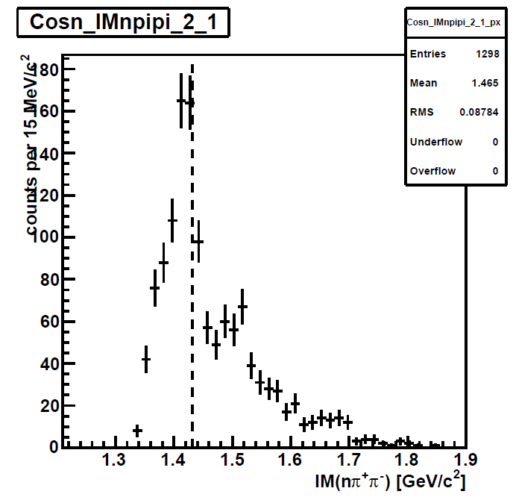
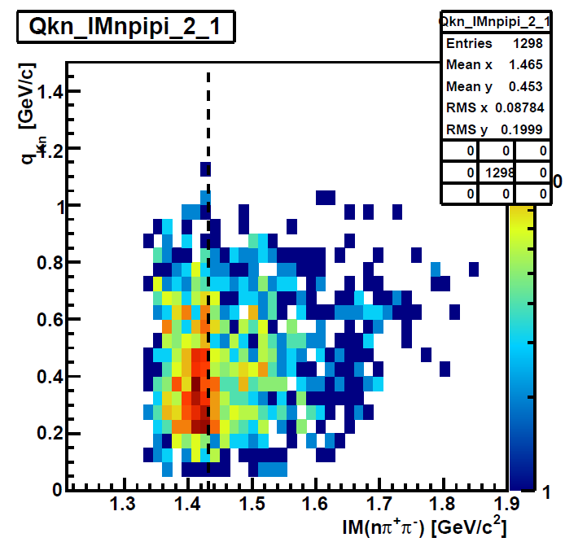


IM($π^{±}Σ^{∓}$) in $π^{±}Σ^{∓}pn$ Final State
Σ(1385)/Λ(1405)
IM($π^{±}Σ^{∓}$)
Λ(1520)
preliminary
Y* can be clearly seen in low q_{Kn}
→ First measurement of Y* in K⁻³He
M(πΣ)
M(K⁻p)
q_{Kn}

Slide 28
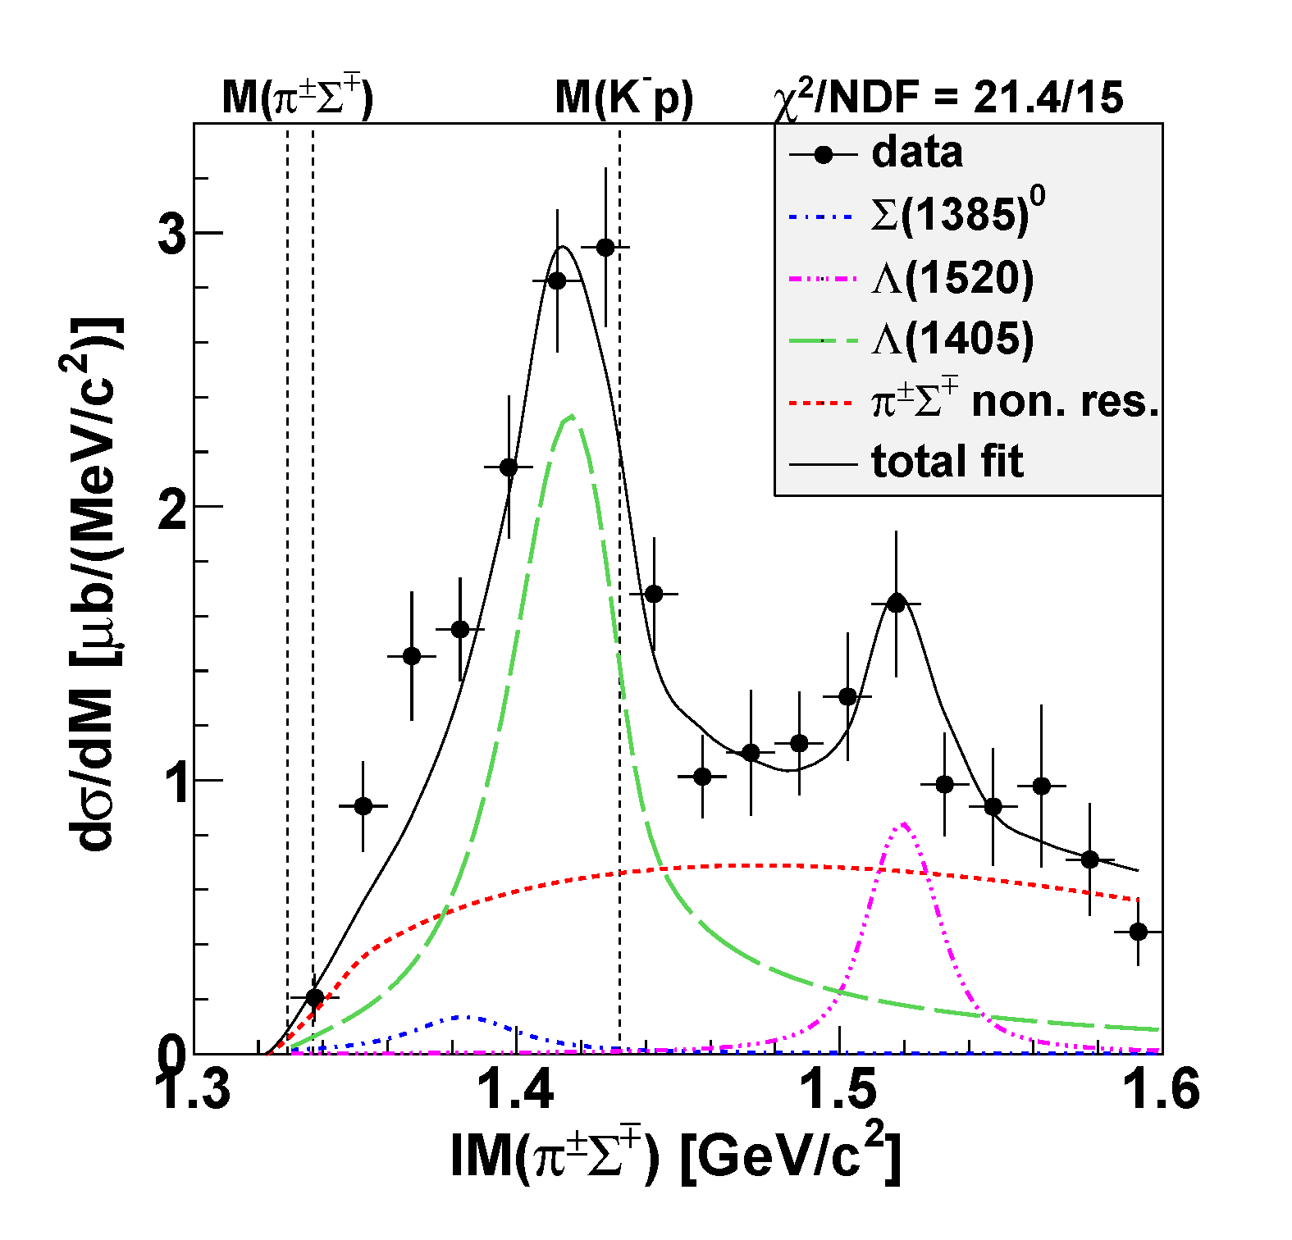
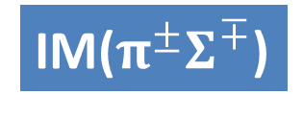
Λ(1405)pn CS
0.2<cosθ_{n}^{CM}
Λ(1405)
IM($π^{±}Σ^{∓}$)
~ 240 μb
Fit w/ Flatté:
Re(z) ~ 1415 MeV
-Im(z) ~ 20 MeV
Λ(1520)
preliminary
~ 100 μb
Σ⁰(1385)
πΣpn
phases-space
  ~ 40-80 μb
  [evaluated from
  Σ^{+/-}(1385)→π^{+/-}Λ
  measurement]
(Σ(1385)→πΛ/πΣ : 87.0/11.7%)

Slide 29
Λ(1405)pn CS
0.2<cosθ_{n}^{CM}
Λ(1405)
IM($π^{±}Σ^{∓}$)
Select region below the threshold
→ Λ(1405)pn is dominant
~ 240 μb
Fit w/ Flatté:
Re(z) ~ 1415 MeV
-Im(z) ~ 20 MeV
Λ(1520)
preliminary
~ 100 μb
Σ⁰(1385)
πΣpn
phases-space
  ~ 40-80 μb
  [evaluated from
  Σ^{+/-}(1385)→π^{+/-}Λ
  measurement]
(Σ(1385)→πΛ/πΣ : 87.0/11.7%)

Slide 30
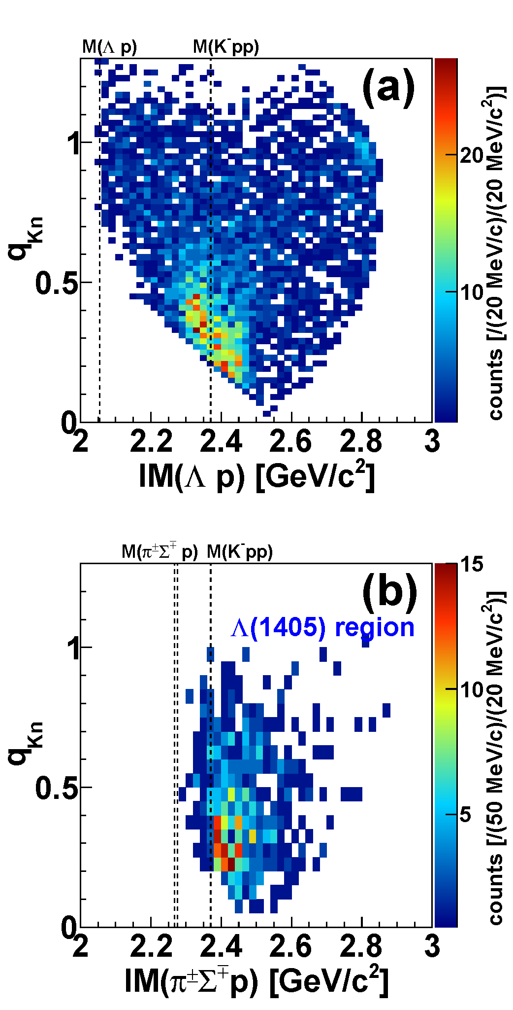
Comparison of Λpn & Λ(1405)pn
Λpn
Λ(1405)pn region
`
QF
QF
kinematical
limit
Kpp
Kpp
kinematical
limit
preliminary
No clear structure below M(Kpp) in the IM(πΣp)
QF followed by Λ(1405)p is dominant

Slide 31
Comparison of Λpn & Λ(1405)pn
Λpn
Λ(1405)pn region
select 0.35 < q_{Kn} < 0.65 GeV/c
`
QF
QF
kinematical
limit
Kpp
Kpp
kinematical
limit
preliminary
No clear structure below M(Kpp) in the IM(πΣp)
QF followed by Λ(1405)p is dominant

Slide 32

Comparison of Λpn & Λ(1405)pn
preliminary
Λ(1405)pn
M(Kpp)
Kpp
Λpn
“K⁻pp”→πΣp decay!?

Slide 33
Comparison of Λpn & Λ(1405)pn
Below the M(Kpp),
πΣp and
“K⁻pp” are the same order:
σ_{πΣp} ~ 10μb
σ_{“Kpp”→Λp} ~ 10μb
preliminary
Λ(1405)pn
M(Kpp)
Kpp
Λpn

Slide 34
Comparison of Λpn & Λ(1405)pn
Above the M(Kpp),
Λ(1405)p is dominant:
σ_{Λ(1405)p} ~ 240μb
preliminary
Λ(1405)pn
M(Kpp)
Kpp
Λpn

Slide 35


Comparison of Λpn & Λ(1405)pn
K-
³He
K-
³He
1 GeV/c
1 GeV/c
p
p
‘K⁻’
n
K⁻
n
p
preliminary
p
p
“K⁻pp”
Λ(1405)pn
n
M(Kpp)
n
“K⁻p”
off-shell
on-shell
$\overline{K}+{\left(pp\right)}_{R}→$ “K⁻pp”
$\overline{K}+{\left(pp\right)}_{R}→$ “K⁻p”+p
Kpp
Λ(1405)=“K⁻p”
Λpn
“K-pp” production is dominant
energy-momentum mismatch is transferred to the proton

Slide 36

Conclusion II
We observed the “K⁻pp” bound state in ³He(K⁻,Λp)n
  Binding energy: ~50 MeV
  Width: ~100 MeV
We found large CS of the Λ(1405)p formation compared to the “K⁻pp”
  quite important measurement for the production mechanism of the “K⁻pp”
← arXiv:1805.12275, accepted in PLB
← paper in preparation

Slide 37

What we have to do next
More quantitative studies of the “K⁻pp”
  J^{P} and other decay modes
Study of other kaonic nuclei:
  Single: “K⁻ppn” via [K⁻ + ⁴He], “K⁻ppnn/K⁻pppnn” via [K⁻ + ⁶Li]
  Double: “K⁻K⁻pp” via [p^{bar} + ³He]
Need the new 4π detector with γ/n sensitive detectors

Slide 38

Thank You!
J-PARC E15 Collaboration

Slide 39
Spares

Slide 40

IM(Λp) vs. cos(θ_{n}^{CM})
E15 collab., arXiv:1805.12275
IM(Λp)
Structures around the K⁻pp threshold can be seen
= bound-state + quasi-elastic
M(K+p+p)
Structures are concentrated in forward-n region
= small momentum-transfer
detector
acceptance
cos(θ_{n}^{CM})

Slide 41

IM(Λp) vs. cos(θ_{n}^{CM})
E15 collab., arXiv:1805.12275
IM(Λp)
Structures around the K⁻pp threshold can be seen
= bound-state + quasi-elastic
M(K+p+p)
K-
³He
K-
³He
Structures are concentrated in forward-n region
= small momentum-transfer
1 GeV/c
1 GeV/c
“x”
p
n
K-
n
p
p
detector
acceptance
p
n
n
cos(θ_{n}^{CM})
Λ
Λ

Slide 42
K^{bar}NN or NOT? --- Other Possibilities
A structure near K^{bar}NN threshold
Λ(1405)N bound state
  loosely-bound system, I=1/2, J^{π}=0⁻
  various decay modes, ΛN/ΣN/πΣN
πΛN-πΣN dibaryon
  structure near πΣN threshold
  I=3/2, J^{π}=2⁺ → no Λp decay (I=1/2)?
Double-pole K^{bar}NN
  loosely-bound K^{bar}NN, &
  broad resonance near the πΣN threshold → πΣN decay
Partial restoration of Chiral symmetry
  enhancement of the K^{bar}N interaction in dense nuclei
T. Uchino et al., NPA868(2011)53.
A structure near πΣN threshold
H. Garcilazo, A. Gal, NPA897(2013)167.
A. Dote, T. Inoue, T. Myo, PTEP (2015) 043D02.
S. Maeda, Y. Akaishi, T. Yamazaki, Proc. Jpn. Acad., B89(2013)418.

Slide 43





Interpretation as the “K⁻pp”
Λ-hypernuclei
“K⁻pp” @ E15
p
p
π⁺
n
Λ
Κ⁺
Κ⁻
p
n
p
Κ⁻
p
n
p
$${}_{}^{89}Y$$
$${}_{Λ}^{89}Y$$
$${}_{}^{3}{He}$$
$${"K}^{−}pp"$$
M_{th}
Bound state
and QF
can be seen
clearly
QF
On the analogy of the formation of Λ-hypernuclei, the observed bump structure would be the “K⁻pp”

Slide 44





BG: 2NA followed by FSI
$$K^{−}+{}_{}^{3}{He}→\left(K^{−}+"pn"\right)+p_{spect}$$
$→Y+n+$ $p_{spect}$
$$K^{−}+{}_{}^{3}{He}→\left(K^{−}+"pp"\right)+n_{spect}$$
$→Y+p+$ $n_{spect}$
(2NA)
(2NA)
$$→\left(Y+"p"\right)+n$$
$→Λ+p+n$
$$→\left(Y+"n"\right)+p$$
$→Λ+p+n$
(FSI)
(FSI)

Slide 45




IM($π^{±}Σ^{∓}$) vs. IM($π^{±}Σ^{∓}p$)
preliminary
K-
³He
IM($π^{±}Σ^{∓}$)
1 GeV/c
p
n
p
p
n
IM($π^{±}Σ^{∓}p$)
Λ(1405)
Small phase-space of “K⁻pp”→πΣN

Slide 46






Detector Acceptance: Λp vs. πΣp
Detector acceptance is different between Λp and πΣp
  At cosθ_{n}~1:
    Λp: flat acceptance
    πΣp: limited acceptance below the threshold
DATA
$$Λp$$
detector
acceptance
MC
DATA
$$π^{±}Σ^{∓}p$$
M(K⁻pp)
M(πΣp)
cf. $π^{±}Σ^{∓}pn$-PS MC
w/ detector acceptance
M(πΣp)
M(K⁻pp)
preliminary
detector
acceptance

Slide 47


Neutron ID with CDS
π⁺π⁻p events (3 tracks) in CDS with 4 CDH hits are selected
a CDH hit with CDC-veto (outer-layer) is applied to identify the “neutral hit”
dE vs. 1/β
dE-cut dependence
1.372 < 1/β
(p_{n}<1GeV/c)
neutron ID
5MeVee < dE
Neutron can be identified with CDS

Slide 48



πΣpn Events
IM(nπ⁺) vs MM(π⁺π⁻pn)
IM(nπ⁻) vs MM(π⁺π⁻pn)
π⁻Σ⁺p n_{miss}
π⁺Σ⁻p n_{miss}
Σ⁺
Σ⁻
n_{miss}
n_{miss}

Slide 49

K⁻p→Σ⁺π⁻/Σ⁻π⁺ Cross Section
* Error box represents systematic error
Σ⁺π⁻
Σ⁻π⁺
consistent with the references

Slide 50


Semi-Inclusive ³He(K⁻,n)X
DATA
sub-threshold
excess
(Y* and/or K^{bar}NN?)
Quasi Elastic
K⁻ + ³He → K⁻ + n + p_{s} + p_{s}
dσ/dΩ_{θ=0deg} ~ 6mb/sr
MC
Charge-Exchange
K⁻ + ³He → K⁰ + n + d_{s}
dσ/dΩ_{θ=0deg} ~ 11mb/sr
T. Hashimoto et al., PTEP (2015) 061D01.

Slide 51


Slide 52





A Theoretical Interpretation of E15
Sekihara, Oset, Ramos, arXiv:1607.02058
Chiral unitary approach
Uncorrelated
Λ(1405)p
state
quasi-elastic
kaon
scattering
K^{bar}NN
bound-state
B=16MeV
Γ=72 MeV
Opt.A (Watson)
Opt.A (Watson)
M[K+p+p]
M[K+p+p]

Slide 53


Exclusive ³He(K⁻,Λp)n
E15^{1st}
E15^{2nd}

Slide 54





Results of ³He(K⁻,Λp)n [E15-2nd]
cosθ_{n} dependence
𝟎.𝟕5<𝐜𝐨𝐬𝜽_{𝒏}^{𝑪𝑴}<𝟏.𝟎
preliminary
0.95<cosθ_{n}<1.0
0.90<cosθ_{n}<0.95
detector
acceptance
0.85<cosθ_{n}<0.90
0.80<cosθ_{n}<0.85
0.75<cosθ_{n}<0.80

Slide 55




Results of ³He(K⁻,Λp)n [E15-2nd]
Peak position
Width
Gaussian
Breit-Wigner
Above M(K-pp):
  peak shift by recoil kaon energy
Below M(K-pp):
  peak is independent to cosθ_{n}
  ( ~ momentum transfer)
Similar tendency as a theoretical calc., but QF seems to be originated from recoil kaon
QF
B.S.
Sekihara, Oset, Ramos,
PTEP(2016)123D03

