Slide 1
Experimental Investigations of the K^{bar}N Interaction at J-PARC K1.8BR
F. Sakuma, RIKEN
for the J-PARC E15/E31/E57/E62 collaboration
Reimei workshop, JAEA, Jan.18-20, 2016

Slide 2
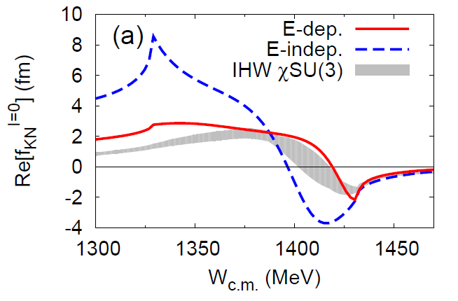
K^{bar}N Interaction
A good prove for low energy QCD
At the K^{bar}N threshold:
precise K-p atom / K-p scattering experiments data
isospin dependent K^{bar}N interaction?
Below the K^{bar}N threshold:
structure of the Λ(1405)?
existence of the bound kaonic-nuclear states?
K^{bar}N
S.Ohnish et al.,arXiv:1512.00123

Slide 3
Experiments at J-PARC K1.8BR
Sensitive in different energy region & isospin
At the K^{bar}N threshold:
precise K-p atom / K-p scattering experiments data
K^{bar}-atom
Below the K^{bar}N threshold:
Λ(1405)
K^{bar}NN
→ E31
→ E15
→ E17/E57
K^{bar}N
S.Ohnish et al.,arXiv:1512.00123

Slide 4

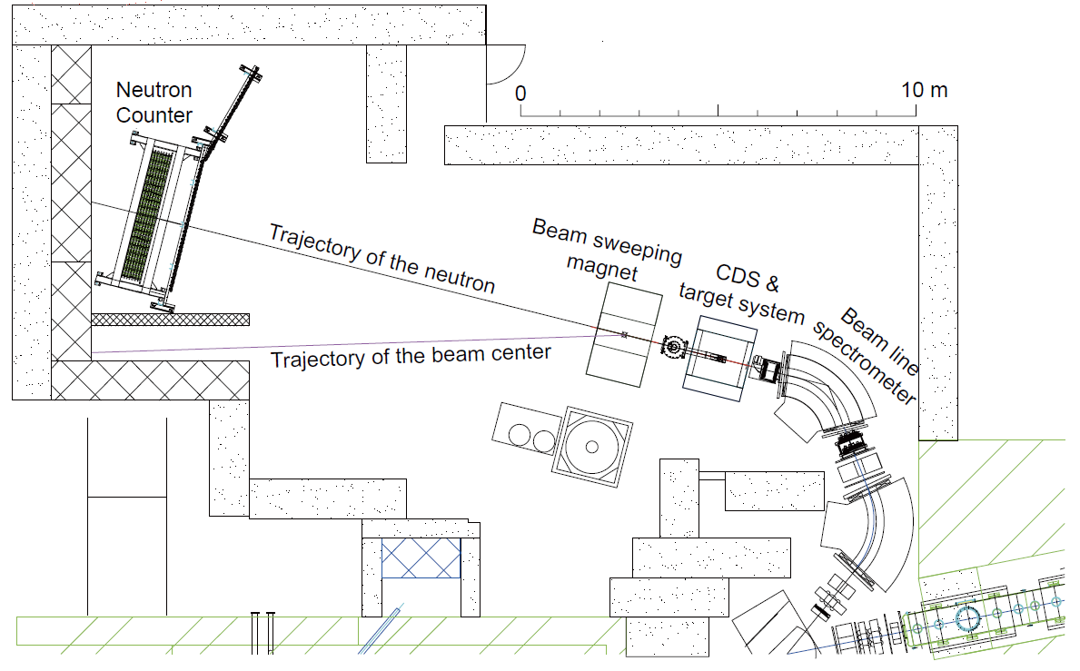
J-PARC K1.8BR Spectrometer
15m

Slide 5
Kaonic-atom:
E17(→E62)/E57
K^{bar}N
S.Ohnish et al.,arXiv:1512.00123

Slide 6
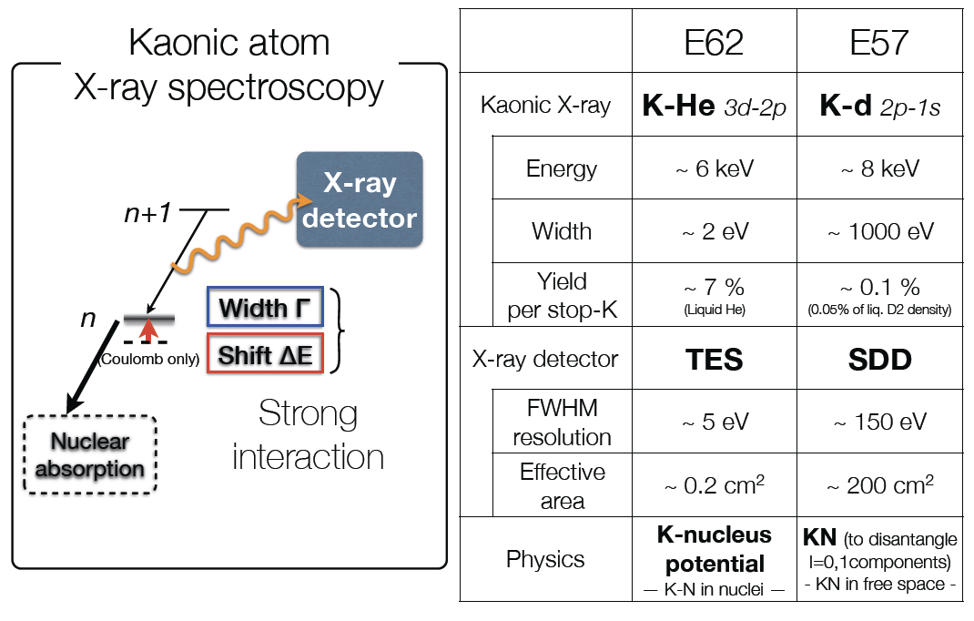
K^{bar}N Interaction via Kaonic-atoms
S.Okada, 21th J-PARC PAC

Slide 7
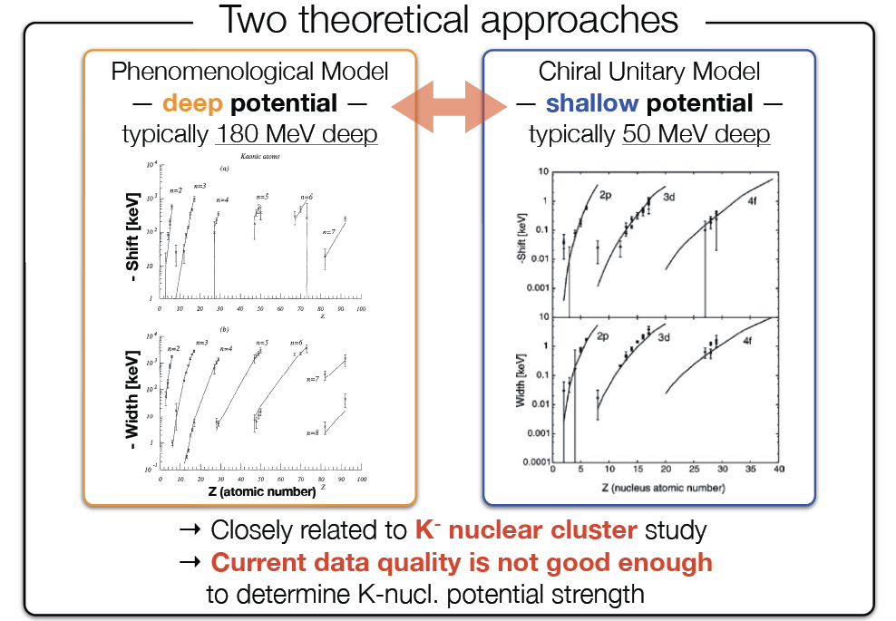
E17(→E62): KHeX with TES
S.Okada, 21th J-PARC PAC

Slide 8
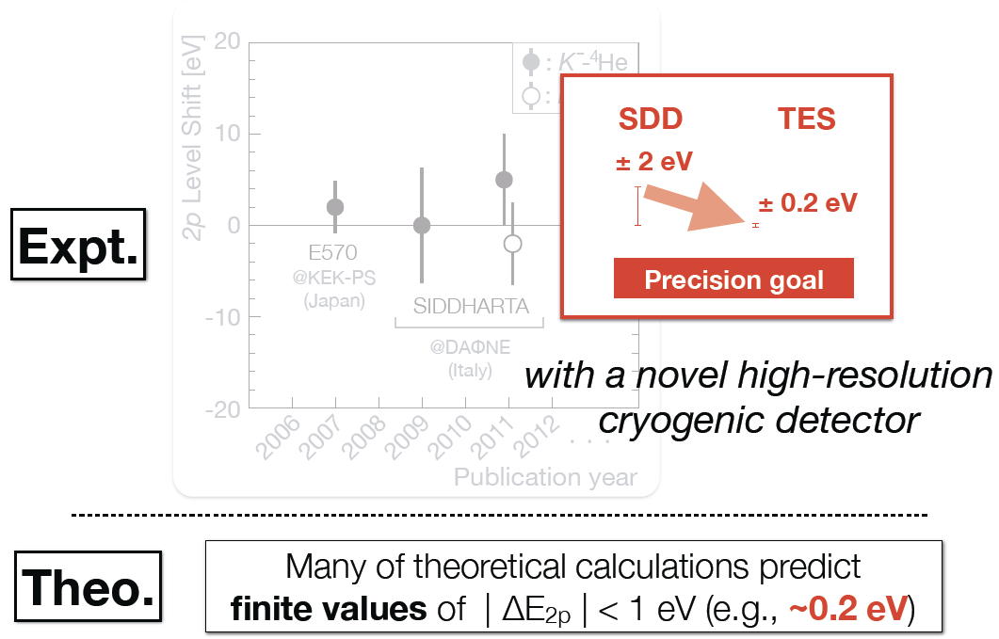
E17(→E62): KHeX with TES
S.Okada, 21th J-PARC PAC

Slide 9
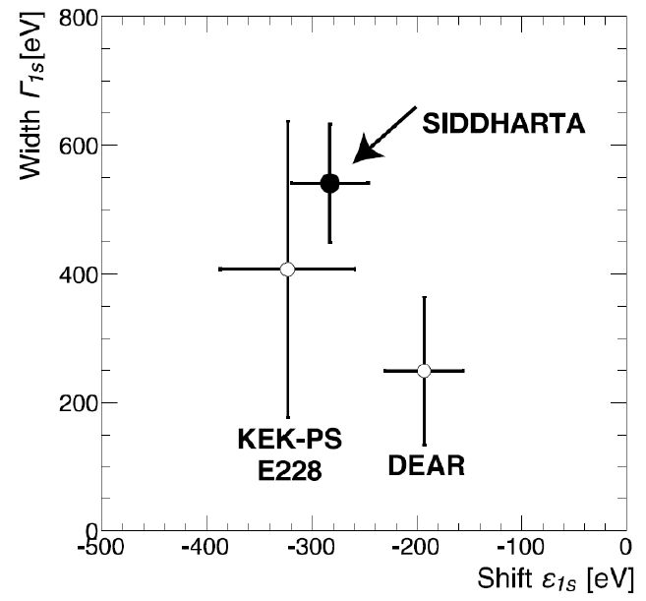
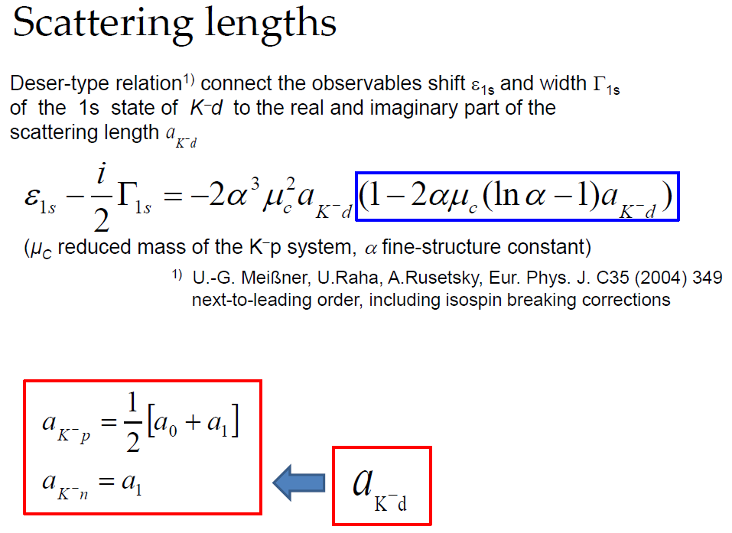
E57: KdX with SDD
K-p scattering length
Precise measurement @ SIDDHARTA
the strong‐int. shift and width of the kaonic hydrogen 1s
K-d scattering length
NO experimental results
due to the difficulty of the X‐ray measurement
missing information in the low-energy K^{bar}N int.
KpX
J.Zmeskal, 20th J-PARC PAC

Slide 10
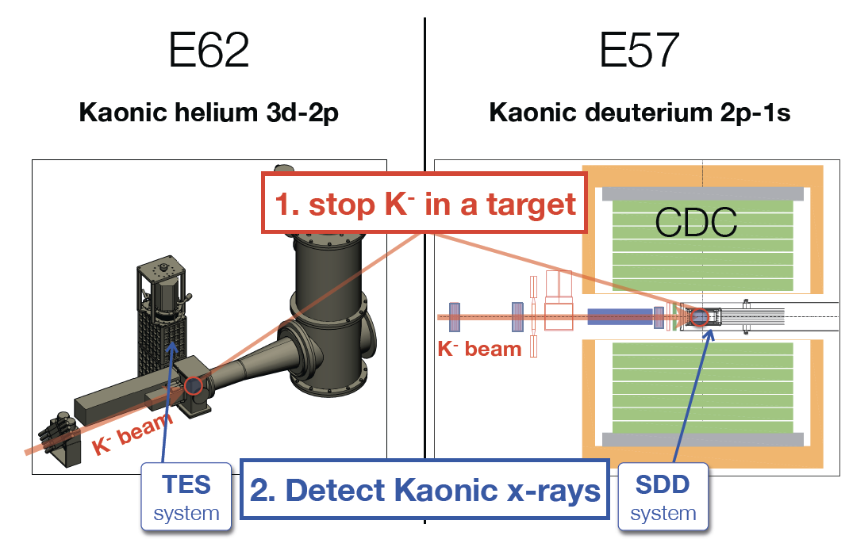
Kaonic-atom Experiments @ K1.8BR
S.Okada, 21th J-PARC PAC

Slide 11
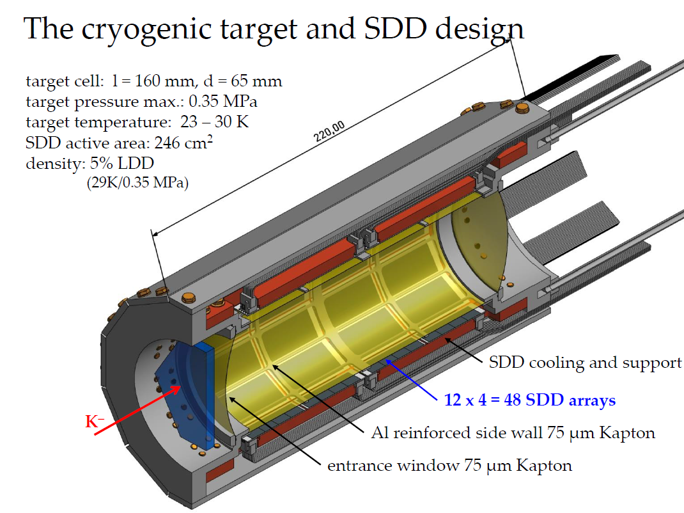
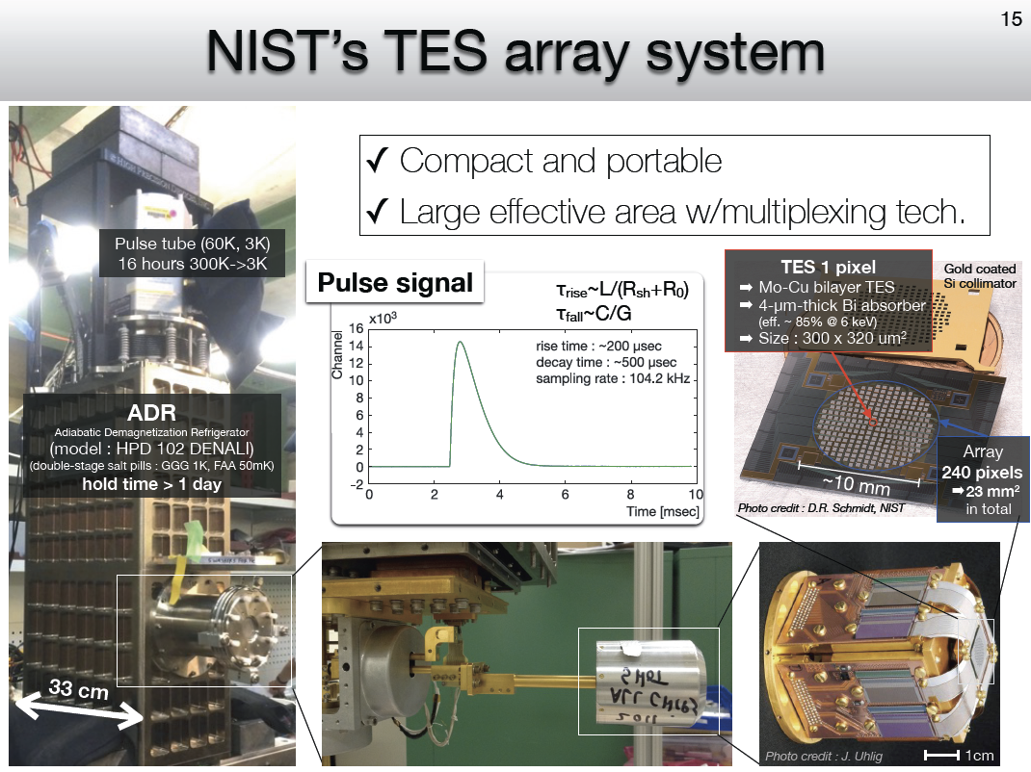
Experimental Apparatus
E62 - TES
S.Okada, 20th J-PARC PAC
will be performed in 2017 (³He/⁴He)
E57 - SDD
J.Zmeskal, 20th J-PARC PAC
will be started from H₂
in 2017 (E57^{1st})

Slide 12
Λ(1405) via d(K⁻,n):
E31
K^{bar}N
S.Ohnish et al.,arXiv:1512.00123

Slide 13
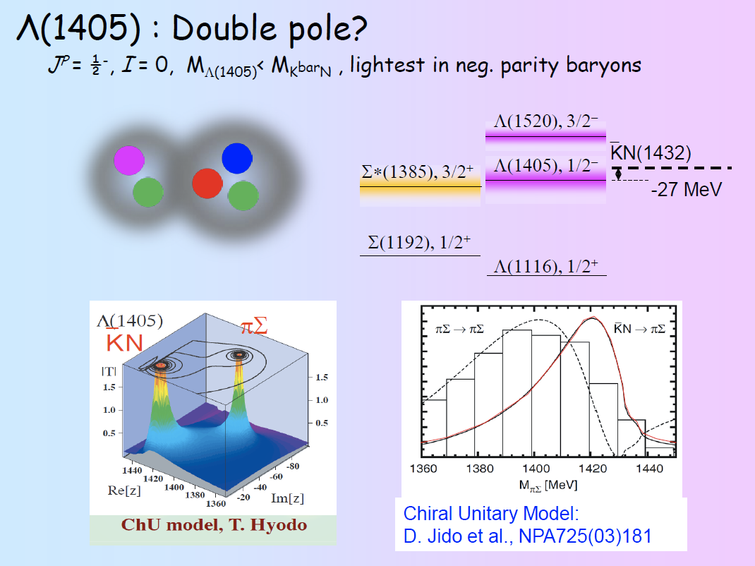
Open Problem of Λ(1405)
H.Noumi, 21th J-PARC PAC

Slide 14




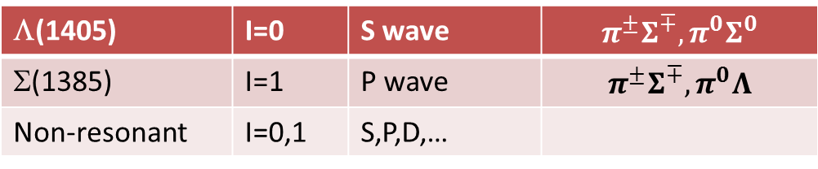

J-PARC E31 Experiment
aim to reveal line shape of Λ(1405) via K^{bar}N→πΣ
K⁻
n
$$N$$
$$\overline{K}$$
$$π^{∓,0}$$
d
$$Σ^{±,0}$$
$$N$$
employ d(K⁻,n)πΣ reactions at θ_{n}~0 deg., which is expected to enhance an S-wave K^{bar}N→πΣ scattering
K-
d
Λ(1405)
~0.25 GeV/c
n
1 GeV/c
~1.25 GeV/c
Σ
π
n
π
identify all the final states to decompose the I=0 and I=1 amplitudes.
Λ(1405) | I=0 | S wave | $$π^{±}Σ^{∓}, π^{0}Σ^{0}$$
Σ(1385) | I=1 | P wave | $$π^{±}Σ^{∓}, π^{0}Λ$$
Non-resonant | I=0,1 | S,P,D,…

Slide 15
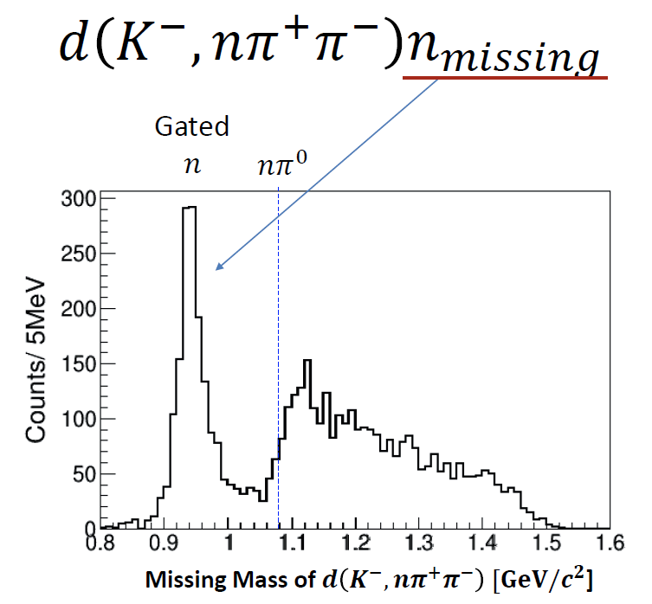
π±π∓n“n” Final States in E15 Calibration
K-
d
n
NC
1 GeV/c
n
π⁺
π⁻
CDS
π±π∓n“n” final states can be identified clearly

Slide 16
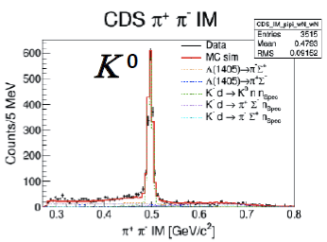
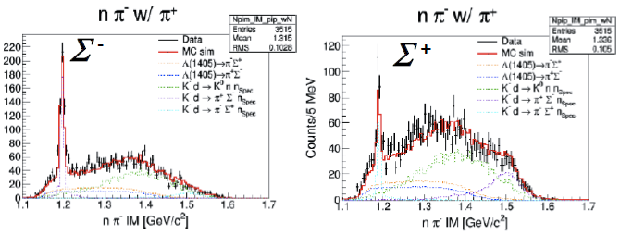
Signal & Background in π±π∓n“n”
K-
d
Λ(1405)
~0.25 GeV/c
n
NC
Signal
(Λ* production)
1 GeV/c
~1.25 GeV/c
Σ
π
n
π
CDS
n_{spectator}
CDS
n
NC
Background
(K⁰ production)
π⁻
K⁰
π⁺
n_{spectator}
NC
Σ±
n
Background
(Σ production)
π ∓
π ±
CDS

Slide 17
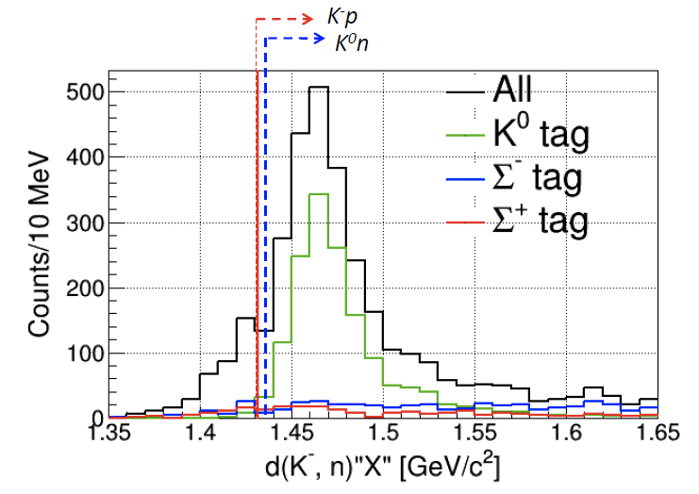
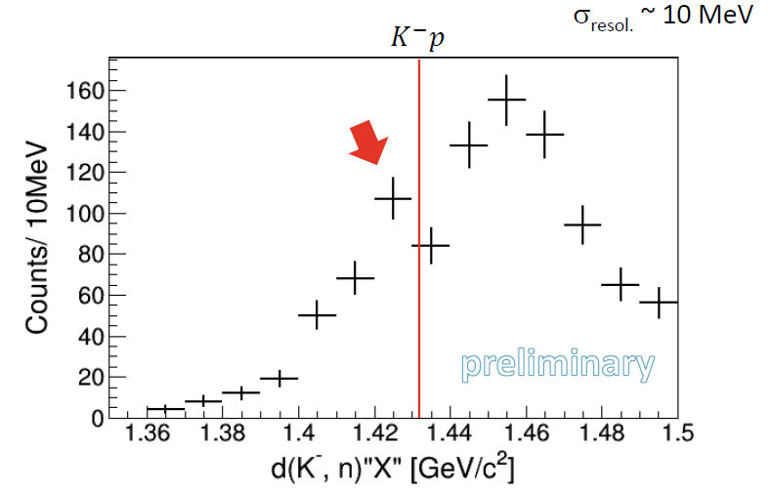
d(K⁻,n)π±π∓“n” Spectrum
BG subtraction
d(K⁻,n)π±π∓“n”
d(K⁻,n)π±Σ∓
preliminary
A bump structure around 1420 MeV/c²
  a K^{bar}N pole ?
A “QF” like structure above the K⁻p mass threshold
  as predicted by Faddeev calculation (AGS)

Slide 18
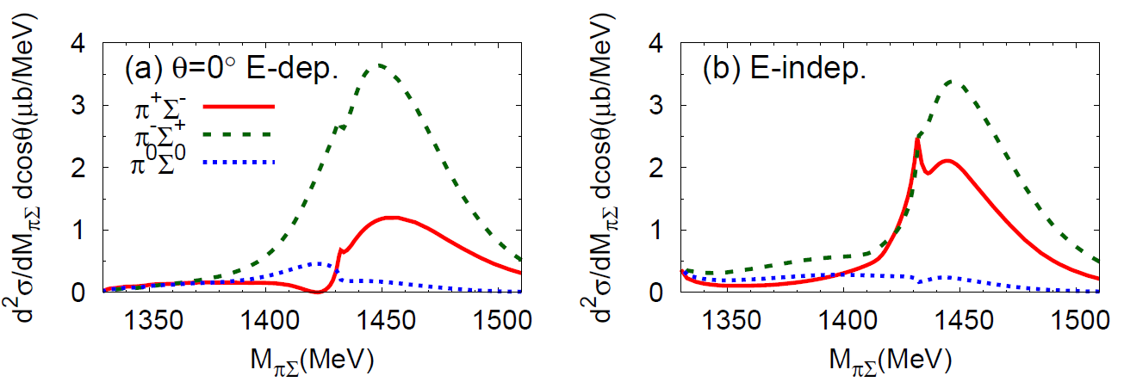
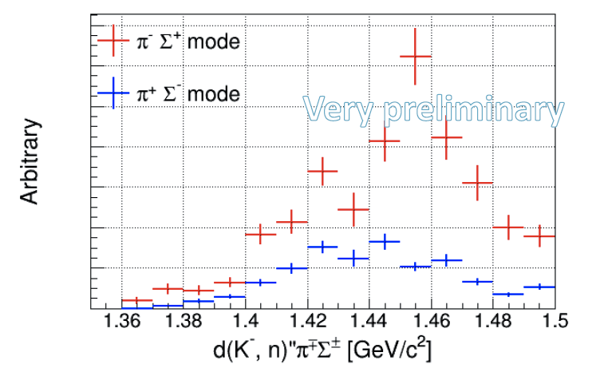
π±Σ∓ Mode Separation
K⁻p
K⁻p
  c.f.
  Faddeev calc. (AGS)
S.Ohnishi et al.,
Nucl-th: arXiv:1512.00123
w/ angular dependence
Applying acceptance correction & cocktail fitting
K⁻p
both I=0 & I=1 channels are contained
π⁰Σ⁰ mode is essential
→ More data is needed
E31 will start in May 2016

Slide 19
K^{bar}NN via ³He(K⁻,n):
E15
?
K^{bar}N
S.Ohnish et al.,arXiv:1512.00123

Slide 20
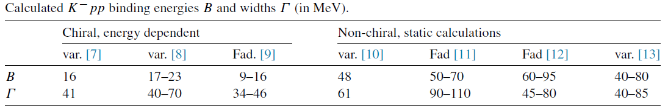
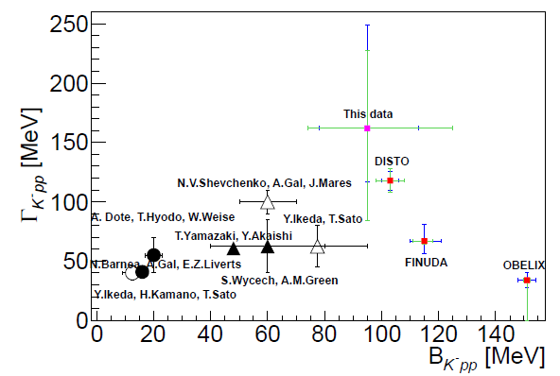
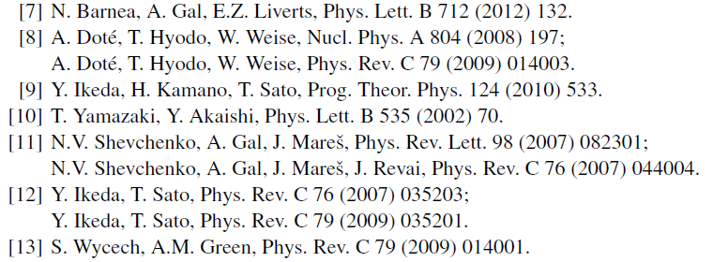
K^{bar}NN Bound State
K^{bar}NN : the simplest K^{bar}-nuclear state
A.Gal, NPA914(2013)270
Y.Ichikawa, EXA2014
E27
All theoretical studies predict existence of the K^{bar}NN
→ However, the situation is still controversial!

Slide 21

J-PARC E15 Experiment
A search for the simplest kaonic nucleus, K^{bar}NN, using ³He(in-flight K⁻,n) reaction
two-nucleon absorption
hyperon decays
CAN be discriminated kinematically

Slide 22
Status of the E15 Experiment
~10% of the approved proposal was successfully carried out in 2013/2015.
 | Exp. Target | Primary-beam intensity | Secondary-kaon intensity | Duration | Kaons on target (w/ tgt selection)
May, 2013 (Run#49c) | ³He | 24 kW (30 Tppp, 6s) | 140 k/spill | 88 h | 5.3 x 10⁹
Apr-May, 2015 (Run#62) | H₂ | 26.5 kW (33 Tppp, 6s) | 130 k/spill | 73 h | 3.7 x 10⁹
Apr-May, 2015 (Run#62) | D₂ | 26.5 kW (33 Tppp, 6s) | 130 k/spill | 53 h | 2.8 x 10⁹
Nov-Dec, 2015 (Run#65) | ³He | 42 kW (48 Tppp, 5.52s) | 190k/spill | 520h | 43 x 10⁹
E15^{1st}
calibration
calibration
E15^{2nd}
* production target: Au 50% loss, spill length: 2s, spill duty factor: 35~45%, K/pi ratio: ~1/2
* ~70% of beam kaons hit the fiducial volume of ³He target

Slide 23
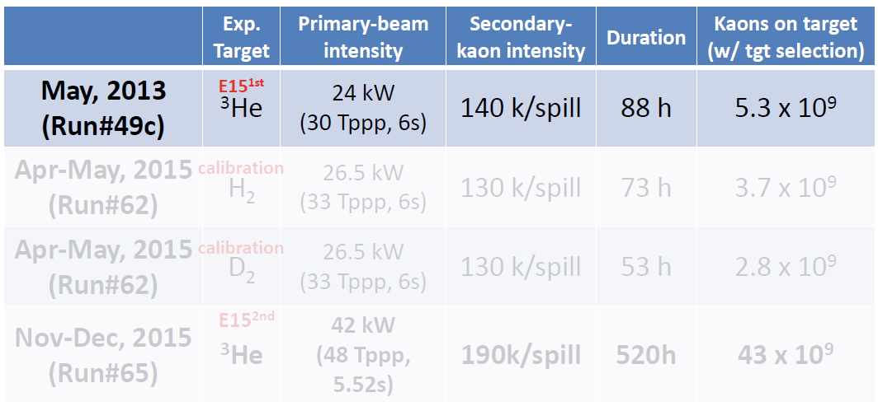
Results of E15-1st Experiment
--- only 4days data-taking ---

Slide 24
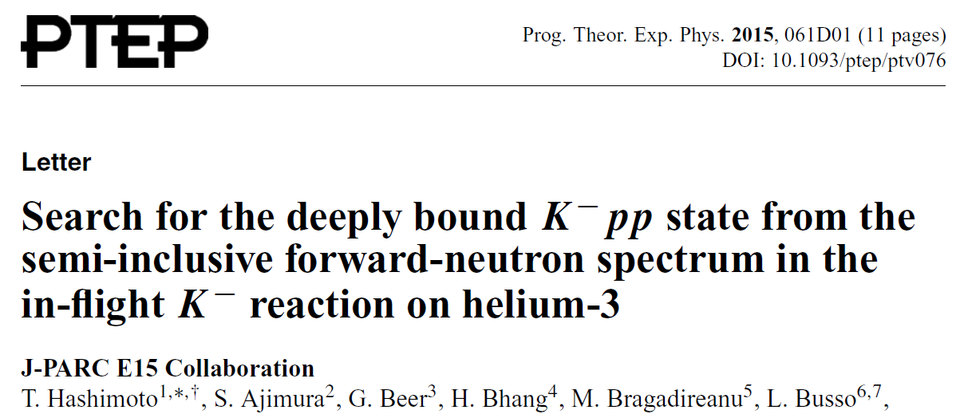
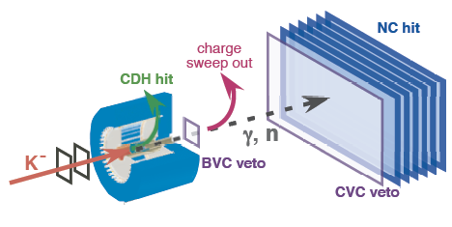
Formation Channel,
Semi-Inclusive ³He(K⁻,n)X
T.Hashimoto et al., PTEP(2015)061D01.

Slide 25
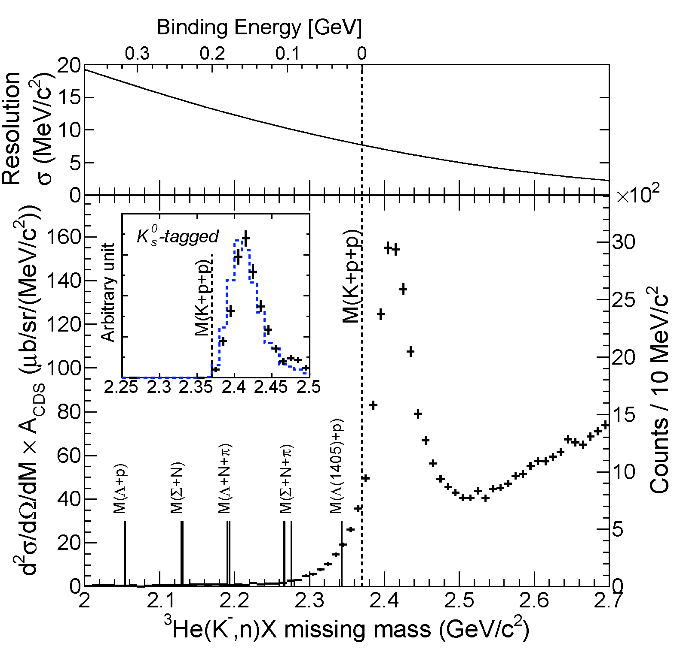
Semi-Inclusive Spectrum of ³He(K⁻,n)X
Quasi Elastic
K⁻ + ³He → K⁻ + n + p_{s} + p_{s}
dσ/dΩ_{θ=0deg} ~ 6mb/sr
Charge-Exchange
K⁻ + ³He → K⁰ + n + d_{s}
dσ/dΩ_{θ=0deg} ~ 11mb/sr
sub-threshold excess
Hyperon decay

Slide 26
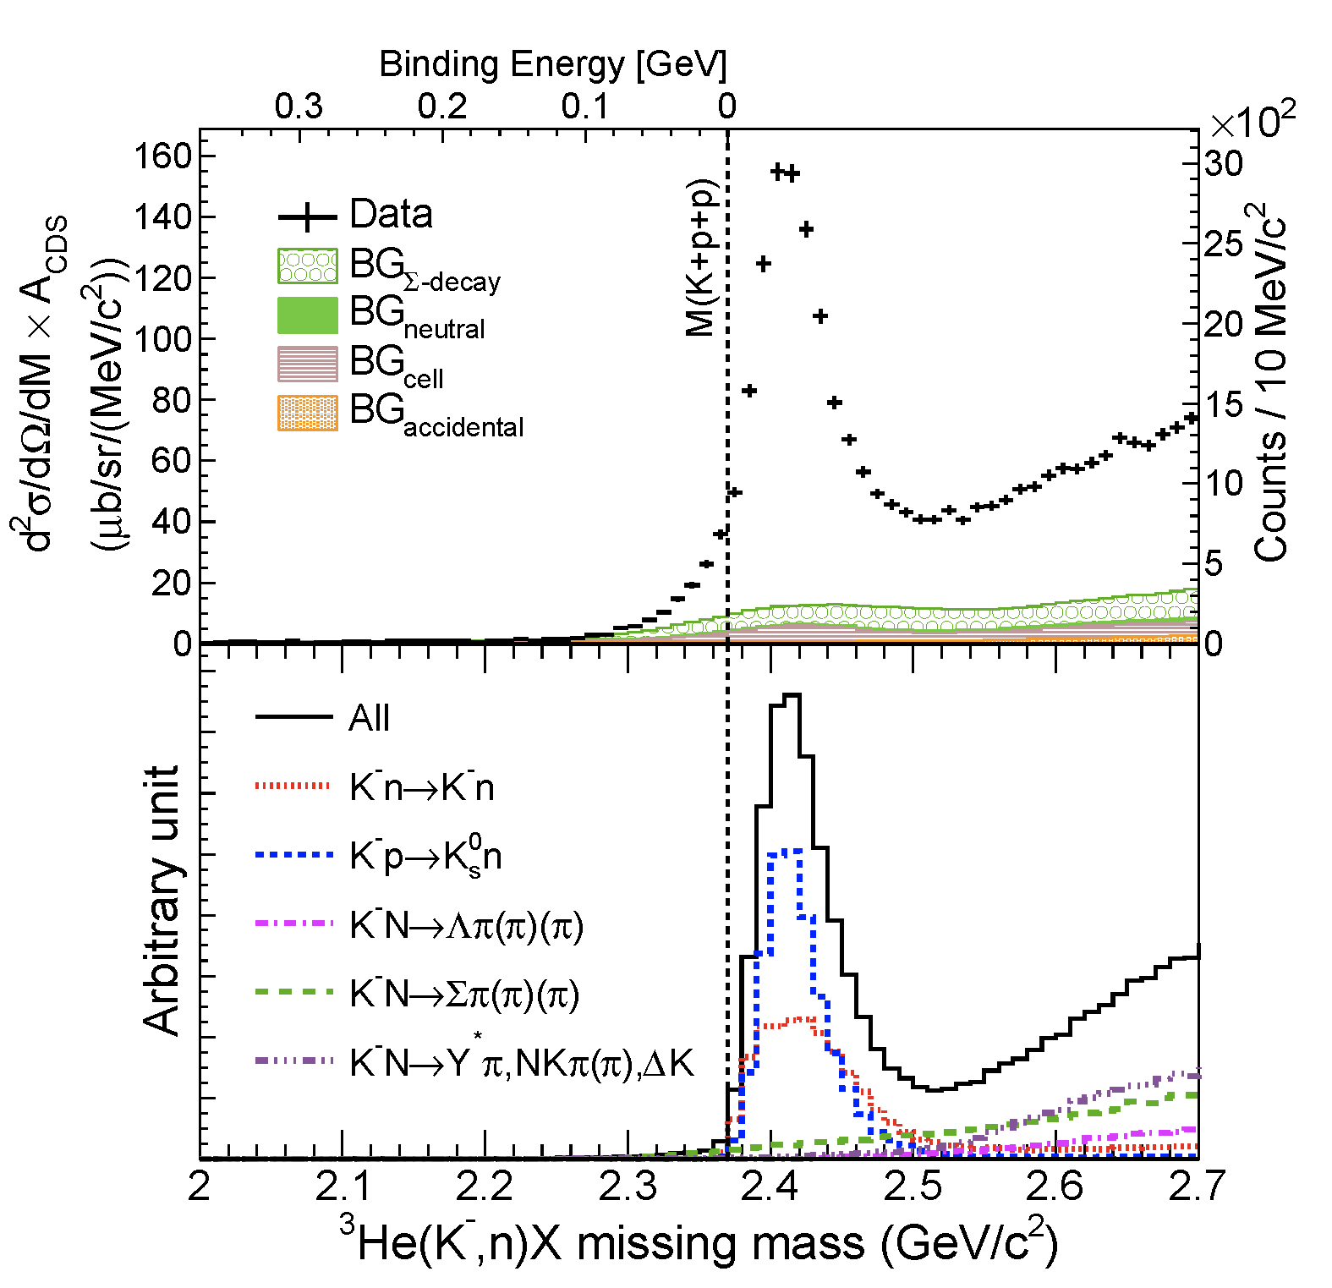
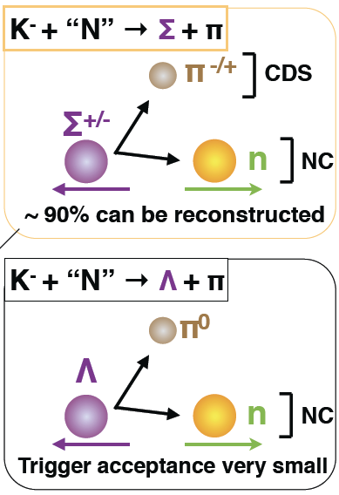
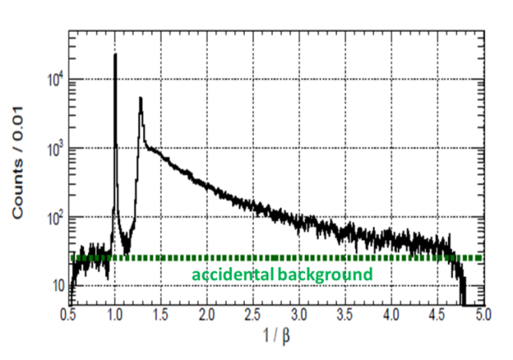
Comparison of
³He(K⁻,n)X
The sub-threshold excess could be originated from
K⁻³He→[K⁻pp]+n_{fw}
Y*N
DATA
MC
1/β distribution for γ/n

Slide 27
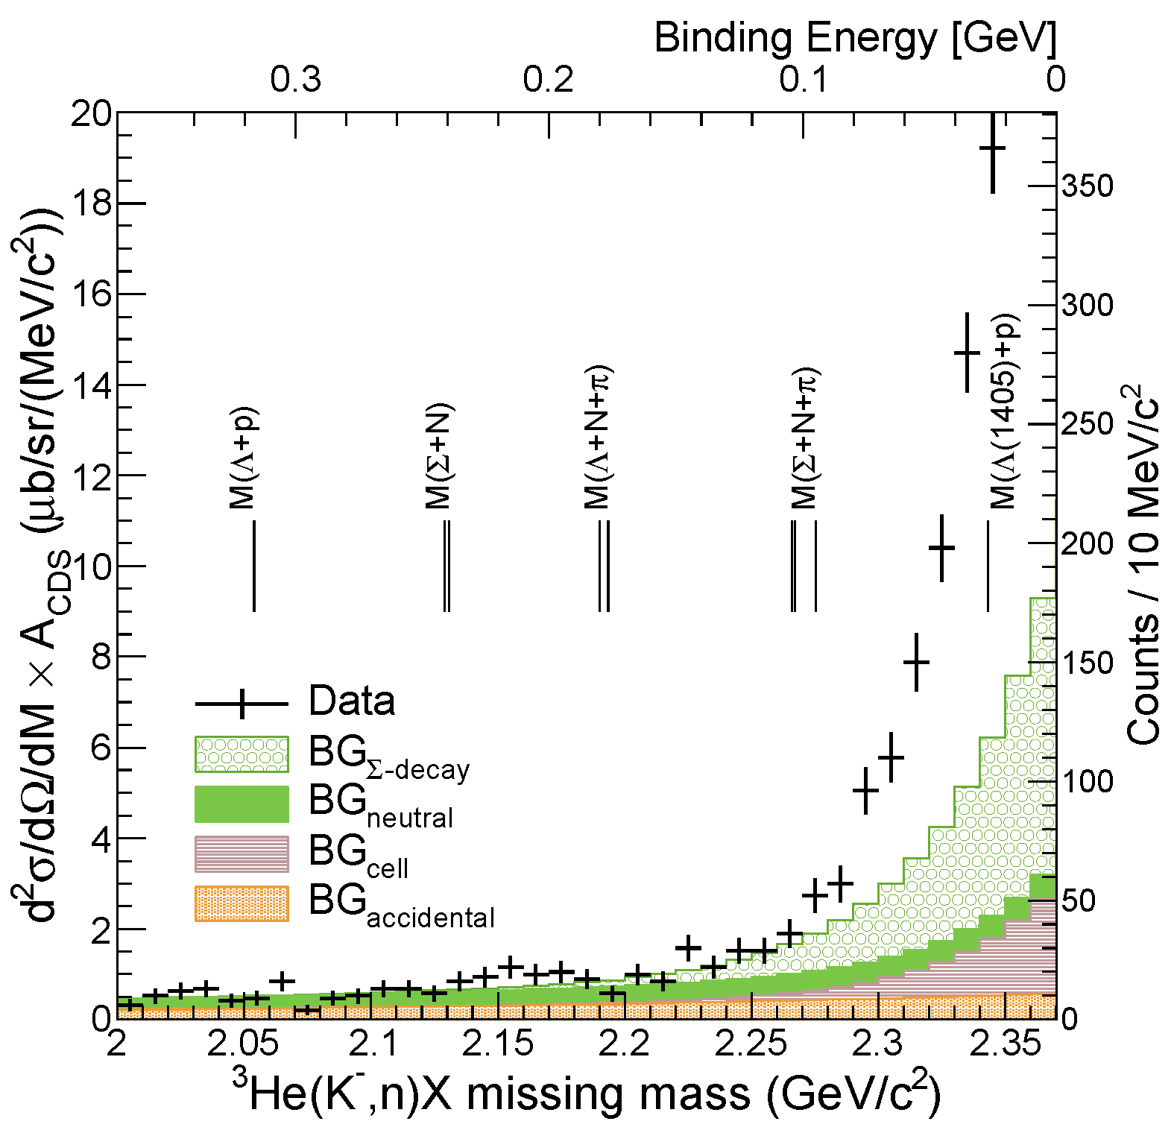
the Deeply-Bound Region
NO bump structure
FINUDA/DISTO/
E27

Slide 28
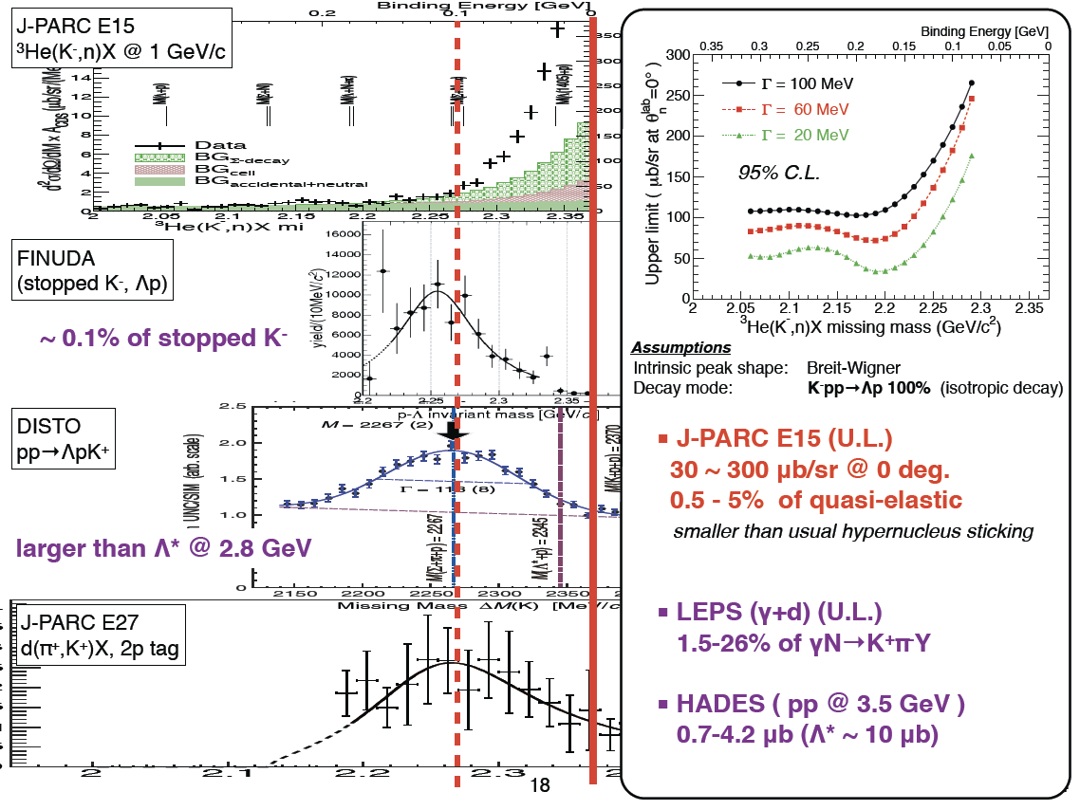

Slide 29
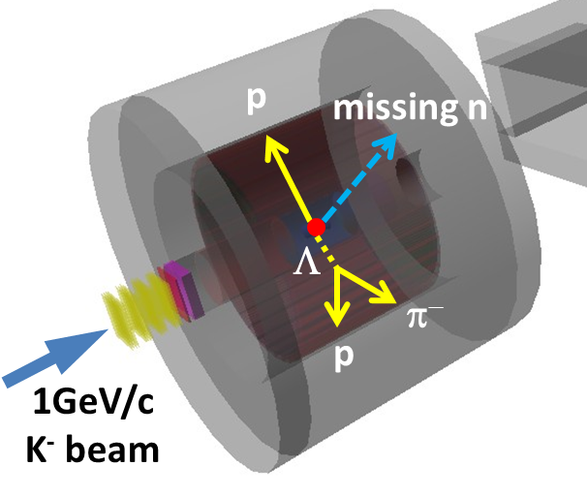
Decay Channel,
Exclusive ³He(K⁻,Λp)n
Y.Sada et al., paper in preparation

Slide 30
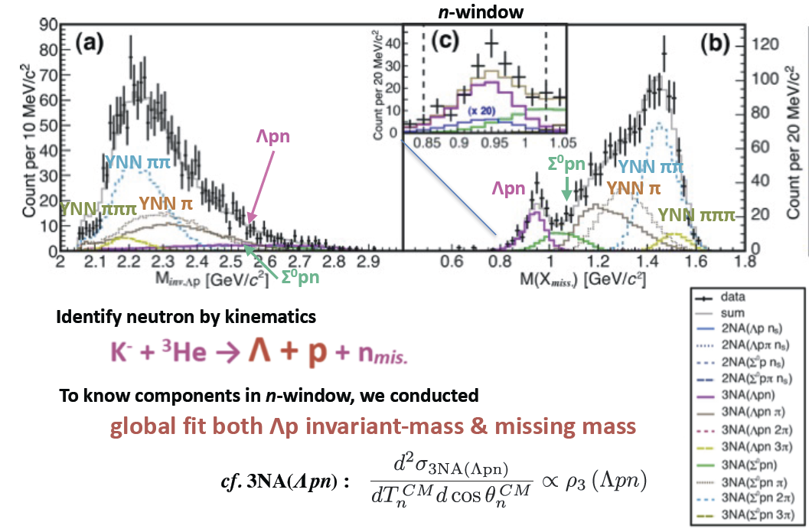
Inclusive ³He(K⁻,Λp)X
  # of Λpn events: ~200
  Σ⁰pn contamination: ~20%

Slide 31
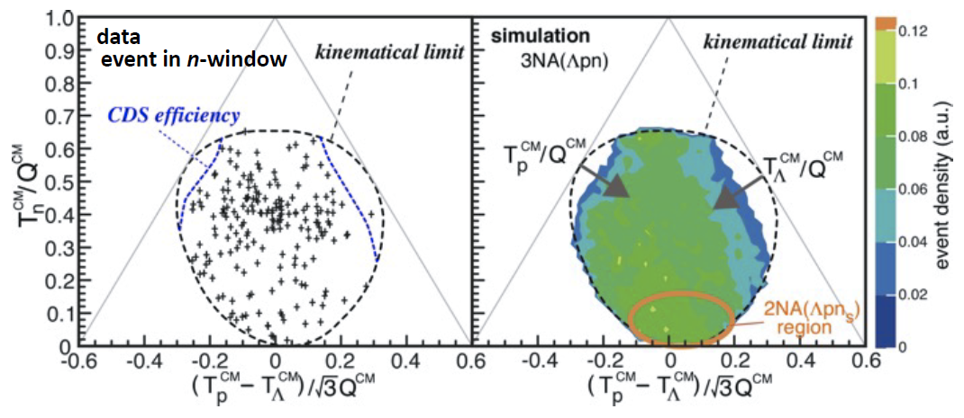
Exclusive ³He(K⁻,Λp)n
preliminary
The events widely distribute in the phase space
  Contribution from 2NA processes seem to be very small
Event concentration is seen at T^{CM}_{n}/Q^{CM}~0.4

Slide 32
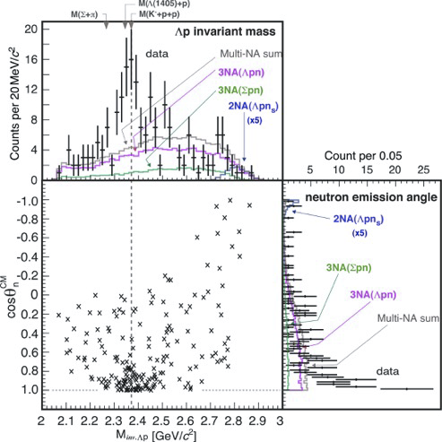
A Global-fit Result for ³He(K⁻,Λp)n
A bump structure exists near the K-pp threshold
Smaller momentum transfer to Λp is preferred (0.8<cosθ^{CM}_{n})
preliminary

Slide 33
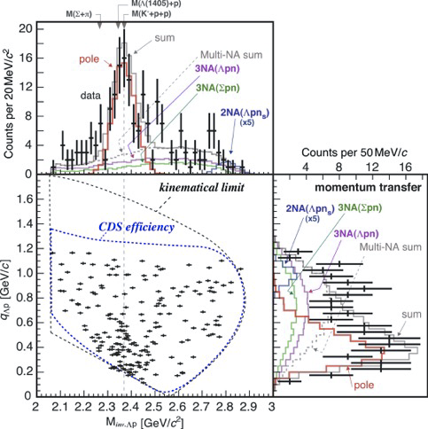
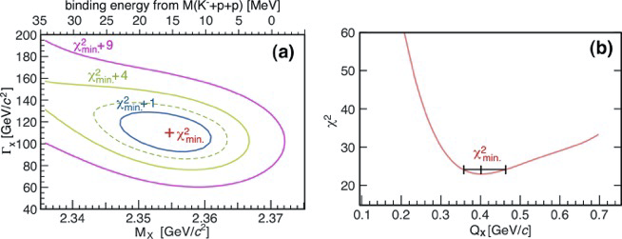
Assuming a Breit-Wigner
χ2-test with pole & 3NA(Ypn)
– S-wave Breit-Wigner pole
– w/ Gaussian form-factor
preliminary
S=-1 di-baryon?
Y*N system?
compact system?

Slide 34
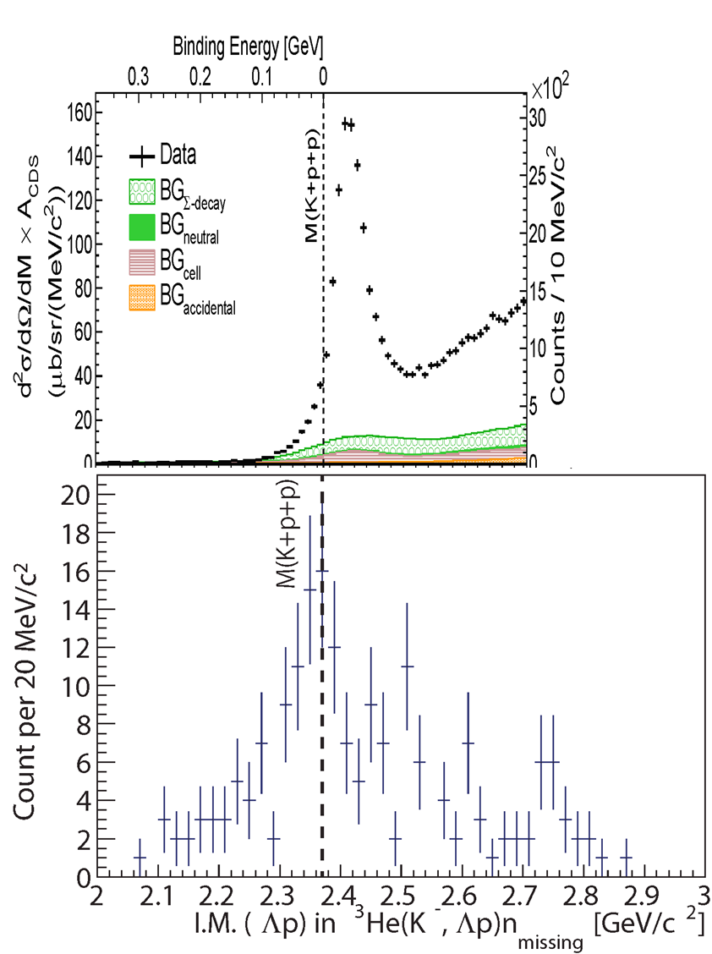
Summary of E15^{1st}
FINUDA/DISTO/E27
³He(K⁻,n)X M.M.
Deeply-bound region
The bump-structure, which was reported by FINUDA/DISTO/E27, has NOT been observed
Around the threshold
Structure has been seen both in formation- and decay-channel
Contribution of Y*?
Hint of S=-1 di-baryon state?
Reaction dependence?
K^{bar}NN formation strongly depends on reaction channel?
γ/π/K/p induced reaction?
momentum transfer?
Λp I.M.
of ³He(K⁻,Λp)n
preliminary

Slide 35
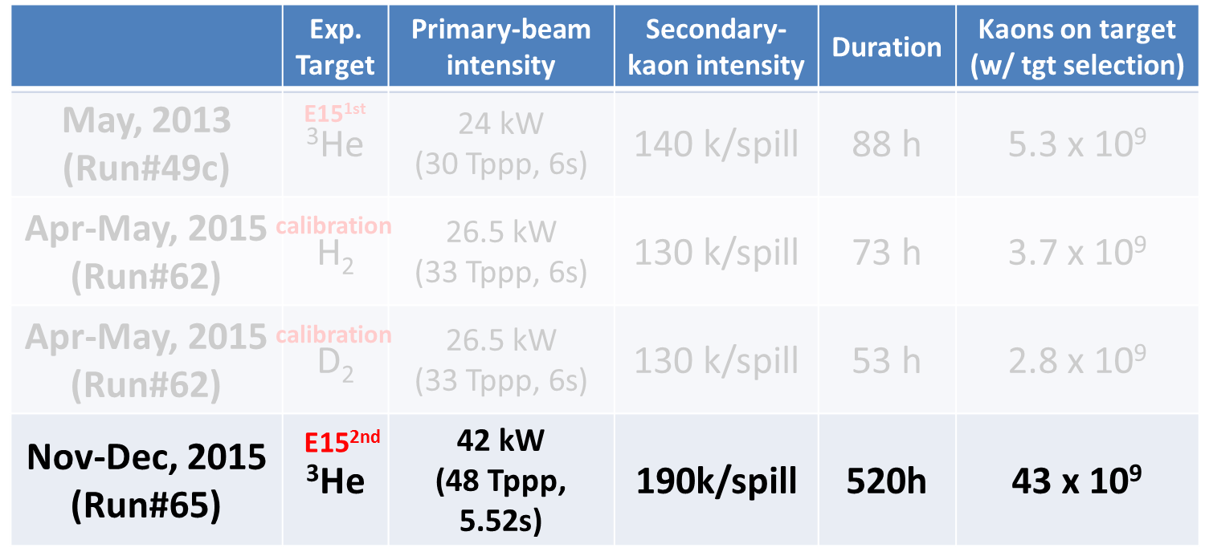
Status of E15-2nd Experiment
--- just completed in Dec. 2015 ---
calibration is ongoing by T.Yamaga et al.
~x8

Slide 36
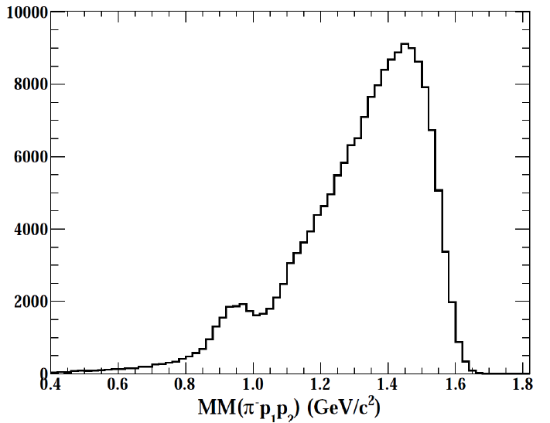
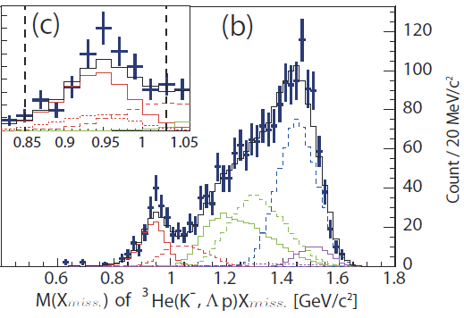
³He(K⁻,Λp) events in E15^{2nd}
n_{missing} (Λpn events)
E15^{2nd}
E15^{1st}
w/ loose-cut condition
very
preliminary
~0.2k
~12k
preliminary
Dedicated trigger (CDH3) was introduced for ³He(K-,Λp)n
³He(K-,Λp) events increase by ~50 times compared with E15^{1st} data as expected

Slide 37
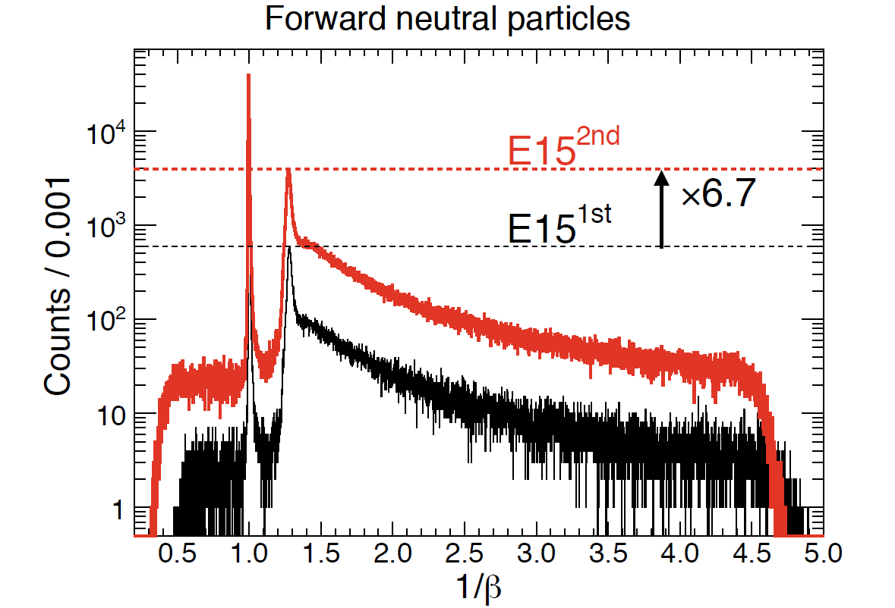
³He(K⁻,n) events in E15^{2nd}
γ
n (quasi-free)
preliminary
³He(K-,n) events increase by ~7 times compared with E15^{1st} data as expected

Slide 38
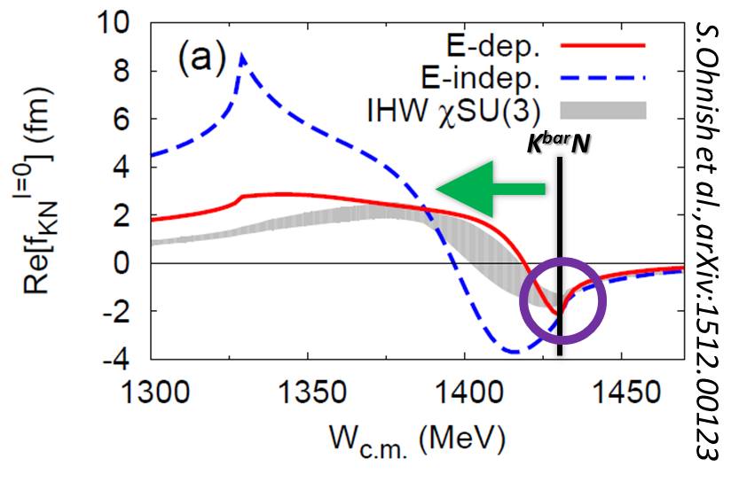
Summary
To investigate the K^{bar}N interaction,
various experiments are proposed/conducting at K1.8BR
- Sensitive in different energy region & isospin -
Kaonic-atom: E62/E57
  will start in 2017
Λ(1405): E31
  pre-analysis will be finalized
  will start in 2016
K^{bar}NN: E15
  fruitful results have been obtained in E15^{1st}
  E15^{2nd} has been just completed
  E15^{3rd} be discussed after analyzing new data

Slide 39
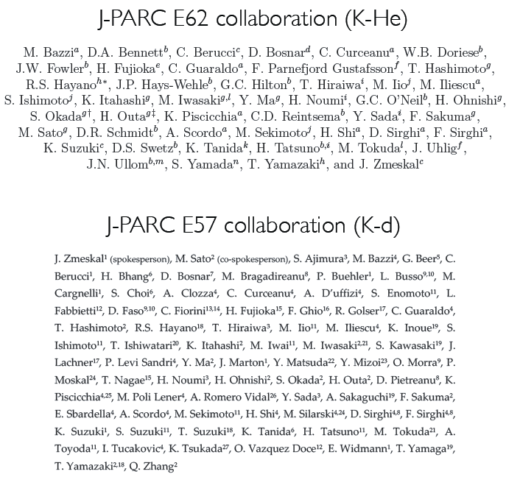
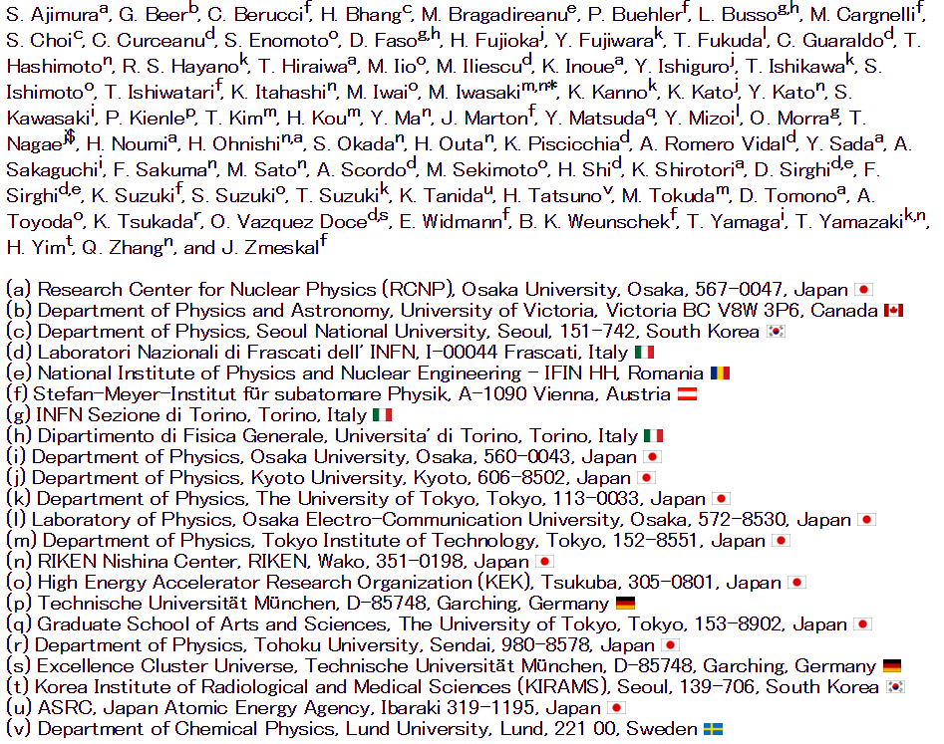
The Collaborations
J-PARC E15/E31 collaboration

