Slide 1

Experimental studies on the K^{bar}N interaction
- Recent Topics from J-PARC -
F. Sakuma, RIKEN
on behalf of the J-PARC
E15/E31/E57/E62 collaboration
SNP2017, Mar. 12-14, 2017, Osaka

Slide 2
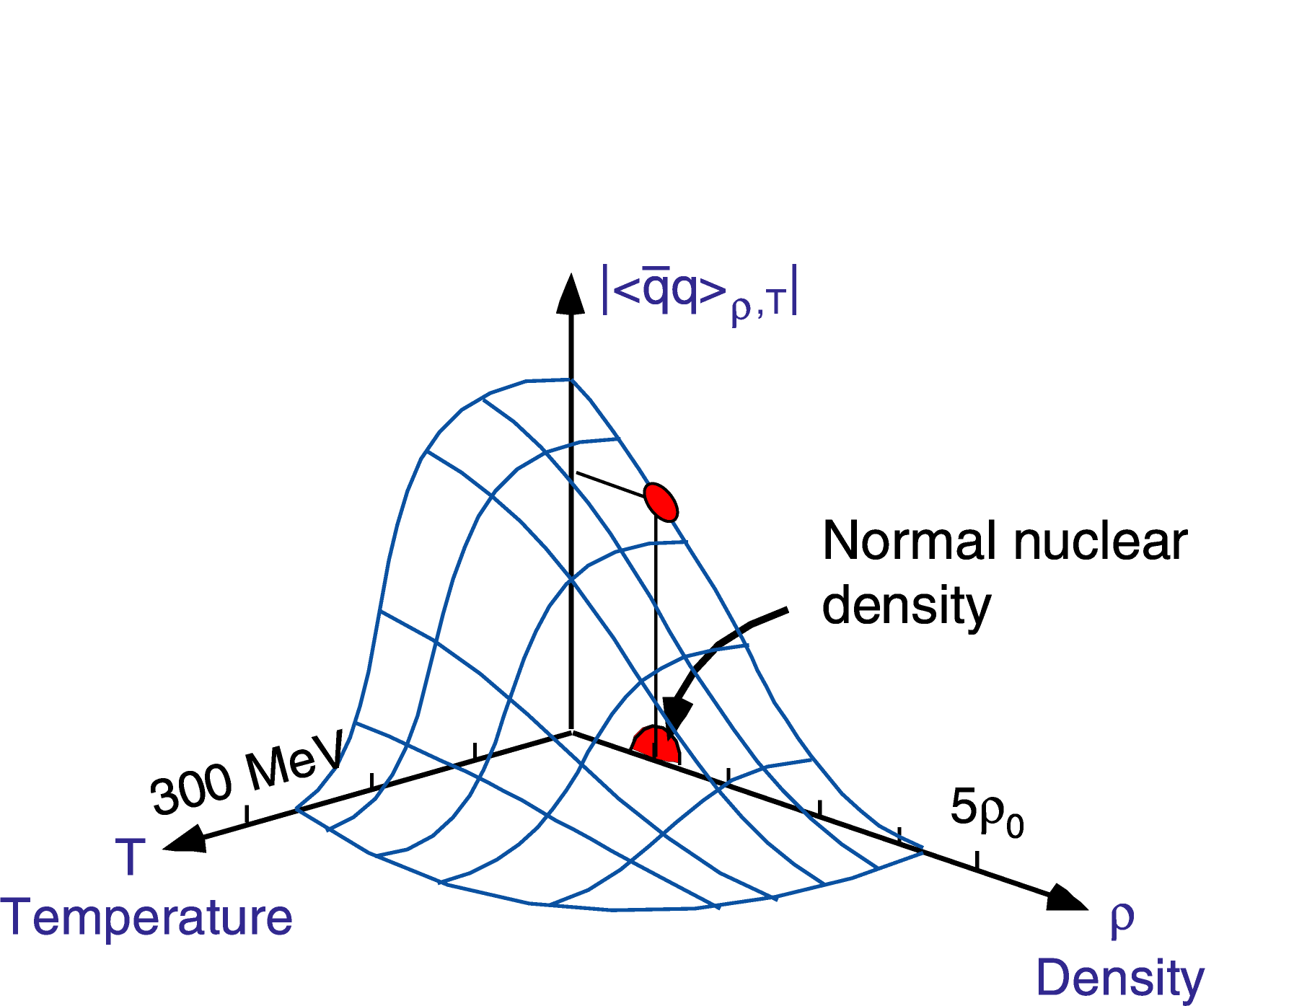
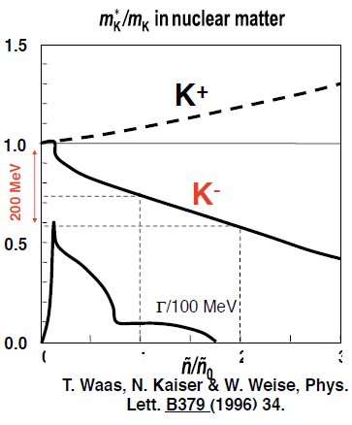
Physics Motivation
Meson properties change in nuclear media?
K^{bar}N interaction : attractive in I=0
→ A good probe for low energy QCD
0
1
2
3
W.Weise NPA553, 59 (1993).
provide new insight on M-B interaction in media

Slide 3
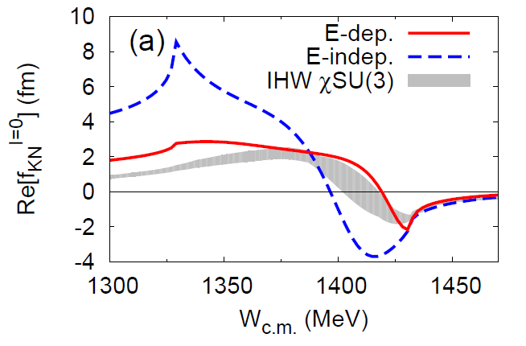
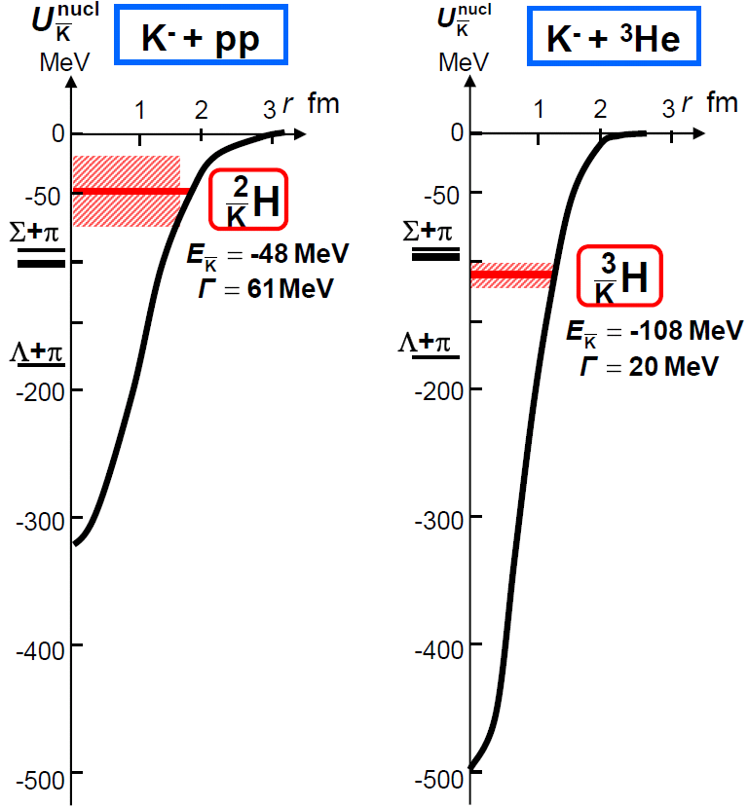
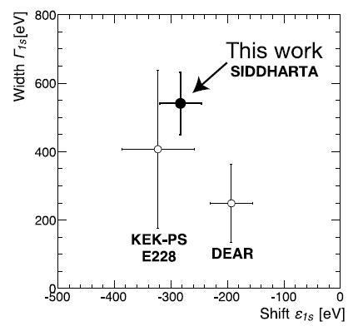
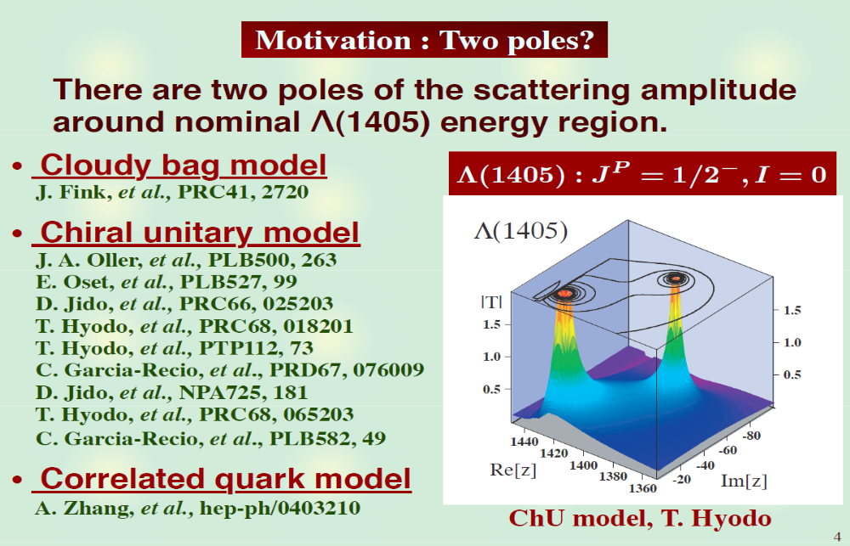
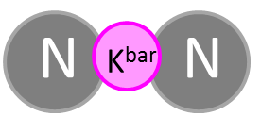

Investigation of K^{bar}N int. @ J-PARC
S.Ohnish et al.,PRC93(2016) 025207
Calculation on
K^{bar}N amplitude
in I = 0
?
K^{bar}N
M. Bazzi et al.,
(SIDDHARTA Coll.),
Phys. Lett. B704(2011)113
K^{bar}NN: E27/E15
Λ(1405): E31
K-atom: E62/E57
πΣ
‾ＫＮ
$$I=\frac{1}{2}, J^{P}=0^{−}$$
- Sensitive in different energy region & isospin -
expected to be produced as a
Λ(1405)p doorway

Slide 4
Kaonic-Atom Measurements

Slide 5
K^{bar}N Interaction at the threshold
Low-energy K-p scattering
Kaonic hydrogen X-ray
M. Bazzi et al.,(SIDDHARTA Coll.),
Phys. Lett. B704(2011)113
S.Ohnish et al.,PRC93(2016) 025207
K^{bar}N

Slide 6
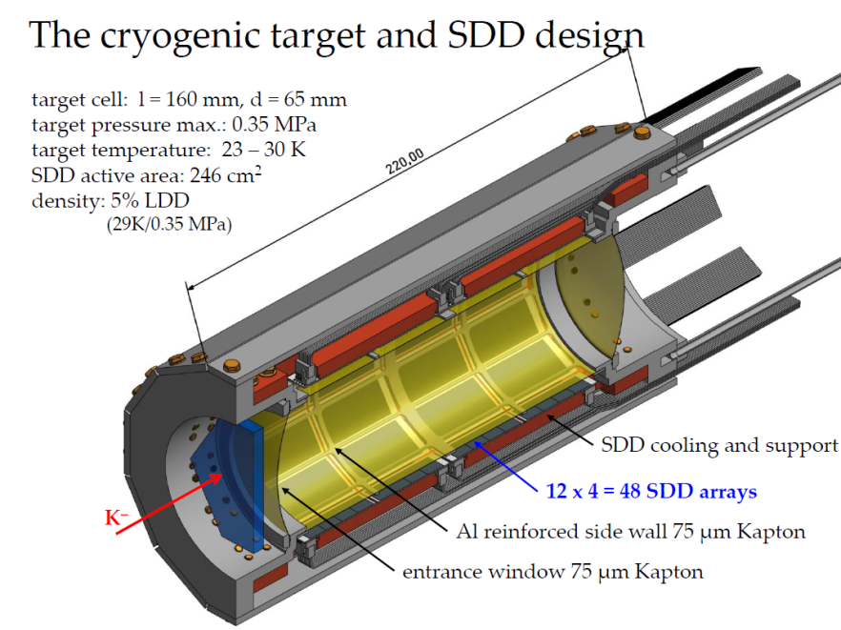
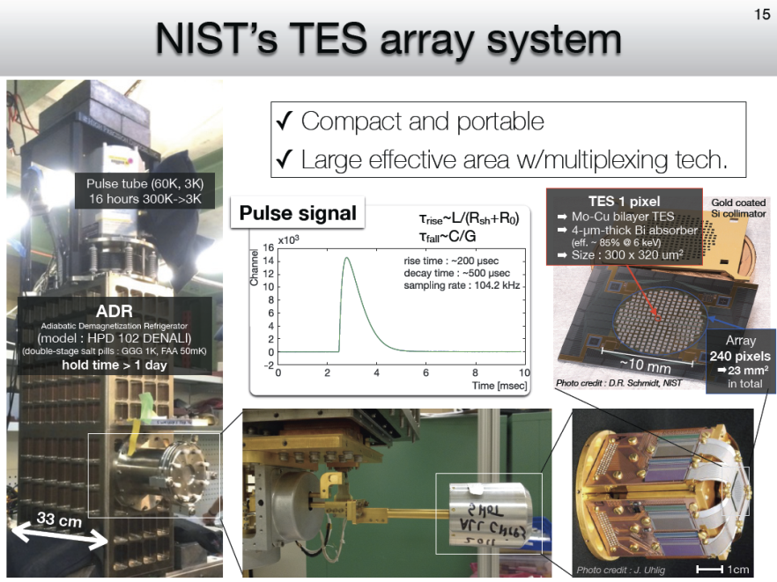
K^{bar}N Interaction at the threshold
Low-energy K-p scattering
Kaonic hydrogen X-ray
isospin dependent K^{bar}N
J-PARC E57:
kaonic deuterium with SDD
S.Ohnish et al.,PRC93(2016) 025207
J.Zmeskal
J-PARC E62:
kaonic ³He/⁴He with TES
K^{bar}N
S.Okada

Slide 7
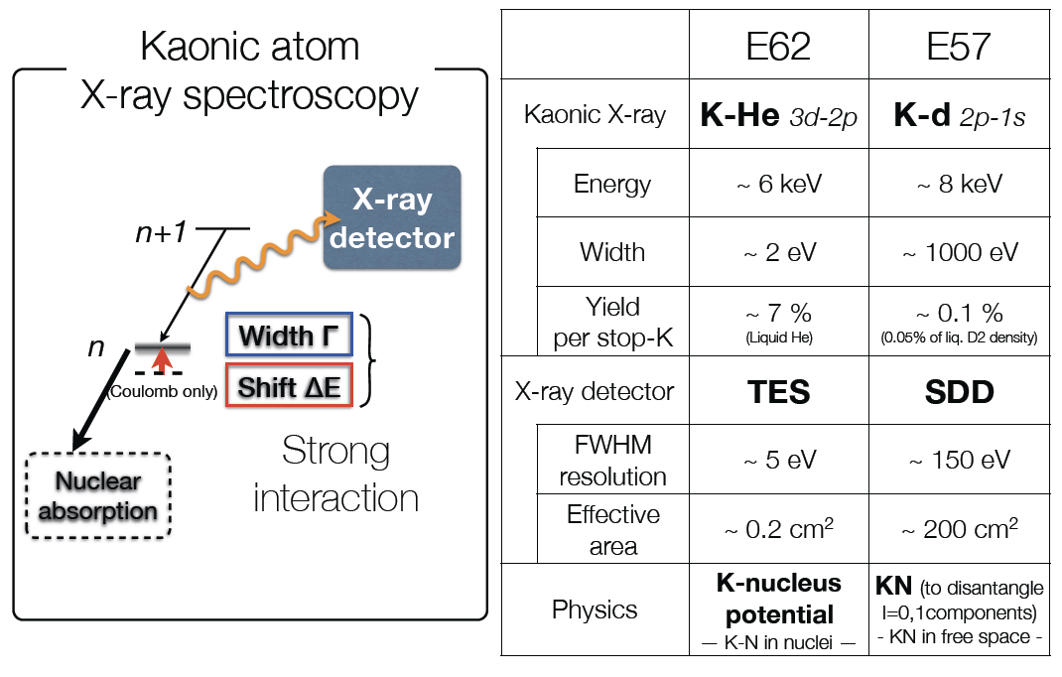
K^{bar}N Interaction via Kaonic-atoms
S.Okada, 21th J-PARC PAC

Slide 8
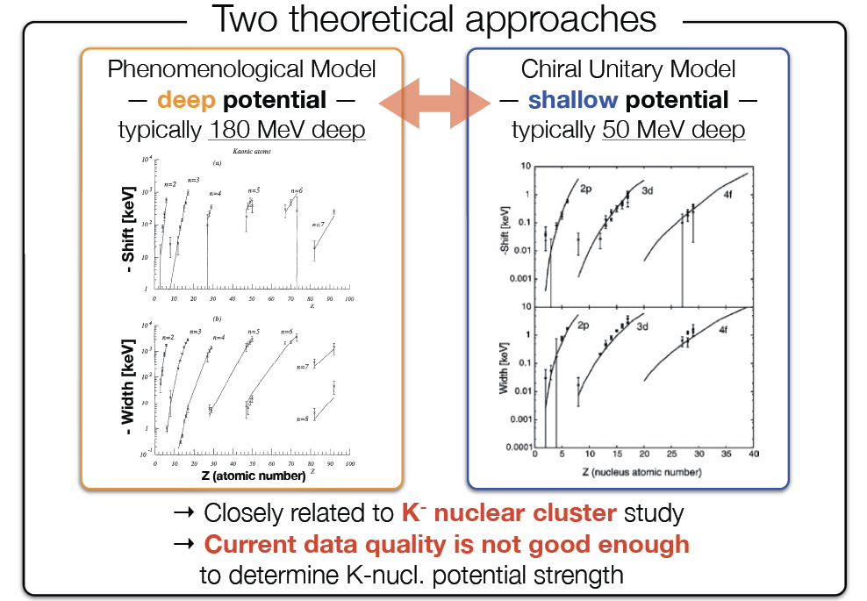
E62: K-nucleus Potential
S.Okada, 21th J-PARC PAC

Slide 9
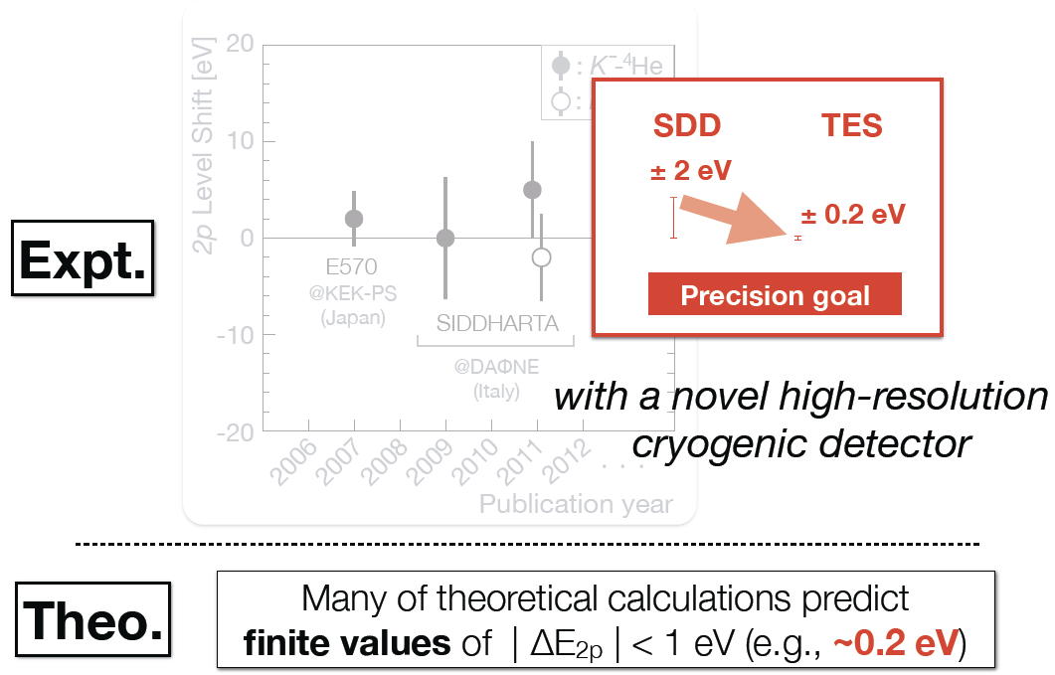
E62: K^{3/4}HeX with TES
S.Okada, 21th J-PARC PAC

Slide 10
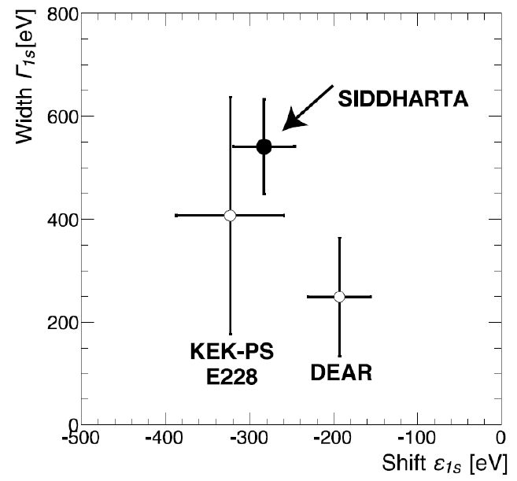
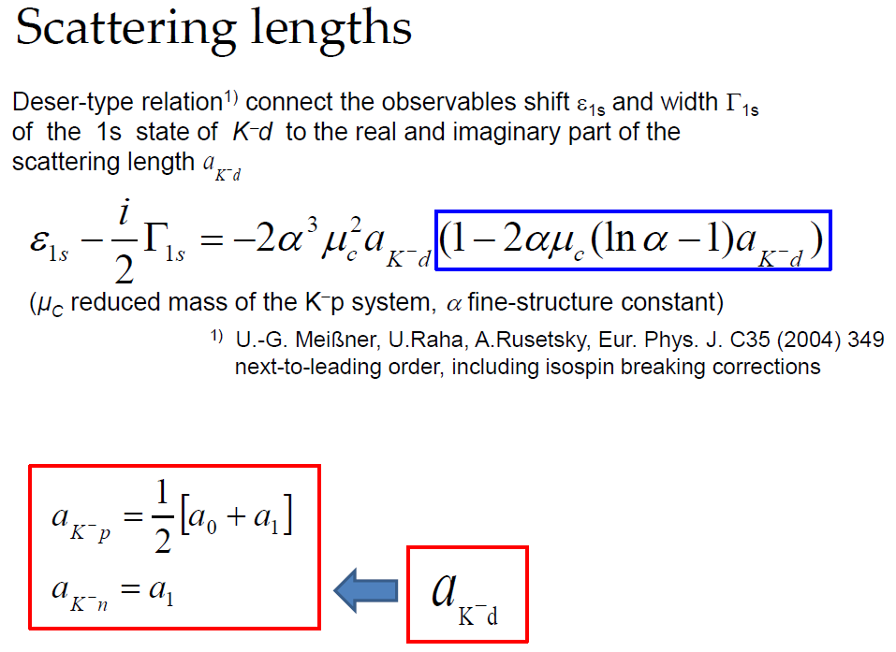
E57: KdX Measurement
K-p scattering length
Precise measurement @ SIDDHARTA
the strong‐int. shift and width of the kaonic hydrogen 1s
K-d scattering length
NO experimental results
due to the difficulty of the X‐ray measurement
missing information in the low-energy K^{bar}N int.
KpX
J.Zmeskal, 20th J-PARC PAC

Slide 11
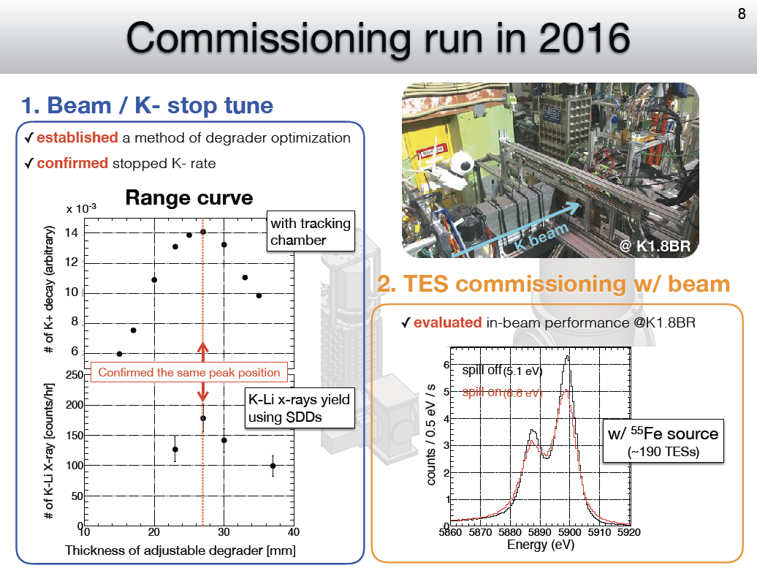
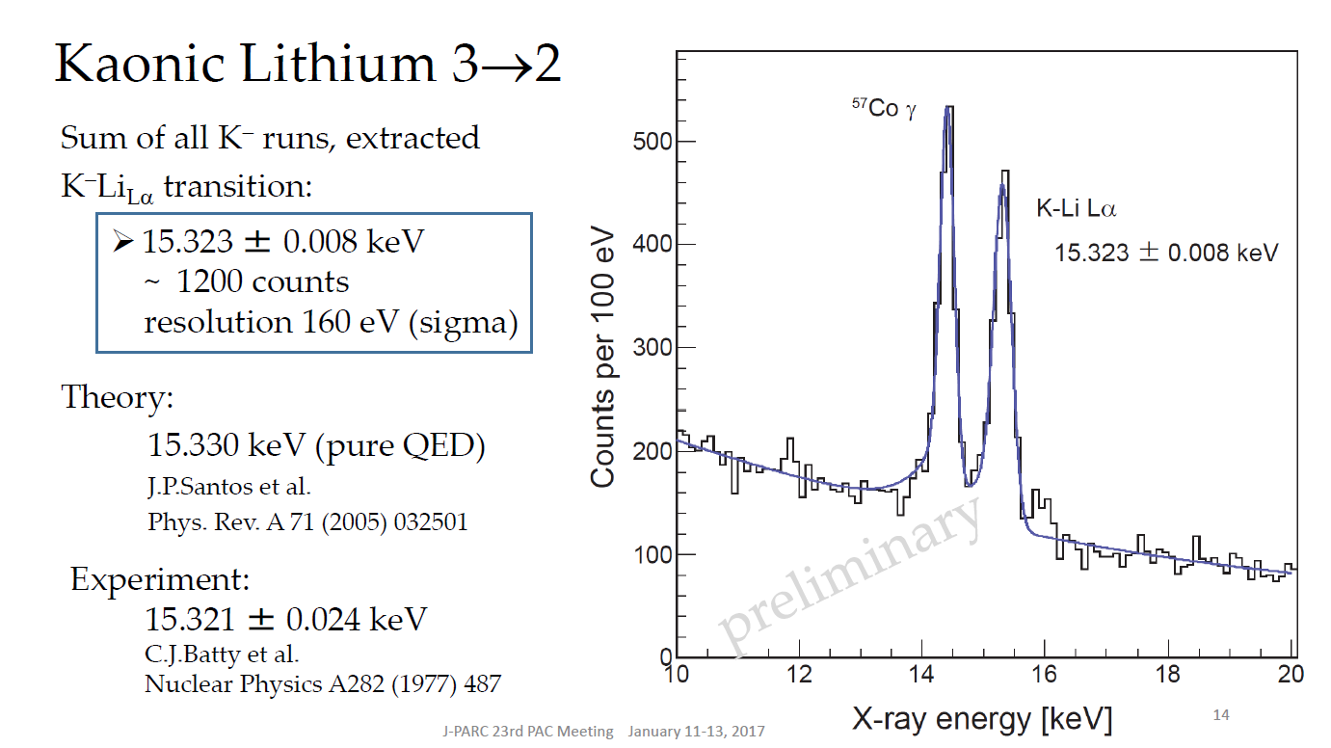
Commissioning Runs
S.Okada, 23th J-PARC PAC
Successfully performed in 2016
  E62: TES under beam-condition
  E57: K-Li Lα with prototype SDD
J.Zmeskal, 23th J-PARC PAC
Scheduled in 2018
  E62: production
  E57: start from K-p before K-d

Slide 12
Λ(1405) Measurement

Slide 13
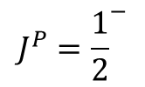
K^{bar}N Interaction below the threshold
K^{bar}N int. plays an important role for Λ(1405)
Λ(1405) or Λ(1420)
  Depending on K^{bar}N int. model
s
$$J^{P}={\frac{1}{2}}^{−}$$
Moriya et al., (CLAS Coll.),
Phys. Rev. Lett. 112(2014)082004
K^{bar}N molecular from LQCD
J.M.M. Hall et al.,
Phys. Rev. Lett. 114(2015)132002.
?
S.Ohnish et al.,PRC93(2016) 025207
K^{bar}N

Slide 14
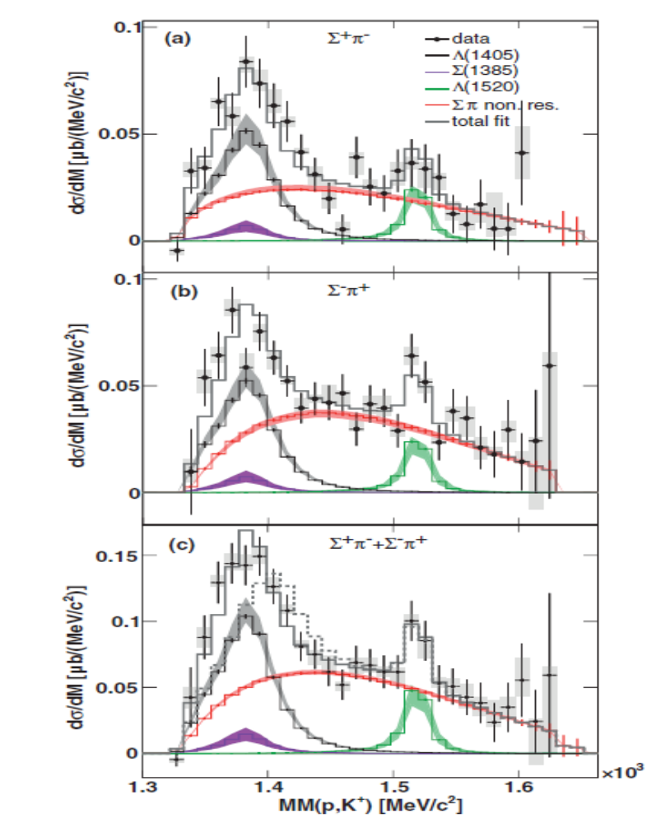
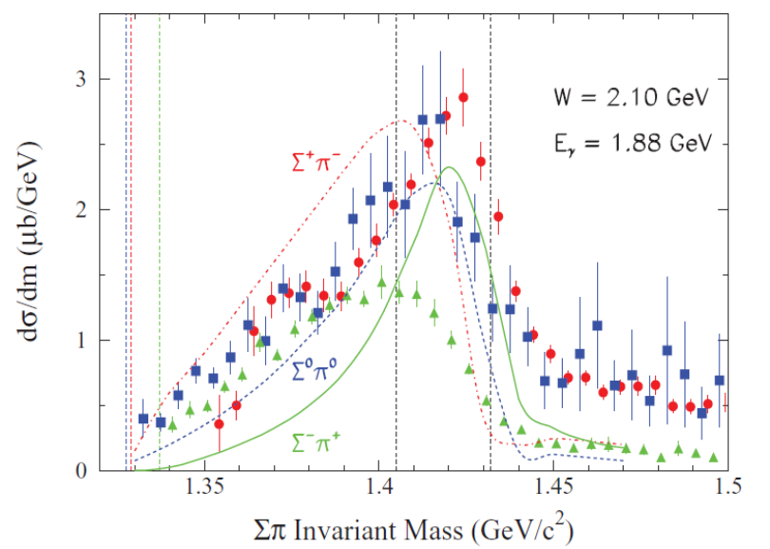


Spectral Shape of Λ(1405)?
γ/p-induced experiments
  Spectral shape is still controversial
$$pp→K^{+}pπ^{−}Σ^{+}{, K}^{+}pπ^{+}Σ^{−}$$
$$γp→K^{+}π^{−}Σ^{+},K^{+}π^{0}Σ^{0}{, K}^{+}π^{+}Σ^{−}$$
CLAS collaboration: PRC87, 035206
HADES collaboration: PRC87, 025201

Slide 15




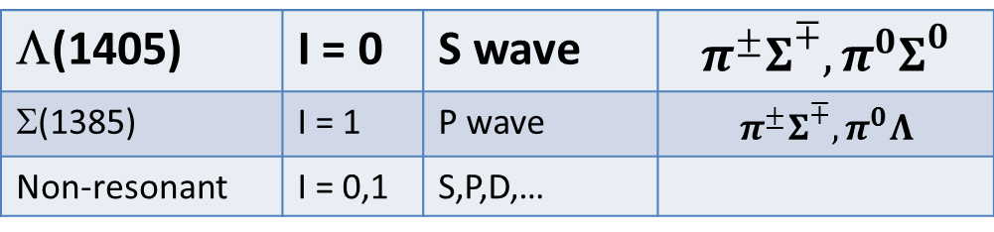

J-PARC E31 Experiment
Measurement of Λ(1405) line shape via K^{bar}N→πΣ
K⁻
n
$$N$$
$$\overline{K}$$
$$π^{∓,0}$$
Inoue
d
$$Σ^{±,0}$$
$$N$$
d(K⁻,n)πΣ reactions at θ_{n}~0 degree to enhance S-wave K^{bar}N→πΣ reaction
K-
d
Λ(1405)
~0.25 GeV/c
n
1 GeV/c
~1.25 GeV/c
Σ
π
n
π
Decomposition of I=0 and 1 amplitudes by identifying final state
Λ(1405) | I = 0 | S wave | $$π^{±}Σ^{∓}, π^{0}Σ^{0}$$
Σ(1385) | I = 1 | P wave | $$π^{±}Σ^{∓}, π^{0}Λ$$
Non-resonant | I = 0,1 | S,P,D,…

Slide 16
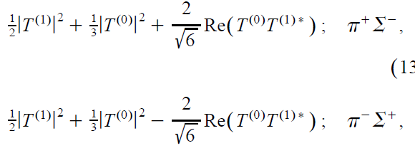
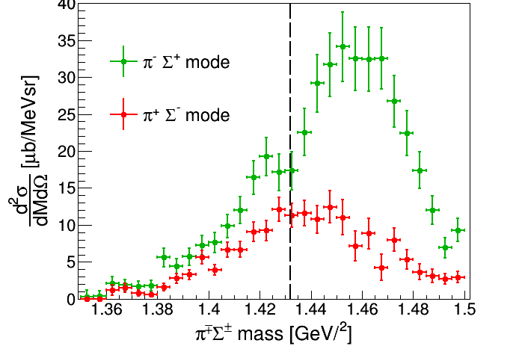
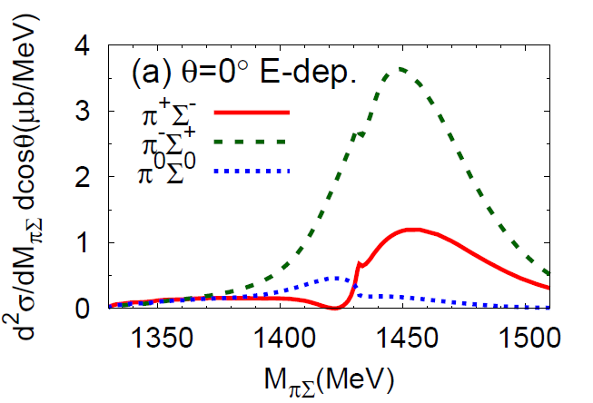
I = 0, 1 Mode (π±Σ∓)
  c.f.
  Faddeev calc. (AGS)
S.Ohnishi et al.,
PRC93(2016)025207
w/ angular dependence
K⁻p
preliminary
interference between the I = 0 and 1 terms of the πΣ scattering amplitudes is observed

Slide 17
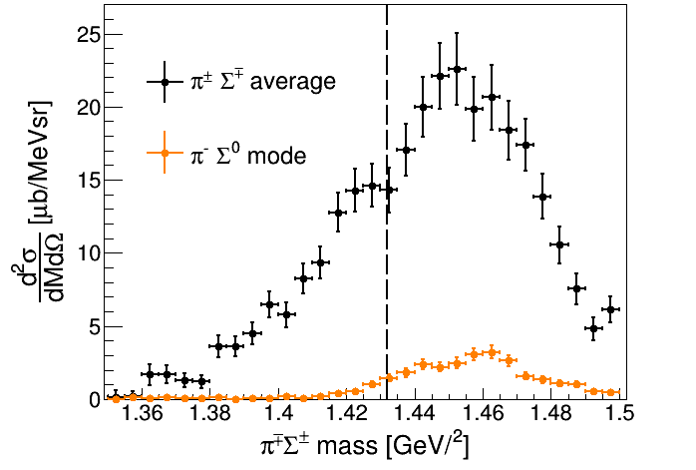
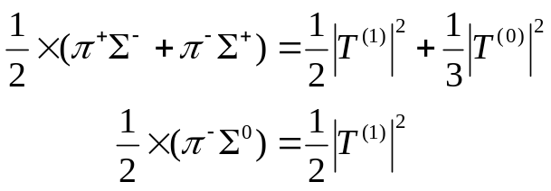
Comparison between
I = 0, 1 (π±Σ∓) & I = 1 (π⁻Σ⁰)
preliminary
I = 0 dominant below the threshold
  |T⁽⁰⁾|²/|T⁽¹⁾|² ~ 100

Slide 18
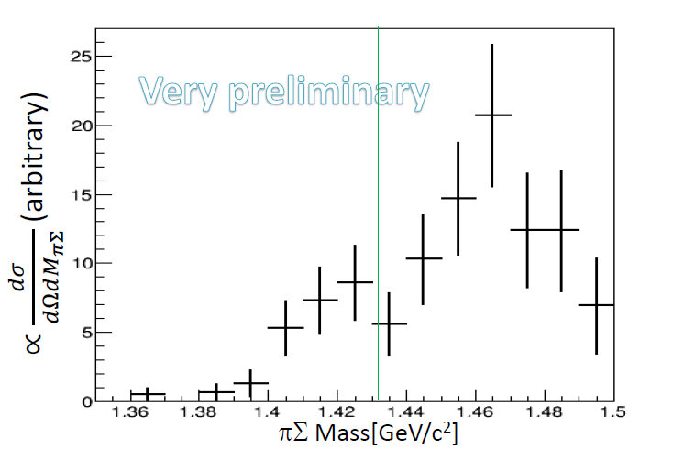

I = 0 Mode (π⁰Σ⁰)
preliminary
The pure I = 0 channel is observed
For further statistics:
  E31-2nd will be performed in May-Jun. 2017

Slide 19
Kaonic-Nuclei Searches

Slide 20
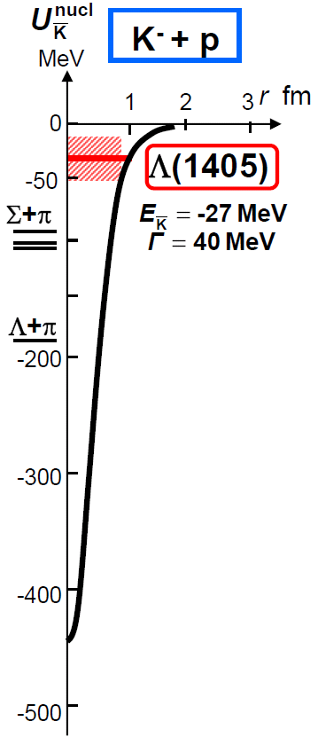
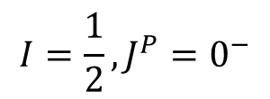
Kaonic Nuclei
Bound states of nucleus and anti-kaon
Predicted as a consequence of attractive K^{bar}N interaction in I=0
the simplest kaonic nuclei:
$$I=\frac{1}{2}, J^{P}=0^{−}$$
?
K^{bar}N
Y.Akaishi & T.Yamazaki, PLB535, 70(2002).

Slide 21
Theoretical Calculations on K^{bar}NN
K^{bar}N int. | Chiral SU(3) (energy dependent) |  |  | Phenomenological (energy independent)
Method | Variational |  | Faddeev | Variational |  | Faddeev
 | Barnea, Gal, Liverts | Dote, Hyodo, Weise | Ikeda, Kamano, Sato | Yamazaki, Akaishi | Wyceck, Green | Shevchenko, Gal, Mares | Ikeda, Sato
B (MeV) | 16 | 17-23 | 9-16 | 48 | 40-80 | 50-70 | 60-95
Γ (MeV) | 41 | 40-70 | 34-46 | 61 | 40-85 | 90-110 | 45-80
K^{bar}N interaction model:
  Chiral SU(3) [energy dependent]
  Phenomenological [energy independent]
Calculation method:
  Almost the same results = depending on K^{bar}N interaction
→ B.E. ~ 20 MeV
→ B.E. ~ 40-70 MeV

Slide 22
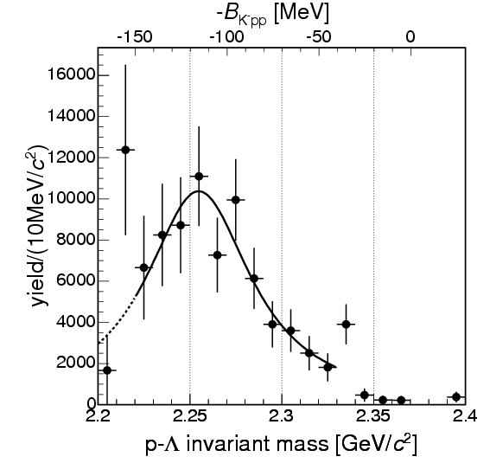
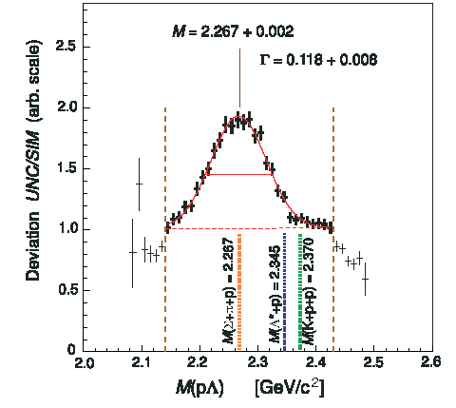
Pioneering Experiments on K^{bar}NN
B.E. = 115MeV
Γ = 67MeV
B.E. = 103MeV
Γ = 118MeV
“K⁻pp”→Λp?
Exp/Sim
FINUDA@DAΦNE
DISTO@SATURNE
PRL94(2005)212303
PRL104(2010)132502
⁶Li+⁷Li+¹²C(stopped K⁻, Λp)
p + p → (Λ + p) + K⁺ @ 2.85GeV
2NA followed by FSI?
PRC74(2006)025206
PRC82(2010)034608 etc.
pp→p(N*)→p(ΛK⁺)?
PRC92(2015)044002
vs.
K.Suzuki, HYP2015 talk

Slide 23
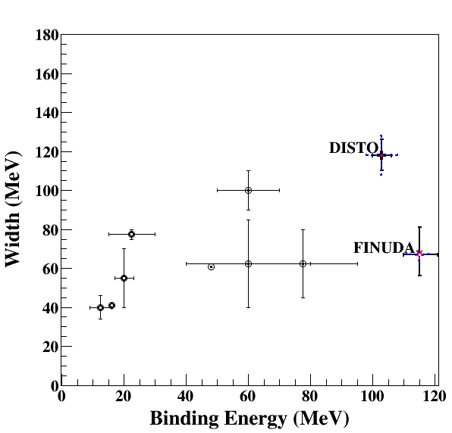
Comparison between Calcs. and Exps.
Binding energy
  Chiral:
  B.E. ~ 20MeV
  Phenomenological:
  B.E. ~ 40-80MeV
  FINUDA/DISTO (if K^{bar}NN):
  B.E. ~ 100MeV
Width
  almost agreement in Γ~40-100MeV
    Theor.: mesonic decay
    Exp.: non-mesonic decay
Chiral
Phenomenological
Upper limits were also obtained:
LEPS@SPring8 [Inclusive d(γ, K⁺π⁻)X]
HADES@GSI [Exclusive pp→pΛK⁺]

Slide 24
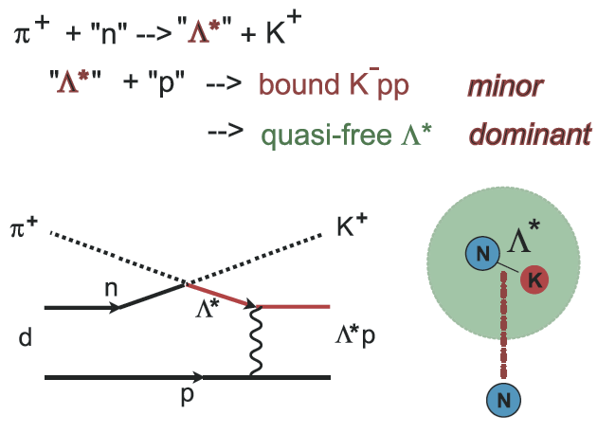
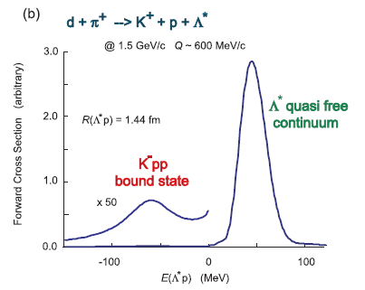
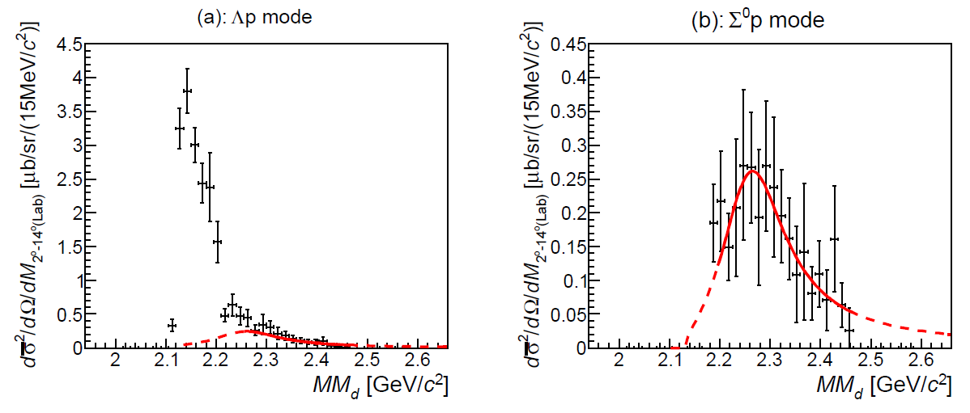
Recent Measurement at J-PARC E27
Exclusive π⁺d→K⁺Yp
  p_{π+} = 1.69 GeV/c
  Δp/p ~ 2x10⁻³
  ΔΩ ~ 100 msr
  final-state is identified by MM[d(π⁺,K⁺pp)X]
Bump structure in Σ⁰p decay mode:
  Mass
  Binding energy
  Width
M(π+Σ+N)
Σ⁰p
M(K+p+p)
Y. Ichikawa et al., PTEP (2015) 021D01.

Slide 25
Recent Measurement at J-PARC E27
Y. Ichikawa et al., PTEP (2015) 021D01.
Decay branch:
Σ⁰p
Theor. Cal. on Y*N→YN : Γ_{Λp}/Γ_{Σ0p} = 1.2
Sekihara, Jido, Kanda-En’yo PRC79(2009)062201(R).
dσ/dΩ_{“K-pp”→Σ0p}:
dσ²/dΩ/dM_{2-14 deg.(Lab)} [μb/sr/(15MeV/c²)]
Λp
Y.Ichikawa, PhD-thesis. Kyoto-U (2015)
M(π+Σ+N)
p(π⁻,K⁰)Λ(1405) @ 1.69GeV/c:
dσ/dΩ_{Λ(1405)}=36.9μb/sr
M(K+p+p)
BNL, NPB56(1973)15
preliminary
= (dσ/dΩ_{”K-pp”→Yp}) / (dσ/dΩ_{Λ(1405)}) ~ 7-8%
→ large prob. of Λ(1405)p→“K⁻pp”
c.f., large prob. in DISTO, but < 50% in HADES
T.Nagae

Slide 26

J-PARC E15 Experiment
³He(in-flight K⁻,n) reaction @ 1.0 GeV/c
  2NA processes and Y decays can be discriminated kinematically
semi-inclusive ³He(K⁻,n)
T. Hashimoto et al., PTEP (2015) 061D01.
exclusive (K⁻,Λp)n_{missing}
Y. Sada et al., PTEP (2016) 051D01.

Slide 27
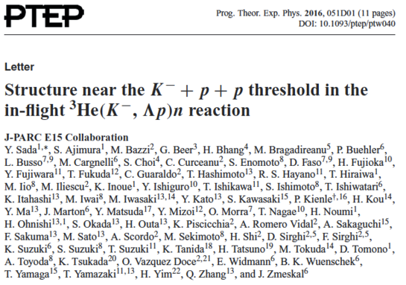
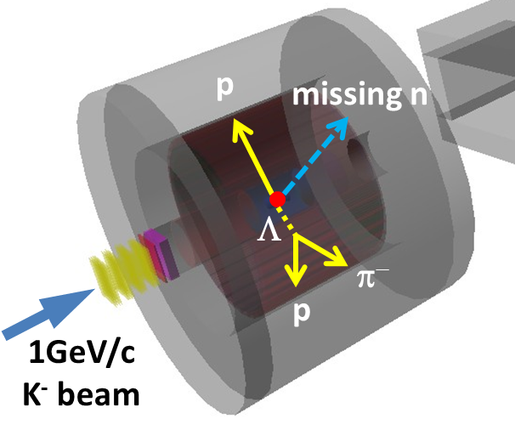
Exclusive ³He(K⁻,Λp)n
--- result of E15-1st in 2013 ---
Y.Sada et al., PTEP (2016) 051D01.

Slide 28

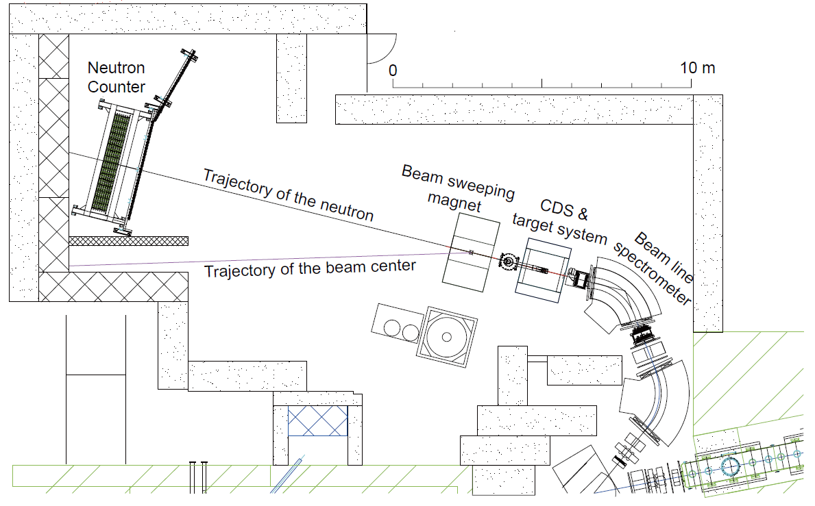
Experimental Setup
15m

Slide 29
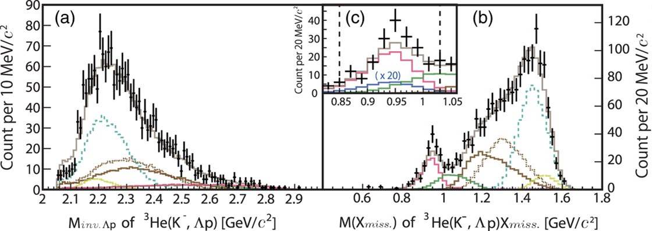

n-ID from Inclusive ³He(K⁻,Λp)X
Y. Sada et al., PTEP (2016) 051D01.
Σ⁰pn
Λpn
Λpn_{s}
(2NA)
x20
Λpn
Σ⁰pn
YNNππ
YNNππ
YNNπ
YNNπππ
YNNπ
YNNπππ
Global fit both in Λp invariant- and missing-mass
  σ ~ 10 MeV/c²
  w/ simulated spectra of 2NA/3NA
Neutron was identified by kinematics
  ³He(K⁻, Λp)n_{missing}
3NA(Λpn):
  # of Λpn events: ~200
  Σ⁰pn contamination: ~20%

Slide 30
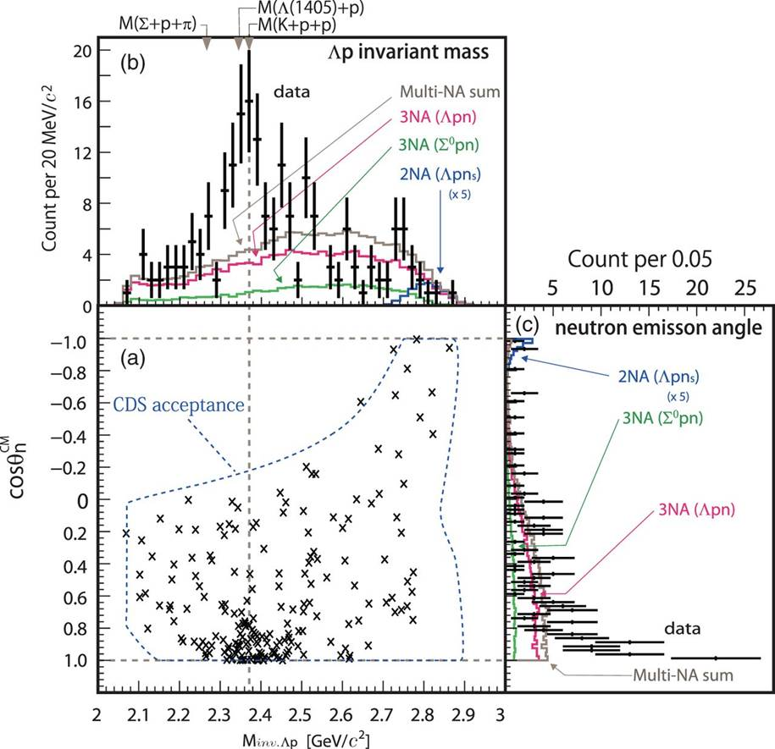
Exclusive ³He(K⁻,Λp)n
A bump structure exists near the K-pp threshold
Prefers Smaller momentum transfer to Λp (0.8<cosθ^{CM}_{n})
  S=-1 dibaryon?
    Λ*N?
    K^{bar}NN?
    …
Y. Sada et al., PTEP (2016) 051D01.

Slide 31
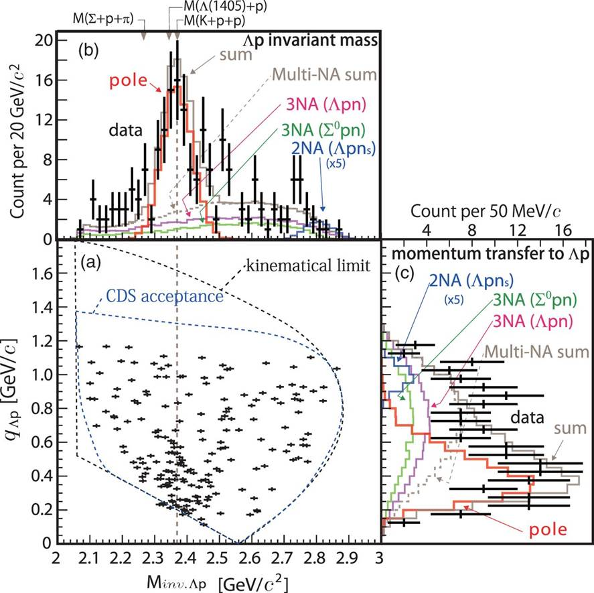

Assuming a Breit-Wigner
χ2-test with pole & 3NA(Ypn)
– S-wave Breit-Wigner pole
– w/ Gaussian form-factor
  [B.E = 15 MeV/c²]
Y. Sada et al., PTEP (2016) 051D01.

Slide 32
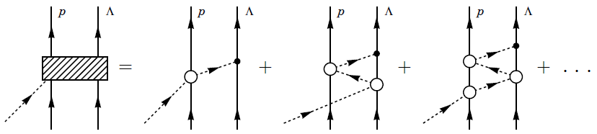
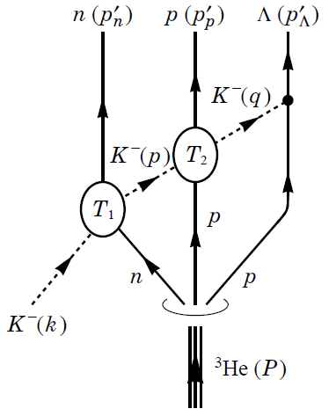
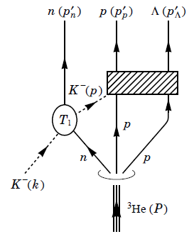
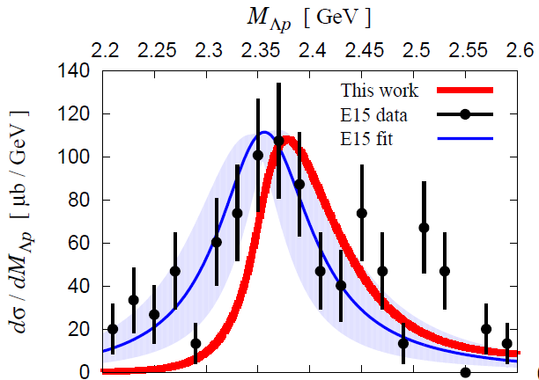
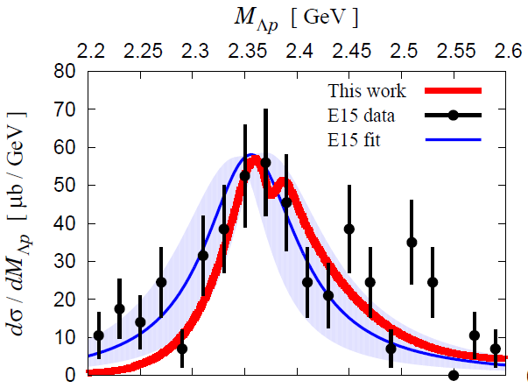
A Theoretical Interpretation
Sekihara, Oset, Ramos, PTEP(2016)123D03.
Chiral unitary approach
Sekihara
Uncorrelated
Λ(1405)p
state
quasi-elastic
kaon
scattering
K^{bar}NN
bound-state
B=16MeV
Γ=72 MeV
Opt.A (Watson)
Opt.A (Watson)
M[K+p+p]
M[K+p+p]

Slide 33
E15-2nd Experiment
--- completed in Dec. 2015 ---
What is the structure observed in E15^{1st} data?
 | E15-1st in 2013 | E15-2nd in 2015
data-taking | 4 days | 3 weeks
(K⁻,n) | ~7 times more data
(K⁻,Λp) | ~30 times more data*
* dedicated trigger was introduced for (K-,Λp)
Will be published as “T.Yamaga et al., XXX (2017) XXX.”

Slide 34
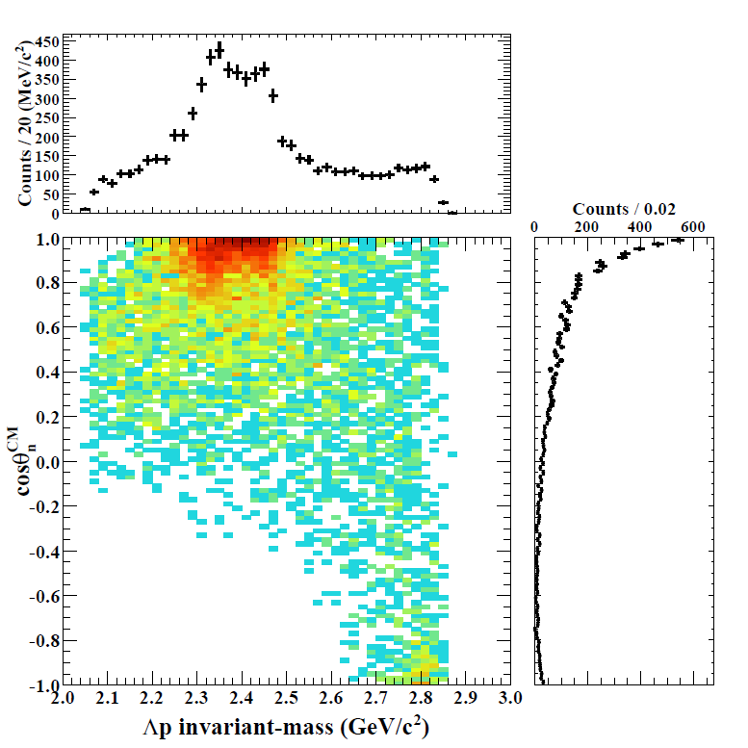
Results of ³He(K⁻,Λp)n [E15-2nd]
IM(Λp)
Structures around the Kpp threshold can be seen
= bound-state + QF
M(K+p+p)
preliminary
Structures are concentrated in forward-n region
= small momentum-transfer
detector
acceptance
cos(θ_{n})

Slide 35
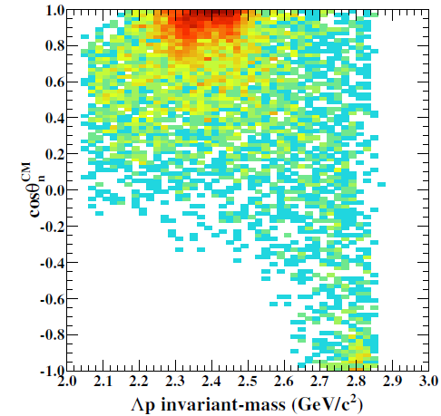
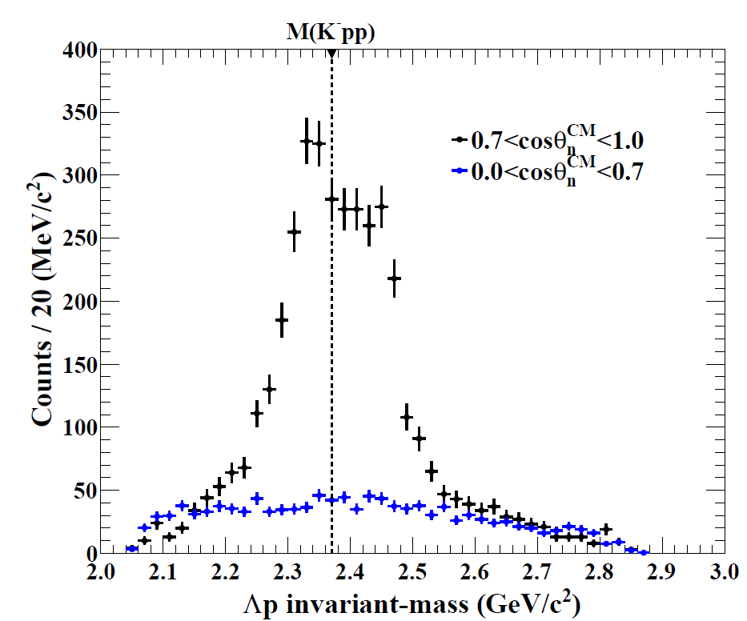
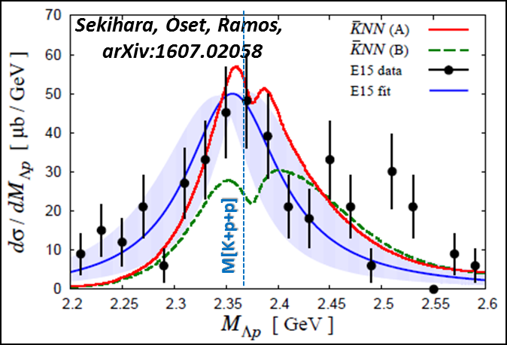
Results of ³He(K⁻,Λp)n [E15-2nd]
𝟎.𝟕<𝐜𝐨𝐬𝜽_{𝒏}^{𝑪𝑴}<𝟏.𝟎
𝟎.𝟎<𝐜𝐨𝐬𝜽_{𝒏}^{𝑪𝑴}<𝟎.𝟕
Above M(Kpp)
→ QF = [Quasi-elastic K] x [KNN→Λp]
Below M(Kpp)
→ Bound-State!?
detector
acceptance
𝟎.𝟕<𝐜𝐨𝐬𝜽_{𝒏}^{𝑪𝑴}<𝟏.𝟎
missing acceptance
preliminary
Flat distribution
prop. to phase space
→ Point like 3NA?
(𝟎.𝟎<𝐜𝐨𝐬𝜽_{𝒏}^{𝑪𝑴}<𝟎.𝟕)
×𝟎.𝟒𝟕

Slide 36
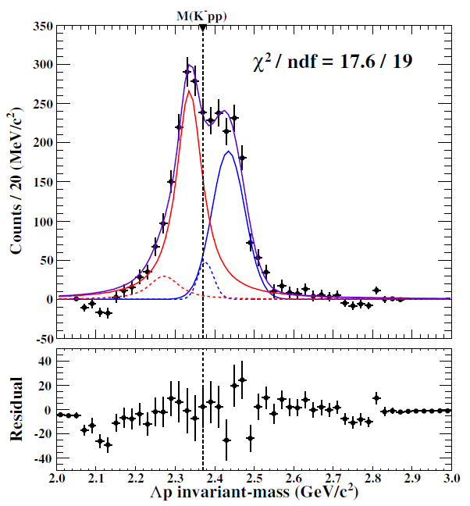
Results of ³He(K⁻,Λp)n [E15-2nd]
Simple fitting w/o 3NA
  B.S.: Breit-Wigner
  QF: Gaussian
  w/ Σ⁰p contamination
Well reproduce the spectrum
  B.E ~ 34 MeV/c²
  Γ ~ 75 MeV/c²
preliminary
← Fermi-mom. Eff.
← from MM(³He(K⁻,Λp)X)
preliminary

Slide 37





Results of ³He(K⁻,Λp)n [E15-2nd]
cosθ_{n} dependence
𝟎.𝟕5<𝐜𝐨𝐬𝜽_{𝒏}^{𝑪𝑴}<𝟏.𝟎
preliminary
0.95<cosθ_{n}<1.0
0.90<cosθ_{n}<0.95
detector
acceptance
0.85<cosθ_{n}<0.90
0.80<cosθ_{n}<0.85
0.75<cosθ_{n}<0.80

Slide 38




Results of ³He(K⁻,Λp)n [E15-2nd]
Peak position
Width
Gaussian
Breit-Wigner
Above M(K-pp):
  peak shift by recoil kaon energy
Below M(K-pp):
  peak is independent to cosθ_{n}
  ( ~ momentum transfer)
Similar tendency as a theoretical calc.
QF
B.S.
Sekihara, Oset, Ramos,
PTEP(2016)123D03

Slide 39

Present Status of K^{bar}NN
Exp. CANDIDATES
  Upper limit
    LEPS/HADES
  B.E ~ 10-40 MeV
    E15
  B.E. ~ 100 MeV
    FINUDA/DISTO/E27
Theor. calculations.
  Difficult to reproduce deeply bound state using normal K^{bar}N int.
E15-2nd
?
Chiral
Phenomenological
For further understanding:
Λ(1405) production ◊ Λ∗N doorway
πΣN decay channel → new info. of K^{bar}NN

Slide 40

Summary
To investigate the K^{bar}N interaction,
various experiments are proposed/conducting at J-PARC
- Sensitive in different energy region & isospin -
Kaonic-atom: E62/E57
  will start in 2018/2019
Λ(1405): E31
  1st: analysis will be finalized
  2nd: will start in 2017
K^{bar}NN: E27/E15
  fruitful results were obtained in E27/E15^{1st}
  analysis of E15^{2nd} data is going on
  E15^{3rd} be discussed after analyzing new data

Slide 41


The Collaborations @ J-PARC K1.8BR
J-PARC E15/E31 collaboration

Slide 42
Spares

Slide 43


K^{bar}N Interaction below the threshold
Λ(1405) plays an important role
s
$$J^{P}={\frac{1}{2}}^{−}$$
Moriya et al., (CLAS Coll.),
Phys. Rev. Lett. 112(2014)082004.
K^{bar}N molecular from LQCD
J.M.M. Hall et al.,
Phys. Rev. Lett. 114(2015)132002.
S.Ohnish et al.,PRC93(2016) 025207
K^{bar}N

Slide 44


Recent Measurement at LEPS
A.O. Tokiyasu et al., Phys. Lett. B 728 (2014) 616.
Inclusive d(γ, K⁺π⁻)X
  E_{γ} = 1.5-2.4 GeV
  cosθ^{lab}_{K+/π-} > 0.95
  σ_{MM} ~ 10 MeV
BG: γN→K⁺π⁻Λ/Σ/Λ(1520)
NO peak structure
  U.L.: 0.17-2.9 μb
  (= 1.5-26% CS of γd→K⁺π⁻Y)
M[K+p+p]
◊ LEPS2 (4π measurement)

Slide 45


Recent Measurement at HADES
G. Agakishiev et al., Phys. Lett. B 742 (2015) 242
Kpp th
Exclusive pp→pΛK⁺
  E = 3.5 GeV
Bonn–Gatchina PWA
  Well reproduces the data with N* resonances
    pp→pN*→pΛK⁺
NO peak structure
  U.L.: 0.7-4.2 μb
  (= 2-12% CS of pp→pK⁺Λ)
  Λ(1405) production = 9.2 μb
  → σ(X=K^{bar}NN)/σ(Λ*) < ~50%
PRC87(2013)025201
vs.
DISTO: σ(X) > σ(Λ(1405)) @ 2.85GeV
◊ Combined analysis with COSY-TOF/DISTO/HOPI/HADES (pp→pK⁺Λ)

Slide 46

E15: Publications
E15^{1st} experiment:
Only 4days data-taking in 2013
inclusive ³He(K⁻,n)X
exclusive ³He(K⁻,Λp)n
T. Hashimoto et al., PTEP (2015) 061D01.
Y. Sada et al., PTEP (2016) 051D01.

Slide 47


Semi-Inclusive ³He(K⁻,n)X
DATA
sub-threshold
excess
(Y* and/or K^{bar}NN?)
Quasi Elastic
K⁻ + ³He → K⁻ + n + p_{s} + p_{s}
dσ/dΩ_{θ=0deg} ~ 6mb/sr
MC
Charge-Exchange
K⁻ + ³He → K⁰ + n + d_{s}
dσ/dΩ_{θ=0deg} ~ 11mb/sr
T. Hashimoto et al., PTEP (2015) 061D01.

Slide 48


Semi-Inclusive ³He(K⁻,n)X
NO bump structure
FINUDA/DISTO/
E27
T. Hashimoto et al., PTEP (2015) 061D01.

Slide 49

Assuming a Breit-Wigner
Y. Sada et al., PTEP (2016) 051D01.
phase space
Breit-Wigner
form factor
B.E = 15⁺⁶₋₈ (stat.) ± 12(syst.) MeV/c²
= 110⁺¹⁹₋₁₇(stat.) ± 27(syst.) MeV/c²
Q = 400⁺⁶⁰₋₄₀ MeV/c

Slide 50


Experimental Setup
Beamline spectrometer
  1.0 GeV/c K⁻
  Δp/p: 0.2%
Target System
  ~0.5l Liquid 3He @ 1.4K
    ρ = 0.081 g/cm³
Cylindrical Detector System
  Acceptance: 54<θ<126 deg.
    59% of 4π
  Δp_{t}/p_{t}: 5.3% p_{t} + 0.5%/β
Neutron Counter
  Acceptance: 20 msr
  Δp/p for 1.2GeV/c n: 0.7%

Slide 51

A Theoretical Interpretation
Sekihara, Oset, Ramos, arXiv:1607.02058
Chiral unitary approach
Sekihara, Tue. A-1
K^{bar}NN state
Sekihara, Oset, Ramos,
arXiv:1607.02058
A: Watson app.
B: Faddeev app.
B=16MeV, Γ=72 MeV
quasi-elastic kaon
scattering
M[K+p+p]
K^{bar}NN bound-state picture reproduces the data
→ The data CANNOT be explained with uncorrelated Λ(1405)p

Slide 52


E15 1st vs 2nd
Y. Sada et al., PTEP (2016) 051D01.
E15-2nd

Slide 53

Exclusive ³He(K⁻,Λp)n
The events widely distribute in the phase space
  Contribution from 2NA processes seem to be small
Event concentration is seen at T^{CM}_{n}/Q^{CM}~0.4

Slide 54

Exclusive ³He(K⁻,Λp)n
E15^{1st}
E15^{2nd}
preliminary

Slide 55
K^{bar}NN or NOT? --- Other Possibilities
A structure near K^{bar}NN threshold
Λ(1405)N bound state
  loosely-bound system, I=1/2, J^{π}=0⁻
  various decay modes, ΛN/ΣN/πΣN
πΛN-πΣN dibaryon
  structure near πΣN threshold
  I=3/2, J^{π}=2⁺ → no Λp decay (I=1/2)?
Double-pole K^{bar}NN
  loosely-bound K^{bar}NN, &
  broad resonance near the πΣN threshold → πΣN decay
Partial restoration of Chiral symmetry
  enhancement of the K^{bar}N interaction in dense nuclei
T. Uchino et al., NPA868(2011)53.
A structure near πΣN threshold
H. Garcilazo, A. Gal, NPA897(2013)167.
A. Dote, T. Inoue, T. Myo, PTEP (2015) 043D02.
S. Maeda, Y. Akaishi, T. Yamazaki, Proc. Jpn. Acad., B89(2013)418.

Slide 56



Exclusive ³He(K⁻,Λp)n
Small cos(θ_{n})
M[K+p+p]
preliminary
sliced
Large cos(θ_{n})
Sekihara, Oset, Ramos,
arXiv:1607.02058
Smaller momentum transfer is preferred

Slide 57


³He(K⁻,Λp)n: Decay Channel
Λp
M[K+p+p]
preliminary
Λp
Σ⁰p
sliced
Λp
Σ⁰p
Λp~Σ⁰p
Σ⁰p
πYN
Σ⁰p~πYN
Γ(Λp) > Γ(Σ⁰p) !?

Slide 58

³He(K⁻,Λp)n: q-dependence
M[K+p+p]
preliminary
Kinematical
Limit

Slide 60


E27: Experimental Setup
SKS spectrometer
K1.8 beam line spectrometer
  1.69 GeV/c π⁺
  Δp/p ~ 2x10⁻³
SKS spectrometer
  0.8-1.3 GeV/c K⁺
  Δp/p ~ 2x10⁻³
  ΔΩ ~ 100 msr
Target : liquid deuterium (1.99 g/cm²)
K⁺
π⁺
K1.8 beam line
spectrometer
p_{π} = 1.69 GeV/c
Y.Ichikawa

Slide 61


E27: Inclusive d(π⁺,K⁺)X
Y. Ichikawa et al., PTEP (2014) 101D03.
expected spectrum
“K⁻pp” signal is hidden by QF!?
+ data
- expected
ΣN-ΛN cusp
Y* mass shift?
Ichikawa, Tue. A-1
Tokiyasu, Fri. E-1
T.Nagae

Slide 62


E27: Experimental Setup
SKS spectrometer
K1.8 beam line spectrometer
  1.69 GeV/c π⁺
  Δp/p ~ 2x10⁻³
SKS spectrometer
  0.8-1.3 GeV/c K⁺
  Δp/p ~ 2x10⁻³
  ΔΩ ~ 100 msr
Target : liquid deuterium (1.99 g/cm²)
K⁺
π⁺
Range Counter Arrays
Range Counter Arrays (RCA)
  5 layers of Plastic scinti.
  39-122 deg. (L+R)
  50 cm TOF
Y.Ichikawa

Slide 63


E27: One-Proton Coincidence
Y. Ichikawa et al., PTEP (2015) 021D01.
p_{p} > 250 MeV/c
  QFs are suppressed
ΣN-ΛN cusp is clearly seen @ 2.13 GeV/c²
Broad enhancement is observed @ 2.28 GeV/c²
< 1p coincidence spectrum >
< 1p coincidence probability >
=
< Inclusive spectrum >
ΣN-ΛN cusp
Broad bump

Slide 64


E27: Two-Proton Coincidence
Y. Ichikawa et al., PTEP (2015) 021D01.
p_{p} > 250 MeV/c
  QFs are suppressed
ΣN-ΛN cusp is clearly seen @ 2.13 GeV/c²
Broad enhancement is observed @ 2.28 GeV/c²
< 2p coincidence spectrum >
< 2p coincidence probability >
=
Y.Ichikawa, PhD-thesis.
Kyoto-U (2015)
< Inclusive spectrum >
ΣN-ΛN cusp
Broad bump
Y.Ichikawa

Slide 65

E27: Decay Mode Separation
Y. Ichikawa et al., PTEP (2015) 021D01.
①
②
③
Decay mode can be separated with MM[d(π⁺,K⁺pp)X]
  two-protons in final state: K⁺Λp, K⁺Σ⁰p, K⁺Yπp
①
②
③

