Slide 1


Light kaonic nuclei at J-PARC
F. Sakuma, RIKEN
on behalf of the J-PARC E15/E80 collaborations
Strangeness Nuclear Physics Workshop, 2021
18-19 December 2021, Online

Slide 2
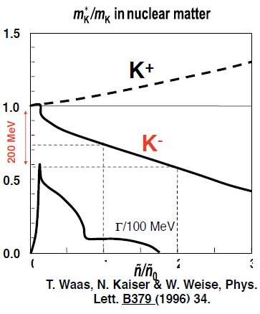
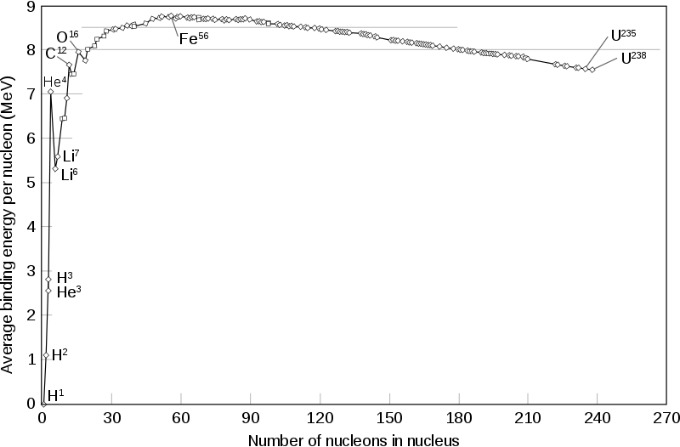
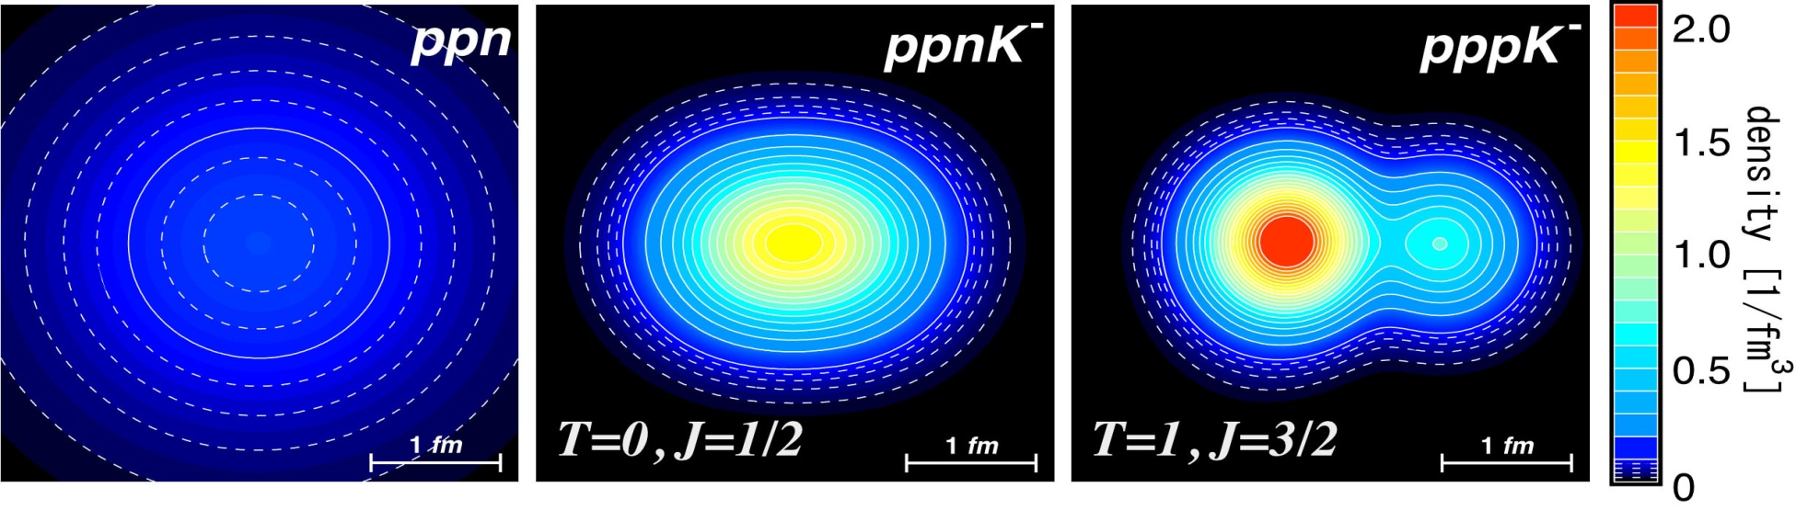
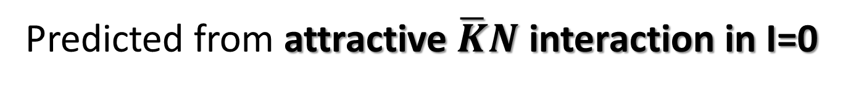
Kaonic Nuclei
Predicted from attractive $\overline{K}N$ interaction in I=0
Kaonic Nuclei | Binding Energy [MeV] | Width [MeV]
Λ(1405) = K⁻p | 27 | 40
K⁻pp | 48 | 61
K⁻ppp | 97 | 13
K⁻ppn | 118 | 21
PL7(1963)288., PRC65(2002)044005., etc.
c.f. Nuclear Binding Energy
few MeV @ A = 2,3
0
1
2
3
An important probe to investigate
changes of meson property
in nuclear media

Slide 3
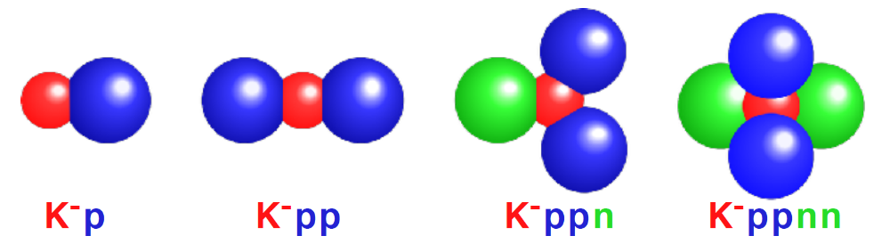
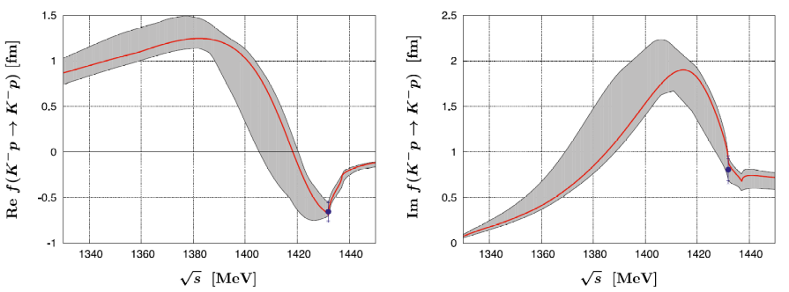
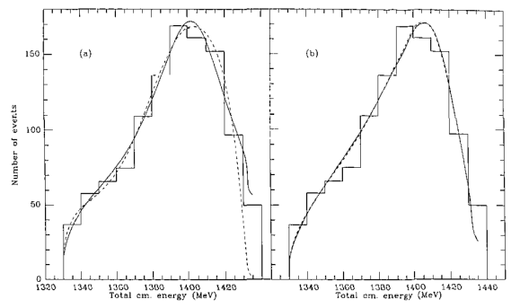
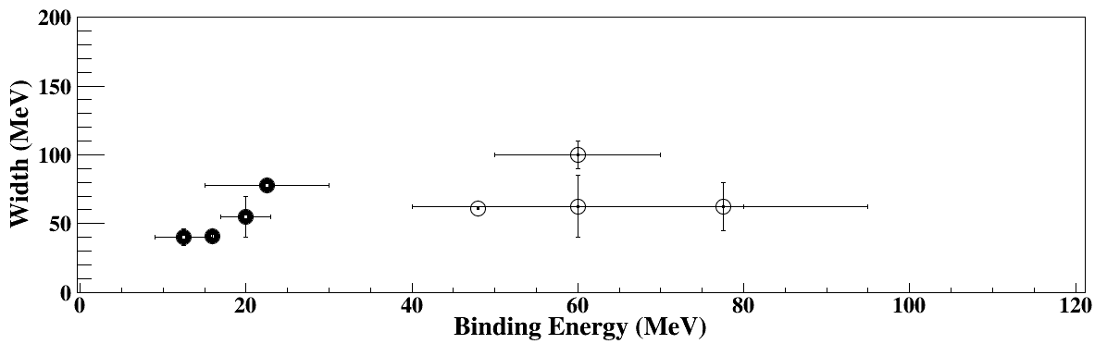
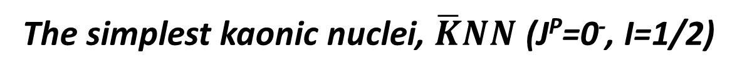
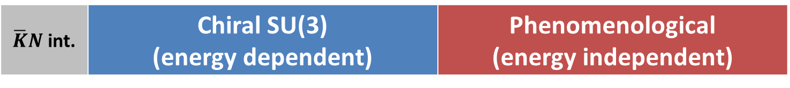
Theoretical Calculations on “K⁻pp”
The simplest kaonic nuclei, $\overline{K}NN$ (J^{P}=0⁻, I=1/2)
$\overline{K}N$ int. | Chiral SU(3) (energy dependent) | Phenomenological (energy independent)
M_{Λ(1405)}~1420, double pole
M_{Λ(1405)}~1405, single pole
NPA881(2012)98
JPhys17(1991)289
B.E. ~ 20 MeV
B.E. ~ 40-70 MeV
not compact compared
to pheno. models
compact & dense system
The bound state exists

Slide 4


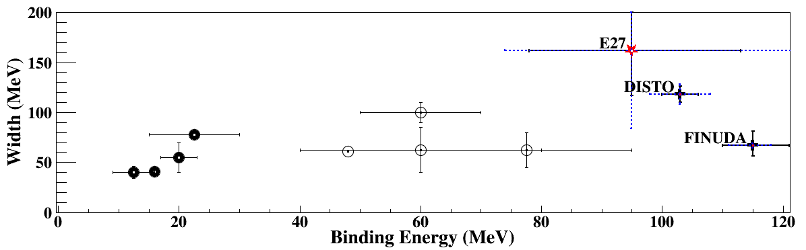
Experimental Situation “before E15”
Negative results
Positive results
AMADEUS@DAΦNE
FINUDA@DAΦNE
PRL94(2005)212303
¹²C(K⁻_{stopped}, Λp)
EPJC79(2019)190
⁶Li/⁷Li/¹²C(K⁻_{stopped}, Λp)
Multi-NA processes?
HADES@GSI
DISTO@SATURNE
PRL104(2010)132502
p + p → (Λ + p) + K⁺ @ 3.5GeV
p + p → (Λ + p) + K⁺ @ 2.85GeV
PLB742(2015)242
Intermediate N*→pK⁺?
LEPS@SPring-8
E27@J-PARC
PTEP(2015)021D01.
d(γ, π⁻K⁺)X @ 1.5-2.4 GeV
d(π⁺, K⁺)Σ⁰p @ 1.69 GeV/c
PLB728(2014)616
Need more data
Controversial
→ J-PARC E15 experiment

Slide 5


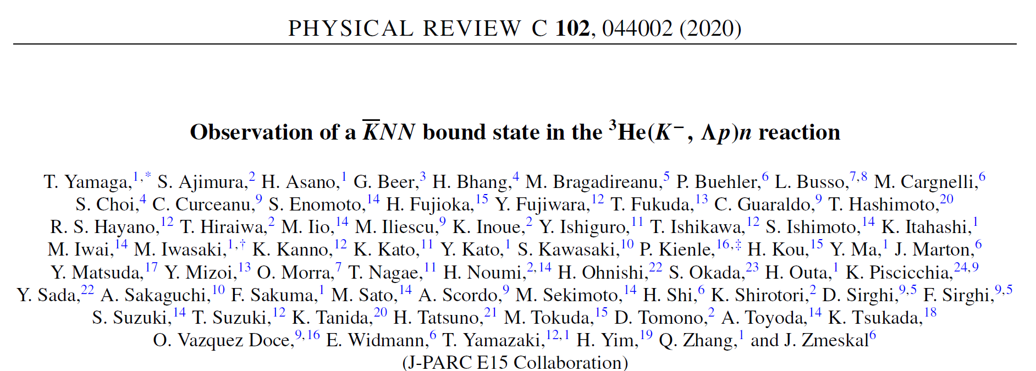
J-PARC E15 Experiment
³He(in-flight K⁻,n) reaction @ 1.0 GeV/c
  2NA and Y decays can be discriminated kinematically
semi-inclusive ³He(K⁻,n)
PTEP (2015) 061D01.
exclusive (K⁻,Λp)n_{missing}
PTEP (2016) 051D01.,
PLB789(2019)620., PRC102(2020)044002.

Slide 6

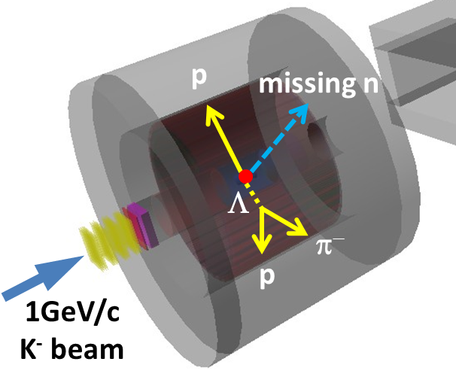
Experimental Setup @ K1.8BR
15m

Slide 7
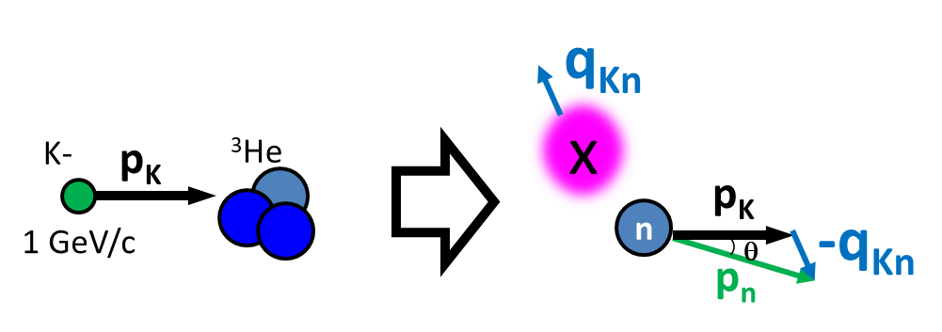
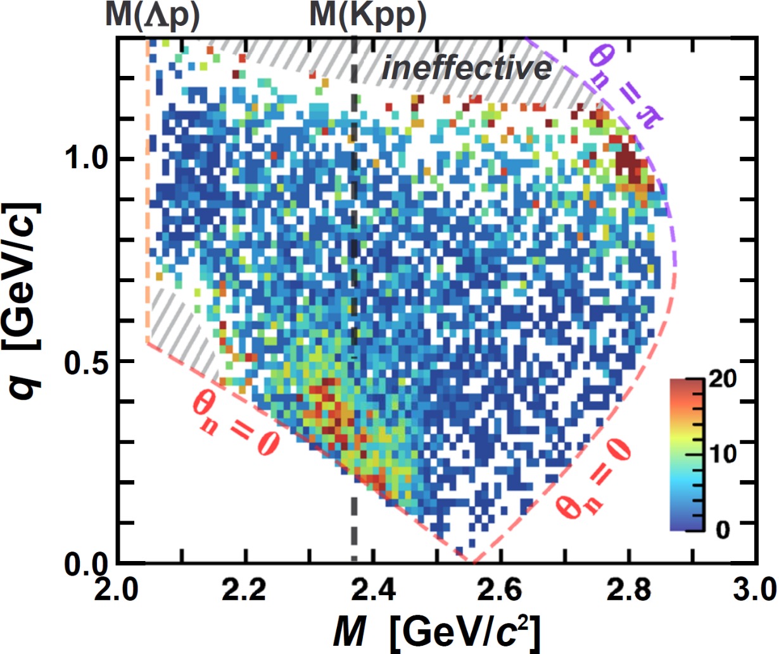
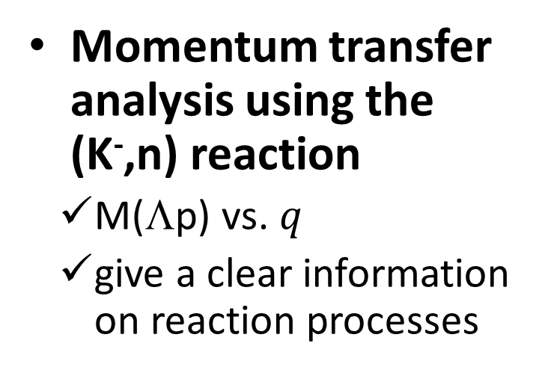
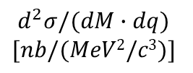
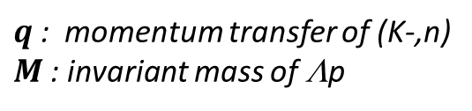
Exclusive ³He(K⁻,Λp)n
T.Yamaga et. al., PRC102(2020)044002.
$$d^{2}σ/(dM∙dq)$$
$$[nb/(MeV2/c3)]$$
Bound
Un-bound
Momentum transfer analysis using the (K⁻,n) reaction
  M(Λp) vs. $q$
  give a clear information on reaction processes
acceptance &
efficiency
corrected
$q$: momentum transfer of (K-,n)
$M$: invariant mass of Λp

Slide 8
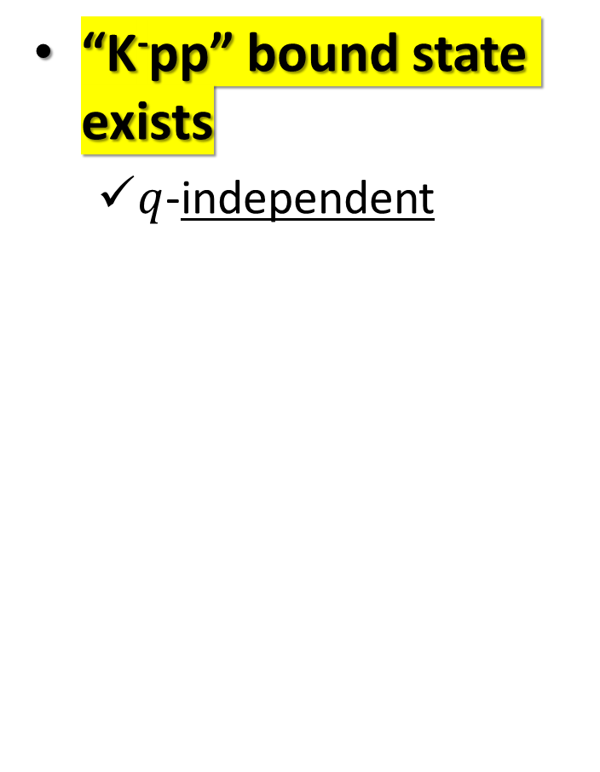
Exclusive ³He(K⁻,Λp)n
T.Yamaga et. al., PRC102(2020)044002.
“K⁻pp” bound state exists
  $q$-independent
$$d^{2}σ/(dM∙dq)$$
$$[nb/(MeV2/c3)]$$
Bound
Un-bound
K-
³He
1 GeV/c
“x”
n
acceptance &
efficiency
corrected
p
n
$q$: momentum transfer of (K-,n)
$M$: invariant mass of Λp
Λ

Slide 9
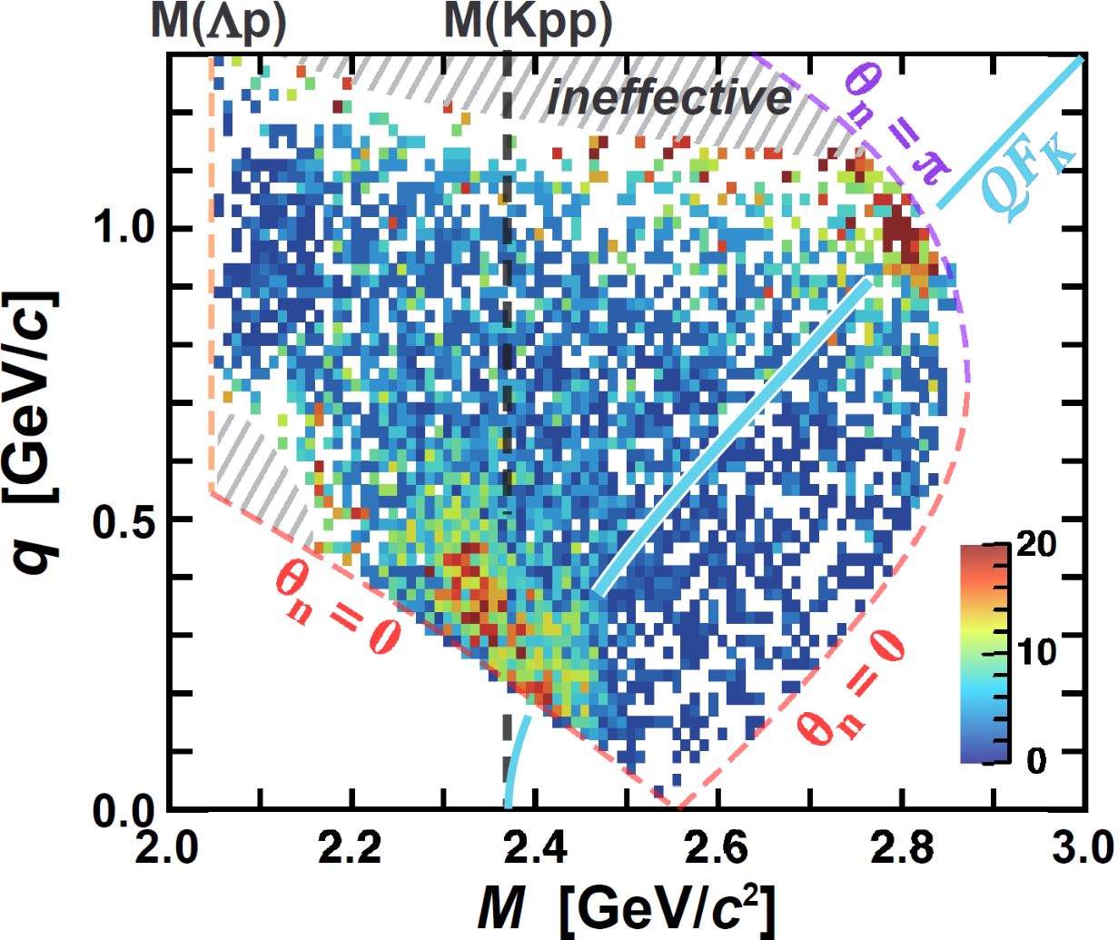
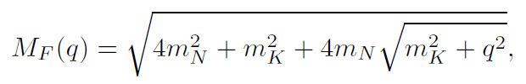
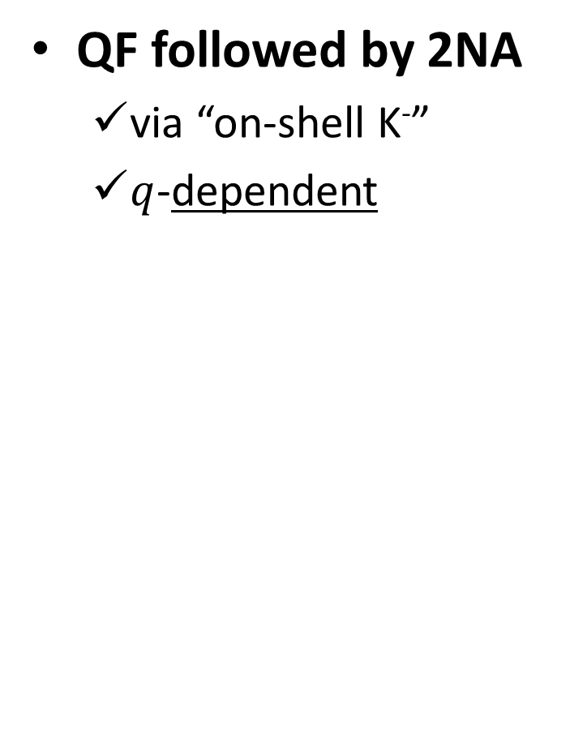
Exclusive ³He(K⁻,Λp)n
T.Yamaga et. al., PRC102(2020)044002.
QF followed by 2NA
  via “on-shell K⁻”
  $q$-dependent
$$d^{2}σ/(dM∙dq)$$
$$[nb/(MeV2/c3)]$$
Bound
Un-bound
K-
³He
1 GeV/c
p
K-
n
acceptance &
efficiency
corrected
p
p
n
$q$: momentum transfer of (K-,n)
$M$: invariant mass of Λp
Λ

Slide 10

Exclusive ³He(K⁻,Λp)n
T.Yamaga et. al., PRC102(2020)044002.
Broad Component
  3NA reaction?
  Further investigations are ongoing
$$d^{2}σ/(dM∙dq)$$
$$[nb/(MeV2/c3)]$$
BS and QF are well separated in
0.3 < $q$ < 0.6 GeV/c
Bound
Un-bound
K-
³He
1 GeV/c
acceptance &
efficiency
corrected
p
n
Λ
$q$: momentum transfer of (K-,n)
$M$: invariant mass of Λp

Slide 11
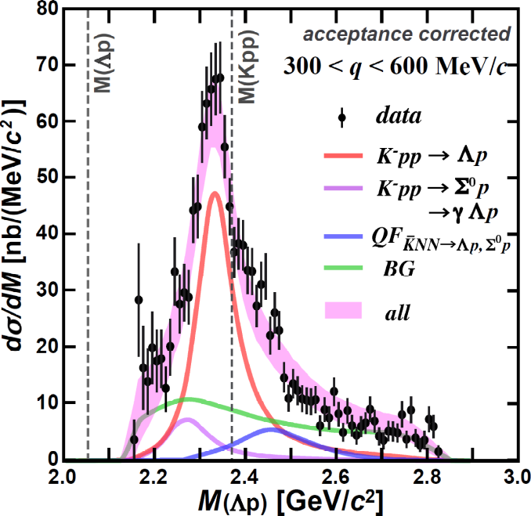
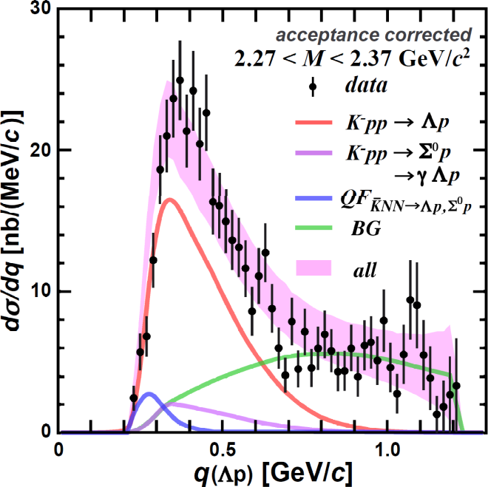

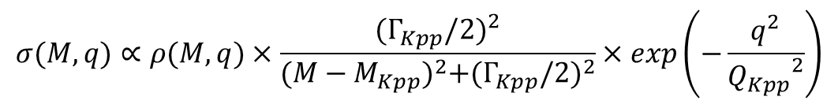
“K-pp” Bound State
$$σ(M,q)∝ρ(M,q)×\frac{{(Γ_{Kpp}/2)}^{2}}{{(M−M_{Kpp})}^{2}+{(Γ_{Kpp}/2)}^{2}}×exp\left(−\frac{q^{2}}{{Q_{Kpp}}^{2}}\right)$$
Fit with PWIA
PRC102(2020)044002.
B_{Kpp} ~ 40 MeV, Γ_{Kpp} ~ 100 MeV
Q_{kpp} ~ 400 MeV (c.f. Q_{QF} ~ 200 MeV)
→ large binding energy
→ wide momentum transfer
→ suggest the “K⁻pp” is quite compact

Slide 12
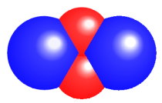
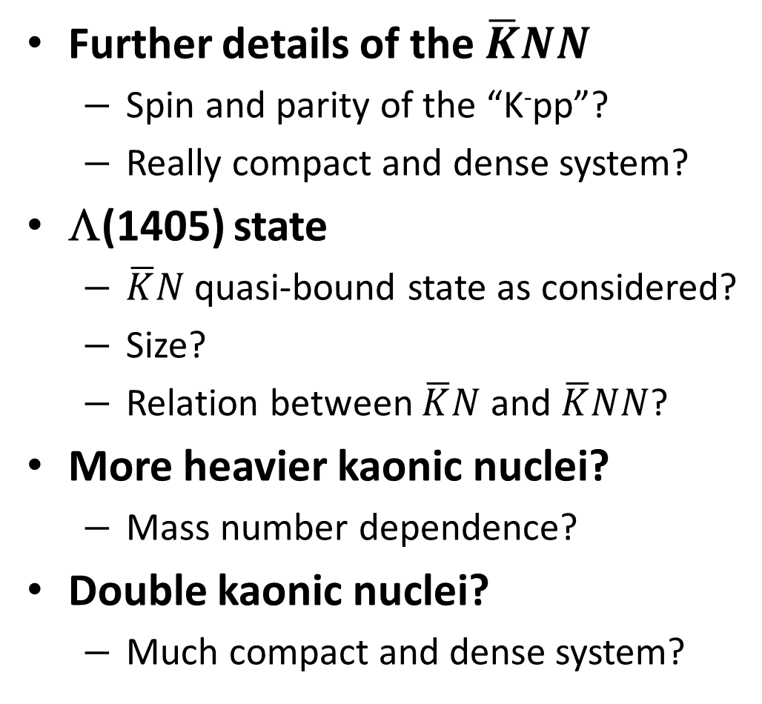
Many Questions to be Answered
Further details of the $\overline{K}NN$
  Spin and parity of the “K⁻pp”?
  Really compact and dense system?
Λ(1405) state
  $\overline{K}N$ quasi-bound state as considered?
  Size?
  Relation between $\overline{K}N$ and $\overline{K}NN$?
More heavier kaonic nuclei?
  Mass number dependence?
Double kaonic nuclei?
  Much compact and dense system?
K⁻K⁻pp

Slide 13
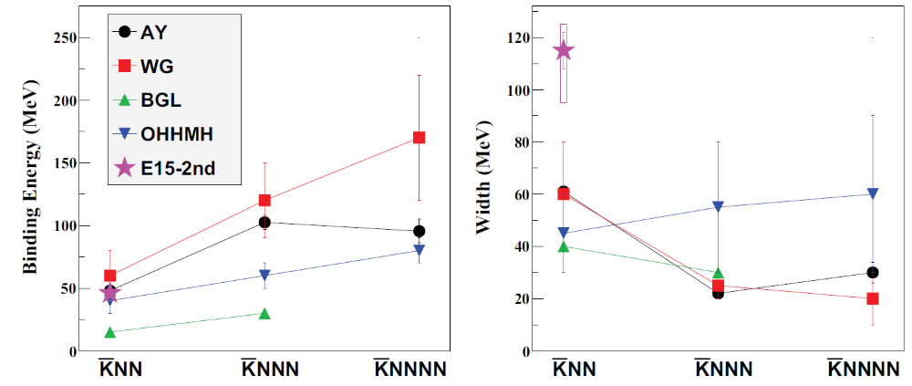

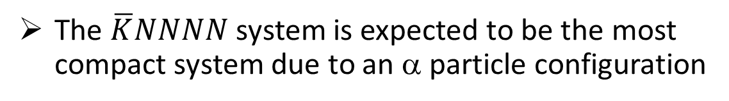
$\overline{K}NNN$ and $\overline{K}NNNN$
More heavier system must be explored to provide more conclusive evidence of the kaonic nuclei
B.E.
Γ
the larger nuclei → the larger B.E.
Discrepancy would be resolved if the models adopt both mesonic & non-mesonic decays
(E15=Λp)
The $\overline{K}NNNN$ system is expected to be the most compact system due to an α particle configuration

Slide 14
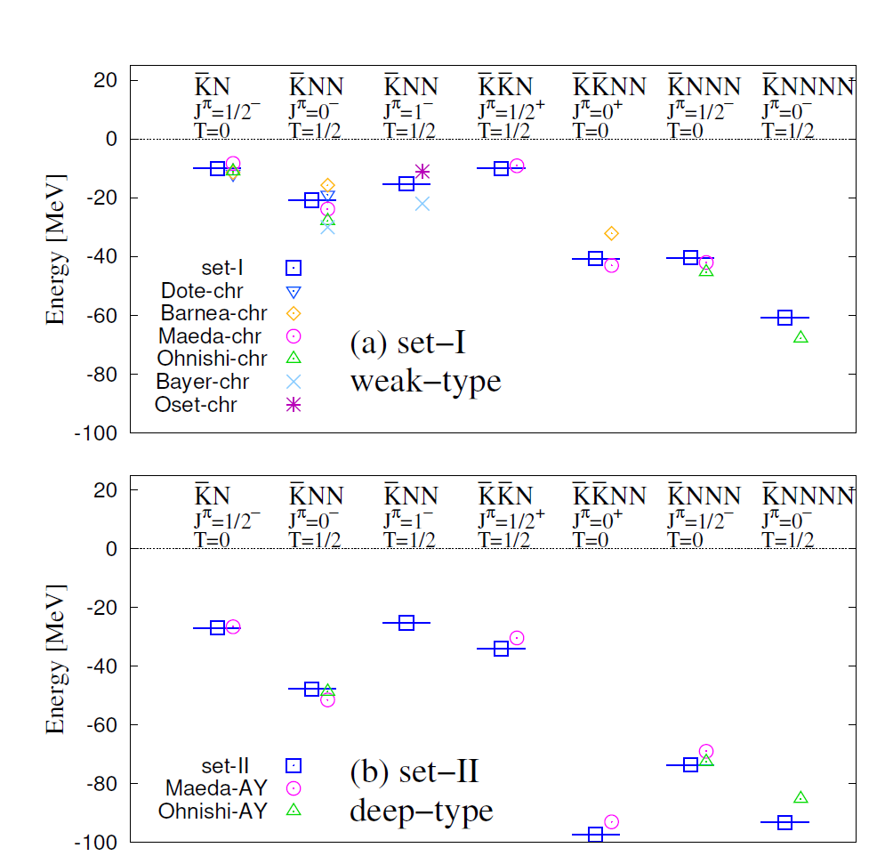
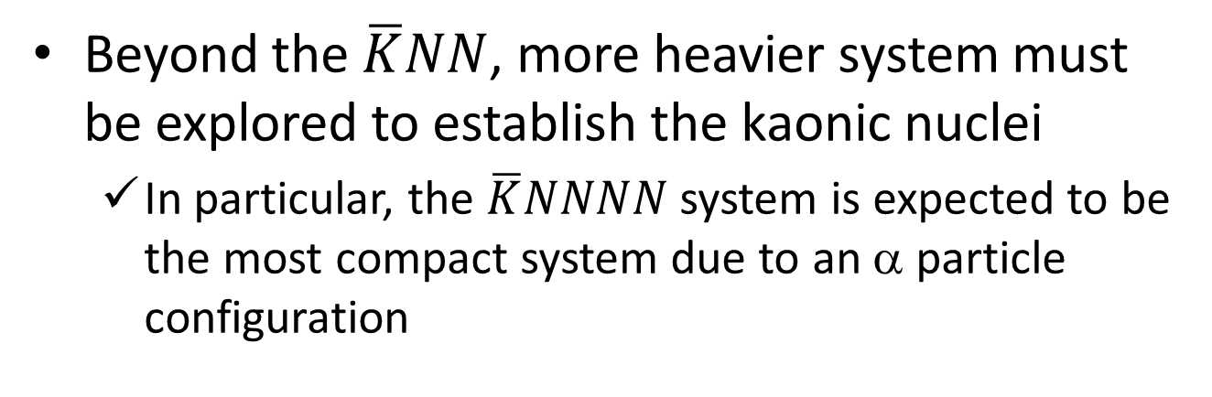
$\overline{K}NNN$ and $\overline{K}NNNN$
Y.Kanada-En’yo EPJA57(2021)185
Beyond the $\overline{K}NN$, more heavier system must be explored to establish the kaonic nuclei
  In particular, the $\overline{K}NNNN$ system is expected to be the most compact system due to an α particle configuration
E15
systematic investigation is essential
both in experiment and calculation
the larger nuclei → the larger B.E.
would become large if the models adopt mesonic & non-mesonic decays
E15

Slide 15
New Project @ J-PARC
-- systematic investigation of the light kaonic nuclei --

Slide 16
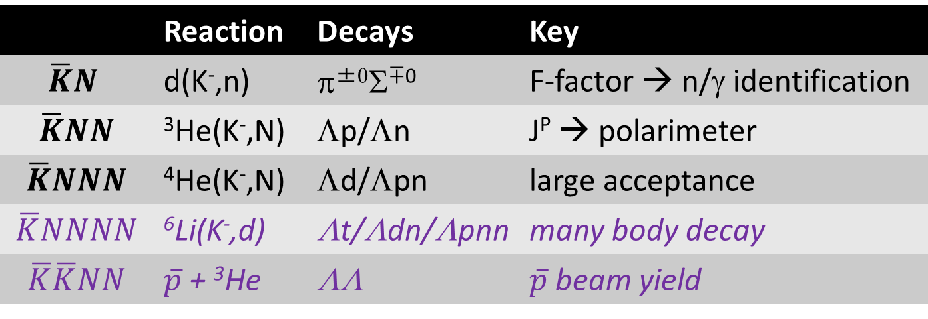
Strategy of the New Project
- for systematic study from the $\overline{K}N$ to $\overline{K}NNNN$ systems -
 | Reaction | Decays | Key
$$\overline{K}N$$ | d(K⁻,n) | π^{±0}Σ^{∓0} | F-factor → n/γ identification
$$\overline{K}NN$$ | ³He(K⁻,N) | Λp/Λn | J^{P} → polarimeter
$$\overline{K}NNN$$ | ⁴He(K⁻,N) | Λd/Λpn | large acceptance
$$\overline{K}NNNN$$ | ⁶Li(K⁻,d) | Λt/Λdn/Λpnn | many body decay
$$\overline{K}\overline{K}NN$$ | $\overline{p}$ + ³He | ΛΛ | $\overline{p}$ beam yield
← A first step
To realize the systematic measurements, we need
  a large acceptance spectrometer
    detect/identify all particles to specify the reaction
  high-intensity kaon beam
    more K⁻ yield than the existing beamline
We take a step-by-step approach
← new CDS
← modified K1.8BR

Slide 17
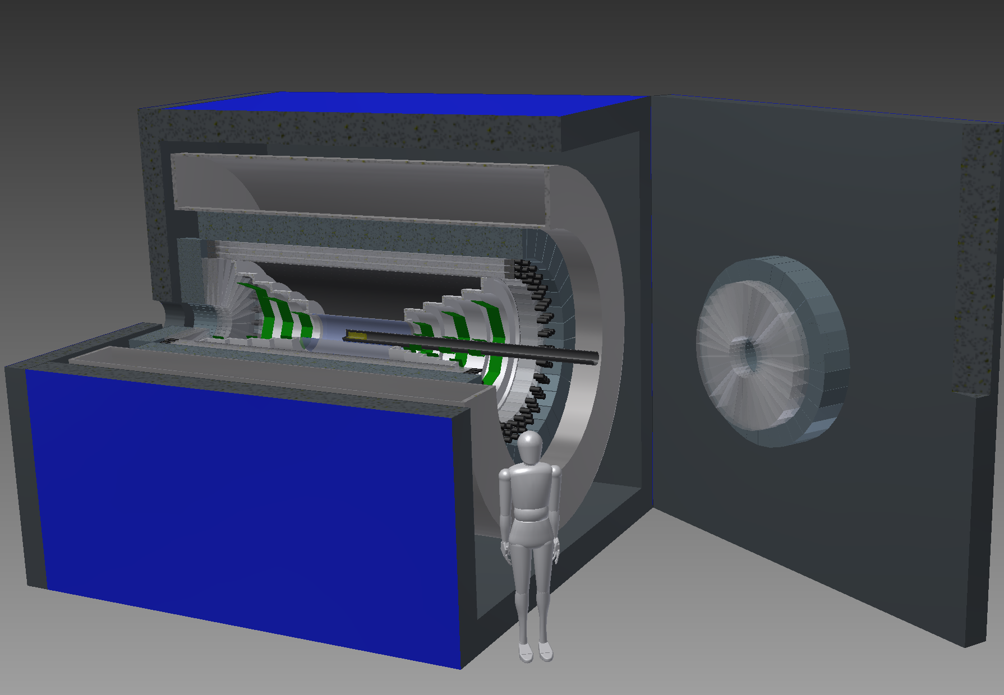
A New Cylindrical Detector System
A new 4π spectrometer with n/γ detection capability

Slide 18
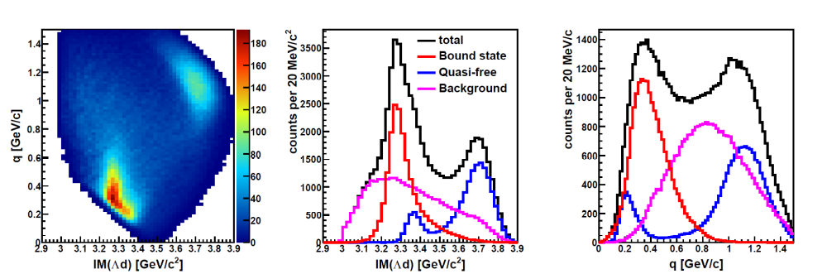
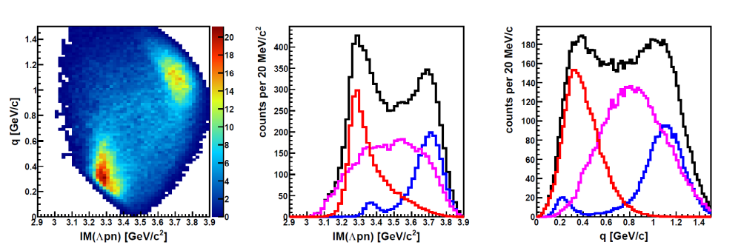

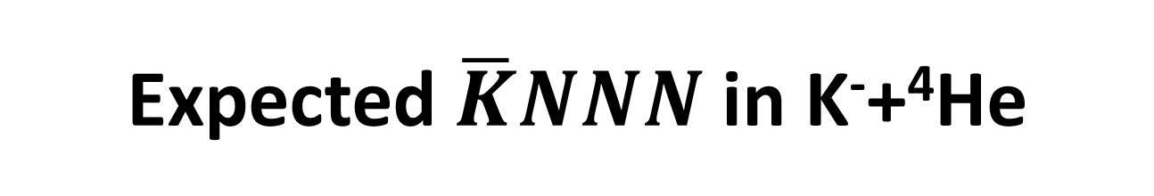
Expected $\overline{K}NNN$ in K⁻+⁴He
K⁻+⁴He→Λd+n
K⁻+⁴He→Λpn+n
M(K⁻ppn)
M(K⁻ppn)
Simulation
Simulation
B_{Kppn} ~ 40 MeV
Γ_{Kppn} ~ 100 MeV
Q_{kppn} ~ 400 MeV/c
BS and QF will be
well separated in
0.3 < $q$ < 0.6 GeV/c
σ(K⁻ppn)*Br ~ 10 μb
σ(QF) ~ 10 μb
σ(BG) ~ 20 μb
@ 3 weeks, 90kW
Similar parameters obtained with the K⁻+³He→Λpn (PRC102(2020)044002.) are adopted to K⁻ppn/QF/BG shapes
“K⁻ppn” signal [q-independent] will be seen clearly

Slide 19
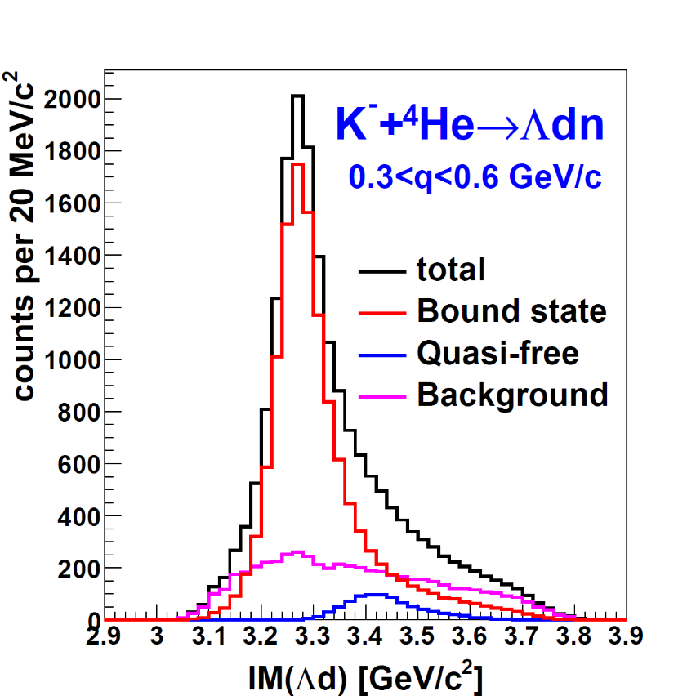
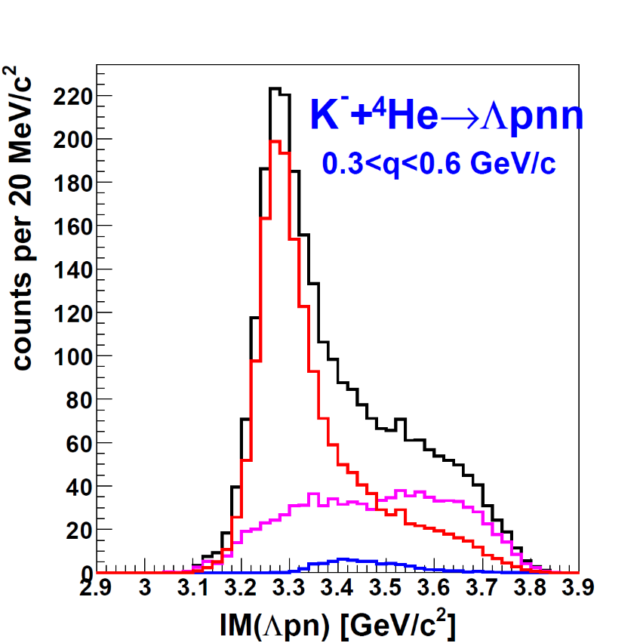

Expected $\overline{K}NNN$ in K⁻+⁴He
K⁻+⁴He→Λd+n
K⁻+⁴He→Λpn+n
M(K⁻ppn)
M(K⁻ppn)
Simulation
Simulation
Broad comp.
@ 3 weeks, 90kW
Assumption: similar parameters obtained at E15
Mass-number dependence of the kaonic nuclei will be provided for the first time.

Slide 20
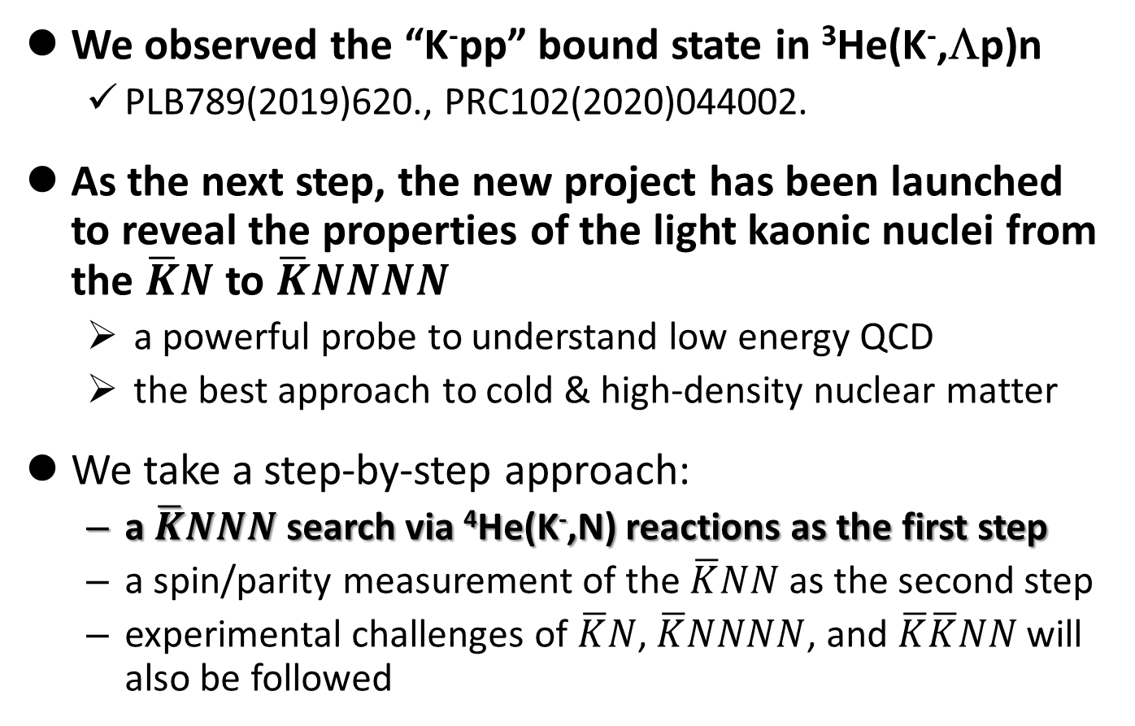
Summary
We observed the “K⁻pp” bound state in ³He(K⁻,Λp)n
  PLB789(2019)620., PRC102(2020)044002.
As the next step, the new project has been launched to reveal the properties of the light kaonic nuclei from the $\overline{K}N$ to $\overline{K}NNNN$
  a powerful probe to understand low energy QCD
  the best approach to cold & high-density nuclear matter
We take a step-by-step approach:
  a $\overline{K}NNN$ search via ⁴He(K⁻,N) reactions as the first step
  a spin/parity measurement of the $\overline{K}NN$ as the second step
  experimental challenges of $\overline{K}N$, $\overline{K}NNNN$, and $\overline{K}\overline{K}NN$ will also be followed
J-PARC E15
J-PARC E80
J-PARC P89

Slide 21
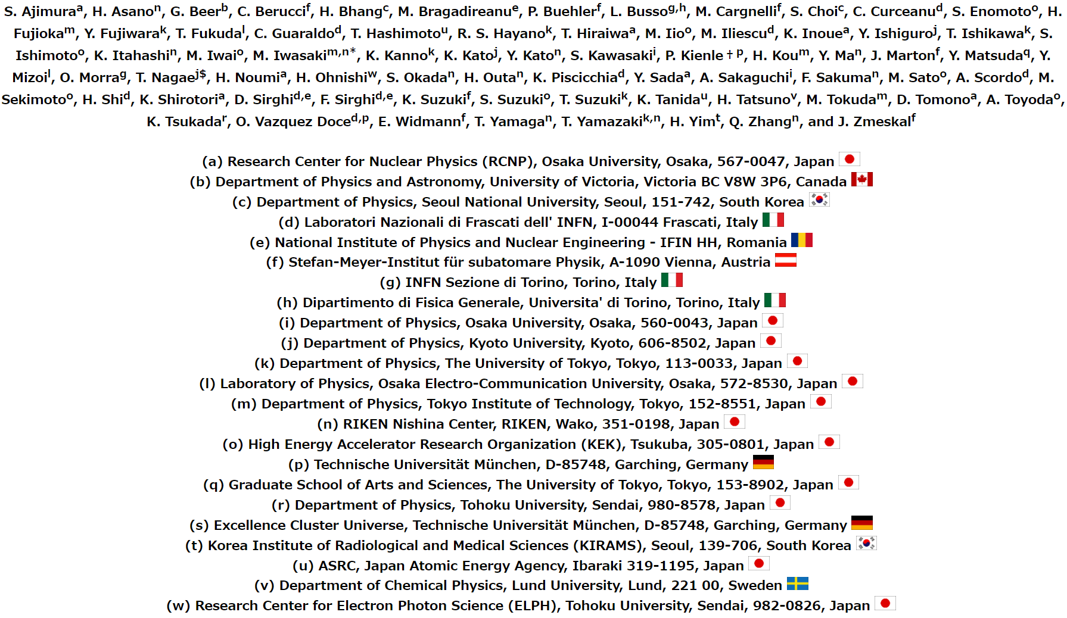
J-PARC E15 Collaboration

Slide 22
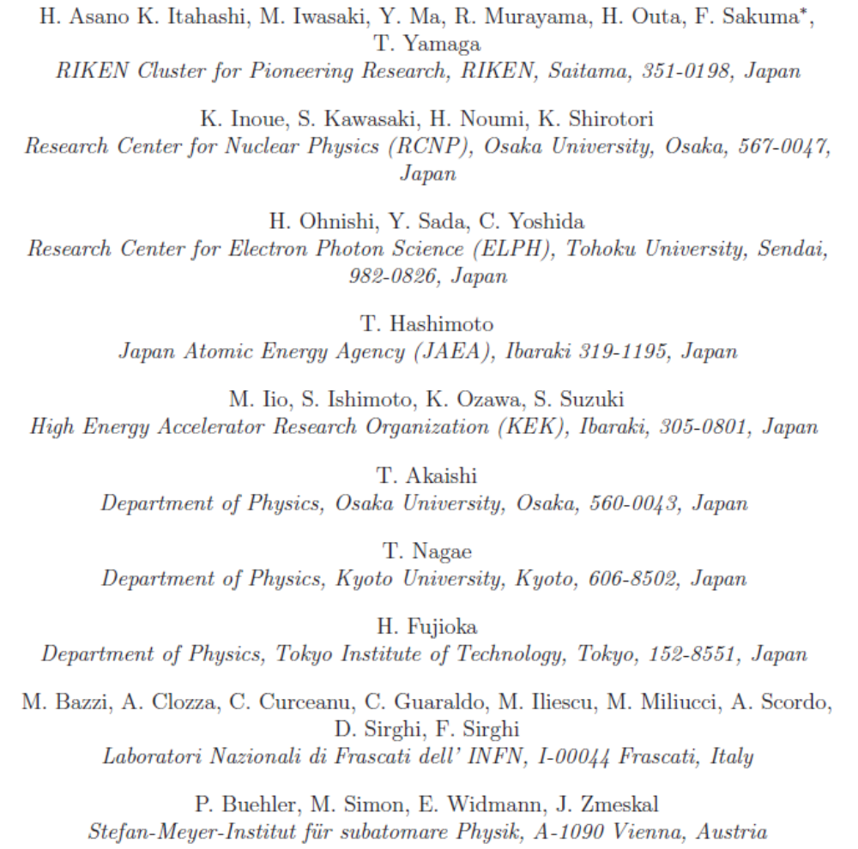









J-PARC E80 Collaboration
We're looking for new collaborators!

Slide 23

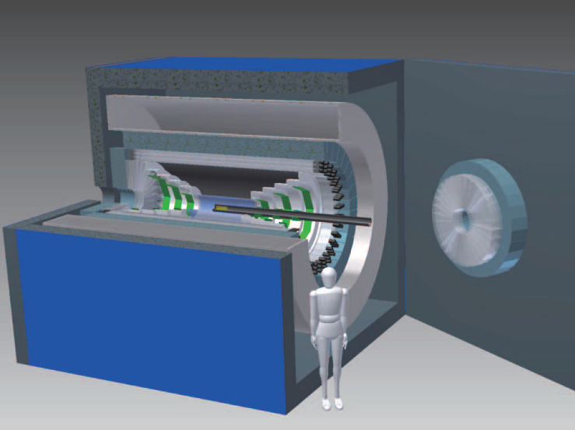
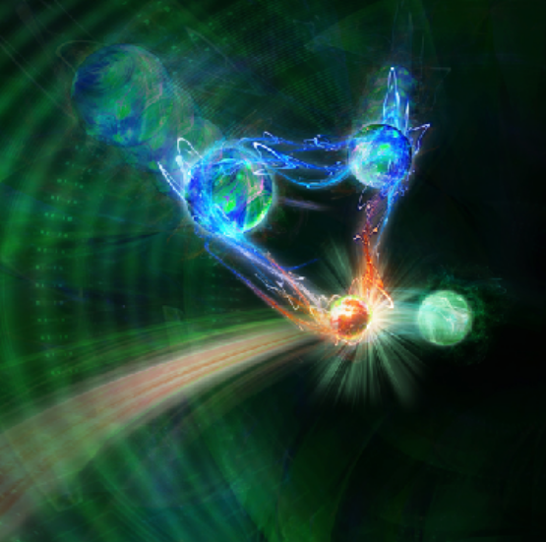
Thank you for your attention!
High intense K beam
New large CDS
ÖWA/Harald Ritsch
New era of kaonic nuclei
A first step of the new project
via in-flight ⁴He(K⁻,N)

Slide 25
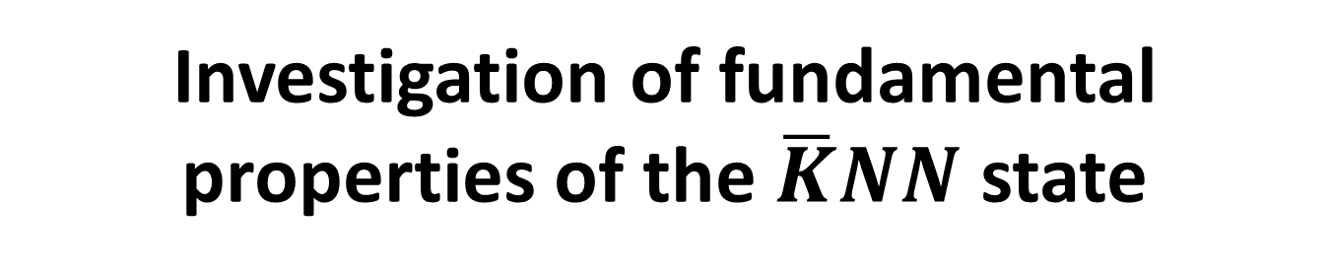
Investigation of fundamental properties of the $\overline{K}NN$ state
J-PARC P89

Slide 26
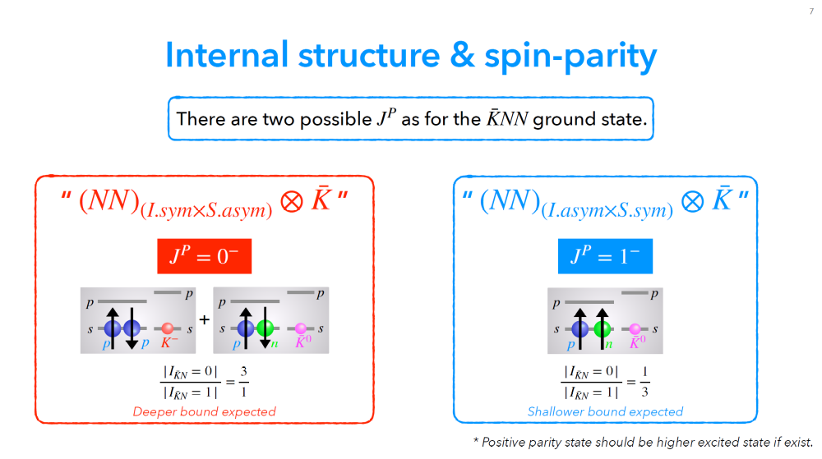
J-PARC P89
T. Yamaga (RIKEN), 32nd J-PARC PAC meeting, Jul.14-16, https://kds.kek.jp/event/38719/

Slide 27
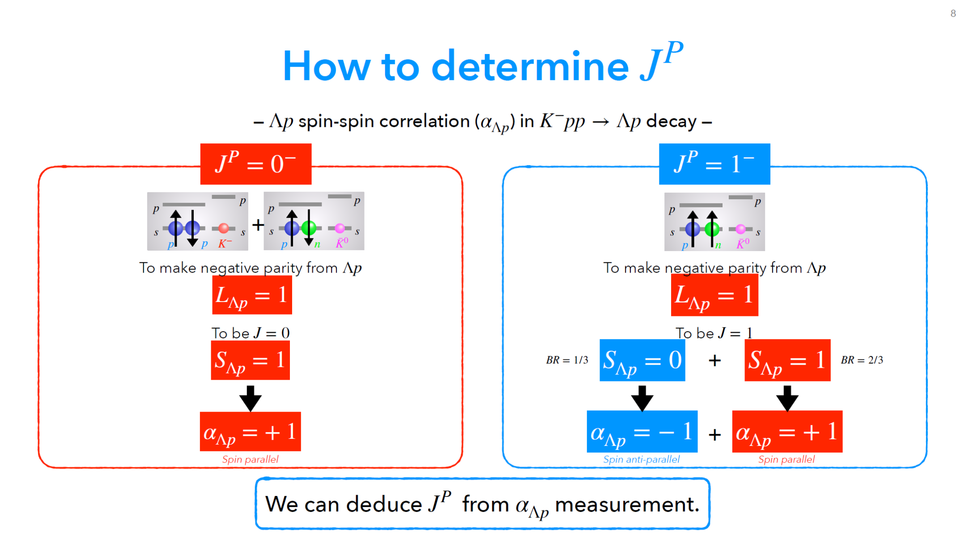
J-PARC P89
T. Yamaga (RIKEN), 32nd J-PARC PAC meeting, Jul.14-16, https://kds.kek.jp/event/38719/

Slide 28
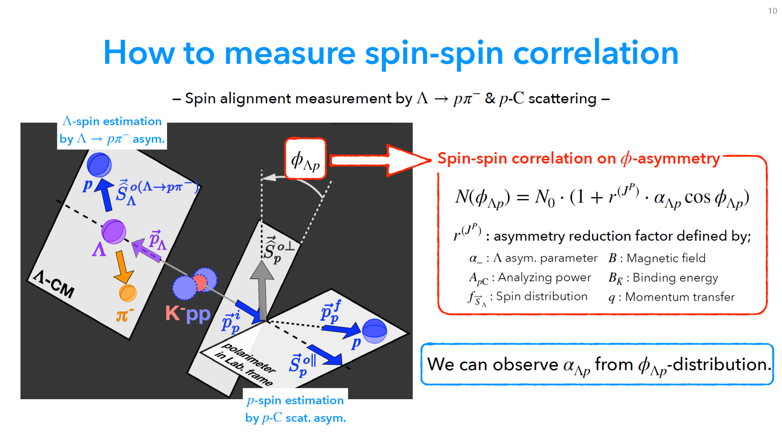
J-PARC P89
T. Yamaga (RIKEN), 32nd J-PARC PAC meeting, Jul.14-16, https://kds.kek.jp/event/38719/

Slide 29
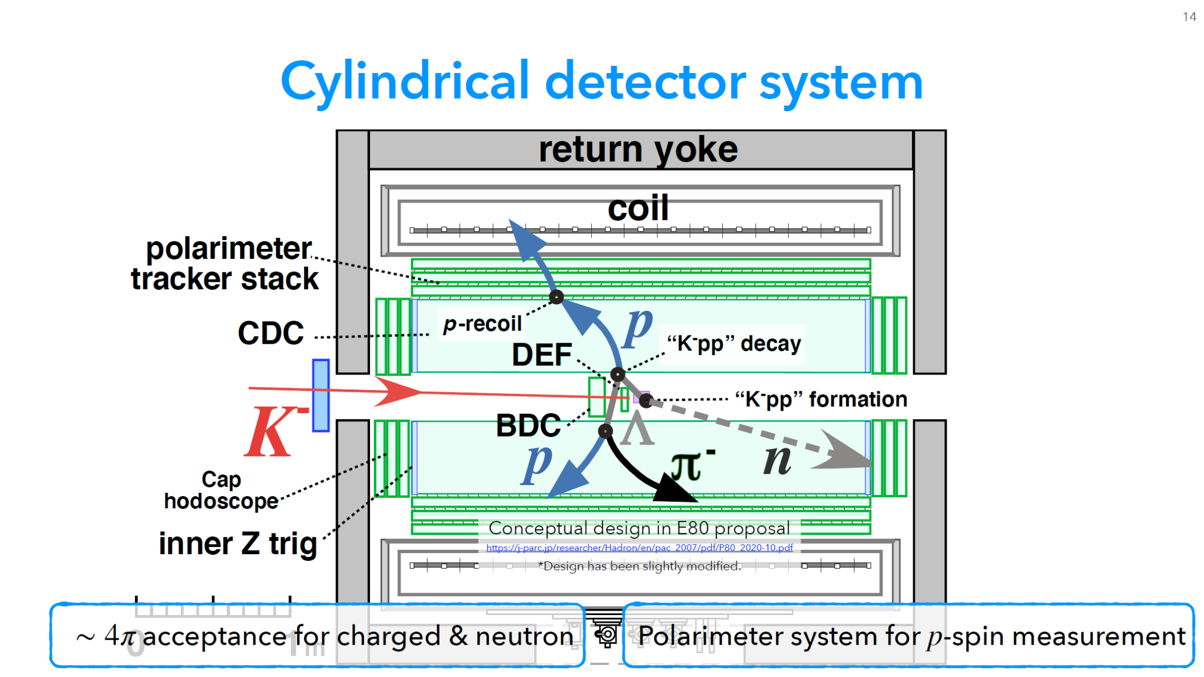
J-PARC P89
T. Yamaga (RIKEN), 32nd J-PARC PAC meeting, Jul.14-16, https://kds.kek.jp/event/38719/

Slide 30
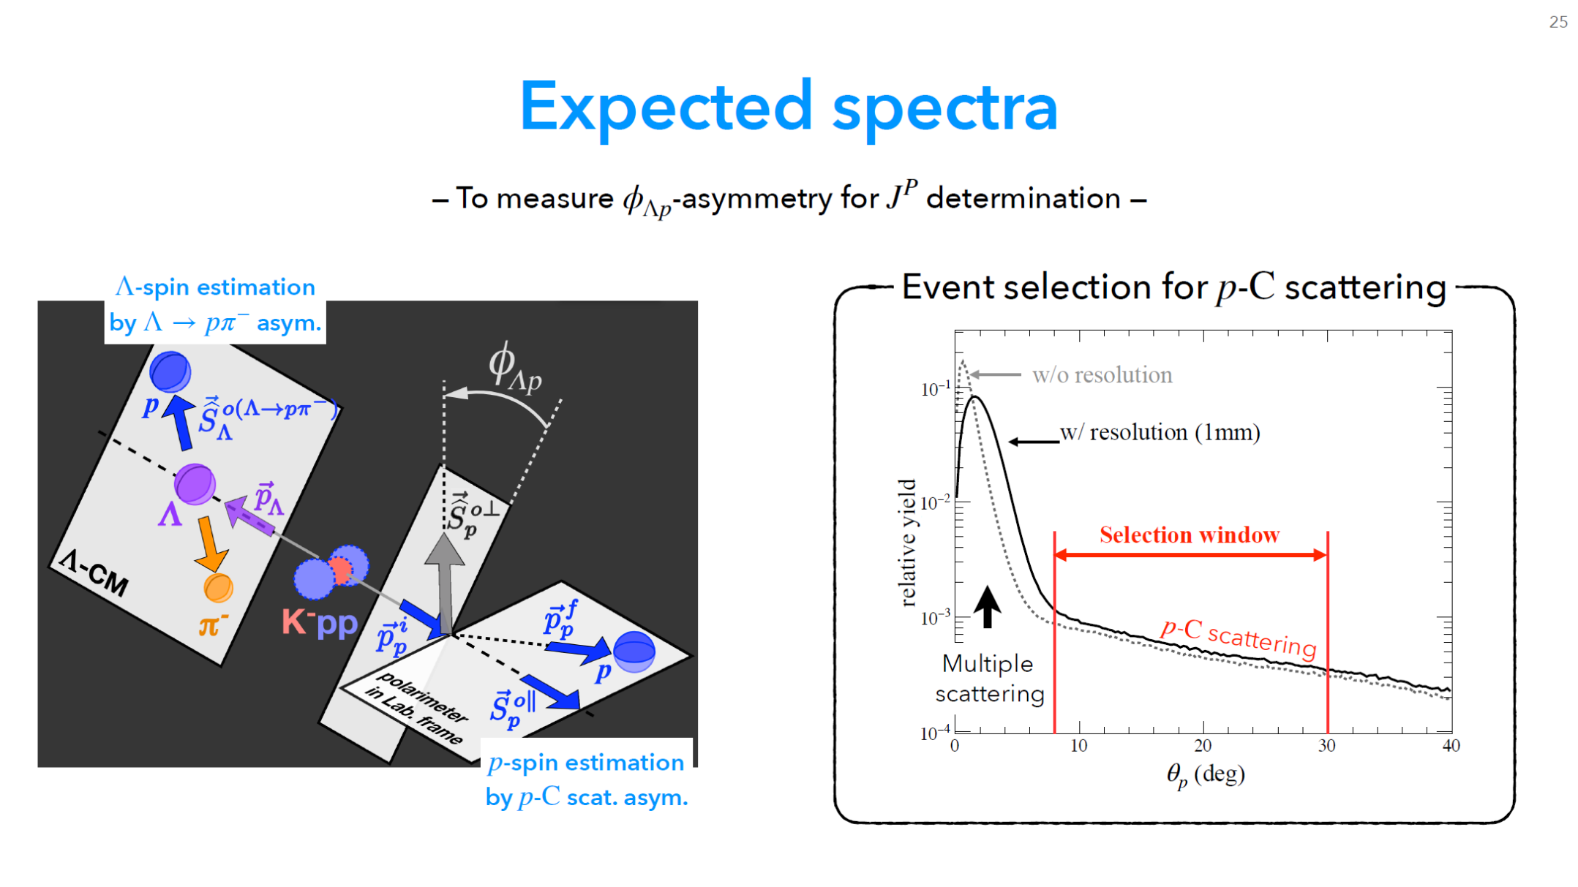
J-PARC P89
T. Yamaga (RIKEN), 32nd J-PARC PAC meeting, Jul.14-16, https://kds.kek.jp/event/38719/

Slide 31
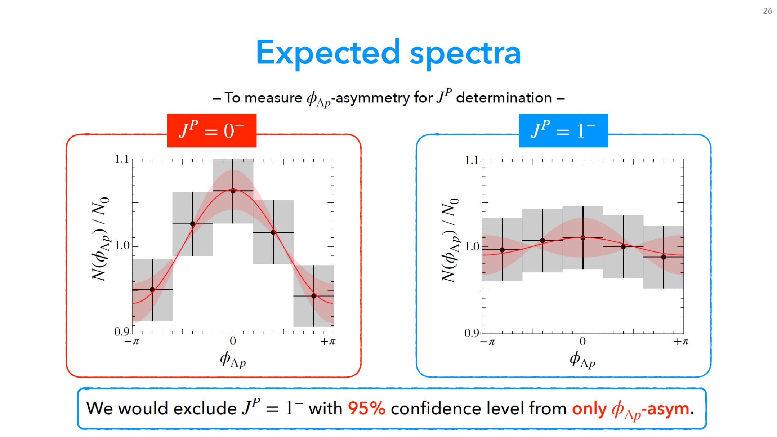
J-PARC P89
T. Yamaga (RIKEN), 32nd J-PARC PAC meeting, Jul.14-16, https://kds.kek.jp/event/38719/

Slide 33





Size of “K⁻pp”?
$$σ(M,q)∝ρ(M,q)×\frac{{(Γ_{Kpp}/2)}^{2}}{{(M−M_{Kpp})}^{2}+{(Γ_{Kpp}/2)}^{2}}×exp\left(−\frac{q^{2}}{{Q_{Kpp}}^{2}}\right)$$
Fit with PWIA
B_{Kpp} ~ 40 MeV
Q_{kpp} ~ 400 MeV
→ large binding energy
→ wide momentum transfer
suggest the “K⁻pp” is quite compact (R_{Kpp} ~ 0.6 fm)
→ Need more realistic theoretical calculations
a whole new probe to reveal
the structure of a nucleon
Still an open question ($\overline{K}N$ = strong force)
Radius of “K⁻pp”
Interaction range of “K⁻”
?
~ 0.8 fm
$$\overline{K}$$
$$\overline{K}$$
& effect of K size?
~ 0.6 fm
~ 0.6 fm

Slide 34





A Theoretical Interpretation
A calculation with chiral unitary approach reproduces the mass spectrum with the $\overline{K}NN$
K^{bar}NN
bound-state
quasi-elastic
kaon scattering
Watson approach
Faddeev approach
Theoretical investigations are indispensable!
(BG subtracted)
JPS Conf. Proc.26(2019)023009.

Slide 35

Many Questions to be Answered
Further details of the $\overline{K}NN$
  Spin and parity of the “K⁻pp”?
  Really compact and dense system?
  Other decay modes?
πΣN mesonic decay
  expected to be the dominant channel
    only YN non-mesonic decays were reported
Reaction mechanism
  relation between Λ(1405)=“K⁻p” & “K⁻pp”
    “K⁻pp” is expected to be produced via Λ(1405)+p→”K⁻pp” door-way process

Slide 36


K⁻ ³He → πΣpn @ E15
CDS
Exclusive measurement of $π^{±}Σ^{∓}pn$ final state in K⁻+³He
p
“X”
K-
³He
n
1 GeV/c
Σ
π
n
π
CDS
Experimental challenge of neutron detection with thin scintillation counter (t=3cm)
t = 3cm
79cm
10cm
n detection efficiency ~ 3-10%

Slide 37



πΣpn Events
IM(nπ⁺) vs MM(π⁺π⁻pn)
IM(nπ⁻) vs MM(π⁺π⁻pn)
π⁻Σ⁺p n_{miss}
π⁺Σ⁻p n_{miss}
Σ⁺
Σ⁻
n_{miss}
n_{miss}

Slide 38



BG Subtracted IM($π^{±}Σ^{∓}$) in $π^{±}Σ^{∓}pn$
preliminary

Slide 39



$Y^{∗}pn$ Final State
Λ(1405)
IM($π^{±}Σ^{∓}$)
~ 250 μb
Fit with BW:
M ~ 1422 MeV
Γ ~ 40 MeV
preliminary
Λ(1520)
~ 100 μb
πΣpn
non-resonant
Σ (1385) ⁰
  ~ 100-150 μb
  [evaluated from
  Σ (1385)^{+/-}→π^{+/-}Λ
  measurement]
(Σ(1385)→πΛ/πΣ : 87.0/11.7%)

Slide 40

$Λ(1405)pn$ Final State Selection
IM($π^{±}Σ^{∓}$)
Select Λ(1405) region
preliminary
Below Λ(1520)
Small contribution from Σ(1385)

Slide 41



IM(πΣp) in Λ(1405)pn Final State
IM($π^{±}Σ^{∓}p$)
Dominant above the threshold
M(Kpp)
preliminary
IM(Λ(1405)p) distributes above the M(Kpp)
QF K⁻N→K^{bar}n followed by K^{bar}NN→Λ(1405)p

Slide 42


Investigation of K⁻pp → πΣp decay
preliminary

Slide 43


Detector acceptances of
Λpn and πΣpn
Λp
πΣp

Slide 44



Recent progress of the E15 analysis
In the E15 analysis so far, we assumed a point-like 3NA process for the background to explain the IM(Λp) spectrum, by parametrizing a fitting function
E15 DATA
K⁻pp
QF
(K⁻,n) mom. transfer
IM(Λp)
BG

Slide 45


Recent progress of the E15 analysis
For the K⁻pp and QF, we assume the following processes
On the other hand, “p” and “n” can be swapped in the reactions when the isospin partner of the K⁻pp (=K⁰nn) is also generated
K⁻pp
QF
K⁰nn
QF

Slide 46

Recent progress of the E15 analysis
IM(Λp) and IM(Λn)
  Acceptances are quite different between the “Λp” and “Λn”
  In IM(Λn), a forward going proton is out of the acceptance
E15 DATA
(Dr. T.Yamaga)
Backward-”p_{detected}”
(K⁻,n) mom. transfer
(K⁻,p) mom. transfer
K⁰nn
RoI
K⁰nn→Λn can not
be identified
Forward-”n_{missing}”
IM(Λp)
IM(Λn)

Slide 47

Recent progress of the E15 analysis
Both of IM(Λp) and IM(Λn) can be reproduced by the “signal” and “QFs”
  Eye fit results → further analysis is on going
need further data with the new 4π spectrometer
E15 DATA
preliminary
(Dr. T.Yamaga)
K⁻pp
QF(Λp)
K⁻pp
QF(Λn)
QF(Λp)
QF(Λn)
IM(Λp)
IM(Λn)
(all mom. transfer region selected)

Slide 48


Σ*N bound state? Other possibilities?
Σ* coupling through K^{bar}-N channel (P-wave) would be weak
  A.Cieply et al., PRC84(2011)045206, etc.
Naively, Σ*N system with 1⁺/2⁺ state (S-wave) could not be bound, because corresponding ΔN system (non-strangeness sector) is considered to be no-bound or quite-weakly bound
  R. D. Mota et al., PRC59(1999)46, etc.
need J^{P} determination with a polarimeter
The K^{bar}NN state (I=1/2, J^{P}=0⁻) is calculated with a K^{bar}NN-πΣN-πΛN coupled channel system, where the πΛN coupling is expected to be small
The K^{bar}NN state with J^{P}=1⁻ (K^{bar}-d like configuration) is expected to not be bound, or have small B.E.
  S.Ohnishi et al., PRC95(2017)065202, etc.

Slide 49


Σ*N bound state? Other possibilities?
One theoretical possibility is a “πΛN-πΣN dibaryon”
Calculated πΛN resonance with Σ*N-ΔΣ configuration is:
  I=1/2, J^{P}=2⁺ : E = -10-i52 MeV
  I=3/2, J^{P}=2⁺ : E = -120-i2.6 MeV
The obtained K⁻pp parameter at E15 is E=-40-i50 MeV
Therefore, the “observed K-pp structure” would be different from the “πΛN-πΣN dibaryon”
with respect to M(K^{bar}NN)

Slide 51




“K⁻ppn” Candidates so far
⁴He(stopped-K⁻,p/n)X
A few candidates have been reported in inclusive measurements
E471/E549@KEK
  ⁴He(stopped-K⁻,p/n)X
FINUDA@DAΦNE
  Li/C(stopped-K⁻,Λd)
FOPI@GSI
  Λd in Ni+Ni
Exclusive measurement using a simple reaction (in-flight & light nuclei) is crucial
PLB659(2008)107, PLB688(2010)43
← NULL results
  Li/C(stopped-K⁻,Λd)
← Observed?
← Observed?
PLB654(2007)80
  Λd in Ni+Ni
EXA05 Conference (2005)

Slide 52

A New Cylindrical Detector System
SC Solenoid Magnet
Cylindrical Drift Chamber
Neutron Counter
FWD/BWD Drift Chambers
Vertex Fiber Tracker
Electromagnetic Calorimeter (constructed in 2nd-stage)
Solid angle: ~x1.5 (~90%)
Neutron detection capability: ~x10 ( ~1.5x15%)

Slide 53


Improvement of Kaon Intensity
K1.8BR beamline
Shorten the beamline (~3.7m) by removing the final D magnet
We propose a new configuration of the beamline
  K- yield is expected to increase by ~ 1.4 times @ 1.0 GeV/c

Slide 54


Expected Yield of $\overline{K}NNN$
absorption of stopped K⁻ on ⁴He
We assume the K⁻ppn cross section of
$$σ\left(K^{−}ppn\right)∙Br\left(Λd\right) \sim 10 μb$$
$$σ\left(K^{−}ppn\right)∙Br\left(Λpn\right) \sim 10 μb$$
  The same CS of “K-pp”→Λp in E15
  As for Λd decay, we refer to the absorption of stopped K⁻ on ⁴He
  → decay fraction to Σ⁻pd : Σ⁻ppn ~ 1 : 1
PRD1(1970)1267

Slide 55
Expected Yield of $\overline{K}NNN$
N_{beam} = 100 G K- on target
  under the MR beam power of 90 kW with 5.2 s repetition cycle.
    3.2 x 10⁵ K- on target / spill @ 1.0 GeV/c
  3 weeks data taking (90% up-time)
 | Λd / Λpn
σ(K⁻ppn)*Br | 10 μb
N(K⁻ on target) | 100 G
N(target) | 2.65 x 10²³
ε(DAQ) | 0.9
ε(trigger) | 0.93
ε(beam) | 0.55
Ω(CDC) | 0.27 / 0.077
ε(CDC) | 0.6 / 0.3
N(K⁻ppn) | 19 k / 2.8 k
around 2024
N(K⁻ppn→Λd) ~ 2 x 10⁴
N(K⁻ppn→Λpn) ~ 3 x 10³
  c.f. 1.7 x 10³ “K⁻pp”→Λp accumulated in E15-2nd (40 G K⁻)
* improved from E15

Slide 56

Spin-Parity of $\overline{K}NN$
Λ
+
p
½+
L=1
½+
T.Nagae, “The 4th Symposium on Clustering as a window on the hierarchical structure of quantum systems”, May 28th, 2020

Slide 57


Spin-Parity of $\overline{K}NN$
Λ polarization can be measured via π⁻p decay
Λ
+
p
½+
L=1
½+
preliminary
Λ pol. in K⁻+p→π⁰Λ
Past meas.
E15 data
$$\frac{dN}{d\cos{θ}}∝(1+αP\cos{θ})$$
good agreement
Proton polarization is measured with a polarimeter
  Tracking system
  Plastic scintillator

Slide 58





Toward $\overline{K}\overline{K}NN$
K⁻K⁻pp
We also wish to access the S = −2 kaonic nuclei such as the theoretically predicted “K⁻K⁻pp” state
  as previously submitted LoI
  A good probe to the $\overline{K}N$ int.
The $\overline{K}\overline{K}NN$ system could give us a chance to access much higher density than the S = −1 kaonic nuclei
E31
E15
?
?
Proc. Jpn. Acad., B89 (2013) 418.
The $\overline{K}\overline{K}NN$ production cross section would be quite small
→ roughly 1/1000 of that of the $\overline{K}NN$

