Slide 1

J-PARC E15実験における πΣN崩壊チャンネルを用いた
K^{bar}NN束縛状態の研究
Search for the K^{bar}NN bound state
via πΣN decay channel at J-PARC E15
理化学研究所 仁科加速器センター
佐久間 史典
日本物理学会第73回年次大会 @ 東京理科大学 2018, 3/22

Slide 2
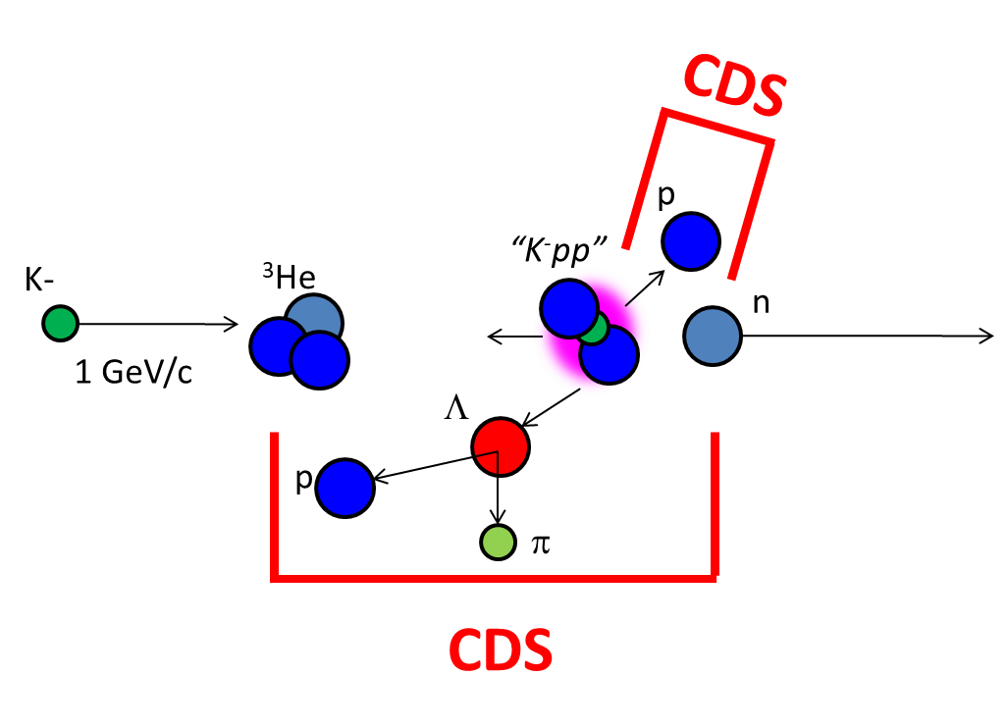
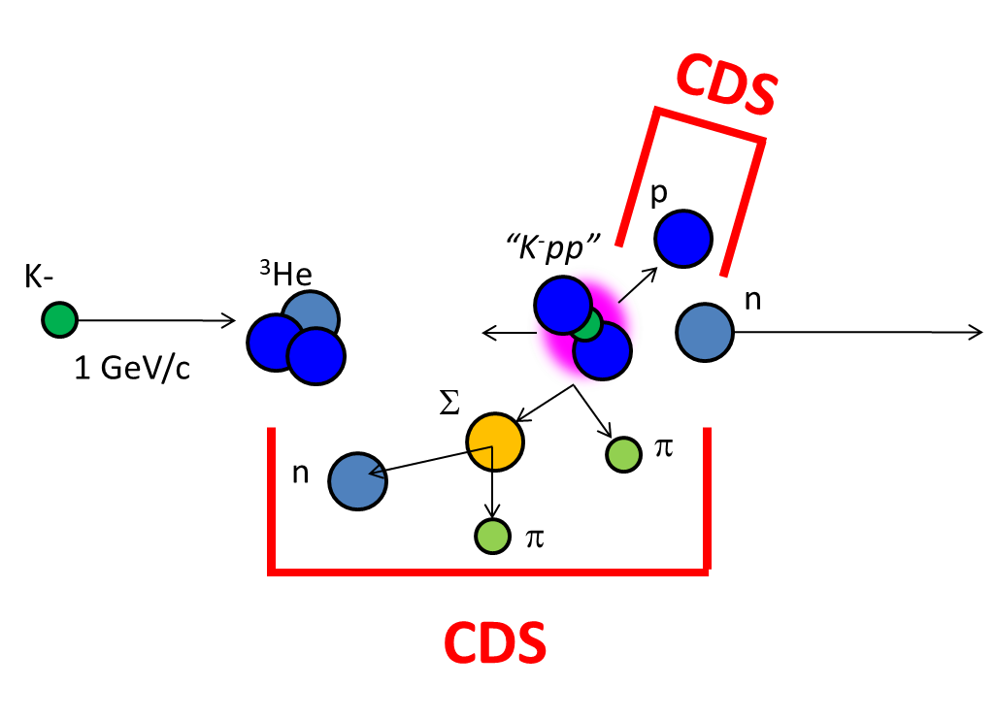
Outline of the Talk
1. K^{bar}NN search via Λp channel
→ Non-mesonic channel
2. K^{bar}NN search via πΣp channel
→ Mesonic channel

Slide 3
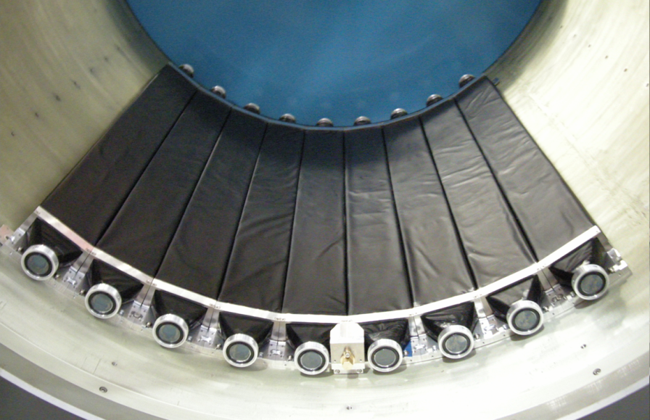
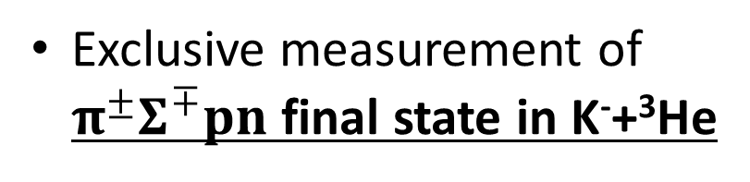
K⁻ ³He → πΣpn @ E15
CDS
Exclusive measurement of $π^{±}Σ^{∓}pn$ final state in K⁻+³He
p
“K⁻pp”
K-
³He
n
1 GeV/c
Σ
π
n
π
CDS
Experimental challenge of neutron detection with thin scintillation counter (t=3cm)
t = 3cm
79cm
10cm
n detection efficiency ~ 3%

Slide 4
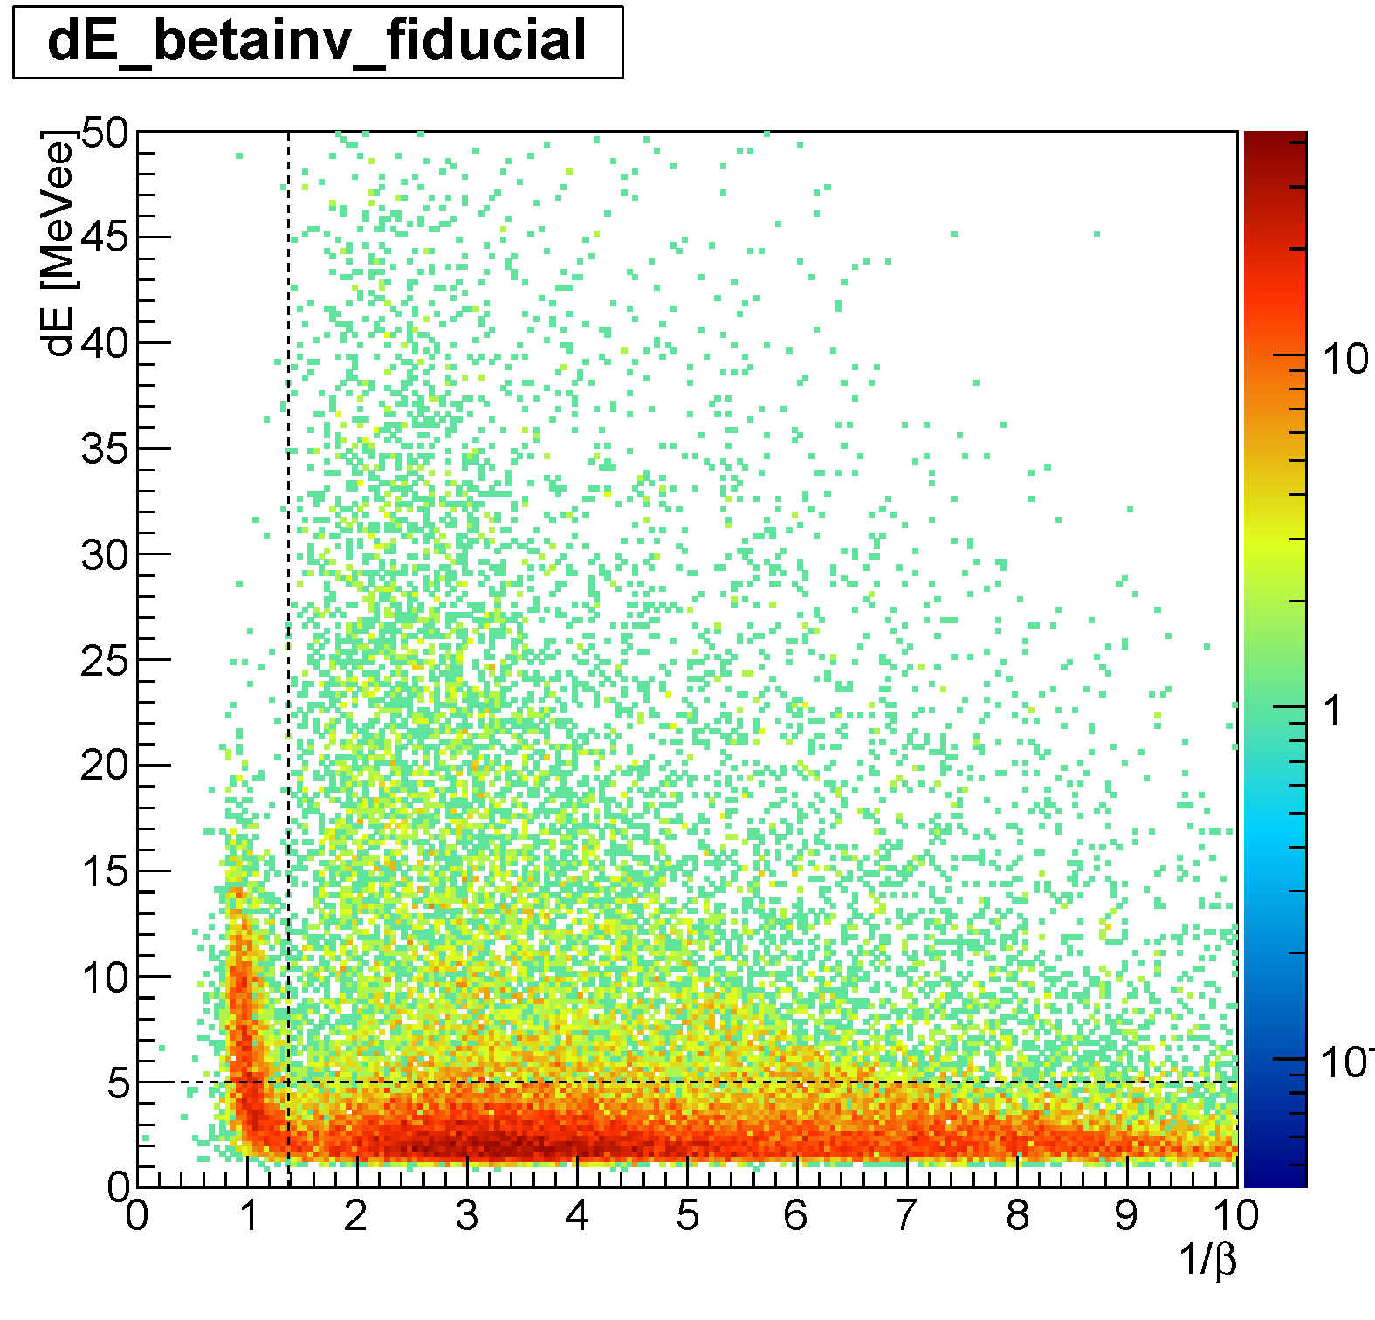
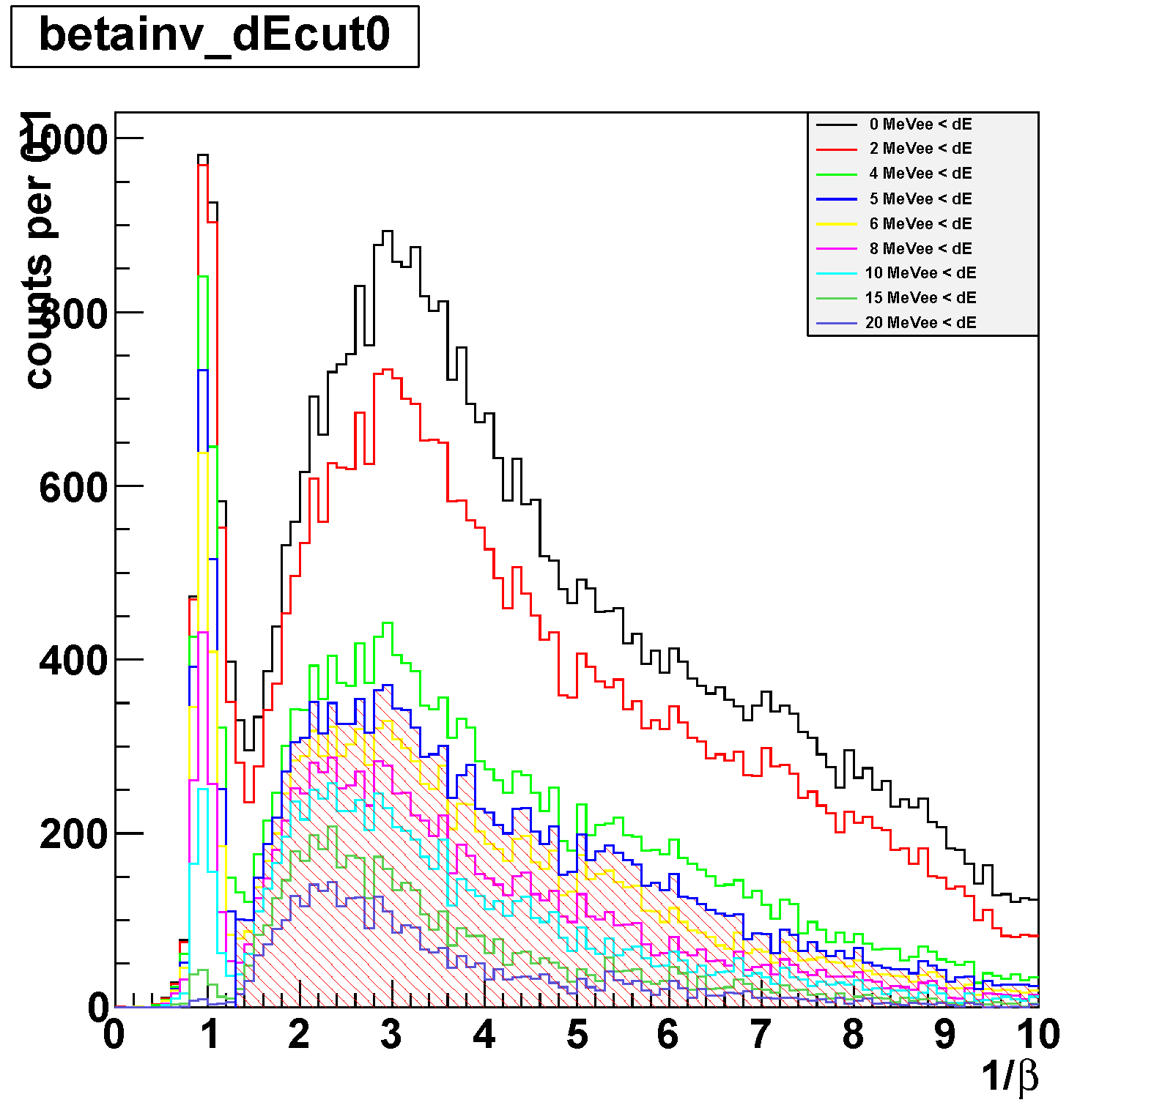
Neutron ID with CDS
π⁺π⁻p events (3 tracks) in CDS with 4 CDH hits are selected
a CDH hit with CDC-veto (outer-layer) is applied to identify the “neutral hit”
dE vs. 1/β
dE-cut dependence
1.372 < 1/β
(p_{n}<1GeV/c)
neutron ID
5MeVee < dE
Neutron can be identified with CDS

Slide 5
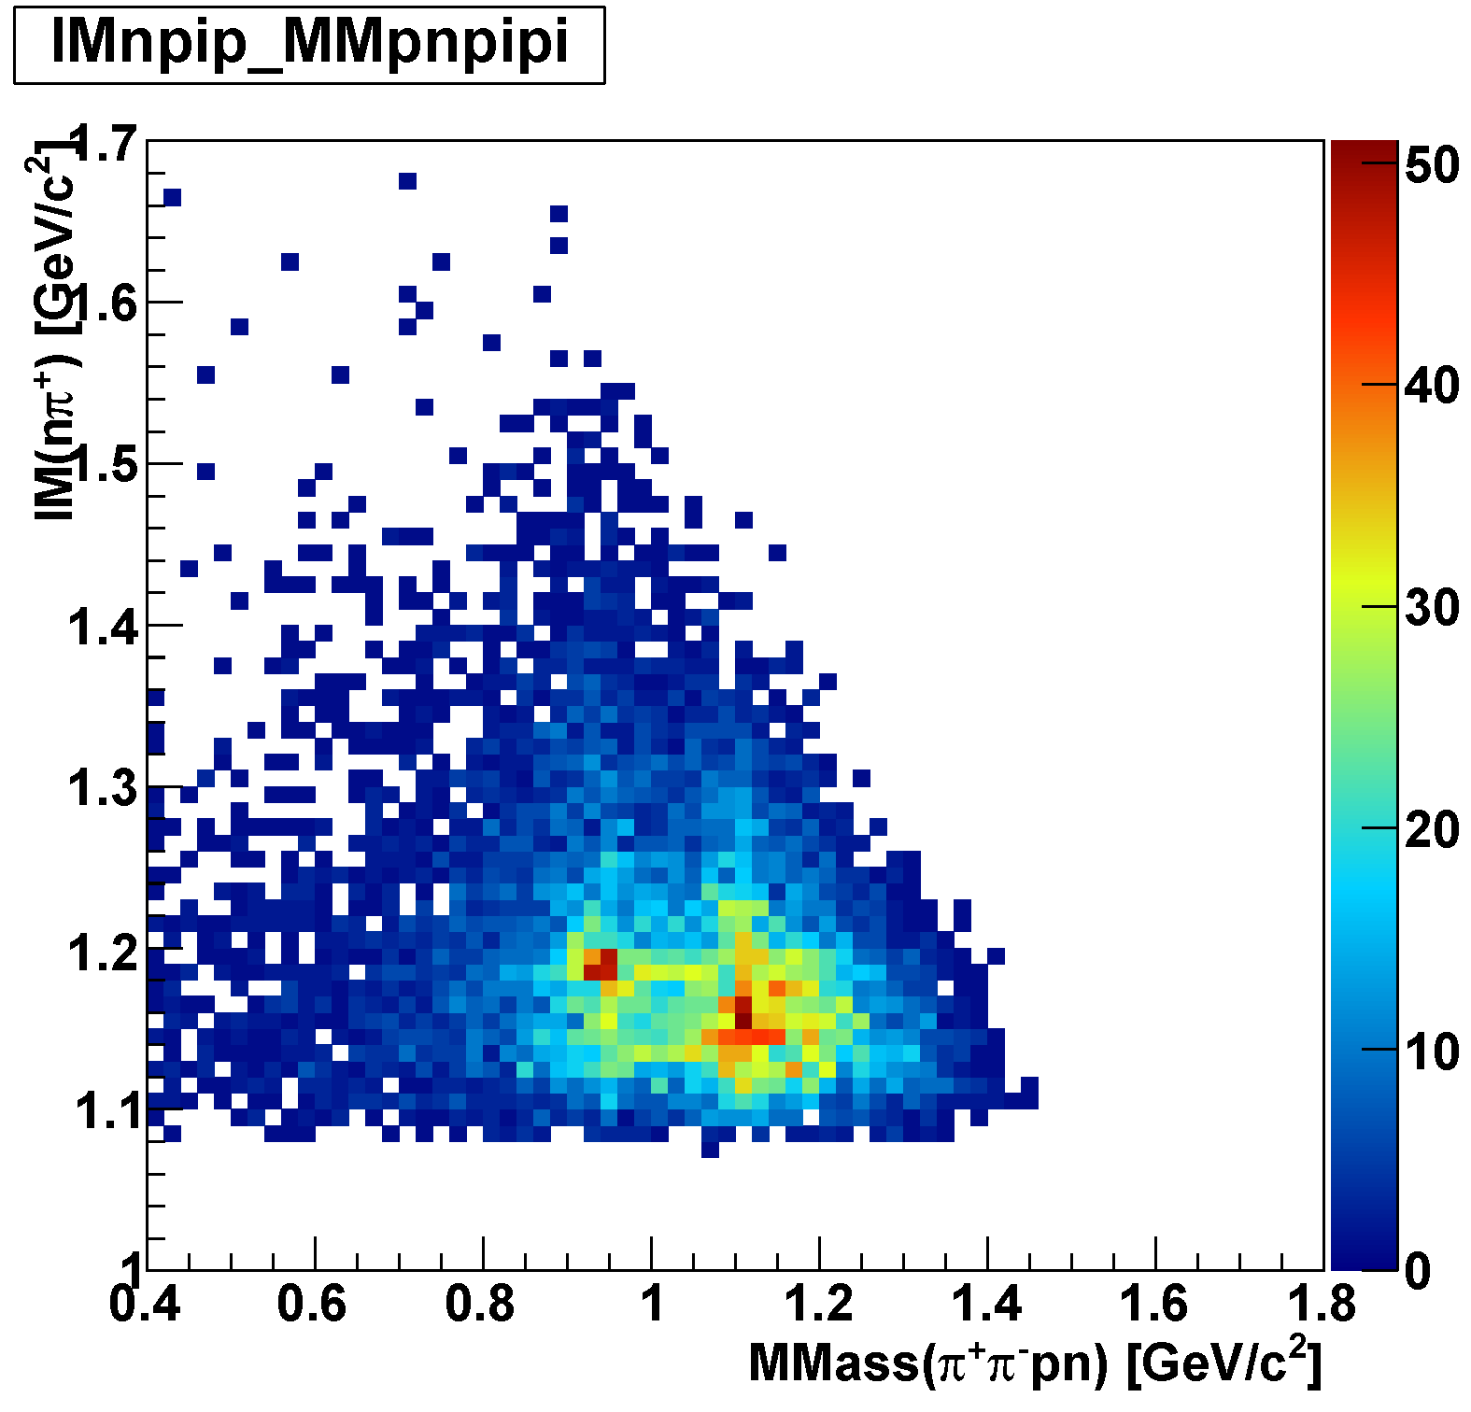
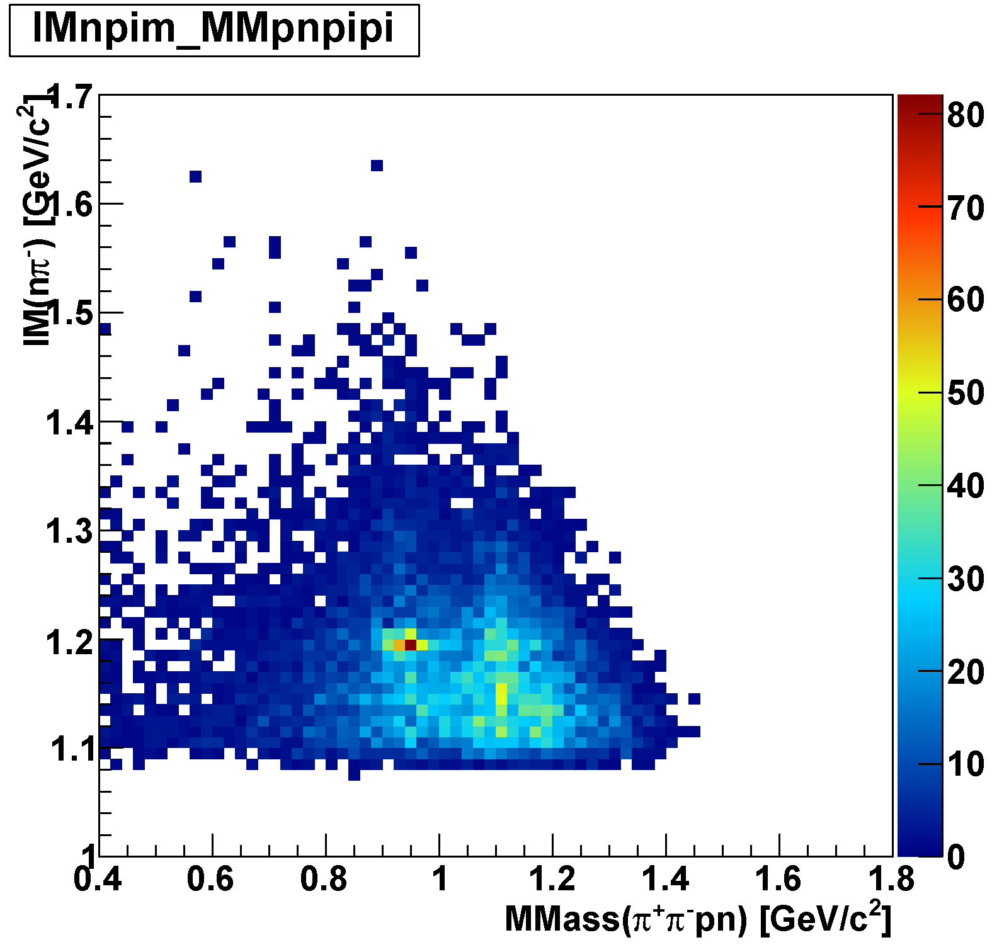
πΣpn Events
IM(nπ⁺) vs MM(π⁺π⁻pn)
IM(nπ⁻) vs MM(π⁺π⁻pn)
π⁻Σ⁺p n_{miss}
π⁺Σ⁻p n_{miss}
M(Σ)
M(Σ)
M(n)
M(Λ)
M(n)
M(Λ)

Slide 6
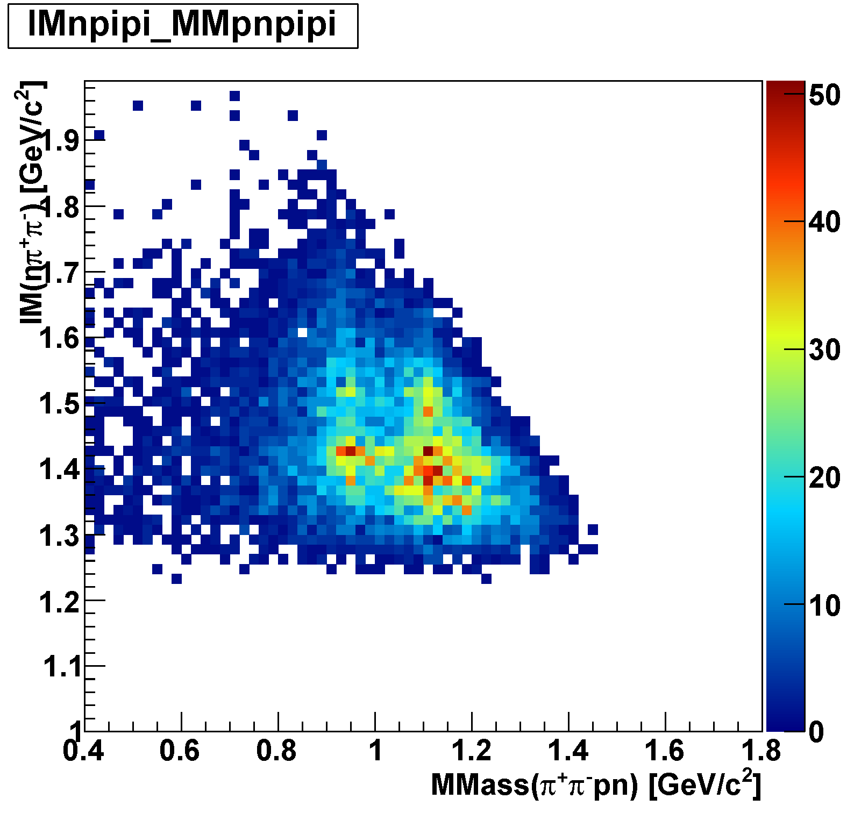

Λ*pn Events
IM(nπ⁺π⁻) vs MM(π⁺π⁻pn)
M(Λ(1520))
M(Λ(1405))
Λ(1520)p n_{miss}
Λ(1405)p n_{miss}
M(n)
M(Λ)

Slide 7
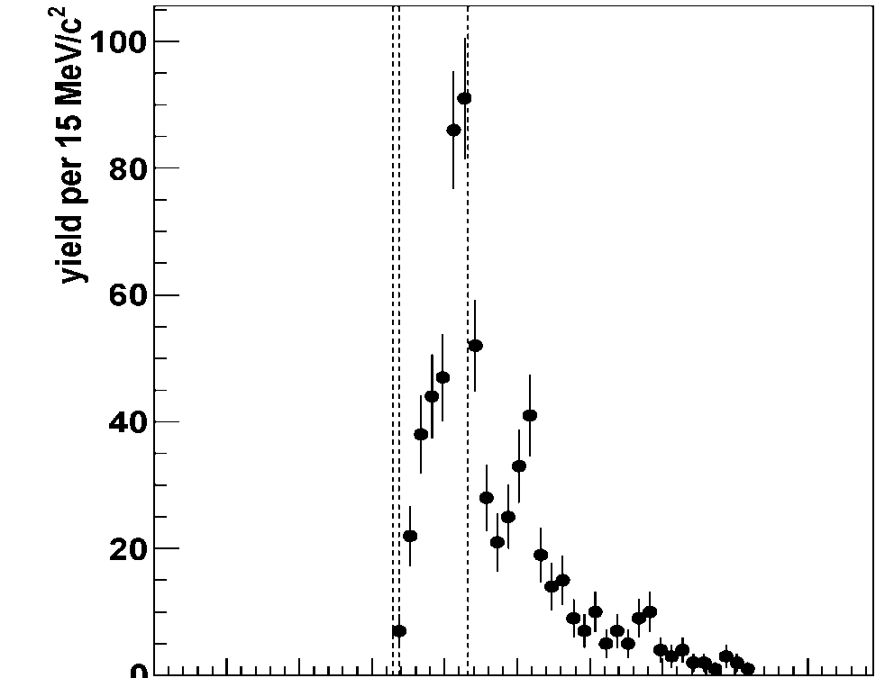
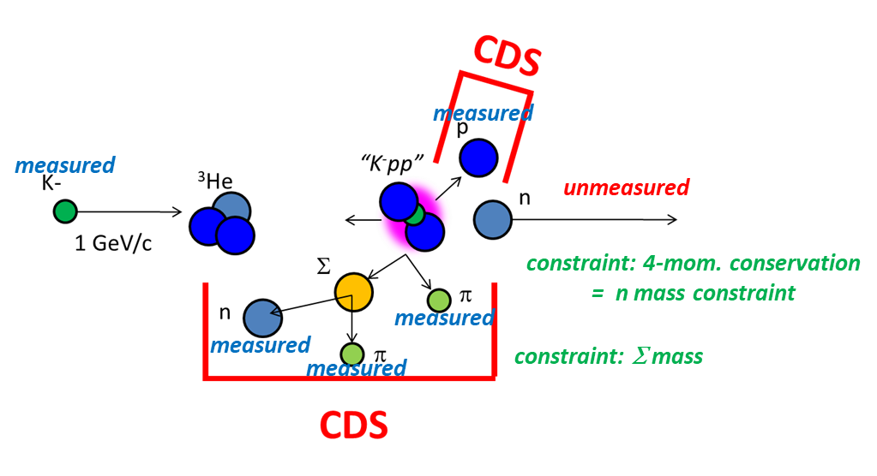
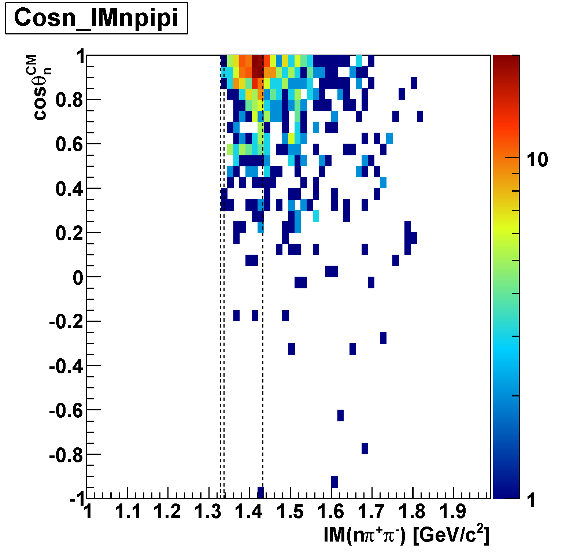
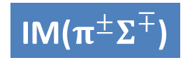
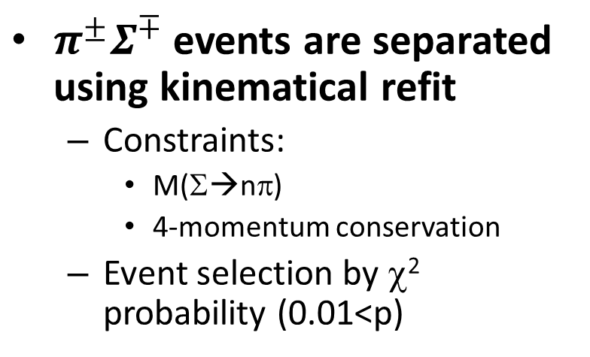
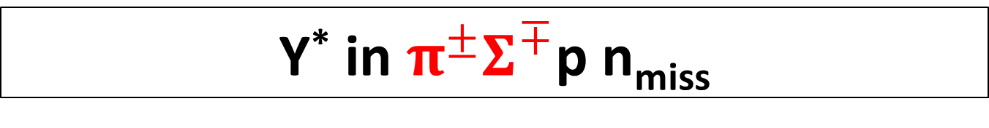
Y* in $π^{±}Σ^{∓}$p n_{miss}
Σ(1385)/Λ(1405)
$π^{±}Σ^{∓}$ events are separated using kinematical refit
  Constraints:
    M(Σ→nπ)
    4-momentum conservation
  Event selection by χ² probability (0.01<p)
IM($π^{±}Σ^{∓}$)
Λ(1520)
preliminary
cos(θ_{n-miss})
M(πΣ)
M(K⁻p)

Slide 8
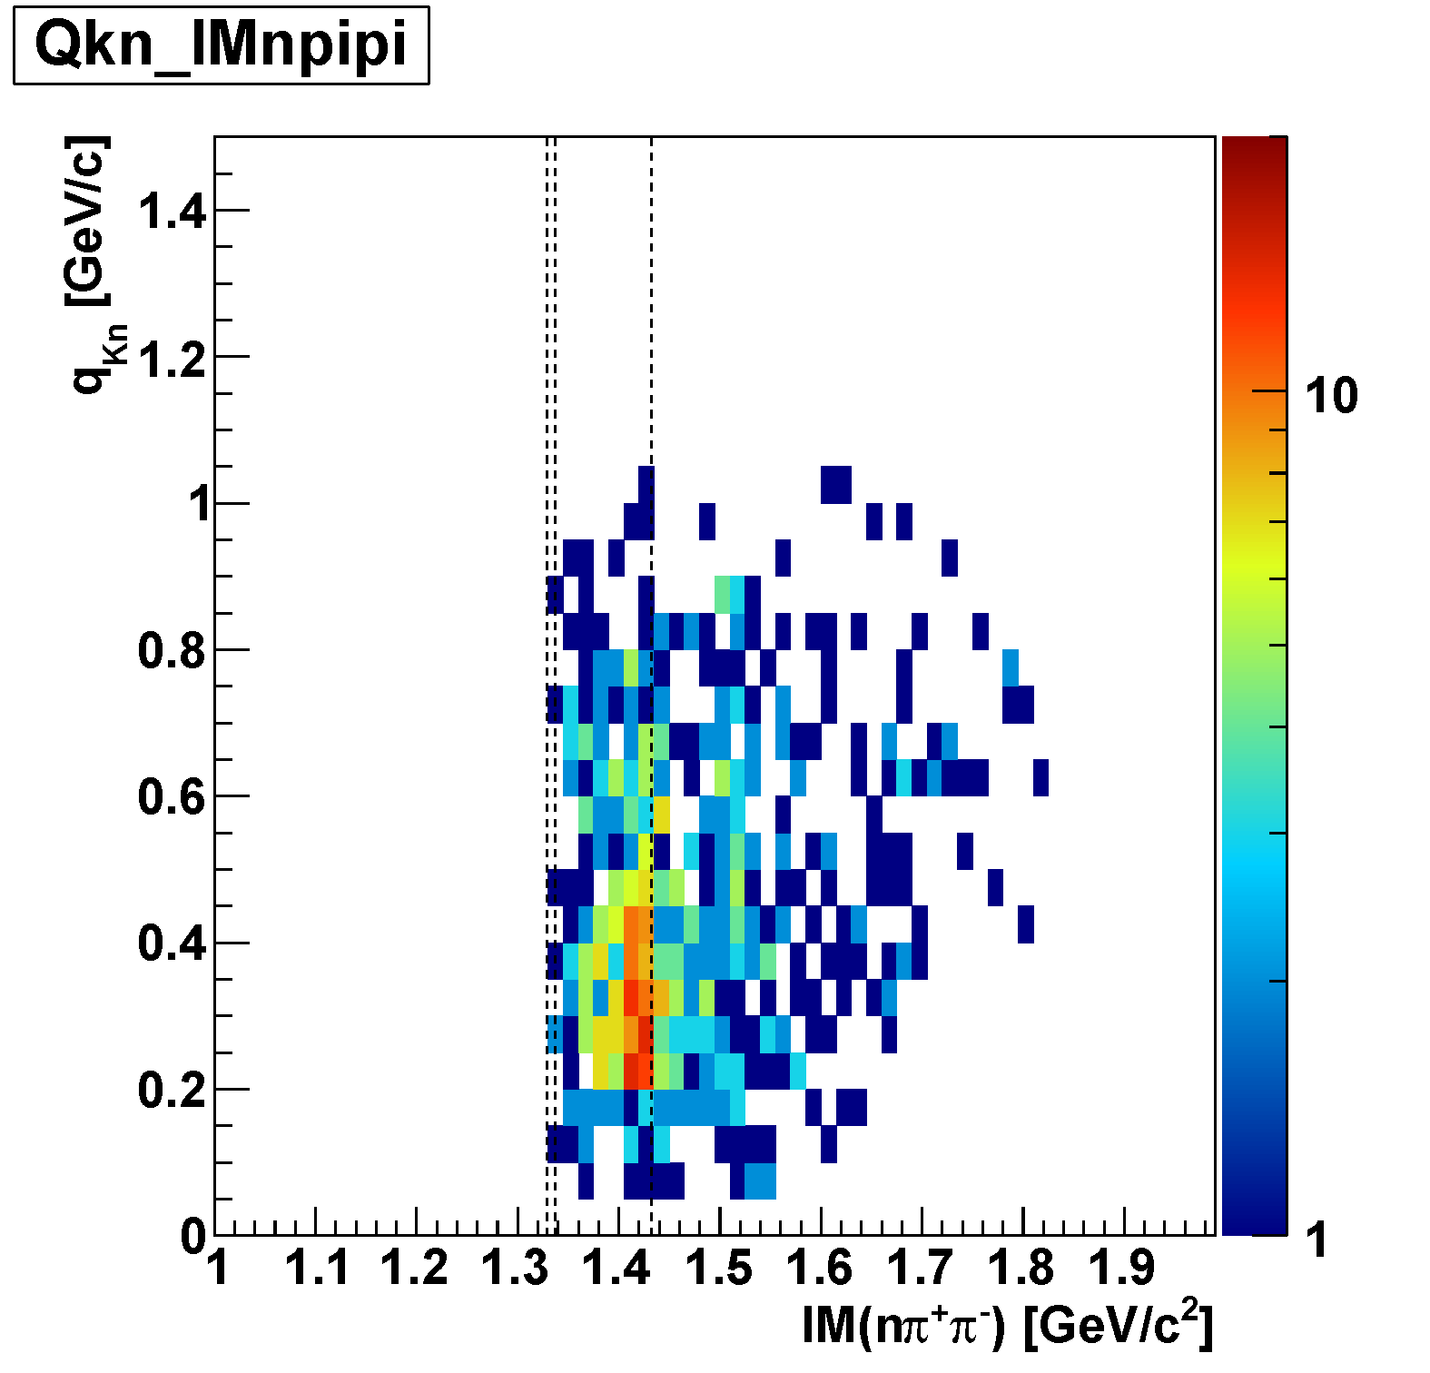
Y* in $π^{±}Σ^{∓}$p n_{miss}
Σ(1385)/Λ(1405)
To compare “K⁻pp” and Λ∗ production CS’s, we select q<0.7 GeV/c region
  Both of “K⁻pp” and Λ* signals are seen in q<0.7 GeV/c
  πΣ(p) acceptance is limited in q>0.7 GeV/c
IM($π^{±}Σ^{∓}$)
Λ(1520)
preliminary
M(πΣ)
M(K⁻p)
q_{Kn}
q<0.7

Slide 9
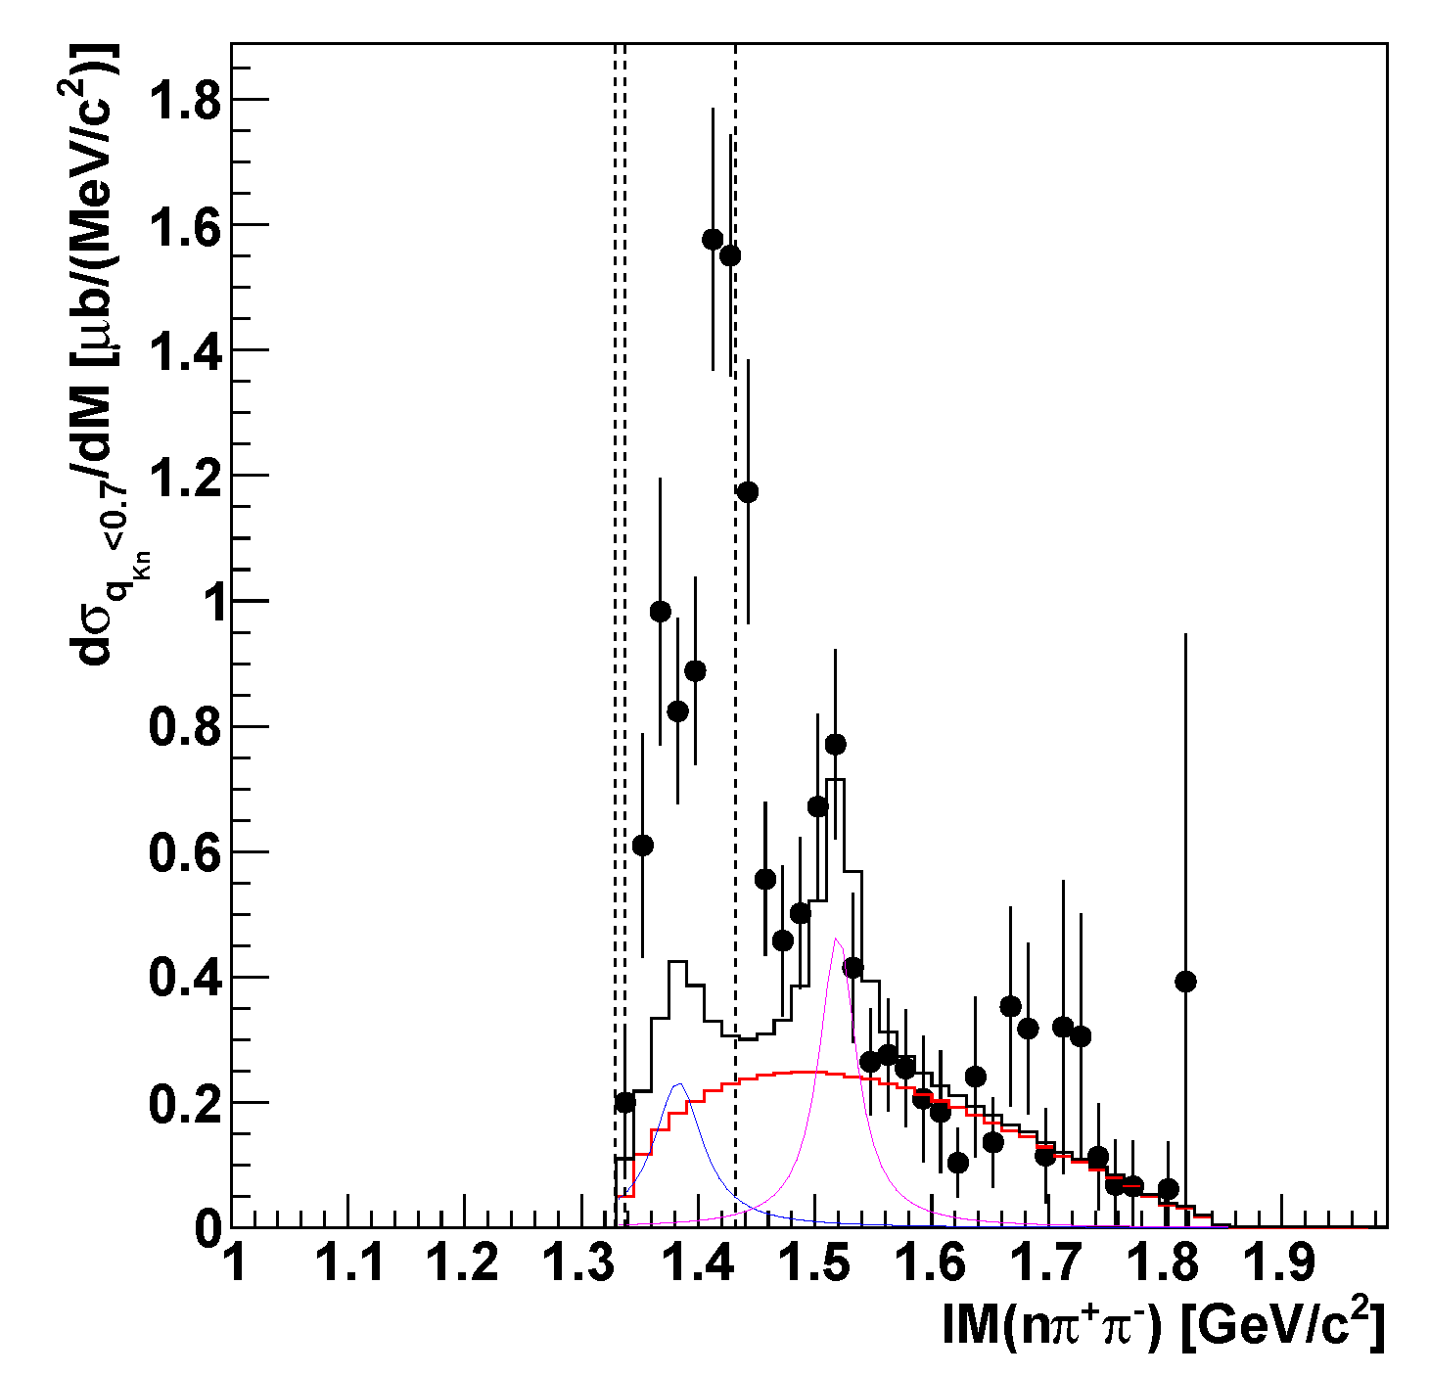
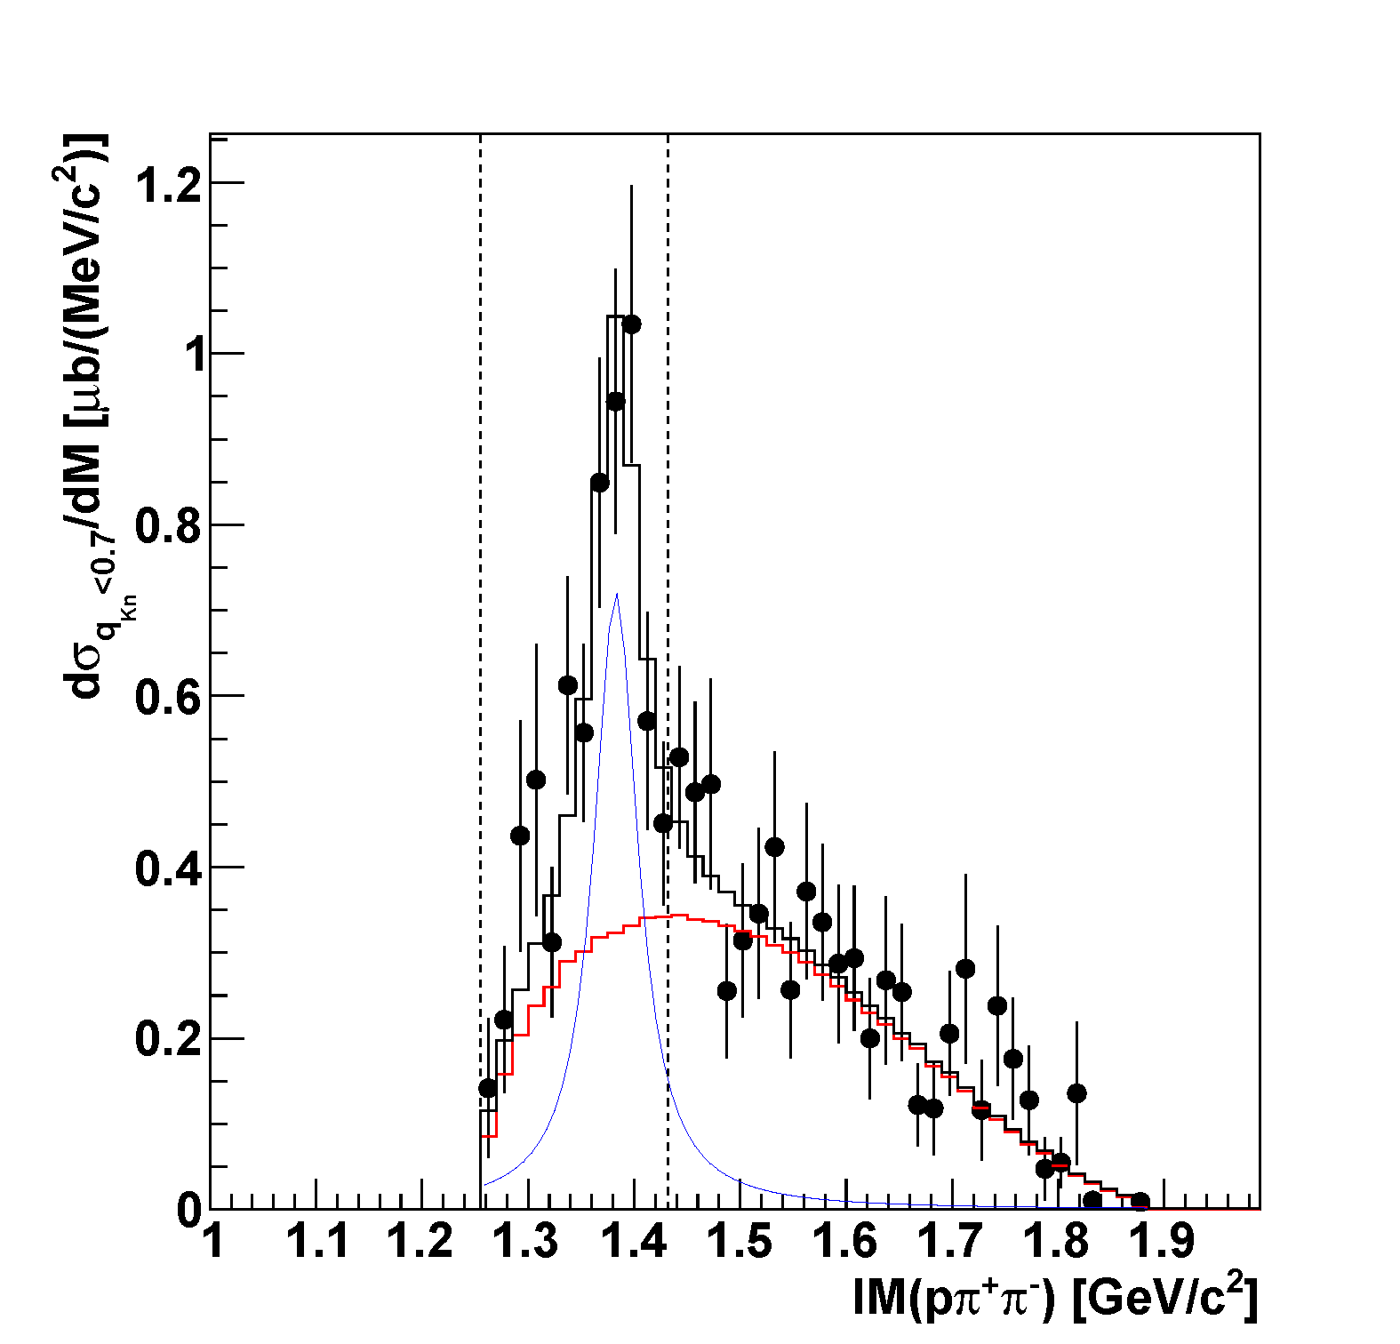
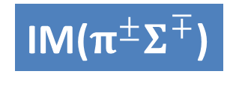


Y* CS in q<0.7 GeV/c
$π^{+}Λ$n n_{miss} final state
M(πΣ)
M(K⁻p)
IM($π^{±}Σ^{∓}$)
M(πΛ)
M(K⁻p)
IM($π^{+}Λ$)
Λ(1405)
preliminary
Σ⁺(1385)
preliminary
L = 3.0 nb⁻¹
~ 60 μb
πΛpn
phases-space
Λ(1520)
πΣpn
phases-space
scaled
we assume Σ⁰(1385) CS at 1.0 GeV/c to be:
σ(Σ^{*0}) = 2.3 x σ(Σ^{*+})
by considering reaction combination in K⁻³He
Σ⁰(1385)
  K⁻ + ³He → Σ⁰(1385) + p + n: ~ 140 μb
  K⁻ + ³He → Λ(1405) + p + n: ~ 130 μb
  K⁻ + ³He → Λ(1520) + p + n: ~ 70 μb

Slide 10
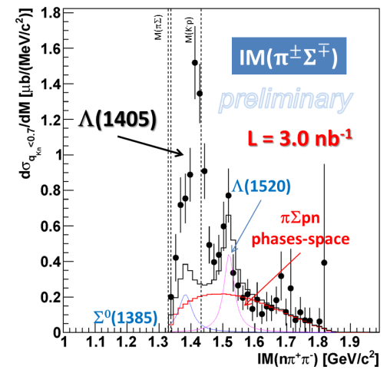
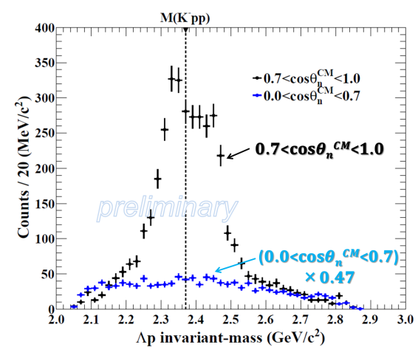

Production of Λ* and “K⁻pp”
Λ(1405)
K-
³He
n
1 GeV/c
p
“free” Λ*
“K⁻pp” formation
p
p
~ 130μb in q<0.7
“K⁻pp”
~ 10μb in q<0.7
n
n
IM($π^{±}Σ^{∓}$)
Λ
Λ(1405)
IM(Λp)
Large CS of Λ*compared to “K⁻pp”

Slide 11
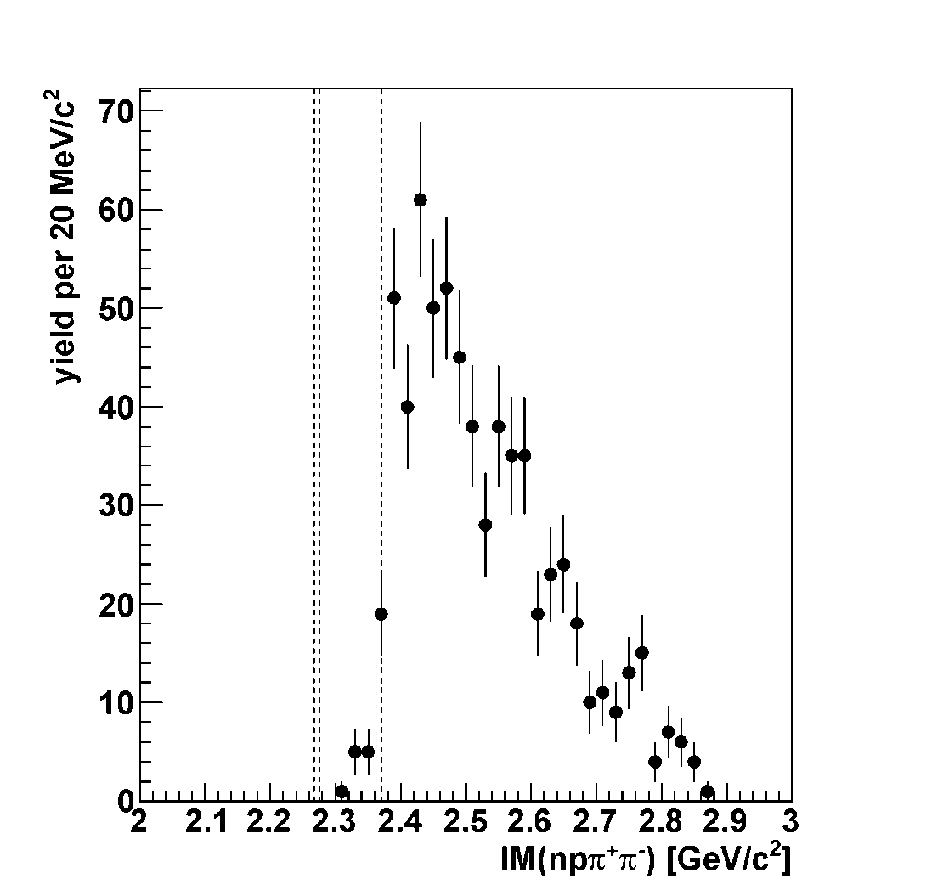
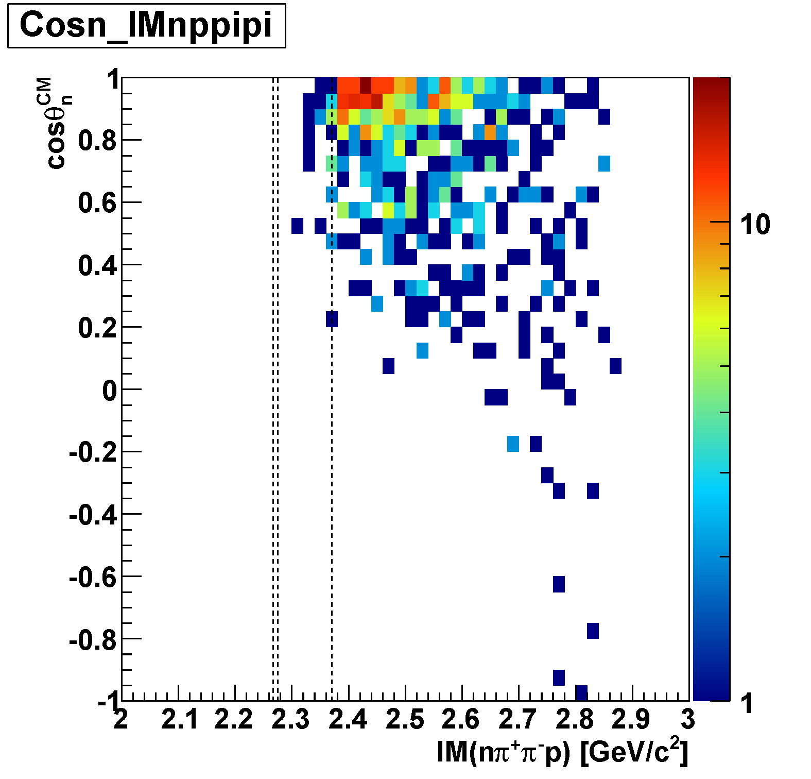
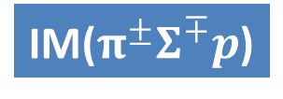
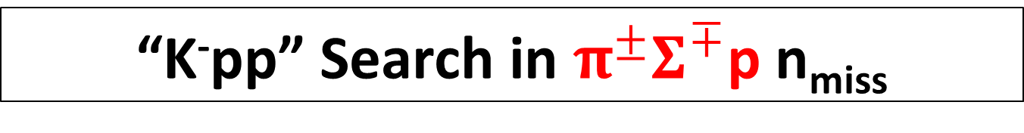
“K⁻pp” Search in $π^{±}Σ^{∓}$p n_{miss}
IM($π^{±}Σ^{∓}p$)
M(πΣp)
M(K⁻pp)
preliminary
cos(θ_{n-miss})

Slide 12
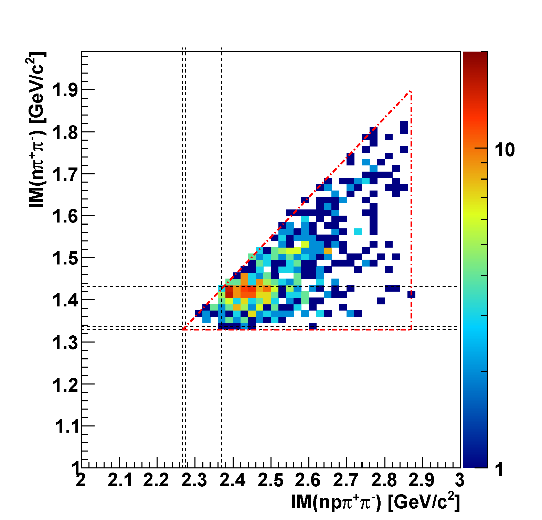
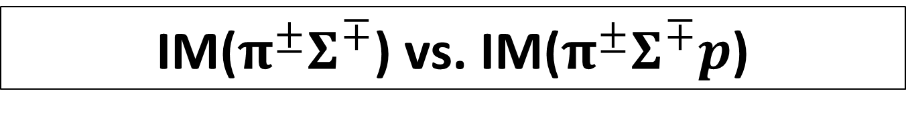

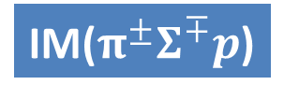
IM($π^{±}Σ^{∓}$) vs. IM($π^{±}Σ^{∓}p$)
preliminary
IM($π^{±}Σ^{∓}$)
K-
³He
1 GeV/c
kinematical limit
p
n
Λ(1405)
M(K⁻p)
Bound Region
p
M(πΣ)
p
QF
n
M(πΣp)
M(K⁻pp)
IM($π^{±}Σ^{∓}p$)
Λ(1405)
Small phase-space of “K⁻pp”→πΣN

Slide 13
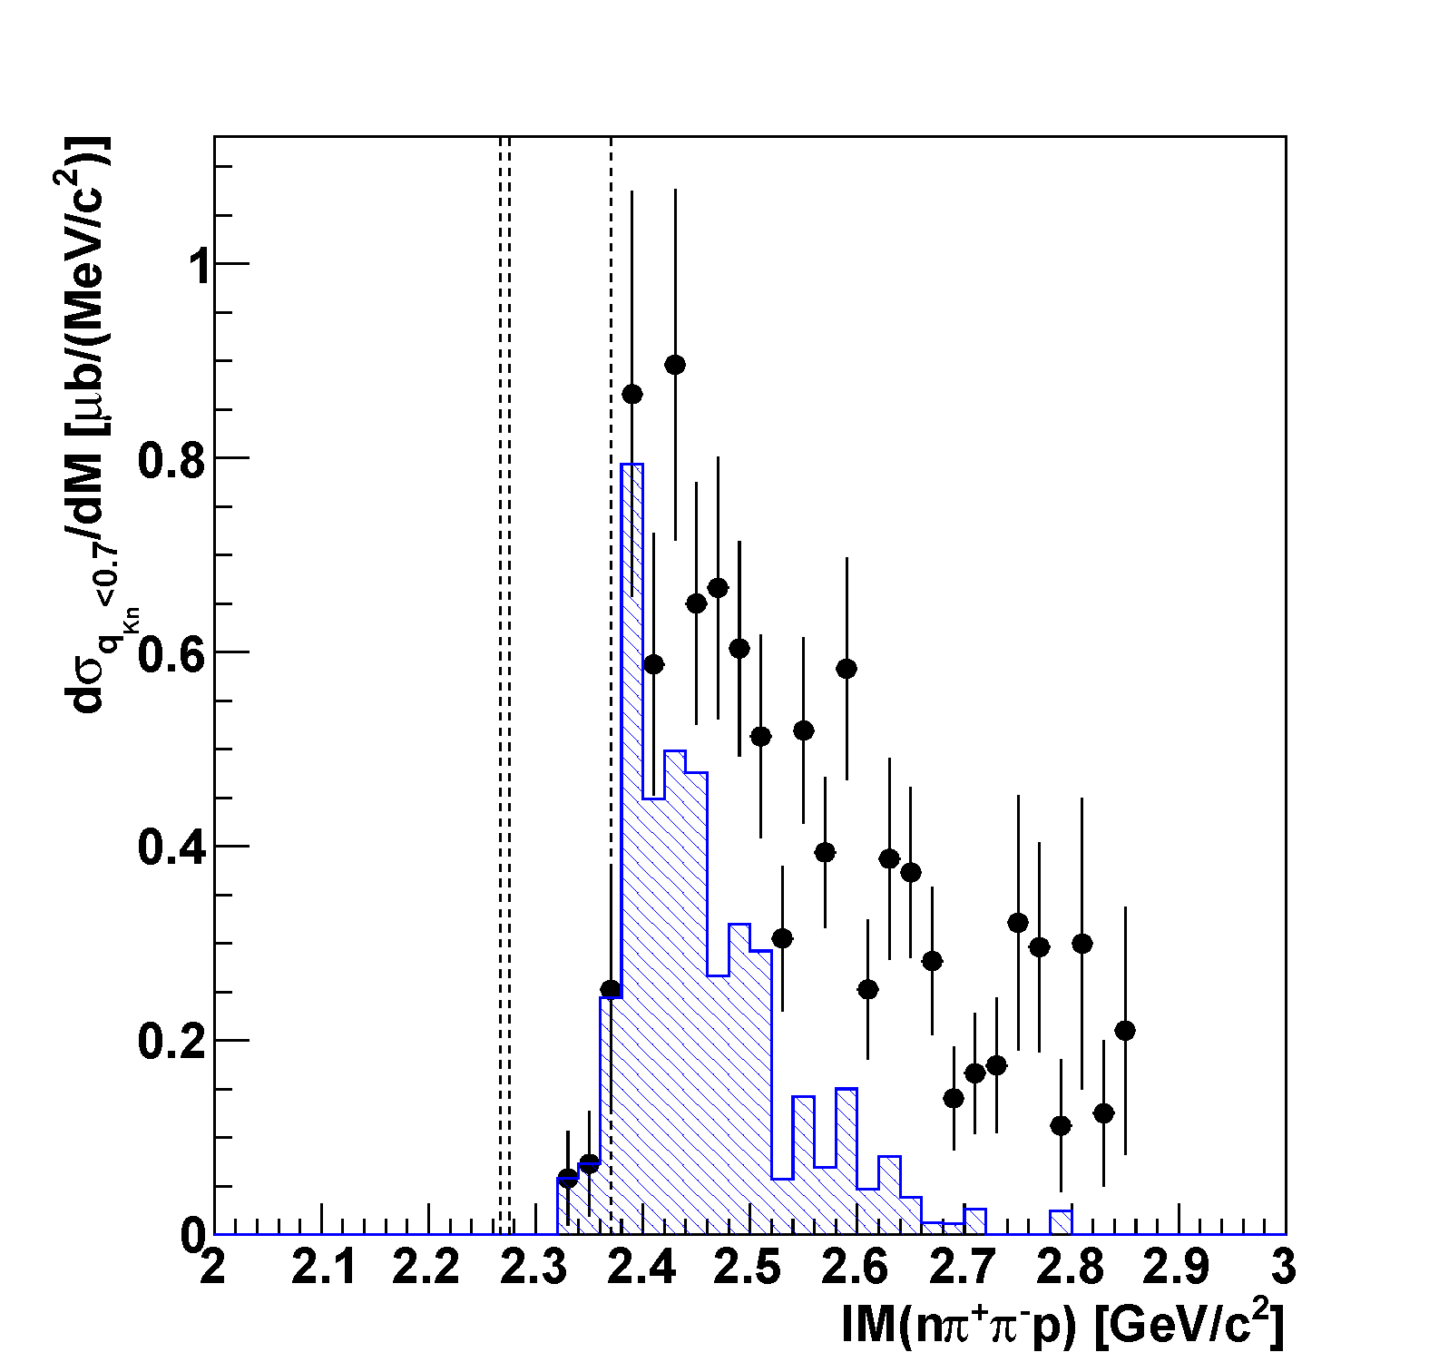
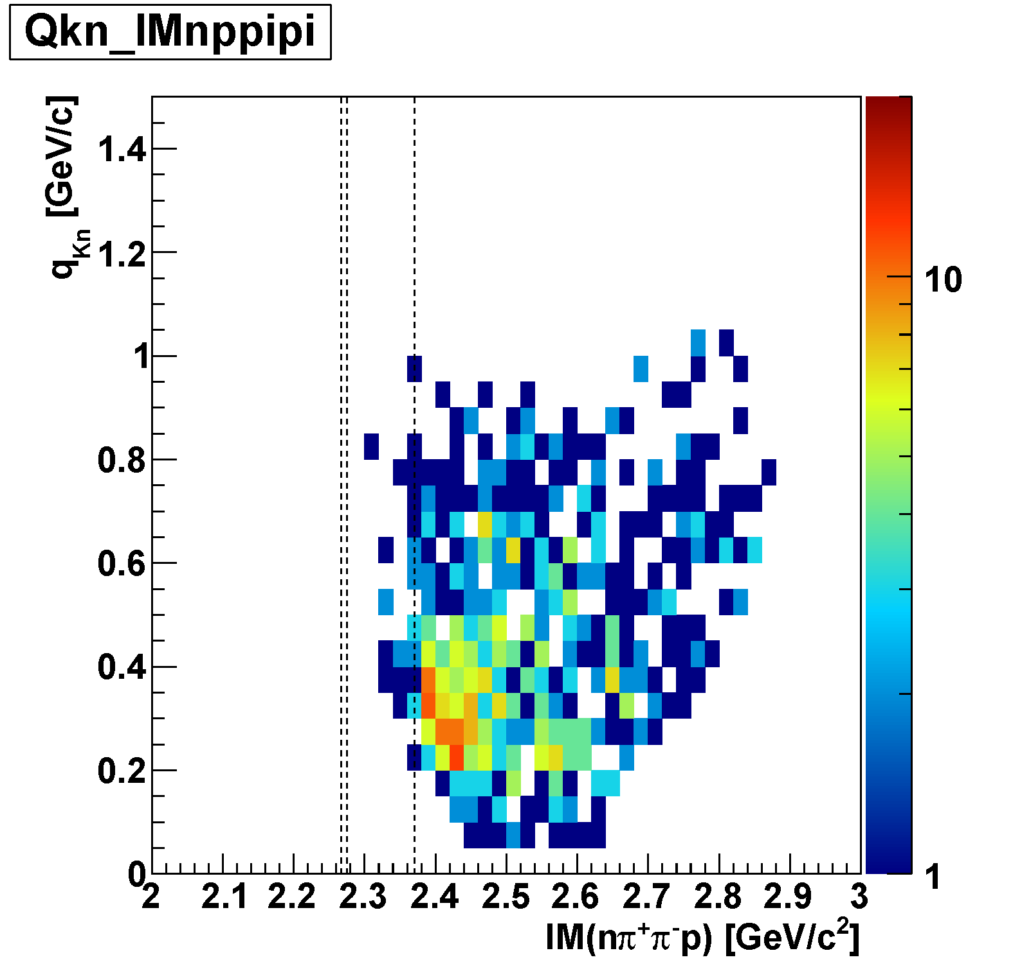
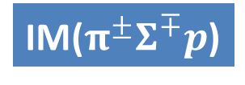
“K⁻pp” Search in $π^{±}Σ^{∓}$p n_{miss}
IM($π^{±}Σ^{∓}p$)
M(πΣp)
M(K⁻pp)
q<0.7 GeV/c
preliminary
Corresponding to
Λ(1405) mass-region
~ 3 μb
Λp decay is dominant
below M(K⁻pp)
[σ(“K⁻pp”→Λp) ~ 10 μb]
q_{Kn}
q<0.7

Slide 14

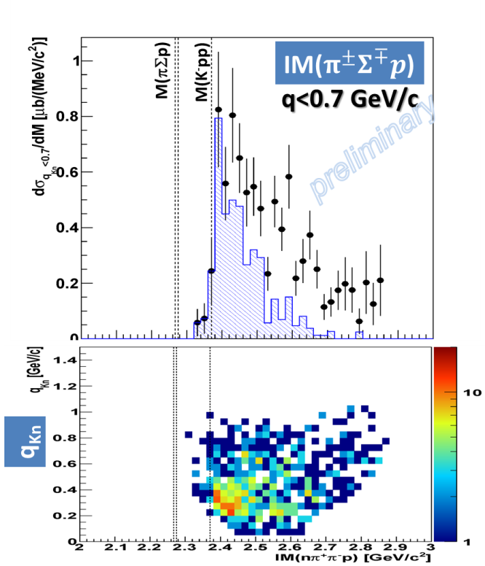
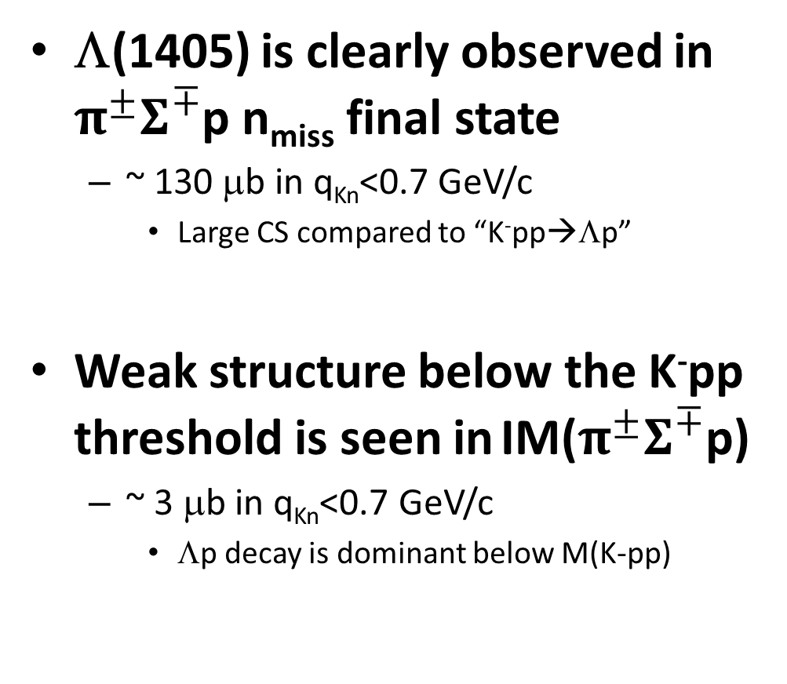
Summary
Λ(1405) is clearly observed in $π^{±}Σ^{∓}$p n_{miss} final state
  ~ 130 μb in q_{Kn}<0.7 GeV/c
    Large CS compared to “K⁻pp→Λp”
Weak structure below the K⁻pp threshold is seen in IM($π^{±}Σ^{∓}$p)
  ~ 3 μb in q_{Kn}<0.7 GeV/c
    Λp decay is dominant below M(K-pp)
  need further investigation of πΣN channel

Slide 16
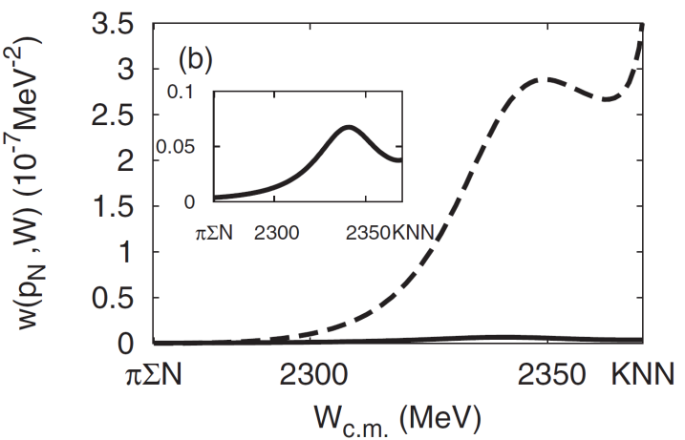
“K⁻pp”→πΣN Decay Channel
S.Ohnish et al.,PRC88(2013)025204
Theoretically,
πΣN decay is expected to be
the dominant channel
kaon absorption probability
of Λ*N→πΣN/ΛN
πΣN channel
ΛN channel
CDS
p
“K⁻pp”
K-
³He
n
1 GeV/c
Σ
π
n
π
CDS

Slide 17
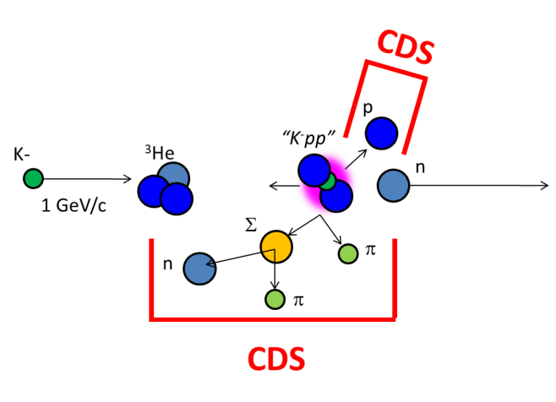
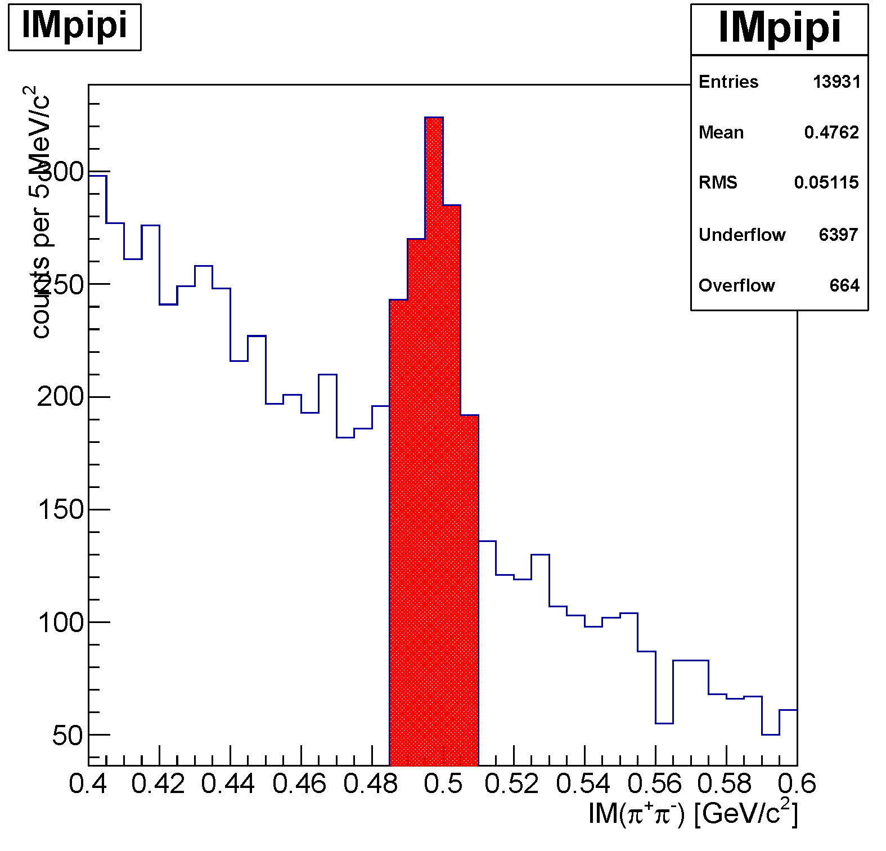
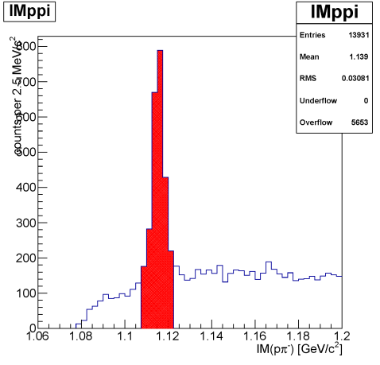
πΣpn Events
IM(nπ⁺) vs MM(π⁺π⁻pn)
π⁻Σ⁺p n_{miss}
K⁰→π⁺π⁻
IM(nπ⁻) vs MM(π⁺π⁻pn)
removed
π⁺Σ⁻p n_{miss}
Λ→pπ⁻
M(n)
M(Λ)
removed

Slide 18
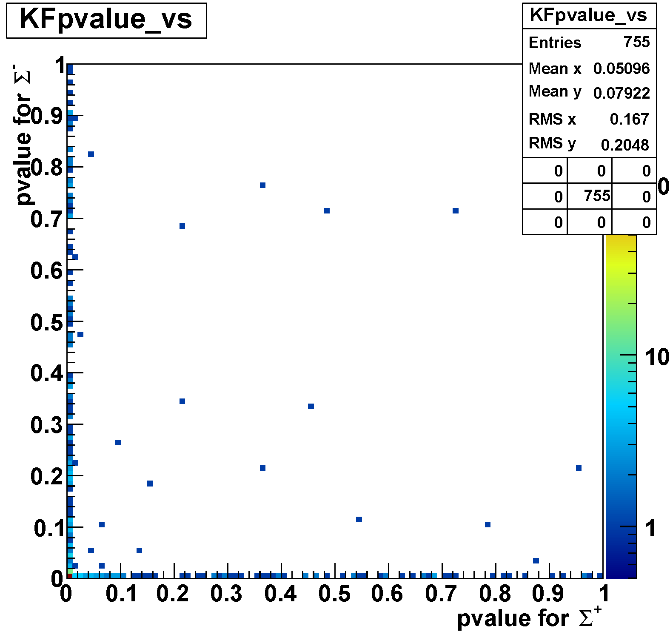
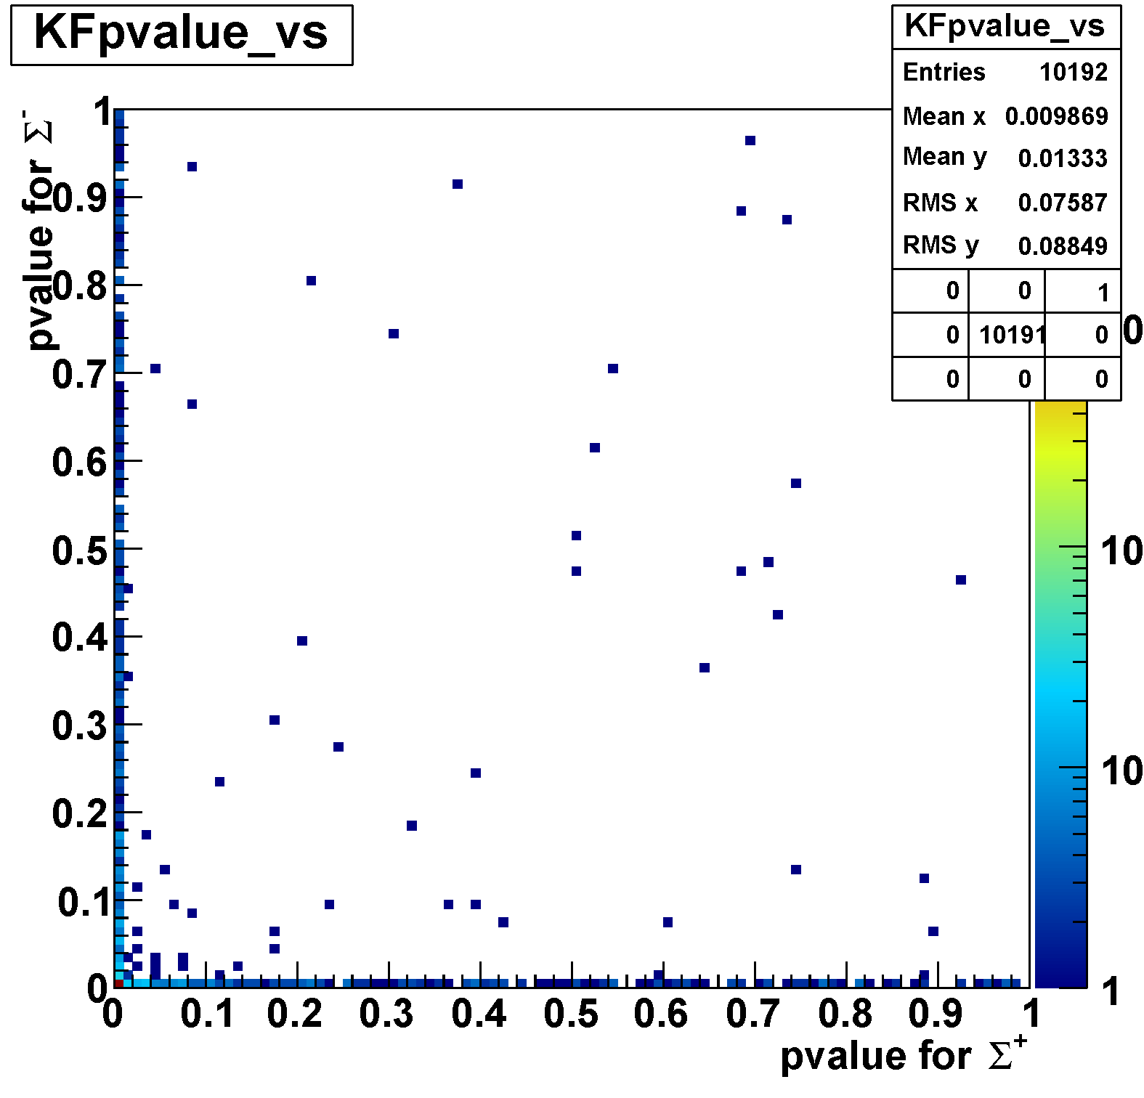
Event Selection by χ² Probability
MC
  [4-body PS K⁻+³He→π∓ Σ± p n]
data
Σ⁻π⁺ selection
Σ⁻π⁺ selection
Σ⁻π⁺ assumption
Σ⁻π⁺ assumption
Σ⁺π⁻ selection
Σ⁺π⁻ selection
Σ⁺π⁻ assumption
Σ⁺π⁻ assumption

Slide 19
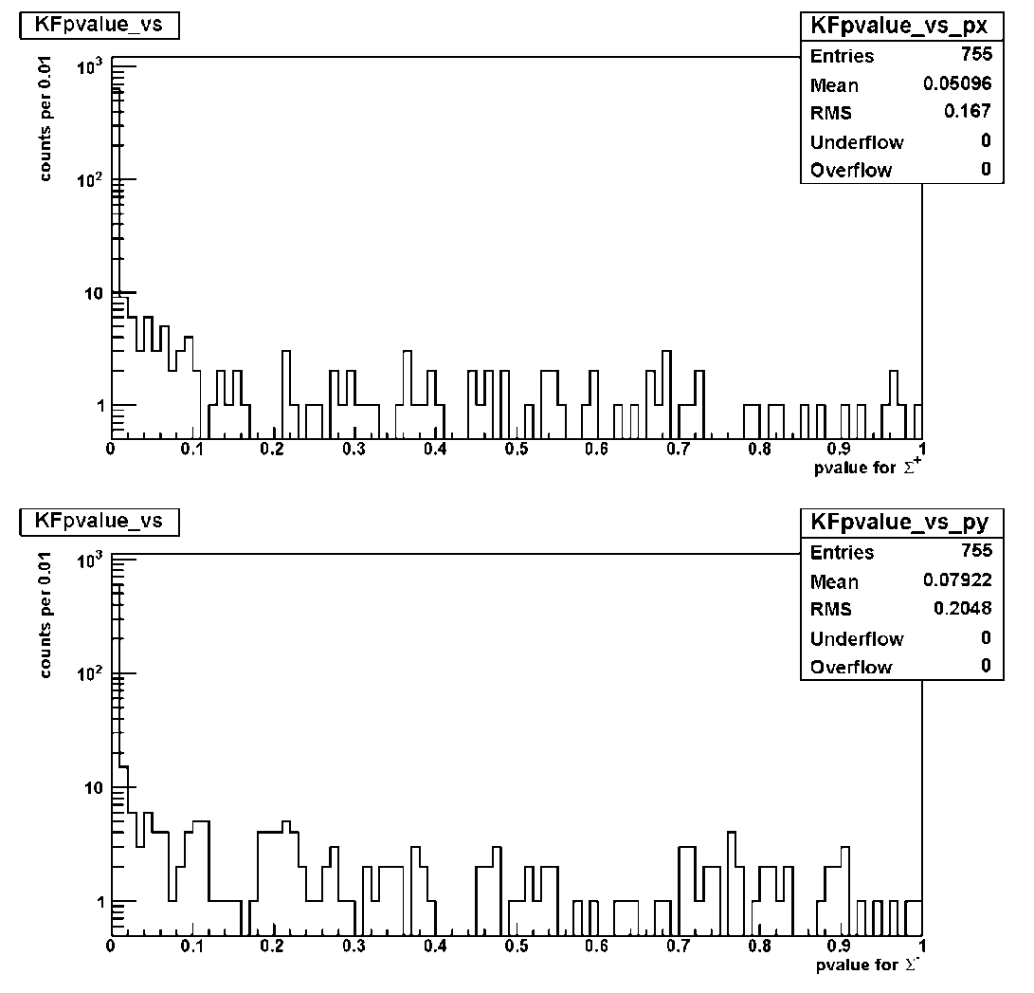
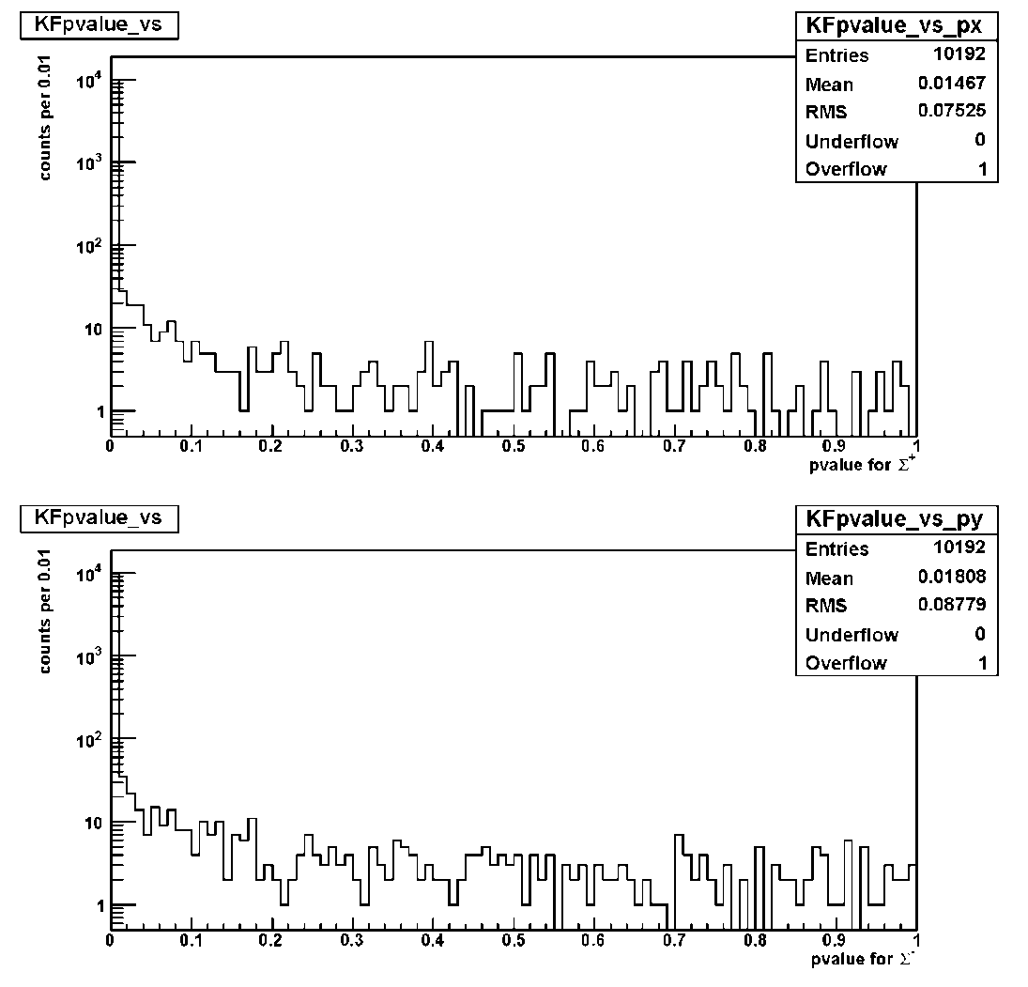
Event Selection by χ² Probability
MC
  [4-body PS K⁻+³He→π∓ Σ± p n]
data
Σ⁺π⁻ assumption
Σ⁺π⁻ assumption
Σ⁻π⁺ assumption
Σ⁻π⁺ assumption

Slide 20
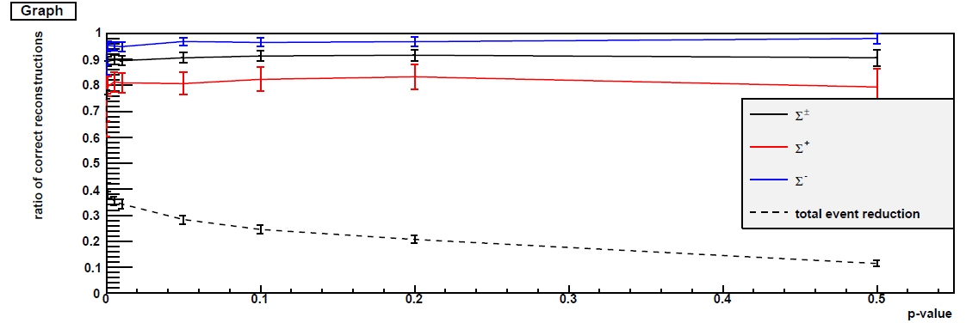
Event Selection by χ² Probability
MC
  [4-body PS K⁻+³He→π∓ Σ± p n]
data
Σ⁺π⁻ assumption
Σ⁺π⁻ assumption
MC
Correctness of the Identification
Σ⁻π⁺ assumption
Σ⁻π⁺ assumption
* reconstruction eff. = (πΣpn reconstruction) / (π⁺π⁻pn detection)
at 0.01<prob.
Σ⁺π⁻ assumption = 81.0%
Σ⁻π⁺ assumption = 95.0%
Σ±π∓ total = 89.6%

Slide 21
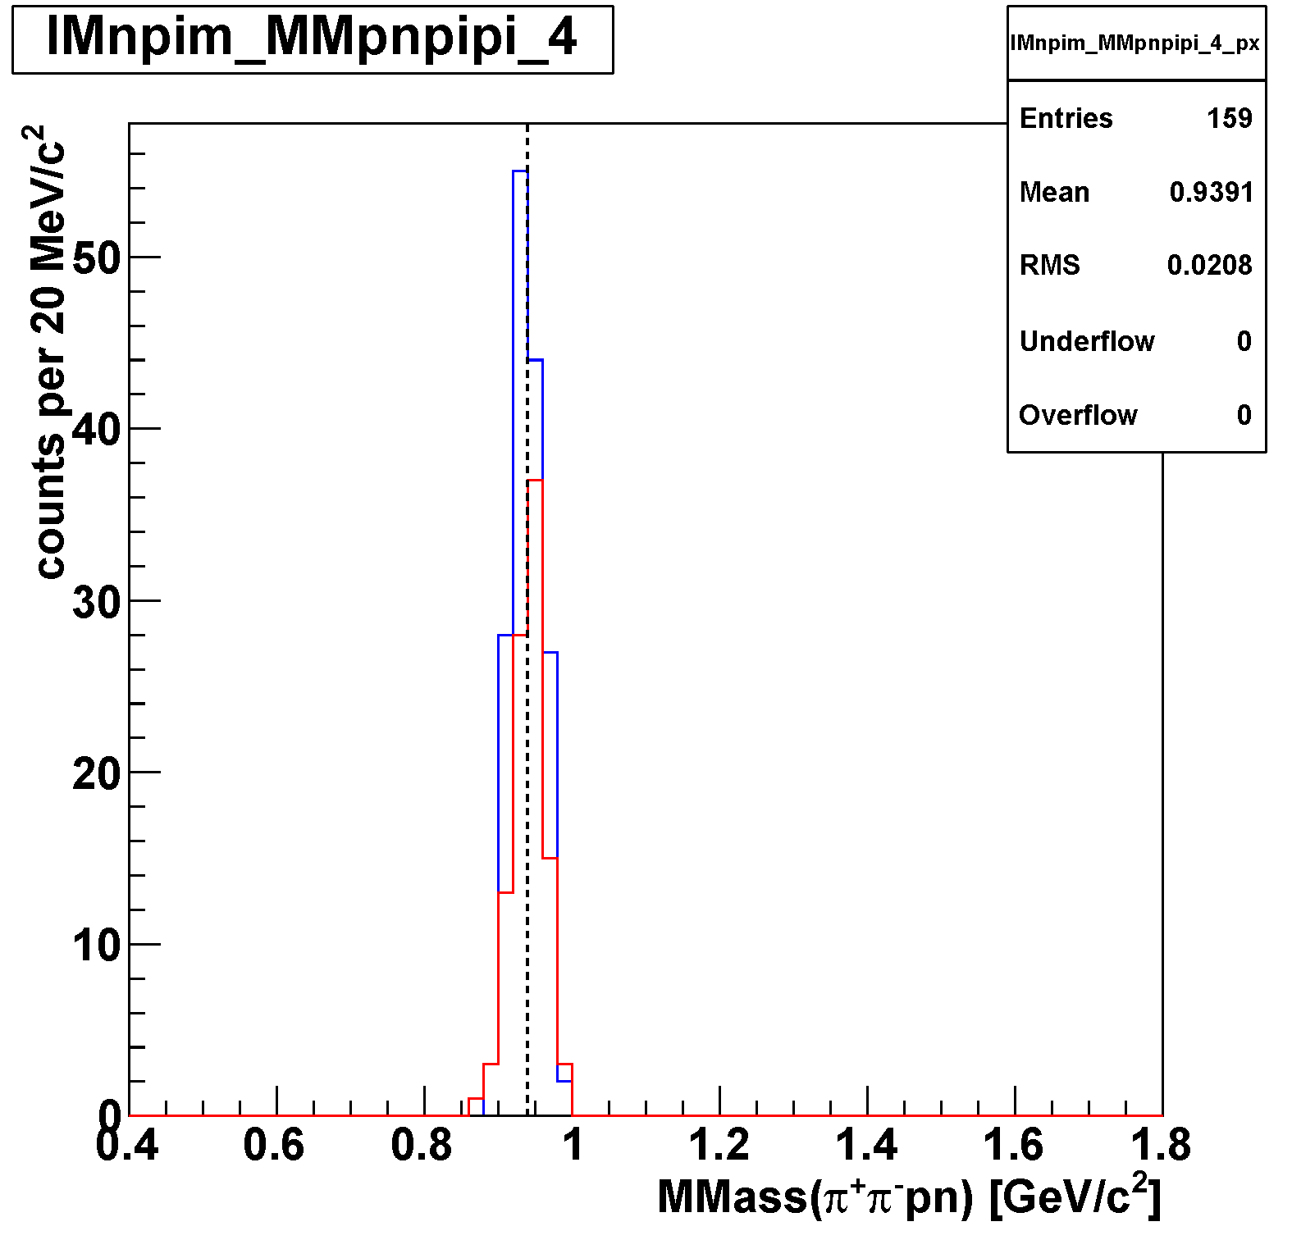
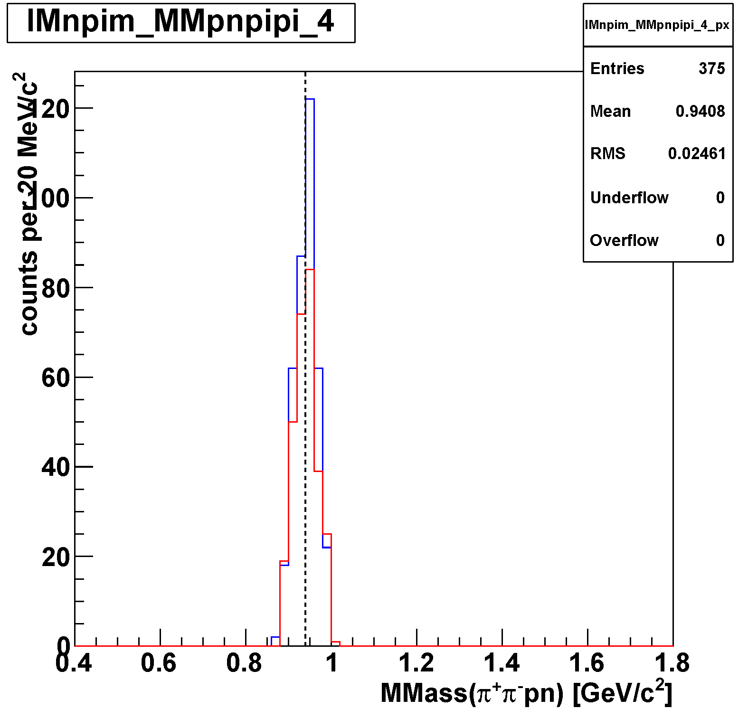
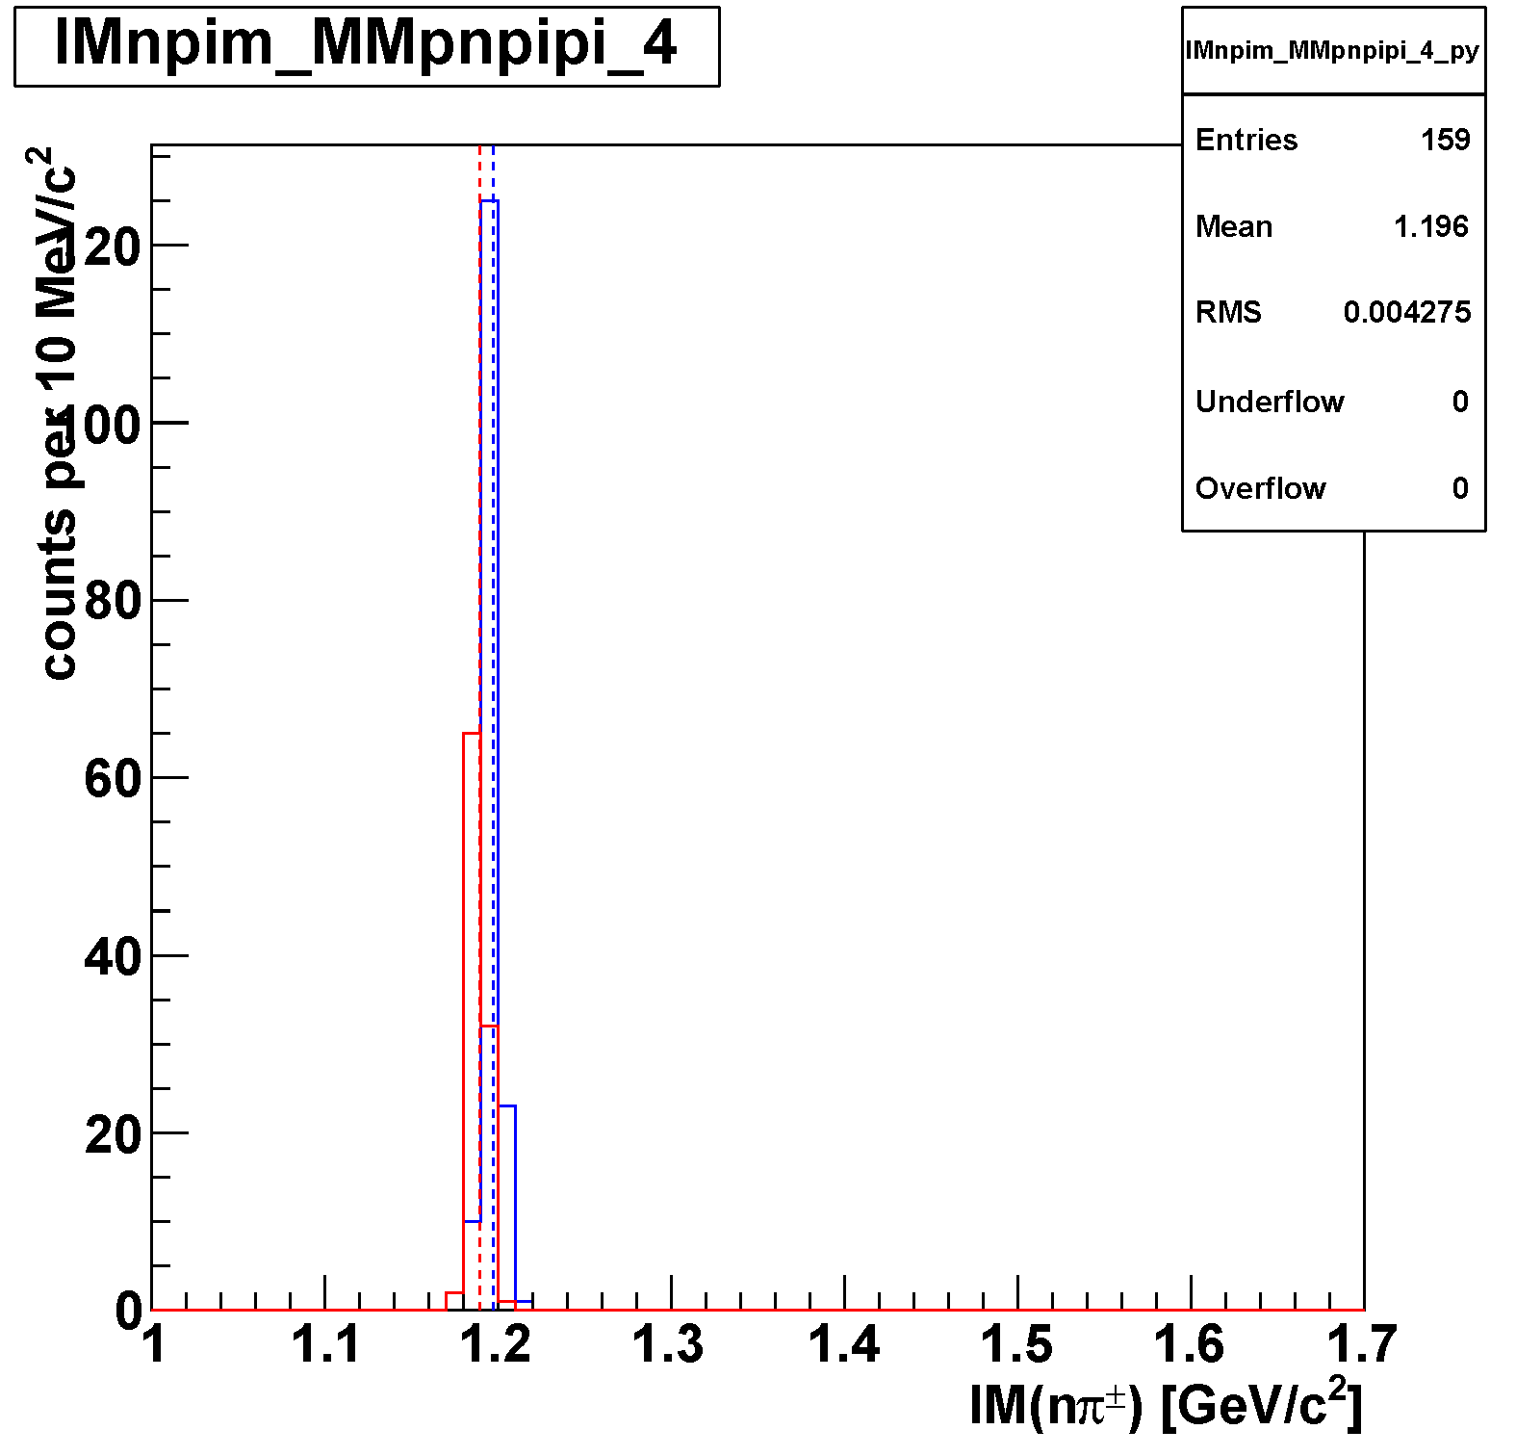
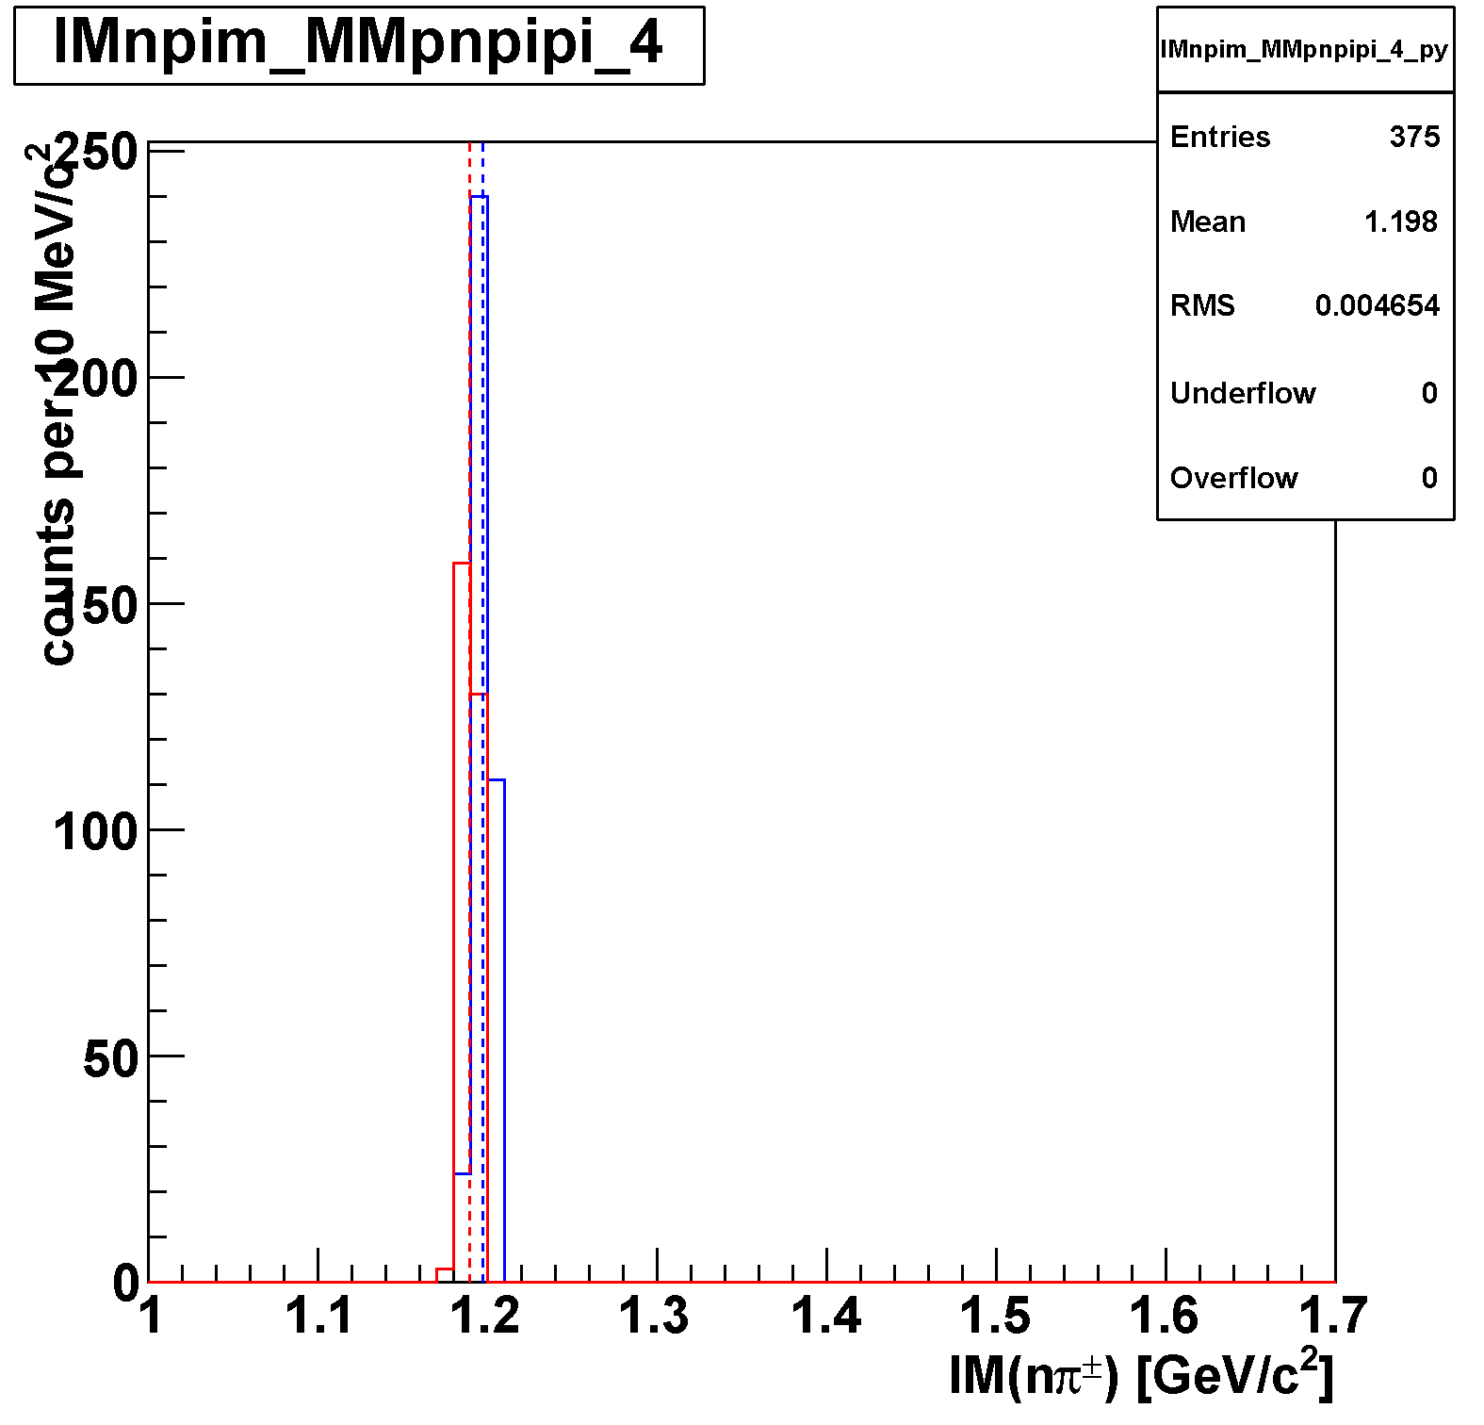
n_{missing} and Σ Selection [0.01< p-value]
MC
  [4-body PS K⁻+³He→π∓ Σ± p n]
data
n_{missing}
n_{missing}
Σ
Σ

Slide 22
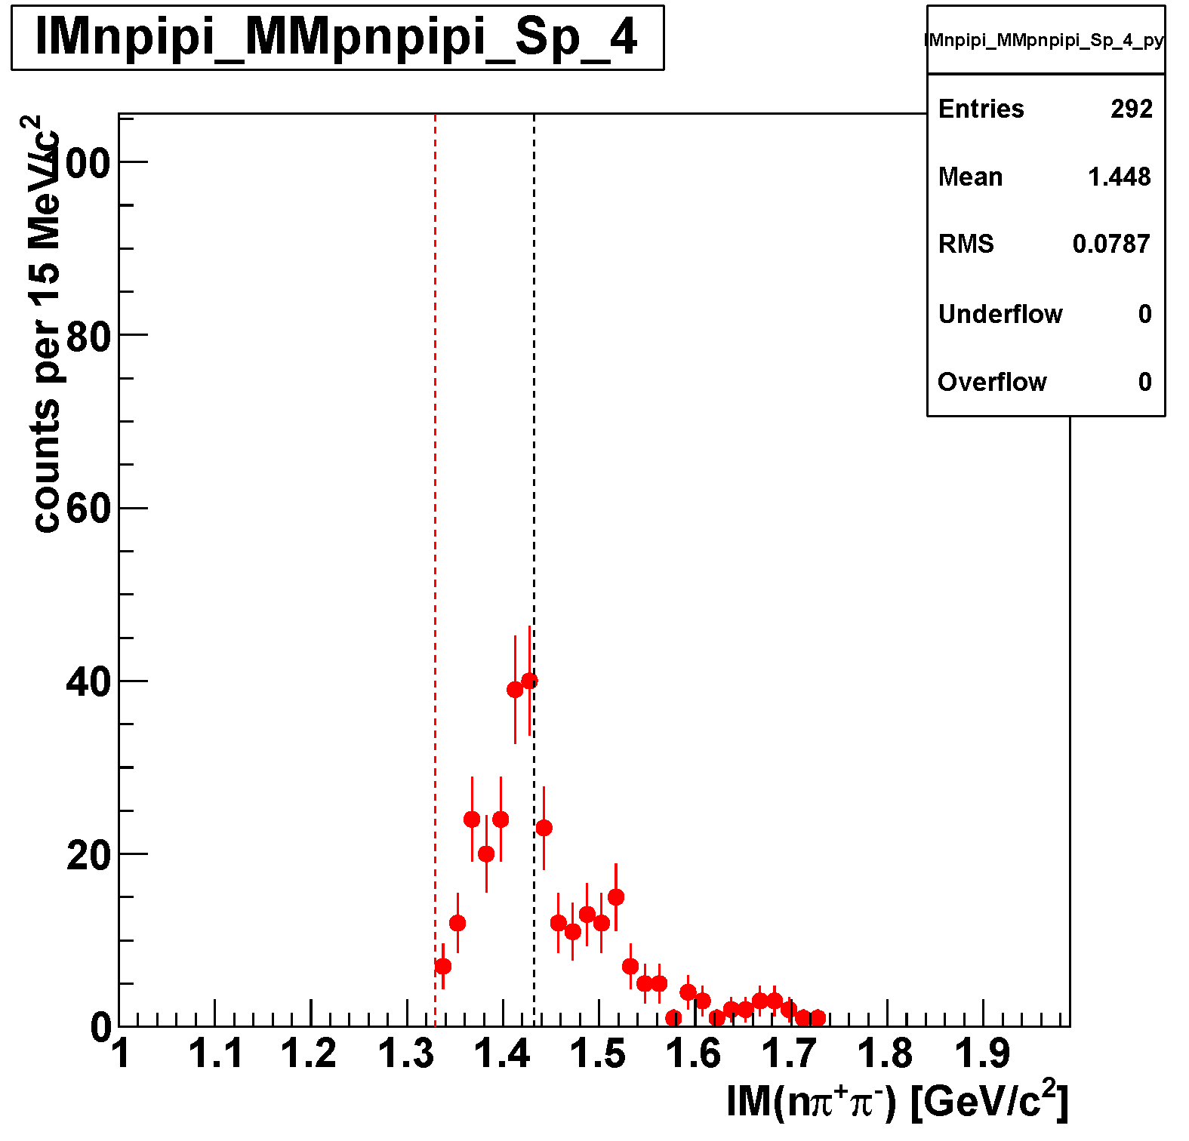
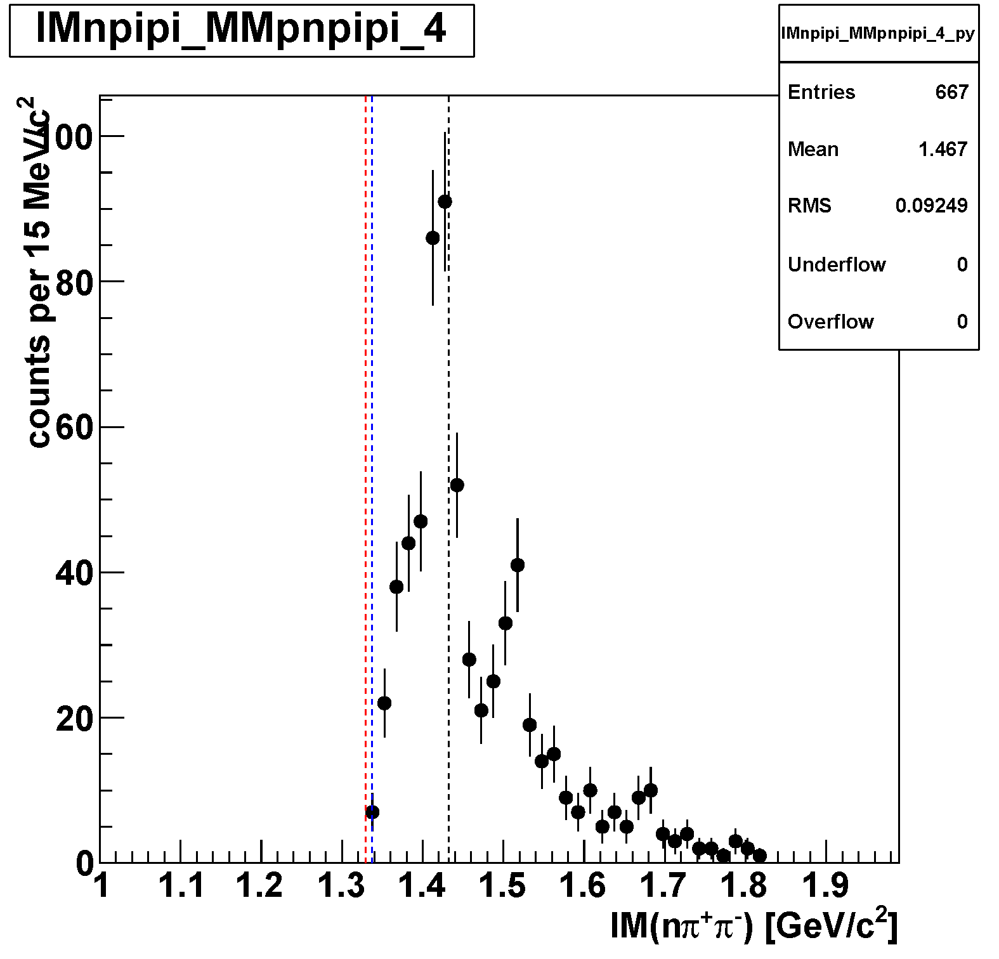
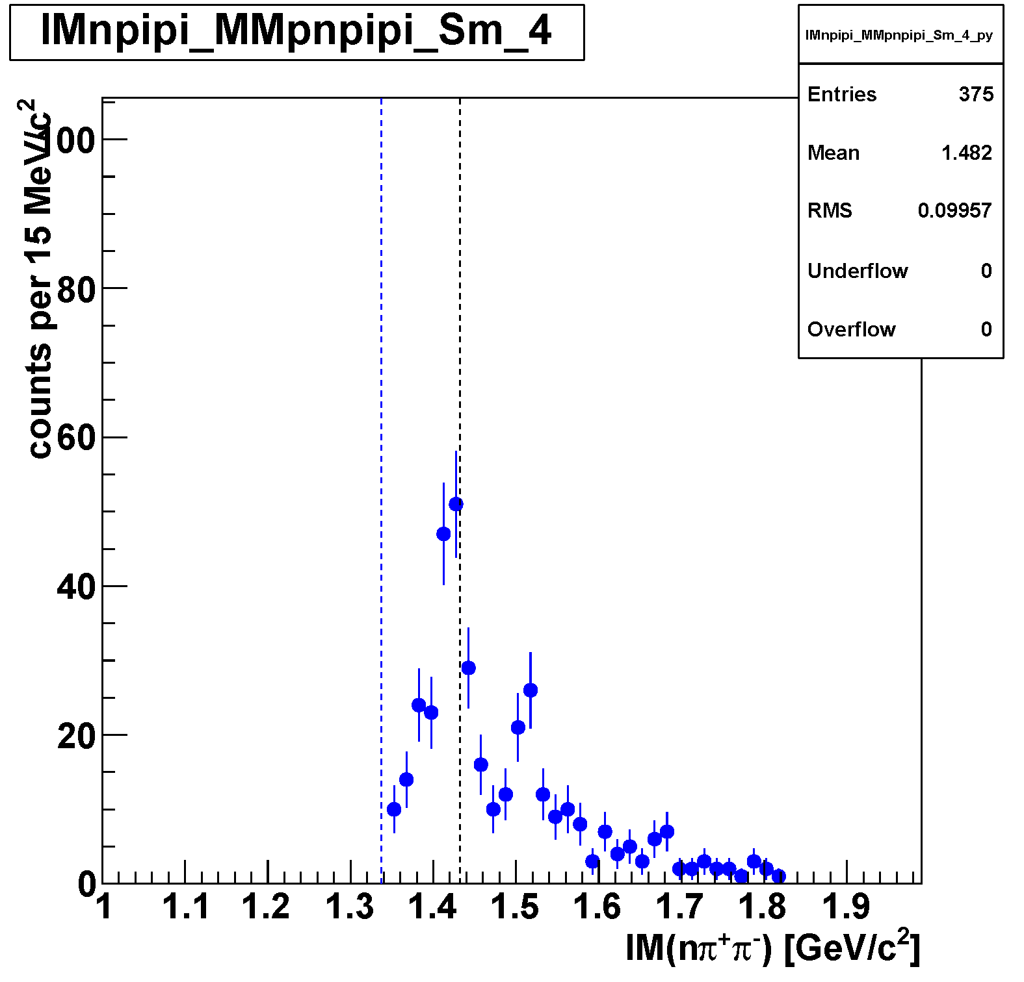
π⁻Σ⁺ and π⁺Σ⁻
Σ⁺π⁻
all
Σ⁻π⁺

Slide 23
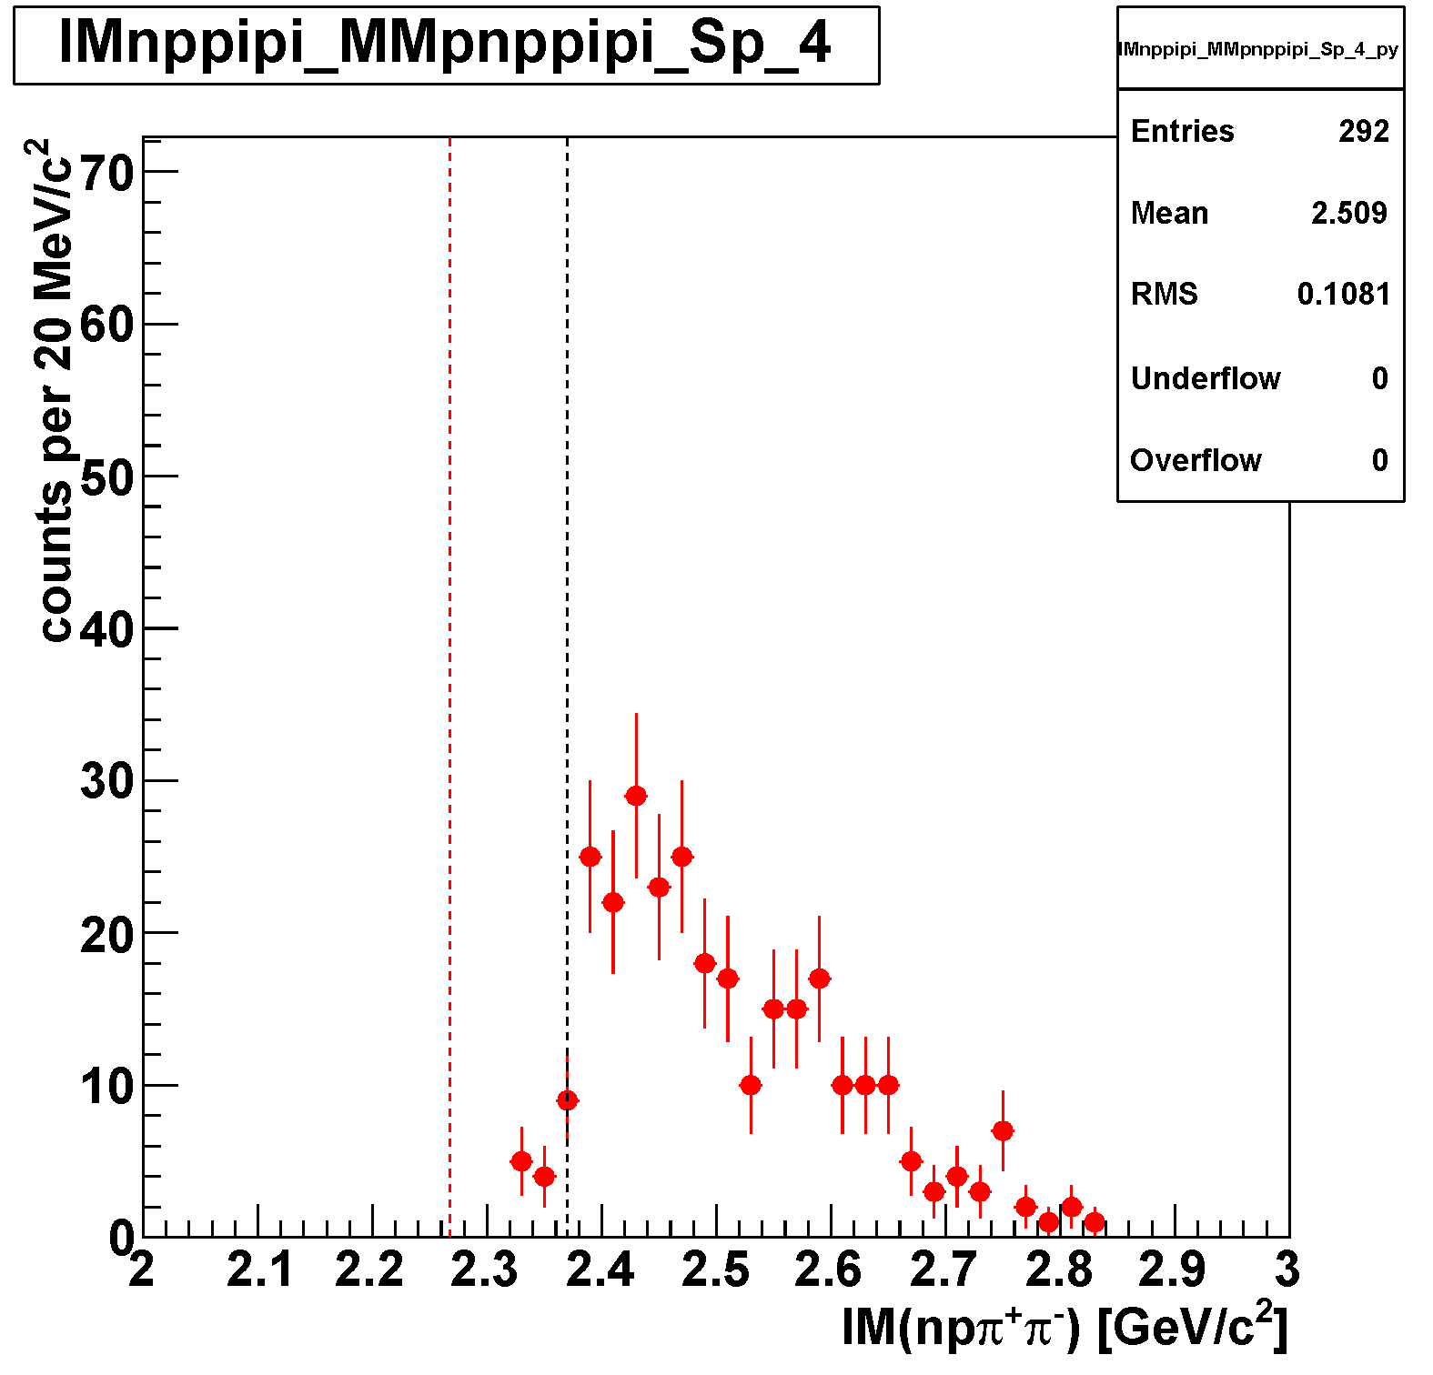


π⁻Σ⁺p and π⁺Σ⁻p
Σ⁺π⁻
all
Σ⁻π⁺

Slide 24

Σ⁰(1385) Cross-Section?
K-p = elastic: 22mb
K-p = n K0: 7 mb
K-n = elastic: 20 mb
No data of Σ⁰(1385) CS around 1.0 GeV/c
In 1.2~1.8 GeV/c, CS of QF Σ⁰(1385) was measured, and is almost the same as that of Σ±(1385)
Relative ratios of Σ* productions via 2-step reaction are assumed as follows:
  K⁻³He → (K⁻p_{s}p_{s})n → Σ^{*0}pn (1*20*0.5=10)
  K⁻³He → (K⁻p_{s}p_{s})n → Σ^{*+}nn (1*20*0.5=10)
  K⁻³He → (K⁻n_{s}p_{s})p → Σ^{*0}pn (2*22*0.5=22)
  K⁻³He → (K⁻n_{s}p_{s})p → Σ^{*-}nn (2*22*0.5=22)
  K⁻³He → (K⁰n_{s}p_{s})n → Σ^{*0}pn (2*7*0.5=7)
  K⁻³He →(K⁰n_{s}p_{s})n → Σ^{*+}nn (2*7*0.5=7)
where cross sections of 2NA Σ^{*0+-} are assumed to be the same
Then we assume Σ⁰(1385) CS at 1.0 GeV/c to be:
σ(Σ^{*0}) = 39/17 x σ(Σ^{*+}) = 2.3 x σ(Σ^{*+})

