Slide 1



軽いK中間子原子核の系統的測定
Systematic Investigation of the Light Kaonic Nuclei
F. Sakuma, RIKEN
on behalf of the J-PARC P80 collaboration

Slide 2
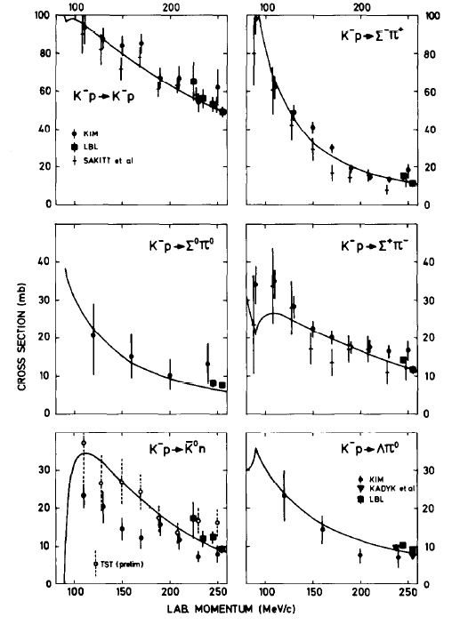
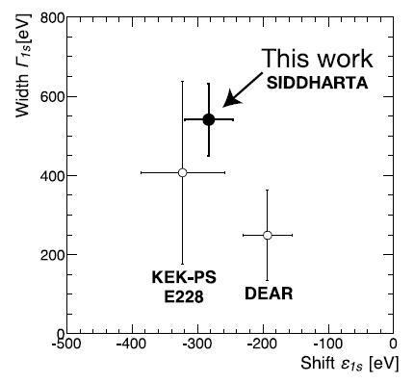
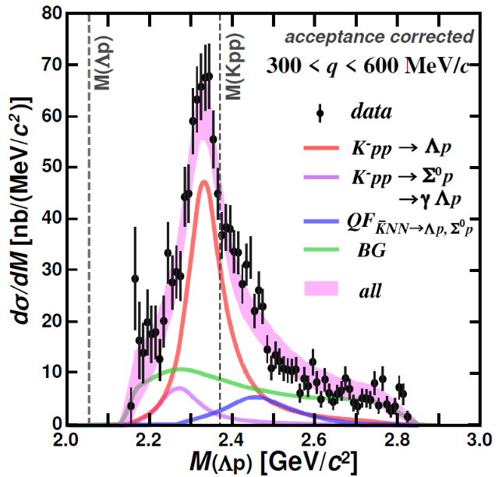
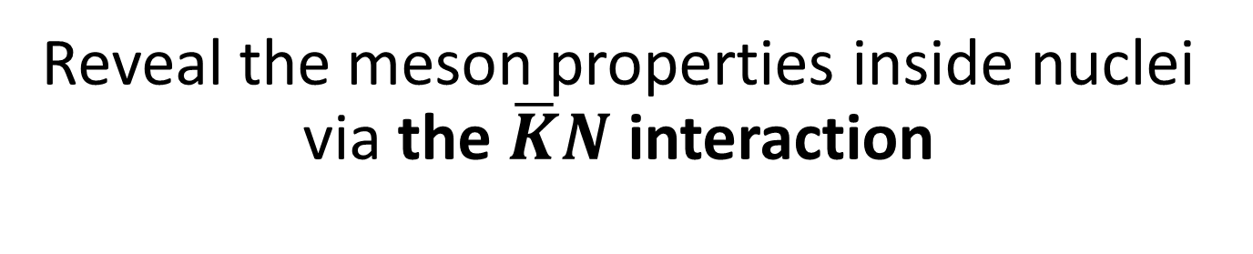
Physics Goal
Reveal the meson properties inside nuclei via the $\overline{K}N$ interaction
A powerful probe to understand low energy QCD
Strongly attractive in I=0 from extensive measurements
→ Kaonic Nuclei
"K⁻pp" @ E15
PLB789(2019)620.
PRC102(2020)044002.
K⁻N scattering
NPB179(1981)33.
K⁻p atom
PLB704(2011)113.

Slide 3
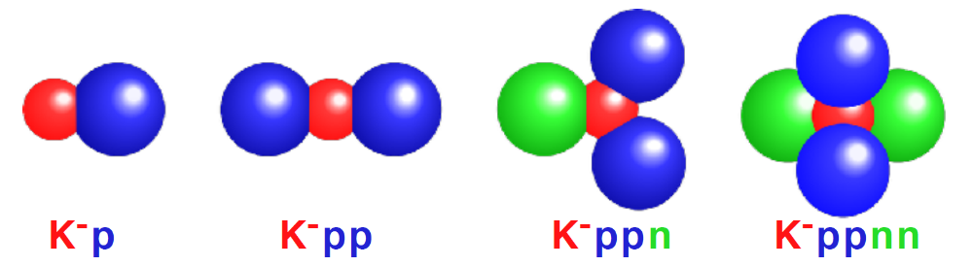
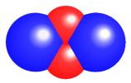
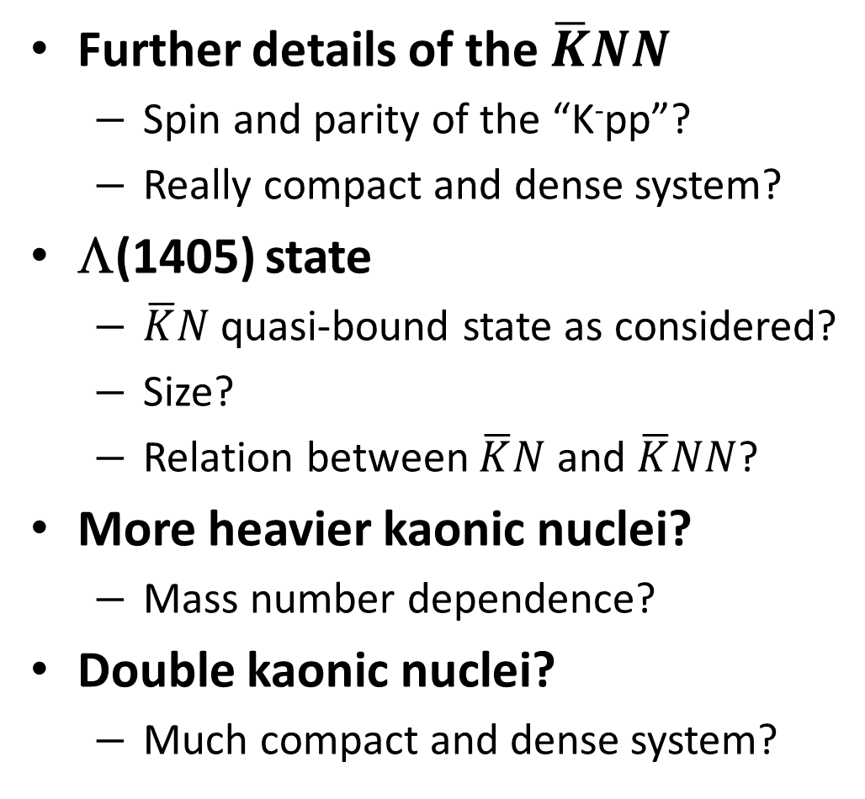
Many Questions to be Answered
Further details of the $\overline{K}NN$
  Spin and parity of the “K⁻pp”?
  Really compact and dense system?
Λ(1405) state
  $\overline{K}N$ quasi-bound state as considered?
  Size?
  Relation between $\overline{K}N$ and $\overline{K}NN$?
More heavier kaonic nuclei?
  Mass number dependence?
Double kaonic nuclei?
  Much compact and dense system?
K⁻K⁻pp

Slide 4
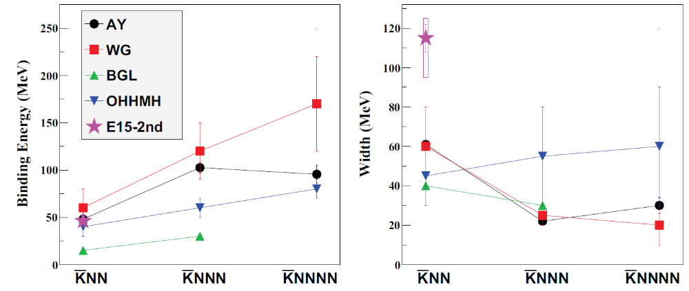

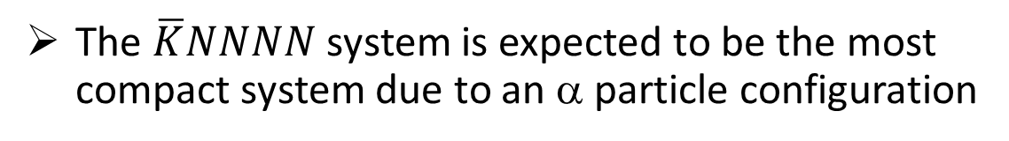
$\overline{K}NNN$ and $\overline{K}NNNN$
More heavier system must be explored to provide more conclusive evidence of the kaonic nuclei
B.E.
Γ
the larger nuclei → the larger B.E.
Discrepancy would be resolved if the models adopt both mesonic & non-mesonic decays
(E15=Λp)
The $\overline{K}NNNN$ system is expected to be the most compact system due to an α particle configuration

Slide 5
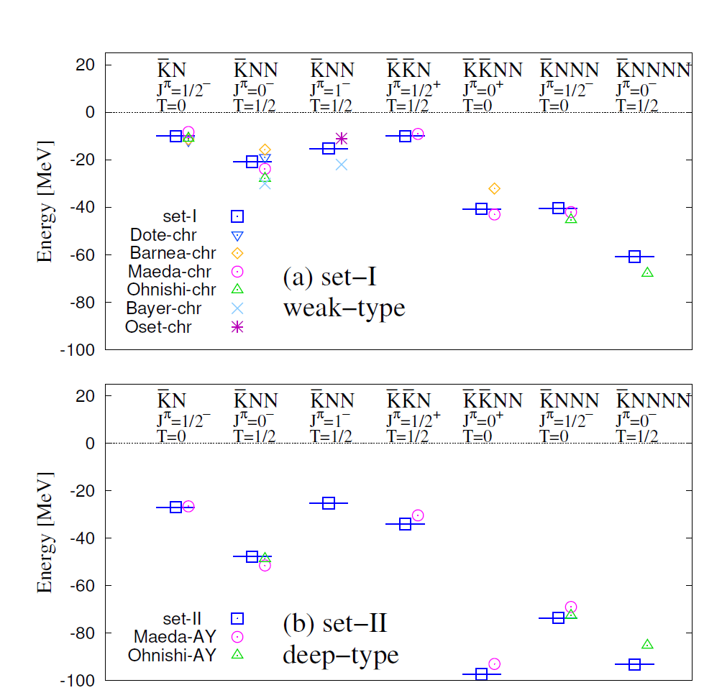
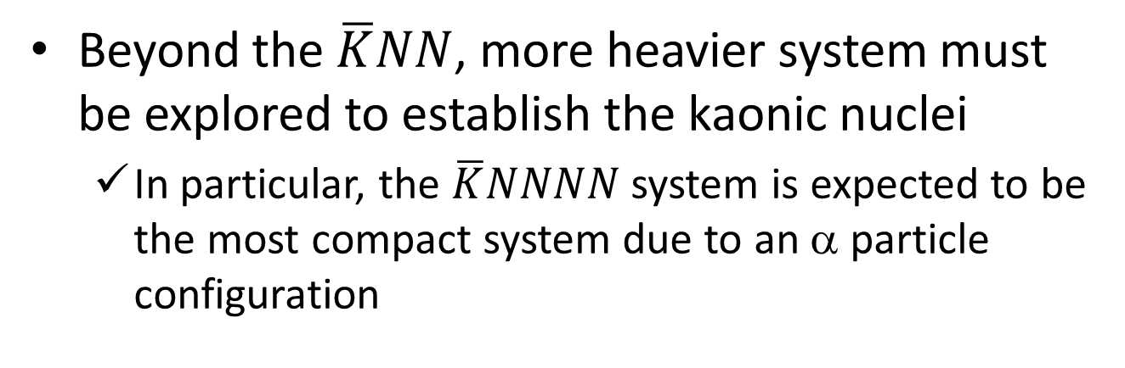
$\overline{K}NNN$ and $\overline{K}NNNN$
Y.Kanada-En’yo arXiv:2008.06802
Beyond the $\overline{K}NN$, more heavier system must be explored to establish the kaonic nuclei
  In particular, the $\overline{K}NNNN$ system is expected to be the most compact system due to an α particle configuration
E15
systematic investigation is essential
both in experiment and calculation
the larger nuclei → the larger B.E.
would become large if the models adopt mesonic & non-mesonic decays
E15

Slide 6
New Project @ J-PARC
-- systematic investigation of the light kaonic nuclei --

Slide 7
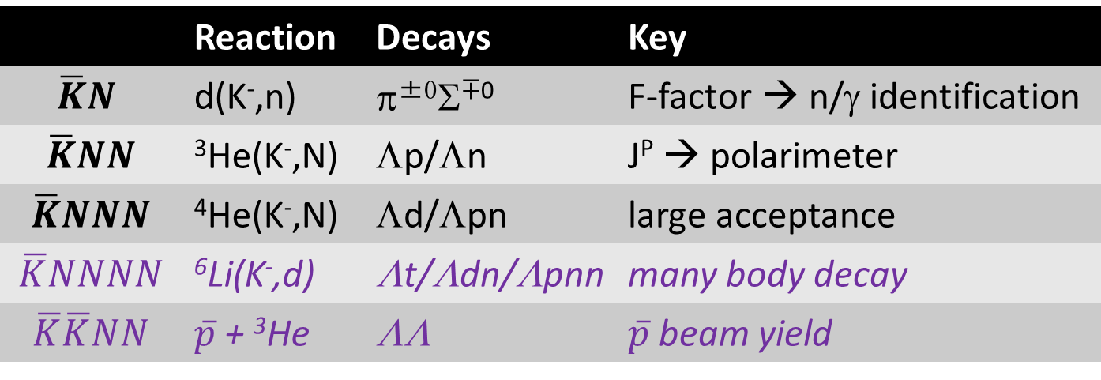
Strategy of the New Project
- for systematic study from the $\overline{K}N$ to $\overline{K}NNNN$ systems -
 | Reaction | Decays | Key
$$\overline{K}N$$ | d(K⁻,n) | π^{±0}Σ^{∓0} | F-factor → n/γ identification
$$\overline{K}NN$$ | ³He(K⁻,N) | Λp/Λn | J^{P} → polarimeter
$$\overline{K}NNN$$ | ⁴He(K⁻,N) | Λd/Λpn | large acceptance
$$\overline{K}NNNN$$ | ⁶Li(K⁻,d) | Λt/Λdn/Λpnn | many body decay
$$\overline{K}\overline{K}NN$$ | $\overline{p}$ + ³He | ΛΛ | $\overline{p}$ beam yield
← A first step
To realize the systematic measurements, we need
  a large acceptance spectrometer
    detect/identify all particles to specify the reaction
  high-intensity kaon beam
    more K⁻ yield than the existing beamline
We take a step-by-step approach
← new CDS
← modified K1.8BR

Slide 8

A First Step: Search for $\overline{K}NNN$
via ⁴He(1 GeV/c K⁻, n) reaction
Goals of the proposed experiment:
Observe the K⁻ppn state via 2-body Λd decay
  Establish the existence of the kaonic nuclei
Reconstruct the K⁻ppn state via 3-body Λpn decay
  As a feasibility study to access heavier system
Feasibility study of proton spin-direction measurement
  e.g., by installing a prototype module of a polarimeter

Slide 9
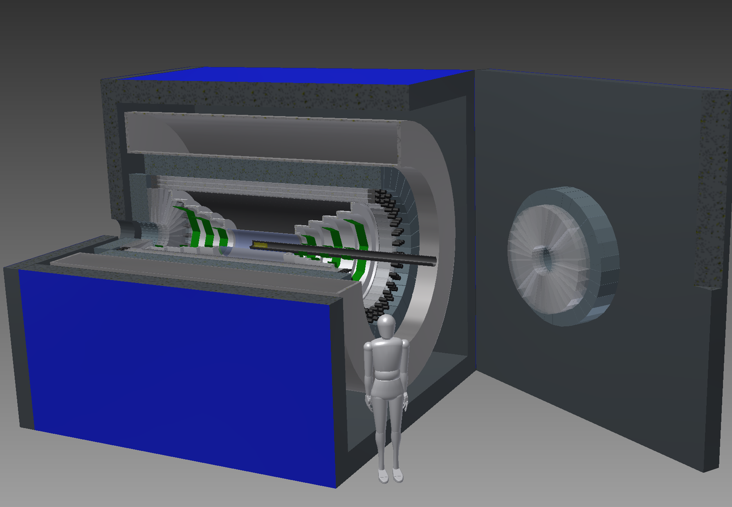
A New Cylindrical Detector System
A new 4π spectrometer with n/γ detection capability

Slide 10
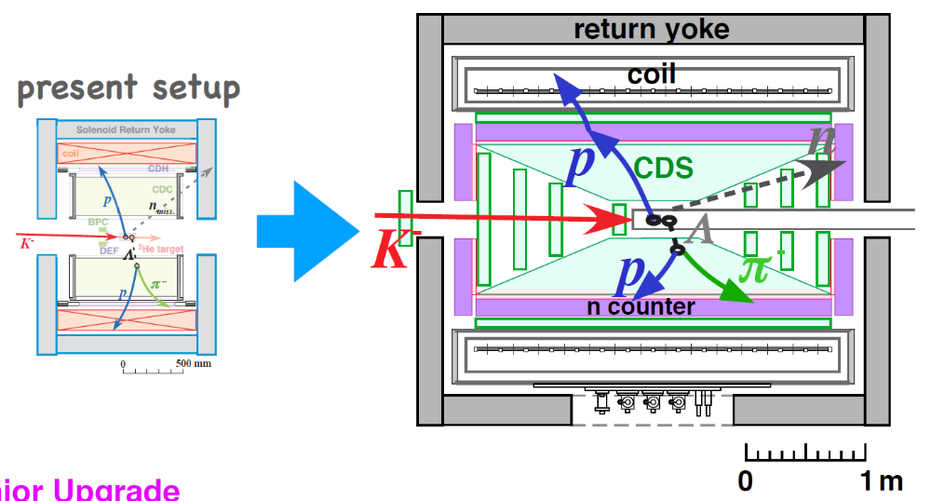
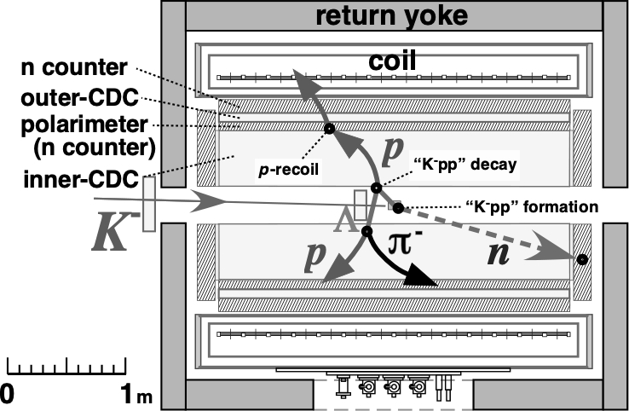
A New Cylindrical Detector System
SC Solenoid Magnet
Cylindrical Drift Chamber
Neutron Counter
FWD/BWD Drift Chambers
Vertex Fiber Tracker
Electromagnetic Calorimeter (constructed in 2nd-stage)
Solid angle: ~x1.5 (~90%)
Neutron detection capability: ~x10 ( ~1.5x15%)

Slide 11
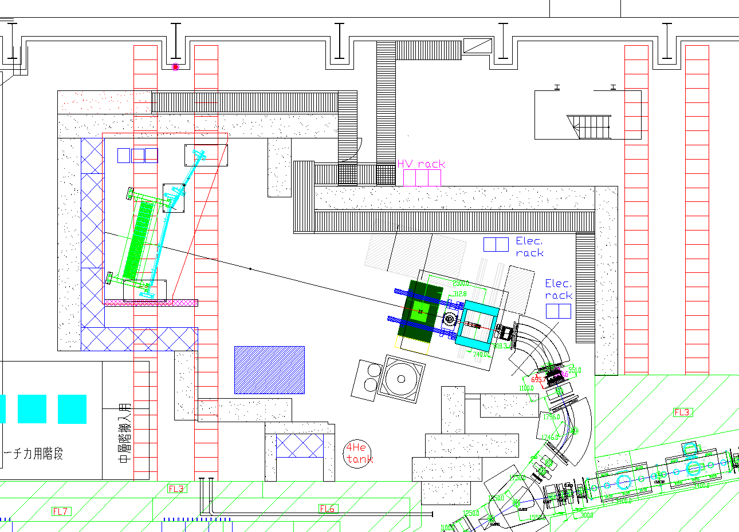
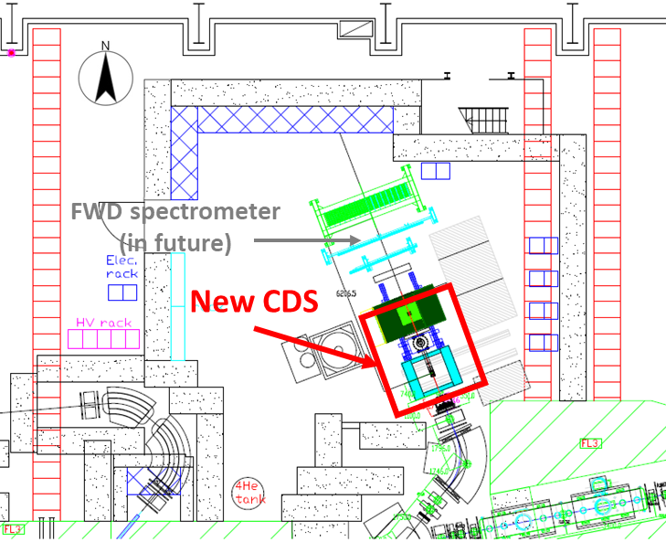
Improvement of Kaon Intensity
K1.8BR beamline
Shorten the beamline (~3.7m) by removing the final D magnet
We propose a new configuration of the beamline
  K- yield is expected to increase by ~ 1.4 times @ 1.0 GeV/c

Slide 12
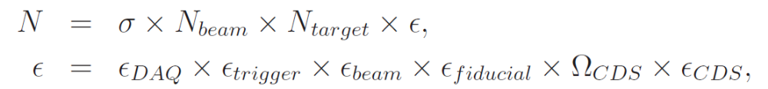
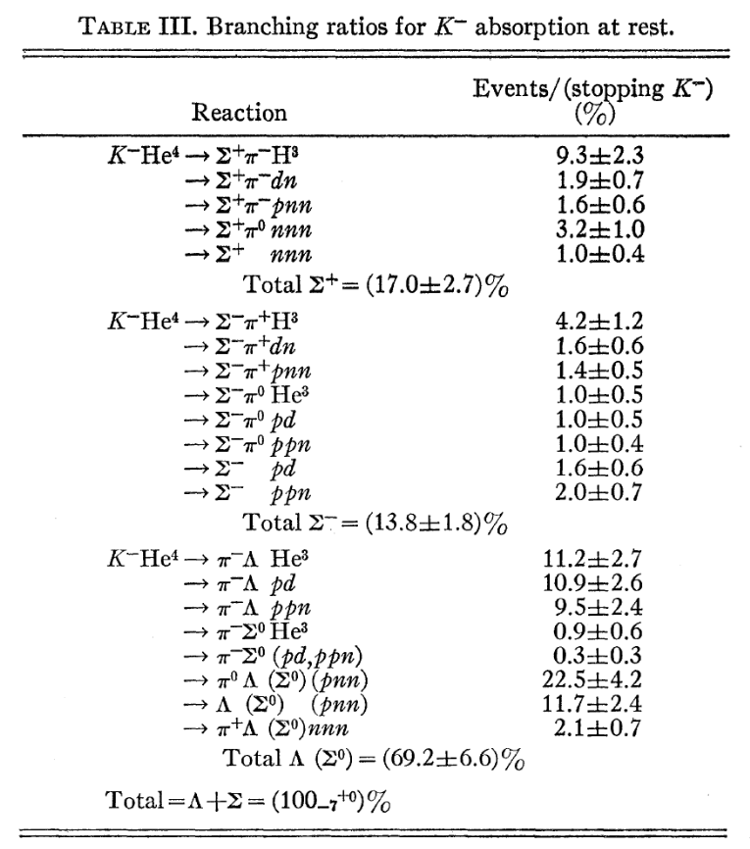

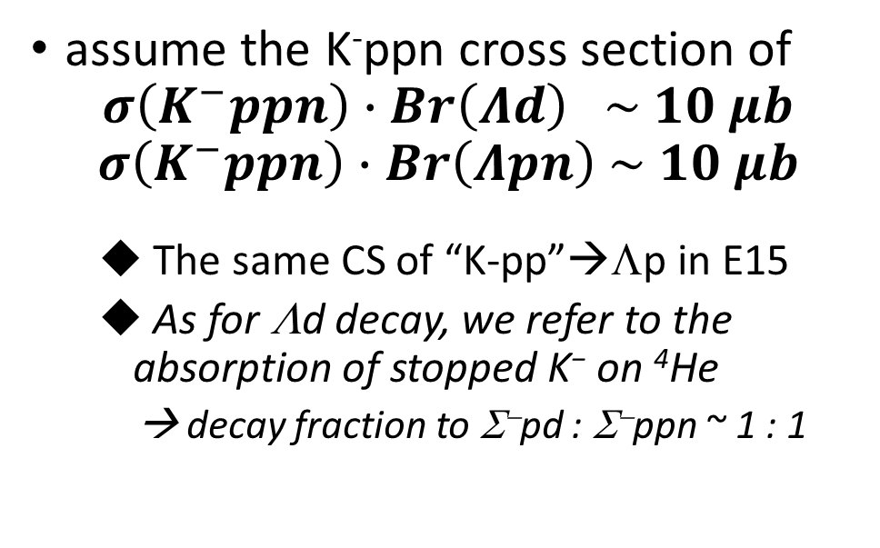
Expected Yield of $\overline{K}NNN$
absorption of stopped K⁻ on ⁴He
assume the K⁻ppn cross section of
$$σ\left(K^{−}ppn\right)∙Br\left(Λd\right) \sim 10 μb$$
$$σ\left(K^{−}ppn\right)∙Br\left(Λpn\right) \sim 10 μb$$
  The same CS of “K-pp”→Λp in E15
  As for Λd decay, we refer to the absorption of stopped K⁻ on ⁴He
  → decay fraction to Σ⁻pd : Σ⁻ppn ~ 1 : 1
PRD1(1970)1267

Slide 13
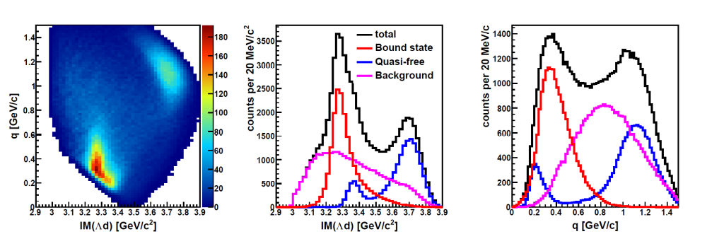
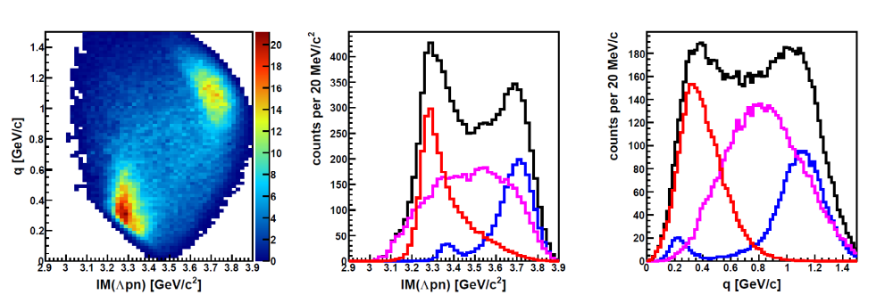

Expected Spectra of K⁻+⁴He
K⁻+⁴He→Λd+n
K⁻+⁴He→Λpn+n
M(K⁻ppn)
M(K⁻ppn)
B_{Kppn} ~ 40 MeV
Γ_{Kppn} ~ 100 MeV
Q_{kppn} ~ 400 MeV/c
BS and QF will be
well separated in
0.3 < $q$ < 0.6 GeV/c
σ(K⁻ppn)*Br ~ 10 μb
σ(QF) ~ 10 μb
σ(BG) ~ 20 μb
@ 3 weeks, 90kW
Similar parameters obtained with the K⁻+³He→Λpn (PRC102(2020)044002.) are adopted to K⁻ppn/QF/BG shapes
K-ppn signal [q-independent] will be seen clearly

Slide 14
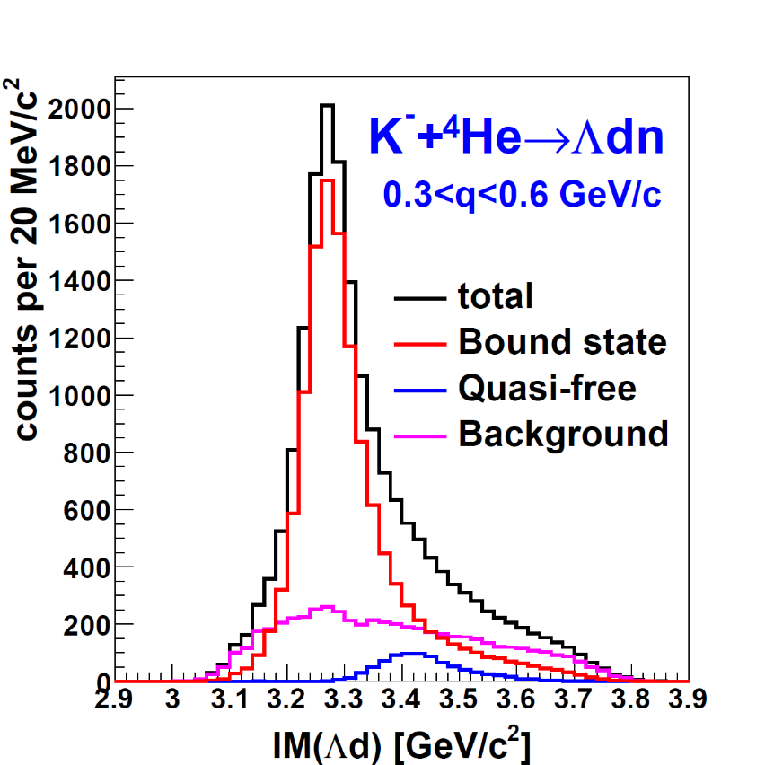
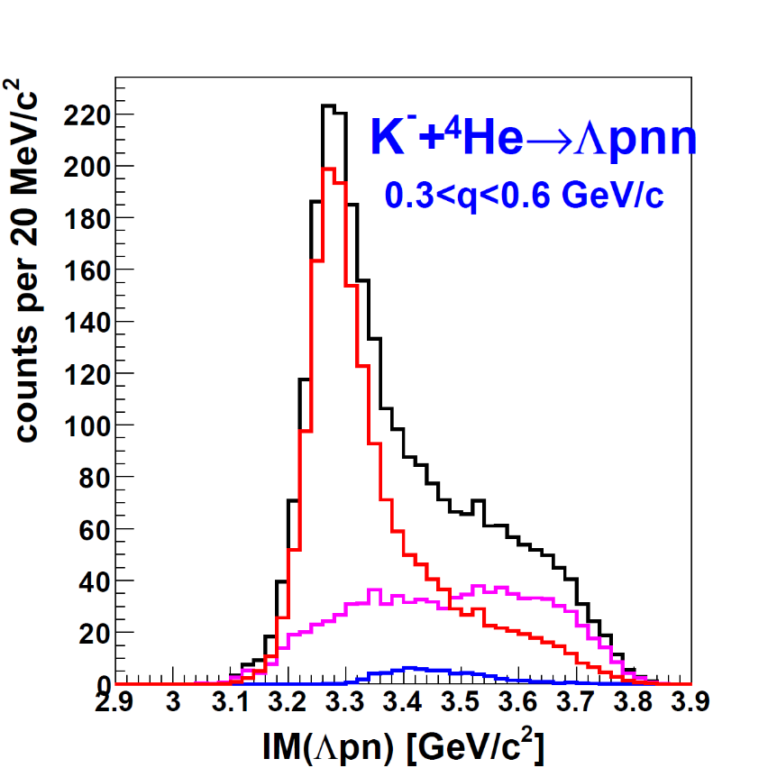
Expected Spectra of K⁻+⁴He
K⁻+⁴He→Λd+n
K⁻+⁴He→Λpn+n
M(K⁻ppn)
M(K⁻ppn)
Broad comp.
@ 3 weeks, 90kW
Assumption: similar parameters obtained at E15
Mass-number dependence of the kaonic nuclei will be provided for the first time.

Slide 15
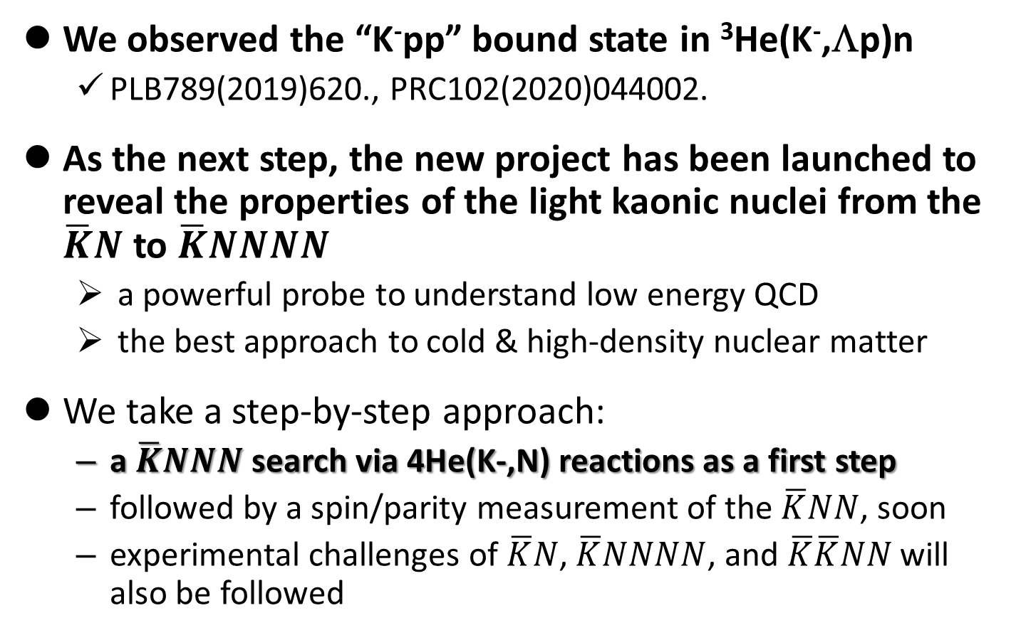
Summary
We observed the “K⁻pp” bound state in ³He(K⁻,Λp)n
  PLB789(2019)620., PRC102(2020)044002.
As the next step, the new project has been launched to reveal the properties of the light kaonic nuclei from the $\overline{K}N$ to $\overline{K}NNNN$
  a powerful probe to understand low energy QCD
  the best approach to cold & high-density nuclear matter
We take a step-by-step approach:
  a $\overline{K}NNN$ search via 4He(K-,N) reactions as a first step
  followed by a spin/parity measurement of the $\overline{K}NN$, soon
  experimental challenges of $\overline{K}N$, $\overline{K}NNNN$, and $\overline{K}\overline{K}NN$ will also be followed

Slide 16
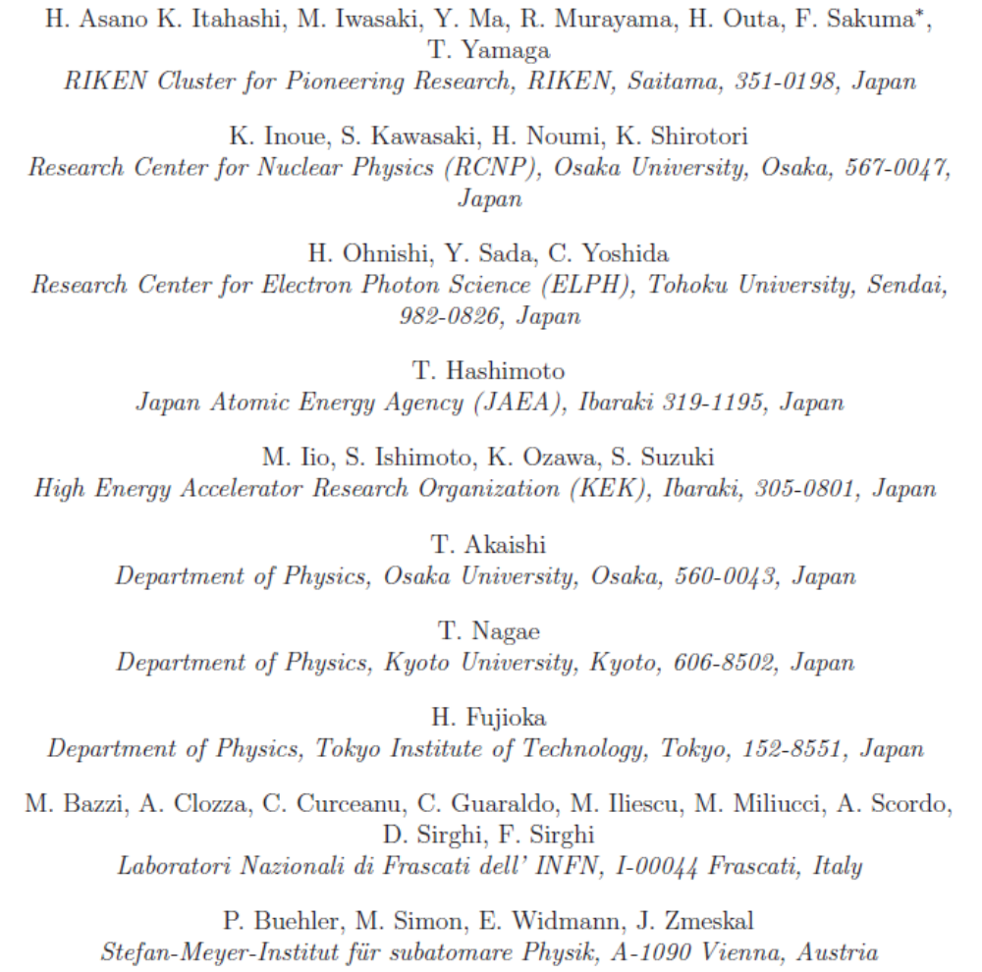









J-PARC P80 Collaboration
We're looking for new collaborators!

Slide 17

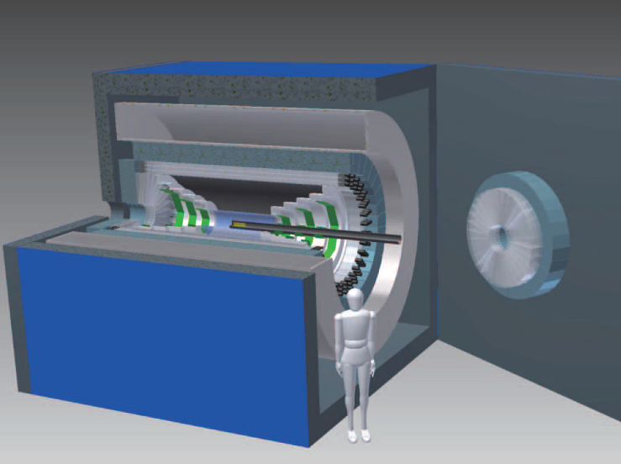
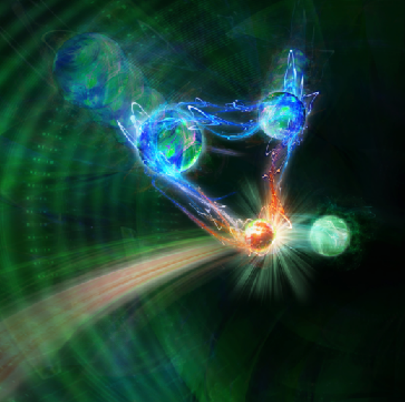
Thank you for your attention!
High intense K beam
New large CDS
ÖWA/Harald Ritsch
New era of kaonic nuclei
A first step of the new project
via in-flight ⁴He(K⁻,N)

Slide 19
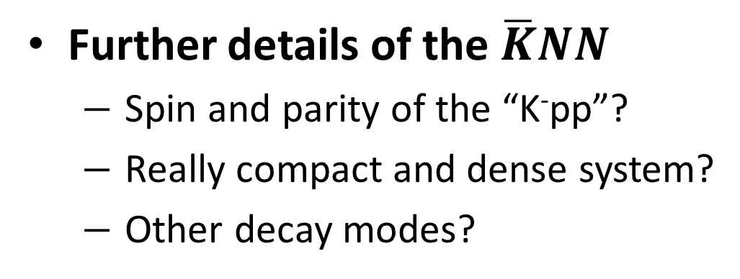
Many Questions to be Answered
Further details of the $\overline{K}NN$
  Spin and parity of the “K⁻pp”?
  Really compact and dense system?
  Other decay modes?
πΣN mesonic decay
  expected to be the dominant channel
    only YN non-mesonic decays were reported
Reaction mechanism
  relation between Λ(1405)=“K⁻p” & “K⁻pp”
    “K⁻pp” is expected to be produced via Λ(1405)+p→”K⁻pp” door-way process

Slide 20
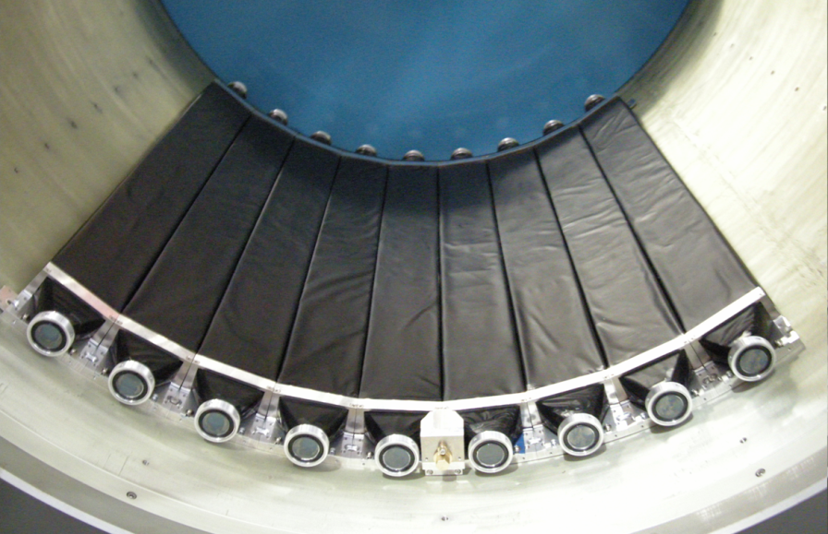
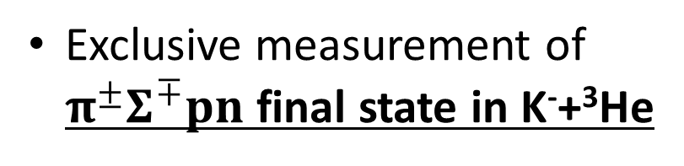
K⁻ ³He → πΣpn @ E15
CDS
Exclusive measurement of $π^{±}Σ^{∓}pn$ final state in K⁻+³He
p
“X”
K-
³He
n
1 GeV/c
Σ
π
n
π
CDS
Experimental challenge of neutron detection with thin scintillation counter (t=3cm)
t = 3cm
79cm
10cm
n detection efficiency ~ 3-10%

Slide 21
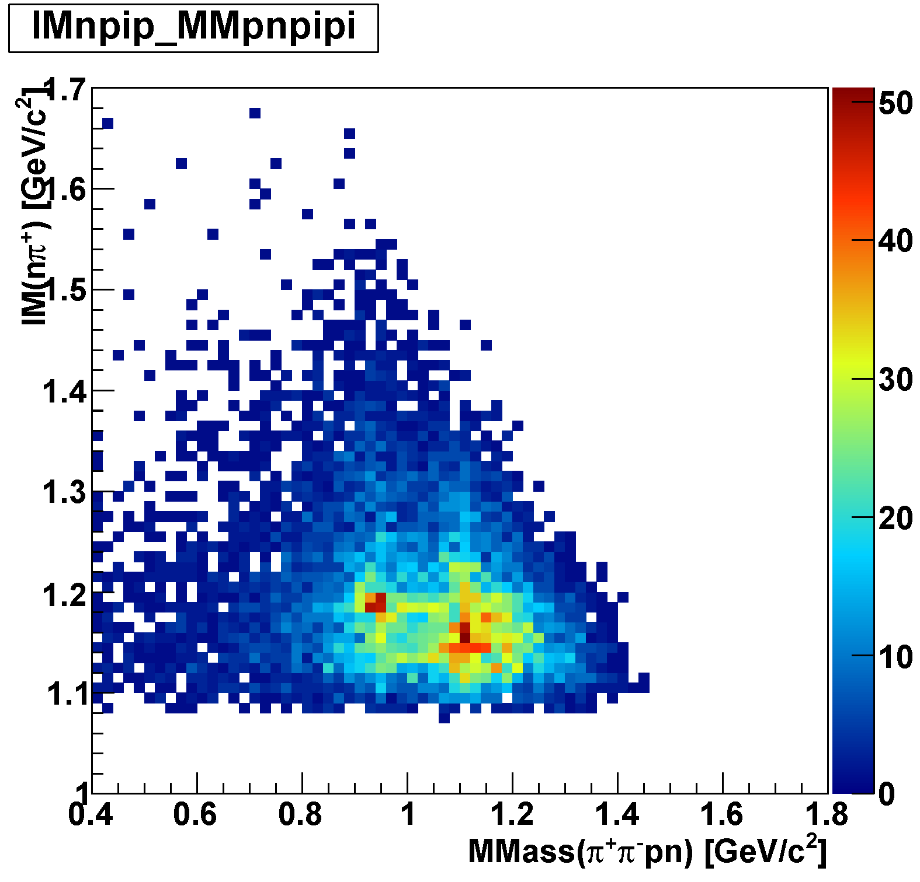
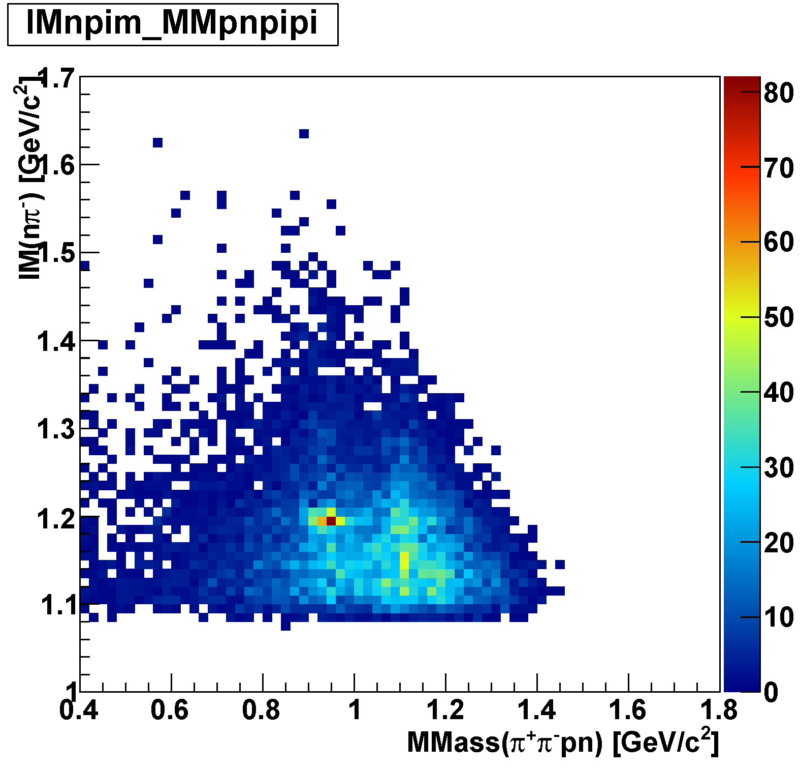
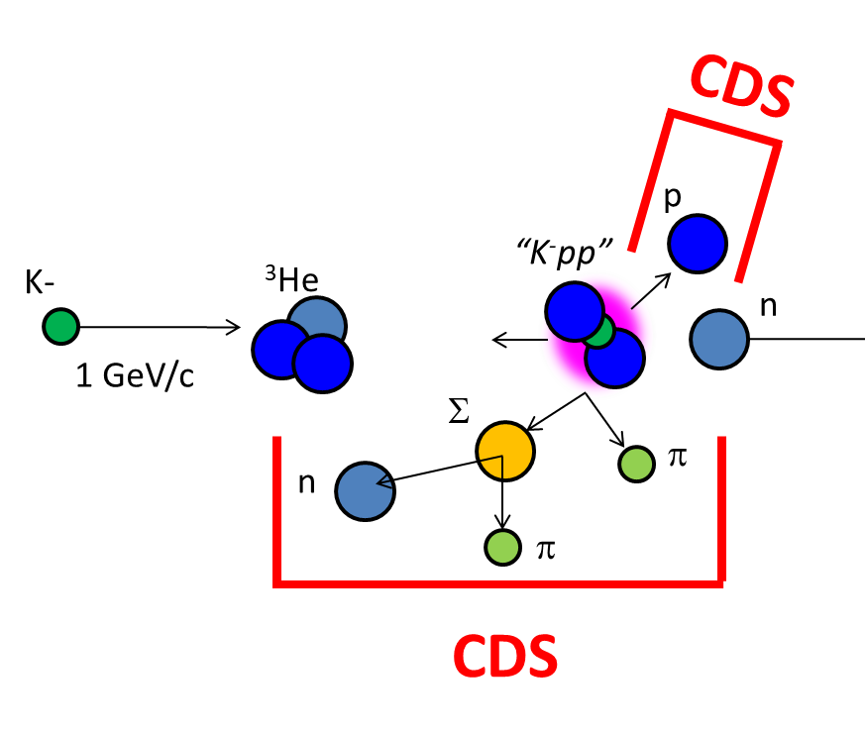
πΣpn Events
IM(nπ⁺) vs MM(π⁺π⁻pn)
IM(nπ⁻) vs MM(π⁺π⁻pn)
π⁻Σ⁺p n_{miss}
π⁺Σ⁻p n_{miss}
Σ⁺
Σ⁻
n_{miss}
n_{miss}

Slide 22
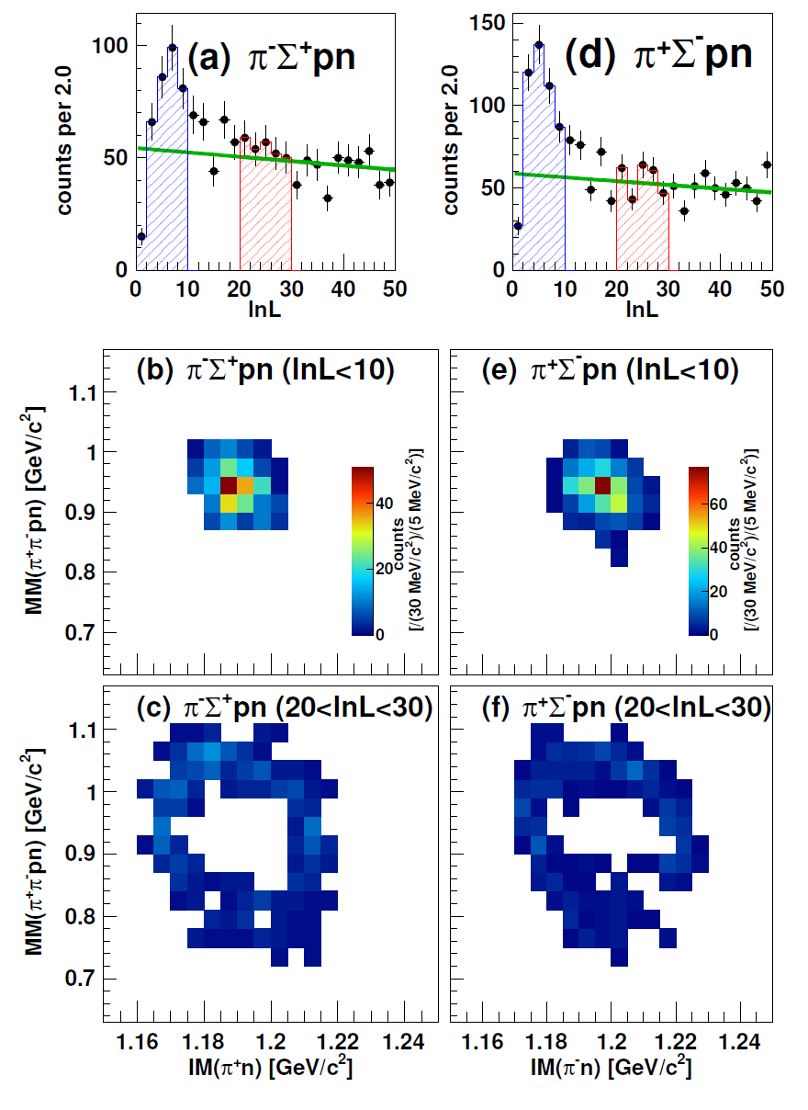
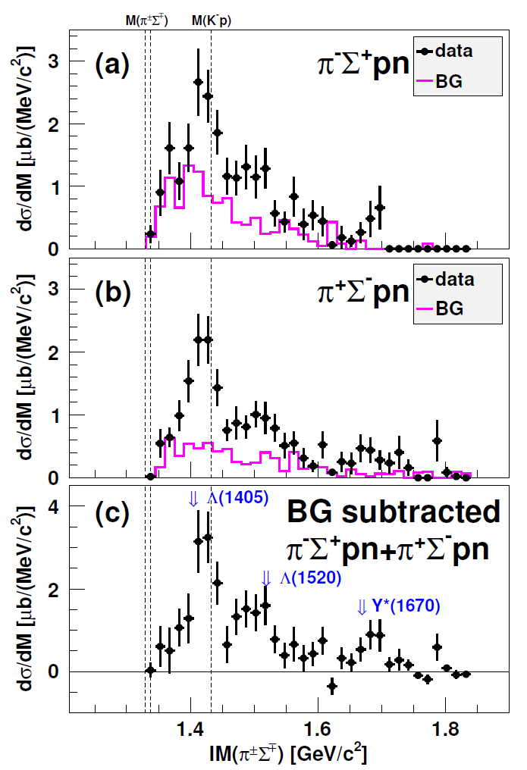
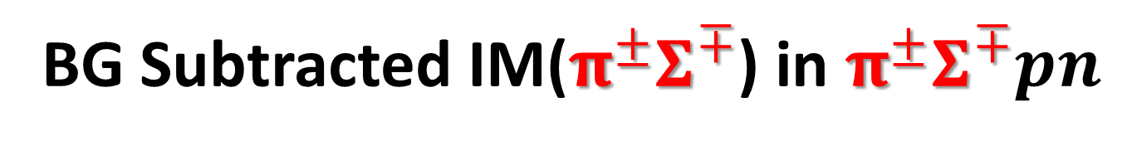
BG Subtracted IM($π^{±}Σ^{∓}$) in $π^{±}Σ^{∓}pn$
preliminary

Slide 23
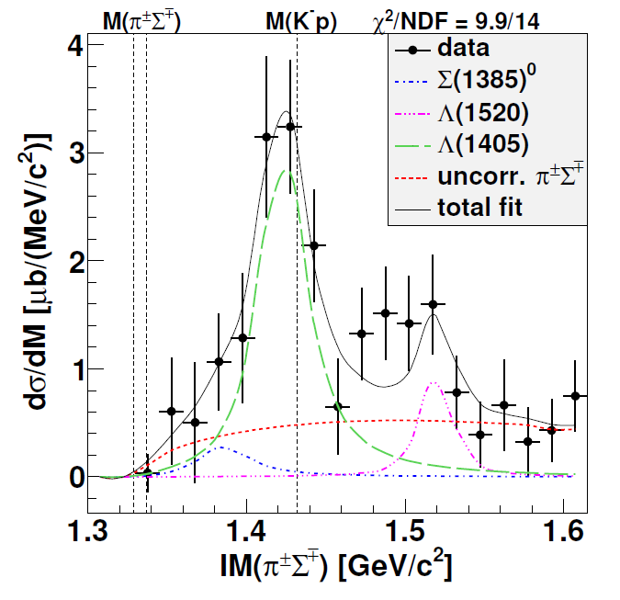


$Y^{∗}pn$ Final State
Λ(1405)
IM($π^{±}Σ^{∓}$)
~ 250 μb
Fit with BW:
M ~ 1422 MeV
Γ ~ 40 MeV
preliminary
Λ(1520)
~ 100 μb
πΣpn
non-resonant
Σ (1385) ⁰
  ~ 100-150 μb
  [evaluated from
  Σ (1385)^{+/-}→π^{+/-}Λ
  measurement]
(Σ(1385)→πΛ/πΣ : 87.0/11.7%)

Slide 24

$Λ(1405)pn$ Final State Selection
IM($π^{±}Σ^{∓}$)
Select Λ(1405) region
preliminary
Below Λ(1520)
Small contribution from Σ(1385)

Slide 25
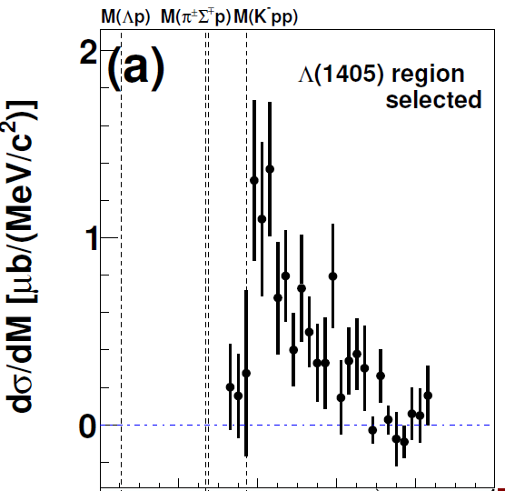
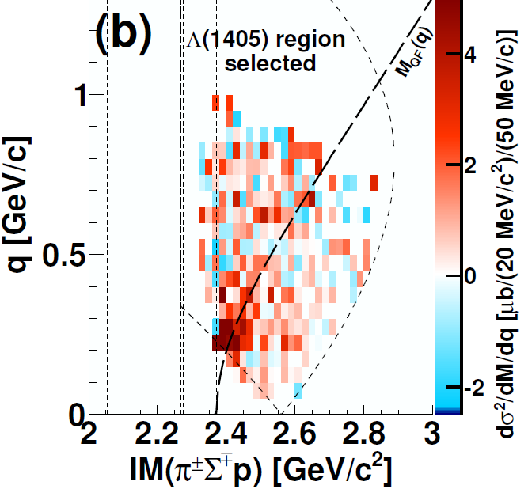
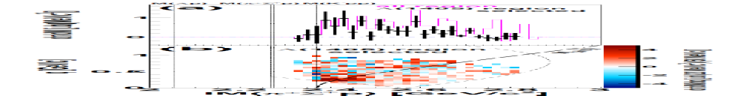
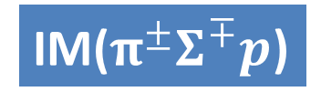
IM(πΣp) in Λ(1405)pn Final State
IM($π^{±}Σ^{∓}p$)
Dominant above the threshold
M(Kpp)
preliminary
IM(Λ(1405)p) distributes above the M(Kpp)
QF K⁻N→K^{bar}n followed by K^{bar}NN→Λ(1405)p

Slide 26
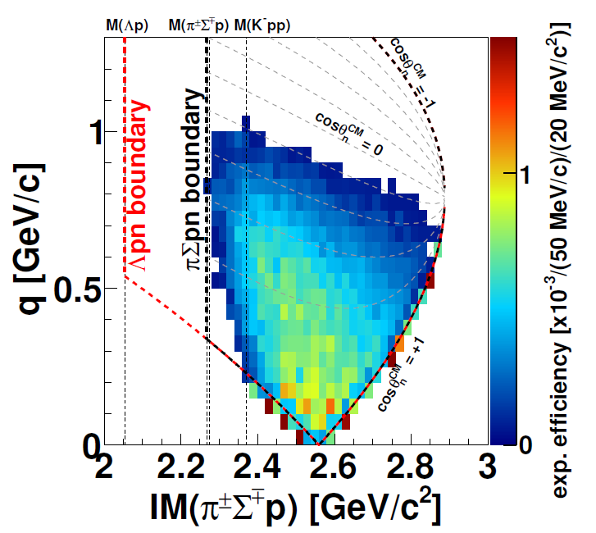
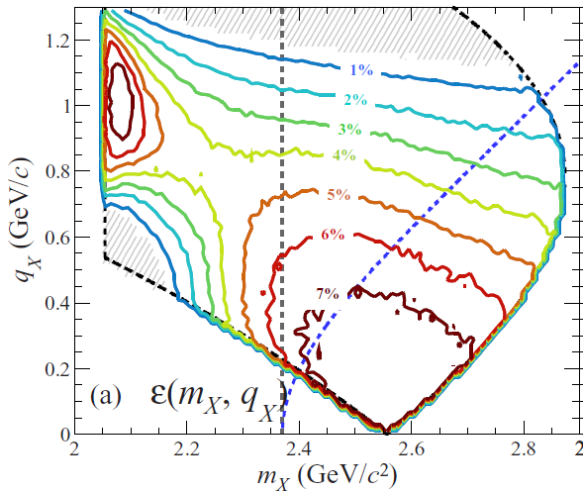
Detector acceptances of
Λpn and πΣpn
Λp
πΣp

Slide 27


Σ*N bound state? Other possibilities?
Σ* coupling through K^{bar}-N channel (P-wave) would be weak
  A.Cieply et al., PRC84(2011)045206, etc.
Naively, Σ*N system with 1⁺/2⁺ state (S-wave) could not be bound, because corresponding ΔN system (non-strangeness sector) is considered to be no-bound or quite-weakly bound
  R. D. Mota et al., PRC59(1999)46, etc.
need J^{P} determination with a polarimeter
The K^{bar}NN state (I=1/2, J^{P}=0⁻) is calculated with a K^{bar}NN-πΣN-πΛN coupled channel system, where the πΛN coupling is expected to be small
The K^{bar}NN state with J^{P}=1⁻ (K^{bar}-d like configuration) is expected to not be bound, or have small B.E.
  S.Ohnishi et al., PRC95(2017)065202, etc.

Slide 28
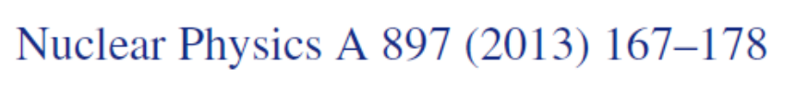
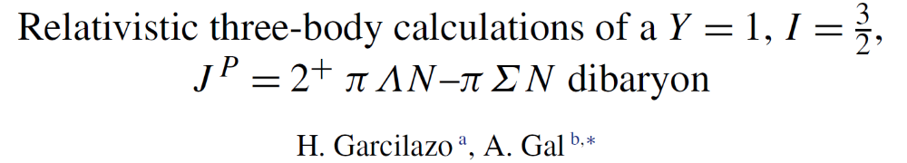
Σ*N bound state? Other possibilities?
One theoretical possibility is a “πΛN-πΣN dibaryon”
Calculated πΛN resonance with Σ*N-ΔΣ configuration is:
  I=1/2, J^{P}=2⁺ : E = -10-i52 MeV
  I=3/2, J^{P}=2⁺ : E = -120-i2.6 MeV
The obtained K⁻pp parameter at E15 is E=-40-i50 MeV
Therefore, the “observed K-pp structure” would be different from the “πΛN-πΣN dibaryon”
with respect to M(K^{bar}NN)

Slide 30
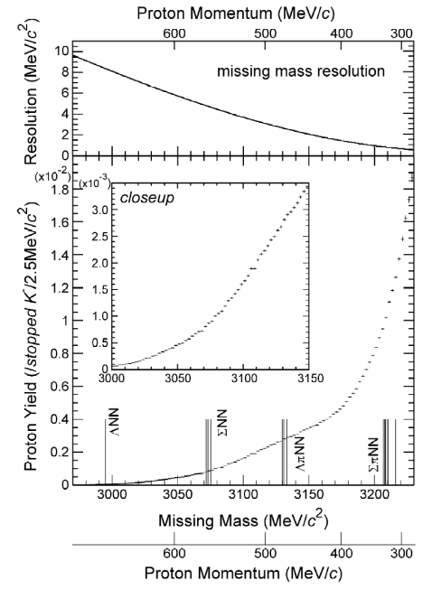
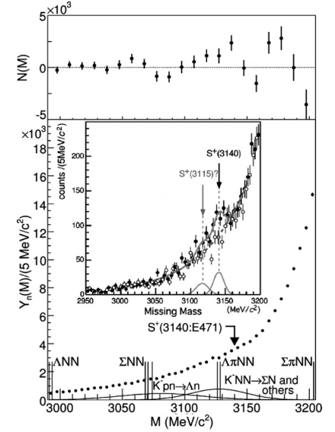
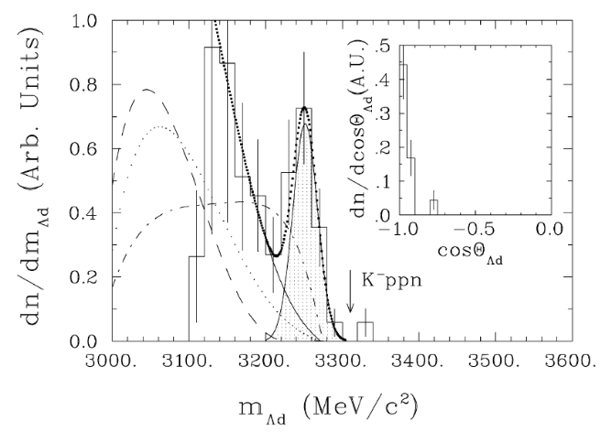
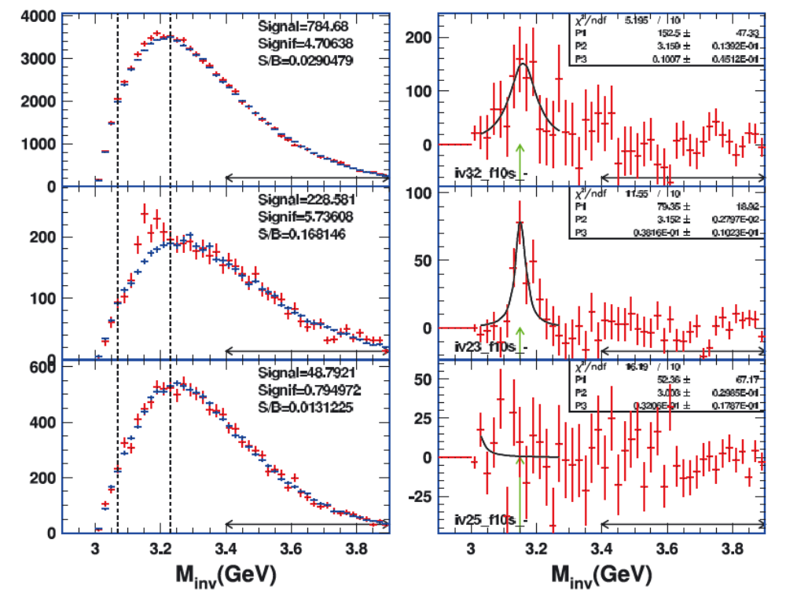
“K⁻ppn” Candidates so far
⁴He(stopped-K⁻,p/n)X
A few candidates have been reported in inclusive measurements
E471/E549@KEK
  ⁴He(stopped-K⁻,p/n)X
FINUDA@DAΦNE
  Li/C(stopped-K⁻,Λd)
FOPI@GSI
  Λd in Ni+Ni
Exclusive measurement using a simple reaction (in-flight & light nuclei) is crucial
PLB659(2008)107, PLB688(2010)43
← NULL results
  Li/C(stopped-K⁻,Λd)
← Observed?
← Observed?
PLB654(2007)80
  Λd in Ni+Ni
EXA05 Conference (2005)

Slide 31
Expected Yield of $\overline{K}NNN$
N_{beam} = 100 G K- on target
  under the MR beam power of 90 kW with 5.2 s repetition cycle.
    3.2 x 10⁵ K- on target / spill @ 1.0 GeV/c
  3 weeks data taking (90% up-time)
 | Λd / Λpn
σ(K⁻ppn)*Br | 10 μb
N(K⁻ on target) | 100 G
N(target) | 2.65 x 10²³
ε(DAQ) | 0.9
ε(trigger) | 0.93
ε(beam) | 0.55
Ω(CDC) | 0.27 / 0.077
ε(CDC) | 0.6 / 0.3
N(K⁻ppn) | 19 k / 2.8 k
around 2024
N(K⁻ppn→Λd) ~ 2 x 10⁴
N(K⁻ppn→Λpn) ~ 3 x 10³
  c.f. 1.7 x 10³ “K⁻pp”→Λp accumulated in E15-2nd (40 G K⁻)
* improved from E15

